Slide 1
Intro to ITECH

Slide 2
By the end of Week 1...
By the end of Week 1, you should be able to:
1. Understand the types of web applications
2. Understand tiered architectures and their benefits
3. Interpret and create high-level architecture diagrams
4. Understand data modeling and create ER diagrams
5. Apply Information Architecture principles to develop user requirements, sitemaps, user flows, and wireframes
This lecture covers most of what you need for the first part of your group coursework!

Slide 3
What is A Web APPLICATION?

Slide 4









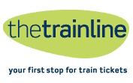

Web Applications Examples
Notes:
Students will be familiar with web applications – they are in use within the University (e.g., Moodle, MyCampus) and of course in all areas of life outside of University (social media online shopping, news websites, streaming media,…)

Slide 5
What is a Web Application?
Software that you use on your browser
The frontend and backend communicate over the web (requests and responses)
Many users can use it at the same time, who need to access timely and useful information
Has two parts: the page you see (frontend) + code on a server (backend)
Stores and loads data (often from a database)

Slide 6


Internet vs Web
Internet: the network connecting computers
Web: what browsers use on that network – links, pages, web applications
Notes:
Internet: the road network
Web: cars and traffic laws

Slide 7
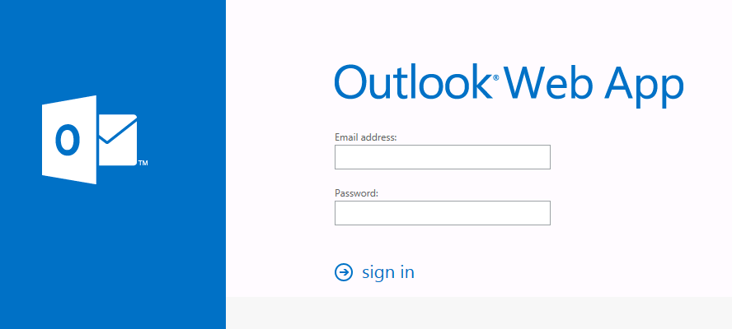

Frontend vs Backend
Frontend: what you see
(text, images, buttons, forms)
Backend: what happens (rules,processing, security,data)
ThePhoto by PhotoAuthor is licensed under CCYYSA.
Type password
Check password and permissions

Slide 8



Frontend Building Blocks
HTML =
content
CSS = appearance
JavaScript =
behavior

Slide 9
What is a Web Application? (some jargon)
It is a distributed information management system (DIM)
Enables management, sharing, finding and presentation of information over the web
Does so over a network, in a distributed fashion
Typically has many users, often geographically separated
Ideally DIMs enable users to access timely, relevant and useful information in a seamless manner

Slide 10
Types of Web Apps (1)
Static
Originally web applications were just collections of hand-built HTML pages
These required manual update and introduced the possibility of inconsistency
Interactive
Forms, selection menus and radio buttons on web pages offer the possibility of selectively chosen pages generated by server-side programs
CGI was the first technology but has been superseded by others (ASP, JSP, PHP, Cold Fusion, etc.)
e.g. an online survey site
Transactional
Forms also offer the capture of data and database storage at the server
Although the data management may be separated from the internet server
e.g. e-commerce checkout/payment process
Workflow-based
Support for functionality express as a sequence of pages reflecting a business process
e.g. hotel booking, flight booking
Notes:
https://en.yeeply.com/blog/6-different-kinds-web-app-development/

Slide 11
Types of Web Apps (2)
Portal Oriented
One point of access is given to multiple web sites
e.g. Virtual Shopping malls
Collaborative
Web sites which permit multiple users to share information management
e.g. Wikis such as Wikipedia
Social Web
Many sites provide a focal point for communities
e.g. Photo sharing sites, Facebook, etc.
Mobile and Ubiquitous
“Web” applications increasingly provide access by small, mobile and non-visual devices (i.e. phones) as well as data capture by sensors
e.g. Maps applications
Notes:
https://en.yeeply.com/blog/6-different-kinds-web-app-development/

Slide 12
Web App Evolution
Mobile
Social
Complexity
Search
Collaborative
Transactional
Ubiquitous
Workflow
Based
Interactive
Portal
Oriented
Dynamic
Navigational
Static
Beginning of the Web
Time

Slide 13
Web Complexities
The nature and structure of the application
The hypertext structure
The presentation and layout
Content usage and management
Service usage
The users and usage of the application
Instant online access, with permanent availability
A wide variety of usually anonymous users
On a variety of devices
The development process behind the application
by a multidisciplinary team
In a state of continuous development
A mixture of legacy technologies and immature technologies
Understanding Website Complexity?
https://web.eecs.umich.edu/~harshavm/papers/imc11.pdf
Notes:
The hypertext structure means there is a need to
avoid user disorientation and cognitive overload
provide multiple paths to support users with different requirements
provide a good superstructure including site maps, search facilities and guided tours
The presentation or user interface must be
self-explanatory with no user manuals for web sites!
aesthetically pleasing and adaptable to different contexts
ideally self-adapting, but somehow there must be a version of the user interface which works in each context
Content delivery must
be fast, up-to-date, consistent and reliable
be secure - particularly for financial transactions
adapt to different contexts in terms of how much can be delivered
Users expect immediate and fast availability
They also expect permanent availability
They come from a very diverse background culturally and linguistically
They have a low tolerance threshold for slow or hard to use sites
There may be lots of them!
They also expect access on a variety of devices
quality of service becomes an issue
The nature of the developers
Professional development is by a multidisciplinary team
programmers, UX designers, visual designers, content designers, domain experts
Much development is by amateurs or inexperienced programmers
Development can be communal by a geographically distributed group
The development environment consists of
a wide variety of technologies each of which is programmed differently
many of the technologies are immature but some are legacy technologies
each of the technologies has multiple competing products and upgrades to the site often mean a change of product
The development process
follows no accepted internet application development methodologies
must be flexible and not rigid
Parallel development of components (and even of versions) is necessary
Agile processes seem valuable here

Slide 14
Need for principled and disciplined approach…
Design
System Architecture
Information Architecture
Notes:
System architecture – to build the infrastructure for the distributed information management system
Information architecture – to create the environment for users and clients to interact with the system effectively and efficiently. Tailoring the system to their needs
Each architecture has a number of design elements that should be created in order to under a principled and disciplined approach to developing an application.

Slide 15
Architecture Design
System Architecture (system focused)
Specifications and Technical Requirements
High Level System Architecture
Sequence Diagrams
Entity Relationship Diagrams
Information Architecture (user focused)
User Requirements
Site maps
User Flows / Journeys
Wireframes
We will learn how to produce a number of these design elements during the course. They are also a significant component of your group project.
Notes:
During the course we will be going through how to produce a number of these design elements to provide the basis for the design of our applications.
This is because it is important to be able to communicate to others how the system is going to work, what information it captures, how the user interacts with it. These elements provide a way to formally describe, but often quite quickly describe how and what should be built.

Slide 16
Design and Diagrams
Architects need to communicate to developers how the application and its components fit together and who is responsible for what
The designs also serve as a communication tool with the client
It is important to be able to draw and read such diagrams especially when projects become large and complex

Slide 17
System Architecture

Slide 18
System Architecture
Every component of a system must be designed
The architecture of the system shows the blueprint or plans of how each component fits together.
Architectural diagrams can be at various levels
Data structure / algorithm / object level
Component / library level
Application level
Various diagrams are needed
We focus on the application level or the high-level system architecture
Notes:
https://mobidev.biz/blog/web-application-architecture-types

Slide 19
Tasks of an application
The main tasks that any application must support:
user interface management
the implementation of algorithms – the business logic
information manipulation
data storage
Notes:
1-Tier Architecture is the simplest, single tier on single user, and is the equivalent of running an application on a personal computer. All the required component to run the application are located within it. User interface, business logic, and data storage are all located on the same machine. They are the easiest to design, but the least scalable. Because they are not part of a network, they are useless for designing web applications.

Slide 20
Monolithic Programs
Example: A monolithic program in JAVA performs all the tasks
user interface with SWING
algorithms in methods
information manipulation in methods, e.g. sort methods
data storage using File I/O
This reflects a 1-tier architecture – not suitable for web applications!
Notes:
1-Tier Architecture is the simplest, single tier on single user, and is the equivalent of running an application on a personal computer. All the required component to run the application are located within it. User interface, business logic, and data storage are all located on the same machine. They are the easiest to design, but the least scalable. Because they are not part of a network, they are useless for designing web applications.

Slide 21
Tiered Architectures
The structure of applications have changed from:
Monolithic programs in which every aspect of the application is coded
To tiered structures in which different aspects are separated into different levels
The advantage of the tiered architectures are
Each tier can be coded separately without the programmer having to deal with everything
The different tiers can be distributed over the network leading to increased efficiency
The tiers must interact effectively!
There must be well defined interfaces between adjacent tiers
Internet protocols and database connection software do this well
Notes:
1-Tier Architecture is the simplest, single tier on single user, and is the equivalent of running an application on a personal computer. All the required component to run the application are located within it. User interface, business logic, and data storage are all located on the same machine. They are the easiest to design, but the least scalable. Because they are not part of a network, they are useless for designing web applications.

Slide 22
Two-Tier Architectures
Notes:
2-Tier Architectures supply a basic network between a client and a server. For example, the basic web model is a 2-Tier Architecture. A web browser makes a request from a web server, which then processes the request and returns the desired response, in this case, web pages. This approach improves scalability and divides the user interface from the data layers. However, it does not divide application layers so they can be utilized separately. This makes them difficult to update and not specialized. The entire application must be updated because layers aren’t separated.

Slide 23
Data Management (1)
Data and Information Management is common to many applications
Handling and dealing with large amounts of data is required by many applications
Access to a shared repository of data is highly beneficial to facilitate information flows between actors
Storing, retrieving, modifying and securing are common to many application
Databases Systems and Information Retrieval Systems provide ways to manage this data and information (efficiently)

Slide 24
Data Management (2)
It is hard/difficult/time-consuming to write the code which accesses large amounts of data efficiently
Solution: Separate the concerns
Let Database Systems to handle the data management
And then use a Client application to interact with the database:
The client acts like a database user sending in queries and updates and making use of the result
The standard mechanism is to code SQL statements as strings inside the program

Slide 25
Static Web Application
Static web sites consist of a set of hyper-linked HTML files
Each HTML file describes one page of the web site
Each page includes one or more links to other pages
If a user clicks a links or enters a URL then a request is sent to the web server identifying the next page to load

Slide 26

Two Tier Architecture
Thin Client: This is the standard architecture for serving up static content on the web.
The Request
The Response

Slide 27
Style and Substance
Initially, the HTML files contained all the information on how to render the page
The text/data (html) and the style (css),
With lots of pages there is lots of overhead in creating and maintaining the site.
Solution: Separate the concerns
Use external Cascading Style Sheets (CSS) which act upon the different elements in the html.
The web server/application returns a html file and css file.
i.e. one to hold the Content and one to represent the Style

Slide 28
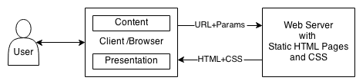
Two Tier with Layers
Extended Thin Client: Layers within the client tier handles the content and look/feel.
The content layer represents/stores the data
The presentation layer renders the data

Slide 29
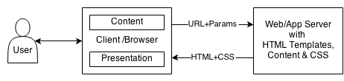
Two Tier with Layers & Servers
Extended Thin Client and Extended Server: Layers within the client tier handles the content and look/feel. The server now houses a web server and an application server.
Web Server handles incoming requests and send outgoing responses, routing them to/from the correct application server
Application Server is typically a script that dynamically generates a response given a request

Slide 30
Two Tier Issues
Distributed applications with a two-tiered architecture distinguish only:
client processes – control the application logic and the user interface
server processes – supply resources, such as data, to the clients
however this:
puts a lot of the load on the client
ties the client software to the database software so changes in each affect the other

Slide 31
Further Tiered Architectures
An improvement is to separate the application into three (or N-) tiers:
presentation processes deal exclusively with the user interface – this might, for instance, be through the use of a browser or other user agent
application processes deal with the logic of the application, queries, calculations, etc. – there is either one (3-tier) or more (N-tier) of such processes
data source processes supply the data from a database (binary) or a file (for instance, XML)
Notes:
Vertical and Horizontal

Slide 32
3- To N-Tier Architectures

Slide 33
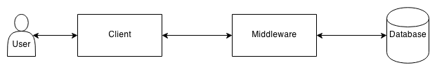
Three Tier Architecture
Basic Three Tier Architecture: where the client handle the interaction with the user, the middleware handles the application logic, and the database stores the data.
Database: persists and manages the data associated with the application.
Notes:
3-Tier Architecture is most commonly used to build web applications. In this model, the browser acts like a client, middleware or an application server contains the business logic, and database servers handle data functions. This approach separates business logic from display and data. So the 3 layers commonly known as: Presentation Layer(PL/UI),Business Logic Layer(BLL) & Data Access Layer(DAL).

Slide 34
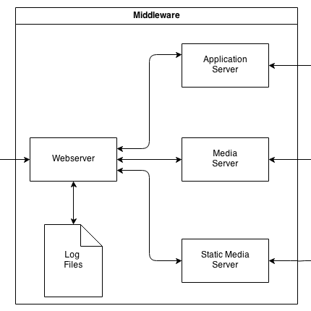
Middleware (Zoomed in)
Within the middleware tier, usually there is a webserver, an application server, and potential media servers.
Webserver: handles incoming responses, directing them to the appropriate server.
Servers could be on the same machine or different machines.

Slide 35
N-Tier Architecture
Client/Browser
Content
Load Balance
Server
Look and Feel
Web Server
Web Server
Web Server
App Server
App Server
App Server
Data Server
Data Server
Data Server
Data Repository
Data Repository
Data Repository
Notes:
N-tier data applications are data applications that are separated into multiple tiers. Also called "distributed applications" and "multitier applications," n-tier applications separate processing into discrete tiers that are distributed between the client and the server.

Slide 36
Load Balancing
There are two main ways to balance the load
Using a Domain Name Server such that when a URL is resolved, it rotates through a series of IP addresses that route the message to that machine.
Using a Load Balancing Server, which farms out the requests to available machines.
Machines in the farm inform the LB Server of their load so that the load can be balanced.
Notes:
[GAC] load balancing improves the distribution of workloads across multiple computing resources, such as computers, a computer cluster, network links, central processing units, or disk drives.
DNS is the Internet’s equivalent of a phone book

Slide 37
Tiered Architecture Benefits
Tiers enable the separation of concerns
Tier encapsulate complexity
they can be broken down into layers or into sub-tiers
Tiers can be distributed across a number of machines
Providing flexibility
Tiers can be replicated across a number of machines
Providing scalability

Slide 38
Group Registration: UPDATE
Groups for this course will now be assigned automatically
Self-formed groups won’t be used
If you’ve already formed a group, you may not stay in the same one
Your assigned group will be posted on Moodle
This change follows a School-level decision to make group work fair and consistent across courses. Sorry for any inconvenience this causes, and thanks for your understanding 🙂

Slide 39
System Architecture Design

Slide 40
Top Down Design
Starting from a high level design is useful because:
it helps to describe the system at a level which makes the goals, scope and responsibilities clear
the abstraction provides a tool for communicating the design
permits the specific technologies to be chosen late or to be changed
maintenance and re-usability also profit
accessibility variants can considered a priori

Slide 41
Bottom Up Design
Piecing together components to give rise to more complex systems, thus making the original elements sub-systems of the emergent system
Specific and basic individual components of the system are first developed
These elements are then linked together to form larger subsystems, which then in turn are linked, sometimes in many levels, until a complete top-level system is formed
This strategy often resembles a "seed" model, by which the beginnings are small but eventually grow in complexity and completeness.
Notes:
The bottom up design model starts with most specific and basic components. It proceeds with composing higher level of components by using basic or lower level components. It keeps creating higher level components until the desired system is not evolved as one single component. With each higher level, the amount of abstraction is increased.
Bottom-up strategy is more suitable when a system needs to be created from some existing system, where the basic primitives can be used in the newer system.
Both, top-down and bottom-up approaches are not practical individually. Instead, a good combination of both is used.

Slide 42
Top-Down vs. Bottom Up
Separates the low level work from the higher level abstractions
Leads to a modular design
Development can be self-contained (tiered)
Emphasizes planning and system understanding
Coding is late, and
Testing is even later
Skeleton code can show how everything integrates
Coding begins early and so Testing can be performed early
Requires really good intuitions to determine functionality of modules
Low level design decisions can have major impact on solutions
Risks integration problems – how do components link together
Often used to add on to existing modules

Slide 43
Notation for System Architecture Diagrams
Modified Dataflow Language where we have the following entities:
User
Client
Middleware
Database/Datastore
Logs/Files
External Service/Application
Communications/DataFlows

Slide 44

System Architecture Diagram: User
The user or client instigates and interacts with the services or applications provided
There are various clients including:
End Users (of varying abilities)
Administrators,
Developers,
Agents,
Other systems,
etc

Slide 45
System Architecture Diagram: Client
The client and the interface presented takes on many forms and can vary greatly:
Web Browser on a PC, Tablet, Mobile, etc
An API for other systems, agents, developers, etc
Devices and Robots
Sensors

Slide 46
System Architecture Diagram: Middleware (1)
The middleware houses an array of possible components from:
Domain Name Servers
Load Balancing Servers
Web Servers
Application Servers
Caching Servers
Typically the first three are predefined or configured using standard software
The Application Server is what is mainly of interest i.e. what needs to be developed.

Slide 47
System Architecture Diagram: Middleware (2)
Often represented as a single component that processes requests between the client and database.
Though encapsulates a number of other components

Slide 48
System Architecture Diagram: Databases
A database server is usually employed to handle the data management side of applications.
i.e. Postgres, SQLServer, MySQL
While the system is usually already in existence, it needs to be configured
i.e. the database tables have to be defined and populated.
To specify this part more precisely, ER Diagrams can be used.

Slide 49
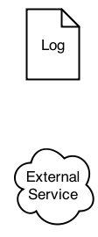
System Architecture Diagram: Logs and External Services
Logs represent data sinks
The application outputs data but does not read it back, directly.
External Services represent applications and services that are used by the application
They provide an API or interface of some kind that which can be used to interact with the service.

Slide 50
System Architecture Diagram: Messaging
The request message is sent to the server from a user agent to:
ask for some information
send some information to be stored
either from user input
or from some device (sensor)
The response message is sent from the server to a user agent to:
return the requested information
affect some change in the environment
Notes:
[GAC] Messaging is the outer layer of the middleware and how client and serve communicate. This slide gives a general overview of how messages are sent across. Make an analogy on how people communicate with WhatsApp or any other chatting app and how English is used to structure messages

Slide 51
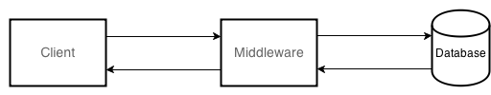
System Architecture Diagram: Data flows
Arrows are used to denote the flow of information
The direction of the arrow denotes the direction of the communication.
Most communications are both ways, where a request is made, followed by a response.
The client makes the requests.
This show how the entities are related.

Slide 52
System Architecture Diagram: Technology and Devices
For each box, we can state/specify the technology/device used, e.g.
Client: Web browser on a mobile device, using HTML/CSS/JS
Middleware: Apache Web Server, with an Application Server built using Django
Database: MySql Database Server
Chrome; Firefox; Edge
Apache Web Server; Django 4.1.5;Bootstrap
MySQL

Slide 53
Database ModellinG

Slide 54
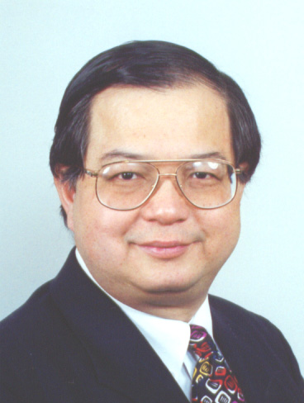
Entity Relationship Model
Provides an abstract representation of the data and how it relates to each other
Developed by Peter Chen in 1976
Lend themselves to being implemented in a database (esp. relational databases)
Three main components:
Entities,
Relationships and
Attributes

Slide 55
Notations
Lots of different notations
Chen’s
Bachman’s
Barker’s
Martin’s
Etc
Each support different ways to draw the ER model
We will be using a Compressed Chen Notation

Slide 56

Example
Many people live in one house
Rectangles represent Entities
Diamonds represent Relationships
1, N or M, represents the cardinality of the relationship
N and M mean Many (usually you put M)
Different notations use crows feet, etc.
Notes:
[GAC] http://www.conceptdraw.com/examples/crowfoot-notation
- YeD free ER diagram app: https://www.yworks.com/products/yed

Slide 57

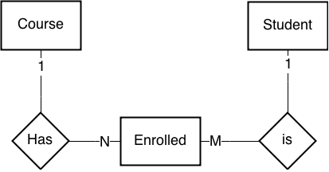
Many to Many
Many courses are taken by many students
Can be represented like:
Or like this:

Slide 58
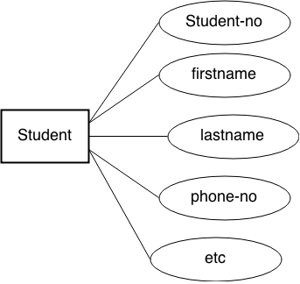
Chen vs Compressed Chen (1)
Chen Notation shows attributes as circles/ellipses
This gets pretty cumbersome

Slide 59
Chen vs Compressed Chen (2)
In compressed Chen notation, we only put entities and relationships in the diagram and then separately list the attributes
This way we can neatly represent the attributes and their types
STUDENT
Field | Type
Student No | Integer
Firstname | Char (128)
SecondName | Char (128)
Phone-no | Char (15), formatted
… | …

Slide 60
Converting to Django Models
As a rule, each entity becomes a model.
Then the relationship between the entities is specified using:
models.ForeignKey - denotes one-to-many
models.OneToOneField - denotes one-to-one
models.ManyToManyField – denotes m-to-n
See TWD Chapter 5 and https://docs.djangoproject.com/en/1.10/topics/db/examples/ for more details

Slide 61
Information Architecture

Slide 62
Information Architecture
The structural design of shared information
The combination of organization, labeling, search and navigation systems within web sites and intranets
The art and science of shaping information products and experiences to support usability and findability.
An emerging discipline and community of practice focused on bringing principles of design and architecture to the digital landscape.
More: http://www.uxbooth.com/articles/complete-beginners-guide-to-information-architecture/
Notes:
Information architecture is a task often shared by designers, developers, and content strategists. But regardless of who takes on the task, IA is a field of its own, with influences, tools, and resources that are worth investigation.
http://www.uxbooth.com/articles/complete-beginners-guide-to-information-architecture/
the purpose of IA is to help users understand where they are, what they’ve found, what’s around, and what to expect.
Information Architecture is concerned with organizing information – concepts, entities, relationships, functionality, events, content – into a coherent structure or “information space” that is comprehensible, navigable, and searchable.

Slide 63
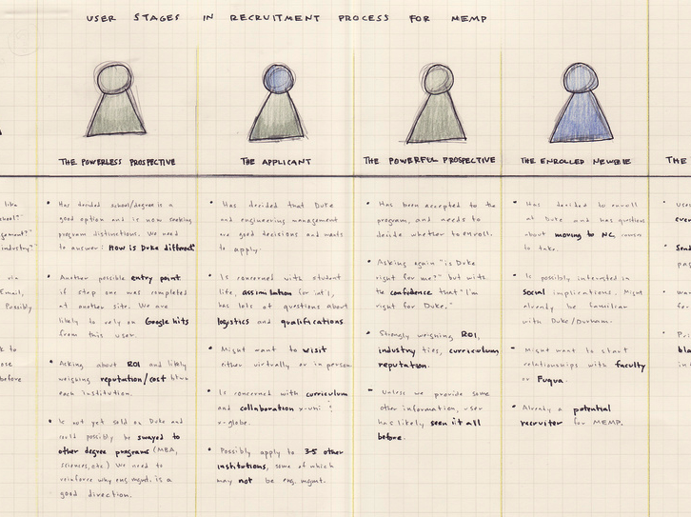
Thinking like a user

Slide 64
An Information Architect
- Assists to identify user-based requirements.
Is responsible for how users interpret and interact with information.
freeing up visual designers to concentrate on visual design elements and programmers to concentrate on code.
Investigate customers and their needs, factor business strategy and technology resources into solutions.
This is done long before programming begins
Can minimize loss of business and wasting of resources
Can increase and maintain revenue from customers
Notes:
[GAC] An information architect is the designer of information – analogous to a graphic designer

Slide 65
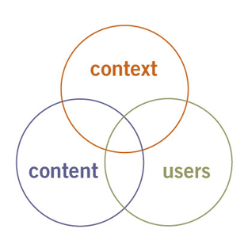
Context, Content & Users
Business Goals, Funding, Politics, Culture, Technology, Resources and Constraints
Document/Data Types
Content Objects,
Volume,
Existing
Structure
Audience,
Experience, Task, Needs,
information seeking behavior,
Rosenfield and Morville (the polar bear book): https://www.oreilly.com/library/view/information-architecture-for/0596527349/
Notes:
https://www.usability.gov/what-and-why/information-architecture.html
In order to create these systems of information, you need to understand the interdependent nature of users, content, and context. Rosenfeld and Morville referred to this as the “information ecology” and visualized it as a venn diagram. Each circle refers to…
More in: http://shop.oreilly.com/product/9780596527341.do

Slide 66
Developing Solutions
Context:
Information
Organization
Findability
Content:
Information
Design
Users:
Interaction
Design / User Experience (UX) Design
Usability
Understandability
Notes:
Intranets, Web applications, websites, software, etc.

Slide 67
IA Components
Navigation structures,
Taxonomy, Content
Search
Findability
Metadata,
Controlled
Vocabulary,
Labeling
Industry
Best Practices,
W3C standards,
Accessibility
Usability
Understandability

Slide 68
User Driven Approach
The fundamental questions an IA seeks to answer is:
Who is the user?
What do they need?
What will they see?
How will they interact with the system?
How will they get value from, accomplish their goals/tasks, etc?

Slide 69
IA Deliverables
To answer such questions, IA have a number of tools and techniques that they employ, these include:
Specifying user requirements
Showing the structure of the site through site maps
Showing the sequence of interaction through user flows
Mocking up Wireframes to show structure of screens/pages
Notes:
[GAC] http://www.fatpurple.com/2010/03/01/using-information-architecture-deliverables-examples-and-samples/

Slide 70
Specifying User Requirements
Many ways to specify user requirements
1. Simple list of requirements from the point of the user / User stories
As a < type of user >, I want < some goal > so that <some reason >.
2. Prioritized "User Needs" matrix
3. Personas

Slide 71
User Stories
Example Website: University Café Menu website
As a <student>, I want < to see today’s menu> so that <I can decide what to eat before going to the café>.
As a <student>, I want < to see the café’s opening hours> so that <I know when it’s open>.
As a <café manager>, I want <to change opening hours> so that <students know when it is open>
As a <café manager>, I want <to add or remove items quickly> so that <daily options can be displayed>

Slide 72
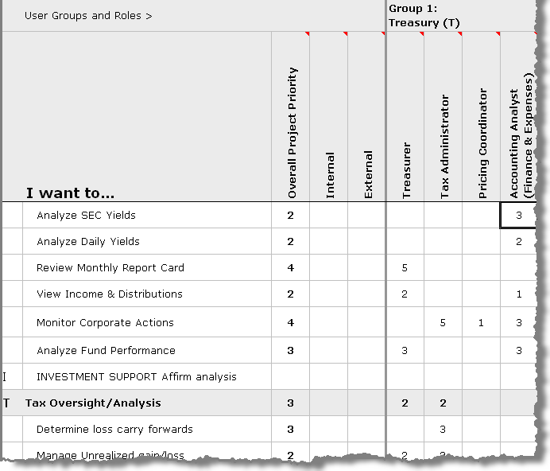
User Needs Matrix
A document to capture user needs of various site users and prioritize them accordingly.
Ensures that all user requirements are captured
Helps in prioritizing user needs and therefore helps in prioritizing page elements
Creates a snapshot view of the user eco-system
Notes:
Matrix structures are often useful for enabling users with different needs to navigate through the same content, because each user need can be associated with one "axis" of the matrix. For example, if some of your users really want to browse products by color, but others need to browse by size, a matrix can accommodate both groups. A matrix of more than three dimensions can cause problems, however, if you expect users to rely on it as their primary navigational tool. The human brain simply isn't very well equipped to visualize movement in four or more dimensions.

Slide 73
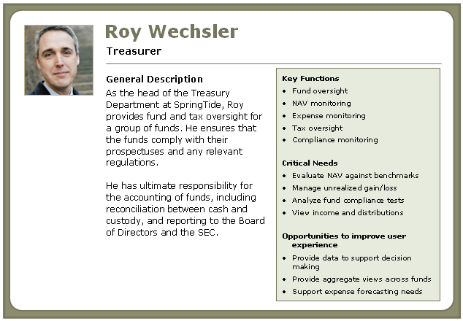
Personas
User archetypes to help to guide decisions about product features, navigation, interactions, and even visual design
Demographics (User group)
Needs (Goals)
Environmental (Context)
https://www.usability.gov/how-to-and-tools/methods/personas.html
Notes:
[GAC] More info: https://www.usability.gov/how-to-and-tools/methods/personas.html
Personas help to focus decisions surrounding site components by adding a layer of real-world consideration to the conversation. They also offer a quick and inexpensive way to test and prioritize those features throughout the development process.

Slide 74
Prioritizing User Requirements
MoSCoW method
Must have: essential for the primary user scenario (no workaround)
Example: sign up/log in; create/edit core item; view list/detail; input validated & saved
Should have: very important, but a temporary workaround exists
Example: search/filter; password reset; userprofile settings
Could have: nice-to-have if time allows
Example: dark mode, social sharing
Won’t have (this iteration): explicitly out of scope for now
Example: real-time chat

Slide 75
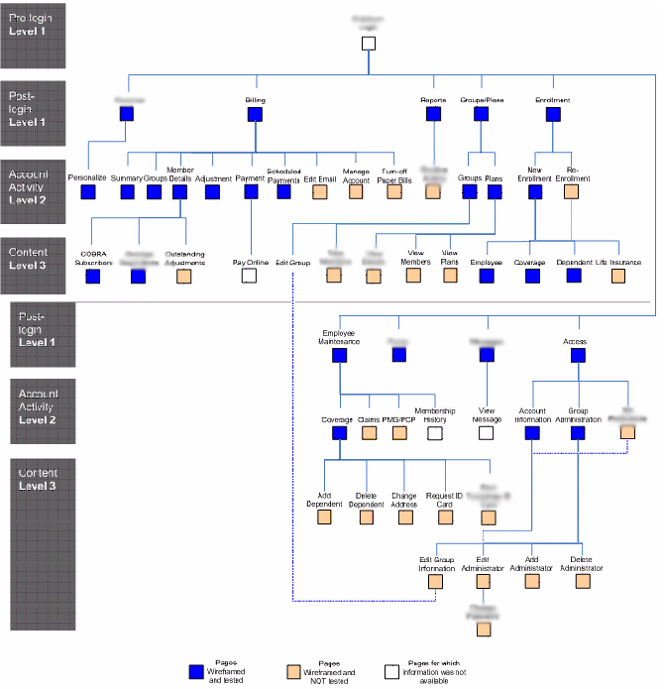
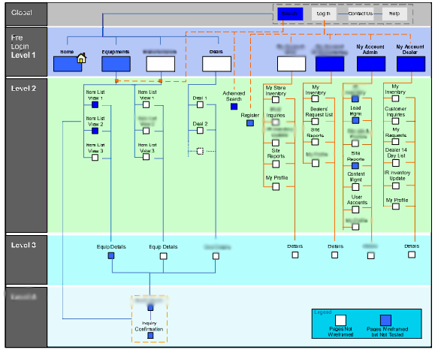
Site Maps
Blueprints that shows how the site is going to be organized (sections/URLs).
Provides the high level snapshot view and relationship between pages of the site.
Helps in restructuring the deep hierarchies.
Helps to figure out navigation.

Slide 76
URL Design Tips
URLs should be obvious, and inferable
URLs should use keywords, where possible
Shorter URLs are better
Try to avoid too many folders/depth
Use lowercase characters and avoid special characters in URLS
Use static URLS when you can
This lets users revisit the information/page
Means that crawlers can index the content
Notes:
http://www.mtu.edu/umc/services/web/resources/great-url/
It should be obvious. If a user can look at your URL and make an accurate guess about the contents of your page, you’re on the right track.
Use keywords when you can. Those golden keywords that you spent so much time researching can be utilized in your URL structure. Name your directories accordingly, using the keywords where appropriate.
Shorter is better. A short URL is easier to copy, paste, say, and write.
Never use multiple subdomains. If you can, avoid using subdomains altogether. They can be viewed separately from the primary domain, thereby negatively influencing your search engine ranking. If you must use a subdomain, make sure it is well interlinked within your site.
Avoid too many folders. A folder creates one more layer that search engines have to crawl through—omit unnecessary folders from your site structure.
Don’t use uppercase characters. URLs can accept both upper and lowercase characters, but that doesn’t mean you should do it. Keep your URLs simple and concise by using lowercase text—always.
Use static URLs when you can. Search engines treat dynamic and static URLs differently, so keep yours static—that means no random characters. “?^&” means nothing to your user.

Slide 77
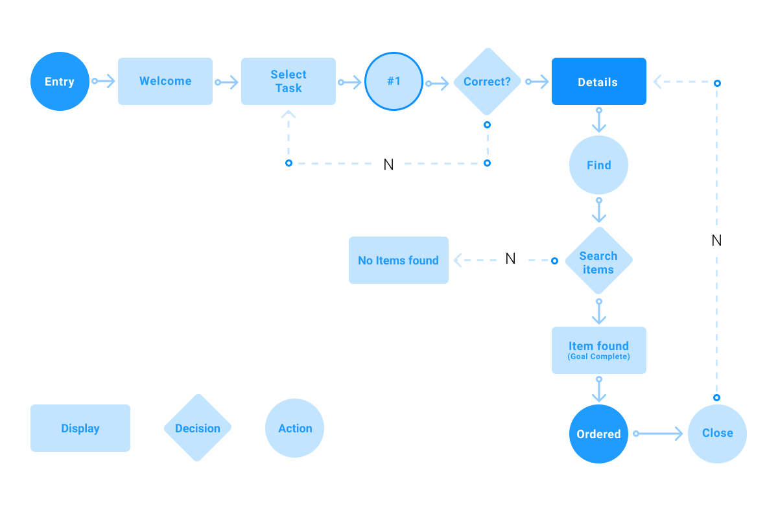
User flows
Diagram that shows how a user moves through the site accomplishing a task
Shows what a user has to accomplish to achieve a goal
Let’s you reduce complexity of interaction
https://careerfoundry.com/en/blog/ux-design/what-are-user-flows/

Slide 78
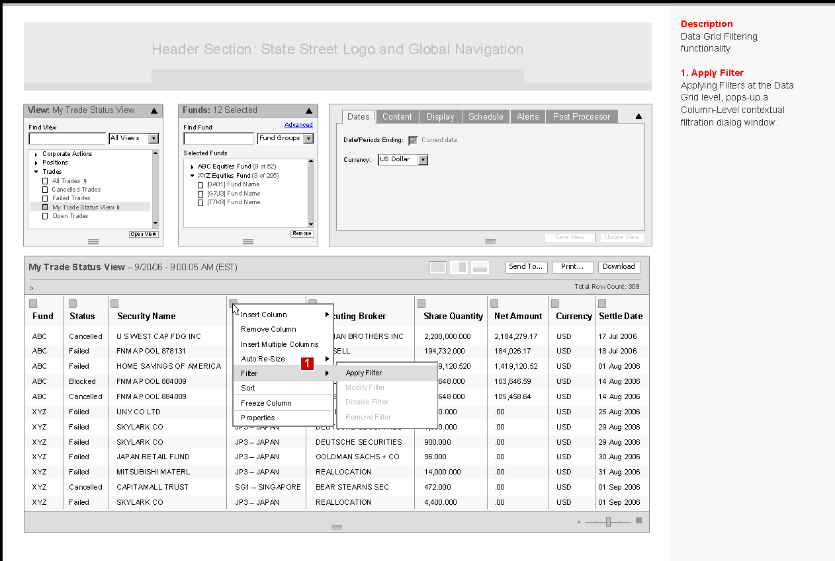
Wireframes
Depict how an individual page or template will look from an architectural perspective. They are the intersection of the site’s IA and its visual and information design.
Saves lot of time
Ideas can be presented without coding
Helps in validating page elements and structure with the user.

Slide 79
Drawing Wireframes (1)
Start by Sketching
Iterate!
Focus on Communication
Keep the wireframe simple, abstract, but representative.
Number/label components
Explain the functionality of each component
Map features to system specifications/requirements
Notes:
http://www.wireframewednesday.com/top-10-wireframe-tips-ux-booth
http://blogdesignguy.com/6-w

Slide 80
Drawing Wireframes (2)
Consider using a grid layout
Determine layout of the main components with boxes
Wireframe with the team in mind – what can be successfully developed?
Use real content – to show clients what to expect and what they will see
Notes:
http://www.wireframewednesday.com/top-10-wireframe-tips-ux-booth
http://blogdesignguy.com/6-web-wireframing-tips-for-the-absolute-beginner/

Slide 81
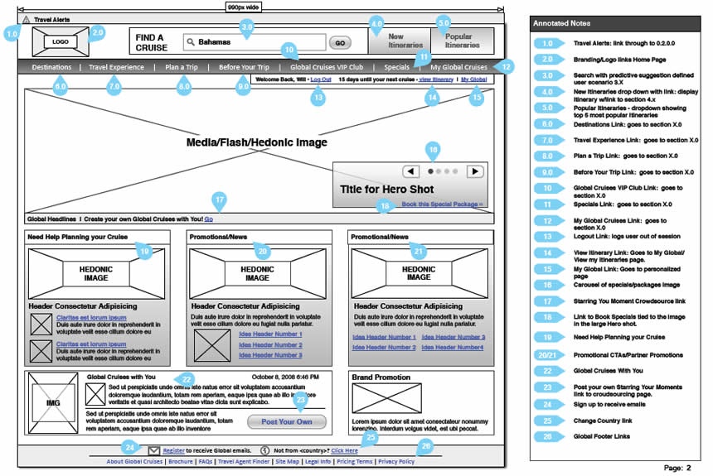
Example specification wireframe

Slide 82
Tools for drawing wireframes
Simplest: Neat drawings by hand
More presentable: Powerpoint, Balsamiq, Draw.io
Specialised tools: e.g. Axure RP
Also able to be interactive

Slide 83
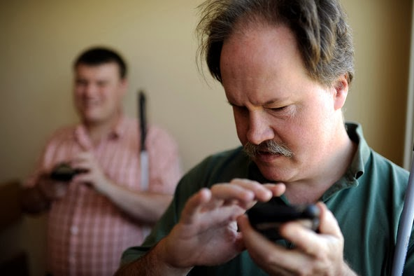
Accessibility
How can people with a disability access/use the web?
A very overlooked topic in web design!
A mixture of good design and coding
For example, always provide ALT text for images (even if it is empty)
Up to 20% of users have some form of disability
Standards and guidelines to make web accessible
Increasing focus on web applications rather than static web sites
https://www.w3.org/WAI/standards-guidelines/wcag/

Slide 84
Summary
Modern business and entertainment relies on web applications
System Architecture
Tiered system architecture aligns well with SE principles
System architecture is designed and expressed through diagrams
DB Modelling
Modeling through ERDs allows you to think about the data and its relationship
Allows you to implement them in a database
Can be directly translated to Django models
Information Architecture
Specifies the web application through the eyes of the user
Addresses findability, usability and understandability
Uses a variety of tools and techniques to communicate the design

