Slide 1
HTML, CSS and Bootstrap
Internet Technology
ITECH
Notes:
Lets get started by recapping the main concepts we have learnt so far –
N-tier architectures
Separation of Concerns
Top-Down vs. Bottom Up Design
Abstraction enables us to deal with complexities – and defer details – separate concerns – assign responsibilities
In passing, I also mentioned that there were ANTI-PATTERNS.. Paralysis by analysis (might result from top down)… while Spaghetti code (is likely to result from bottom up)
Pipe and Filter Architectures
Dataflow diagrams

Slide 2
By the end of Week 3...
By the end of Week 3, you should be able to:
Construct Structured HTML Documents
Apply CSS for Styling and Layout
Understand how front-end frameworks (e.g. Bootstrap) can ease web development
Understand Django Database modeling, and using data in templates (own study)
Learn about accessibility and sustainability in web design and development

Slide 3
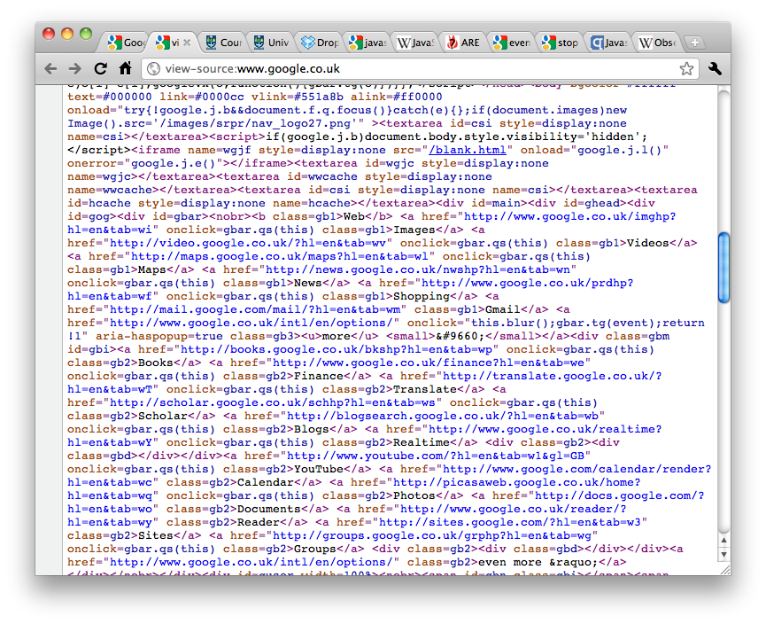
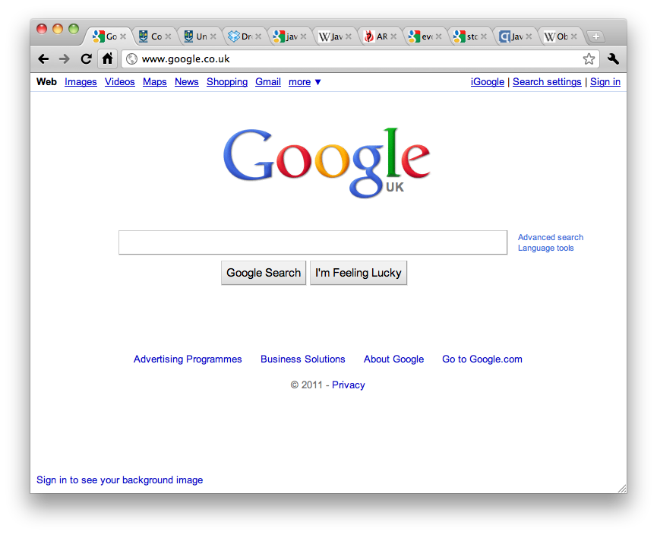
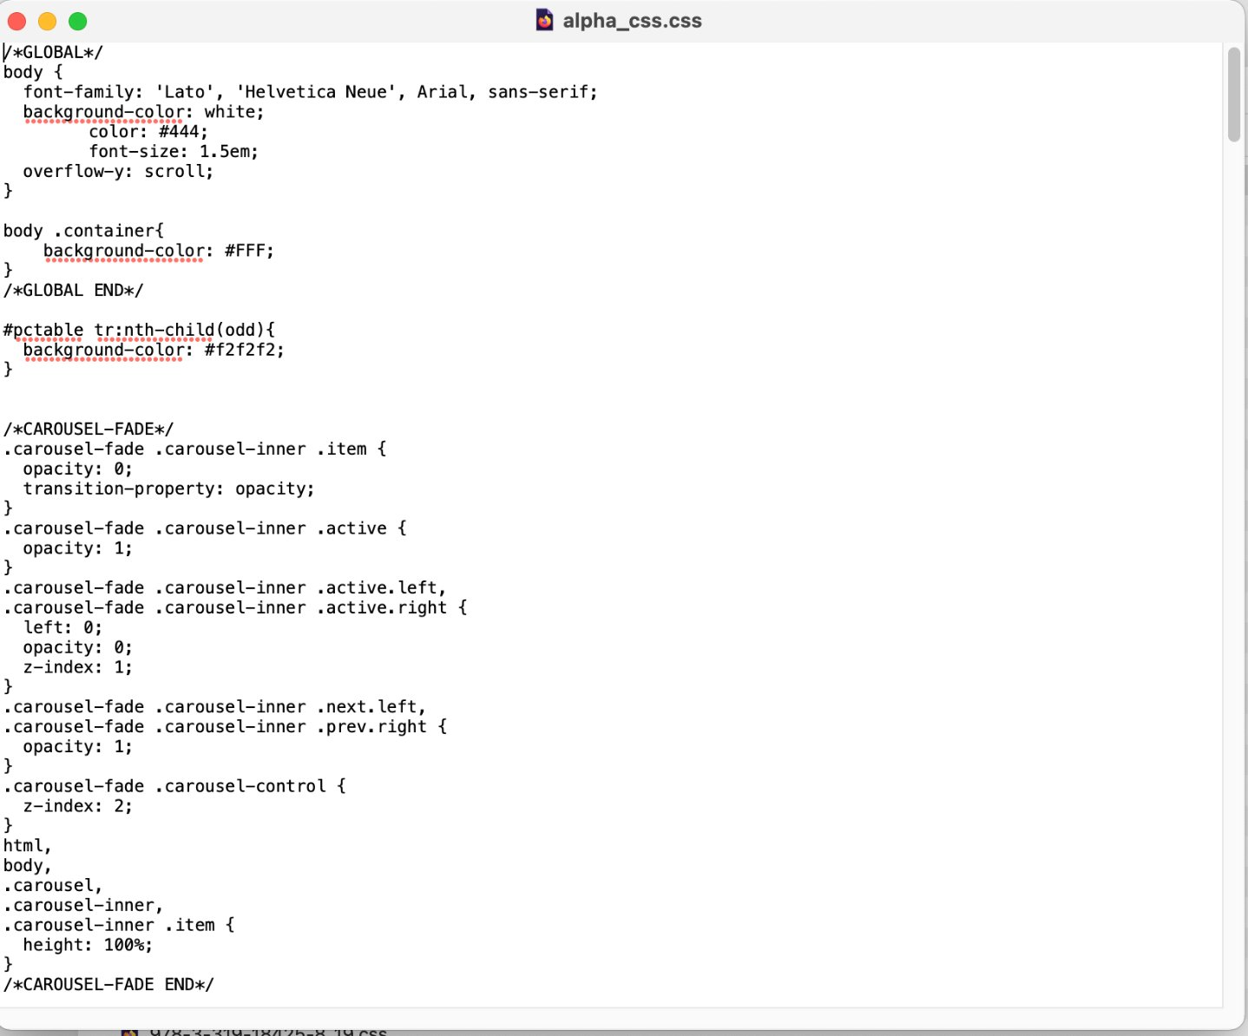
What is in a page?
HTML
CSS
Notes:
Rendered Web Page

Slide 4
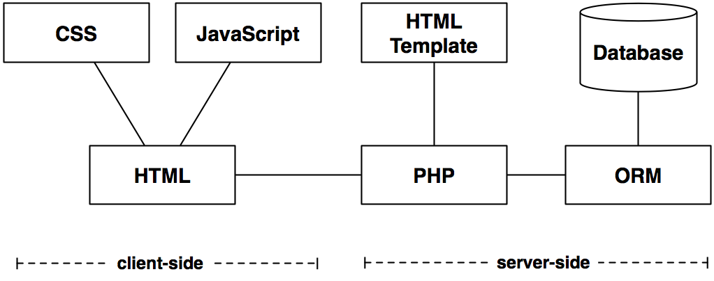
Client-side
Presentation
Processing
Content
Content
Python
Content
Processing
Processing

Slide 5
HTML, CSS, Bootstrap: Evolution
1990
HTML 1.0 introduced (by Tim Berners Lee at CERN)
XHTML introduced (HTML4 + XML)
CSS1 standardized (by the W3C)
2006
Bootstrap launched (by Twitter engineers)
1996
2000
2011
2014
2015
CSS3 (modular CSS)
HTML5 (enhanced semantics, multimedia support, APIs for web apps)
Bootstrap 4

Slide 6
Books
(legacy) Beginning HTML and CSS / Rob Larsen
The Absolute Beginner's Guide to HTML and CSS / Kevin Wilson
The HTML and CSS Workshop : Learn to Build Your Own Websites and Kickstart Your Career As a Web Designer or Developer / Lewis Coulson, Brett Jephson, Rob Larsen, Matt Park, and Marian Zburlea

Slide 7
HTML

Slide 8
What is HTML?
HTML stands for HyperText Markup Language
It is the language web browsers use to interpret what gets displayed when you view a website
Hypertext is the link between documents
A mark-up language is a set of tags which describe document content
HTML documents (webpages) contain HTML mark-up tags and plain text
Notes:
You see the result of HTML every single day
Do a view page source!

Slide 9
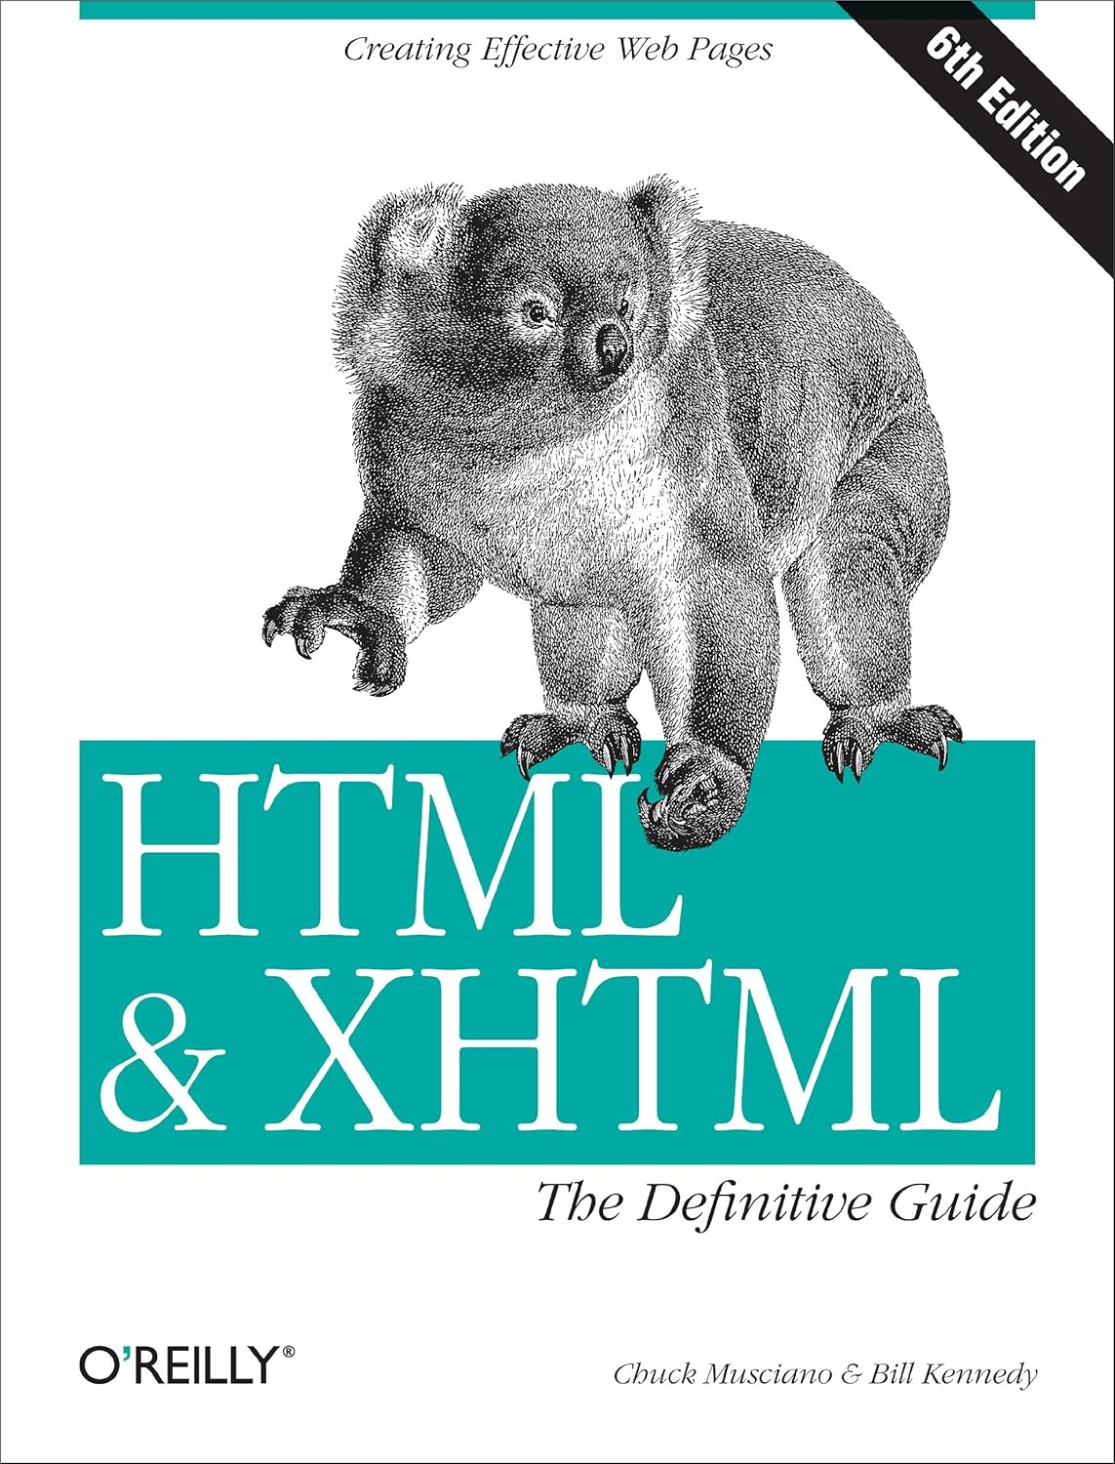
(X)HTML Guide & Reference or visit https://www.w3schools.com/html/

Slide 10
Basic HTML Example: Tags
<html>
<head>
<title> The title</title>
</head> <body> <h1>ISD</h1> <p>My first paragraph.</p> </body> </html>
Begin HTML now
Tags:
Keywords (tag names) surrounded by <>
Normally have opening and closing tags
Plain text:
Between tags
Is the content displayed in the browser
End HTML now
Notes:
Tags tell the browser something about the plain text between an opening and closing tag
e.g. <p> tells the browser it’s a paragraph
Note the basic structure of the html document – you have doctype at the top, we’ll discuss this later, it’s not really an html tag
you have html, surrounds the whole document
then head, and a body – this is the basic structure of all webpages – you need to have doctype, followed by html, head body

Slide 11
Basic HTML Example: HTML Document Structure
<html>
<head>
<title> The title</title>
</head> <body> <h1>ISD</h1> <p>My first paragraph.</p> </body> </html>
HTML Document Structure:
Tags are nested
Starts with <html> tag
<head> tag contains information about the document such as title and other things
<body> tag contains the html to be displayed
Notes:
By nested I mean one inside the other, must have html as the “root” tag, this means all others are contained within it
Then must have head and body – ONLY ONE OF EACH
The head contains info about the doc such as the title
The title appears in the browser tab
The body tag is where you put the html which is displayed by the browser in the main window
Here we have two tags

Slide 12
Basic HTML Example: HTML Elements
<!DOCTYPE html>
<html>
<head>
<title>The title</title>
</head> <body> <h1>Things to do</h1> <p>My first paragraph.</p> </body> </html>
Elements
Everything from an opening tag to a closing tag is called an element
The plain text between opening and closing tags is called the element content

Slide 13
Basic HTML Example: Empty Elements
<!DOCTYPE html>
<html>
<head>
<title>The title</title>
</head> <body> <h1>Things to Do</h1>
Make a HTML page<br>
Add a paragraph <p>My first paragraph.</p> </body> </html>
Empty Elements
There are some tags which have no content
They also have no end tag
e.g. <br> which forces a line break
Notes:
What do you remember about HTML – tags, opening and closing, surrounded by html tags, nested, collapsing white space
Must have html as the “root” tag, this means all others are contained within it
Then must have head and body – ONLY ONE OF EACH
Line break is where text is forced on to the next line, how will it look? show it to students

Slide 14
Basic HTML Example: Headers
<!DOCTYPE html>
Headers:
<h1> - “header 1”
Used just once
Defines the most important heading
Search engines use <h1> to defer the content of your web pages
There are h1,…,h6 headers. <h1> is the most important.
<html>
<head>
<title> The title</title>
</head> <body> <h1>Things to To</h1> <p>My first paragraph.</p> </body> </html>
Notes:
What do you think a header does?
NOT for sizing of text, though by default H1 has largest size getting smaller
Used to denote importance
use H1 just once, used by search engines to categorise your webpage, so better to improve ranking of page

Slide 15
Basic HTML Example: Paragraph
<!DOCTYPE html>
<html>
<head>
<title>The title</title>
</head> <body> <h1>ISD</h1> <p>My first paragraph.</p> </body> </html>
Paragraph:
<p> is the paragraph tag
Browsers add space (margin) before and after each <p> element
They ignore your own formatting
Notes:
'collapsing whitespace‘ - With only a few exceptions, HTML treats whitespace characters - treated as a single space and leading/trailing whitespace is eliminated.
Here’s a paragraph, denoted by p, again this is structure

Slide 16
Other useful HTML tags
List items / unordered list
<ul>
<li> List item one</li>
<li> List item two</li>
</ul>
Div elements let you create sections to divide up the page in different ways when coupled with CSS.
<div> </div>

Slide 17
HTML First
HTML First: A writing style for web development -- not necessary the best
If you can do it with HTML, use HTML
If you can’t do it with HTML, use CSS
If you can’t do it with HTML or CSS, use Javascript

Slide 18
HTML AND WEB SUSTAINABILITY

Slide 19



Web Sustainability
Carbon Footprint?
Total greenhouse gases emitted (tons of CO₂ )
Energy sources:
Increased data = Higher emissions
Data Centers: High energy use to store data
Networks: High energy use to transfer data
User devices: High emergy use to load/interact with data
Green energy:
Low emissions
Brown energy: High emissions
The internet produces ~4% of the world’s emissions (and increasing)
This Photo by Unknown Author is licensed under CC BY-SA-NC

Slide 20
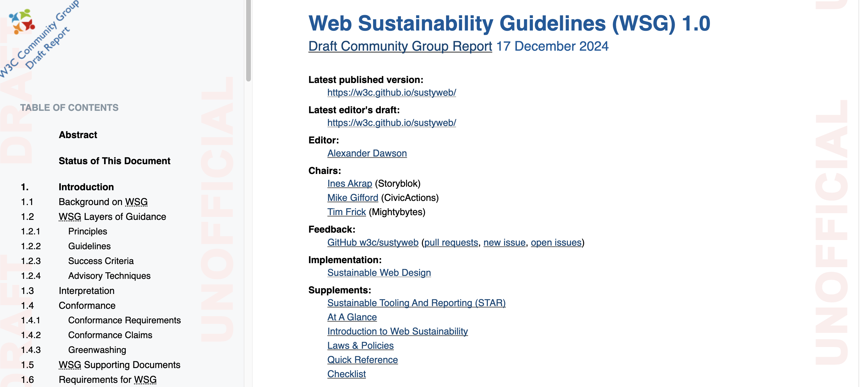
Web Sustainability Guidelines
Web Sustainability Guidelines: a working draft from the W3C
https://w3c.github.io/sustyweb/
24 guidelines relevant to Web Development (Section 3): https://sustainablewebdesign.org/guideline-categories/web-development/
” If the Internet was a country, it would be the 4th largest polluter” – Sustainable Web Manifesto
Products and services should:
Use clean energy
Use the least amount of energy
Be accessible
Not exploit/mislead users
Support an economy for people and the planet
Function in times and places where people need them the most

Slide 21
Web Sustainability and HTML
Guideline #3.2: Minify your HTML, CSS, and Javascript
- No value in whitespace
- Improves page loading times

Slide 22
Web Sustainability and HTML
Guideline #3.8: Use HTML elements correctly
- Bloated markup wastes data, increases energy
- Deprecated code is not optimized

Slide 23
Deprecated HTML Elements
Deprecated Element | Instead, use:
basefont, font | CSS font family, font size, color
<dir> | <ol>, <ul>
<strike> | CSS text-decoration
<center> | CSS text-align:center
<frame> | <iframe>, <frameset>
Useful sources:
ObsoHTML: A tool to find Obsolete HTML
https://blog.logrocket.com/deprecated-html-elements-and-what-to-use-instead
https://css-tricks.com/why-do-some-html-elements-become-deprecated/

Slide 24

Deprecated HTML
Only 0.5% of websites use valid HTML!
https://meiert.com/en/blog/html-conformance-2024/

Slide 25
Cascading Style Sheets

Slide 26
Style on the Web
Decisions of Style: Most aspects about any element of a web page can be controlled:
position, color, size, font etc
This can be achieved in any number of ways:
by describing the page in XML and then using XSL to generate formatted XHTML
by using Cascading Style Sheets in combination with XML
by using Cascading Style Sheets in combination with XHTML

Slide 27
Benefits of CSS
Cascading Style Sheets (CSS) is a method of separating a document’s structure and content from its presentation – remember separation of concerns?
CSS allows for a much richer document appearance than (X)HTML alone
CSS can save time as the appearance of the entire document can be created and changed in just one place
CSS can improve load times as it compactly stores the presentation concerns of a document in one place instead of being repeated throughout the document

Slide 28
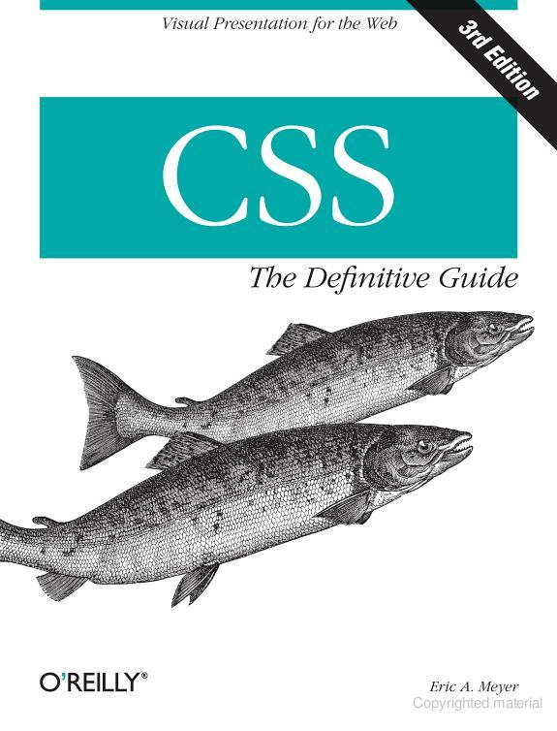
CSS Guide & Reference or visit https://www.w3schools.com/css/

Slide 29
Cascading Style Sheets
Stylesheets describe the rendering of html elements
they specify some style for individual elements or all elements of a particular kind
A CSS consists of a set of formatting rules, which are specified in the following way:
selector indicates the element (or set of)
property refers to the stylistic aspect
value is the specific configuration.
selector {
property1: value1;
property2: value2;
…
}
h3 {
color: yellow;
size: 18px;
…
}
Notes:
they can be attached to an (X)HTML document in several different ways (inline, embedded or external)

Slide 30
CSS: How to Find and Apply Pattern
p {
font-size: 12pt;
font-face: “Verdana”; }
h1, h2, h3 {
color: red;
font-size: 18px; }
*{ text-align: left; }
#menu a {
padding: 45px 25px 0px 25px;
border: none;
height: 80px; }
Apply to all <p> elements
Apply to all <h1>, <h2>, <h3> elements
Apply to all elements
Apply to all <a> elements with id=“menu”

Slide 31
CSS Values and Units
Units affect the colors, distances, and sizes of a whole host of properties of an element’s style
Numbers
can be integers or real numbers
Percentages
real number followed by %
generally relative to some other number
e.g. font-size:90% of the default or inherited value
Color
named color (e.g. ‘red’), functional rgb(0,0,255), or hexadecimal RGB codes (#FF0000)

Slide 32
CSS Length Units
Absolute Length Units
inches (in), centimeters (cm), millimeters (mm), points (pt – 72pt to 1 inch), and picas (pi – 1pi = 12pt)
Relative Length Units
em is relative to the given font-size value
e.g. font-size is 14px, 1em = 14px
ex is relative to the size of a lowercase x for the given font family
px is (should be) the size of a pixel on the monitor
px is generally the recommended unit to use

Slide 33
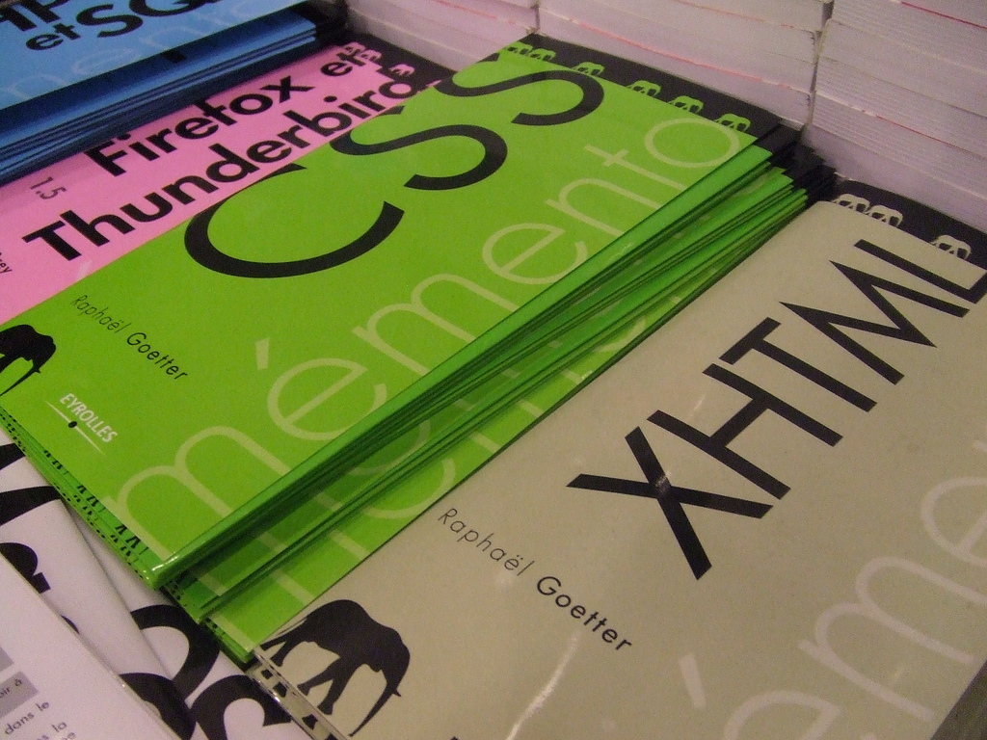
Using CSS with (X)HTML

Slide 34
Inline CSS Specification
Inline: within HTML
We add CSS syntax to one particular element
We use the style attribute in an HTML tag
Inline CSS only affects this element, and others of the same type are not affected.
Useful to override existing style
but...breaks the separation of content and presentation
<h3 style=“color: yellow; font-size: 18pt”>

Slide 35
Embedded CSS Specification
Embedded: In the <head> section of an HTML document
We add CSS style rules
The CSS rules will be applied to the entire document
<html>
<head>
<style>
h3 { color: yellow; font-size: 18pt; }
</style>
</head>
<body>
… <h3> This will be in yellow font size 18 </h3> …
</body>
</html>

Slide 36
External CSS Specification
External: In a separate document
The file extension is ".css"
The specified style can be shared by several pages
This is generally the best method in terms of:
Separation of concerns
Maintenance
Performance*
<head>
<link rel="stylesheet" href="master.css" type="text/css">
</head>

Slide 37
Specialization of Presentation
Class and ID selectors can be used for finer control
This involves more planning/effort with document markup
But can result in a better user experience
It is also very important for manipulating elements in Javascript
The effort also pays off if you use libraries like JQuery
Class selectors: work on a set of specified elements through the class attribute
ID selectors: provide a way to stylize unique elements through the id attribute

Slide 38
Class Selectors
Class selector allow you to style items with the same (X)HTML element differently
They work when the class attribute of an HTML tag is given a name
The dot (.) operator is used to define the class
<style>
*.warning {font-weight: bold;}
</style>
<p class="warning">This text will be displayed in bold.</p>
<p>This text will NOT be displayed in bold.</p>

Slide 39
ID Selectors
Similar to class but they define a special case for an element
IDs are meant to be unique and only used once
However, browsers are not particularly fussy about enforcing the uniqueness of identifiers
The hash symbol (#) is used to specify a unique ID
<style>
#first-para { font-weight: bold; }
</style>
<p id=“first-para”>This paragraph will be bold-faced</p>
<p>This will not be bold</p>
Notes:
“octothorpe” or hash symbol

Slide 40
Combining selectors
You can combine selectors into lists
<style>
.warning, h1 {color: red;}
</style>

Slide 41
Pseudo-classes and pseudo-elements
You can also style certain states of an element or certain parts of elements
<style>
a:hover {color: red;}
p::first-line {color: blue;}
</style>

Slide 42
Descendent Selectors
Elements that are descended from a particular element are styled according to the rule of the descendent selector
This means that the rules will be applied to a set of elements in one context but not in another
<style>
p em { color: red; font-weight: bold; }
</style>
<body>
<p>this will be the default color
<em>this will be coloured red and bold</em>
back to the default colour</p>
</body>
Notes:
Another variation on the CSS selector takes advantage of the hierarchical structure of HTML documents
//not to be confused with ‘comma’ grouping
</style>

Slide 43
Cascading Style Sheets
You might specify conflicting rules in your CSS e.g. different values of the same property apply to the same element
In this case it’s important to understand how these rules get sorted out through cascades, specificity and inheritance

Slide 44
Inheritance of Style
The order of application of styles is through inheritance
Styles are applied not only to a specified element, but also to its descendants
For example, below <em> will inherit the style of its parent <p>
<style>
p { color: red;
font-weight: bold }
</style>
<body>
<p>happily grey <em>really emphasizing redness</em></p>
</body>

Slide 45
Specificity of Style
Sometimes more than one rules apply to the same element
When rules conflict, CSS uses weights to decide which one applies
Adds a specificity weight
Specificity order (highest → lowest):
ID selectors #header
Class / attribute / pseudo-class .menu, [type="text"], :hover
Element selectors div, p, h1, ::before
Calculator: https://specificity.keegan.st/
h1 {color: red;} /* specificity = 0,0,1 */
body h1 {color: green;} /* specificity = 0,0,2 */
#content h2 {color: silver;} /* specificity = 1,0,1 */
h2.grape {color: purple;} /* specificity = 0,1,1 */
h2 {color: silver;} /* specificity = 0,0,1 */

Slide 46
Cascade of Style
However, sometimes there is still a conflict between two or more rules.
i.e. if they all have the same weight
CSS is based on a method of causing styles to cascade together, which is made possible by combining inheritance, specificity and order
The purpose of “cascading” is to find one winning rule among a set of rules that apply to a given element
In essence, if two rules have the same specificity, then the one that is defined last in the stylesheet wins!

Slide 47
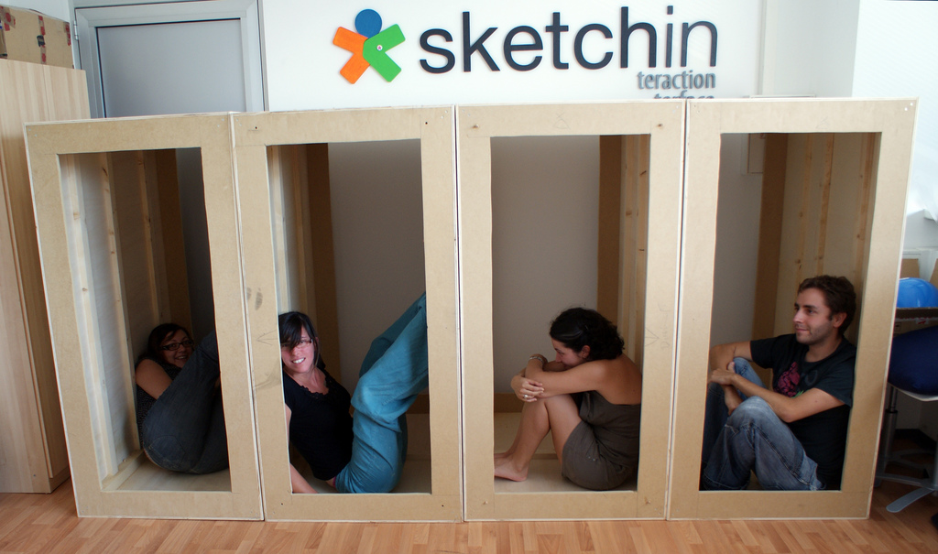
The Box Model

Slide 48
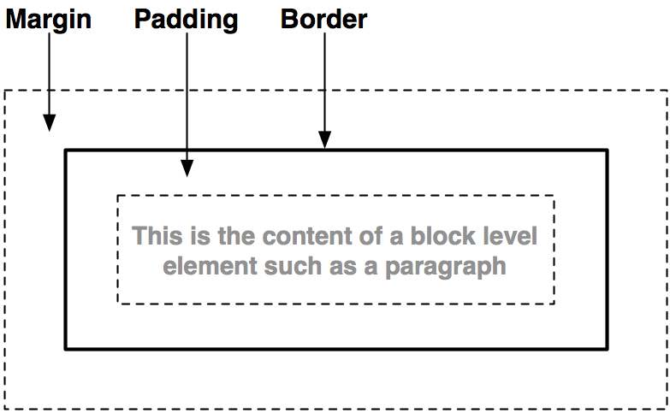
The Box Model
Every element generates one or more rectangular element boxes which houses the content. The element box is surrounded by optional amounts of padding, borders, and margins.
Notes:
CSS assumes that every element generates one or more rectangular boxes, called element boxes
each element box has a content area at its core
the content is surrounded by optional amounts of padding, borders and margins

Slide 49
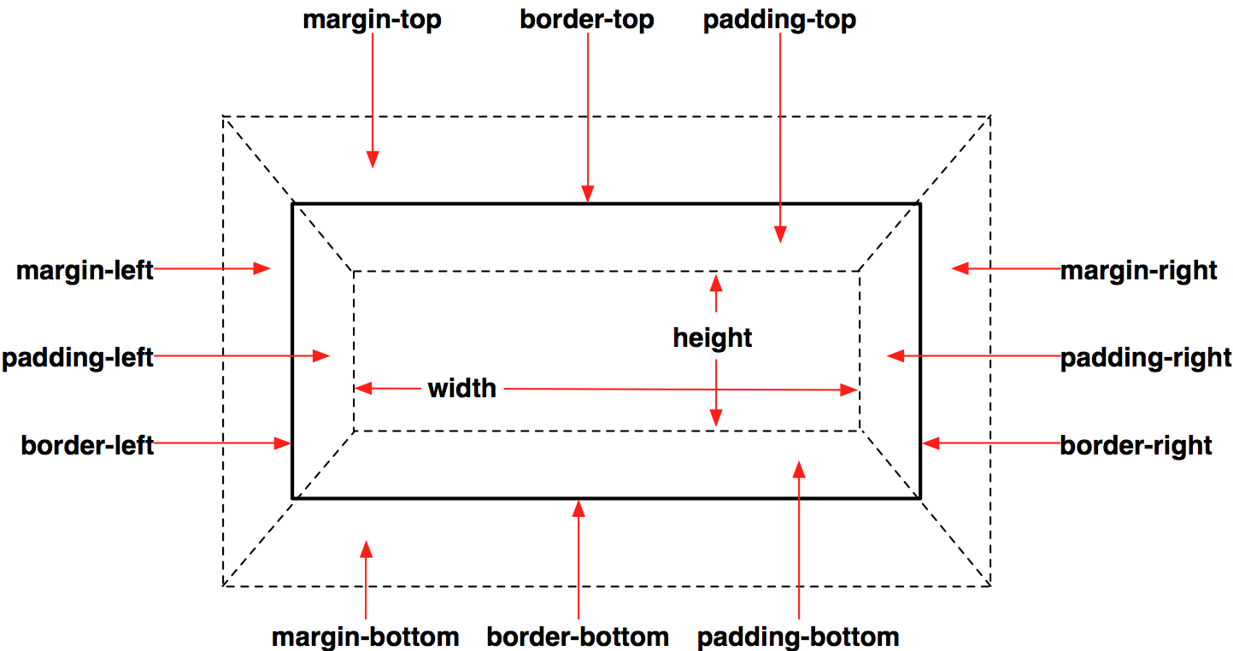
Box Model Properties

Slide 50
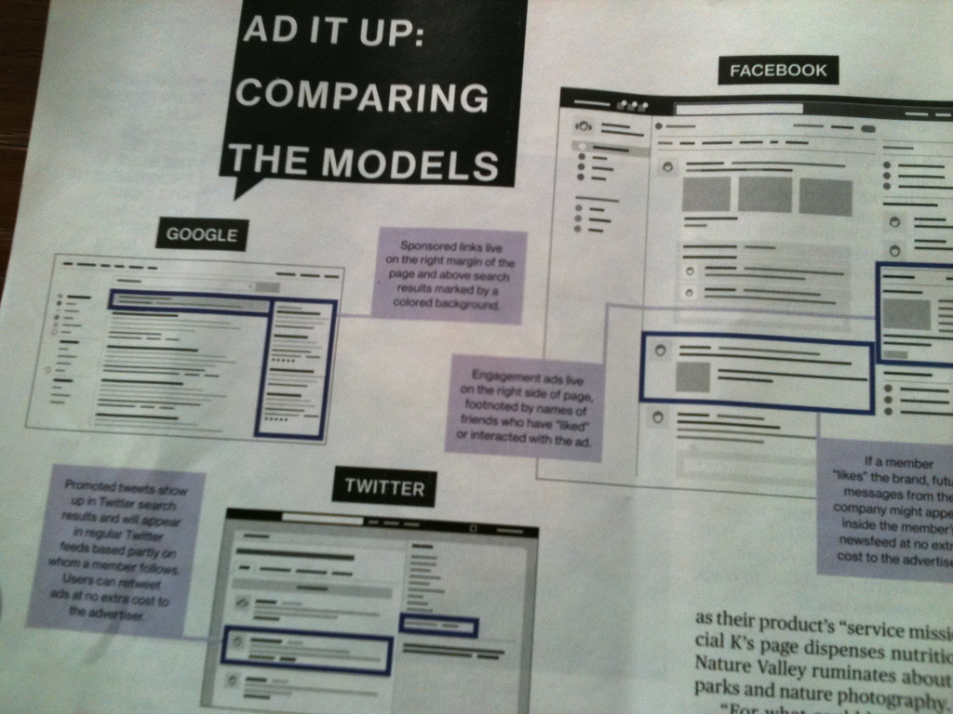
Page Layout

Slide 51
Page Layout
Layout of major elements on a webpage (e.g. columns, navigation bars, sidebars, headers and footers) can be specified using CSS
In bygone days, tables were heavily used for layout
simple to use for simple tasks
painful for complex layout
tables are meant for content, not layout
not accessible for impaired users
The preferred solution is to divide a page into a collection of <div> (division/section) elements
<div id=“header”> … </div>
<div id=“sidebar”> … </div>

Slide 52



Floating
CSS floating properties allow you to float elements horizontally.
Elements can be floated: left and right, but not up and down!
Elements after the floating element will flow around. So if screen size changes elements will move down.
<head><style type="text/css" media="screen">
.thumbnail {
float:left;
width:110px;
height:90px;
margin:5px; }
</style> </head>
<body>
<img class="thumbnail" src="klematis_small.jpg”>
<img class="thumbnail" src="klematis2_small.jpg”>
<img class="thumbnail" src="klematis3_small.jpg">
</body>
Notes:
Elements are floated horizontally, this means that an element can only be floated left or right, not up or down.
A floated element will move as far to the left or right as it can. Usually this means all the way to the left or right of the containing element.
The elements after the floating element will flow around it.
The elements before the floating element will not be affected.

Slide 53
Positioning
CSS positioning properties allow you to position an element.
Elements can be positioned using: top, bottom, left and right properties.
There are four different ways to position: static (default), fixed, relative and absolute.
<style type="text/css" media="screen">
div {
border: 1px solid #999;
margin: 20px; }
div.fixed {
position: fixed;
top: 30px;
right: 5px; }
div.Relative {
position: relative;
top: -50px; }
div.Absolute {
position: absolute;
left: 100px;
top: 150px; }
</style>
Notes:
The CSS positioning properties allow you to position an element. It can also place an element behind another, and specify what should happen when an element's content is too big.
Elements can be positioned using the top, bottom, left, and right properties. However, these properties will not work unless the position property is set first. They also work differently depending on the positioning method.
Fixed: will stay there even if I scroll Absolute: fixed position within its block Relative: relative to its container
Static Positioning
HTML elements are positioned static by default. A static positioned element is always positioned according to the normal flow of the page.
Static positioned elements are not affected by the top, bottom, left, and right properties.
Fixed Positioning
An element with fixed position is positioned relative to the browser window.
p.pos_fixed
{
position:fixed;
top:30px;
right:5px;
}
Relative Positioning
A relative positioned element is positioned relative to its normal position.
h2.pos_top
{
position:relative;
top:-50px;
}
Absolute Positioning
An absolute position element is positioned relative to the first parent element that has a position other than static.
h2
{
position:absolute;
left:100px;
top:150px;
}

Slide 54
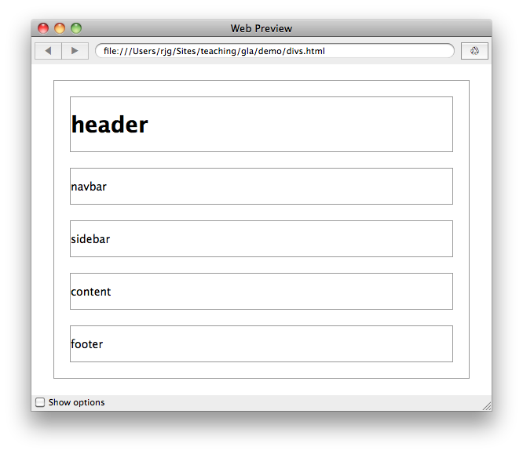
Floating & Positioning
<head>
<style type="text/css" media="screen">
div { border: 1px solid #999;
margin: 20px;}
</style>
</head>
<body>
<div id="page">
<div id="header"> <h1>header</h1> </div>
<div id="navbar"> <p>navbar</p> </div>
<div id="content"> <p>content</p> </div>
<div id="sidebar"> <p>sidebar</p> </div>
<div id="footer"> <p>footer</p> </div>
</div> <!-- end of page -->
</body>

Slide 55
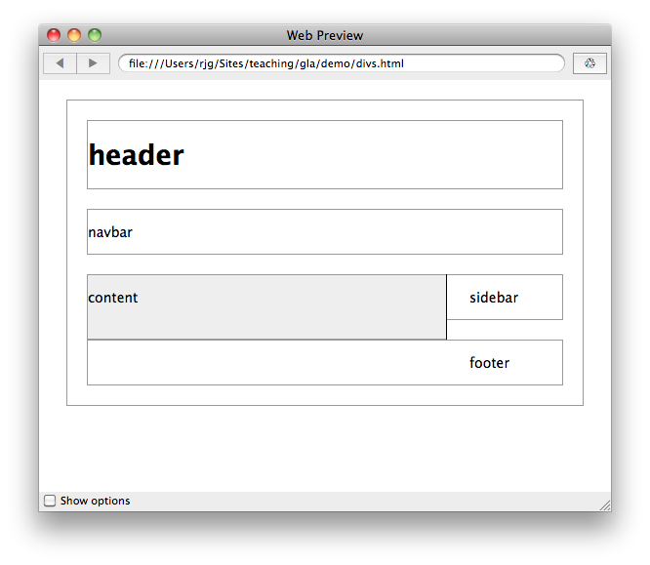
Floating and Positioning
#content {
float: left;
width: 67%;
background: #eee;
margin-top: 0;
margin-right: 1.67em;
border-right: 1px solid black;
padding-top: 0;
padding-right: 1em;
padding-bottom: 20px;
}

Slide 56
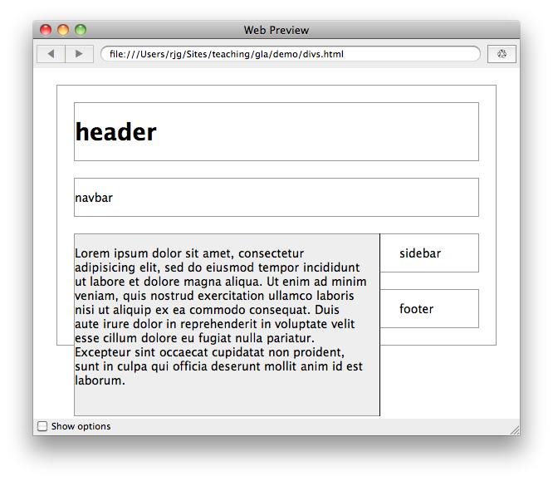
Floating and Positioning
Due to the natural flow
layout, the footer block
has appeared in the incorrect location.

Slide 57
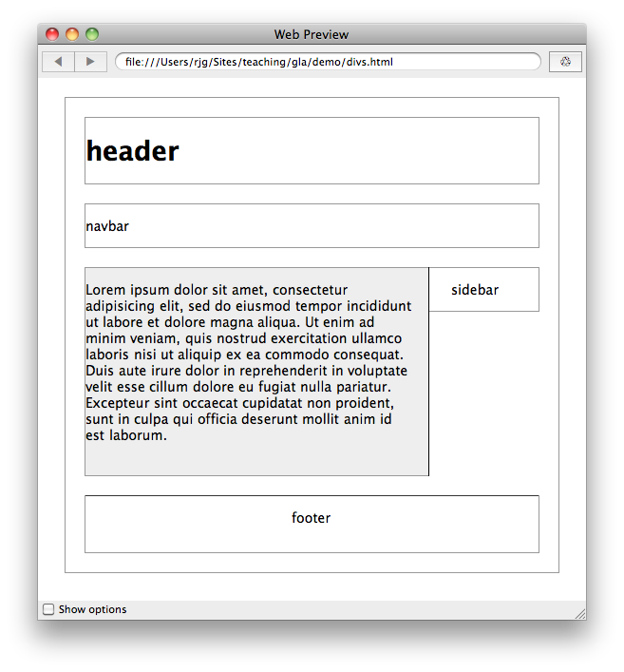
Floating and Positioning
#footer {
clear: both;
padding-bottom: 1em;
border-top: 1px solid #333;
text-align: center;
}

Slide 58
New Layouts
Laying out pages with just floats and positioning is incredibly tricky and tedious
Newer methods like Flexbox and Grids solve some of these issues
These newer methods are also responsive so can deal with different screen sizes

Slide 59
CSS Properties
The full list of properties can be found: https://www.w3.org/TR/CSS/#css
Compact CSS Cheatsheets are useful: http://www.lesliefranke.com/files/reference/csscheatsheet.html
background-color | border-width | font-family | height | size
text-align | width | color | font-size | margin
padding | list-style | position | text-decorations | ~100+ more!

Slide 60
Web sustainability and CSS
CSS helps avoid duplication
One CSS class to handle everything
CSS helps ease of management and code readability
CSS makes it easier to design responsive content for different devices

Slide 61
Web sustainability and CSS
Guideline #3.6: Avoid code duplication
- CSS add more code to your markup, but improve maintainability
- Repetitive code increases energy

Slide 62
Web sustainability and CSS
Guideline #3.6: Avoid code duplication
- CSS add more code to your markup, but improve maintainability
- Repetitive code increases energy

Slide 63
How should I structure my CSS?
Write CSS for sections or files
Search for duplicate declarations
Check order
Determine which rule should come first
Remove duplicate declarations

Slide 64
Web sustainability and CSS
Guideline #3.13: Adapt to User Preferences
- Users often have preferences that are more environmentally-friendly
- CSS media/preference queries should enable users, e.g. monochrome, prefers-reduced-data, prefers-reduced motion, prefers-color-scheme

Slide 65
Web sustainability and CSS
Guideline #3.14: Develop a Device-Adaptable Layout
- Many different types of devices: desktops/laptops, mobiles, tablets, watches, TVs with different screen sizes, memory, power/energy require appropriate layouts
- Smaller devices are underpowered

Slide 66
Device-adaptable layouts
Responsive design:
Fluid pages that adapt to screen size
Modern CSS layout methods are responsive (Flexbox, Grid)
Optimized photos, graphics, media
Resize images for different devices, reduce page weight
Images are ~50% of a desktop page weight
Dark mode - proceed with caution! https://www.businessinsider.com/guides/tech/does-dark-mode-save-battery?r=US&IR=T

Slide 67
Mobile First
Mobile First: A guideline for web designers to aid sustainability
Determine a budget for your page weight
The median webpage is 2.3MB – 600% up in the last 10 years
Optimize media
Remove unnecessary elements
Minify HTML, CSS, Javascript

Slide 68
What is Bootstrap?
Another web application framework (WAF) for front-end development
Very commonly used toolkit for designing and styling responsive web applications
Provides layouts, containers, elements, examples, themes (and JavaScript!)
Advantages
Easy to use
Responsive features
Mobile-first approach
Cross-browser compatibility

Slide 69
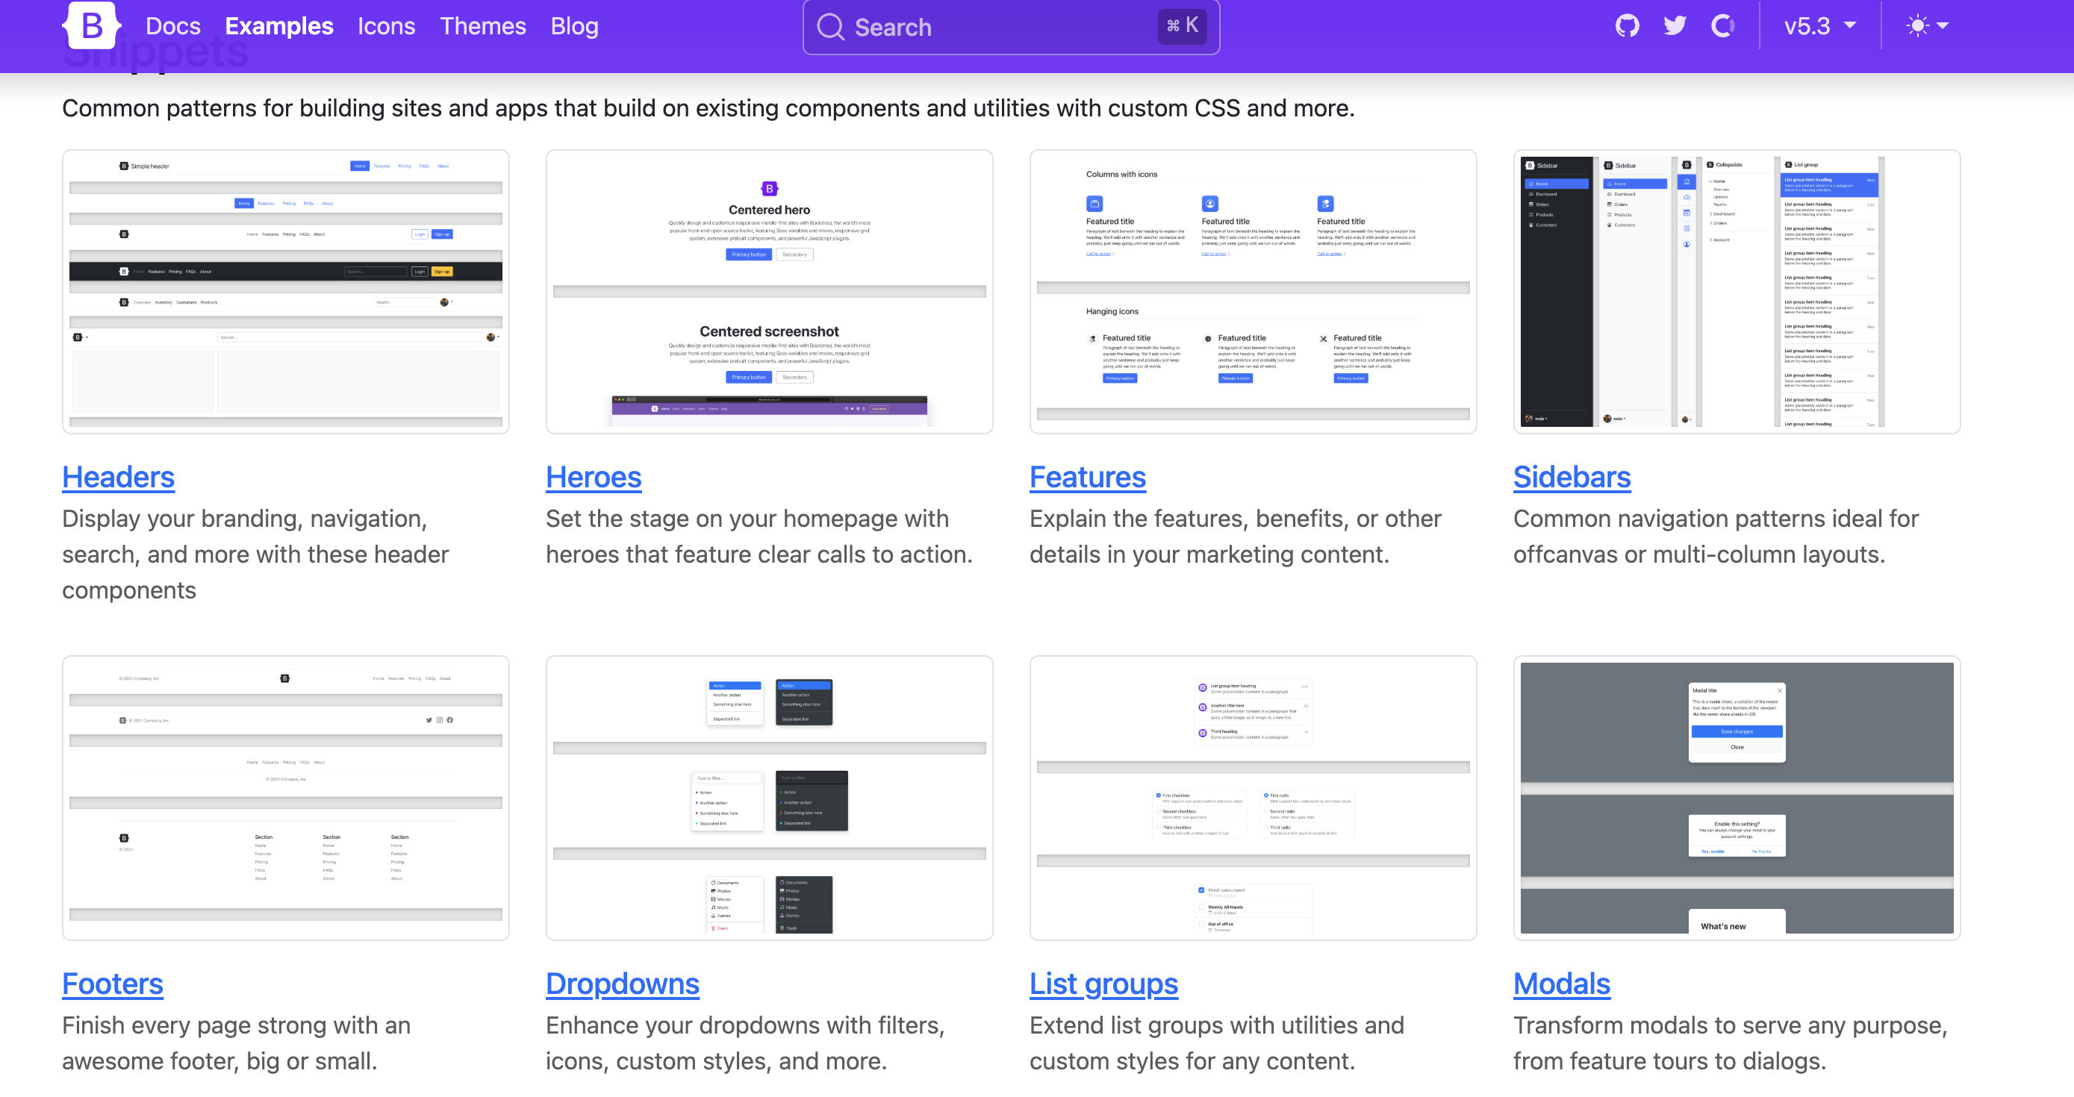
Boostrap examples

Slide 70
Using Bootstrap
https://getbootstrap.com/ provides different releases. Latest is 5.*, TWD book uses 4
Go to w3schools and follow the tutorial (also other good resources out there)
Download an example and adapt it

Slide 71
Summary
Covered two major building blocks of web pages
HTML is the basic building block of the web using a markup language to provide content and structure
CSS is a powerful method of specifying the style of web pages
separates presentation from structure and content
Bootstrap is a toolkit to help design responsive web pages

