Slide 1

TAKE HOME TASK
(BikeHub trip duration)

Slide 2
Hubway Trips data
Following columns removed as didn’t carry any information:
seq_id
hubway_id
status
end_date
end_statn
Some of the independent variables contain NULL values:
birth_date – 78% data missing
Gender – 30% data missing
Zip_code – 30% data missing

Slide 3
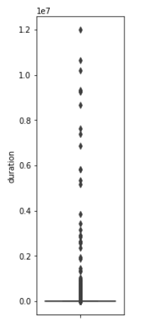
Target variable issues
Duration variable boxplot
Extremely high values
median = 11 min
75th percentile = 18 min
max value = 137 days
Negative values
0.2% of values are <= 0
Extremely low values
values like 3 seconds are too small considering nature of target variable

Slide 4
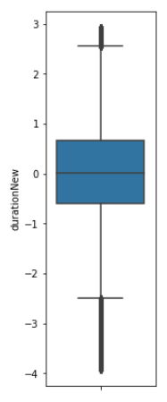
Target variable action taken
Before transformation
Before transformation
Extremely high values
Clipped at 99.5th percentile
Transformed with PowerTransformer
Negative values
All data points with negative values removed
Extremely low values
All data with duration less then 00.5th percentile removed
Transformed with PowerTransformer

Slide 5
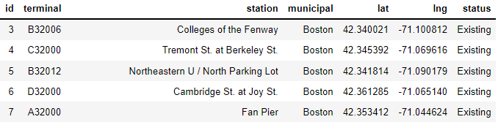
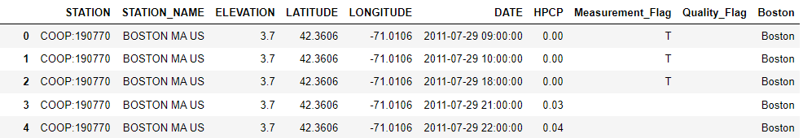
Additional data
Hubway stations
Merged using stations_id
Only using municipal feature
Removed data where station status is ‘Removed’ (5% of data)
Weather
Merged using municipal == ‘Boston’ and trip start_date (hour)
Only using HPCP feature
Only covers Boston (76% of data)

Slide 6
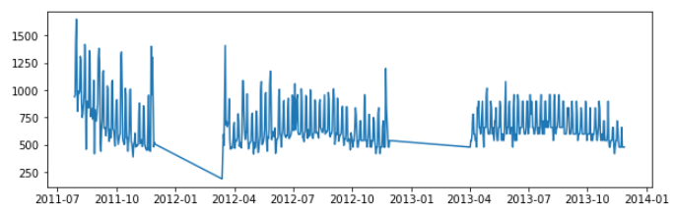
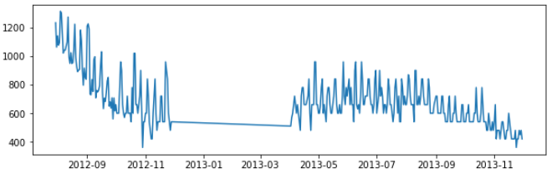
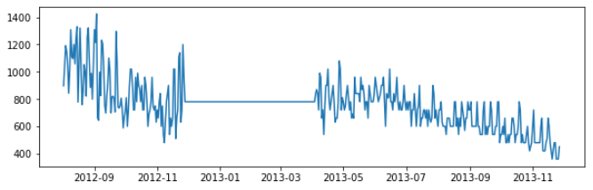
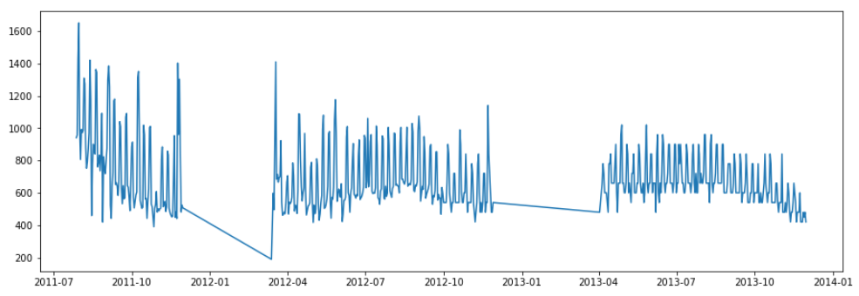
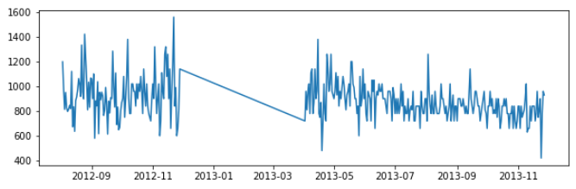
Target variable over time
Target is of a sequential nature
Seasonality
Different patter for 1 year and similar in each city
Boston
Cambridge
Duration variable daily median trend
Somerville
Brookline

Slide 7
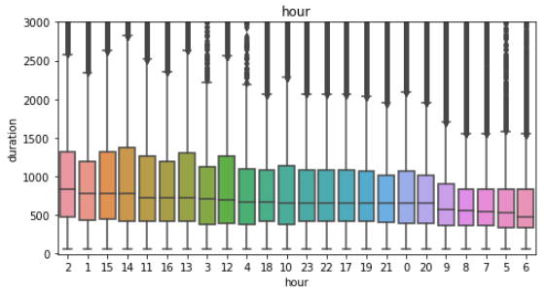
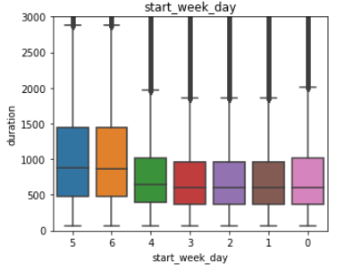
Target variable time dependencies
Target variable shows different behaviour based not only on time of year.
Duration of a trip varies depending on hour and weekdays
Duration by hours
Duration by weekdays

Slide 8
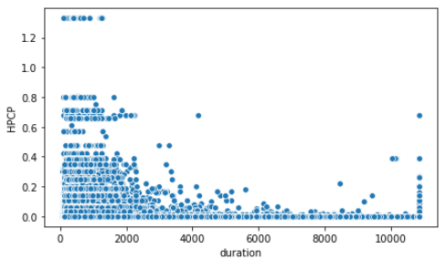
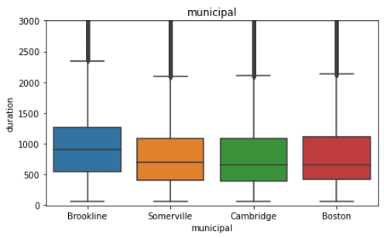
Target variable other dependencies
For almost all the categorical variables - duration differs between group
For municipal – only different for Boston
Slight dependence between duration and HPCP
No dependence between age and duration of trip
Duration over HPCP
Duration by municipal

Slide 9
Features created
Numerical
Age - is a substitute to birth date feature
Duration mean, same day week ago
HPCP mean, same day week ago
Duration mean, same day week ago same part of day
HPCP mean, same day week ago same part of day
Duration mean, 1 day ago same part of day
HPCP mean, 1 day ago same part of day
Duration mean, 2 day ago same part of day
HPCP mean, 2 day ago same part of day
Duration mean, 2 day ago same part of day
HPCP mean, 3 day ago same part of day
Duration mean for previous week
HPCP mean for previous week
Duration mean for previous week, same part of day
Categorical
Day of week
Start or ongoing service
Hour of day
* Numerical features chosen in a way so that there is on strong correlation between them

Slide 10
Handling missing values
Some of the features in data, both natural and generated contain missing values and may need to be handled
Categorical
Values imputed with ‘na’
Numerical except Age
Fraction less than 1%
Left as is (model handles internally)
Alternative : impute using clustering or other more advanced approaches
Age
Only 20% present
Left as is (model handles internally)
Alternative: make categories by creating bins, assign missing values to ‘na’

Slide 11
Model
Model used – LGBM
Hyperparameters tuned using Optuna software
Trained on RMSE objective
RMSE 827 on test set (20% of data)
*Alternative model build that’s is running LSTM on ‘duration’ and concatenates output to non-sequential features, then performs regression

Slide 12
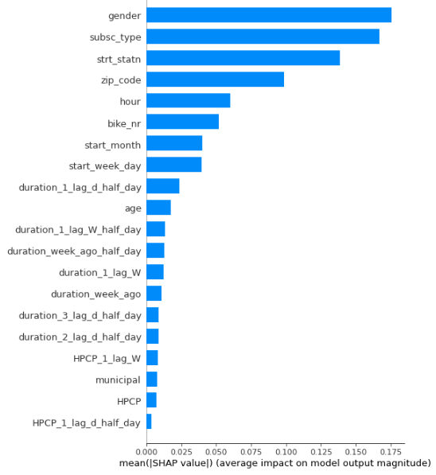
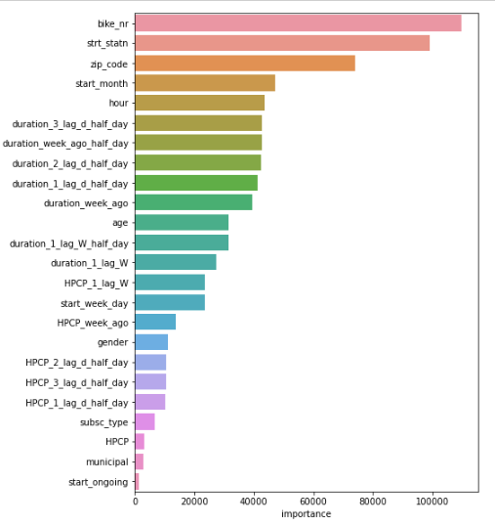
Model importance
SHAP values feature importance
LGBM feature importance

Slide 13
TO DO
Test the alternative model
Learn more about data to better handle outliers
More feature engineering around autoregression
Revisit disregarded features (station names may contain useful keywords, geospatial date may be useful etc
Remove features that are not important (LGBM, SHAP, BORUTA)
Enrich data using other data sources (transactional, events, neighbourhood info, competitors etc)

