Slide 1
DS!
Model Overfitting
Introduction to Data Mining, 2nd Edition
by
Tan, Steinbach, Karpatne, Kumar
with slides added by Ch. Eick

Slide 2
Classification Errors
Training errors (apparent errors)
Errors committed on the training set
Test errors
Errors committed on the test set
Generalization errors
Expected error of a model over random selection of records from same distribution

Slide 3
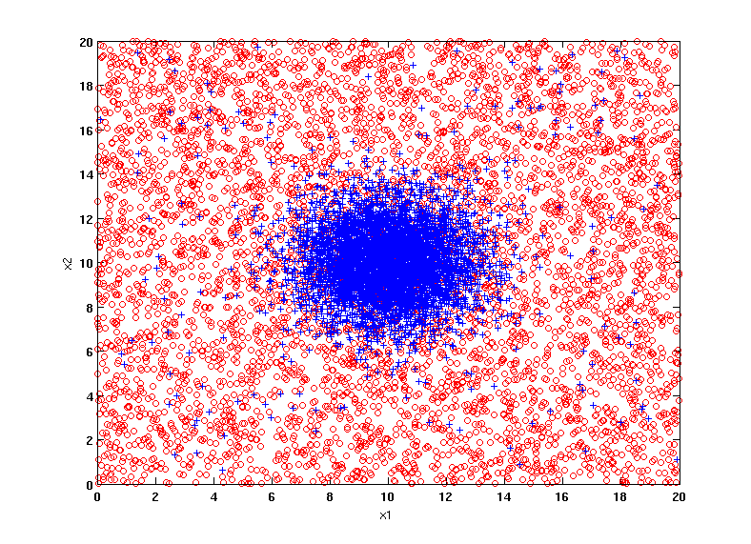
Example Data Set
Two class problem:
+ : 5200 instances
5000 instances generated from a Gaussian centered at (10,10)
200 noisy instances added
o : 5200 instances
Generated from a uniform distribution
10 % of the data used for training and 90% of the data used for testing

Slide 4
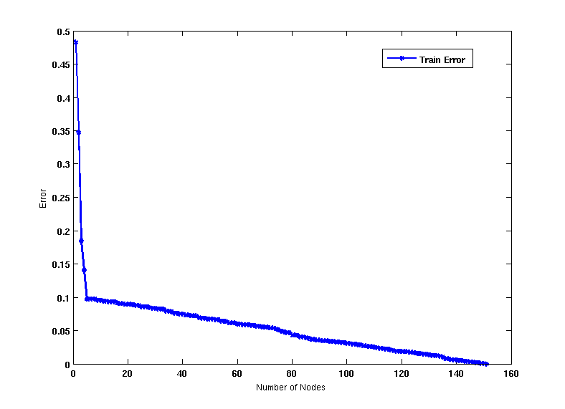
Increasing number of nodes in Decision Trees

Slide 5
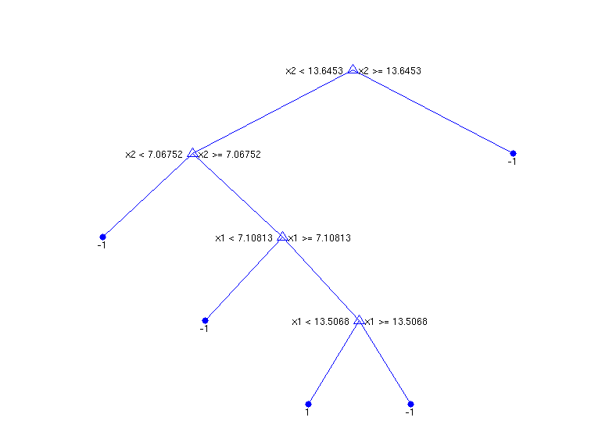
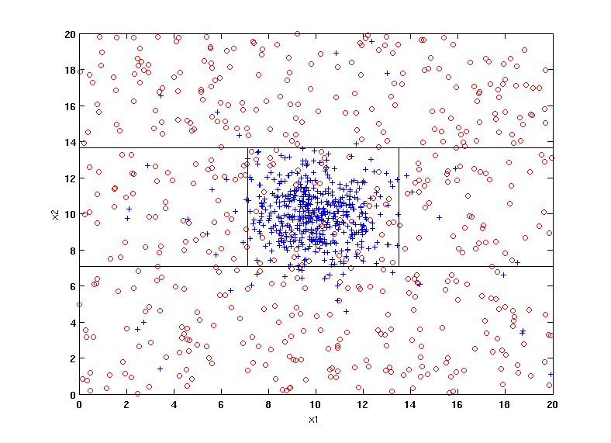
Decision Tree with 4 nodes
Decision Tree
Decision boundaries on Training data

Slide 6
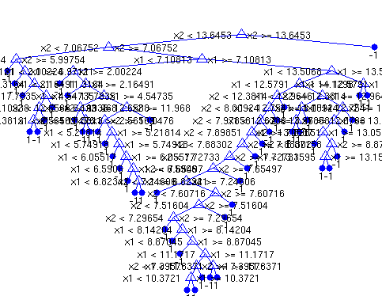
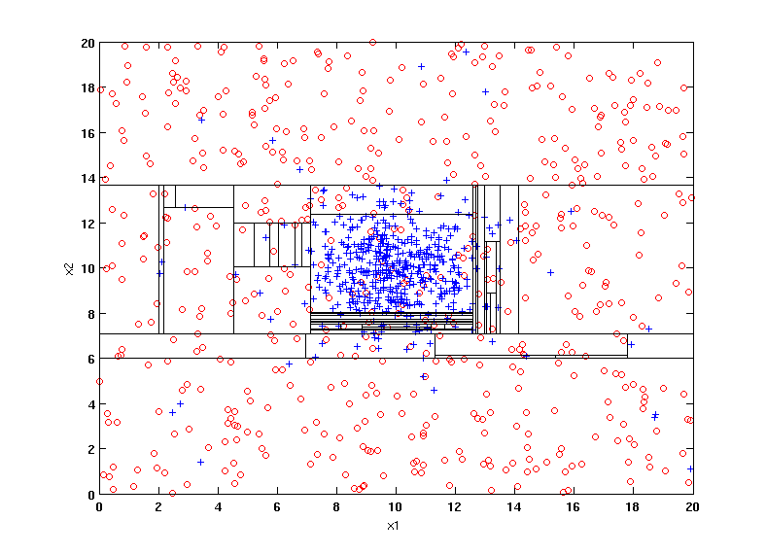
Decision Tree with 50 nodes
Decision Tree
Decision Tree
Decision boundaries on Training data

Slide 7
Which tree is better?
Decision Tree with 4 nodes
Which tree is better ?
Decision Tree with 50 nodes

Slide 8
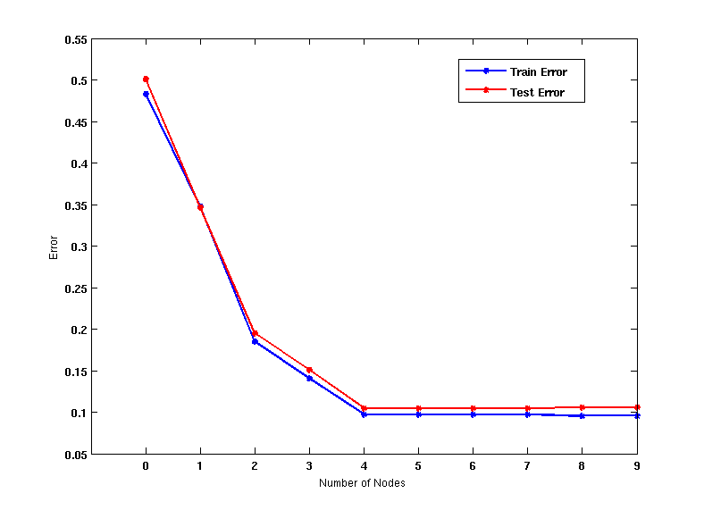
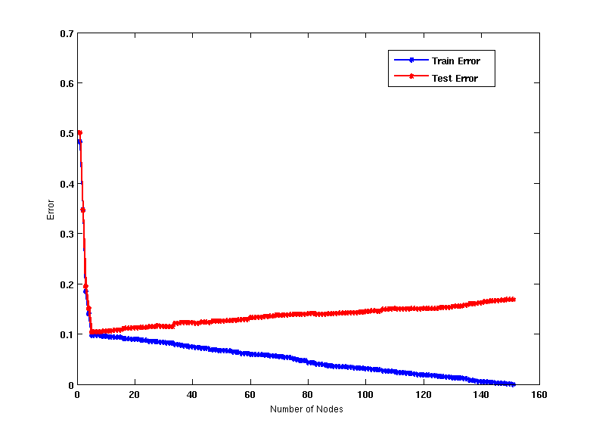
Model Overfitting
Underfitting: when model is too simple, both training and test errors are large
Overfitting: when model is too complex, training error is small but test error is large

Slide 9
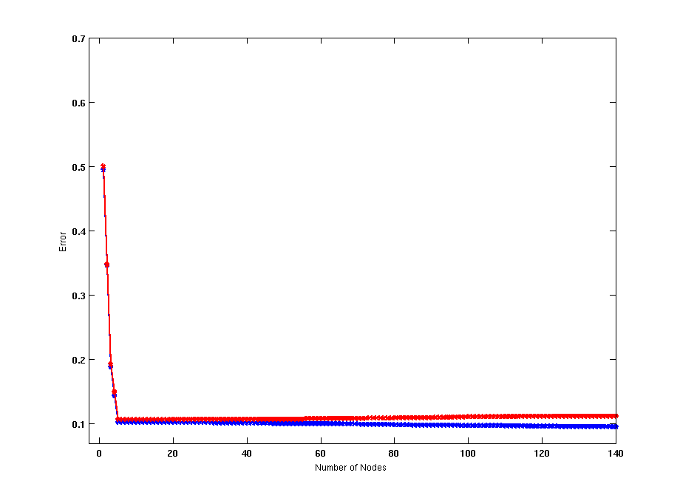
Model Overfitting
Using twice the number of data instances
If training data is under-representative, testing errors increase and training errors decrease on increasing number of nodes
Increasing the size of training data reduces the difference between training and testing errors at a given number of nodes

Slide 10
Reasons for Model Overfitting
Limited Training Set Size
Non-Representative Training Examles
High Model Complexity
Multiple Comparison Procedure

Slide 11
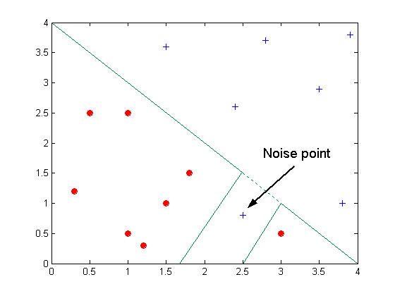
Overfitting due to Noise
Decision boundary is distorted by noise point

Slide 12
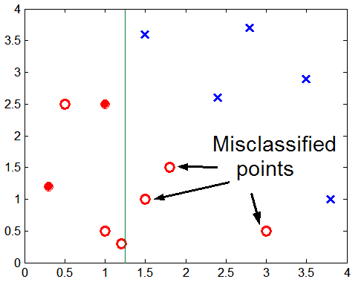
Overfitting due to Insufficient Examples
Lack of data points in the lower half of the diagram makes it difficult to predict correctly the class labels of that region
- Insufficient number of training records in the region causes the decision tree to predict the test examples using other training records that are irrelevant to the classification task

Slide 13
Occam’s Razor
Given two models of similar generalization errors, one should prefer the simpler model over the more complex model
For complex models, there is a greater chance that it was fitted accidentally by errors in data
Usually, simple models are more robust with respect to noise

Slide 14
How to Address Overfitting
Pre-Pruning (Early Stopping Rule)
Stop the algorithm before it becomes a fully-grown tree
Typical stopping conditions for a node:
Stop if all instances belong to the same class
Stop if all the attribute values are the same
More restrictive conditions:
Stop if number of instances is less than some user-specified threshold
Stop if class distribution of instances are independent of the available features (e.g., using χ ² test)
Stop if expanding the current node does not improve impurity measures (e.g., Gini or information gain).

Slide 15
How to Address Overfitting…
Post-pruning
Grow decision tree to its entirety
Trim the nodes of the decision tree in a bottom-up fashion
If generalization error improves after trimming, replace sub-tree by a leaf node.
Class label of leaf node is determined from majority class of instances in the sub-tree

Slide 16
Example of Post-Pruning
One approach is to use a separate validation set---which is like a test set that is used during training, and assess validation set accuracy for different tree sizes, and pick the tree with the highest validation set accuracy, breaking ties in favor smaller trees.
Class = Yes | 20
Class = No | 10
Error = 10/30
Class = Yes | 8
Class = No | 4
Class = Yes | 3
Class = No | 4
Class = Yes | 4
Class = No | 1
Class = Yes | 5
Class = No | 1

Slide 17
“Final” Notes on Overfitting
Overfitting results in decision trees that are more complex than necessary: after learning knowledge they “tend to learn noise”
More complex models tend to have more complicated decision boundaries and tend to be more sensitive to noise, missing examples,…
Training error no longer provides a good estimate of how well the tree will perform on previously unseen records
When learning complex models, large representative training sets are needed.
Need “new” ways for estimating errors; e.g. an approach that considers both model complexity and training error.

