Slide 1
Classification: Basic Concepts, Decision Trees, and Model Evaluation
Classification Part1
COSC 3337

Slide 2
Classification: Definition
Given a collection of records (training set )
Each record contains a set of attributes, one of the attributes is the class.
Find a model for the class attribute as a function of the values of other attributes.
Goal: previously unseen records should be assigned a class as accurately as possible.
A test set is used to determine the accuracy of the model. Usually, the given data set is divided into training and test sets, with training set used to build the model and test set used to validate it.

Slide 3
Illustrating Classification Task

Slide 4

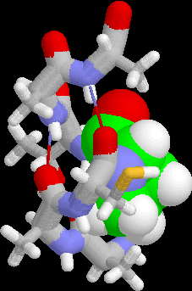
Examples of Classification Task
Predicting tumor cells as benign or malignant
Classifying credit card transactions as legitimate or fraudulent
Classifying secondary structures of protein as alpha-helix, beta-sheet, or random coil
Categorizing news stories as finance, weather, entertainment, sports, etc

Slide 5
Classification Techniques
Decision Tree based Methods *
Rule-based Methods
Memory based reasoning, instance-based learning, kNN *
Neural Networks *
Naïve Bayes and Bayesian Belief Networks
Support Vector Machines *
Ensemble Methods ?
*:= to be discussed in Fall 2021

Slide 6
Example of a Decision Tree
categorical
categorical
continuous
class
Splitting Attributes
Refund
Yes
No
NO
MarSt
Single, Divorced
Married
TaxInc
NO
< 80K
> 80K
NO
YES
Training Data
Model: Decision Tree

Slide 7
Another Example of Decision Tree
categorical
categorical
continuous
class
MarSt
Single, Divorced
Married
NO
Refund
Yes
No
NO
TaxInc
< 80K
> 80K
NO
YES
There could be more than one tree that fits the same data!

Slide 8
Introduction to Classification: Basic Concepts and Decision Trees
Organization COSC 4355
Decision Tree Basics
Decision Tree Induction Algorithms
Overfitting and Underfitting
Other Issues with Decision Trees
Advantages and Disadvantages of Decision Trees
Regression Trees (brief)
Model Evaluation

Slide 9
Another Example of Decision Tree
categorical
categorical
continuous
class
MarSt
Single, Divorced
Married
NO
Refund
Yes
No
NO
TaxInc
< 80K
> 80K
NO
YES
There could be more than one tree that fits the same data!

Slide 10
Decision Tree Induction
Many Algorithms:
Hunt’s Algorithm (one of the earliest)
CART
ID3, C4.5
SLIQ,SPRINT

Slide 11
General Structure of Hunt’s Algorithm
Let D_{t} be the set of training records that reach a node t
General Procedure:
If D_{t} contains records that belong the same class y_{t}, then t is a leaf node labeled as y_{t}
If D_{t} is an empty set, then t is a leaf node labeled by the default class, y_{d}
If D_{t} contains records that belong to more than one class, use an attribute test to split the data into smaller subsets. Recursively apply the procedure to each subset.
D_{t}
?

Slide 12
Hunt’s Algorithm
Refund
Don’t
Cheat
Yes
No
Don’t
Cheat
Don’t
Cheat
Refund
Refund
Yes
No
Yes
No
Don’t
Cheat
Marital
Status
Don’t
Cheat
Marital
Status
Single,
Divorced
Single,
Divorced
Married
Married
Cheat
Don’t
Cheat
Taxable
Income
Don’t
Cheat
< 80K
>= 80K
Don’t
Cheat
Cheat

Slide 13
News September 16
Lectures on Sept. 21 and 23 will be, unless you hear otherwise, F2F!
A first draft of the group project posted; it will be discussed in the lecture on Sept. 23! You will get an e-mail from Sadat about how we will set up the groups on Monday.
Read the News Section of the Course Webpage regularly!
Today:
R-Refresher Lab (≈35 minutes)
Group Homework Credit Presentation Group A
Group Homework Credit Presentation Group A
Demo of some useful R code for Task1
Finish Discussion Decision Tree Induction Algorithm
Overfitting (likely next week)

Slide 14
Tree Induction
Greedy strategy
Split the records based on an attribute test that optimizes certain criterion.
Remark: Finding optimal decision trees is NP-hard.
http://en.wikipedia.org/wiki/NP-hard
Issues
Determine how to split the records
How to specify the attribute test condition?
How to determine the best split?
Determine when to stop splitting

Slide 15
Tree Induction
Greedy strategy (http://en.wikipedia.org/wiki/Greedy_algorithm ) Creates the tree top down starting from the root, and splits the records based on an attribute test that optimizes certain criterion.
Issues
Determine how to split the records
How to specify the attribute test condition?
How to determine the best split?
Determine when to stop splitting

Slide 16
Side Discussion “Greedy Algorithms”
Makes locally optimal choices at each stage
Fast and therefore attractive to solve NP-hard and other problems with high complexity. Later decisions are made in the context of decision selected early dramatically reducing the size of the search space.
They do not backtrack: if they make a bad decision (based on local criteria), they never revise the decision.
They are not guaranteed to find the optimal solution(s), and sometimes can get deceived and find really bad solutions.
In spite of what is said above, a lot successful and popular algorithms in Computer Science are greedy algorithms.
Greedy algorithms are particularly popular in AI and Operations Research.
See also: http://en.wikipedia.org/wiki/Greedy_algorithm
Popular Greedy Algorithms: Decision Tree Induction,…

Slide 17
How to Specify Test Condition?
Depends on attribute types
Nominal
Ordinal
Continuous
Depends on number of ways to split
2-way split
Multi-way split

Slide 18
Splitting Based on Nominal Attributes
Multi-way split: Use as many partitions as distinct values.
Binary split: Divides values into two subsets. Need to find optimal partitioning.
CarType
Family
Luxury
Sports
CarType
CarType
{Sports, Luxury}
OR
{Family, Luxury}
{Family}
{Sports}

Slide 19
Splitting Based on Ordinal Attributes
Multi-way split: Use as many partitions as distinct values.
Binary split: Divides values into two subsets. Need to find optimal partitioning.
What about this split?
Size
Small
Large
Medium
Size
Size
{Small, Medium}
OR
{Medium, Large}
{Large}
{Small}
Size
{Small, Large}
{Medium}

Slide 20
Splitting Based on Continuous Attributes
Different ways of handling
Discretization to form an ordinal categorical attribute
Static – discretize once at the beginning
Dynamic – ranges can be found by equal interval bucketing, equal frequency bucketing (percentiles), clustering, or supervised
clustering.
Binary Decision: (A < v) or (A ≥ v)
consider all possible splits and finds the best cut v
can be more compute intensive

Slide 21
Splitting Based on Continuous Attributes

Slide 22
Tree Induction
Greedy strategy.
Split the records based on an attribute test that optimizes certain criterion.
Issues
Determine how to split the records
How to specify the attribute test condition?
How to determine the best split?
Determine when to stop splitting

Slide 23
How to determine the Best Split?
Before Splitting: 10 records of class 0, 10 records of class 1
Before: E(1/2,1/2)
After: 4/20*E(1/4,3/4) + 8/20*E(1,0) + 8/20*E(1/8,7/8)
Gain: Before-After
Pick Test that has the highest gain!
Remark: E stands for Gini, H (Entropy), Impurity(1-Purity), …

Slide 24
Example: Entropy of 3-way Split X
x, o, and * represent examples belonging to 3 classes C1, C2, and C3.
H(X)= Σ_{r=1} (|C_{r}|/|Σ_{p=1}|C_{p}|)*H(p_{r})
Cluster 1
∗ x o
Before the Split into X: H(0.6,0.3,0.1)
After the 3 way Split into X:
H(X)=
3/10*H((1/3,1/3,1/3))+ 4/10*H((1/2,1/2,0))+ 3/10*H((0,1,0))=
3/10*log₂(3) + 4/10*1 + 3/10*0=
0.8754888
X
Cluster 2
x o x o
Cluster 3
o o o

Slide 25
How to determine the Best Split
Greedy approach:
Nodes with homogeneous class distribution (pure nodes) are preferred
Need a measure of node impurity, named E and H before:
Non-homogeneous,
High degree of impurity
Homogeneous,
Low degree of impurity

Slide 26
Measures of Node Impurity
Gini Index
Entropy
Misclassification error
Remark: All three approaches center on selecting tests that maximize purity. They just disagree in how exactly purity is measured.

Slide 27
How to Find the Best Split
Before Splitting:
M0
A?
B?
Yes
No
Yes
No
Node N1
Node N2
Node N3
Node N4
M1
M2
M3
M4
M12
M34
Gain = M0 – M12 vs M0 – M34

Slide 28
Measure of Impurity: GINI
Gini Index for a given node t :
(NOTE: p( j | t) is the relative frequency of class j at node t).
Maximum (1 - 1/n_{c}) when records are equally distributed among all classes, implying least interesting information
Minimum (0.0) when all records belong to one class, implying most interesting information

Slide 29
Examples for computing GINI
P(C1) = 0/6 = 0 P(C2) = 6/6 = 1
Gini = 1 – P(C1)² – P(C2)² = 1 – 0 – 1 = 0
P(C1) = 1/6 P(C2) = 5/6
Gini = 1 – (1/6)² – (5/6)² = 0.278
P(C1) = 2/6 P(C2) = 4/6
Gini = 1 – (2/6)² – (4/6)² = 0.444

Slide 30
Examples for computing GINI for More than 2 classes
GINI((0.2,0.4,0.4,0))= 1- 0.2**2 – 2*0.4**2=…
GINI((0,1,0,0))=0

Slide 31
Splitting Based on GINI
Used in CART, SLIQ, SPRINT.
When a node p is split into k partitions (children), the quality of split is computed as,
where, n_{i} = number of records at child i,
n = number of records at node p.

Slide 32
Binary Attributes: Computing GINI Index
Splits into two partitions
Effect of Weighing partitions:
Larger and Purer Partitions are sought for.
B?
Yes
No
Node N1
Node N2
Gini(N1) = 1 – (5/7)² – (2/7)² = …
Gini(N2) = 1 – (1/5)² – (4/5)² = …
Gini(Children) = 7/12 * Gini(N1) + 5/12 * Gini(N2)=y

Slide 33
Continuous Attributes: Computing Gini Index
Use Binary Decisions based on one value
Several Choices for the splitting value
Number of possible splitting values = Number of distinct values
Each splitting value has a count matrix associated with it
Class counts in each of the partitions, A < v and A ≥ v
Simple method to choose best v
For each v, scan the database to gather count matrix and compute its Gini index
Computationally Inefficient! Repetition of work.

Slide 34
Continuous Attributes: Computing Gini Index...
For efficient computation: for each attribute,
Sort the attribute on values
Linearly scan these values, each time updating the count matrix and computing gini index
Choose the split position that has the least gini index
Sorted Values
Split Positions

Slide 35
Alternative Splitting Criteria based on INFO
Entropy at a given node t:
(NOTE: p( j | t) is the relative frequency of class j at node t).
Measures homogeneity of a node.
Maximum (log n_{c}) when records are equally distributed among all classes implying least information
Minimum (0.0) when all records belong to one class, implying most information
Entropy based computations are similar to the GINI index computations

Slide 36
Examples for computing Entropy
P(C1) = 0/6 = 0 P(C2) = 6/6 = 1
Entropy = – 0 log 0 – 1 log 1 = – 0 – 0 = 0
P(C1) = 1/6 P(C2) = 5/6
Entropy = – (1/6) log₂ (1/6) – (5/6) log₂ (1/6) = 0.65
P(C1) = 2/6 P(C2) = 4/6
Entropy = – (2/6) log₂ (2/6) – (4/6) log₂ (4/6) = 0.92

Slide 37
Splitting Based on INFO...
Information Gain:
Parent Node, p is split into k partitions;
n_{i} is number of records in partition i
Measures Reduction in Entropy achieved because of the split. Choose the split that achieves most reduction (maximizes GAIN)
Used in ID3 and C4.5
Disadvantage: Tends to prefer splits that result in large number of partitions, each being small but pure.

Slide 38
Information Gain vs. Gain Ratio
Result:
I_Gain_Ratio:
city>age>car
Result:
I_Gain:
age > car=city
D=(2/3,1/3)
Gain(D,city=)= H(1/3,2/3) – ½ H(1,0) –
½ H(1/3,2/3)=0.45
G_Ratio_pen(city=)=H(1/2,1/2)=1
city=la
city=sf
D1(1,0)
D2(1/3,2/3)
G_Ratio_pen(car=)=H(1/2,1/3,1/6)=1.45
D=(2/3,1/3)
Gain(D,car=)= H(1/3,2/3) – 1/6 H(0,1) –
½ H(2/3,1/3) – 1/3 H(1,0)=0.45
car=merc
car=taurus
car=van
D1(0,1)
D2(2/3,1/3)
D3(1,0)
G_Ratio_pen(age=)=log₂(6)=2.58
D=(2/3,1/3)
Gain(D,age=)= H(1/3,2/3) – 6*1/6 H(0,1)
= 0.90
age=22
age=25
age=27
age=35
age=40
age=50
D1(1,0)
D2(0,1)
D3(1,0)
D4(1,0)
D5(1,0)
D6(0,1)

Slide 39
Example Entropy Function H Computations
m
Let H(D=(p₁,…,p_{m}))= Σ_{i=1} (p_{i} *log₂(1/p_{i})) (called the entropy function)
H((1/2,1/4,1/8,1/8,0))= ½*log_2(2) + ¼*log_2(4) + 2*1/8*log_2(8)+ 0*log_2(∞)
=1/2+1/2+2*3/8+0=1.75
Remark: The above formula is the same as the formula given earlier and in most textbooks because:
−log_2(p)=log_2(1/p)
For example: −log_2(1/16)=-(-4)=4=log_2(16)
R-Bloggers-Link: https://www.r-bloggers.com/2020/02/how-is-information-gain-calculated/

Slide 40
Entropy and Gain Computations
Assume we have m classes in our classification problem. A test S subdivides the examples D= (p₁,…,p_{m}) into n subsets D₁ =(p₁₁,…,p_{1m}) ,…,D_{n} =(p₁₁,…,p_{1m}). The qualify of S is evaluated using Gain(D,S) (ID3) or GainRatio(D,S) (C5.0):
Let H(D=(p₁,…,p_{m}))= Σ_{i=1} (p_{i} *log₂(1/p_{i})) (called the entropy function)
Gain(D,S)= H(D) − Σ_{i=1} (|D_{i}|/|D|)*H(D_{i})
Gain_Ratio(D,S)= Gain(D,S) / H(|D₁|/|D|,…, |D_{n}|/|D|)
Remarks:
|D| denotes the number of elements in set D.
D=(p₁,…,p_{m}) implies that p₁+…+ p_{m} =1 and indicates that of the |D| examples p₁*|D| examples belong to the first class, p₂*|D| examples belong to the second class,…, and p_{m}*|D| belong the m-th (last) class.
H(0,1)=H(1,0)=0; H(1/2,1/2)=1, H(1/4,1/4,1/4,1/4)=2, H(1/p,…,1/p)=log₂(p).
C5.0 selects the test S with the highest value for Gain_Ratio(D,S), whereas ID3 picks the test S for the examples in set D with the highest value for Gain (D,S).
m
n

Slide 41
News September 21
Lectures from now on will be F2F!
A first draft of the group project has been posted; it will be discussed in the lecture on Sept. 23! Forming groups is in progress!
Group D Group Credit Task has been Posted (for Sept. 28)
Today:
Demo of some useful R code for Task1 and of Decision Tree Tools
Homework Group Credit Presentation Group C
Finish Discussion Decision Tree Induction Algorithm
Overfitting (likely on Sept. 23)
Python Data Science Basics (taught by Sadat ≈35 minutes)

Slide 42
News September 23
Task 1 ProblemSet1 is due on Mo., Sept. 26 in MS Teams! You can submit Task1 by clicking on ‘Assignments’! Make sure you use the most recent version of the Task1 specification (added a clarification what to focus on when comparing scatter plots, some time ago!)
Today:
Finish Discussion Decision Tree Induction Algorithm
Overfitting
Other Issues with Decision Trees and Learning Classification Models in General
Brief Discussion of the 2021 Group Project
K-nearest neighbors and Support Vector Machines (likely discussed next week and not today)

Slide 43
Splitting Based on INFO...
Gain Ratio:
Parent Node, p is split into k partitions
n_{i} is the number of records in partition i
Adjusts Information Gain by the entropy of the partitioning (SplitINFO). Tests which generate more nodes are penalized!
Used in C4.5
Designed to overcome the disadvantage of information gain not considering the number of nodes generated by a split.

Slide 44
Information Gain vs. Gain Ratio
Result:
I_Gain_Ratio:
city>age>car
Result:
I_Gain:
age > car=city
D=(2/3,1/3)
Gain(D,city=)= H(1/3,2/3) – ½ H(1,0) –
½ H(1/3,2/3)=0.45
G_Ratio_pen(city=)=H(1/2,1/2)=1
city=la
city=sf
D1(1,0)
D2(1/3,2/3)
G_Ratio_pen(car=)=H(1/2,1/3,1/6)=1.45
D=(2/3,1/3)
Gain(D,car=)= H(1/3,2/3) – 1/6 H(0,1) –
½ H(2/3,1/3) – 1/3 H(1,0)=0.45
car=merc
car=taurus
car=van
D1(0,1)
D2(2/3,1/3)
D3(1,0)
G_Ratio_pen(age=)=log₂(6)=2.58
D=(2/3,1/3)
Gain(D,age=)= H(1/3,2/3) – 6*1/6 H(0,1)
= 0.90
age=22
age=25
age=27
age=35
age=40
age=50
D1(1,0)
D2(0,1)
D3(1,0)
D4(1,0)
D5(1,0)
D6(0,1)

Slide 45
Splitting Criteria based on Classification Error
Classification error at a node t :
Measures misclassification error made by a node.
Maximum (1 - 1/n_{c}) when records are equally distributed among all classes, implying least interesting information
Minimum (0.0) when all records belong to one class, implying most interesting information
Comment: same as impurity which is (1-Purity)!
Example:
Error((0.4,0.2,0,0.1,0.3))= 1-Purity((0.4,0.2,0,0.1,0.3))=1-0.4=0.6

Slide 46
Examples for Computing Error
P(C1) = 0/6 = 0 P(C2) = 6/6 = 1
Error = 1 – max (0, 1) = 1 – 1 = 0
P(C1) = 1/6 P(C2) = 5/6
Error = 1 – max (1/6, 5/6) = 1 – 5/6 = 1/6
P(C1) = 2/6 P(C2) = 4/6
Error = 1 – max (2/6, 4/6) = 1 – 4/6 = 1/3

Slide 47
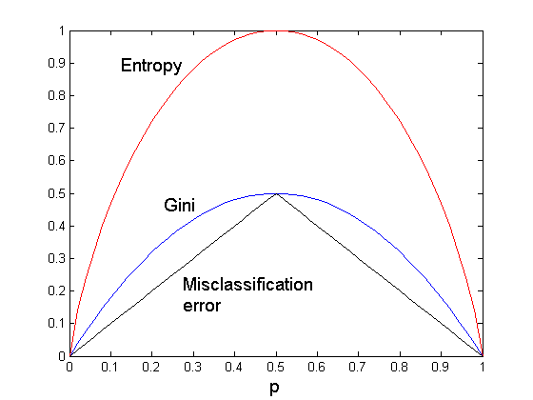
Comparison among Splitting Criteria
For a 2-class problem:

Slide 48
Tree Induction
Greedy strategy.
Split the records based on an attribute test that optimizes certain criterion.
Issues
Determine how to split the records
How to specify the attribute test condition?
How to determine the best split?
Determine when to stop splitting

Slide 49
Stopping Criteria for Tree Induction
Stop expanding a node when all the records belong to the same class
Stop expanding a node when all the records have similar attribute values
Early termination (used by many decision tree tools to avoid overfitting); examples include:
Terminate the number of examples left is less than x (e.g. x=4)
Terminate if the depth of the tree has reached a limit (e.g. limit=6)
Terminate if the purity of the examples associated with a node is x% or more (e.g. x=90)

Slide 50
Example: C4.5
Simple depth-first construction.
Uses Information Gain (Entropy)
Sorts Continuous Attributes at each node.
Needs entire data to fit in memory.
One of the Top 10 Data Mining Algorithms in 2007!

Slide 51
Decision and Regression Trees in R
For survey see: http://www.r-bloggers.com/a-brief-tour-of-the-trees-and-forests/
The most popular libraries are:
rpart (the most advanced tree package, based on CART)
tree (the original, more basic package)
randomForrest (learns an ensemble of trees instead of a single tree; more competitive as this approach accomplished higher accuracies than single trees)
CORElearn (a very general package that contains trees, forrests, and many other approaches)
Some packages are not compatible; be warned if you use a mixture of packages!

Slide 52
Practical Issues of Classification
Underfitting and Overfitting discussion replaced by slides in a separate files
Missing Values (not covered in 2021)
Other issues

Slide 53
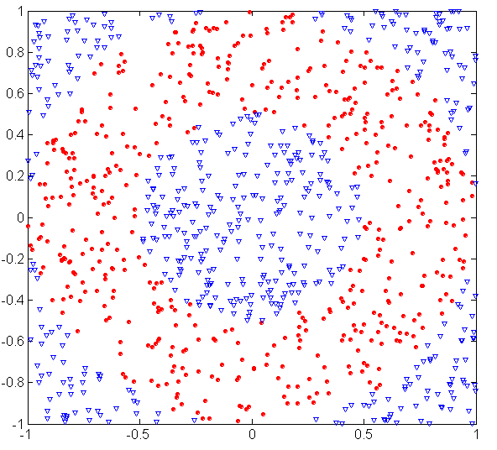
3. Underfitting and Overfitting
500 circular and 500 triangular data points.
Circular points:
0.5 ≤ sqrt(x₁²+x₂²) ≤ 1
Triangular points:
sqrt(x₁²+x₂²) > 0.5 or
sqrt(x₁²+x₂²) < 1

Slide 54
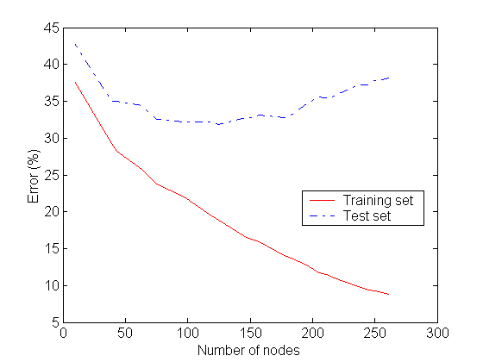
Underfitting and Overfitting
Underfitting
Overfitting
Complexity of a Decision
Tree := number of nodes
It uses
Complexity of the classification function
Underfitting: when model is too simple, both training and test errors are large
Overfitting: when model is too complex and test errors are large although training errors are small.

Slide 55
How to cope with missing values
Not covered in 2021!
Before Splitting: Entropy(Parent) = -0.3 log(0.3)-(0.7)log(0.7) = 0.8813
Split on Refund:
Entropy(Refund=Yes) = 0
Entropy(Refund=No) = -(2/6)log(2/6) – (4/6)log(4/6) = 0.9183
Entropy(Children) = 0.3 (0) + 0.6 (0.9183) = 0.551
Gain = 0.9 × (0.8813 – 0.551) = 0.3303
Missing value
Idea: ignore examples with null values for the test attribute; compute M(…) only using examples for
Which Refund is defined.

Slide 56
Distribute Instances to Make Predictions
Not covered in 2021!
Refund
Yes
No
Probability that Refund=Yes is 3/9
Probability that Refund=No is 6/9
Assign record to the left child with weight = 3/9 and to the right child with weight = 6/9
Refund
Yes
No

Slide 57
Classify Instances
Not covered in 2021!
New record:
 | Married | Single | Divorced | Total
Class=No | 3 | 1 | 0 | 4
Class=Yes | 6/9 | 1 | 1 | 2.67
Total | 3.67 | 2 | 1 | 6.67
Refund
Yes
No
NO
MarSt
Single, Divorced
Married
Probability that Marital Status = Married is 3.67/6.67
Probability that Marital Status ={Single,Divorced} is 3/6.67
TaxInc
NO
< 80K
> 80K
NO
YES

Slide 58
4. Other Issues
Data Fragmentation
Search Strategy
Decision Boundaries of Decision Tree Models
Oblique Decision Trees

Slide 59
Data Fragmentation
Number of instances gets smaller as you traverse down the tree
Number of instances at the leaf nodes could be too small to make any statistically significant decision ➔ increases the danger of overfitting

Slide 60
Search Strategy
Finding an optimal decision tree is NP-hard
The algorithm presented so far uses a greedy, top-down, recursive partitioning strategy to induce a reasonable solution
Other strategies?
Bottom-up
Bi-directional

Slide 61
Decision Boundary
Border line between two neighboring regions of different classes is known as decision boundary
Decision boundary is parallel to axes because test condition involves a single attribute at-a-time

Slide 62
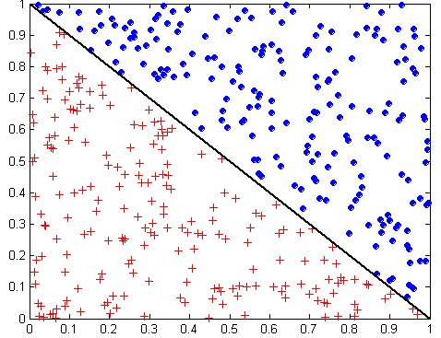
Oblique Decision Trees
x + y < 1
Class = +
Class =
Test condition may involve multiple attributes
More expressive representation
Finding optimal test condition is computationally expensive

Slide 63
5. Advantages Decision Tree Based Classification
Inexpensive to construct
Extremely fast at classifying unknown records
Easy to interpret for small-sized trees; strategy understandable to domain expert
Okay for noisy data
Can handle both continuous and symbolic attributes
Useful for exploratory data analysis
Accuracy is comparable to other classification techniques for many simple data sets
Decent average performance over many datasets
Can handle multi-modal class distributions
Kind of a standard—if you want to show that your “new” classification technique really “improves the world” → compare its performance against decision trees (e.g. C 5.0) using 10-fold cross-validation
Does not need distance functions; only the order of attribute values is important for classification: 0.1,0.2,0.3 and 0.331,0.332, and 0.333 is the same for a decision tree learner.

Slide 64
Disadvantages Decision Tree Based Classification
Relies on rectangular approximation that might not be good for some dataset
Selecting good learning algorithm parameters (e.g. degree of pruning) is non-trivial; however, some of the competing methods have worth parameter selection problems
Ensemble techniques, neural networks, support vector machines, and sometimes kNN, might obtain higher accuracies for a specific dataset.

Slide 65
News September 28
The groups of the 7-week long group projects have been set up!
Topics of Today’s Lecture:
Regression Trees
Classification Model Performance Evaluation
Group D Group Homework Presentation
K-nearest neighbors
Support Vector Machines
The midterm exam will be 2 days later on Th., October 14!
Important: Please watch the 2 3blueonebrown videos, discussing neural networks in the next 48 hours (this should take 35 minutes). This is the “makeup” for the cancelled Sept. 12 lecture!
We will discuss the content of the video next week and Group Homework Credit Group E will prepare a Q&A session concerning the content of these two videos for the October 4 week. There will be also a short discussion of “NN Basics” in the next lecture!

Slide 66
Group E Homework Credit
Watch the 2 3blueonebrown neural network videos and try to come up with a list of 6-8 questions which will be discussed in the Oct. 4 week:
Review questions concerning the content of the video with answers! There should be at least 4 review questions.
Clarification questions---if there is something in the videos you did not understand, please phrase it as a question
General questions concerning NNs.
Clarification and General questions are optional; at the end just prepare 6-8 questions including answers for the review questions.
Hoang,David V
Hoang,Ryan
Hoang,William
Holcombe,Matthew C
Hua,Henderson V

Slide 67
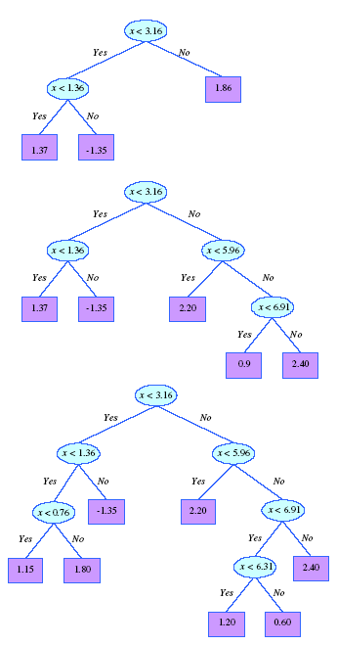
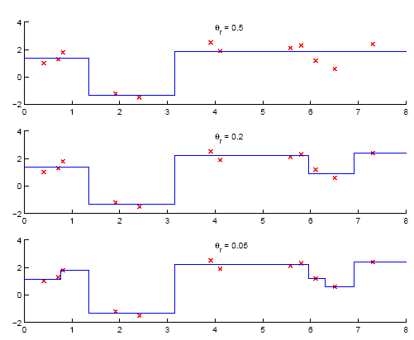
Not in textbook!
6. Regression Trees

Slide 68
Summary Regression Trees
Not in textbook!
Regression trees work as decision trees except
Leafs carry numbers which predict the output variable instead of class label
If a leaf is created the average value of the dependent variables of the examples associated with the leaf node is used as the prediction of the leaf node.
Instead of entropy/purity the squared prediction error serves as the performance measure.
Tests that reduce the squared prediction error the most are selected as node test; test conditions have the form y>threshold where y is an independent variable of the prediction problem.
Instead of using the majority class, leaf labels are generated by averaging over the values of the dependent variable of the examples that are associated with the particular class node
Like decision trees, regression tree employ rectangular tessellations with a fixed number being associated with each rectangle; the number is the output for the inputs which lie inside the rectangle.
In contrast to ordinary regression that performs curve fitting, regression tries use averaging with respect to the output variable when making predictions; the output for inputs of a particular patch is constant.

Slide 69
7. Model Evaluation
Problems of Model Performance Evaluation
1. What performance metrics do we use to evaluate classification models?
2. How to obtain reliable estimates?
http://en.wikipedia.org/wiki/Cross-validation_(statistics)
the “gold standard” to determine accuracy is to use 10-fold cross validation repeated 10 times
Alternatively, class stratified cross validation is frequently used
Will explain those later not now!

Slide 70
Metrics for Performance Evaluation
Focus on the predictive capability of a model
Rather than how fast it takes to classify or build models, scalability, etc.
Confusion Matrix:
Important: If there are problems with obtaining
a “good” classifier: inspect the confusion matrix!
 | PREDICTED CLASS
ACTUAL CLASS |  | Class=Yes | Class=No
 | Class=Yes | a | b
 | Class=No | c | d
a: TP (true positive)
b: FN (false negative)
c: FP (false positive)
d: TN (true negative)

Slide 71
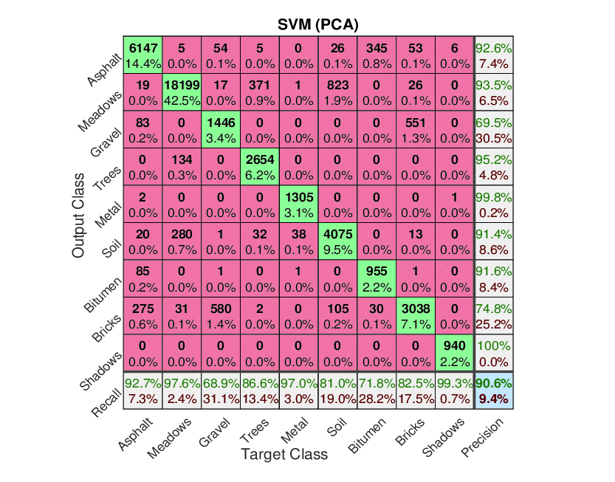
Confusion Matrix

Slide 72
Metrics for Performance Evaluation…
Most widely-used metric:
 | PREDICTED CLASS
ACTUAL CLASS |  | Class=Yes | Class=No
 | Class=Yes | a (TP) | b (FN)
 | Class=No | c (FP) | d (TN)

Slide 73
Cost-Sensitive Measures
 | PREDICTED CLASS
ACTUAL CLASS |  | Class=Yes | Class=No
 | Class=Yes | a=6 | b=6
 | Class=No | c=0 | d=6
Precision: The classifier predict class C; how often is this decision correct?
Recall: The correct class is C; how often does the classifier predict class C correctly?
F-measure somewhat combines recall and precision using harmonic mean

Slide 74
Confusion Matrix

Slide 75
Another Example
Difference Between Precision and Recall
Assume we have a search engine with assigns a relevance value r to each document and then returns all web documents whose relevance threshold is above a user-defined relevance threshold θ. Moreover, we assume for the particular web search we conduct there are 16 relevant documents.
Case 1 we use θ=0.6 and the search returns 5 documents with 4 of those documents are being relevant; in this case we receive: precision: 0.8 and recall=0.25.
Case 2 we use a lower threshold of θ=0.6 and in this case we the search returns 24 documents with 12 being relevant; in this case, we receive: precision=0.5 and recall=0.75.
The example shows that the classification algorithm performance can be tweaked by using an appropriate threshold for which considers the different cost of false positives and false negatives θ; e.g. if the cost of false negatives is higher than those of false positives, we tend to use lower thresholds to miss fewer relevant documents
Costs in the example:
FP: Cost of having to read irrelevant document
FN: Cost of not missing a relevant document

Slide 76
N-Fold Cross Validation
10-fold cross validation is the most popular technique to evaluate classifiers based on a performance metric (e.g. accuracy)
Leave one out and stratified cross validation also has some popularity
Cross validation is usually performed class stratified (frequencies of examples of a particular class are approximately the same in each fold).
Example should be assigned to folds randomly (if not → cheating!)
Accuracy:= % of testing examples classified correctly
Example: 3-fold Cross-validation; examples of the dataset are subdivided into 3 joints sets (preserving class frequencies); then training/test-set pairs are constructed as follows:
1
2
1
3
2
3
Training:
3
2
1
Testing:

Slide 77

Objectives Data Science Course
Lecture Notes for Chapter 4
Introduction to Data Mining
by
Tan, Steinbach, Kumar
Using R for
Data Analysis
And Data Mining
Data Science for Real World Datasets
Exploratory Data Analysis
and Preprocessing
Goals and Objectives of Data Mining/Data Seicne
Making Sense
of Data
Data Mining/Science Algorithms
Classification Techniques
Learn How to Interpret
Data Mining Results
Association Analysis
Clustering Algorithms

