Slide 1
2018 Teaching of COSC 4335
Introduction to Similarity Assessment and Clustering
What is Clustering? Kind of short
Similarity Assessment
Partitioning/Representative-based Clustering
K-means
K-medoids/PAM only briefly covered
Hierarchical Clustering
Density Based Clustering centering on DBSCAN
K-means,DBSCAN and Hierarchical Clustering in R
Discussion of and Hints for Assignment2

Slide 2
Illustrating Clustering
Intracluster distances
are minimized
Intercluster distances
are maximized
Euclidean Distance Based Clustering in 3-D space.

Slide 3
What is Cluster Analysis?
Cluster: a collection of data objects
Cluster analysis: Grouping a set of data objects into clusters such that the data objects are
similar to one another within the same cluster
dissimilar to the objects in other clusters
The quality of a clustering result depends on both the distance measure used and on the clustering method employed, and algorithm parameters.
Clustering is unsupervised classification: no predefined classes and no classified training examples

Slide 4
Data Structures for Clustering
Data matrix
(n objects,
p attributes)
(Dis)Similarity matrix
(nxn)

Slide 5
Similarity Assessment Framework
The goal of similarity assessment is the definition of distance functions for object u,v∈T d (u, v) that belong to the same type T; d: T×T→[0,∞)
Useful Distance Functions: http://en.wikipedia.org/wiki/Distance
Jaccard: http://en.wikipedia.org/wiki/Jaccard_index
Other: http://www.quora.com/Graph-Theory/What-is-the-standard-measurement-for-the-distance-between-two-groups-of-nodes-e-g-cliques , http://crpit.com/confpapers/CRPITV137Wang.pdf , http://en.wikipedia.org/wiki/Fr%C3%A9chet_distance, http://en.wikipedia.org/wiki/Hausdorff_distance, http://www.google.com/patents/US7299245

Slide 6
Similarity Assessment Framework
Dissimilarity/Similarity metric: Similarity is expressed in terms of a normalized distance function d, which is typically metric; typically: δ (o_{i}, o_{j}) = 1 - d (o_{i}, o_{j})
The definitions of similarity functions are usually very different for interval-scaled, boolean, categorical, ordinal and ratio-scaled variables.
Weights should be associated with different variables based on applications and data semantics.
Variables need to be normalized to “even their influence”
It is hard to define “similar enough” or “good enough”
the answer is typically highly subjective.

Slide 7
Challenges in Obtaining Object Similarity Measures
Many Types of Variables
Interval-scaled variables
Binary variables and nominal variables
Ordinal variables
Ratio-scaled variables
Objects are characterized by variables belonging to different types (mixture of variables)

Slide 8
Case Study: Patient Similarity
The following relation is given (with 10000 tuples):
Patient(ssn, weight, height, cancer-sev, eye-color, age)
Attribute Domains
ssn: 9 digits
weight between 30 and 650; m_{weight}=158 s_{weight}=24.20
height between 0.30 and 2.20 in meters; m_{height}=1.52 s_{height}=19.2
cancer-sev: 4=serious 3=quite_serious 2=medium 1=minor
eye-color: {brown, blue, green, grey}
age: between 3 and 100; m_{age}=45 s_{age}=13.2
Task: Define Patient Similarity

Slide 9
Generating a Global Similarity Measure from Single Variable Similarity Measures
Assumption: A database may contain up to six types of variables: symmetric binary, asymmetric binary, nominal, ordinal, interval and ratio.
Standardize/Normalize variables and associate similarity measure δ_{i} with the standardized i-th variable and determine weight w_{i} of the i-th variable.
Create the following global (dis)similarity measure δ:

Slide 10
A Methodology to Obtain a Similarity Matrix
Understand Variables
Remove (non-relevant and redundant) Variables
(Standardize and) Normalize Variables (typically using z-scores or variable values are transformed to numbers in [0,1])
Associate (Dis)Similarity Measure d_{f}/δ_{f} with each Variable
Associate a Weight (measuring its importance) with each Variable
Compute the (Dis)Similarity Matrix
Apply Similarity-based Data Mining Technique (e.g. Clustering, Nearest Neighbor, Multi-dimensional Scaling,…)

Slide 11
Standardization --- Z-scores
Standardize data using z-scores
Calculate the mean, the standard deviation s_{f} :
Calculate the standardized measurement (z-score)
Using mean absolute deviation is more robust than using standard deviation
http://en.wikipedia.org/wiki/Standard_score

Slide 12
Normalization in [0,1]
Problem: If non-normalized variables are used the maximum distance between two values can be greater than 1.
Solution: Normalize interval-scaled variables using
where min_{f} denotes the minimum value and max_{f} denotes the maximum value of the f-th attribute in the data set and σ is constant that is choses depending on the similarity measure (e.g. if Manhattan distance is used σ is chosen to be 1). Remark: frequently used after applying some form of outlier removal.

Slide 13
Similarity Between Objects
Distances are normally used to measure the similarity or dissimilarity between two data objects
Some popular ones include: Minkowski distance:
where i = (x_{i1}, x_{i2}, …, x_{ip}) and j = (x_{j1}, x_{j2}, …, x_{jp}) are two p-dimensional data objects, and q is a positive integer
If q = 1, d is Manhattan distance

Slide 14
Similarity Between Objects (Cont.)
If q = 2, d is Euclidean distance:
Distance Functions Properties
d(i,j) ≥ 0
d(i,i) = 0 important
d(i,j) = d(j,i)
d(i,j) ≤ d(i,k) + d(k,j) important

Slide 15
Similarity with respect to a Set of Binary Variables
A contingency table for binary data
Object j
Object i
Ignores agree-
ments in O’s
Considers agree-
ments in 0’s and 1’s
to be equivalent.

Slide 16
Example
Example: Books bought by different Customers
i=(1,0,0,0,0,0,0,1) j=(1,1,0,0,0,0,0,0)
δ_{Jaccard}(i,j)=1/3 “excludes agreements in O’s”
δ_{sym}(i,j)=6/8 “computes percentage of agreement considering 1’s and 0’s.

Slide 17
Nominal Variables
A generalization of the binary variable in that it can take more than 2 states, e.g., red, yellow, blue, green
Method 1: Simple matching
m: # of matches, p: total # of variables
Method 2: use a large number of binary variables
creating a new binary variable for each of the M nominal states

Slide 18
Ordinal Variables
An ordinal variable can be discrete or continuous
order is important (e.g. UH-grade, hotel-rating)
Can be treated like interval-scaled
replacing x_{if} by their rank:
map the range of each variable onto [0, 1] by replacing the f-th variable of i-th object by
compute the dissimilarity using methods for interval-scaled variables

Slide 19
Continuous Variables (Interval or Ratio)
Usually no problem (but see next transparencies); traditional distance functions do a good job…

Slide 20
Ratio-Scaled Variables
Ratio-scaled variable: a positive measurement on a nonlinear scale, approximately at exponential scale, such as Ae^{Bt} or Ae^{-Bt}
Methods:
treat them like interval-scaled variables — not a good choice! (why?)
apply logarithmic transformation
y_{if} = log(x_{if})
treat them as continuous ordinal data treat their rank as interval-scaled.

Slide 21
Case Study --- Normalization
Patient(ssn, weight, height, cancer-sev, eye-color, age)
Attribute Relevance: ssn no; eye-color minor; other major
Attribute Normalization:
ssn remove!
weight between 30 and 650; m_{weight}=158 s_{weight}=24.20; transform to z_{weight}= (x_{weight}-158)/24.20 (alternatively, z_{weight}=(x_{weight}-30)/620));
height normalize like weight!
cancer_sev: 4=serious 3=quite_serious 2=medium 1=minor; transform 4 to 1, 3 to 2/3, 2 to 1/3, 1 to 0 (and maybe normalize it)
age: normalize like weight!

Slide 22
Case Study --- Weight Selection and Distance Measure Selection
Patient(ssn, weight, height, cancer-sev, eye-color, age)
For z-score normalized attributes use Manhattan distance function; e.g.:
d_{weight}(w1,w2)= | ((w1-158)/24.20) − ((w2-158)/24.20)|
d_{height}(w1,w2)= |(w1-w2)/19.2|
d_{age}(w1,w2)= | (w1-w2)/13.2|
D_{cancer-sev}(w1,w2) |φ(w1)-φ(w2)|
With 1= φ(serious), 2/3=φ(quite_serious), 1/3=φ(medium) and 0=φ(minor)
For eye-color use: d_{eye-color}(c1,c2)= if c1=c2 then 0 else 1
Weight Assignment: 0.2 for eye-color; 1 for all others
Final Solution --- chosen distance measure d:
Let o1=(s1,w1,h1,cs1,e1,a1) and o2=(s2,w2,h2,cs2,e2,a2)
d(o1,o2):= (d_{weight}(w1,w2) + d_{height}(h1,h2) + d_{cancer-sev}(cs1,cs2) + d_{age}(a1,a2) + 0.2* d_{eye-color}(e1,e2)) /4.2
d((111111111,170,182,serious,blue,55),(222222222,160,174,medium,blue,58)=
(10/24.2 + 8/19.2 + 2/3 + 0.2*0 + 3/13.2)/4.2= 0.4104355

Slide 23
Another Example of Creating a Distance Function
3) Similarity Assessment [9]
Design a distance function to assess the similarity of bank customers; each customer is characterized by the following attributes:
Ssn
Cr (“credit rating”) which is ordinal attribute with values ‘very good’, ‘good, ‘medium’, ‘poor’, and ‘very poor’.
Av-bal (avg account balance, which is a real number with mean 7000, standard deviation is 4000, the maximum 3,000,000 and minimum -20,000)
Services (set of bank services the customer uses)
Assume that the attributes Cr and Av-bal are of major importance and the attribute Services is of a medium importance.
Using your distance function compute the distance between the following 2 customers: c1=(111111111, good, 7000, {S1,S2}) and c2=(222222222, poor, 1000, {S2,S3,S4})
Solution: We convert Avbal into z-score; let abl be an average balance, then
z-score(abl)= (abl-7000)/4000
The distance between two average balances can then be computed using
d_{abl}(abl1,abl2)= |abl1-7000-abl2+7000|/4000=|abl1-abl2|/4000
We convert the credit rating values ‘very good’, ‘good, ‘medium’, ‘poor’, and ‘very poor’ to: 0:4 using a function ψ;
And use the Jaccard distance function for the services: d_{services}(ser1,ser2)= 1- (|ser1∩ser2|)/(|ser1∪ ser2|)
Putting this together distance between two customers u and v can be computed as follows:
d(u,v)=(1* |ψ(u.Cr)- ψ(v.Cr)|/4 + 1* |u.Av-bal - v.Av-bal|/4000) +
0.2* (1-(|u.Services ∩ v.Services|)/ (|u.Services ∪ v. Services|))/2.2)
For the 2 customer we receive: d(c1,c2)= (2/4 + 1.5 +0.2*3/4)/2.2=2.15/2.2≈0.98

Slide 24
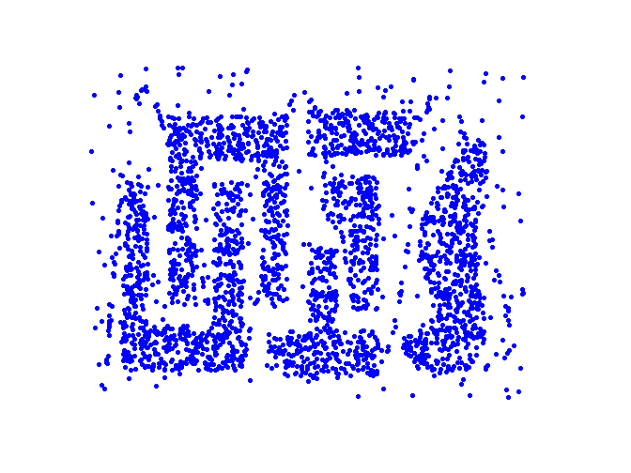
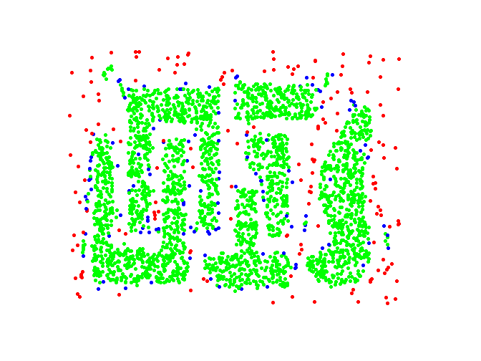
Goal of Clustering
K Clusters
Outliers
Objects
Original Points
Point types: core, border and noise
DBSCAN Result, Eps = 10, MinPts = 4

Slide 25
Motivation: Why Clustering?
Problem: Identify (a small number of) groups of similar objects in a given (large) set of objects.
Goals:
Find representatives for homogeneous groups →Data Compression
Find “natural” clusters and describe their properties →”natural” Data Types
Find suitable and useful grouping →”useful” Data Classes
Find unusual data object →Outlier Detection

Slide 26
Examples of Clustering Applications
Plant/Animal Classification
Cloth Sizes
Fraud Detection (Find outlier)

Slide 27
Requirements of Clustering in Data Mining
Scalability
Ability to deal with different types of attributes
Discovery of clusters with arbitrary shape
Minimal requirements for domain knowledge to determine input parameters
Able to deal with noise and outliers
Insensitive to order of input records
High dimensionality
Incorporation of user-specified constraints
Interpretability and usability

Slide 28
Data Structures for Clustering
Data matrix
(n objects,
p attributes)
(Dis)Similarity matrix
(nxn)

Slide 29
Major Clustering Approaches
Partitioning algorithms/Representative-based/Prototype-based Clustering Algorithm: Construct various partitions and then evaluate them by some criterion or fitness function
Hierarchical algorithms: Create a hierarchical decomposition of the set of data (or objects) using some criterion
Density-based: based on connectivity and density functions
Grid-based: based on a multiple-level granularity structure
Model-based: A model is hypothesized for each of the clusters and the idea is to find the best fit of that model to the data distibution

Slide 30
Representative-Based Clustering
Aims at finding a set of objects among all objects (called representatives) in the data set that best represent the objects in the data set. Each representative corresponds to a cluster.
The remaining objects in the data set are then clustered around these representatives by assigning objects to the cluster of the closest representative.
Remarks:
The popular k-medoid algorithm, also called PAM, is a representative-based clustering algorithm; K-means also shares the characteristics of representative-based clustering, except that the representatives used by k-means not necessarily have to belong to the data set.
If the representative do not need to belong to the dataset we call the algorithms prototype-based clustering. K-means is a prototype-based clustering algorithm
Notes:
There are many possible supervised clustering algorithm. In our work, we investigate representative-based supervised clustering algorithms that aim

Slide 31
Representative-Based Clustering … (Continued)
Attribute1
2
1
3
4
Attribute2

Slide 32
Representative-Based Clustering … (continued)
Attribute1
2
1
3
4
Attribute2
Objective of RBC: Find a subset O_{R} of O such that the clustering X
obtained by using the objects in O_{R} as representatives minimizes q(X);
q is an objective/fitness function.
Notes:
The objective of representative-based supervised clustering is…

Slide 33
Partitioning Algorithms: Basic Concept
Partitioning method: Construct a partition of a database D of n objects into a set of k clusters
Given a k, find a partition of k clusters that optimizes the chosen partitioning criterion or fitness function.
Global optimal: exhaustively enumerate all partitions
Heuristic methods: k-means and k-medoids algorithms
k-means (MacQueen’67): Each cluster is represented by the center of the cluster (prototype)
k-medoids or PAM (Partition around medoids) (Kaufman & Rousseeuw’87): Each cluster is represented by one of the objects in the cluster; truly representative-based.

Slide 34
The K-Means Clustering Method
Given k, the k-means algorithm is implemented in 4 steps:
Partition objects into k nonempty subsets
Compute seed points as the centroids of the clusters of the current partition. The centroid is the center (mean point) of the cluster.
Assign each object to the cluster with the nearest seed point.
Go back to Step 2, stop when no more new assignment.

Slide 35
The K-Means Clustering Method
Example

Slide 36
More on K-means
K-means minimizes the SSE function:
where c_{i} is the centroid of cluster C_{i} and k is the
number of clusters and dist is a distance function
Clustering Notations: Let O be a dataset; then
X={C₁,…,C_{k}} is a clustering of O with C_{i} ⊆O (for i=1,…,k), C₁∪…∪C_{k} ⊆O and C_{i}∩C_{j}=∅ (for i≠ j)
Demo r-clustering.r
Manual: http://stat.ethz.ch/R-manual/R-patched/library/stats/html/kmeans.html
http://www.rdatamining.com/examples/kmeans-clustering .

Slide 37
Example: Empty Clusters
K=3
X X X X
X X
X X X X
We assume that the k-means initialization assigns the
green, blue, and brown points to a single cluster; after
centroids are computed and objects are reassigned,
it can easily be seen that that the brown cluster becomes empty.

Slide 38
Comments on K-Means
http://stat.ethz.ch/R-manual/R-patched/library/stats/html/kmeans.html
Strength
Relatively efficient: O(t*k*n*d), where n is # objects, k is # clusters, and t is # iterations, d is the # dimensions. Usually, d, k, t << n; in this case, K-Mean’s runtime is O(n).
Storage only O(n)—in contrast to other representative-based algorithms, only computes distances between centroids and objects in the dataset, and not between objects in the dataset; therefore, the distance matrix does not need to be stored.
Easy to use; well studied; we know what to expect
Finds local minimum of the SSE fitness function. The global optimum may be found using techniques such as: deterministic annealing and genetic algorithms
Implicitly uses a fitness function (finds a local minimum for SSE see later) --- does not waste time computing fitness values
Weakness
Applicable only when mean is defined --- what about categorical data?
Need to specify k, the number of clusters, in advance
Sensitive to outliers; does not identify outliers
Not suitable to discover clusters with non-convex shapes
Sensitive to initialization; bad initialization might lead to bad results.

Slide 39
Convex Shape Cluster
Convex Shape: if we take two points belonging to a cluster then all the points on a direct line connecting these two points must also in the cluster.
Shape of K-means/K-mediods clusters are convex polygons⊆ Convex Shape.
Shapes of clusters of a representative-based clustering algorithm can be computed as a Voronoi diagram for the set of cluster representatives.
Voronoi cells are always convex, but there are convex shapes that a different from those of Voronoi cells.

Slide 40
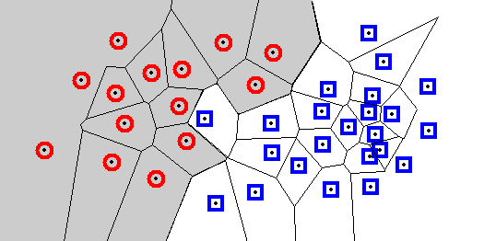
Voronoi Diagram for a Representative-based Clustering
Each cell contains one representatives, and every location within the cell is closer to that sample than to any other sample.
A Voronoi diagram divides the space into such cells.
Voronoi cells define cluster boundary!
Cluster Representative (e.g. medoid/centroid)

Slide 41
Pseudo Code PAM Algorithm
Covered!!
Reading Material: http://en.wikipedia.org/wiki/K-medoids
Add the dataset medoid to curr. Create an initial set of k representatives curr by greedily adding points to curr that increase q(X) the least.
WHILE NOT DONE DO
Create new solutions S by replacing a single representative in curr by a single non-representative.
Determine the element s in S for which q(s) is minimal (if there is more than one minimal element, randomly pick one).
IF q(s)<q(curr) THEN curr:=s
ELSE terminate and return curr as the solution for this run.
curr: current set of cluster representatives
Remark: commonly SSE is used as the fitness function q;
PAM was developed by Kaufman and Rousseeuw, 1987
also called k-medoids (http://en.wikipedia.org/wiki/Medoid )

Slide 42
PAM’s Fitness Function
Most common measure to evaluate a clustering X is the Sum of Squared Error (SSE)
For each point, the error is the distance to the nearest cluster / representative
To get SSE, we square these errors and sum them.
x is a data point in cluster C_{i} and m_{i} is the representative point for cluster C_{i}
The MSE-error computes the average value the squared value takes instead

Slide 43
Example PAM
Distance Matrix:
0 2 4 5 6
0 2 3 3
0 5 5
0 2
0
Example: Run PAM with k=3
Current set of representatives: R={3,4,5} clusters {1,2,3} {4}{5}
Fitness: 2**2+4**2=20
Create new solutions replacing 3 or 4 or 5 by 1 or 2 (6 new solutions)
e.g.: R6={2,3,4} clusters {1,2} {3} {4,5}
Fitness: 2**2+2**2=8
R6 becomes new set of representatives
6 new solutions will be created and the process continues until there is no more improvement; in this particular case it will terminate with R6.

Slide 44
PAM’s Complexity
Briefly covered
Number of clusterings formed
in one iteration
Cluster
generation
Number of iterations
Runtime: t*[(n-k)*k]* [(n-k)*k] ≈O(n² ) where n is the number of objects, k is the number of clusters, and t is the number of iterations
Storage: O(n² ) assuming that the distance matrix is stored
If the distance function is not stored the runtime becomes (distances have to be computed (O(d)) and cannot be look up (O(1))):
t*[(n-k)*k]* [(n-k)*k*d]
Incremental implementations are usually faster!

Slide 45




Covariance and Correlation
http://en.wikipedia.org/wiki/Correlation
https://en.wikipedia.org/wiki/Estimation_of_covariance_matrices
estimates

Slide 46
Correlation and Covariance Matrix
Covariance Matrix
A1 A2 A3
1 2 -1
4 1
4
Correlation(A1,A2)= 2/sqrt(1)*sqrt(4)= 1
Correlation(A1,A3)=-1/sqrt(1)*sqrt(4)=-0.5
Correlation (A2,A3)=1/sqrt(4)*sqrt(4)=0.25
Variance(A1)=1
Variance(A2)=Variance(A3)=4

