Slide 1
News October 28, 2021
Today’s Lecture
Density-based Clustering
Hierarchical Clustering
Task 3 has been posted; it is due Nov. 7! If you have questions send Sadat an e-mail or meet him during his office Hour
Group Project Status Report: What to submit on October 29:
Briefly describe your topic (can be similar to the first status report)
describe which work was already done
describe what work will be done in the next 2.5 weeks.

Slide 2
Group I Group Homework
MbodjiAbibou | I
Moffatt,William Grant | I
Mohammed,Ammaar Aziz | I
Monroy,Stephany | Dropped
Ngimbi,Jorge | I
Jorge had problems contacting team members!

Slide 3
Density Based Clustering Centering on DBSCAN
Density-based Clustering
DBSCAN
Other Density-based Clustering Algorithms maybe near the end of the semester, if time left

Slide 4
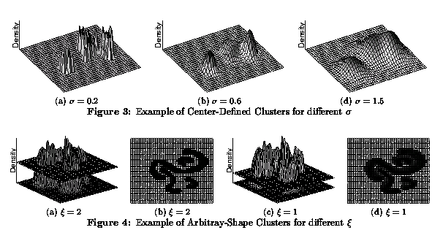
Density-based Clustering
Density-based Clustering algorithms use density-estimation techniques:
to obtain density functions over the space of the attributes; then clusters are identified as areas whose density is above a certain threshold θ (DENCLUE’s Approach)
to create a proximity graph which connects objects whose density is above a certain threshold θ in the neighborhood of an object; then clustering algorithms identify contiguous, connected subsets in the graph which are dense (DBSCAN’s Approach). DBSCAN employs a naïve density estimation approach to estimate the density of dataset points.

Slide 5
Density Estimation
In probability and statistics, density estimation is the construction of an estimate, based on observed data, of an unobservable underlying probability density function. The unobservable density function is thought of as the density according to which a large population is distributed; the data are usually thought of as a random sample from that population (Wikipedia)
Different Density Estimation Approaches:
Naïve Approaches which estimate density by counting the number of objects in grids or other shapes.
Parametric approaches which employ Gaussian or other models as density functions.
Non-parametric approach which use the points in the dataset in influence functions to estimate the density in a query point. Most popular approach: Kernel density estimation(Kernel density estimation - Wikipedia).

Slide 6
Non-Parametric Density Estimation
D={x1,x2,x3,x4}
f^{D}_{Gaussian}(x)= influence(x1,x) + influence(x2,x) +
influence(x3,x) + influence(x4)= 0.04+0.06+0.08+0.6=0.78
Key Idea: if a point y is closer to x it has a stronger influence on x; that is, the values of influence(x,y) decrease as the distance between x and y increases.
x1
0.04
x3
y
0.08
x2
x4
0.06
0.6
x
Remark: the estimated density of y would be larger than the one for x

Slide 7
DBSCAN (http://www2.cs.uh.edu/~ceick/7363/Papers/dbscan.pdf )
DBSCAN is a density-based algorithm.
Density = number of points within a specified radius (Eps)
Input parameter: MinPts and Eps
A point is a core point if it has more than a specified number of points (MinPts) within Eps
These are points that are at the interior of a cluster
A border point has fewer than MinPts within Eps, but is in the neighborhood of a core point
A noise point is any point that is not a core point or a border point.

Slide 8
DBSCAN: Core, Border, and Noise Points
MinPts = 7

Slide 9
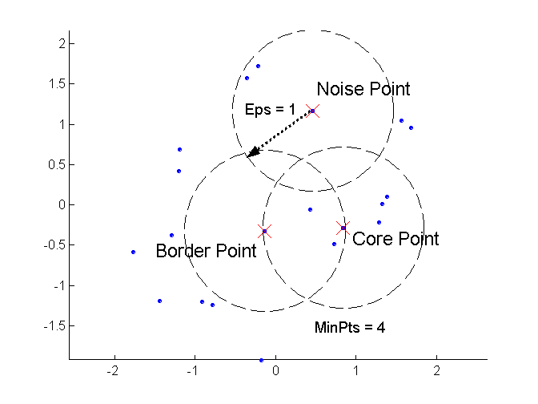
DBSCAN: Core, Border, and Noise Points
Remark: Noise and border points have no outgoing edges in the assumed graph.
Moreover, if there is an edge from a to b then b is directly density reachable from a!

Slide 10
DBSCAN Algorithm (simplified view for teaching)
Create a graph whose nodes are the points to be clustered
For each core-point c create an edge from c to every point p in the ε-neighborhood of c
Set N to the nodes of the graph;
If N does not contain any core points terminate
Pick a core point c in N
Let X be the set of nodes that can be reached from c by going forward;
create a cluster containing X∪{c}
N=N/(X∪{c})
Continue with step 4
Remarks: points that are not assigned to any cluster are outliers;
http://www2.cs.uh.edu/~ceick/7363/Papers/dbscan.pdf gives a more efficient implementation by
performing steps 2 and 6 in parallel

Slide 11
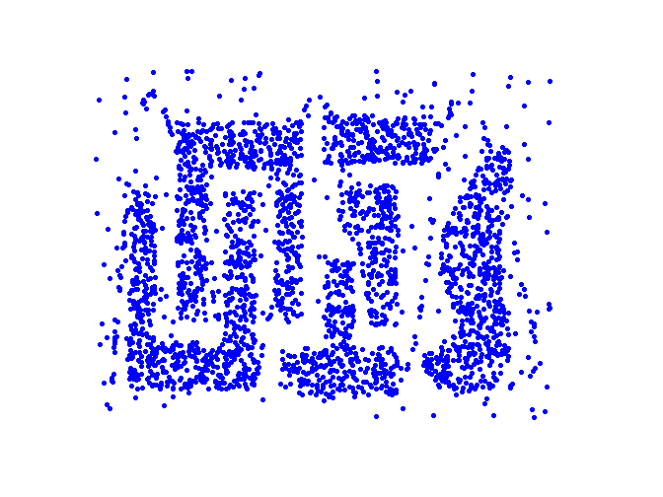
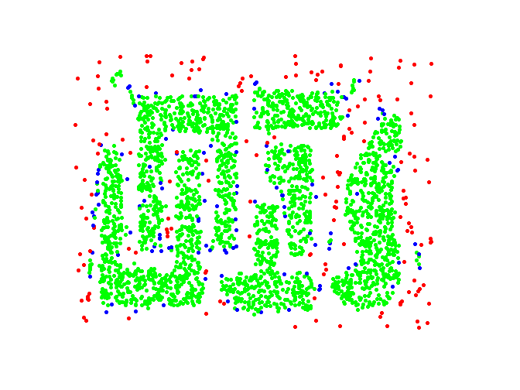
DBSCAN: Core, Border and Noise Points
Original Points
Point types: core, border and noise
Eps = 10, MinPts = 4

Slide 12
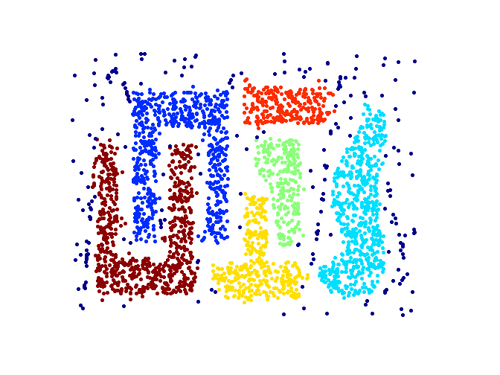
When DBSCAN Works Well
Original Points
Clusters
Resistant to Noise
Supports Outliers
Can handle clusters of different shapes and sizes

Slide 13
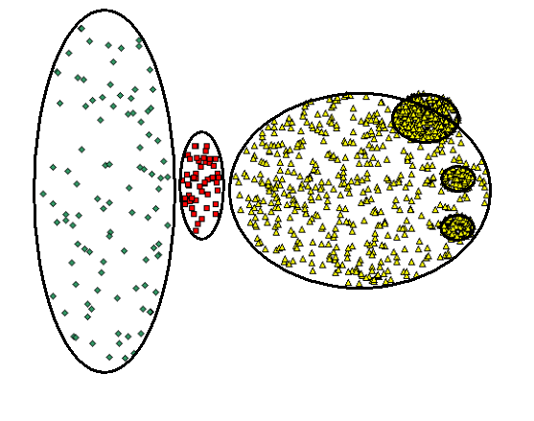
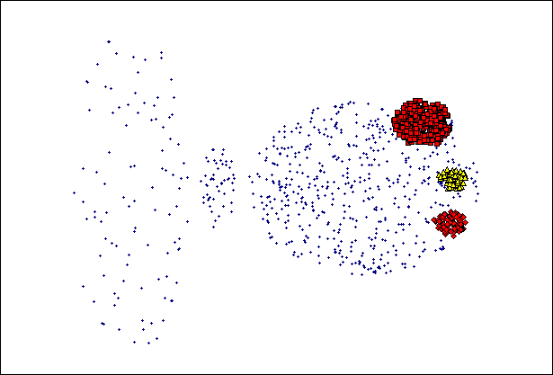
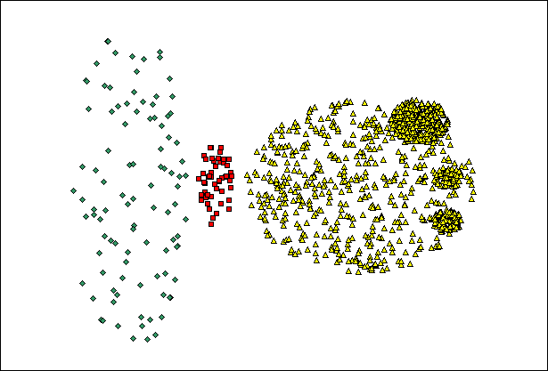
When DBSCAN Does NOT Work Well
(MinPts=4, Eps=9.75).
Original Points
Problems with
Varying densities
High-dimensional data
(MinPts=4, Eps=9.12)

Slide 14
DBSCAN in R
dbscan(iris[3:4], 0.15, 3, showplot=1)
dbscan Pts=150 MinPts=3 eps=0.15
0 1 2 3 4 5 6
border 20 2 5 0 3 2 1
seed 0 46 54 3 9 1 4
total 20 48 59 3 12 3 5
dbscan.r (demo)
http://www.inside-r.org/node/59838

Slide 15
DBSCAN—A Second Introduction
Two parameters:
Eps: Maximum radius of the neighbourhood
MinPts: Minimum number of points in an Eps-neighbourhood of that point
N_{Eps}(p): {q belongs to D | dist(p,q) <= Eps}
Directly density-reachable: A point p is directly density-reachable from a point q wrt. Eps, MinPts if
1) p belongs to N_{Eps}(q)
2) core point condition:
|N_{Eps} (q)| >= MinPts
p
MinPts = 5
Eps = 1 cm
q

Slide 16
Density-Based Clustering: Background (II)
Density-reachable:
A point p is density-reachable from a point q wrt. Eps, MinPts if there is a chain of points p₁, …, p_{n}, p₁ = q, p_{n} = p such that p_{i+1} is directly density-reachable from p_{i}
Density-connected
A point p is density-connected to a point q wrt. Eps, MinPts if there is a point o such that both, p and q are density-reachable from o wrt. Eps and MinPts.
p
p₁
q
p
q
o
Remark: All pairs of points belonging to the same cluster a density connected

Slide 17
DBSCAN: Density Based Spatial Clustering of Applications with Noise
Relies on a density-based notion of cluster: A cluster is defined as a maximal set of density-connected points
Capable to discovers clusters of arbitrary shape in spatial datasets with noise
Not density reachable
from core point
Density reachable
from core point
Outlier
Border
Eps = 1cm
MinPts = 5
Core

Slide 18
DBSCAN: The Algorithm
Arbitrary select a point p
Retrieve all points density-reachable from p wrt Eps and MinPts.
If p is a core point, a cluster is formed.
If p ia not a core point, no points are density-reachable from p and DBSCAN visits the next point of the database.
Continue the process until all of the points have been processed.
Remark: Some bookkeeping is needed to make sure that only points that have not been assigned to a cluster yet, will be used in step 2.

Slide 19
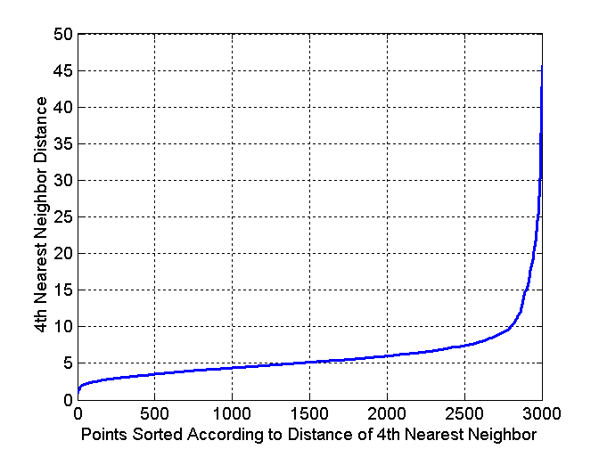
DBSCAN: Determining EPS and MinPts
Idea is that for points in a cluster, their k^{th} nearest neighbors are at roughly the same distance
Noise points have the k^{th} nearest neighbor at farther distance
So, plot sorted distance of every point to its k^{th} nearest neighbor
Run DBSCAN for Minp=4 and ε=5
Core-points
Non-Core-points

Slide 20
DBSCAN Questions from Previous Exams
Assume you have two core points a and b, and a is density reachable from b, and b is density reachable from a; what will happen to a and b when DBSCAN clusters the data?
Assume we have a border point a that is within the radius of two core points b and c that are not density connected. What happens with this border point? Create an example dataset which matches this situation!
Assume you run dbscan(iris[3:4], 0.15, 3) in R and obtain.
0 1 2 3 4 5 6
border 20 2 5 0 3 2 1
seed 0 46 54 3 9 1 4
total 20 48 59 3 12 3 5
What does the displayed result mean with respect to number of clusters, outliers, border points and core points?
Now you run DBSCAM, increasing MinPoints to 5:
dbscan(iris[3:4], 0.15, 5).
How do you expect the clustering results to change?
Next, we run DBSCAN changing epsilon to 0.25; how do the results change? [6]
Discussion to be
continued on Nov. 19

Slide 21
Density-based Clustering: Pros and Cons
+: can (potentially) discover clusters of arbitrary shape
+: not sensitive to outliers and supports outlier detection
+: can handle noise
+−: medium algorithm complexities O(n**2), O(n*log(n))
−: finding good density estimation parameters is frequently difficult; more difficult than using K-means.
−: usually, does not do well in clustering high-dimensional datasets.
−: cluster models are not well understood (yet)

Slide 22
Disregard the remaining slides of this slide show! We might discuss more density-based clustering algorithms in late November, if any time left.

Slide 23
DENCLUE Questions
Source code of DENCLUE??
What is a density attractor and how are density attractors computed by DENCLUE?
What is a cluster in DENCLUE? How are clusters formed by DENCLUE?
What is a path in DENCLUE? How are paths computed in DENCLUE? What algorithm is used to determine which clusters are merged?
DENCLUE places a (hyper)grid on the top of the dataset… Why??
How does DENCLUE’s hill climbing procedure work? How was it enhanced in DENCLUE 2.0 in comparison of its older version?
What objects in the dataset does DENCLUE classify as outliers?
Remark: Dr. Eick will only listen, and maybe make some comments after the discussion.

Slide 24
DENCLUE: Clustering using density functions
DENsity-based CLUstEring by Hinneburg & Keim (KDD’98)
Paper: http://www2.cs.uh.edu/~ceick/DM/Denclue2.pdf
Slides Morteza Morteza H. Chehreghani Chehreghani from Sharif University: http://www2.cs.uh.edu/~ceick/DM/DENCLUE.pdf

