Slide 1
More on Clustering in COSC 4335
Hierarchical Clustering
DBSCAN

Slide 2
1. Hierarchical Clustering
Produces a set of nested clusters organized as a hierarchical tree
Can be visualized as a dendrogram
A tree like diagram that records the sequences of merges or splits

Slide 3
Agglomerative Clustering Algorithm
More popular hierarchical clustering technique
Basic algorithm is straightforward
Compute the proximity matrix
Let each data point be a cluster
Repeat
Merge the two closest clusters
Update the proximity matrix
Until only a single cluster remains
Key operation is the computation of the proximity of two clusters
Different approaches to defining the distance between clusters distinguish the different algorithms

Slide 4
Starting Situation
Start with clusters of individual points and a proximity matrix
p1
p2
p3
p4
p5
. . .
p1
p2
p3
p4
p5
.
.
.
Proximity Matrix

Slide 5
Intermediate Situation
After some merging steps, we have some clusters
C1
C2
C3
C4
C5
C1
C2
C3
C3
C4
C4
C5
Proximity Matrix
C1
C2
C5

Slide 6
Intermediate Situation
We want to merge the two closest clusters (C2 and C5) and update the proximity matrix.
C1
C2
C3
C4
C5
C1
C2
C3
C3
C4
C4
C5
Proximity Matrix
C1
C2
C5

Slide 7
After Merging
The question is “How do we update the proximity matrix?”
C2 U C5
C1
C3
C4
C1
?
C2 U C5
? ? ? ?
C3
C3
?
C4
C4
?
Proximity Matrix
C1
C2 U C5

Slide 8
How to Define Inter-Cluster Similarity
p1
p2
p3
p4
p5
. . .
p1
Similarity?
p2
p3
p4
p5
MIN
MAX
Group Average
Distance Between Centroids
Other methods driven by an objective function
Ward’s Method uses squared error
.
.
.
Proximity Matrix

Slide 9
How to Define Inter-Cluster Similarity
p1
p2
p3
p4
p5
. . .
p1
p2
p3
p4
p5
MIN (single link)
MAX (complete link)
Group Average (average link)
Distance Between Centroids
Other methods driven by an objective function
Ward’s Method uses squared error: http://en.wikipedia.org/wiki/Ward%27s_method
.
.
.
Proximity Matrix

Slide 10
How to Define Inter-Cluster Similarity
p1
p2
p3
p4
p5
. . .
p1
p2
p3
p4
p5
MIN
MAX
Group Average
Distance Between Centroids
Other methods driven by an objective function
Ward’s Method uses squared error
.
.
.
Proximity Matrix

Slide 11
How to Define Inter-Cluster Similarity
p1
p2
p3
p4
p5
. . .
p1
p2
p3
p4
p5
MIN
MAX
Group Average
Distance Between Centroids
Other methods driven by an objective function
Ward’s Method uses squared error
.
.
.
Proximity Matrix

Slide 12
How to Define Inter-Cluster Similarity
p1
p2
p3
p4
p5
. . .
p1
×
×
p2
p3
p4
p5
MIN
MAX
Group Average
Distance Between Centroids
Other methods driven by an objective function
Ward’s Method uses squared error
.
.
.
Proximity Matrix

Slide 13
Hierarchical Clustering in R
https://stat.ethz.ch/R-manual/R-patched/library/stats/html/hclust.html (hclust)
https://stat.ethz.ch/R-manual/R-patched/library/stats/html/dist.html (dist function to create distance matrices)
Example R-Code:
#Created by Christoph Eick for COSC 4335 at UH.
#applying hierarchical clustering
hc <- hclust(dist(iris[1:4]), "ave")
plot(hc)
plot(hc, hang = -1)
hc$merge

Slide 14
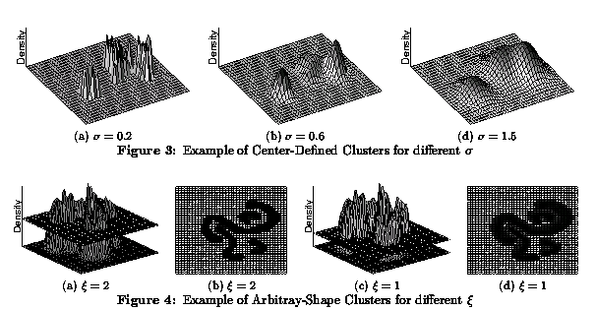
2. Density-based Clustering
Density-based Clustering algorithms use density-estimation techniques
to create a density-function over the space of the attributes; then clusters are identified as areas in the graph whose density is above a certain threshold (DENCLUE’s Approach)
to create a proximity graph which connects objects whose density is above a certain threshold θ; then clustering algorithms identify contiguous, connected subsets in the graph which are dense (DBSCAN’s Approach).

Slide 15
DBSCAN (http://www2.cs.uh.edu/~ceick/7363/Papers/dbscan.pdf )
DBSCAN is a density-based algorithm.
Density = number of points within a specified radius (Eps)
Input parameter: MinPts and Eps
A point is a core point if it has more than a specified number of points (MinPts) within Eps
These are points that are at the interior of a cluster
A border point has fewer than MinPts within Eps, but is in the neighborhood of a core point
A noise point is any point that is not a core point or a border point.

Slide 16
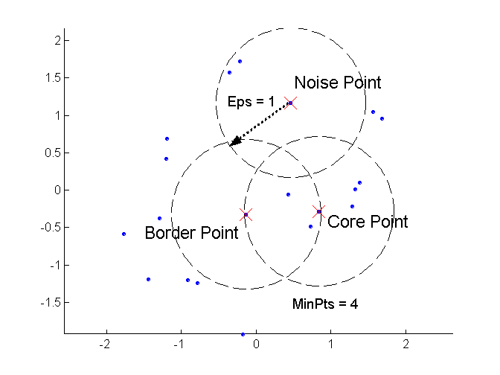
DBSCAN: Core, Border, and Noise Points

Slide 17
DBSCAN Algorithm (simplified view for teaching)
Create a graph whose nodes are the points to be clustered
For each core-point c create an edge from c to every point p in the ε-neighborhood of c
Set N to the nodes of the graph;
If N does not contain any core points terminate
Pick a core point c in N
Let X be the set of nodes that can be reached from c by going forward;
create a cluster containing X∪{c}
N=N/(X∪{c})
Continue with step 4
Remarks: points that are not assigned to any cluster are outliers;
http://www2.cs.uh.edu/~ceick/7363/Papers/dbscan.pdf gives a more efficient implementation by
performing steps 2 and 6 in parallel

Slide 18
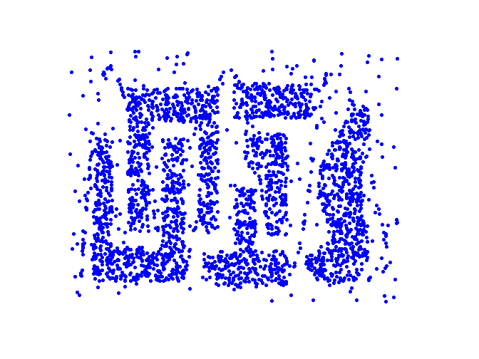
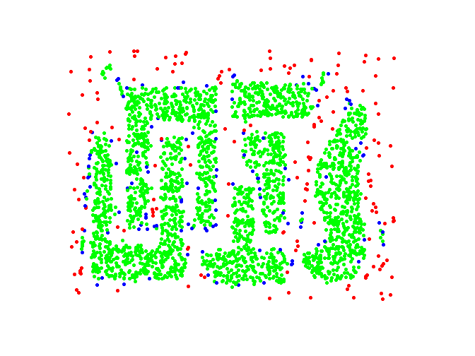
DBSCAN: Core, Border and Noise Points
Original Points
Point types: core, border and noise
Eps = 10, MinPts = 4

Slide 19
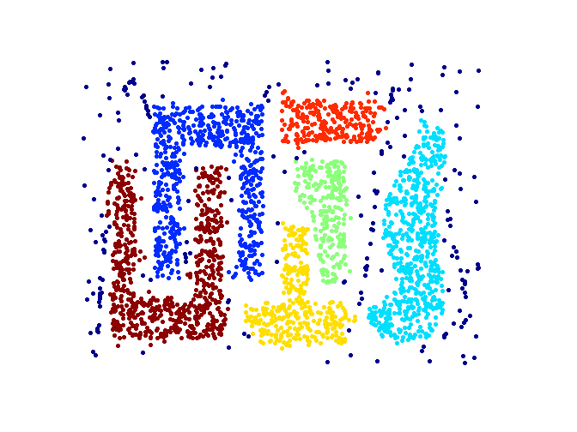
When DBSCAN Works Well
Original Points
Clusters
Resistant to Noise
Supports Outliers
Can handle clusters of different shapes and sizes

Slide 20
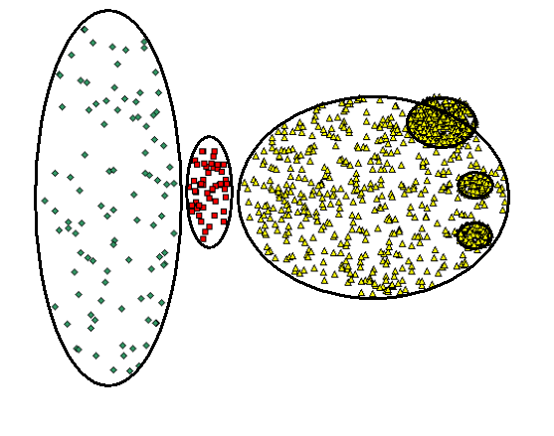
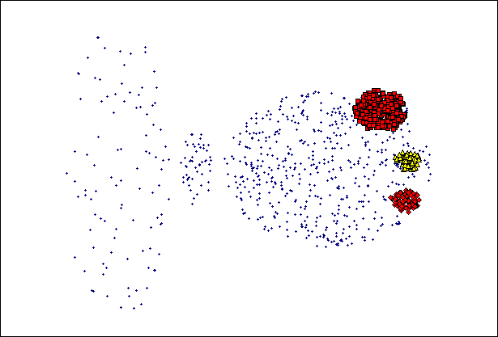
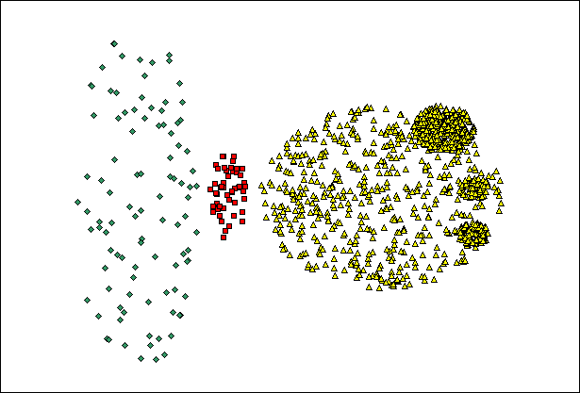
When DBSCAN Does NOT Work Well
(MinPts=4, Eps=9.75).
Original Points
Problems with
Varying densities
High-dimensional data
(MinPts=4, Eps=9.12)

Slide 21
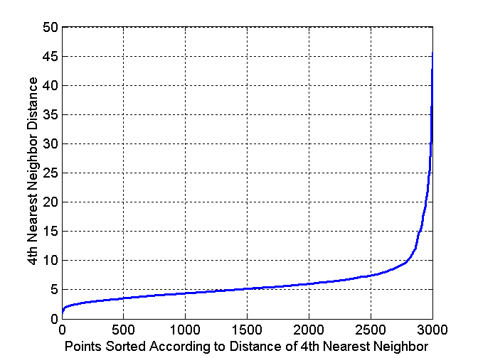
DBSCAN: Determining EPS and MinPts
Idea is that for points in a cluster, their k^{th} nearest neighbors are at roughly the same distance
Noise points have the k^{th} nearest neighbor at farther distance
So, plot sorted distance of every point to its k^{th} nearest neighbor
Run DBSCAN for Minp=4 and ε=5
Core-points
Non-Core-points

Slide 22
DBSCAN in R
dbscan(iris[3:4], 0.15, 3, showplot=1)
dbscan Pts=150 MinPts=3 eps=0.15
0 1 2 3 4 5 6
border 20 2 5 0 3 2 1
seed 0 46 54 3 9 1 4
total 20 48 59 3 12 3 5
dbscan.r (demo)
http://www.inside-r.org/node/59838

Slide 23
DBSCAN—A Second Introduction
Two parameters:
Eps: Maximum radius of the neighbourhood
MinPts: Minimum number of points in an Eps-neighbourhood of that point
N_{Eps}(p): {q belongs to D | dist(p,q) <= Eps}
Directly density-reachable: A point p is directly density-reachable from a point q wrt. Eps, MinPts if
1) p belongs to N_{Eps}(q)
2) core point condition:
|N_{Eps} (q)| >= MinPts
p
MinPts = 5
Eps = 1 cm
q

Slide 24
Density-Based Clustering: Background (II)
Density-reachable:
A point p is density-reachable from a point q wrt. Eps, MinPts if there is a chain of points p₁, …, p_{n}, p₁ = q, p_{n} = p such that p_{i+1} is directly density-reachable from p_{i}
Density-connected
A point p is density-connected to a point q wrt. Eps, MinPts if there is a point o such that both, p and q are density-reachable from o wrt. Eps and MinPts.
p
p₁
q
p
q
o

Slide 25
DBSCAN: Density Based Spatial Clustering of Applications with Noise
Relies on a density-based notion of cluster: A cluster is defined as a maximal set of density-connected points
Capable to discovers clusters of arbitrary shape in spatial datasets with noise
Not density reachable
from core point
Density reachable
from core point
Outlier
Border
Eps = 1cm
MinPts = 5
Core

Slide 26
DBSCAN: The Algorithm
Arbitrary select a point p
Retrieve all points density-reachable from p wrt Eps and MinPts.
If p is a core point, a cluster is formed.
If p ia not a core point, no points are density-reachable from p and DBSCAN visits the next point of the database.
Continue the process until all of the points have been processed.

Slide 27
Density-based Clustering: Pros and Cons
+: can (potentially) discover clusters of arbitrary shape
+: not sensitive to outliers and supports outlier detection
+: can handle noise
+−: medium algorithm complexities O(n**2), O(n*log(n)
−: finding good density estimation parameters is frequently difficult; more difficult to use than K-means.
−: usually, does not do well in clustering high-dimensional datasets.
−: cluster models are not well understood (yet)

