Slide 1
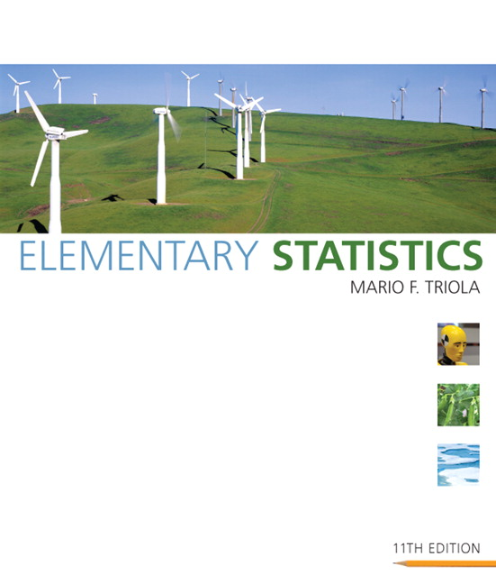

Lecture Slides
Elementary Statistics
Eleventh Edition
and the Triola Statistics Series
by Mario F. Triola

Slide 2
Chapter 6
Normal Probability Distributions
6-1 Review and Preview
6-2 The Standard Normal Distribution
6-3 Applications of Normal Distributions
6-4 Sampling Distributions and Estimators
6-5 The Central Limit Theorem
6-6 Normal as Approximation to Binomial
6-7 Assessing Normality

Slide 3

Section 6-1
Review and Preview

Slide 4
Review
Chapter 2: Distribution of data
Chapter 3: Measures of data sets, including measures of center and variation
Chapter 4: Principles of probability
Chapter 5: Discrete probability distributions

Slide 5
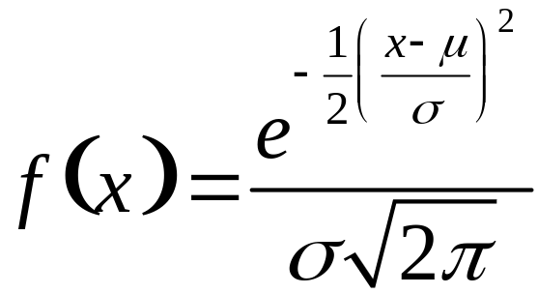
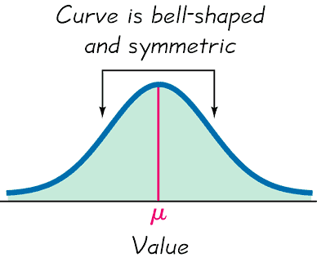
Preview
Chapter focus is on:
Continuous random variables
Normal distributions
Formula 6-1
Distribution determined by fixed values of mean and standard deviation
Figure 6-1

Slide 6
Section 6-2
The Standard Normal Distribution

Slide 7
Key Concept
This section presents the standard normal distribution which has three properties:
It’s graph is bell-shaped.
It’s mean is equal to 0 (μ = 0).
It’s standard deviation is equal to 1 (σ = 1).
Develop the skill to find areas (or probabilities or relative frequencies) corresponding to various regions under the graph of the standard normal distribution. Find z-scores that correspond to area under the graph.

Slide 8
Uniform Distribution
A continuous random variable has a uniform distribution if its values are spread evenly over the range of probabilities. The graph of a uniform distribution results in a rectangular shape.

Slide 9
Density Curve
A density curve is the graph of a continuous probability distribution. It must satisfy the following properties:
1. The total area under the curve must equal 1.
2. Every point on the curve must have a vertical height that is 0 or greater. (That is, the curve cannot fall below the x-axis.)

Slide 10
Because the total area under the density curve is equal to 1, there is a correspondence between area and probability.
Area and Probability

Slide 11
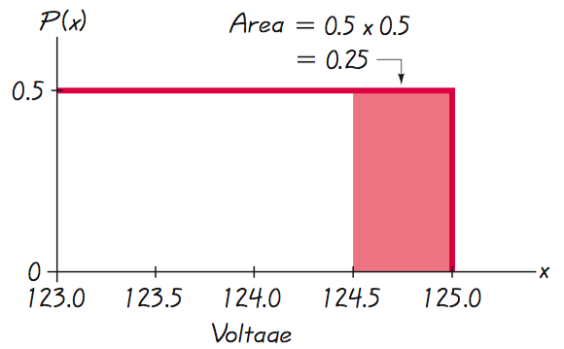
Using Area to Find Probability
Given the uniform distribution illustrated, find the probability that a randomly selected voltage level is greater than 124.5 volts.
Shaded area represents voltage levels greater than 124.5 volts. Correspondence between area and probability: 0.25.

Slide 12
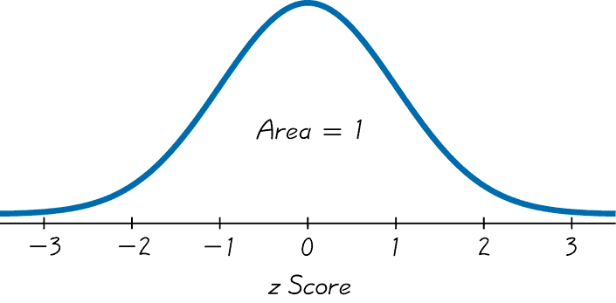
Standard Normal Distribution
The standard normal distribution is a normal probability distribution with μ = 0 and σ = 1. The total area under its density curve is equal to 1.

Slide 13
Finding Probabilities When Given z-scores
Table A-2 (in Appendix A)
Formulas and Tables insert card
Find areas for many different regions

Slide 14
Finding Probabilities – Other Methods
STATDISK
Minitab
Excel
TI-83/84 Plus

Slide 15
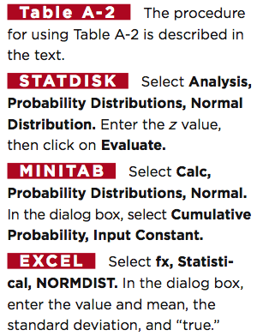
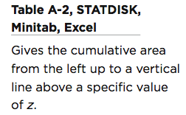
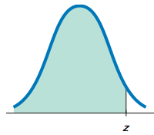
Methods for Finding Normal Distribution Areas

Slide 16
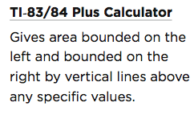
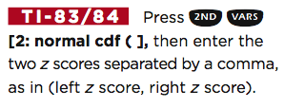
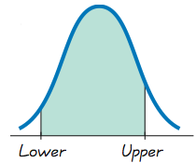
Methods for Finding Normal Distribution Areas

Slide 17
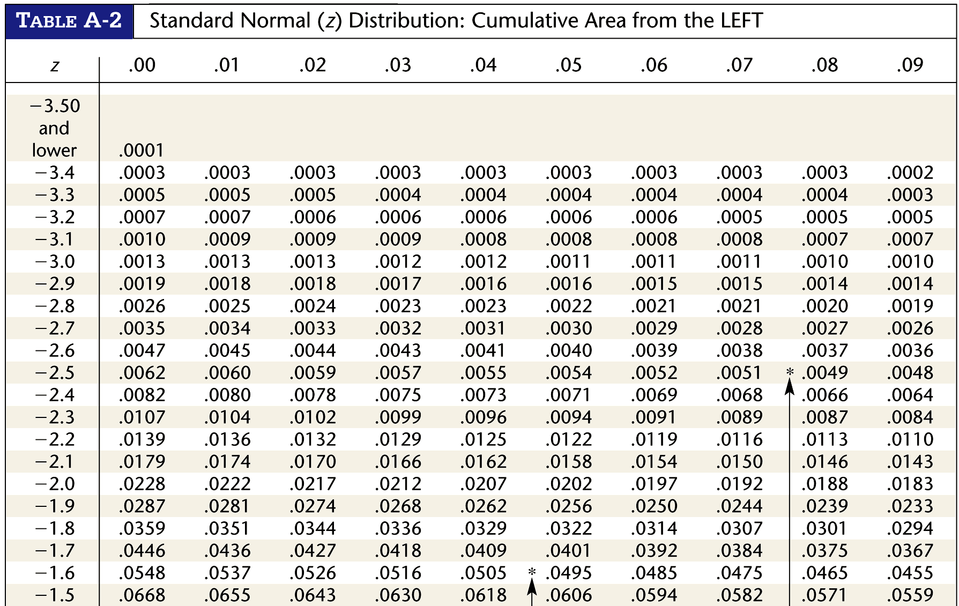
Table A-2

Slide 18
Using Table A-2
It is designed only for the standard normal distribution, which has a mean of 0 and a standard deviation of 1.
It is on two pages, with one page for negative z-scores and the other page for positive
z-scores.
Each value in the body of the table is a cumulative area from the left up to a vertical boundary above a specific z-score.

Slide 19
Using Table A-2
4. When working with a graph, avoid confusion between z-scores and areas.
z Score
Distance along horizontal scale of the standard normal distribution; refer to the leftmost column and top row of Table A-2.
Area
Region under the curve; refer to the values in the body of Table A-2.
5. The part of the z-score denoting hundredths is found across the top.

Slide 20
Example - Thermometers
The Precision Scientific Instrument Company manufactures thermometers that are supposed to give readings of 0ºC at the freezing point of water. Tests on a large sample of these instruments reveal that at the freezing point of water, some thermometers give readings below 0º (denoted by negative numbers) and some give readings above 0º (denoted by positive numbers). Assume that the mean reading is 0ºC and the standard deviation of the readings is 1.00ºC. Also assume that the readings are normally distributed. If one thermometer is randomly selected, find the probability that, at the freezing point of water, the reading is less than 1.27º.

Slide 21
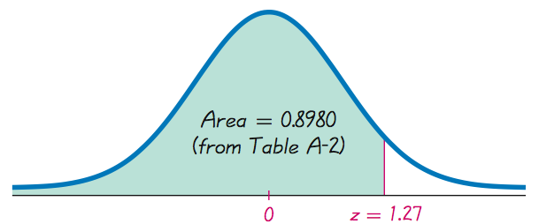
Example - (Continued)
P(z < 1.27) =

Slide 22
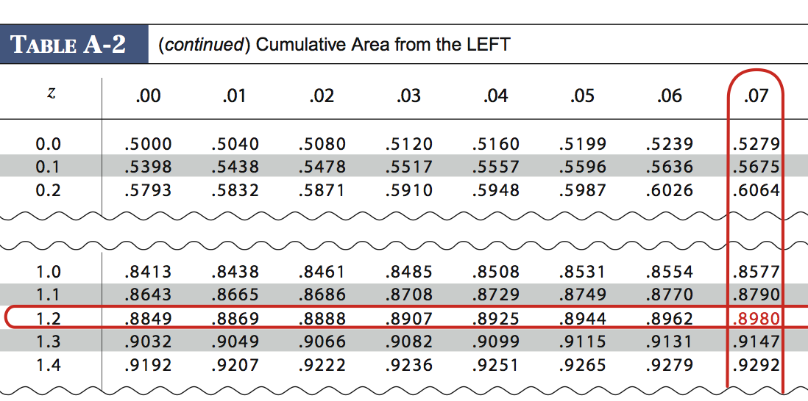
Look at Table A-2

Slide 23
Example - cont
P (z < 1.27) = 0.8980

Slide 24
Example - cont
P (z < 1.27) = 0.8980
The probability of randomly selecting a thermometer with a reading less than 1.27º is 0.8980.

Slide 25
Example - cont
P (z < 1.27) = 0.8980
Or 89.80% will have readings below 1.27º.

Slide 26
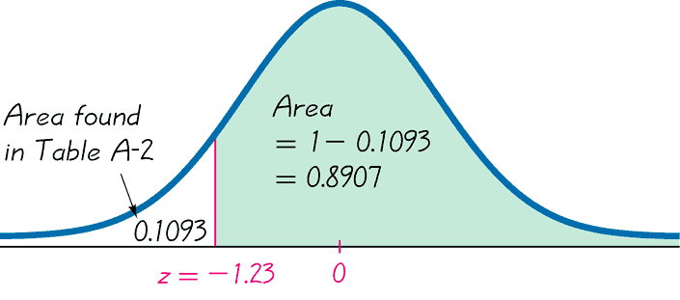
If thermometers have an average (mean) reading of 0 degrees and a standard deviation of 1 degree for freezing water, and if one thermometer is randomly selected, find the probability that it reads (at the freezing point of water) above –1.23 degrees.
Example - Thermometers Again
P (z > –1.23) = 0.8907
Probability of randomly selecting a thermometer with a reading above –1.23º is 0.8907.

Slide 27
Example - cont
P (z > –1.23) = 0.8907
89.07% of the thermometers have readings above –1.23 degrees.

Slide 28
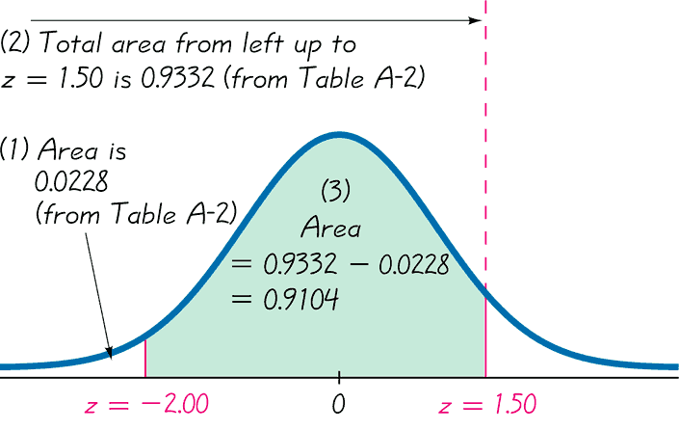
A thermometer is randomly selected. Find the probability that it reads (at the freezing point of water) between –2.00 and 1.50 degrees.
Example - Thermometers III
P (z < –2.00) = 0.0228
P (z < 1.50) = 0.9332
P (–2.00 < z < 1.50) =
0.9332 – 0.0228 = 0.9104
The probability that the chosen thermometer has a reading between – 2.00 and 1.50 degrees is 0.9104.

Slide 29
Example - cont
A thermometer is randomly selected. Find the probability that it reads (at the freezing point of water) between –2.00 and 1.50 degrees.
P (z < –2.00) = 0.0228
P (z < 1.50) = 0.9332
P (–2.00 < z < 1.50) =
0.9332 – 0.0228 = 0.9104
If many thermometers are selected and tested at the freezing point of water, then 91.04% of them will read between –2.00 and 1.50 degrees.

Slide 30
Notation
P(a < z < b)
denotes the probability that the z score is between a and b.
P(z > a)
denotes the probability that the z score is greater than a.
P(z < a)
denotes the probability that the z score is less than a.

Slide 31
Finding a z Score When Given a
Probability Using Table A-2
1. Draw a bell-shaped curve and identify the region under the curve that corresponds to the given probability. If that region is not a cumulative region from the left, work instead with a known region that is a cumulative region from the left.
2. Using the cumulative area from the left, locate the closest probability in the body of Table A-2 and identify the corresponding z score.

Slide 32
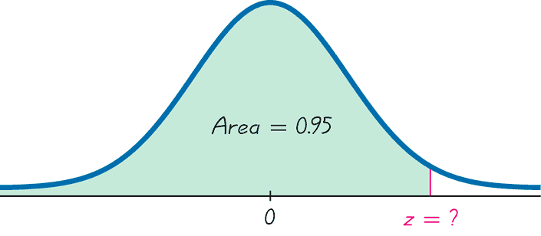
Finding z Scores
When Given Probabilities
^{5% or 0.05}
(z score will be positive)
Finding the 95th Percentile

Slide 33
Finding z Scores
When Given Probabilities - cont
^{5% or 0.05}
(z score will be positive)
1.645
Finding the 95th Percentile

Slide 34
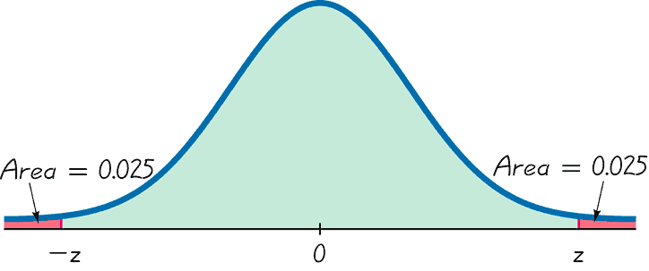
Finding z Scores
When Given Probabilities - cont
(One z score will be negative and the other positive)
Finding the Bottom 2.5% and Upper 2.5%

Slide 35
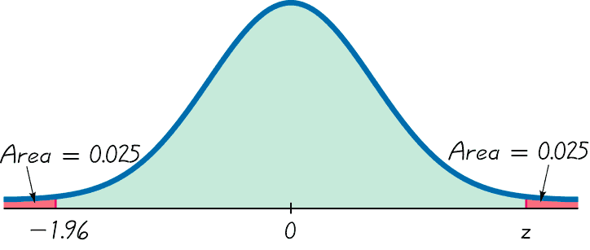
Finding z Scores
When Given Probabilities - cont
(One z score will be negative and the other positive)
Finding the Bottom 2.5% and Upper 2.5%

Slide 36
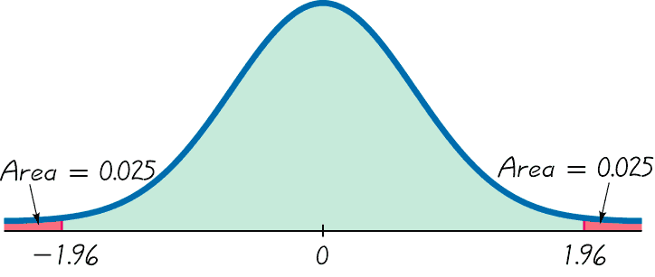
Finding z Scores
When Given Probabilities - cont
(One z score will be negative and the other positive)
Finding the Bottom 2.5% and Upper 2.5%

Slide 37
Recap
In this section we have discussed:
Density curves.
Relationship between area and probability.
Standard normal distribution.
Using Table A-2.

Slide 38
Section 6-3
Applications of Normal Distributions

Slide 39
Key Concept
This section presents methods for working with normal distributions that are not standard. That is, the mean is not 0 or the standard deviation is not 1, or both.
The key concept is that we can use a simple conversion that allows us to standardize any normal distribution so that the same methods of the previous section can be used.

Slide 40
Conversion Formula
x – µ
z =
σ
Round z scores to 2 decimal places

Slide 41
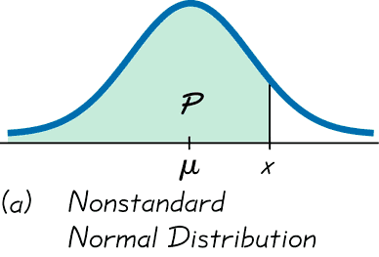
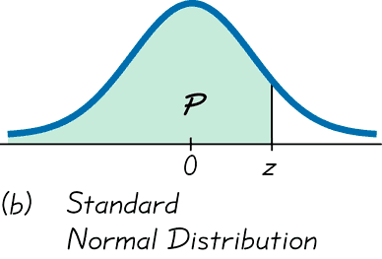
Converting to a Standard
Normal Distribution
x – μ
z =
σ

Slide 42
Example – Weights of Water Taxi Passengers
In the Chapter Problem, we noted that the safe load for a water taxi was found to be 3500 pounds. We also noted that the mean weight of a passenger was assumed to be 140 pounds. Assume the worst case that all passengers are men. Assume also that the weights of the men are normally distributed with a mean of 172 pounds and standard deviation of 29 pounds. If one man is randomly selected, what is the probability he weighs less than 174 pounds?

Slide 43
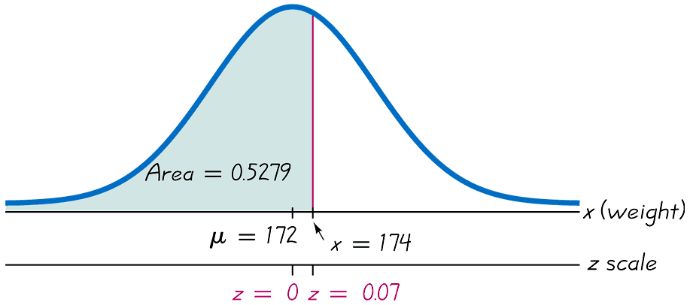
Example - cont
μ = 172
174 – 172
z =
= 0.07
σ = 29
29

Slide 44
Example - cont
μ = 172
σ = 29
P ( x < 174 lb.) = P(z < 0.07)
= 0.5279

Slide 45
Helpful Hints
1. Don’t confuse z scores and areas. z scores are distances along the horizontal scale, but areas are regions under the normal curve. Table A-2 lists z scores in the left column and across the top row, but areas are found in the body of the table.
2. Choose the correct (right/left) side of the graph.
3. A z score must be negative whenever it is located in the left half of the normal distribution.
4. Areas (or probabilities) are positive or zero values, but they are never negative.

Slide 46
Procedure for Finding Values
Using Table A-2 and Formula 6-2
1. Sketch a normal distribution curve, enter the given probability or percentage in the appropriate region of the graph, and identify the x value(s) being sought.
2. Use Table A-2 to find the z score corresponding to the cumulative left area bounded by x. Refer to the body of Table A-2 to find the closest area, then identify the corresponding z score.
3. Using Formula 6-2, enter the values for µ, σ, and the z score found in step 2, then solve for x.
x = µ + (z • σ) (Another form of Formula 6-2)
(If z is located to the left of the mean, be sure that it is a negative number.)
4. Refer to the sketch of the curve to verify that the solution makes sense in the context of the graph and the context of the problem.
Notes:
page 263 of Elementary Statistics, 10th Edition

Slide 47
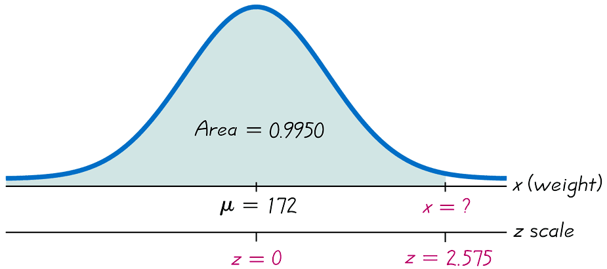
Example – Lightest and Heaviest
Use the data from the previous example to determine what weight separates the lightest 99.5% from the heaviest 0.5%?

Slide 48
Example – Lightest and Heaviest - cont
x = μ + (z ● σ)
x = 172 + (2.575 • 29)
x = 246.675 (247 rounded)

Slide 49
Example – Lightest and Heaviest - cont
The weight of 247 pounds separates the lightest 99.5% from the heaviest 0.5%

Slide 50
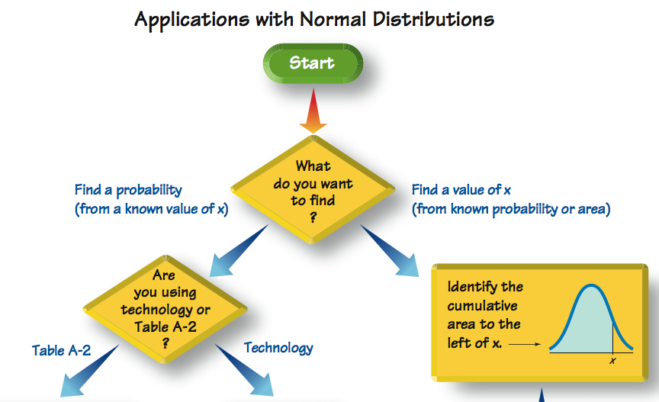

Slide 51

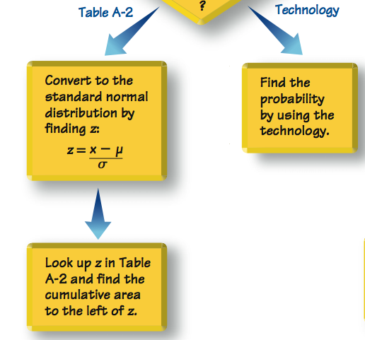

Slide 52
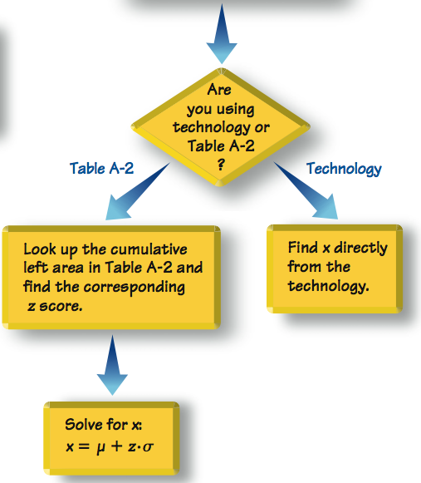


Slide 53
Recap
In this section we have discussed:
Non-standard normal distribution.
Converting to a standard normal distribution.
Procedures for finding values using Table A-2 and Formula 6-2.

Slide 54
Section 6-4
Sampling Distributions and Estimators

Slide 55
Key Concept
The main objective of this section is to understand the concept of a sampling distribution of a statistic, which is the distribution of all values of that statistic when all possible samples of the same size are taken from the same population.
We will also see that some statistics are better than others for estimating population parameters.

Slide 56
Definition
The sampling distribution of a statistic (such as the sample mean or sample proportion) is the distribution of all values of the statistic when all possible samples of the same size n are taken from the same population. (The sampling distribution of a statistic is typically represented as a probability distribution in the format of a table, probability histogram, or formula.)

Slide 57
Definition
The sampling distribution of the mean is the distribution of sample means, with all samples having the same sample size n taken from the same population. (The sampling distribution of the mean is typically represented as a probability distribution in the format of a table, probability histogram, or formula.)

Slide 58
Properties
Sample means target the value of the population mean. (That is, the mean of the sample means is the population mean. The expected value of the sample mean is equal to the population mean.)
The distribution of the sample means tends to be a normal distribution.

Slide 59
Definition
The sampling distribution of the variance is the distribution of sample variances, with all samples having the same sample size n taken from the same population. (The sampling distribution of the variance is typically represented as a probability distribution in the format of a table, probability histogram, or formula.)

Slide 60
Properties
Sample variances target the value of the population variance. (That is, the mean of the sample variances is the population variance. The expected value of the sample variance is equal to the population variance.)
The distribution of the sample variances tends to be a distribution skewed to the right.

Slide 61
Definition
The sampling distribution of the proportion is the distribution of sample proportions, with all samples having the same sample size n taken from the same population.

Slide 62

Definition
We need to distinguish between a population proportion p and some sample proportion:
p = population proportion
= sample proportion

Slide 63
Properties
Sample proportions target the value of the population proportion. (That is, the mean of the sample proportions is the population proportion. The expected value of the sample proportion is equal to the population proportion.)
The distribution of the sample proportion tends to be a normal distribution.

Slide 64
Unbiased Estimators
Sample means, variances and proportions are unbiased estimators.
That is they target the population parameter.
These statistics are better in estimating the population parameter.

Slide 65
Biased Estimators
Sample medians, ranges and standard deviations are biased estimators.
That is they do NOT target the population parameter.
Note: the bias with the standard deviation is relatively small in large samples so s is often used to estimate.

Slide 66

Example - Sampling Distributions
Consider repeating this process: Roll a die 5 times, find the mean , variance s², and the proportion of odd numbers of the results. What do we know about the behavior of all sample means that are generated as this process continues indefinitely?

Slide 67
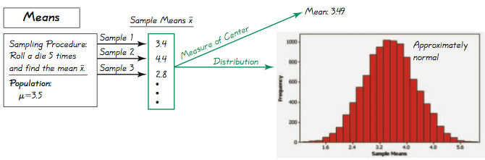
Example - Sampling Distributions
Specific results from 10,000 trials
All outcomes are equally likely so the population mean is 3.5; the mean of the 10,000 trials is 3.49. If continued indefinitely, the sample mean will be 3.5. Also, notice the distribution is “normal.”

Slide 68
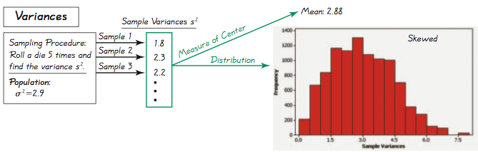
Example - Sampling Distributions
Specific results from 10,000 trials
All outcomes are equally likely so the population variance is 2.9; the mean of the 10,000 trials is 2.88. If continued indefinitely, the sample variance will be 2.9. Also, notice the distribution is “skewed to the right.”

Slide 69
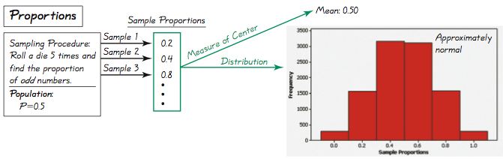
Example - Sampling Distributions
Specific results from 10,000 trials
All outcomes are equally likely so the population proportion of odd numbers is 0.50; the proportion of the 10,000 trials is 0.50. If continued indefinitely, the mean of sample proportions will be 0.50. Also, notice the distribution is “approximately normal.”

Slide 70
Why Sample with Replacement?
Sampling without replacement would have the very practical advantage of avoiding wasteful duplication whenever the same item is selected more than once.
However, we are interested in sampling with replacement for these two reasons:
1. When selecting a relatively small sample form a large population, it makes no significant difference whether we sample with replacement or without replacement.
2. Sampling with replacement results in independent events that are unaffected by previous outcomes, and independent events are easier to analyze and result in simpler calculations and formulas.

Slide 71
Caution
Many methods of statistics require a simple random sample. Some samples, such as voluntary response samples or convenience samples, could easily result in very wrong results.

Slide 72
Recap
In this section we have discussed:
Sampling distribution of a statistic.
Sampling distribution of the mean.
Sampling distribution of the variance.
Sampling distribution of the proportion.
Estimators.

Slide 73
Section 6-5
The Central Limit Theorem

Slide 74
Key Concept
The Central Limit Theorem tells us that for a population with any distribution, the distribution of the sample means approaches a normal distribution as the sample size increases.
The procedure in this section form the foundation for estimating population parameters and hypothesis testing.

Slide 75
Central Limit Theorem
Given:
1. The random variable x has a distribution (which may or may not be normal) with mean µ and standard deviation σ.
2. Simple random samples all of size n are selected from the population. (The samples are selected so that all possible samples of the same size n have the same chance of being selected.)

Slide 76
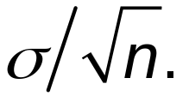
Central Limit Theorem – cont.
Conclusions:
1. The distribution of sample x will, as the sample size increases, approach a normal distribution.
2. The mean of the sample means is the population mean µ.
3. The standard deviation of all sample means
is

Slide 77
Practical Rules Commonly Used
1. For samples of size n larger than 30, the distribution of the sample means can be approximated reasonably well by a normal distribution. The approximation gets closer to a normal distribution as the sample size n becomes larger.
2. If the original population is normally distributed, then for any sample size n, the sample means will be normally distributed (not just the values of n larger than 30).

Slide 78
Notation
the mean of the sample means
the standard deviation of sample mean
(often called the standard error of the mean)
µ_{x} = µ
σ_{x} =
σ
n

Slide 79
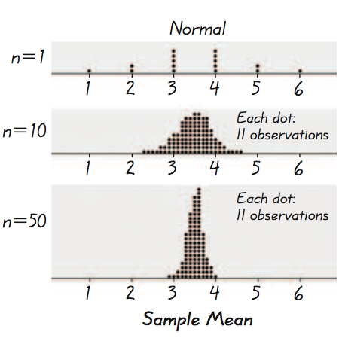
Example - Normal Distribution
As we proceed from n = 1 to
n = 50, we see that the distribution of sample means is approaching the shape of a normal distribution.

Slide 80
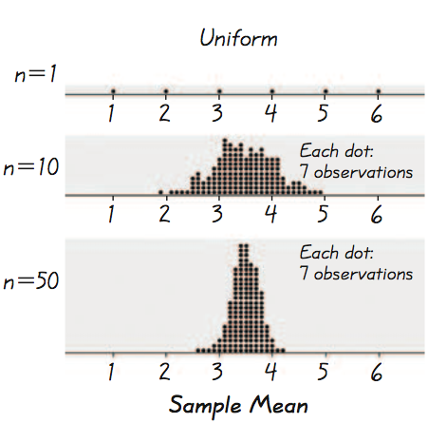
Example - Uniform Distribution
As we proceed from n = 1 to
n = 50, we see that the distribution of sample means is approaching the shape of a normal distribution.

Slide 81
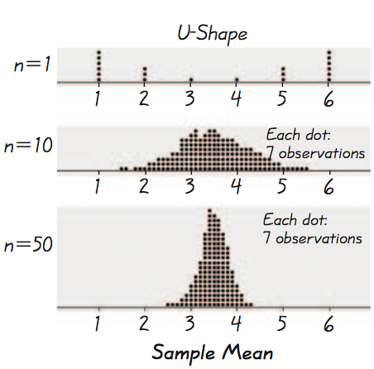
Example - U-Shaped Distribution
As we proceed from n = 1 to
n = 50, we see that the distribution of sample means is approaching the shape of a normal distribution.

Slide 82
Important Point
As the sample size increases, the sampling distribution of sample means approaches a normal distribution.
Notes:
Result of example on p 282 of Elementary Statistics, 10th Edition

Slide 83
Use the Chapter Problem. Assume the population of weights of men is normally distributed with a mean of 172 lb and a standard deviation of 29 lb.
Example – Water Taxi Safety
Find the probability that if an individual man is randomly selected, his weight is greater than 175 lb.
b) Find the probability that 20 randomly selected men will have a mean weight that is greater than 175 lb (so that their total weight exceeds the safe capacity of 3500 pounds).

Slide 84
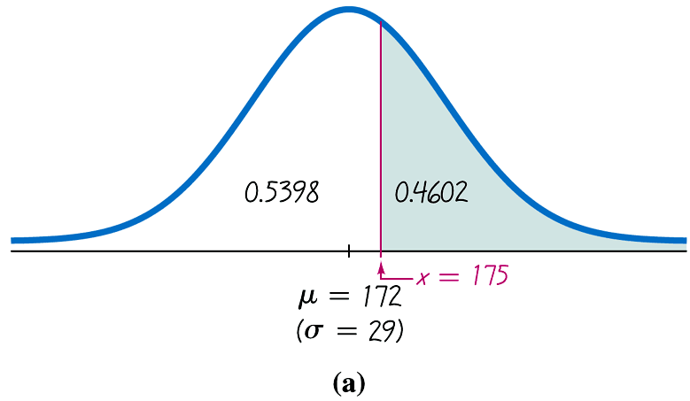
Example – cont
a) Find the probability that if an individual man is randomly selected, his weight is greater than 175 lb.
z = 175 – 172 = 0.10
29

Slide 85
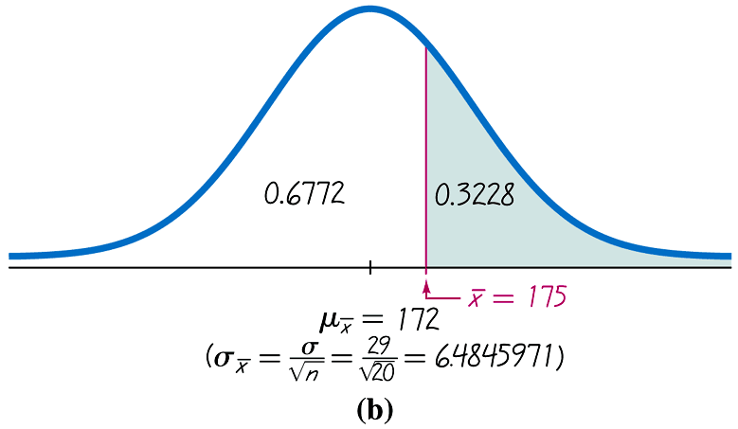
Example – cont
b) Find the probability that 20 randomly selected men will have a mean weight that is greater than 175 lb (so that their total weight exceeds the safe capacity of 3500 pounds).
z = 175 – 172 = 0.46
29
20

Slide 86
Example - cont
a) Find the probability that if an individual man is randomly selected, his weight is greater than 175 lb.
P(x > 175) = 0.4602
b) Find the probability that 20 randomly selected men will have a mean weight that is greater than 175 lb (so that their total weight exceeds the safe capacity of 3500 pounds).
P(x > 175) = 0.3228
It is much easier for an individual to deviate from the
mean than it is for a group of 20 to deviate from the mean.

Slide 87
Interpretation of Results
Given that the safe capacity of the water taxi is 3500 pounds, there is a fairly good chance (with probability 0.3228) that it will be overloaded with 20 randomly selected men.

Slide 88
Correction for a Finite Population
When sampling without replacement and the sample size n is greater than 5% of the finite population of size N (that is, n > 0.05N ), adjust the standard deviation of sample means by multiplying it by the finite population correction factor:
σ
N – n
σ_{x}
=
_{n}
N – 1
finite population
correction factor

Slide 89
Recap
In this section we have discussed:
Central limit theorem.
Practical rules.
Effects of sample sizes.
Correction for a finite population.

Slide 90
Section 6-6
Normal as Approximation to Binomial

Slide 91
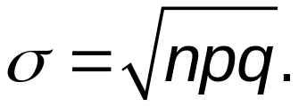
Key Concept
This section presents a method for using a normal distribution as an approximation to the binomial probability distribution.
If the conditions of np ≥ 5 and nq ≥ 5 are both satisfied, then probabilities from a binomial probability distribution can be approximated well by using a normal distribution with mean μ = np and standard deviation

Slide 92
Review
Binomial Probability Distribution
1. The procedure must have a fixed number of trials.
2. The trials must be independent.
3. Each trial must have all outcomes classified into two categories (commonly, success and failure).
4. The probability of success remains the same in all trials.
Solve by binomial probability formula, Table A-1, or technology.
Notes:
A review of necessary requirements for a binomial probability distribution.
page 214 of Elementary Statistics, 10th Edition

Slide 93
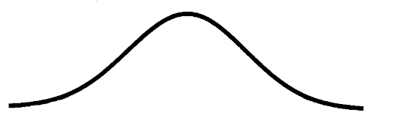
Approximation of a Binomial Distribution with a Normal Distribution
np ≥ 5
nq ≥ 5
then µ = np and σ = npq
and the random variable has
a
distribution.
(normal)

Slide 94
Procedure for Using a Normal Distribution to Approximate a Binomial Distribution
1. Verify that both np ≥ 5 and nq ≥ 5. If not, you must use software, a calculator, a table or calculations using the binomial probability formula.
2. Find the values of the parameters µ and σ by calculating µ = np and σ = npq.
3. Identify the discrete whole number x that is relevant to the binomial probability problem. Focus on this value temporarily.

Slide 95
Procedure for Using a Normal Distribution to Approximate a Binomial Distribution
4. Draw a normal distribution centered about μ, then draw a vertical strip area centered over x. Mark the left side of the strip with the number equal to x – 0.5, and mark the right side with the number equal to x + 0.5. Consider the entire area of the entire strip to represent the probability of the discrete whole number itself.
5. Determine whether the value of x itself is included in the probability. Determine whether you want the probability of at least x, at most x, more than x, fewer than x, or exactly x. Shade the area to the right or left of the strip; also shade the interior of the strip if and only if x itself is to be included. This total shaded region corresponds to the probability being sought.

Slide 96
Procedure for Using a Normal Distribution to Approximate a Binomial Distribution
6. Using x – 0.5 or x + 0.5 in place of x, find the area of the shaded region: find the z score; use that z score to find the area to the left of the adjusted value of x; use that cumulative area to identify the shaded area corresponding to the desired probability.

Slide 97
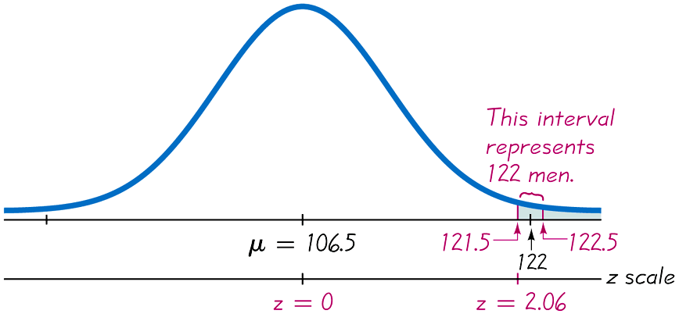
Example – Number of Men Among Passengers
Finding the Probability of
“At Least 122 Men” Among 213 Passengers
Figure 6-21

Slide 98
Definition
When we use the normal distribution (which is a continuous probability distribution) as an approximation to the binomial distribution (which is discrete), a continuity correction is made to a discrete whole number x in the binomial distribution by representing the discrete whole number x by the interval from
x – 0.5 to x + 0.5
(that is, adding and subtracting 0.5).
Notes:
page 295 of Elementary Statistics, 10th Edition

Slide 99
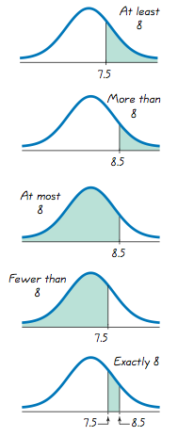
x = at least 8
(includes 8 and above)
x = more than 8
(doesn’t include 8)
x = at most 8
(includes 8 and below)
x = fewer than 8
(doesn’t include 8)
x = exactly 8

Slide 100
Recap
In this section we have discussed:
Approximating a binomial distribution with a normal distribution.
Procedures for using a normal distribution to approximate a binomial distribution.
Continuity corrections.

Slide 101
Section 6-7
Assessing Normality

Slide 102
Key Concept
This section presents criteria for determining whether the requirement of a normal distribution is satisfied.
The criteria involve visual inspection of a histogram to see if it is roughly bell shaped, identifying any outliers, and constructing a graph called a normal quantile plot.

Slide 103
Definition
A normal quantile plot (or normal probability plot) is a graph of points (x,y), where each x value is from the original set of sample data, and each y value is the corresponding z score that is a quantile value expected from the standard normal distribution.
Notes:
page 302 of Elementary Statistics, 10th Edition

Slide 104
Procedure for Determining Whether It Is Reasonable to Assume that Sample Data are From a Normally Distributed Population
1. Histogram: Construct a histogram. Reject normality if the histogram departs dramatically from a bell shape.
2. Outliers: Identify outliers. Reject normality if there is more than one outlier present.
3. Normal Quantile Plot: If the histogram is basically symmetric and there is at most one outlier, use technology to generate a normal quantile plot.

Slide 105
Procedure for Determining Whether It Is Reasonable to Assume that Sample Data are From a Normally Distributed Population
3. Continued
Use the following criteria to determine whether or not the distribution is normal.
Normal Distribution: The population distribution is normal if the pattern of the points is reasonably close to a straight line and the points do not show some systematic pattern that is not a straight-line pattern.

Slide 106
Procedure for Determining Whether It Is Reasonable to Assume that Sample Data are From a Normally Distributed Population
3. Continued
Not a Normal Distribution: The population distribution is not normal if either or both of these two conditions applies:
The points do not lie reasonably close to a straight line.
The points show some systematic pattern that is not a straight-line pattern.

Slide 107
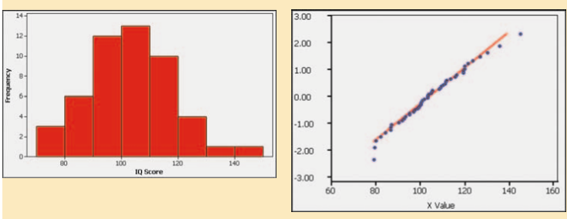
Example
Normal: Histogram of IQ scores is close to being bell-shaped, suggests that the IQ scores are from a normal distribution. The normal quantile plot shows points that are reasonably close to a straight-line pattern. It is safe to assume that these IQ scores are from a normally distributed population.

Slide 108
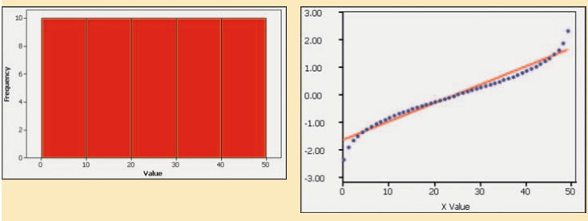
Example
Uniform: Histogram of data having a uniform distribution. The corresponding normal quantile plot suggests that the points are not normally distributed because the points show a systematic pattern that is not a straight-line pattern. These sample values are not from a population having a normal distribution.

Slide 109
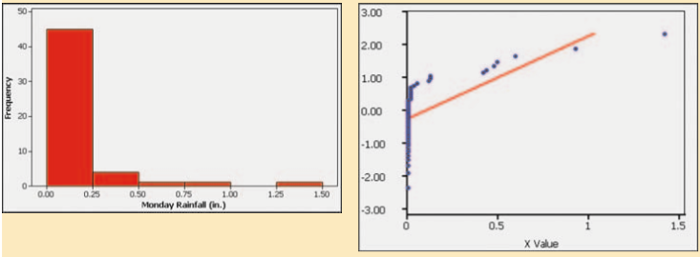
Example
Skewed: Histogram of the amounts of rainfall in Boston for every Monday during one year. The shape of the histogram is skewed, not bell-shaped. The corresponding normal quantile plot shows points that are not at all close to a straight-line pattern. These rainfall amounts are not from a population having a normal distribution.

Slide 110
Manual Construction of a Normal Quantile Plot
Step 1. First sort the data by arranging the values in order from lowest to highest.
Step 2. With a sample of size n, each value represents a proportion of 1/n of the sample. Using the known sample size n, identify the areas of 1/2n, 3/2n, and so on. These are the cumulative areas to the left of the corresponding sample values.
Step 3. Use the standard normal distribution (Table A-2 or software or a calculator) to find the z scores corresponding to the cumulative left areas found in Step 2. (These are the z scores that are expected from a normally distributed sample.)

Slide 111
Manual Construction of a Normal Quantile Plot
Step 4. Match the original sorted data values with their corresponding z scores found in Step 3, then plot the points (x, y), where each x is an original sample value and y is the corresponding z score.
Step 5. Examine the normal quantile plot and determine whether or not the distribution is normal.

Slide 112
Ryan-Joiner Test
The Ryan-Joiner test is one of several formal tests of normality, each having their own advantages and disadvantages. STATDISK has a feature of Normality Assessment that displays a histogram, normal quantile plot, the number of potential outliers, and results from the Ryan-Joiner test. Information about the Ryan-Joiner test is readily available on the Internet.

Slide 113
Data Transformations
Many data sets have a distribution that is not normal, but we can transform the data so that the modified values have a normal distribution. One common transformation is to replace each value of x with log (x + 1). If the distribution of the log (x + 1) values is a normal distribution, the distribution of the x values is referred to as a lognormal distribution.

Slide 114
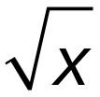
Other Data Transformations
In addition to replacing each x value with the log (x + 1), there are other transformations, such as replacing each x value with , or 1/x, or x². In addition to getting a required normal distribution when the original data values are not normally distributed, such transformations can be used to correct other deficiencies, such as a requirement (found in later chapters) that different data sets have the same variance.

Slide 115
Recap
In this section we have discussed:
Normal quantile plot.
Procedure to determine if data have a normal distribution.

