Slide 1
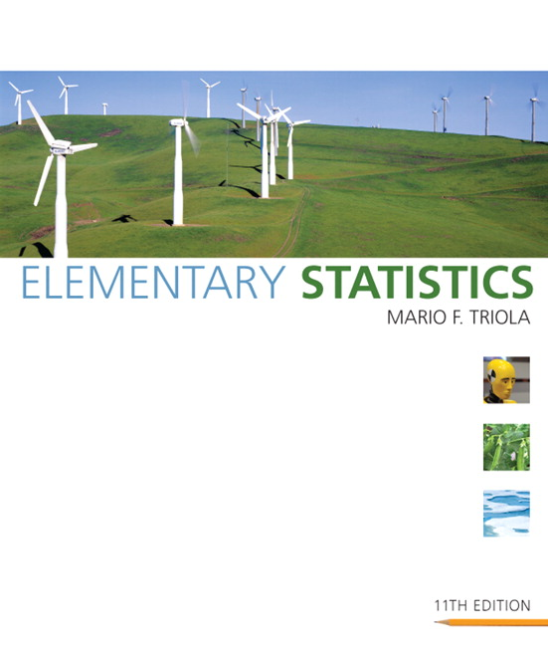

Lecture Slides
Elementary Statistics
Eleventh Edition

Slide 2
Chapter 7
Estimates and Sample Sizes
7-1 Review and Preview
7-2 Estimating a Population Proportion
7-3 Estimating a Population Mean: σ Known
7-4 Estimating a Population Mean: σ Not Known
7-5 Estimating a Population Variance

Slide 3

Section 7-1
Review and Preview

Slide 4
Review
Chapters 2 & 3 we used “descriptive statistics” when we summarized data using tools such as graphs, and statistics such as the mean and standard deviation.
Chapter 6 we introduced critical values:
z_{α} denotes the z score with an area of α to its right.
If α = 0.025, the critical value is z_{0.025} = 1.96.
That is, the critical value z_{0.025} = 1.96 has an area of 0.025 to its right.

Slide 5
_x0010_Preview
This chapter presents the beginning of inferential statistics.
The two major activities of inferential statistics are (1) to use sample data to estimate values of a population parameters, and (2) to test hypotheses or claims made about population parameters.
We introduce methods for estimating values of these important population parameters: proportions, means, and variances.
We also present methods for determining sample sizes necessary to estimate those parameters.

Slide 6
Section 7-2
Estimating a Population Proportion

Slide 7
Key Concept
In this section we present methods for using a sample proportion to estimate the value of a population proportion.
The sample proportion is the best point estimate of the population proportion.
We can use a sample proportion to construct a confidence interval to estimate the true value of a population proportion, and we should know how to interpret such confidence intervals.
We should know how to find the sample size necessary to estimate a population proportion.

Slide 8
Definition
A point estimate is a single value (or point) used to approximate a population parameter.

Slide 9
Definition
ˆ
The sample proportion p is the best point estimate of the population proportion p.

Slide 10

Example:
In the Chapter Problem we noted that in a Pew Research Center poll, 70% of 1501 randomly selected adults in the United States believe in global warming, so the sample proportion is
= 0.70. Find the best point estimate of the proportion of all adults in the United States who believe in global warming.
Because the sample proportion is the best point estimate of the population proportion, we conclude that the best point estimate of p is 0.70. When using the sample results to estimate the percentage of all adults in the United States who believe in global warming, the best estimate is 70%.

Slide 11
Definition
A confidence interval (or interval estimate) is a range (or an interval) of values used to estimate the true value of a population parameter. A confidence interval is sometimes abbreviated as CI.

Slide 12
Definition
A confidence level is the probability 1 – α (often expressed as the equivalent percentage value) that the confidence interval actually does contain the population parameter, assuming that the estimation process is repeated a large number of times. (The confidence level is also called degree of confidence, or the confidence coefficient.)
Most common choices are 90%, 95%, or 99%.
(α = 10%), (α = 5%), (α = 1%)

Slide 13
Interpreting a Confidence Interval
We must be careful to interpret confidence intervals correctly. There is a correct interpretation and many different and creative incorrect interpretations of the confidence interval 0.677 < p < 0.723.
“We are 95% confident that the interval from 0.677 to 0.723 actually does contain the true value of the population proportion p.”
This means that if we were to select many different samples of size 1501 and construct the corresponding confidence intervals, 95% of them would actually contain the value of the population proportion p.
(Note that in this correct interpretation, the level of 95% refers to the success rate of the process being used to estimate the proportion.)

Slide 14
Caution
Know the correct interpretation of a confidence interval.

Slide 15
Caution
Confidence intervals can be used informally to compare different data sets, but the overlapping of confidence intervals should not be used for making formal and final conclusions about equality of proportions.

Slide 16
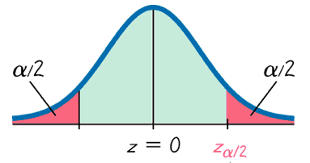
Critical Values
A standard z score can be used to distinguish between sample statistics that are likely to occur and those that are unlikely to occur. Such a z score is called a critical value. Critical values are based on the following observations:
1. Under certain conditions, the sampling distribution of sample proportions can be approximated by a normal distribution.

Slide 17
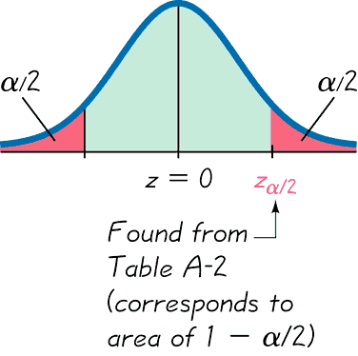
Critical Values
2. A z score associated with a sample proportion has a probability of α/2 of falling in the right tail.

Slide 18
Critical Values
3. The z score separating the right-tail region is commonly denoted by z_{α/2} and is referred to as a critical value because it is on the borderline separating z scores from sample proportions that are likely to occur from those that are unlikely to occur.

Slide 19
Definition
A critical value is the number on the borderline separating sample statistics that are likely to occur from those that are unlikely to occur. The number z_{α/2} is a critical value that is a z score with the property that it separates an area of α/2 in the right tail of the standard normal distribution.

Slide 20
z_{α/2}
The Critical Value

Slide 21
Notation for Critical Value
The critical value z_{α/2} is the positive z value that is at the vertical boundary separating an area of α/2 in the right tail of the standard normal distribution. (The value of –z_{α/2} is at the vertical boundary for the area of α/2 in the left tail.) The subscript α/2 is simply a reminder that the z score separates an area of α/2 in the right tail of the standard normal distribution.

Slide 22
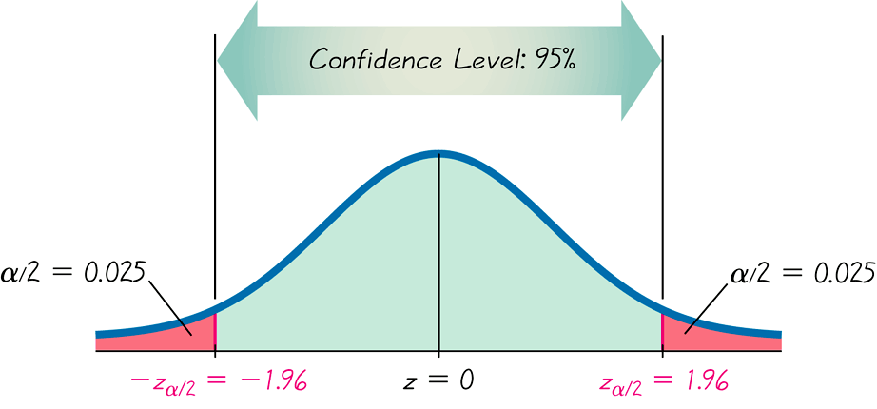
Finding z_{α/2} for a 95% Confidence Level
_{α = 5%}
α/ 2 = 2.5% = .025
-z_{α/2}
z_{α/2}
Critical Values

Slide 23
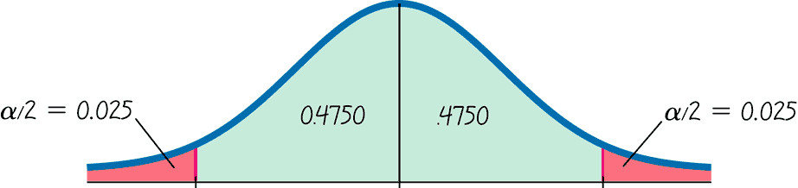
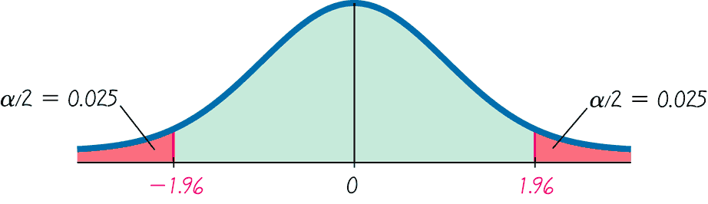
Finding z_{α/2} for a 95% Confidence Level - cont
_{α = 0.05}
Use Table A-2 to find a z score of 1.96
₊
₋
z_{α/2} = 1.96

Slide 24

Definition
When data from a simple random sample are used to estimate a population proportion p, the margin of error, denoted by E, is the maximum likely difference (with probability 1 – α, such as 0.95) between the observed proportion and the true value of the population proportion p. The margin of error E is also called the maximum error of the estimate and can be found by multiplying the critical value and the standard deviation of the sample proportions:

Slide 25
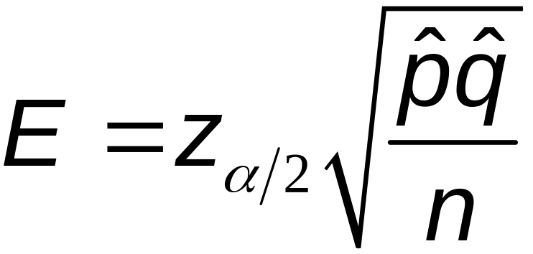
Margin of Error for Proportions

Slide 26

Confidence Interval for Estimating a Population Proportion p
p = population proportion
= sample proportion
n = number of sample values
E = margin of error
z_{α/2} = z score separating an area of α/2 in the right tail of the standard normal distribution

Slide 27
Confidence Interval for Estimating a Population Proportion p
1. The sample is a simple random sample.
2. The conditions for the binomial distribution are satisfied: there is a fixed number of trials, the trials are independent, there are two categories of outcomes, and the probabilities remain constant for each trial.
3. There are at least 5 successes and 5 failures.

Slide 28
Confidence Interval for Estimating a Population Proportion p
p
ˆ
ˆ
p
p – E < < + E
where

Slide 29
Confidence Interval for Estimating a Population Proportion p
p
ˆ
ˆ
p
p – E < < + E
p + E
ˆ
(p – E, p + E)
ˆ
ˆ

Slide 30
Round-Off Rule for
Confidence Interval Estimates of p
Round the confidence interval limits for p to
three significant digits.

Slide 31
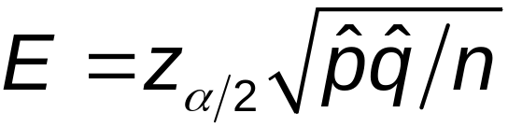
Procedure for Constructing
a Confidence Interval for p
1. Verify that the required assumptions are satisfied. (The sample is a simple random sample, the conditions for the binomial distribution are satisfied, and the normal distribution can be used to approximate the distribution of sample proportions because np ≥ 5, and nq ≥ 5 are both satisfied.)
2. Refer to Table A-2 and find the critical value z_{α/2} that corresponds to the desired confidence level.
3. Evaluate the margin of error

Slide 32
Procedure for Constructing
a Confidence Interval for p - cont
ˆ
4. Using the value of the calculated margin of error, E and the value of the sample proportion, p, find the values of p – E and p + E. Substitute those values in the general format for the confidence interval:
ˆ
ˆ
ˆ
ˆ
p – E < p < p + E
5. Round the resulting confidence interval limits to three significant digits.

Slide 33

Example:
In the Chapter Problem we noted that a Pew Research Center poll of 1501 randomly selected U.S. adults showed that 70% of the respondents believe in global warming. The sample results are n = 1501, and
a. Find the margin of error E that corresponds to a 95% confidence level.
b. Find the 95% confidence interval estimate of the population proportion p.
c. Based on the results, can we safely conclude that the majority of adults believe in global warming?
d. Assuming that you are a newspaper reporter, write a brief statement that accurately describes the results and includes all of the relevant information.

Slide 34
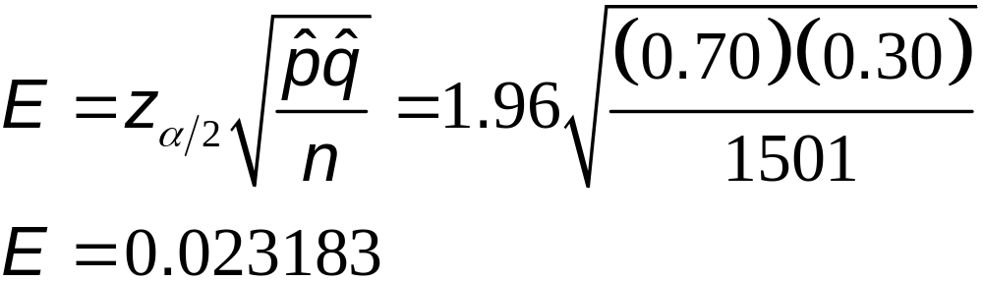
Example:
Requirement check: simple random sample; fixed number of trials, 1501; trials are independent; two categories of outcomes (believes or does not); probability remains constant. Note: number of successes and failures are both at least 5.
a) Use the formula to find the margin of error.

Slide 35
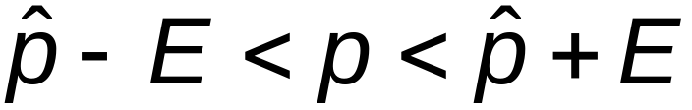

Example:
b) The 95% confidence interval:

Slide 36
Example:
c) Based on the confidence interval obtained in part (b), it does appear that the proportion of adults who believe in global warming is greater than 0.5 (or 50%), so we can safely conclude that the majority of adults believe in global warming. Because the limits of 0.677 and 0.723 are likely to contain the true population proportion, it appears that the population proportion is a value greater than 0.5.

Slide 37
Example:
d) Here is one statement that summarizes the results: 70% of United States adults believe that the earth is getting warmer. That percentage is based on a Pew Research Center poll of 1501 randomly selected adults in the United States. In theory, in 95% of such polls, the percentage should differ by no more than 2.3 percentage points in either direction from the percentage that would be found by interviewing all adults in the United States.

Slide 38
Analyzing Polls
When analyzing polls consider:
1. The sample should be a simple random sample, not an inappropriate sample (such as a voluntary response sample).
2. The confidence level should be provided. (It is often 95%, but media reports often neglect to identify it.)
3. The sample size should be provided. (It is usually provided by the media, but not always.)
4. Except for relatively rare cases, the quality of the poll results depends on the sampling method and the size of the sample, but the size of the population is usually not a factor.

Slide 39
Caution
Never follow the common misconception that poll results are unreliable if the sample size is a small percentage of the population size. The population size is usually not a factor in determining the reliability of a poll.

Slide 40
Sample Size
Suppose we want to collect sample data in order to estimate some population proportion. The question is how many sample items must be obtained?

Slide 41
Determining Sample Size
ˆ
ˆ
z
p q
E =
_{α / 2}
n
(solve for n by algebra)
Z
ˆ
ˆ
( )²
_{α / 2}
n =
p q
E ²

Slide 42
Sample Size for Estimating
Proportion p
ˆ
When an estimate of p is known:
z
ˆ
ˆ
( )²
p q
n =
_{α / 2}
E ²
ˆ
When no estimate of p is known:
z
( )²
_{α / 2}
n =
0.25
E ²

Slide 43
Round-Off Rule for Determining Sample Size
If the computed sample size n is not a whole number, round the value of n up to the next larger whole number.

Slide 44
Example:
The Internet is affecting us all in many different ways, so there are many reasons for estimating the proportion of adults who use it. Assume that a manager for E-Bay wants to determine the current percentage of U.S. adults who now use the Internet. How many adults must be surveyed in order to be 95% confident that the sample percentage is in error by no more than three percentage points?
a. In 2006, 73% of adults used the Internet.
b. No known possible value of the proportion.

Slide 45
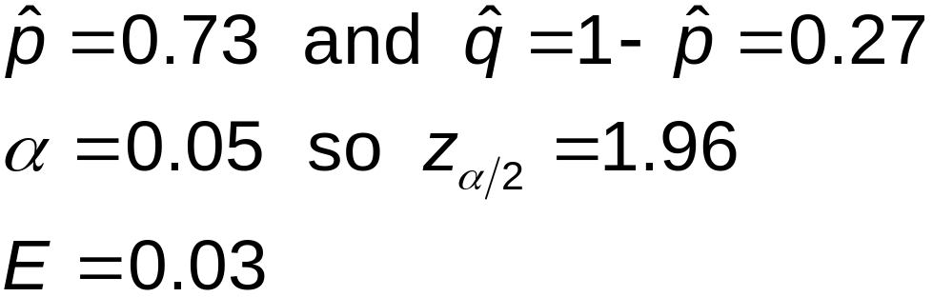
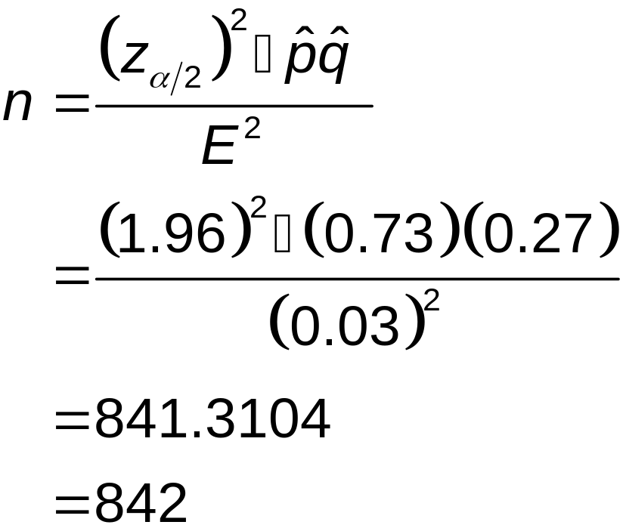
Example:
a) Use
To be 95% confident that our sample percentage is within three percentage points of the true percentage for all adults, we should obtain a simple random sample of 842 adults.

Slide 46
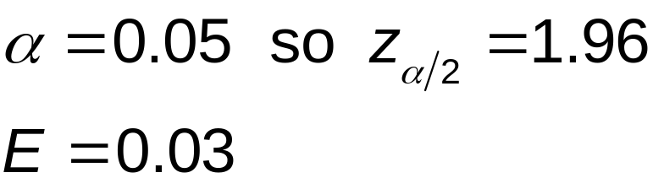
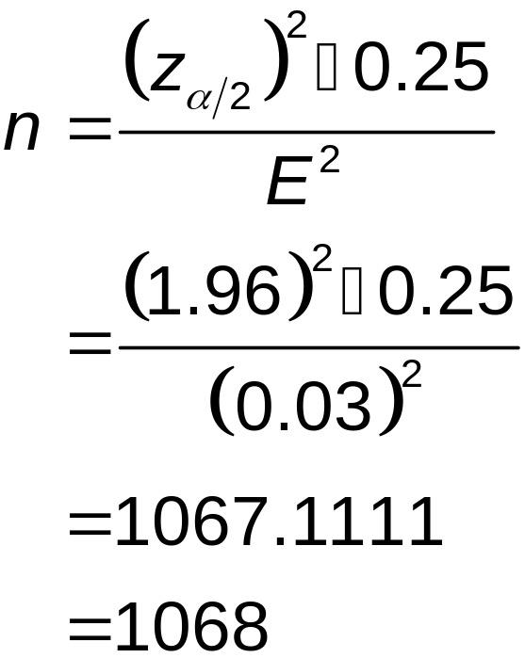
Example:
b) Use
To be 95% confident that our sample percentage is within three percentage points of the true percentage for all adults, we should obtain a simple random sample of 1068 adults.

Slide 47
Finding the Point Estimate and E from a Confidence Interval
Point estimate of p:
p = (upper confidence limit) + (lower confidence limit)
2
ˆ
ˆ
Margin of Error:
E = (upper confidence limit) — (lower confidence limit)
2

Slide 48
Recap
In this section we have discussed:
Point estimates.
Confidence intervals.
Confidence levels.
Critical values.
Margin of error.
Determining sample sizes.

Slide 49
Section 7-3
Estimating a Population Mean: σ Known

Slide 50
Key Concept
This section presents methods for estimating a population mean. In addition to knowing the values of the sample data or statistics, we must also know the value of the population standard deviation, σ.
Here are three key concepts that should be learned in this section:

Slide 51

Key Concept
1. We should know that the sample mean is the best point estimate of the population mean μ.
2. We should learn how to use sample data to construct a confidence interval for estimating the value of a population mean, and we should know how to interpret such confidence intervals.
3. We should develop the ability to determine the sample size necessary to estimate a population mean.

Slide 52
Point Estimate of the Population Mean
The sample mean x is the best point estimate
of the population mean µ.

Slide 53
Confidence Interval for Estimating a Population Mean (with σ Known)
μ = population mean
σ = population standard deviation
= sample mean
n = number of sample values
E = margin of error
z_{α/2} = z score separating an area of a/2 in the right tail of the standard normal distribution
Notes:
page 338 of Elementary Statistics, 10th Edition

Slide 54
Confidence Interval for Estimating a Population Mean (with σ Known)
1. The sample is a simple random sample. (All samples of the same size have an equal chance of being selected.)
2. The value of the population standard deviation σ is known.
3. Either or both of these conditions is satisfied: The population is normally distributed or n > 30.
Notes:
page 338 of Elementary Statistics, 10th Edition

Slide 55
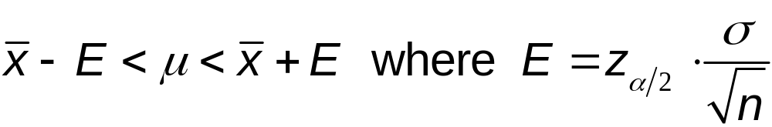

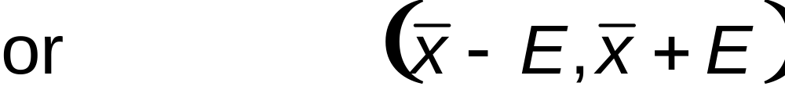
Confidence Interval for Estimating a Population Mean (with σ Known)
Notes:
page 338 of Elementary Statistics, 10th Edition

Slide 56
Definition
The two values x – E and x + E are called confidence interval limits.

Slide 57
Sample Mean
1. For all populations, the sample mean x is an unbiased estimator of the population mean μ, meaning that the distribution of sample means tends to center about the value of the population mean μ.
2. For many populations, the distribution of sample means x tends to be more consistent (with less variation) than the distributions of other sample statistics.
Notes:
page 339 of Elementary Statistics, 10th Edition

Slide 58
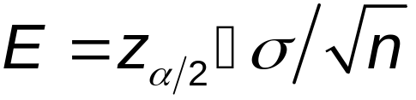

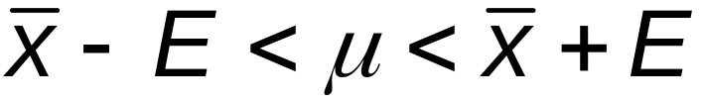
Procedure for Constructing a Confidence Interval for µ (with Known σ)
1. Verify that the requirements are satisfied.
2. Refer to Table A-2 or use technology to find the critical value z_{α/2} that corresponds to the desired confidence level.
3. Evaluate the margin of error
4. Find the values of Substitute those values in the general format of the confidence interval:
5. Round using the confidence intervals round-off rules.
Notes:
page 340 of Elementary Statistics, 10th Edition

Slide 59
Round-Off Rule for Confidence Intervals Used to Estimate µ
When using the original set of data, round the confidence interval limits to one more decimal place than used in original set of data.
When the original set of data is unknown and only the summary statistics (n, x, s) are used, round the confidence interval limits to the same number of decimal places used for the sample mean.

Slide 60
Example:
People have died in boat and aircraft accidents because an obsolete estimate of the mean weight of men was used. In recent decades, the mean weight of men has increased considerably, so we need to update our estimate of that mean so that boats, aircraft, elevators, and other such devices do not become dangerously overloaded. Using the weights of men from Data Set 1 in Appendix B, we obtain these sample statistics for the simple random sample: n = 40 and = 172.55 lb. Research from several other sources suggests that the population of weights of men has a standard deviation given by σ = 26 lb.

Slide 61
Example:
a. Find the best point estimate of the mean weight of the population of all men.
b. Construct a 95% confidence interval estimate of the mean weight of all men.
c. What do the results suggest about the mean weight of 166.3 lb that was used to determine the safe passenger capacity of water vessels in 1960 (as given in the National Transportation and Safety Board safety recommendation M-04-04)?

Slide 62
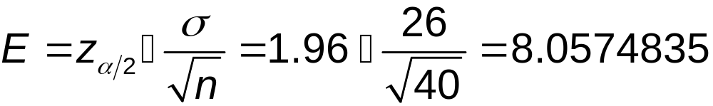
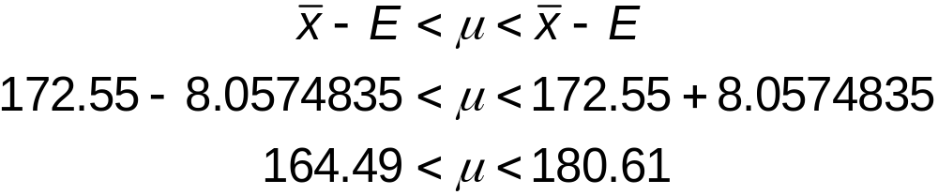
Example:
a. The sample mean of 172.55 lb is the best point estimate of the mean weight of the population of all men.
b. A 95% confidence interval or 0.95 implies
σ = 0.05, so z_{α/2} = 1.96.
Calculate the margin of error.
Construct the confidence interval.

Slide 63
Example:
c. Based on the confidence interval, it is possible that the mean weight of 166.3 lb used in 1960 could be the mean weight of men today. However, the best point estimate of 172.55 lb suggests that the mean weight of men is now considerably greater than 166.3 lb. Considering that an underestimate of the mean weight of men could result in lives lost through overloaded boats and aircraft, these results strongly suggest that additional data should be collected. (Additional data have been collected, and the assumed mean weight of men has been increased.)

Slide 64
Finding a Sample Size for Estimating a Population Mean
μ = population mean
σ = population standard deviation
= population standard deviation
E = desired margin of error
z_{α/2} = z score separating an area of α/2 in the right tail of the standard normal distribution
(z_{α/2}) • σ
2
n =
E

Slide 65
Round-Off Rule for Sample Size n
If the computed sample size n is not a whole number, round the value of n up to the next larger whole number.
Notes:
page 343 of Elementary Statistics, 10th Edition

Slide 66
Finding the Sample Size n
When σ is Unknown
1. Use the range rule of thumb (see Section 3-3) to estimate the standard deviation as follows: σ ≈ range/4.
2. Start the sample collection process without knowing σ and, using the first several values, calculate the sample standard deviation s and use it in place of σ . The estimated value of σ can then be improved as more sample data are obtained, and the sample size can be refined accordingly.
3. Estimate the value of σ by using the results of some other study that was done earlier.
Notes:
page 344 of Elementary Statistics, 10th Edition

Slide 67
Example:
Assume that we want to estimate the mean IQ score for the population of statistics students. How many statistics students must be randomly selected for IQ tests if we want 95% confidence that the sample mean is within 3 IQ points of the population mean?
α = 0.05
α /2 = 0.025
z _{α/ 2} = 1.96
E = 3
σ = 15
2
n = 1.96 • 15 = 96.04 = 97
3
With a simple random sample of only 97 statistics students, we will be 95% confident that the sample mean is within 3 IQ points of the true population mean μ.
Notes:
Example on page 344 of Elementary Statistics, 10th Edition

Slide 68
Recap
In this section we have discussed:
Margin of error.
Confidence interval estimate of the population mean with σ known.
Round off rules.
Sample size for estimating the mean μ.

Slide 69
Section 7-4
Estimating a Population Mean: σ Not Known

Slide 70
Key Concept
This section presents methods for estimating a population mean when the population standard deviation is not known. With σ unknown, we use the Student t distribution assuming that the relevant requirements are satisfied.

Slide 71
Sample Mean
The sample mean is the best point estimate of the population mean.
Notes:
Smaller samples will have means that are likely to vary more. The greater variation is accounted for by the t distribution.
Students usually like hearing about the history of how the Student t distribution got its name.
page 350 of text
See Note to Instructor in margin for other ideas.

Slide 72
Student t Distribution
If the distribution of a population is essentially normal, then the distribution of
x - µ
t =
s
n
is a Student t Distribution for all samples of size n. It is often referred to as a t distribution and is used to find critical values denoted by
t_{α/2}.
Notes:
Student t distribution is usually referred to as the t distribution.

Slide 73
Definition
The number of degrees of freedom for a collection of sample data is the number of sample values that can vary after certain restrictions have been imposed on all data values. The degree of freedom is often abbreviated df.
degrees of freedom = n – 1
in this section.
Notes:
Explain that other statistical procedures may have different formulas for degrees of freedom.

Slide 74
Margin of Error E for Estimate of μ (With σ Not Known)
Formula 7-6
s
E = t_{α/}
n
2
where t_{α/2} has n – 1 degrees of freedom.
Table A-3 lists values for t_{α/2}

Slide 75
Notation
μ = population mean
= sample mean
s = sample standard deviation
n = number of sample values
E = margin of error
t_{α/2} = critical t value separating an area of α/2 in the right tail of the t distribution
Notes:
Smaller samples will have means that are likely to vary more. The greater variation is accounted for by the t distribution.
Students usually like hearing about the history of how the Student t distribution got its name.
page 350 of text
See Note to Instructor in margin for other ideas.

Slide 76
Confidence Interval for the Estimate of μ (With σ Not Known)
x – E < µ < x + E
where
E = t_{α/2}
s
df = n – 1
n
t_{α/2} found in Table A-3

Slide 77

Procedure for Constructing a
Confidence Interval for µ (With σ Unknown)
1. Verify that the requirements are satisfied.
2. Using n – 1 degrees of freedom, refer to Table A-3 or use technology to find the critical value t_{α/2} that corresponds to the desired confidence level.
3. Evaluate the margin of error E = t_{α/2} • s / n .
4. Find the values of Substitute those values in the general format for the confidence interval:
5. Round the resulting confidence interval limits.

Slide 78
Example:
A common claim is that garlic lowers cholesterol levels. In a test of the effectiveness of garlic, 49 subjects were treated with doses of raw garlic, and their cholesterol levels were measured before and after the treatment. The changes in their levels of LDL cholesterol (in mg/dL) have a mean of 0.4 and a standard deviation of 21.0. Use the sample statistics of n = 49, = 0.4 and s = 21.0 to construct a 95% confidence interval estimate of the mean net change in LDL cholesterol after the garlic treatment. What does the confidence interval suggest about the effectiveness of garlic in reducing LDL cholesterol?

Slide 79
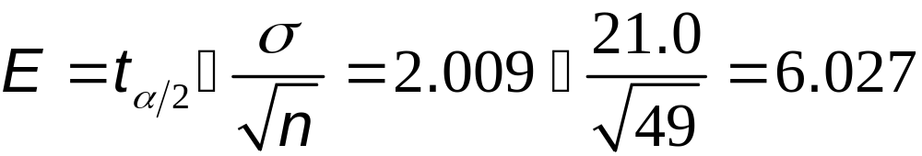
Example:
Requirements are satisfied: simple random sample and n = 49 (i.e., n > 30).
95% implies a = 0.05.
With n = 49, the df = 49 – 1 = 48
Closest df is 50, two tails, so t_{α/2} = 2.009
Using t_{α/2} = 2.009, s = 21.0 and n = 49 the margin of error is:

Slide 80

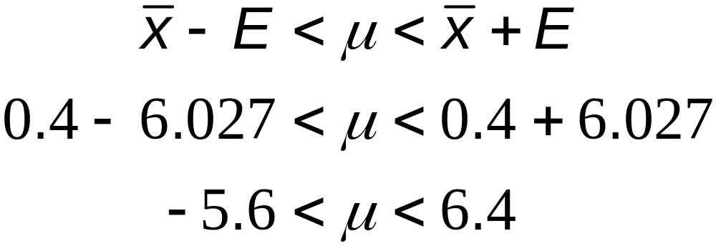
Example:
Construct the confidence interval:
We are 95% confident that the limits of –5.6 and 6.4 actually do contain the value of μ, the mean of the changes in LDL cholesterol for the population. Because the confidence interval limits contain the value of 0, it is very possible that the mean of the changes in LDL cholesterol is equal to 0, suggesting that the garlic treatment did not affect the LDL cholesterol levels. It does not appear that the garlic treatment is effective in lowering LDL cholesterol.

Slide 81
Important Properties of the Student t Distribution
1. The Student t distribution is different for different sample sizes (see the following slide, for the cases n = 3 and n = 12).
2. The Student t distribution has the same general symmetric bell shape as the standard normal distribution but it reflects the greater variability (with wider distributions) that is expected with small samples.
3. The Student t distribution has a mean of t = 0 (just as the standard normal distribution has a mean of z = 0).
4. The standard deviation of the Student t distribution varies with the sample size and is greater than 1 (unlike the standard normal distribution, which has a σ = 1).
5. As the sample size n gets larger, the Student t distribution gets closer to the normal distribution.

Slide 82
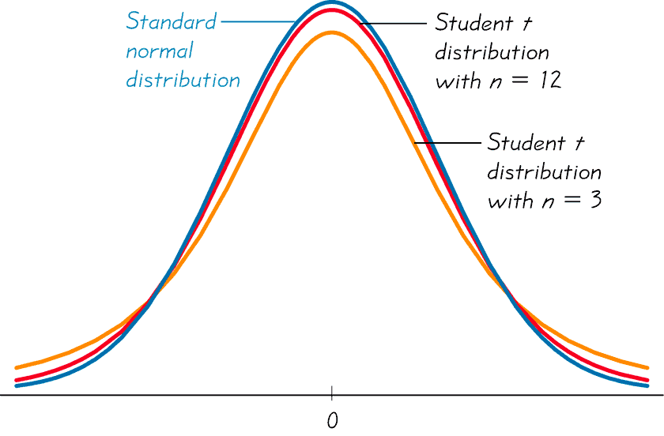
Student t Distributions for
n = 3 and n = 12
Figure 7-5
Notes:
Student t distributions have the same general shape and symmetry as the standard normal distribution, but reflect a greater variability that is expected with small samples.

Slide 83
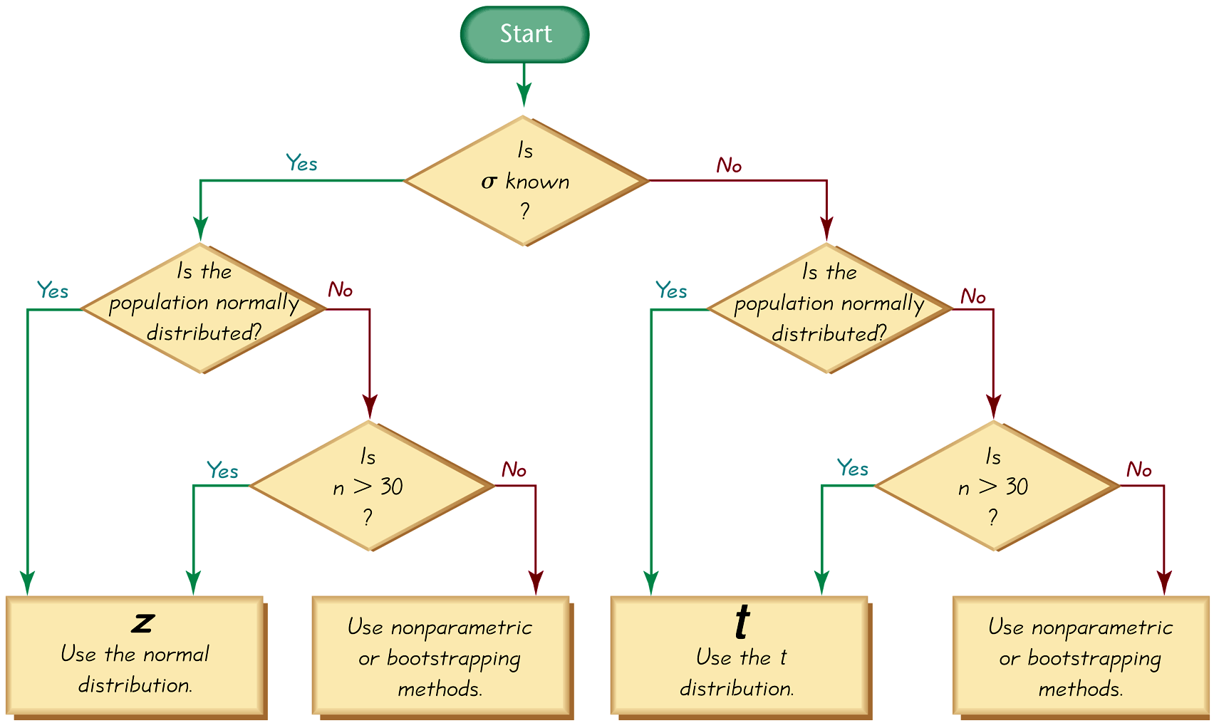
Choosing the Appropriate Distribution

Slide 84
Choosing the Appropriate Distribution
Use the normal (z) distribution
σ known and normally distributed population
or
σ known and n > 30
Use t distribution
σ not known and normally distributed population
or
σ not known and n > 30
Use a nonparametric method or bootstrapping
Population is not normally distributed and n ≤ 30

Slide 85
Finding the Point Estimate
and E from a Confidence Interval
Point estimate of µ:
x = (upper confidence limit) + (lower confidence limit)
2
Margin of Error:
E = (upper confidence limit) – (lower confidence limit)
2

Slide 86
Confidence Intervals for Comparing Data
As in Sections 7-2 and 7-3, confidence intervals can be used informally to compare different data sets, but the overlapping of confidence intervals should not be used for making formal and final conclusions about equality of means.

Slide 87
Recap
In this section we have discussed:
Student t distribution.
Degrees of freedom.
Margin of error.
Confidence intervals for μ with σ unknown.
Choosing the appropriate distribution.
Point estimates.
Using confidence intervals to compare data.

Slide 88
Section 7-5
Estimating a Population Variance

Slide 89
Key Concept
This section we introduce the chi-square probability distribution so that we can construct confidence interval estimates of a population standard deviation or variance. We also present a method for determining the sample size required to estimate a population standard deviation or variance.

Slide 90
Chi-Square Distribution
In a normally distributed population with variance σ ² assume that we randomly select independent samples of size n and, for each sample, compute the sample variance s² (which is the square of the sample standard deviation s). The sample statistic χ² (pronounced chi-square) has a sampling distribution called the chi-square distribution.
Notes:
The requirement of a normal distribution is critical with this test.
Use of non-normal distributions can lead to gross errors.
Use the methods discussed in Section 6-7, Assessing Normality, to verify a normal distribution before proceeding with this procedure.

Slide 91
Chi-Square Distribution
(n – 1) s²
χ ² =
σ ²
where
n = sample size
s ² = sample variance
σ ² = population variance
degrees of freedom = n – 1
Notes:
One place where students tend to make errors with this formula is switching the values for s and σιγμα. Careful reading of the problem should eliminate this difficulty.
page 364 of Elementary Statistics, 10th Edition

Slide 92
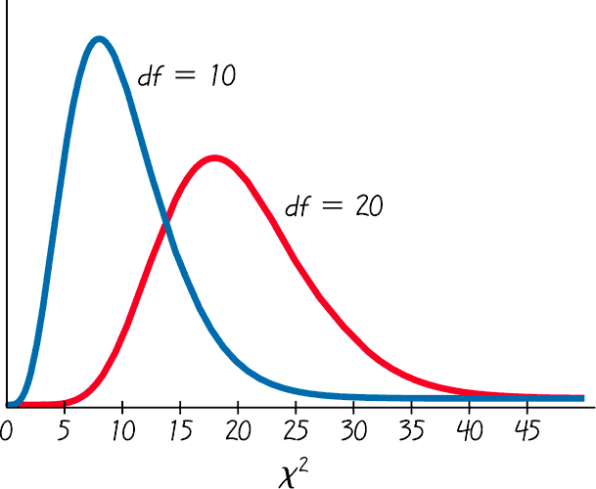
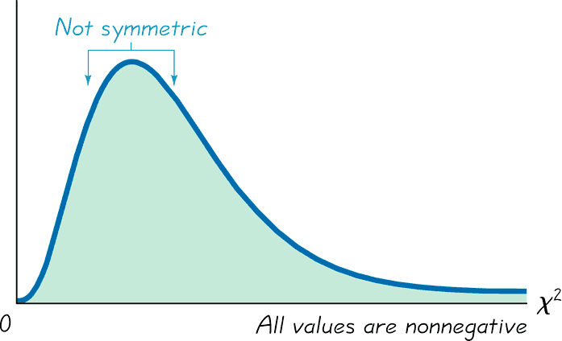
Properties of the Distribution
of the Chi-Square Statistic
1. The chi-square distribution is not symmetric, unlike the normal and Student t distributions.
As the number of degrees of freedom increases, the
distribution becomes more symmetric.
Chi-Square Distribution
Chi-Square Distribution for
df = 10 and df = 20
Notes:
Different degrees of freedom produce different shaped chi-square distributions.

Slide 93
Properties of the Distribution
of the Chi-Square Statistic – cont.
2. The values of chi-square can be zero or positive, but they cannot be negative.
3. The chi-square distribution is different for each number of degrees of freedom, which is df = n – 1. As the number of degrees of freedom increases, the chi-square distribution approaches a normal distribution.
In Table A-4, each critical value of χ² corresponds to an area given in the top row of the table, and that area represents the cumulative area located to the right of the critical value.

Slide 94
Example
A simple random sample of ten voltage levels is obtained. Construction of a confidence interval for the population standard deviation σ requires the left and right critical values of χ² corresponding to a confidence level of 95% and a sample size of n = 10. Find the critical value of χ² separating an area of 0.025 in the left tail, and find the critical value of χ² separating an area of 0.025 in the right tail.

Slide 95
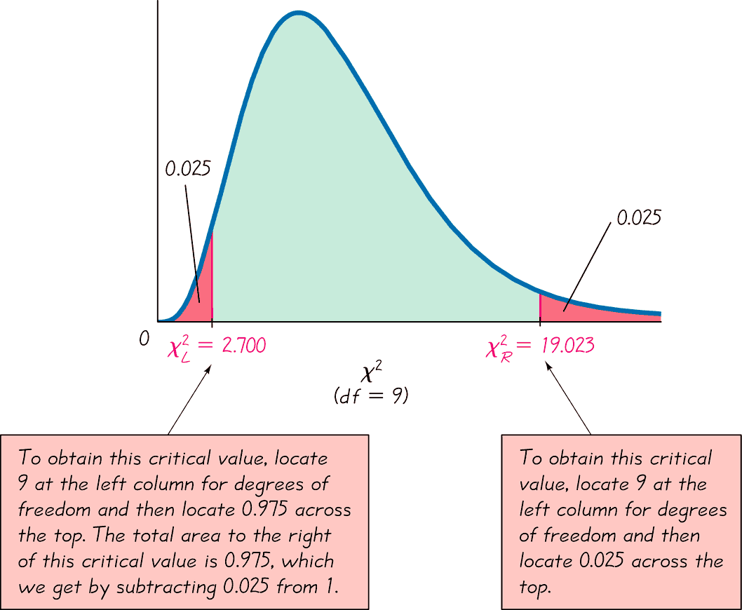
Example
Critical Values of the Chi-Square Distribution

Slide 96
Example
For a sample of 10 values taken from a normally distributed population, the chi-square statistic χ² = (n – 1)s²/σ² has a 0.95 probability of falling between the chi-square critical values of 2.700 and 19.023.
Instead of using Table A-4, technology (such as STATDISK, Excel, and Minitab) can be used to find critical values of χ². A major advantage of technology is that it can be used for any number of degrees of freedom and any confidence level, not just the limited choices included in Table A-4.

Slide 97
Estimators of σ²
The sample variance s² is the best point estimate of the population variance σ².

Slide 98
Estimators of σ
The sample standard deviation s is a commonly used point estimate of σ (even though it is a biased estimate).

Slide 99


Confidence Interval for Estimating a Population Standard Deviation or Variance
σ = population standard deviation
s = sample standard deviation
n = number of sample values
= left-tailed critical value of χ²
σ ² = population variance
s ² = sample variance
E = margin of error
= right-tailed critical value of χ²
Notes:
Remind students that we have started with the variance which is the square of the standard deviation. Therefore, taking the square root of the variance formula will produce the standard deviation formula.

Slide 100
Confidence Interval for Estimating a Population Standard Deviation or Variance
Requirements:
1. The sample is a simple random sample.
2. The population must have normally distributed values (even if the sample is large).
Notes:
Remind students that we have started with the variance which is the square of the standard deviation. Therefore, taking the square root of the variance formula will produce the standard deviation formula.

Slide 101
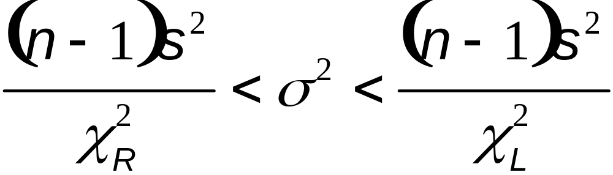
Confidence Interval for Estimating a Population Standard Deviation or Variance
Confidence Interval for the Population Variance σ²
Notes:
Remind students that we have started with the variance which is the square of the standard deviation. Therefore, taking the square root of the variance formula will produce the standard deviation formula.

Slide 102
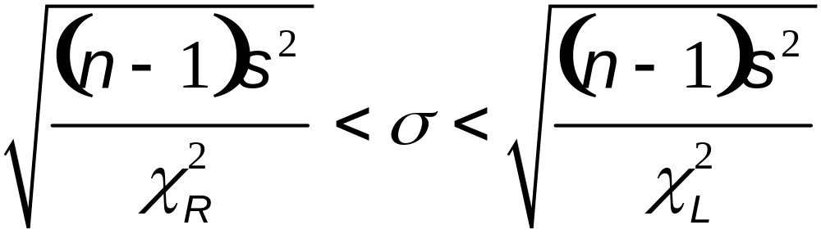
Confidence Interval for Estimating a Population Standard Deviation or Variance
Confidence Interval for the Population Standard Deviation σ
Notes:
Remind students that we have started with the variance which is the square of the standard deviation. Therefore, taking the square root of the variance formula will produce the standard deviation formula.

Slide 103
Procedure for Constructing a
Confidence Interval for σ or σ ²
1. Verify that the required assumptions are satisfied.
2. Using n – 1 degrees of freedom, refer to Table A-4 or use technology to find the critical values χ²_{R} and χ²_{L}that correspond to the desired confidence level.
3. Evaluate the upper and lower confidence interval limits using this format of the confidence interval:

Slide 104
Procedure for Constructing a
Confidence Interval for σ or σ ² - cont
4. If a confidence interval estimate of σ is desired, take the square root of the upper and lower confidence interval limits and change σ ² to σ.
5. Round the resulting confidence level limits. If using the original set of data to construct a confidence interval, round the confidence interval limits to one more decimal place than is used for the original set of data. If using the sample standard deviation or variance, round the confidence interval limits to the same number of decimals places.

Slide 105
Confidence Intervals for Comparing Data
Caution
Confidence intervals can be used informally to compare the variation in different data sets, but the overlapping of confidence intervals should not be used for making formal and final conclusions about equality of variances or standard deviations.

Slide 106
Example:
The proper operation of typical home appliances requires voltage levels that do not vary much. Listed below are ten voltage levels (in volts) recorded in the author’s home on ten different days. These ten values have a standard deviation of s = 0.15 volt. Use the sample data to construct a 95% confidence interval estimate of the standard deviation of all voltage levels.
123.3 123.5 123.7 123.4 123.6 123.5 123.5 123.4 123.6 123.8

Slide 107
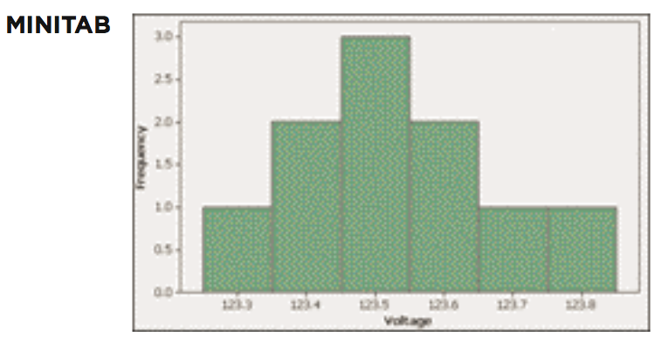
Example:
Requirements are satisfied: simple random sample and normality

Slide 108
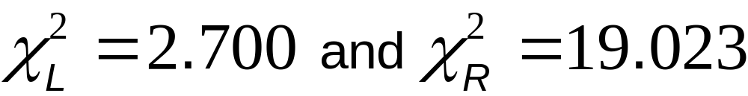
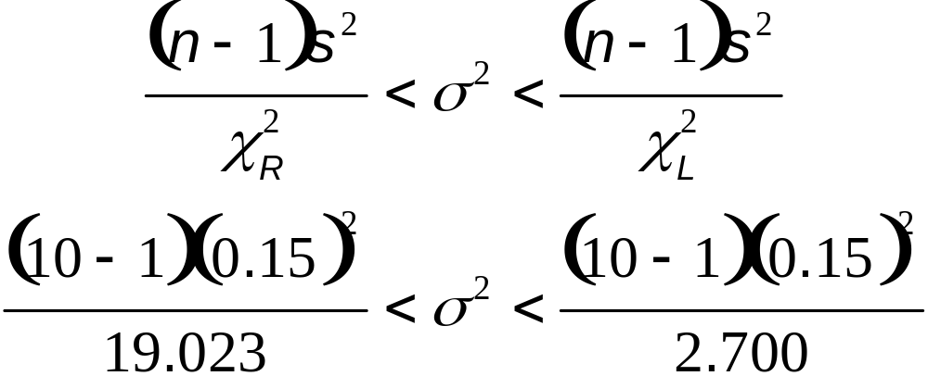
Example:
n = 10 so df = 10 – 1 = 9
Use table A-4 to find:
Construct the confidence interval: n = 10, s = 0.15

Slide 109
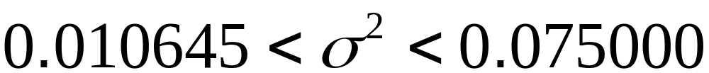
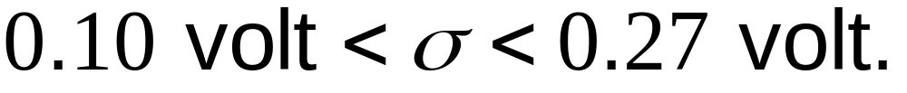
Example:
Evaluation the preceding expression yields:
Finding the square root of each part (before rounding), then rounding to two decimal places, yields this 95% confidence interval estimate of the population standard deviation:
Based on this result, we have 95% confidence that the limits of 0.10 volt and 0.27 volt contain the true value of σ.

Slide 110
Determining Sample Sizes
The procedures for finding the sample size necessary to estimate σ² are much more complex than the procedures given earlier for means and proportions. Instead of using very complicated procedures, we will use Table 7-2.
STATDISK also provides sample sizes. With STATDISK, select Analysis, Sample Size Determination, and then Estimate St Dev.
Minitab, Excel, and the TI-83/84 Plus calculator do not provide such sample sizes.
Notes:
Instead of presenting the much more complex procedures for determining sample size necessary to estimate the population variance, this table will be used.

Slide 111
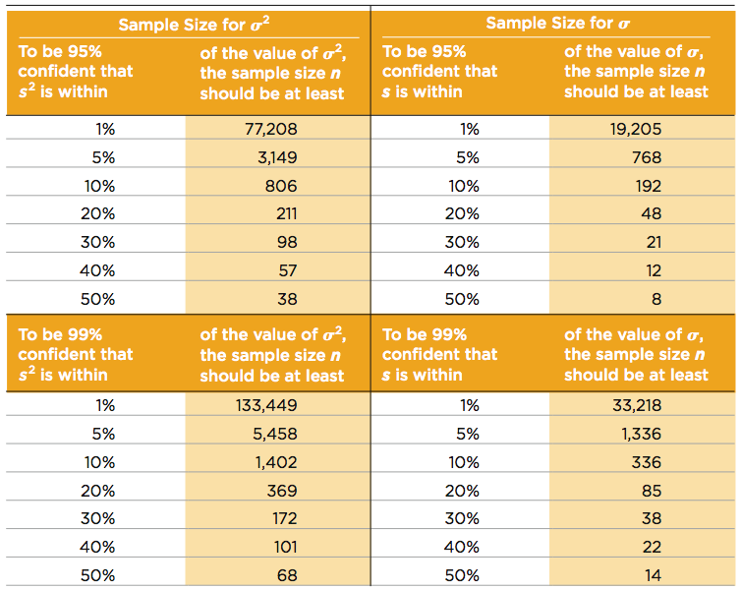
Determining Sample Sizes
Notes:
Instead of presenting the much more complex procedures for determining sample size necessary to estimate the population variance, this table will be used.

Slide 112
Example:
We want to estimate the standard deviation σ of all voltage levels in a home. We want to be 95% confident that our estimate is within 20% of the true value of σ. How large should the sample be? Assume that the population is normally distributed.
From Table 7-2, we can see that 95% confidence and an error of 20% for σ correspond to a sample of size 48. We should obtain a simple random sample of 48 voltage levels form the population of voltage levels.

Slide 113
Recap
In this section we have discussed:
The chi-square distribution.
Using Table A-4.
Confidence intervals for the population variance and standard deviation.
Determining sample sizes.

