Slide 1
Database Project
Qiang Huang
huangq25@mail2.sysu.edu.cn
School of Data and Computer Science
Sun Yat-Sen University

Slide 2
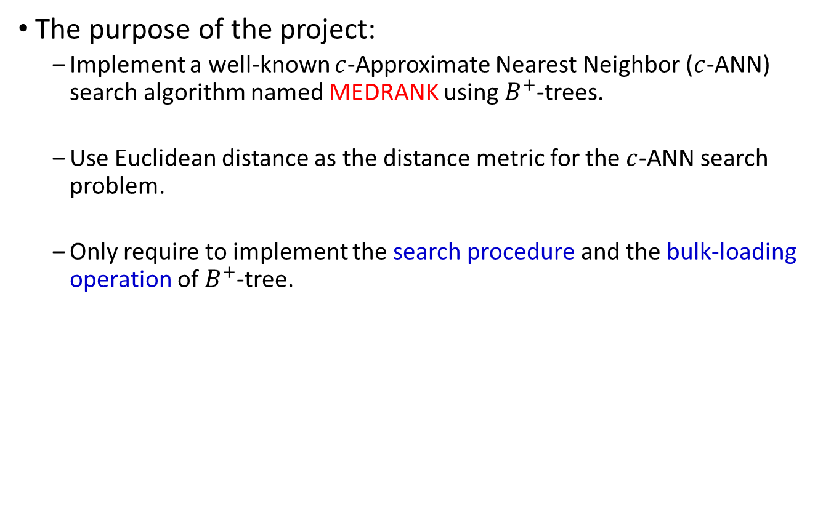
Introduction
The purpose of the project:
Implement a well-known $c$-Approximate Nearest Neighbor ($c$-ANN) search algorithm named MEDRANK using $B^{+}$-trees.
Use Euclidean distance as the distance metric for the $c$-ANN search problem.
Only require to implement the search procedure and the bulk-loading operation of $B^{+}$-tree.

Slide 3
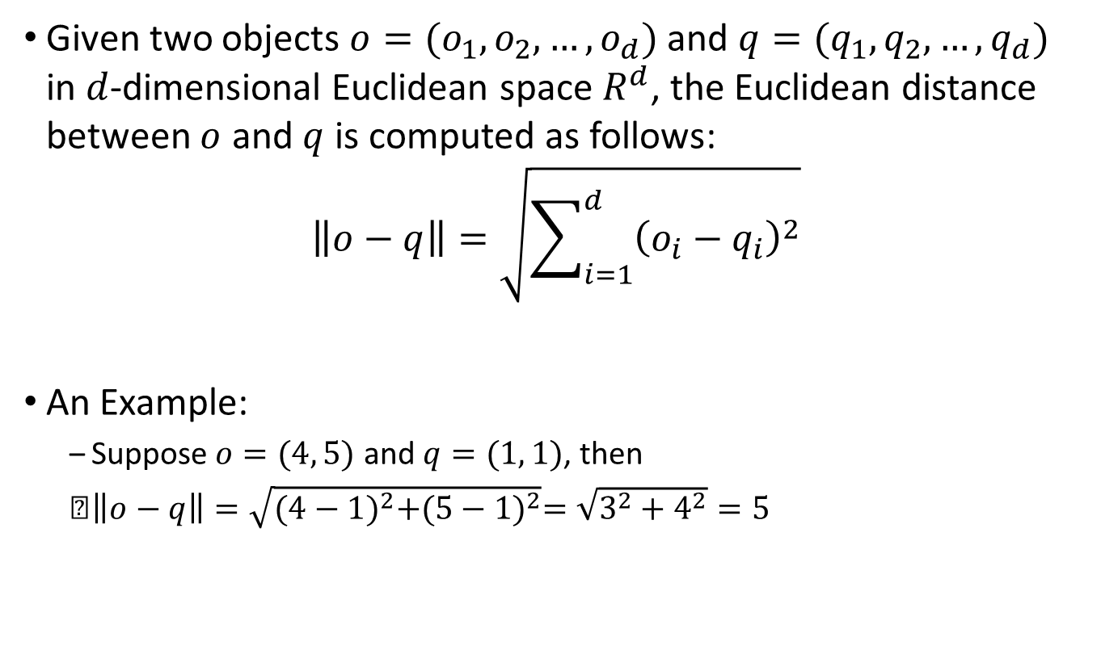
Euclidean distance
Given two objects $o=(o_{1},o_{2},…,o_{d})$ and $q=(q_{1},q_{2},…,q_{d})$ in $d$-dimensional Euclidean space $R^{d}$, the Euclidean distance between $o$ and $q$ is computed as follows:
$$\left\|o−q\right\|=\sqrt{\sum_{i=1}^{d}{{\left(o_{i}−q_{i}\right)}^{2}}}$$
An Example:
Suppose $o=(4, 5)$ and $q=(1, 1)$, then
$\left\|o−q\right\|=\sqrt{{(4−1)}^{2}+{(5−1)}^{2}}=\sqrt{3^{2}+4^{2}}=5$

Slide 4









Problem Definition
Consider a database $D$ of $n$ objects in $R^{d}$ and a query $q$.
The Nearest Neighbor (NN) search is to find the data object $o^{∗}$, where $\left\|o^{∗},q\right\|≤\left\|o,q\right\|$ for all $o∈D$.
A data object $o∈D$ is a $c$-Approximate NN ($c$-ANN) of $q$ if $\left\|o,q\right\|≤c\left\|o^{∗},q\right\|$.
$$o_{4}$$
$$o_{2}$$
Object $o_{2}$ is the NN of $q$
$$q$$
$$o_{3}$$
$$o_{5}$$
Objects $o_{2}$ and $o_{3}$ are $2$-ANN of $q$
$$o_{1}$$

Slide 5
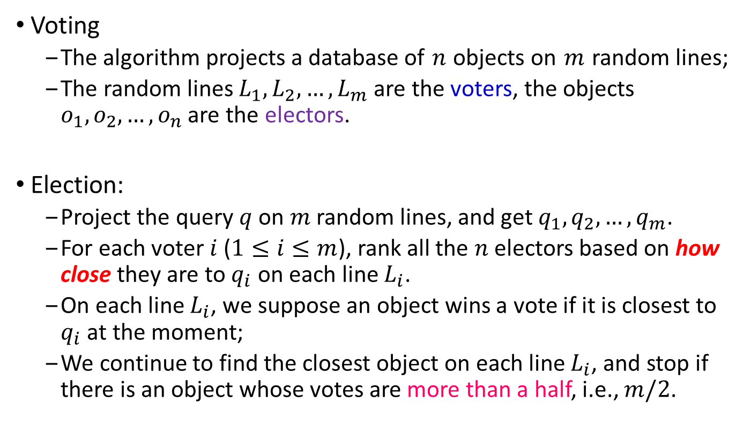
Overview of MEDRANK
Voting
The algorithm projects a database of $n$ objects on $m$ random lines;
The random lines $L_{1},L_{2},…,L_{m}$ are the voters, the objects $o_{1},o_{2},…,o_{n}$ are the electors.
Election:
Project the query $q$ on $m$ random lines, and get $q_{1},q_{2},…,q_{m}$.
For each voter $i$ ($1≤i≤m$), rank all the $n$ electors based on how close they are to $q_{i}$ on each line $L_{i}$.
On each line $L_{i}$, we suppose an object wins a vote if it is closest to $q_{i}$ at the moment;
We continue to find the closest object on each line $L_{i}$, and stop if there is an object whose votes are more than a half, i.e., $m/2$.

Slide 6
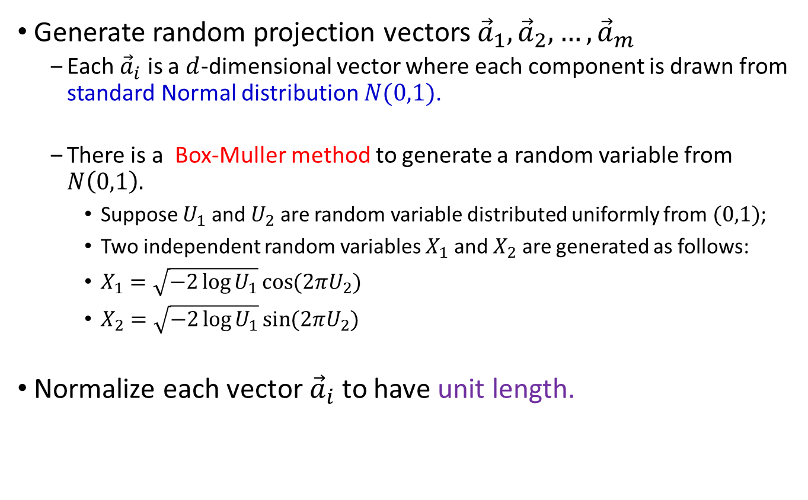
Pre-processing
Generate random projection vectors ${\vec{a}}_{1},{\vec{a}}_{2},…,{\vec{a}}_{m}$
Each ${\vec{a}}_{i}$ is a $d$-dimensional vector where each component is drawn from standard Normal distribution $N(0,1)$.
There is a Box-Muller method to generate a random variable from $N\left(0,1\right).$
Suppose $U_{1}$ and $U_{2}$ are random variable distributed uniformly from $(0,1)$;
Two independent random variables $X_{1}$ and $X_{2}$ are generated as follows:
$X_{1}=\sqrt{−2\log{U_{1}}}\cos{(2πU_{2})}$
$X_{2}=\sqrt{−2\log{U_{1}}}\sin{(2πU_{2})}$
Normalize each vector ${\vec{a}}_{i}$ to have unit length.

Slide 7










Pre-processing
Project all $n$ objects onto the $m$ random lines $L_{1},L_{2},…,L_{m}$;
Sort each $L_{i}$ by the second component in ascending order;
Index each $L_{i}$ by a $B^{+}$-tree via bulk-loading and store it on the disk.
$$y$$
$$o_{1}$$
$${\vec{a}}_{2}$$
$${\vec{a}}_{1}$$
(1, $v_{21}$)
(1, $v_{11}$)
$$o_{3}$$
$$o_{2}$$
$$x$$
The random projection is computed by $v_{ij}={\vec{a}}_{i}⋅{\vec{o}}_{j}$

Slide 8
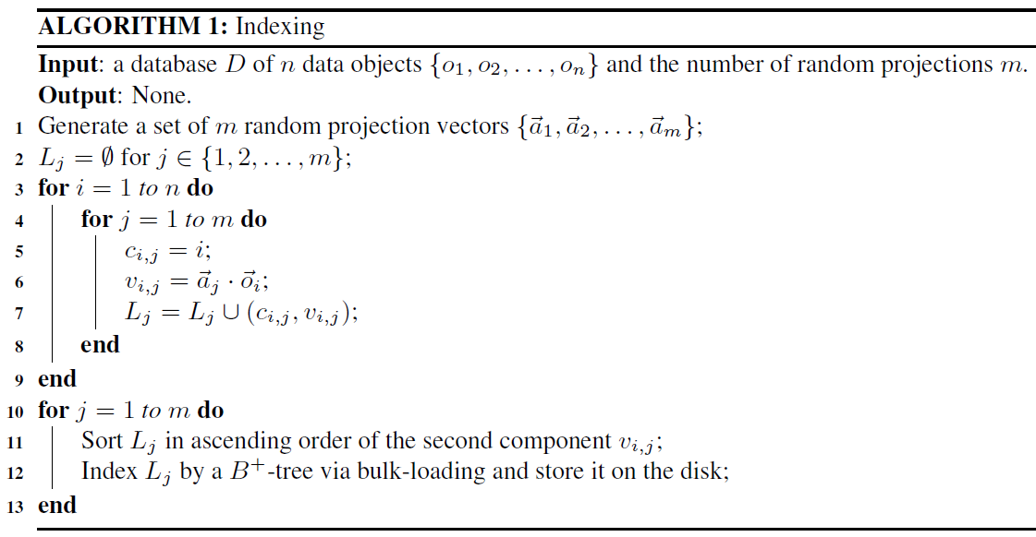
Pre-processing

Slide 9









MEDRANK
Project the query $q$ on $m$ random lines, and get $q_{1},q_{2},…,q_{m}$.
Initialize two pointers $h_{i}$ and $l_{i}$ into $L_{i}$ by the search procedure of $B^{+}$-tree so that $v_{i,h_{i}}≤q_{i}≤v_{i,l_{i}}$
$$y$$
$$o_{1}$$
$${\vec{a}}_{2}$$
$${\vec{a}}_{1}$$
$$q_{1}$$
$$o_{3}$$
$$o_{2}$$
$$q$$
$$x$$
$$q_{2}$$

Slide 10









MEDRANK
An Example:
After random projection, $o_{1}=(4.3, −2.5, 4.7)$, $o_{2}=(4.1,1.8, 3.1)$, $o_{3}=(6.7,2.3,3.7)$ and $q=(4.9,2.1,3.3)$
$f_{o_{1}}=0$, $f_{o_{2}}=0$ and $f_{o_{3}}=0$
$$h_{1}$$
$$l_{1}$$
$$L_{1}$$
$$(2,4.1)$$ | $$(1,4.3)$$ | $$(3,6.7)$$
$$q_{1}=4.9$$
$$L_{2}$$
$$(1,−2.5)$$ | $$(2,1.8)$$ | $$(3,2.3)$$
$$q_{2}=2.1$$
$$L_{3}$$
$$(2,3.1)$$ | $$(3,3.7)$$ | $$(1,4.7)$$
$$q_{3}=3.3$$

Slide 11






MEDRANK
An Example:
After random projection, $o_{1}=(4.3, −2.5, 4.7)$, $o_{2}=(4.1,1.8, 3.1)$, $o_{3}=(6.7,2.3,3.7)$ and $q=(4.9,2.1,3.3)$
$f_{o_{1}}=0$, $f_{o_{2}}=0$ and $f_{o_{3}}=0$
$$h_{1}$$
$$l_{1}$$
$$L_{1}$$
$$(2,4.1)$$ | $$(1,4.3)$$ | $$(3,6.7)$$
$$q_{1}=4.9$$
$$h_{2}$$
$$l_{2}$$
$$L_{2}$$
$$(1,−2.5)$$ | $$(2,1.8)$$ | $$(3,2.3)$$
$$q_{2}=2.1$$
$$h_{3}$$
$$l_{3}$$
$$L_{3}$$
$$(2,3.1)$$ | $$(3,3.7)$$ | $$(1,4.7)$$
$$q_{3}=3.3$$

Slide 12








MEDRANK
An Example:
After random projection, $o_{1}=(4.3, −2.5, 4.7)$, $o_{2}=(4.1,1.8, 3.1)$, $o_{3}=(6.7,2.3,3.7)$ and $q=(4.9,2.1,3.3)$
$f_{o_{1}}=1$, $f_{o_{2}}=0$ and $f_{o_{3}}=0$
$$h_{1}$$
$$l_{1}$$
$$L_{1}$$
$$(2,4.1)$$ | $$(1,4.3)$$ | $$(3,6.7)$$
$$q_{1}=4.9$$
$$h_{2}$$
$$l_{2}$$
$$L_{2}$$
$$(1,−2.5)$$ | $$(2,1.8)$$ | $$(3,2.3)$$
$$q_{2}=2.1$$
$$h_{3}$$
$$l_{3}$$
$$L_{3}$$
$$(2,3.1)$$ | $$(3,3.7)$$ | $$(1,4.7)$$
$$q_{3}=3.3$$

Slide 13



MEDRANK
An Example:
After random projection, $o_{1}=(4.3, −2.5, 4.7)$, $o_{2}=(4.1,1.8, 3.1)$, $o_{3}=(6.7,2.3,3.7)$ and $q=(4.9,2.1,3.3)$
$f_{o_{1}}=1$, $f_{o_{2}}=0$ and $f_{o_{3}}=1$
$$h_{1}$$
$$l_{1}$$
$$L_{1}$$
$$(2,4.1)$$ | $$(1,4.3)$$ | $$(3,6.7)$$
$$q_{1}=4.9$$
$$h_{2}$$
$$l_{2}$$
$$L_{2}$$
$$(1,−2.5)$$ | $$(2,1.8)$$ | $$(3,2.3)$$
$$q_{2}=2.1$$
$$h_{3}$$
$$l_{3}$$
$$L_{3}$$
$$(2,3.1)$$ | $$(3,3.7)$$ | $$(1,4.7)$$
$$q_{3}=3.3$$

Slide 14


MEDRANK
An Example:
After random projection, $o_{1}=(4.3, −2.5, 4.7)$, $o_{2}=(4.1,1.8, 3.1)$, $o_{3}=(6.7,2.3,3.7)$ and $q=(4.9,2.1,3.3)$
$f_{o_{1}}=1$, $f_{o_{2}}=1$ and $f_{o_{3}}=1$
$$h_{1}$$
$$l_{1}$$
$$L_{1}$$
$$(2,4.1)$$ | $$(1,4.3)$$ | $$(3,6.7)$$
$$q_{1}=4.9$$
$$h_{2}$$
$$L_{2}$$
$$(1,−2.5)$$ | $$(2,1.8)$$ | $$(3,2.3)$$
$$q_{2}=2.1$$
$$h_{3}$$
$$l_{3}$$
$$L_{3}$$
$$(2,3.1)$$ | $$(3,3.7)$$ | $$(1,4.7)$$
$$q_{3}=3.3$$

Slide 15

MEDRANK
An Example:
After random projection, $o_{1}=(4.3, −2.5, 4.7)$, $o_{2}=(4.1,1.8, 3.1)$, $o_{3}=(6.7,2.3,3.7)$ and $q=(4.9,2.1,3.3)$
$f_{o_{1}}=1$, $f_{o_{2}}=2$ and $f_{o_{3}}=1$
$$h_{1}$$
$$l_{1}$$
$$L_{1}$$
$$(2,4.1)$$ | $$(1,4.3)$$ | $$(3,6.7)$$
$$q_{1}=4.9$$
$$h_{2}$$
$$L_{2}$$
$$(1,−2.5)$$ | $$(2,1.8)$$ | $$(3,2.3)$$
$$q_{2}=2.1$$
$$l_{3}$$
$$L_{3}$$
$$(2,3.1)$$ | $$(3,3.7)$$ | $$(1,4.7)$$
$$q_{3}=3.3$$

Slide 16









MEDRANK
An Example:
Since $f_{o_{2}}>\frac{m}{2}=1.5$, the MEDRANK algorithm stops and returns $o_{2}$
$$y$$
$$o_{1}$$
$${\vec{a}}_{2}$$
$${\vec{a}}_{1}$$
$$o_{3}$$
$$o_{2}$$
$$q$$
$$x$$

Slide 17
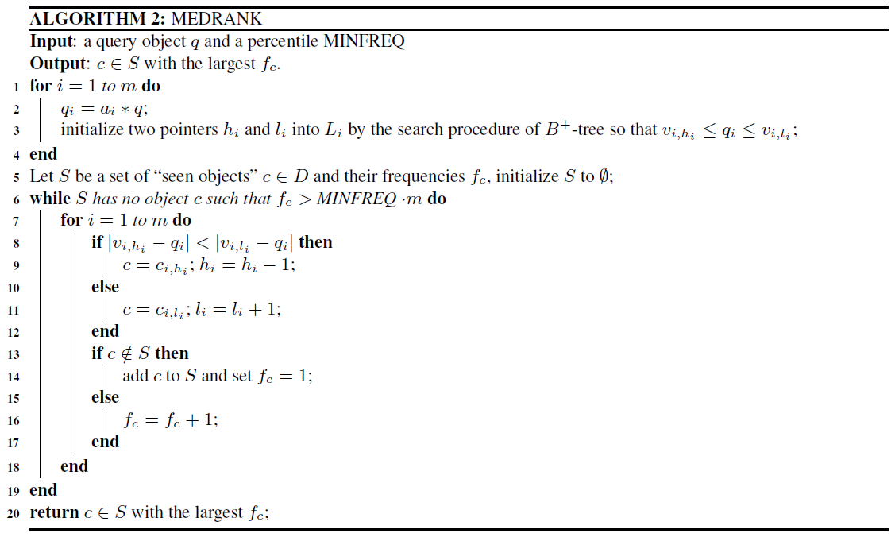
MEDRANK

Slide 18
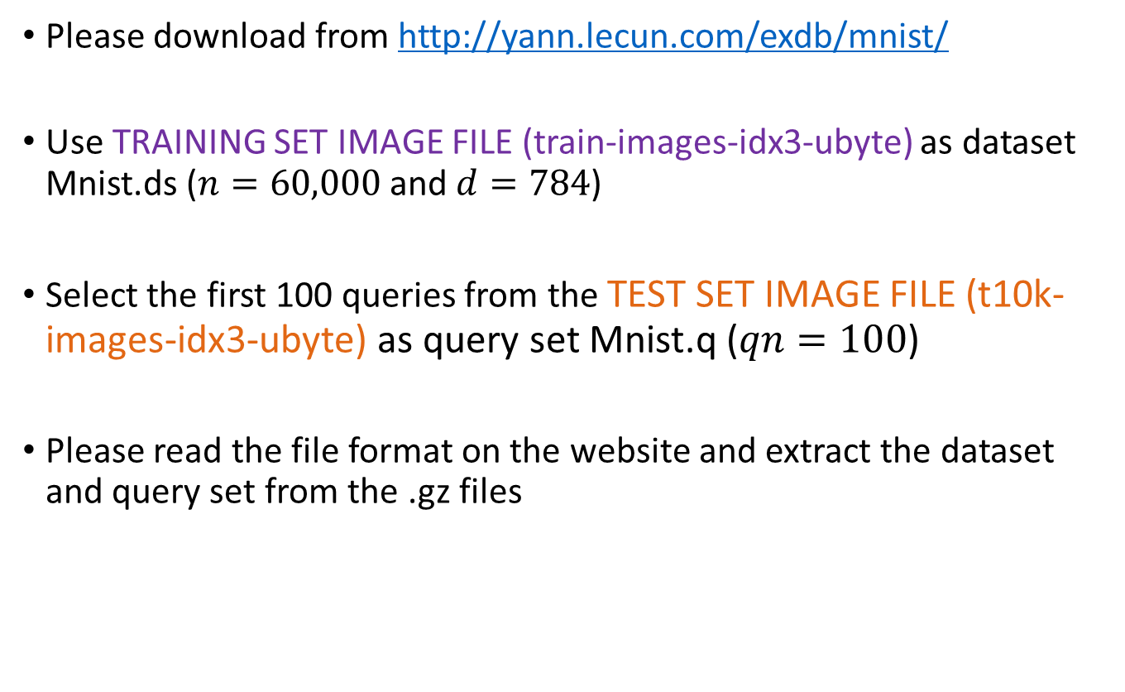
Dataset and Query Set
Please download from http://yann.lecun.com/exdb/mnist/
Use TRAINING SET IMAGE FILE (train-images-idx3-ubyte) as dataset Mnist.ds ($n=60,000$ and $d=784$)
Select the first 100 queries from the TEST SET IMAGE FILE (t10k-images-idx3-ubyte) as query set Mnist.q ($qn=100$)
Please read the file format on the website and extract the dataset and query set from the .gz files

Slide 19
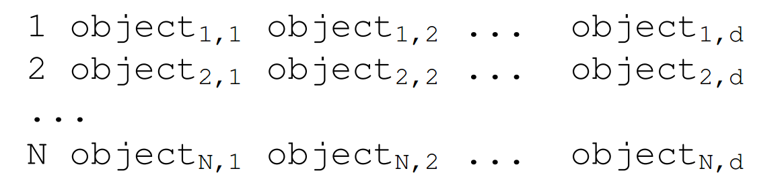

Input Format of the Project
The input format of the dataset and query set is described as follows:
The 1st element is the object id, the 2nd to the ${\left(d+1\right)}^{th}$ elements are the coordinate of the object itself.

Slide 20
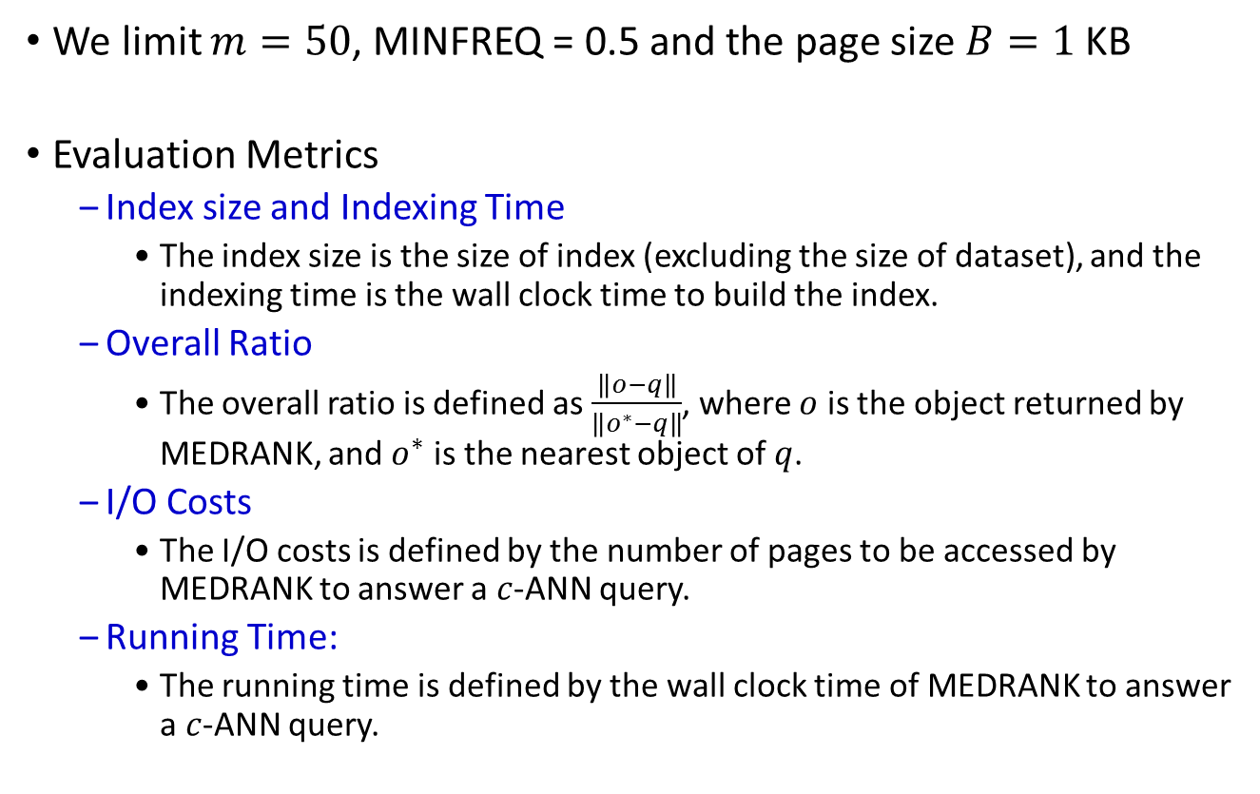
Implementation Requirements
We limit $m=50$, MINFREQ = 0.5 and the page size $B=1$ KB
Evaluation Metrics
Index size and Indexing Time
The index size is the size of index (excluding the size of dataset), and the indexing time is the wall clock time to build the index.
Overall Ratio
The overall ratio is defined as $\frac{\left\|o−q\right\|}{\left\|o^{∗}−q\right\|}$, where $o$ is the object returned by MEDRANK, and $o^{∗}$ is the nearest object of $q$.
I/O Costs
The I/O costs is defined by the number of pages to be accessed by MEDRANK to answer a $c$-ANN query.
Running Time:
The running time is defined by the wall clock time of MEDRANK to answer a $c$-ANN query.

Slide 21









A New Variant of $B^{+}$-tree
Root: level = 2
2 | 29
$d≤m≤2d$, i.e., $2≤m≤4$
$$2≤key<29$$
$$29≤key$$
level = 1
2 | 8 | 17
29 | 43
$$2≤key<8$$
$$8≤key<17$$
$$17≤key<29$$
$$29≤key<43$$
$$43≤key$$
2 | 3 | 5
8 | 10 | 13 | 15
17 | 19 | 25
29 | 34
43 | 47 | 59
Leaf: level = 0

Slide 22


Search 13
2 | 29
$$2≤13<29$$
2 | 8 | 17
29 | 43
$$8≤13<17$$
2 | 3 | 5
8 | 10 | 13 | 15
17 | 19 | 25
29 | 34
43 | 47 | 59
Find it!

Slide 23


Search 48
2 | 29
$$29≤48$$
$$43≤48$$
2 | 8 | 17
29 | 43
2 | 3 | 5
8 | 10 | 13 | 15
17 | 19 | 25
29 | 34
43 | 47 | 59
No found!

Slide 24

Search -3
2 | 29
$$−3<2$$
No found!
2 | 8 | 17
29 | 43
2 | 3 | 5
8 | 10 | 13 | 15
17 | 19 | 25
29 | 34
43 | 47 | 59

Slide 25





Bulk-Loading
Leaf: level = 0
2 | 3 | 5 | 7
8 | 10 | 12 | 13
15 | 17 | 19 | 25
29 | 34 | 43 | 47
59 | 63 | 67
$$1$$
$$2$$
$$3$$
$$4$$
$$5$$
2 | 3 | 5 | 7 | 8 | 10 | 12 | 13 | 15 | 17 | 19 | 25 | 29 | 34 | 43 | 47 | 59 | 63 | 67

Slide 26


Bulk-Loading
level = 1
2 | 8 | 15 | 29
59
$$6$$
$$7$$
Leaf: level = 0
2 | 3 | 5 | 7
8 | 10 | 12 | 13
15 | 17 | 19 | 25
29 | 34 | 43 | 47
59 | 63 | 67
$$1$$
$$2$$
$$3$$
$$4$$
$$5$$
2 | 3 | 5 | 7 | 8 | 10 | 12 | 13 | 15 | 17 | 19 | 25 | 29 | 34 | 43 | 47 | 59 | 63 | 67

Slide 27

Bulk-Loading
Root: level = 2
2 | 59
$$8$$
level = 1
2 | 8 | 15 | 29
59
$$6$$
$$7$$
Leaf: level = 0
2 | 3 | 5 | 7
8 | 10 | 12 | 13
15 | 17 | 19 | 25
29 | 34 | 43 | 47
59 | 63 | 67
$$1$$
$$2$$
$$3$$
$$4$$
$$5$$
2 | 3 | 5 | 7 | 8 | 10 | 12 | 13 | 15 | 17 | 19 | 25 | 29 | 34 | 43 | 47 | 59 | 63 | 67

Slide 28
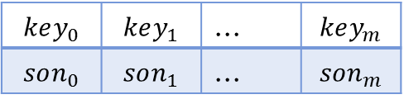
Data Structure of B-Node
$$key_{0}$$ | $$key_{1}$$ | … | $$key_{m}$$
$$son_{0}$$ | $$son_{1}$$ | … | $$son_{m}$$
Left-sibling node
Right-sibling node
class BNode {
// disk params
char level_; // level of b-tree (level > 0)
int num_entries_; // number of entries in this node
int left_sibling_; // addr in disk for left sibling
int right_sibling_; // addr in disk for right sibling
float* key_; // keys
int* son_; // addr of son node or object id
// other params
bool dirty_; // if dirty, write back to file
int block_; // addr of disk for this node
int capacity_; // max num of entries can be stored
BTree* btree_; // b-tree of this node
};

Slide 29


Storage Formats
Header Node
(1 KB)
B-Node
(1 KB)
B-Node
(1 KB)
B-Node
(1 KB)
B-Node
(1 KB)
$B^{+}$ Tree:
 |  |  |  |  | 0 | 1 | … | num - 1
File header
(size of a node,
number of nodes)
$B^{+}$-tree header
(address of root)
B-Node header
1 KB
B-Node:
 |  |  |  | $$key_{0}$$ | $$son_{0}$$ | $$key_{1}$$ | $$son_{1}$$ | … | $$key_{m}$$ | $$son_{m}$$
level
left_sibling
num_entries
right_sibling

Slide 30
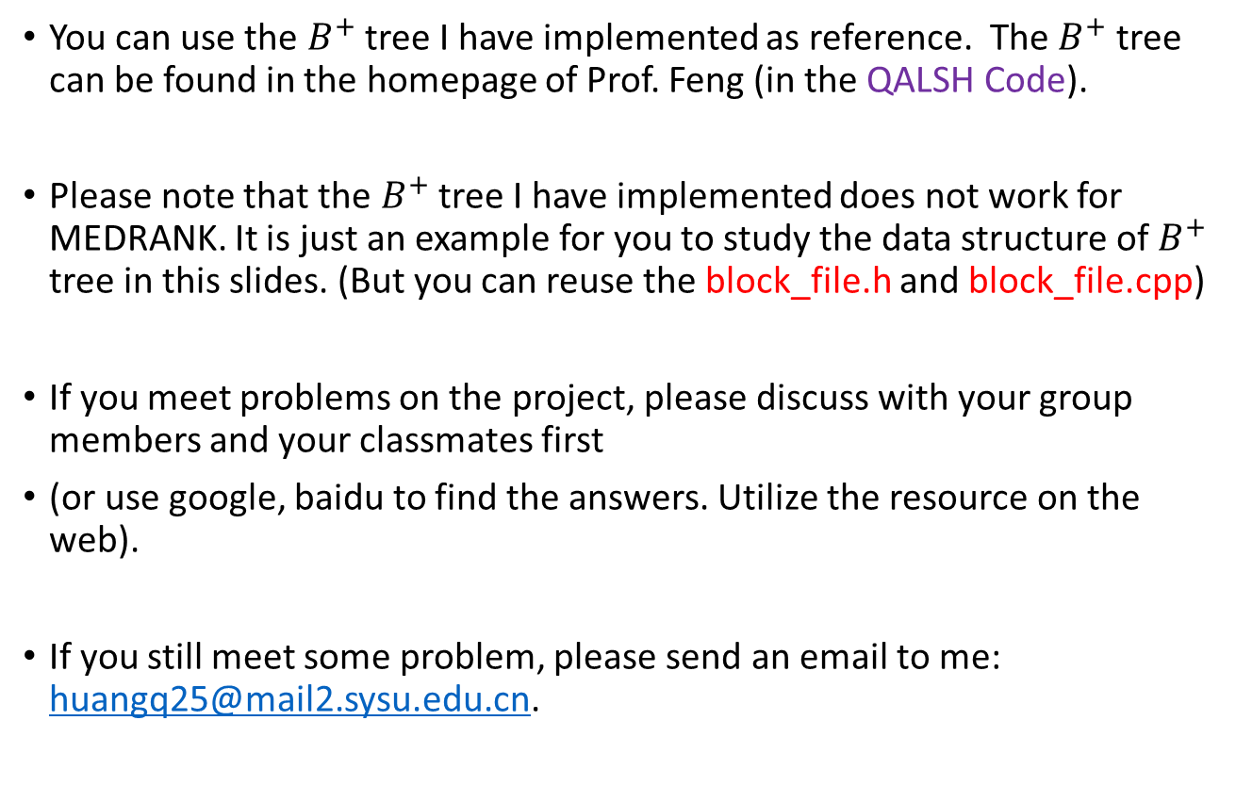
Helpful Comments
You can use the $B^{+}$ tree I have implemented as reference. The $B^{+}$ tree can be found in the homepage of Prof. Feng (in the QALSH Code).
Please note that the $B^{+}$ tree I have implemented does not work for MEDRANK. It is just an example for you to study the data structure of $B^{+}$ tree in this slides. (But you can reuse the block_file.h and block_file.cpp)
If you meet problems on the project, please discuss with your group members and your classmates first
(or use google, baidu to find the answers. Utilize the resource on the web).
If you still meet some problem, please send an email to me: huangq25@mail2.sysu.edu.cn.

Slide 31
Submission
All the files are compressed into a zip file, which is named as “groupID_Name_DBProject”.
Please submit the zip file to ftp://121.40.86.26/database.
The files you submit:
README
Source Code: store under a directory “/src”
Dataset and Query Set: create a directory “/data”, but DO NOT submit these two files into the website.
Makefile: please generate a executable program named medrank after compiling the Makefile. The program should be run by the command:
./medrank -n 60000 -d 784 -qn 100 -ds ./data/Mnist.ds -qs ./data/Mnist.q
Experimental Report

Slide 32


Insert 32
2 | 29
$$29≤32$$
$$29≤32<43$$
2 | 8 | 17
29 | 43
2 | 3 | 5
8 | 10 | 13 | 15
17 | 19 | 25
29 | 34
43 | 47 | 59

Slide 33
Insert 32
2 | 29
$$29≤32$$
$$29≤32<43$$
2 | 8 | 17
29 | 43
2 | 3 | 5
8 | 10 | 13 | 15
17 | 19 | 25
29 | 32 | 34
43 | 47 | 59
Inster entry 32

Slide 34


Insert 1
$$1<2$$
2 | 29
$$1<2$$
2 | 8 | 17
29 | 43
2 | 3 | 5
8 | 10 | 13 | 15
17 | 19 | 25
29 | 32 | 34
43 | 47 | 59

Slide 35
Insert 1
$$1<2$$
Update index entry
1 | 29
$$1<2$$
Update index entry
1 | 8 | 17
29 | 43
1 | 2 | 3 | 5
8 | 10 | 13 | 15
17 | 19 | 25
29 | 32 | 34
43 | 47 | 59
Insert entry 1

Slide 36


Insert 16
1 | 29
$$1≤16<29$$
$$8≤16<17$$
1 | 8 | 17
29 | 43
1 | 2 | 3 | 5
8 | 10 | 13 | 15
17 | 19 | 25
29 | 32 | 34
43 | 47 | 59
Overflow!
Split leaf page

Slide 37
Insert 16
1 | 29
$$1≤16<29$$
$$8≤16<17$$
1 | 8 | 17
29 | 43
1 | 2 | 3 | 5
8 | 10
17 | 19 | 25
29 | 32 | 34
43 | 47 | 59
Split leaf page
13 | 15 | 16

Slide 38
Insert 16
1 | 29
$$1≤16<29$$
$$8≤16<17$$
Update index entry
1 | 8 | 13 | 17
29 | 43
1 | 2 | 3 | 5
8 | 10
17 | 19 | 25
29 | 32 | 34
43 | 47 | 59
13 | 15 | 16

Slide 39


Delete 8
2 | 29
$$2≤8<29$$
$$8≤8<17$$
2 | 8 | 17
29 | 43
2 | 3 | 5
8 | 10 | 13 | 15
17 | 19 | 25
29 | 34
43 | 47 | 59

Slide 40
Delete 8
2 | 29
$$2≤8<29$$
$$8≤8<17$$
Update index entry
2 | 10 | 17
29 | 43
2 | 3 | 5
10 | 13 | 15
17 | 19 | 25
29 | 34
43 | 47 | 59
Delete entry 8

Slide 41


Delete 34
2 | 29
$$29≤34$$
$$29≤34<43$$
2 | 10 | 17
29 | 43
2 | 3 | 5
10 | 13 | 15
17 | 19 | 25
29 | 34
43 | 47 | 59

Slide 42
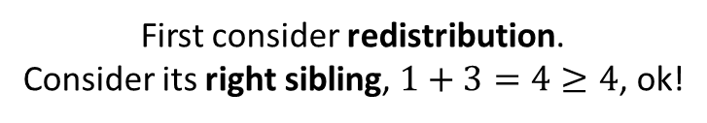
Delete 34
2 | 29
$$29≤34$$
$$29≤34<43$$
2 | 10 | 17
29 | 43
2 | 3 | 5
10 | 13 | 15
17 | 19 | 25
29
43 | 47 | 59
First consider redistribution.
Consider its right sibling, $1+3=4≥4$, ok!
Delete entry 34.
Underflow!

Slide 43
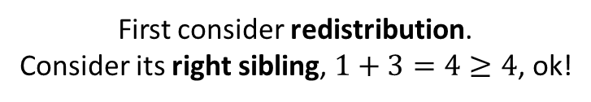
Delete 34
2 | 29
$$29≤34$$
$$29≤34<43$$
2 | 10 | 17
29 | 47
Update index entry
2 | 3 | 5
10 | 13 | 15
17 | 19 | 25
29 | 43
47 | 59
First consider redistribution.
Consider its right sibling, $1+3=4≥4$, ok!

Slide 44


Delete 59
2 | 29
$$29≤59$$
$$47≤59$$
2 | 10 | 17
29 | 47
2 | 3 | 5
10 | 13 | 15
17 | 19 | 25
29 | 43
47 | 59

Slide 45
Delete 59
2 | 29
$$29≤59$$
$$47≤59$$
2 | 10 | 17
29 | 47
2 | 3 | 5
10 | 13 | 15
17 | 19 | 25
29 | 43
47
redistribution is failed!
We should consider to merge.
Delete entry 59.
Underflow!

Slide 46
Delete 59
2 | 29
$$29≤59$$
$$47≤59$$
2 | 10 | 17
29 | 47
2 | 3 | 5
10 | 13 | 15
17 | 19 | 25
29 | 43 | 47
Merge two leaf nodes.

Slide 47
Delete 59
2 | 29
$$29≤59$$
$$47≤59$$
2 | 10 | 17
29 | 47
2 | 3 | 5
10 | 13 | 15
17 | 19 | 25
29 | 43 | 47
Delete the empty leaf node

Slide 48
Delete 59
2 | 29
First consider redistribution.
consider it left sibling,
2 | 10 | 17
29
Delete entry 47.
Underflow!
2 | 3 | 5
10 | 13 | 15
17 | 19 | 25
29 | 43 | 47

Slide 49
Delete 59
2 | 29
First consider redistribution.
consider it left sibling,
2 | 10
17 | 29
Update index entry
2 | 3 | 5
10 | 13 | 15
17 | 19 | 25
29 | 43 | 47

Slide 50
Delete 59
2 | 17
Update index entry
2 | 10
17 | 29
2 | 3 | 5
10 | 13 | 15
17 | 19 | 25
29 | 43 | 47

