Slide 1
Introduction to DS and Algorithms
SIG 1: 28th August 2018, Tuesday

Slide 2
Data Structures
Data structure gives us a way of organising, managing and storing data so as to offer efficient accessibility and modification to it’s members.
Data structures help us to establish relationships between our data, our methods and operators (that help us to access and modify that data)
AIM: Data structures help us efficiently (with help of algorithms) navigate our way through huge data and make sense out of it.

Slide 3
Below are some of the data structures that we’ll cover through the course of these SIG’s ->
Arrays
Stacks and Queues
Lists
Heaps
Trees
Graphs

Slide 4
Algorithms
Algorithms can be thought of any statement that gives instructions on solving a particular class of problems.
Algorithms help in efficiently calculating and processing some input to form a desirable output.
An algorithm is only feasible if it can solve a particular problem in a reasonable amount of time with reasonable memory usage.

Slide 5
Time Complexity
Time complexity analysis is a mathematical tool that is used to determine how well the algorithm scales as the data size increases. It gives an estimate of how quick an algorithm will run proportionally to some input.
An algorithm is said to be scalable if it can efficiently give the same result under different groups of data.
For simplicity we would only be analysing algorithms using the Big Oh “O( )” notation. It helps us analyse the worst case scenario of a particular algorithm.

Slide 6

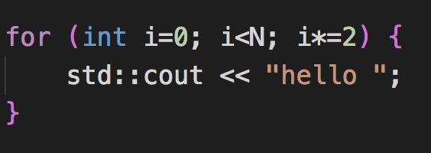
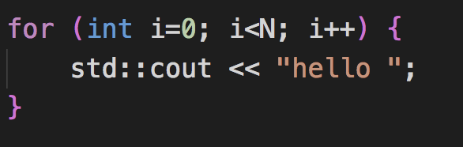
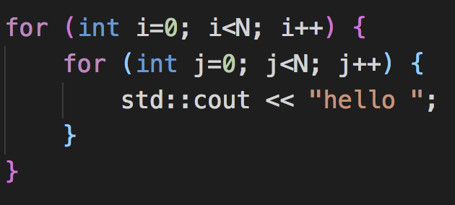
Big Oh notation examples ->
O(1)
O(log2N)
O(N)
O(N²)

Slide 7
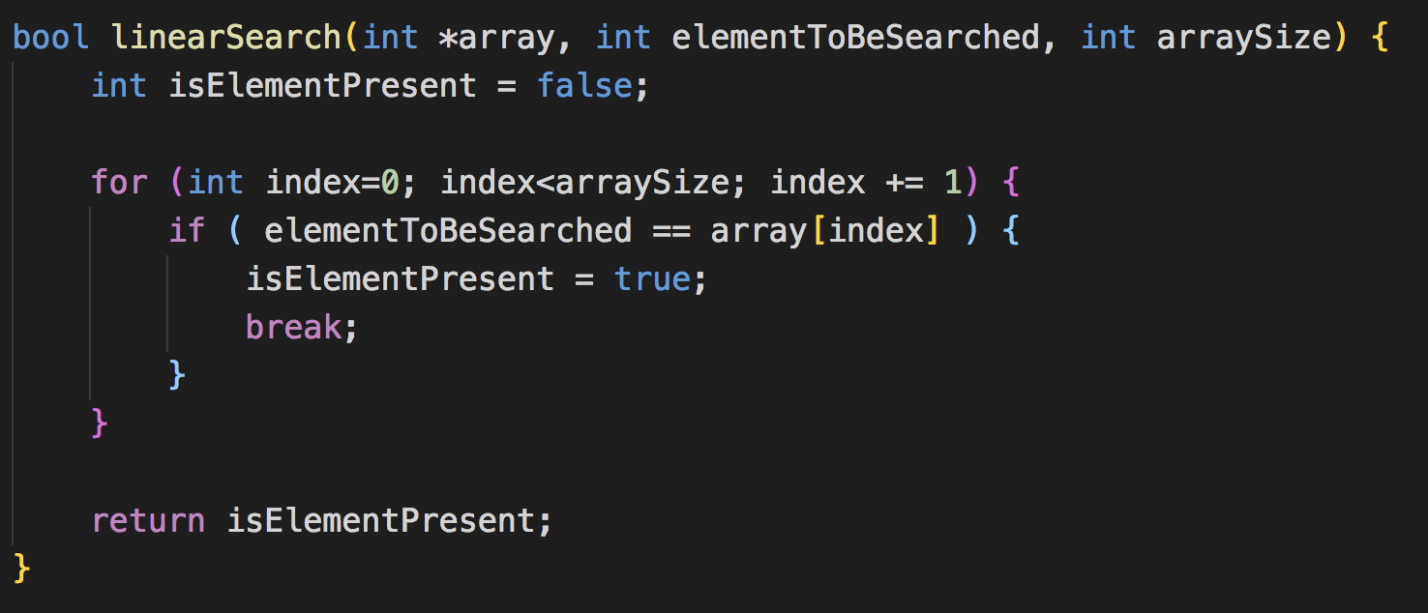
Linear Search
Algorithm :
Time Complexity : O(N)

Slide 8
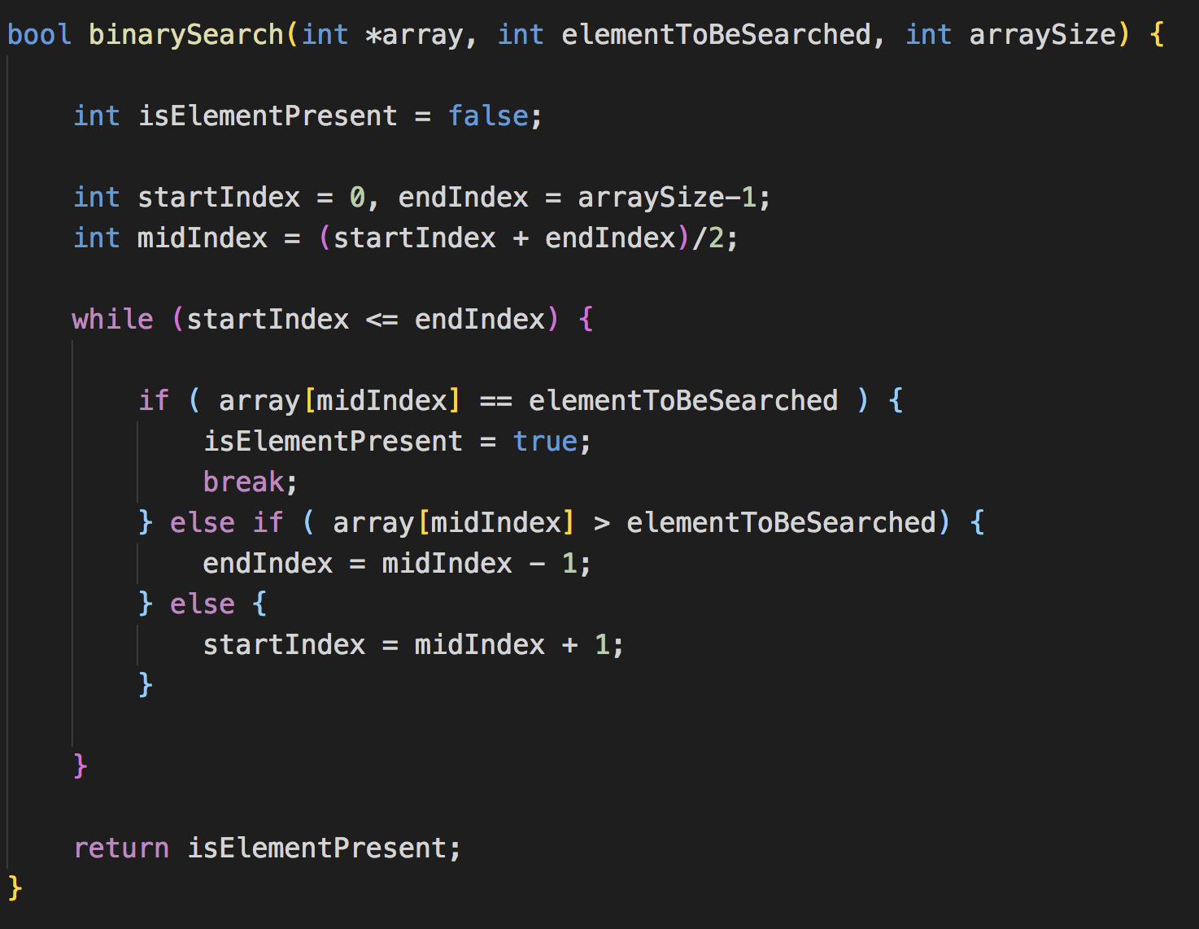
Binary Search
Algorithm :
Time Complexity : O(log2N)

Slide 9
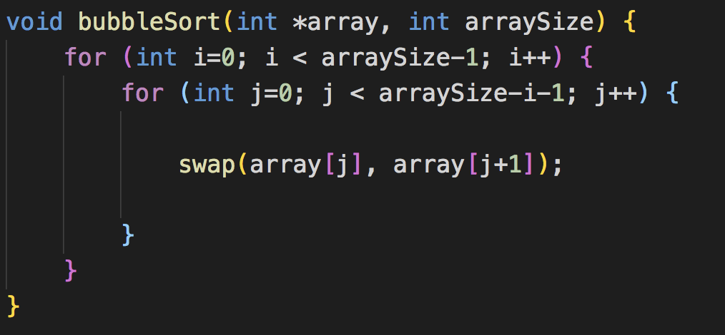
Bubble Sort
Algorithm :
Time Complexity : O(N²)

Slide 10
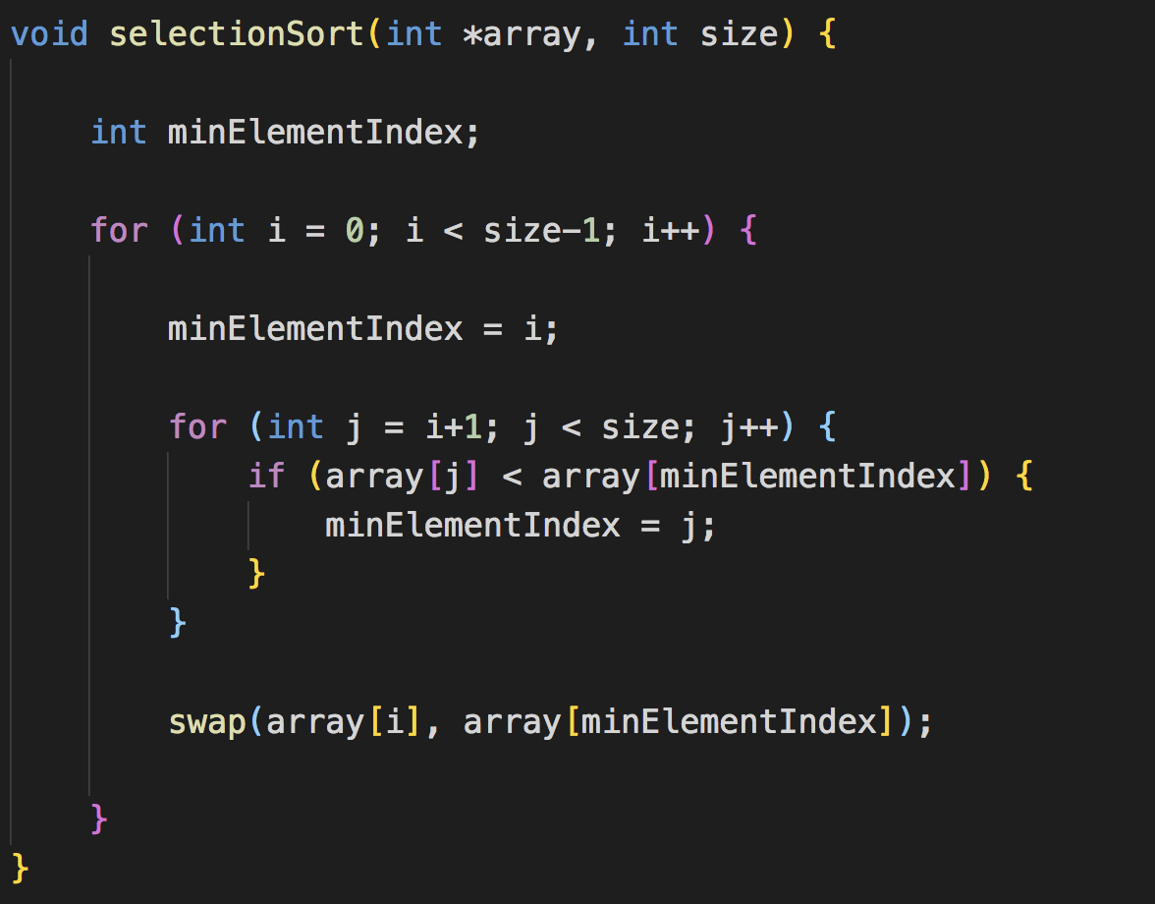
Selection Sort
Algorithm :
Time Complexity : O(N²)

Slide 11
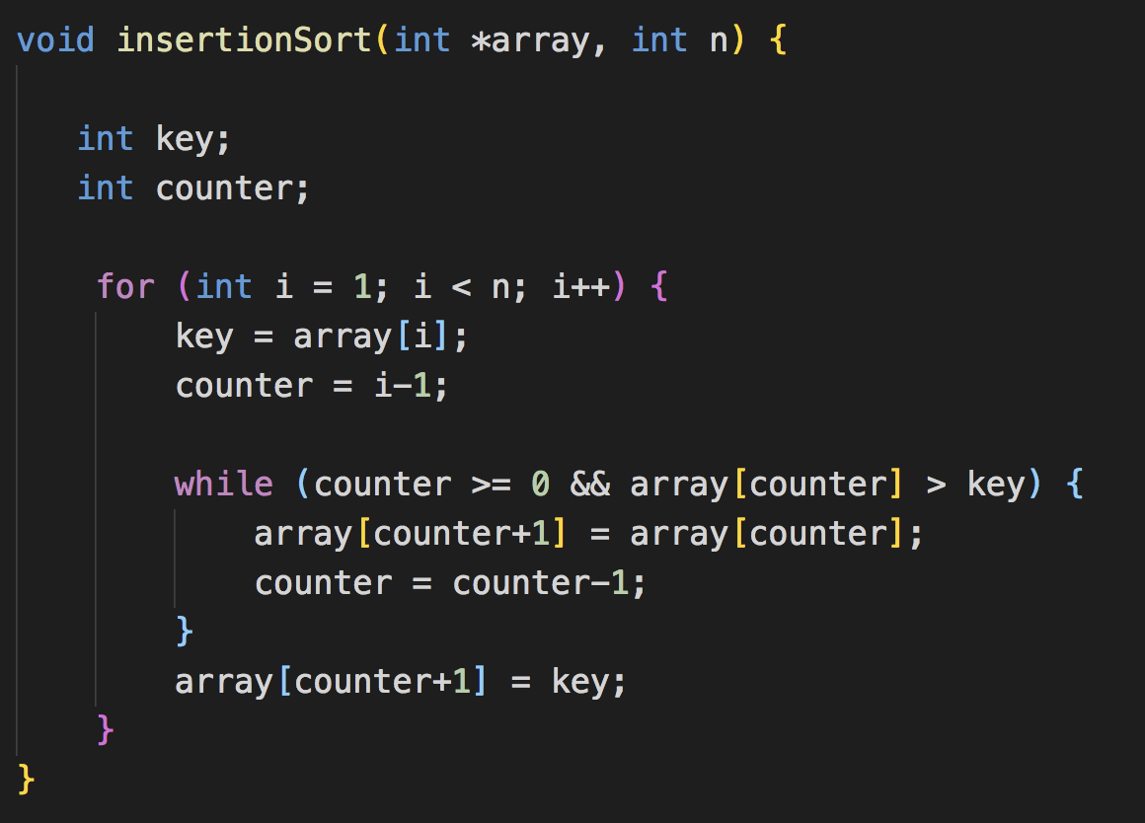
Insertion Sort
Algorithm :
Time Complexity : O(N²)

Slide 12
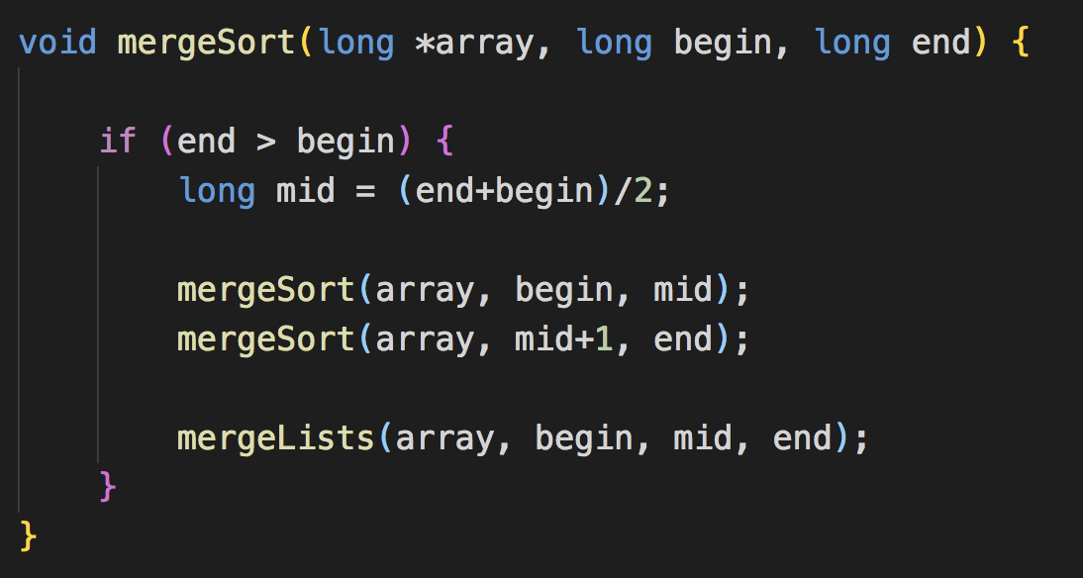
Merge Sort
Algorithm :
Time Complexity : O(N²)

Slide 13
Standard Template Library
C++ offers a built in standard library under the standard namespace to implement commonly used data structure implementations and algorithms.
A namespace binds certain functions and classes to a particular scope. STL methods and classes can be accessed from the std:: namespace.

Slide 14
Below are some of the data structures and algorithms offered by the standard template library->
std::vector<data_type> identifier_name (array)
std::map<key, value> identifier_name (hash)
std::sort(object, start_iterator, end_iterator)

