Slide 1
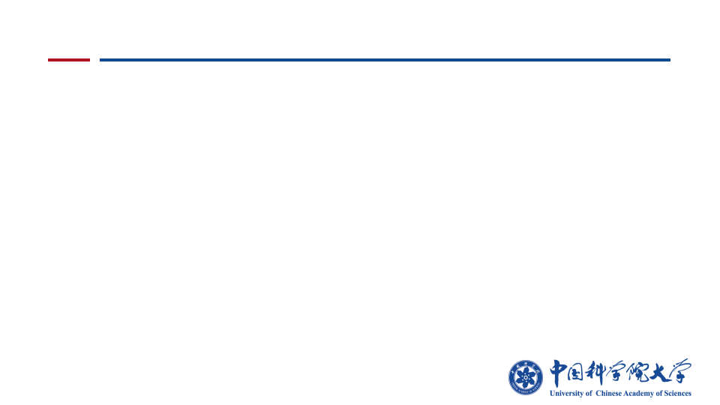



DPIAgent: Agentic Reproduction Test Generation with Structured Phase Boundaries
Hao Liu^{1*,†}, Steven Liu^{1*,†}, Xin Zhang^{1*,‡}, Jane Luo^{1,†}, Yu Kang¹, Jie Wu^{1,2,†}
Fangkai Yang¹, Yangyu Huang¹, Pengfei Gao¹, Scarlett Li¹, Yan Lu¹
¹ Microsoft
² Tsinghua University
Notes:
Cover adapted directly from TestExplora-Pre.pptx. Title, author order, affiliations and venue from the current DPIAgent project page.

