Slide 1
Identifying Student Contributions through Automated Team Summaries
Kai Presler-Marshall, Bowdoin College
Sarah Heckman, North Carolina State University
Kathryn T. Stolee, North Carolina State University
Questions? Rude Comments? k.preslermarshall@bowdoin.edu

Slide 2
Motivation
Teaming is a core element in professional software engineering
Thus, it’s essential for CS and SE programs to teach students how to work in teams
Some students may be inclined to freeride off of the contributions of their peers, receiving a grade not commensurate to their contributions

Slide 3
Motivation
Accurately identifying students’ contributions to team projects remains an open challenge
Thus, teaching assistants may struggle to give students consistent & actionable feedback on their contributions
Can autogenerated summaries of students’ code contributions assist TAs in giving better feedback?
Notes:
Hayes showed that it’s particularly difficult for TAs to accurately discern what individual students have contributed to team-based projects – exactly what we are looking to address here.
Glazer talks about grading more consistently overall, and says that individual instructors may struggle to grade consistently against each other, so it is helpful to have summative, department-wide grading policies for summative assessment.

Slide 4
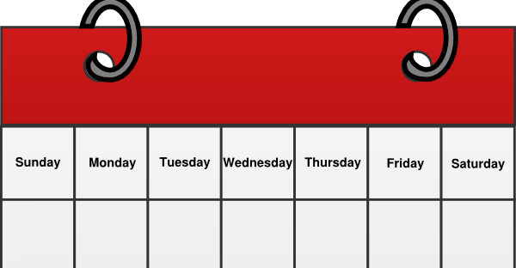



Course Context
Sophomore-level Java programming course
Lecture & projects
Associated lab section
Students work on labs in small teams
Lab grading is mostly automated
x3
Notes:
The only two parts of the grading that are done manually are Javadoc, to ensure that it approximately describes the code, and individual contributions, to ensure that each student is making a non-trivial contribution to out-of-lab tasks
See if we can make a note that the first two rotations are four labs each.

Slide 5
Selected Research Questions
Can automated summaries of student contributions enable:
RQ1: Faster grading by TAs (short answer: no)
RQ2: More consistent grading by TAs?
RQ3: Less frustrating grading from perspective of TAs?
RQ4: Better feedback for students?
Notes:
Henceforth, I’ll use “automated summaries” and “contributions summaries” interchangeably to describe what we’re studying here

Slide 6
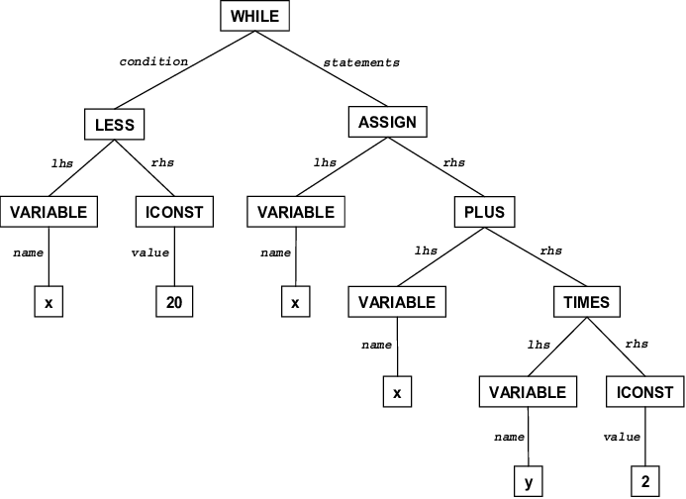






Contributions Summary Algorithm
Class Declaration
public class KaiDemoClass {
private String aField = “demo”;
public String capitaliseAndReturn(){
String modified = aField.toUpperCase();
return modified;
}
}
Field Declaration
Method Declaration
Variable Declaration
Return Statement
Method Call
Class Declaration
public class KaiDemoClass {
private String aField = “demo”;
private String secondField = “moreDemo”;
public String capitaliseAndReturn(){
String modified = aField.toUpperCase();
return modified;
}
public Object anotherMethod(){ return null; }
}
Field Declaration
Method Declaration
Method Declaration
Field Declaration
Variable Declaration
Return Statement
Return Statement
Method Call
Notes:
After showing the generic ASTs by the Git logos, say something like “As abstract syntax trees are, by definition, abstract, it may help to consider a concrete example…”
Then return to explaining the diffs of the ASTs, and the rest of the analysis process

Slide 7
Study Outline
I recruited 13 former or current CS TAs
12 of 13 TAs had experience grading team-based projects
I tasked participants with:
Grading projects
Considering feedback from their peers
Reflecting on the experience
Introduction (~10m)
Part 1: Grading (~90m) RQ1, RQ2, RQ4
Part 2: Evaluating Feedback (~10m) RQ4
Reflection (~5m) RQ3

Slide 8
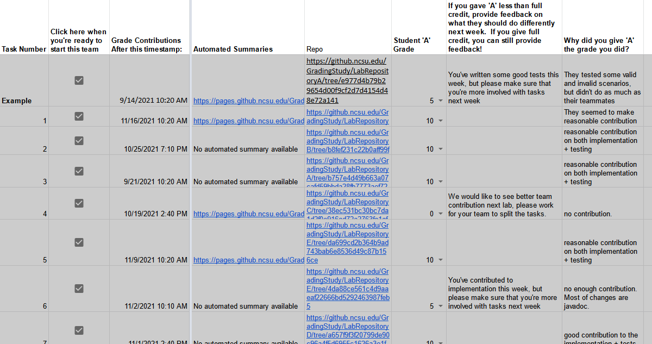
Part 1
Notes:
Screenshot of spreadsheet
First, show that we have individual assignments laid out on rows of the spreadsheet, as is typically done for grading in this class.
Next, we have automated summaries available for some projects
A link to Github is available for all projects;
TAs then provide three pieces of information for each student:
A contributions grade
Feedback to the student
And rationale behind _why_ they gave the grade that they did

Slide 9
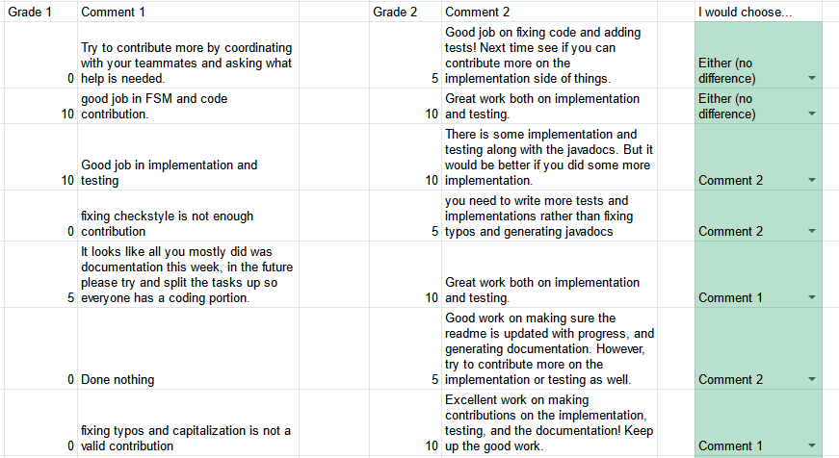
Part 2
Notes:
Screenshot of spreadsheet

Slide 10
RQ2: Grading Consistency
TAs grade projects much more consistently (q = .021) with contributions summaries to assist them
However, consistency still remains a challenge even with contributions summaries (α = .609)
Notes:
How can we make figures/images for this?
See if we can replace consistency w. another word

Slide 11
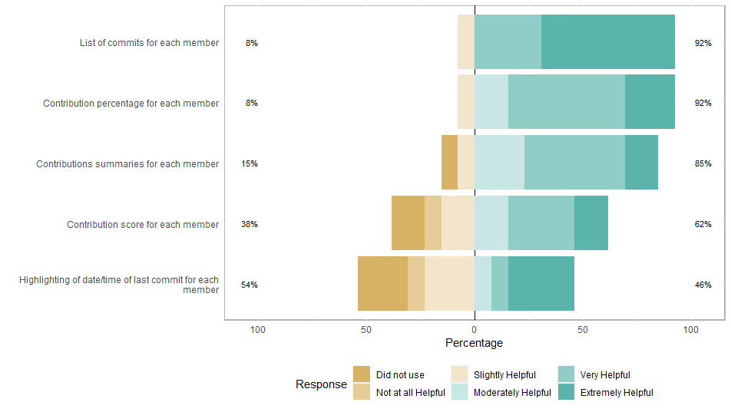
RQ3: Grading Preferences
All participants prefer grading with automated summaries; 11/13 strongly prefer them
Notes:
Might get a question on why people didn’t use the other things? Make sure to have answers.

Slide 12
RQ4: Feedback Quality
TAs consider feedback from assignments graded with contributions summaries more actionable (p = .031)
TAs provide more partial credit when grading with contributions summaries (p = .018)
Since we require TAs to provide feedback with partial credit, but not full credit, this shows they can improve the quantity of feedback provided
Notes:
Need some sort of visual for this too :thinking:

Slide 13
Discussion & Future Work
Despite a small sample size & relatively primitive summaries algorithm, a lab study showed value of my contributions summary algorithm
I am running a follow-on classroom study
Same experimental & control groups
Do students find feedback more actionable? Do they improve more over the semester?
Do we get the same consistency benefits with an entire semester of assignments?
Notes:
Language-agnostic AST analysis can f.ex be done with something like TreeSitter; George Mathew has also done some interesting work in this area

Slide 14
Discussion & Future Work
There is, of course, a lot more that goes into SE work than just Java code
How can we efficiently handle other types of (code) contributions? Can language-agnostic AST analysis help with scalability?
Can we account for all of the other (non-code) contributions to a SE project?
These are some of the questions I’m hoping to ponder in detail this summer
Notes:
Language-agnostic AST analysis can f.ex be done with something like TreeSitter; George Mathew has also done some interesting work in this area

Slide 15
Summary
I designed an algorithm to summarise individual students’ contributions to team projects, and built it into a tool, AutoVCS
Through a quantitative lab study, I demonstrated that TAs who use these summaries grade more consistently, provide feedback that is possibly more actionable, and they prefer the grading process

