Slide 1
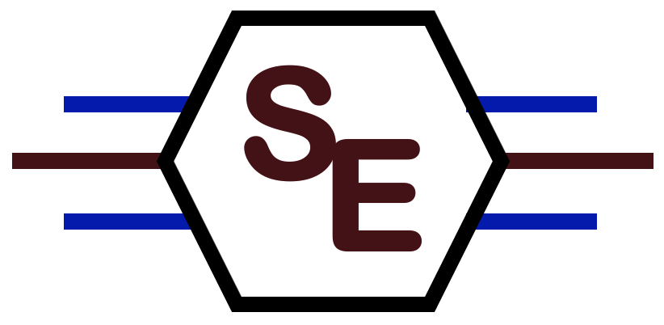
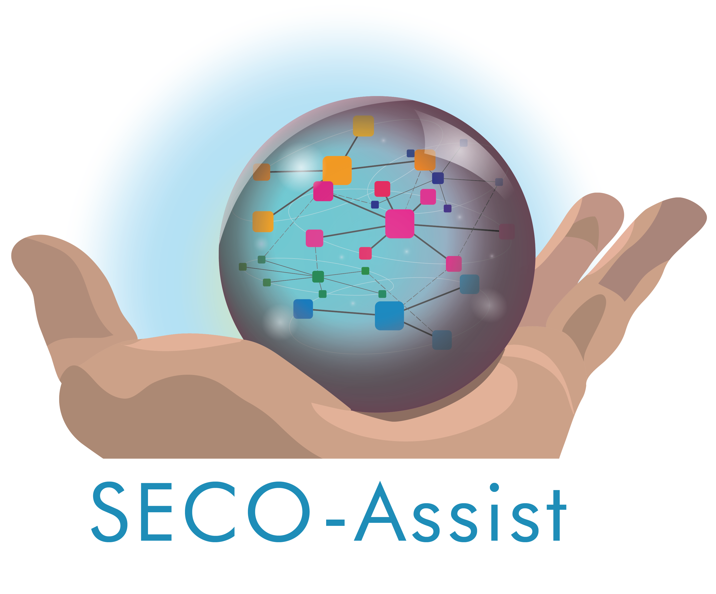

Patched Clones and Missed Patches among Variants of a Software Family
John Businge
Assistant Professor – UNLV
Never Work in Theory (NWiT) – Spring 2023
Notes:
Hello, My name is John Businge, I am an assistant professor at UNLV
It’s an delighted to present my work in event of the“Never work in Theory” - Spring 2023
I would le to thank Britteny and Greg for the invitation. I would like to thank Mike for the comments on the presentation.
I will be presenting to you my work on Patches and Missed patches among variants in a software family.
This is work has been presented at FSE-2022
I would like to thank the sponsors of this project – Seco-Assist

Slide 2



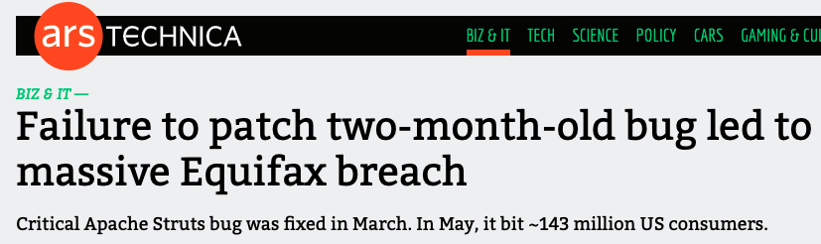
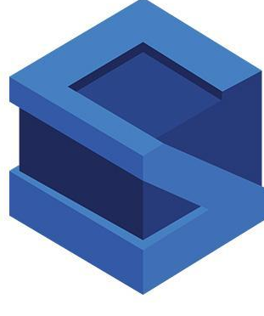
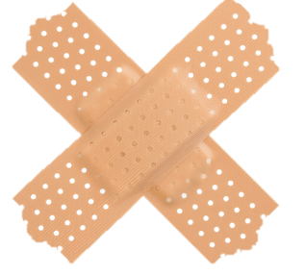


Context
The Equifax data breach occurred between May and July 2017 at the American credit bureau Equifax. Private records of 147.9 million Americans along with 15.2 million British citizens and about 19,000 Canadian citizens were compromised in the breach, making it one of the largest cybercrimes related to identity theft.
Wired Magazine, “Equifax has no excuse”, September 2017
$425M
Recommender system
March 2017
CVE-2017- 5638
DATA BREACH
May 2017
https://www.istockphoto.com/
Notes:
Some of you might be knowing the Equifax software - which is a credit score software.
Equifax was identified with cybercrime in 2017. About 150M people affected losing over $400M.
How did this happen?
Equifax depended on opensource Apache Struts.
Apache Struts identified a vulnerability in March 2017 which was fixed almost immediately. Equifax did not have this fix immediately.
Two months later, Equifax got a data breach because they did not update the dependency.
The problem could have been avoided if they had a recommender tool.
If they had a recommender tool then the patch could have been recommended to Equifax.

Slide 3

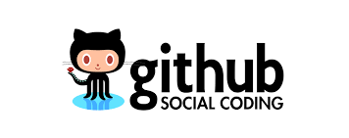
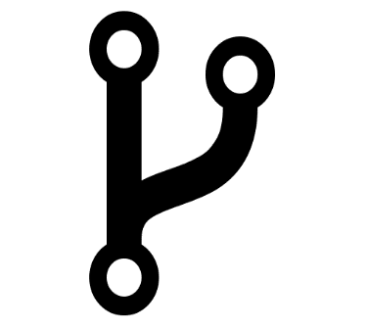
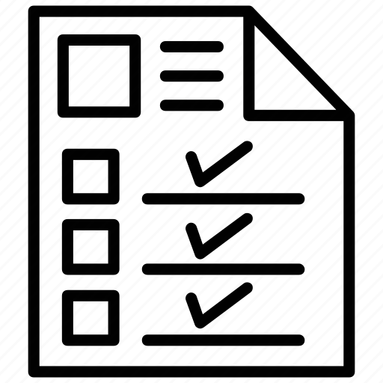
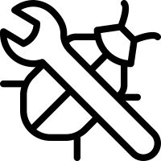
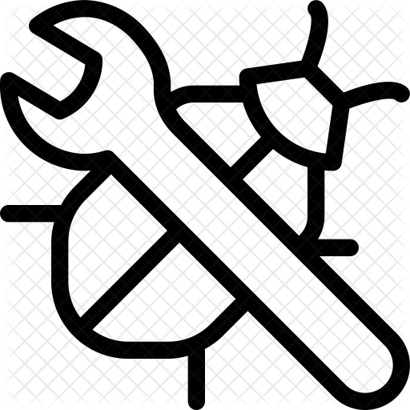
Patched Clones and Missed Patches among Variants of a Software Family
Upstream
Fork
Software family – >= 2 variants
Social Fork
2. Variant Forks
Social Fork
1. Social Forks
Original project
Original project
Variant 1
Optionally
Variant 2
Social Fork
Social Fork
Focus
Notes:
Now lets get to the actual study
What do we mean with the phrases Variants and Sofware Families?
In this slide and the next slide I will explain what the two phrases mean.
On any social coding platform, it is common for developers to fork the main repository when they want to contribute.
There are two types of forks:
Social forks: Are created for the sole reason of introducing new artifacts (bugfixes, refactorings, new features, ...). When the artifact is fully developed, it is integrated back into the main branch through a PR. That marks the end of the fork
Variant forks: Are created by splitting off a new development branch to steer development in a new direction while leveraging the code of the mainline project. They can contribute back code artifacts but they are not obliged.
They may also have their own communities that contribute back.
Our focus is on variant forks.
The reason is a lot of studies have been carried out on social forks but limited studies on variant forks

Slide 4
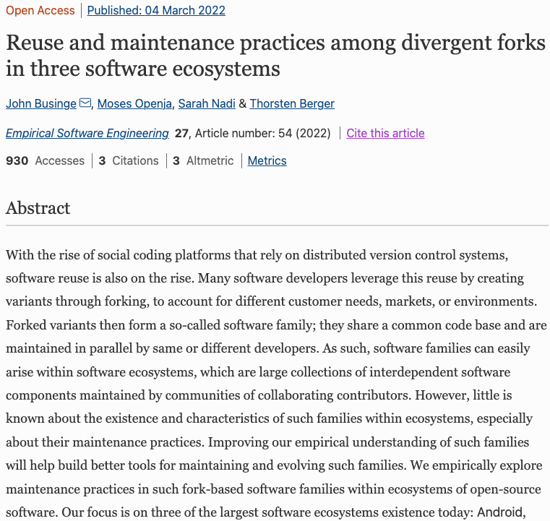
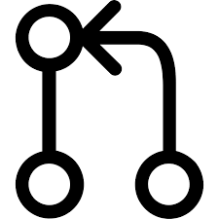




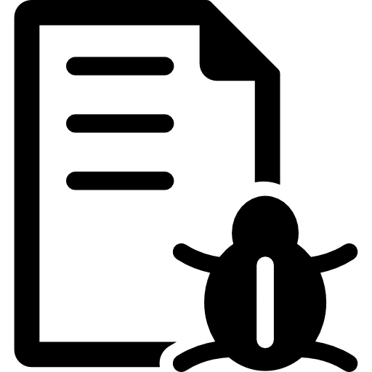
>10K variants from three ecosystems on Github
Rarely share updates
Social Fork
Original project
Variant 1
Optionally
Variant 2
Social Fork
Notes:
Why are we interested in variant forks?

Slide 5
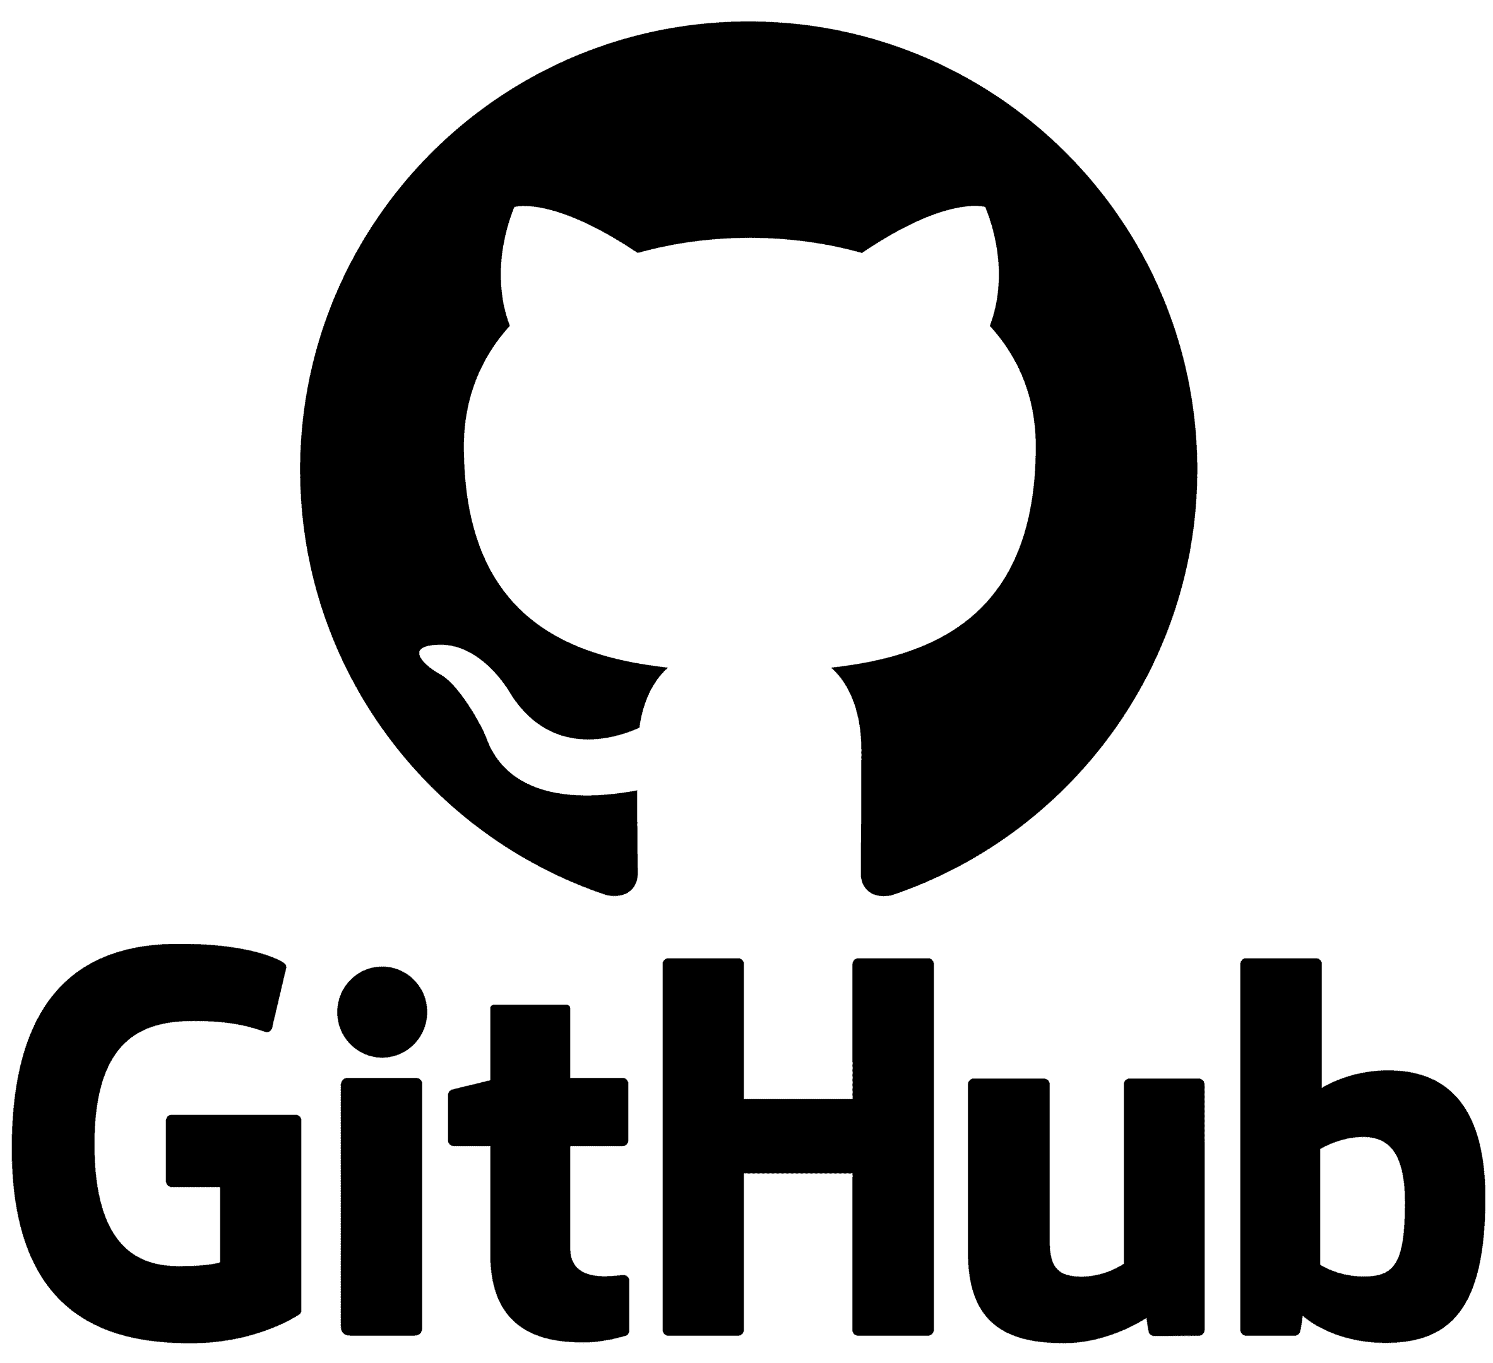



Problem
foo
foo
social fork
current_date
fork_date
divergence_date
Pull request
variant1
(source)
Inherited commits
PR merge_commit
Synchronized commits
Unique commits
target git_head
variant2
(target)
foo
foo
foo
foo
Split
case
Missed
opportunity
Effort duplication
Uninteresting
Notes:
Using an illustration, let me explain the context of our problem. (the numbers represent the clicks you will be making)
Let’s say we have variant1 on Github with three revisions.
A different developer sees variant1, and they want to use it as a starting point to build variant2. They fork, and therefore they would inherit all the revisions of variant1.
Between the fork_date and the divergence date, the two variants pull from each other updates and synchronize commits. At this point, the two variants are even.
Between the divergence_date and the current_date, for some reason, the two variants stop synchronizing commits. Each variant has got commits not present in the other (unique commits)
Let us assume that a bug was found at this commit. The developer created a social fork or a bug-fixing-branch, patched the bug, and then integrated the patch back into variant1.
At the git_head of the target variant, four scenarios are possible:
Foo has been patched by the developer in variant2 – effort duplication
Foo is still buggy - missed opportunity
Foo has both buggy and patched lines – split case
Foo is changed beyond comparison of V1.foo and V2.foo – uninteresting.

Slide 6
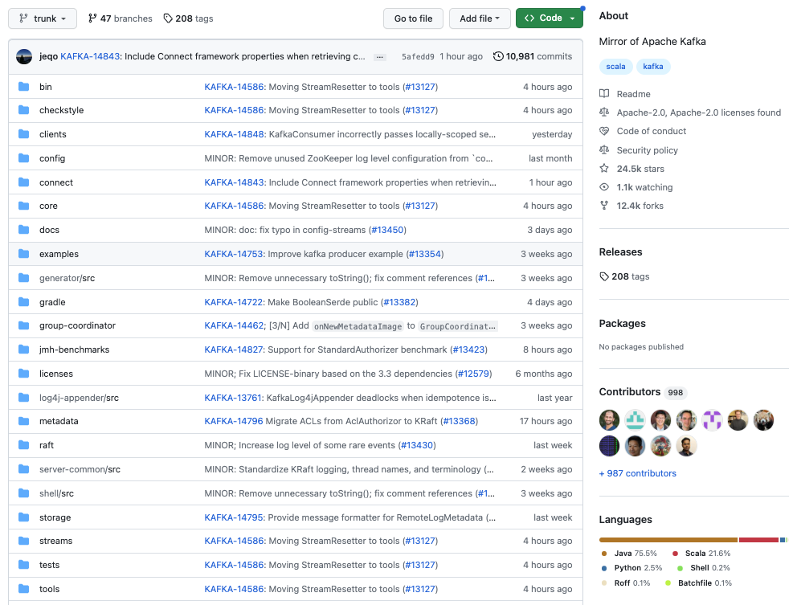
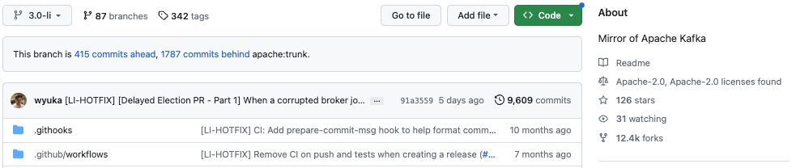
Concrete Example
extraction_date 2023-03-27
415
linkedin
unique commits
1,787
apache
unique commits
This is the version of Kafka running at LinkedIn.

Slide 7
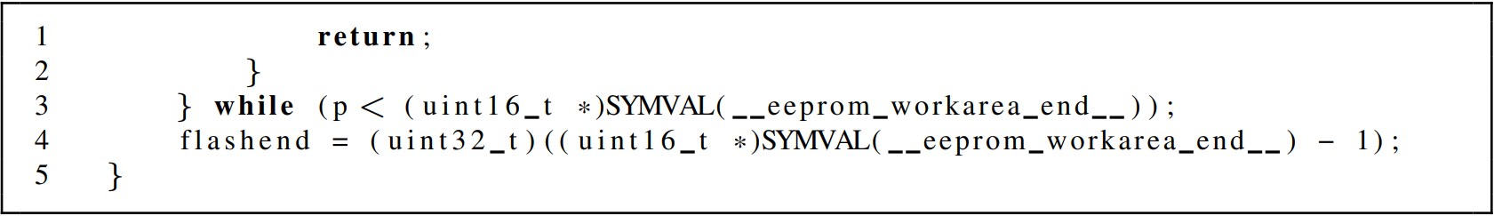
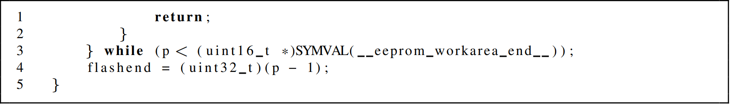
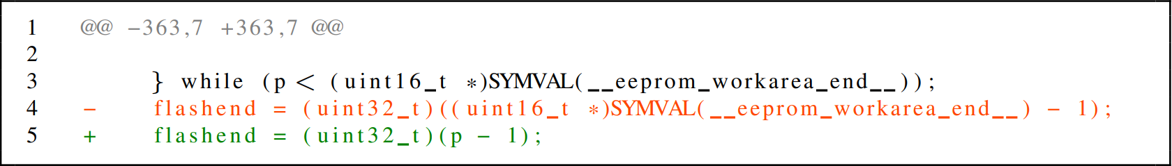

Concrete Example: Missed Opportunity
Buggy code from upstream
qmk/qmk_firmware
1 file - Pull request
Buggy line
extraction_date 2021-07-20
gcc10 [...] build warning #12587
Patched code from upstream (Pull request)
Patched line
Diff for patch in upstream
Hunk
File from divergent fork at git_head
sekigon-gonnoc/qmk_firmware
Buggy line
Notes:
Now, using a concrete example from our dataset, let me demostrate the case of missed opportunity

Slide 8
Research Questions
RQ1: How many cases of effort duplication and missed opportunities exist between divergent variants?
RQ2: How much patch technical lag exists between the source and target variants in divergent variants?

Slide 9
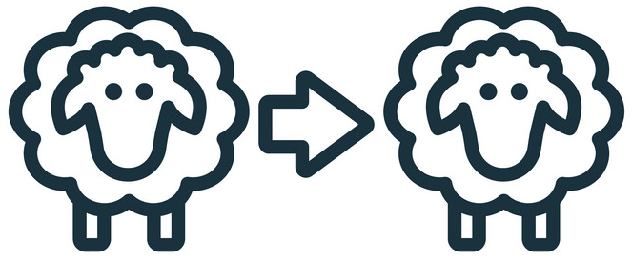
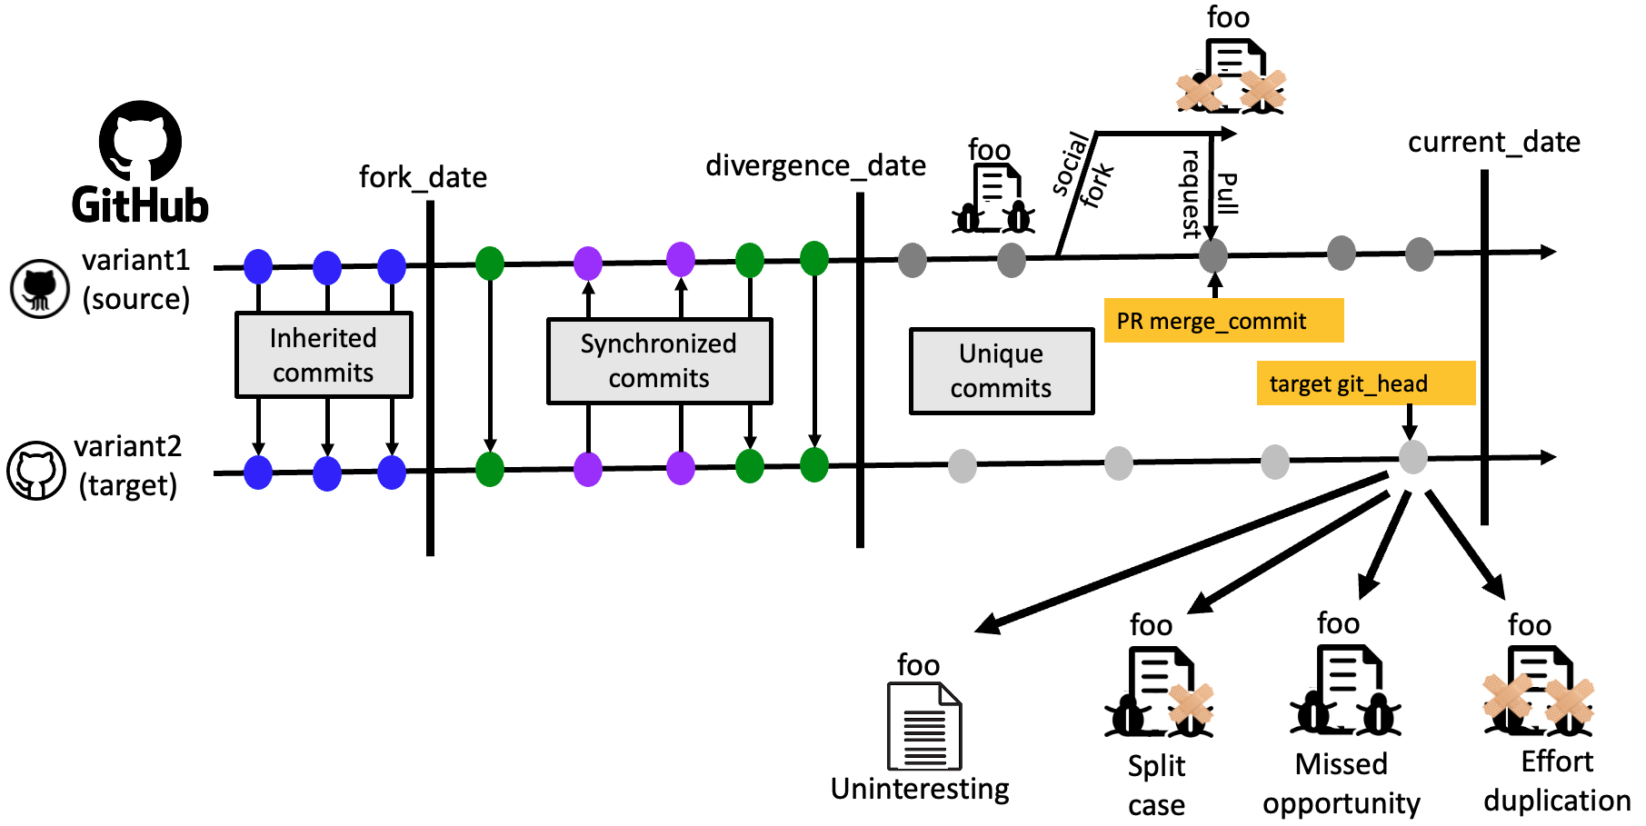

Method
keywords {fix, fixes, resolves, …}
clone detection tool (PaReco)
Search
PR Title
foo
foo
Patched lines
ED
Pull request
Git head
Source
variant
Target
variant
foo
foo
Extract files
Buggy lines
MO
Notes:
We search for certain keywords of a merged PR
We then extract files from the PR in the source variant and look up the same files in the git_head.
Using our developed clone detection tool (called PaReco), we compare the files and identify if the file in the target has patched lines or buggy lines

Slide 10
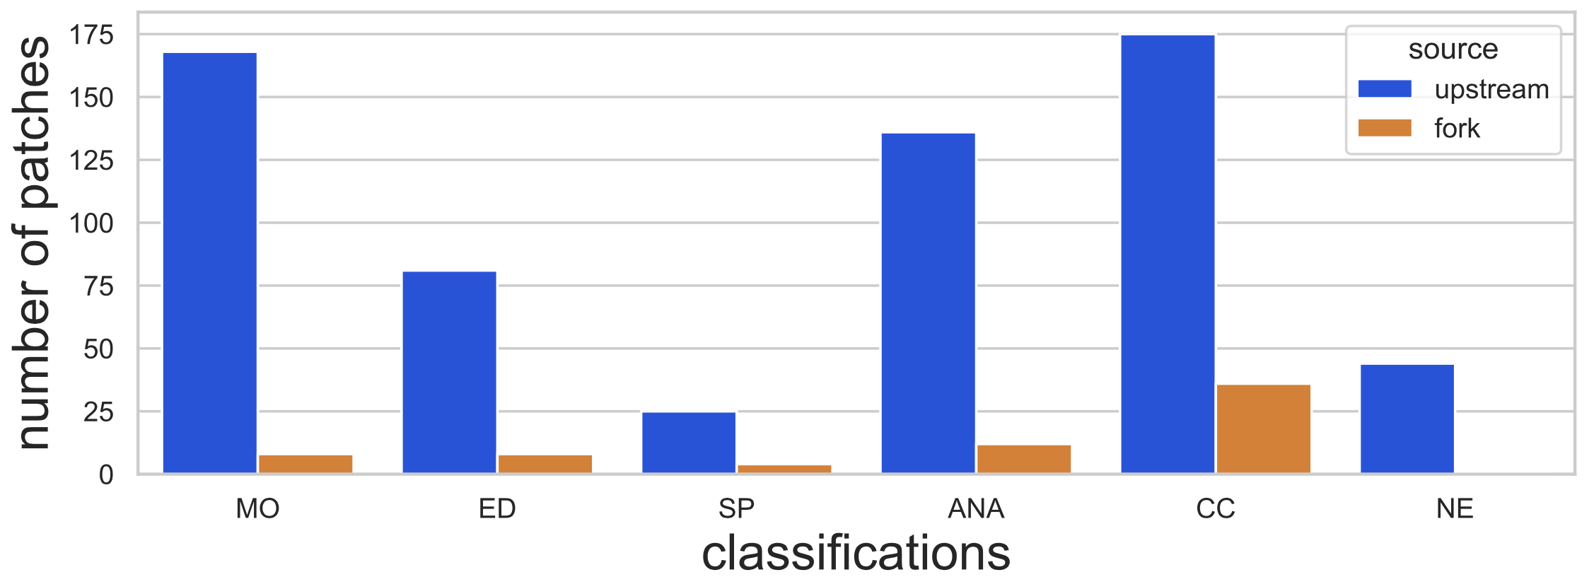
Results
RQ1: How many cases of effort duplication and missed opportunities exist between divergent variants?
apache/kafka (upstream) - linkedin/kafka (fork)
MO – Missed opportunity
ED – Effort duplication
SP – Both buggy and patched lines
NI – Uninteresting
CC – Unhandled programming language
NE – Missing file in target
EE – Error

Slide 11
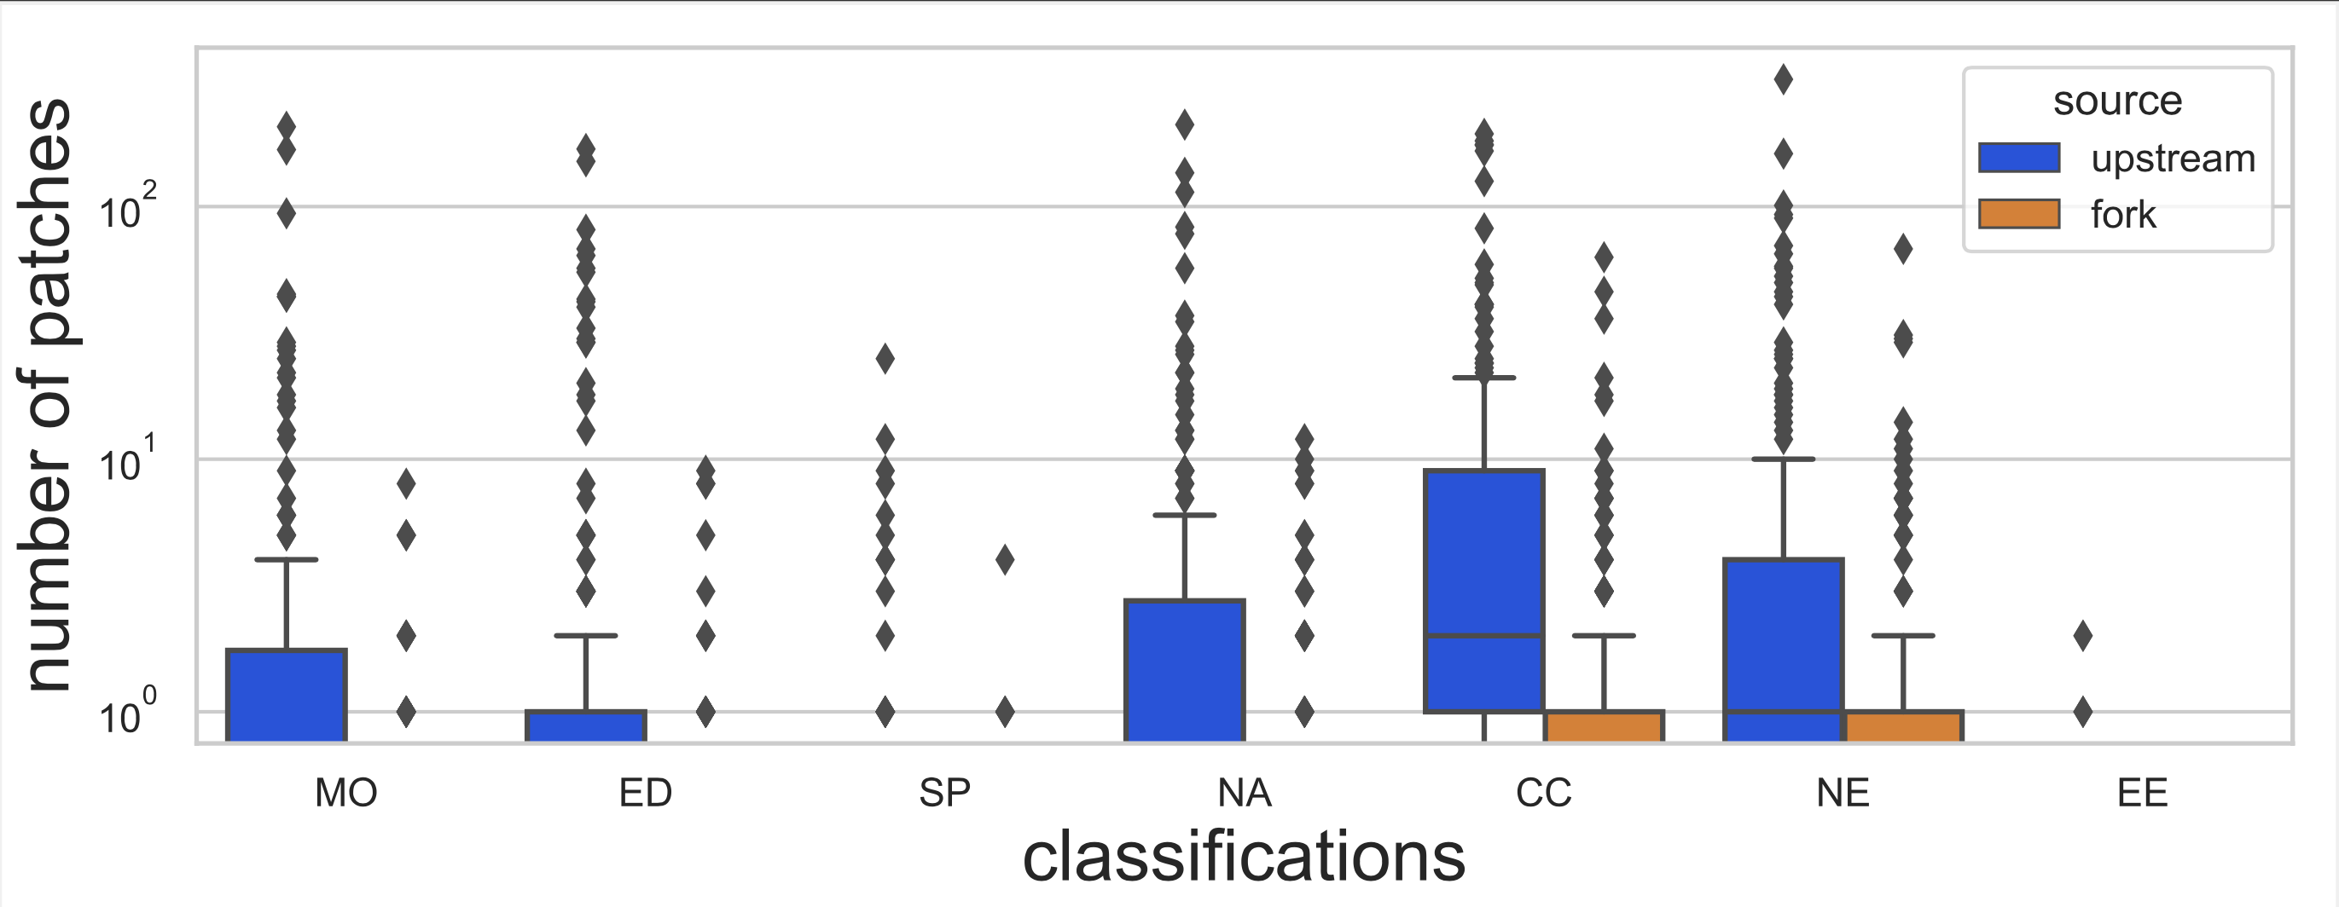
Results
RQ1: How many cases of effort duplication and missed opportunities exist between divergent variants?
Precision | Recall | Accuracy | F1-Score
91.0% | 80.2% | 88.0% | 85.3%
8,323 patches from 364 source variants
1,008
1,116
101
2,225 interesting patches
NI

Slide 12
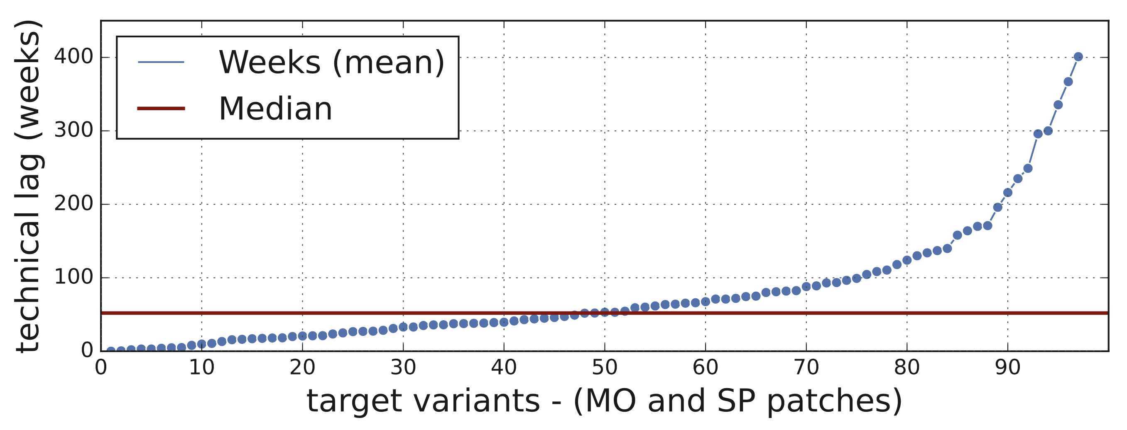
Results
RQ2: How much patch technical lag exists between the source and target variants in divergent variants?
52 weeks late
Notes:
1109 MO and SP cases. Average 27 weeks.
Each point on the graph represents a target variant (x-axis) and the number of weeks (y-axis) it has missed a patch introduced in the source variant
This means that on average the patches that are missed in the target variant have been introduced in source variants 52 weeks earlier.
If you are a developer, you would not want to be in this side of the graph.

Slide 13
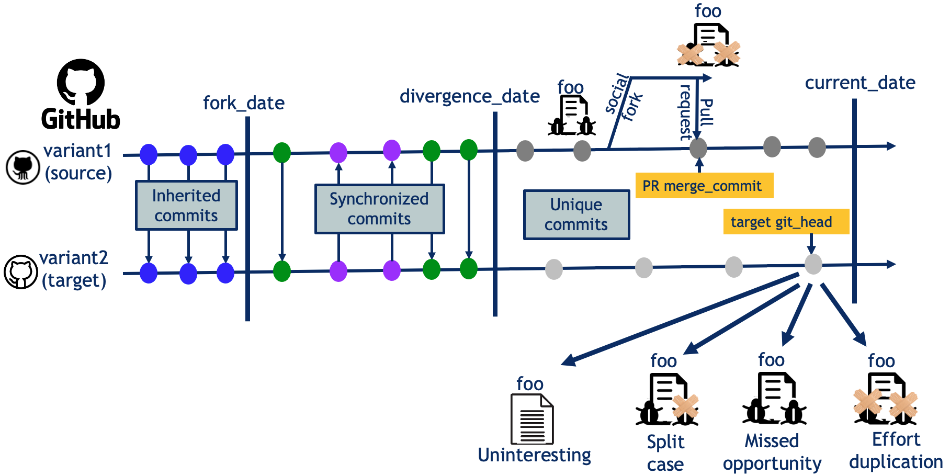
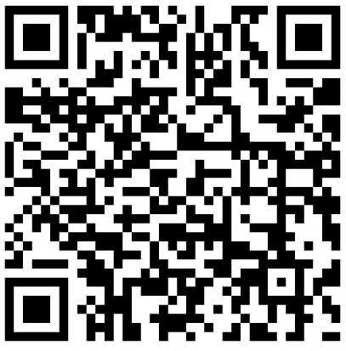
What do we learn from the results?
Variants on social coding platforms exhibit suboptimal maintenance
PaReco: Proof-of-Concept patch recommender tool
Notes:
What do we learn from the results?
We learn that the variants on social coding platforms exhibit suboptimal maintenance.
Researchers and practitioners need to come together to address this challenge.
We have developed a proof-of-concept patch recommender tool named PaReco. We are still working to extend PaReco into a patch recommender tool.

Slide 14
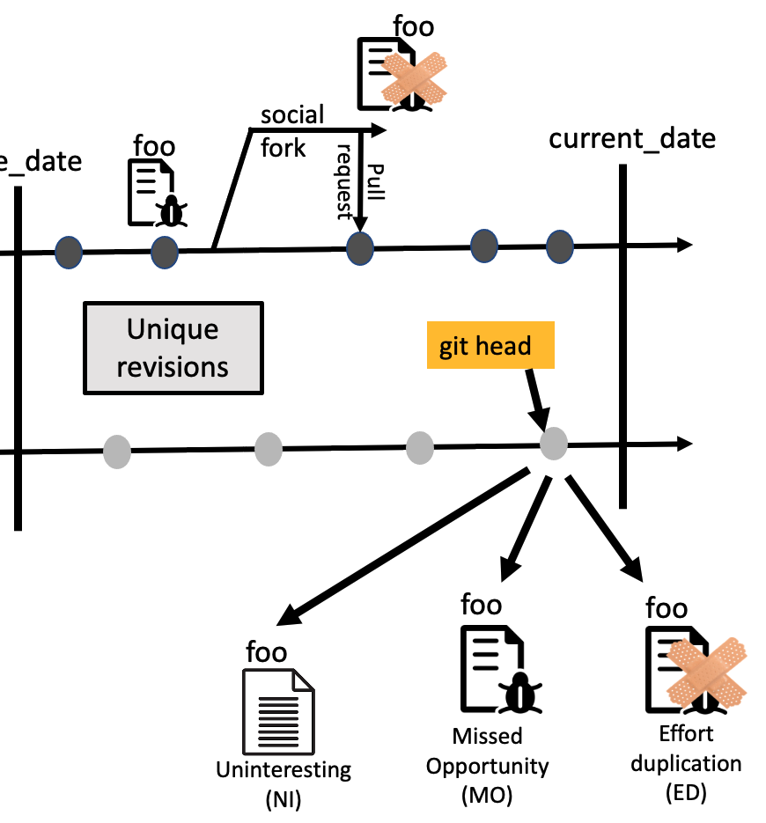
Current Work on PaReco
Genetic Improvement
foo
foo
Patch
Transplantation tool (aTrans)
Pull request
foo
PaReco: Proof-of-Concept patch recommender tool
Notes:
We are working with my students to see how far we can extend this tool

