Slide 1



It Will Never Work in Theory – Lightning Talks 2023 Understanding and Predicting Delays in Large-Scale Software Development Lightning Talk
Elvan Kula, Ph.D. Candidate @ TU Delft & ING
25 April 2023

Slide 2

The Case for Software Effort Estimation
Late delivery and cost overruns have been common problems in the software industry for decades (average overrun of 30%).
With software projects being complex socio-technical systems, a large pool of interrelated factors can affect the development effort.
Rule of thumb and general models do not work!

Slide 3



A Series of Case Studies at ING
Mixed-methods approach
Extract influential factors from > 600 teams:
Survey data from 631 participants
An analysis of years of backlog data
An analysis of years of code quality and deployment data
RQ1: What factors affect on-time delivery?
RQ2: How are these factors related to each other?

Slide 4
Factors and Factor Relationships

Slide 5

Organizational Factors
Factor Top 2 Rank
Organizational alignment 90% #3
Organizational politics 86% #4
Geographic distribution 83% #5
Executive support 77% #14
Organizational stability 66% #20

Slide 6
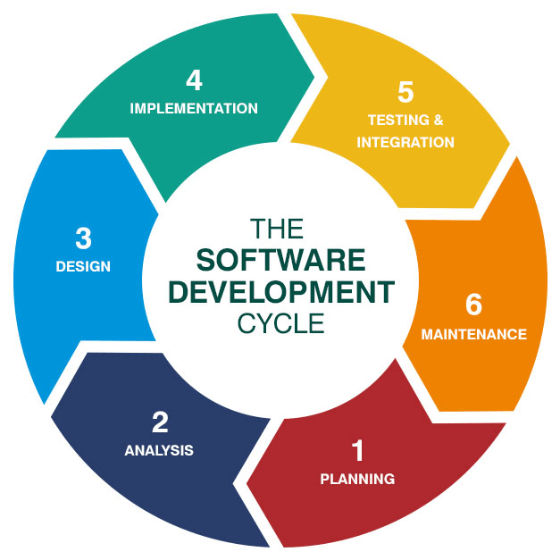
Process Factors
Factor Top 2 Rank
Requirements refinement 91% #1
Agile maturity 84% #7
Regularity in delivery 87% #8
Work in progress 75% #16
User involvement 71% #19

Slide 7

Project Factors
Factor Top 2 Rank
Task dependencies 92% #2
Project size 84% #11
Project newness 83% #13
Project security 65% #22

Slide 8

People Factors
Factor Top 2 Rank
Team stability 85% #9
Skills and knowledge 83% #10
Team familiarity 76% #15
Team commitment 69% #18
Communication 47% #25

Slide 9
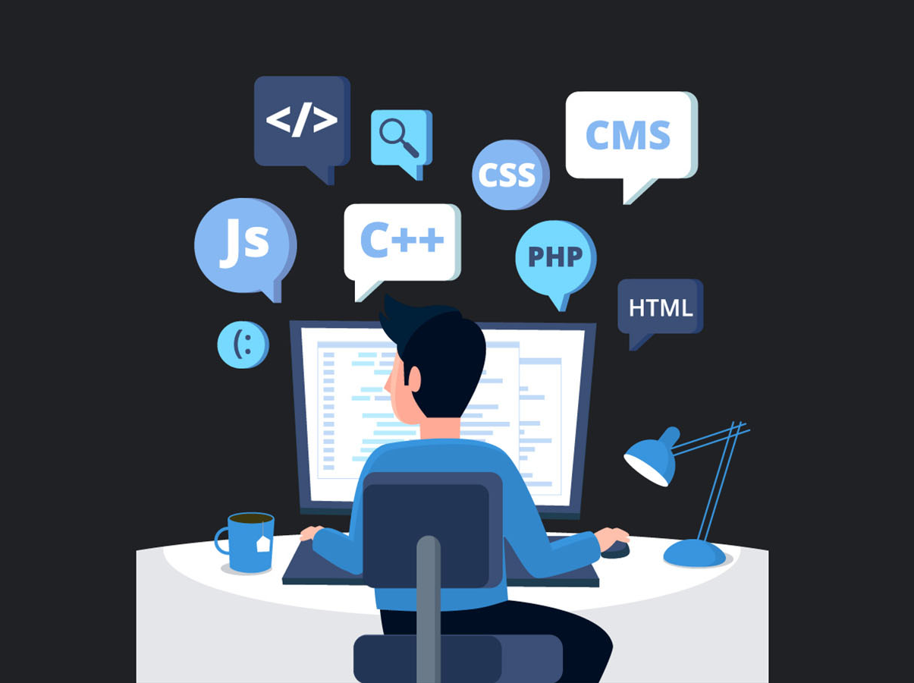
Technical Factors
Factor Top 2 Rank
Technical dependencies 89% #6
Poor code documentation 82% #12
Unreliable infrastructure 70% #17
Bugs or incidents 68% #21
Lack of code quality 65% #23
Insufficient testing 62% #24

Slide 10

Top Influential Factors
The top influential factors are not in software and they are controllable
Factor Top 2 Rank
Requirements refinement 91% #1
Task dependencies 92% #2
Organizational alignment 90% #3
Organizational politics 86% #4
Geographic distribution 83% #5

Slide 11
Factor Interactions
We focused on three types of relationships between factors:
Direct relationship (X → delay): X is an immediate reason for delay
Indirect relationship (X → Y → delay): X leads to events that, in turn, lead to delay
Contributory relationship (Y (+ X) → delay): X is a necessary condition for Y to lead to delay

Slide 12
Conceptual Framework

Slide 13
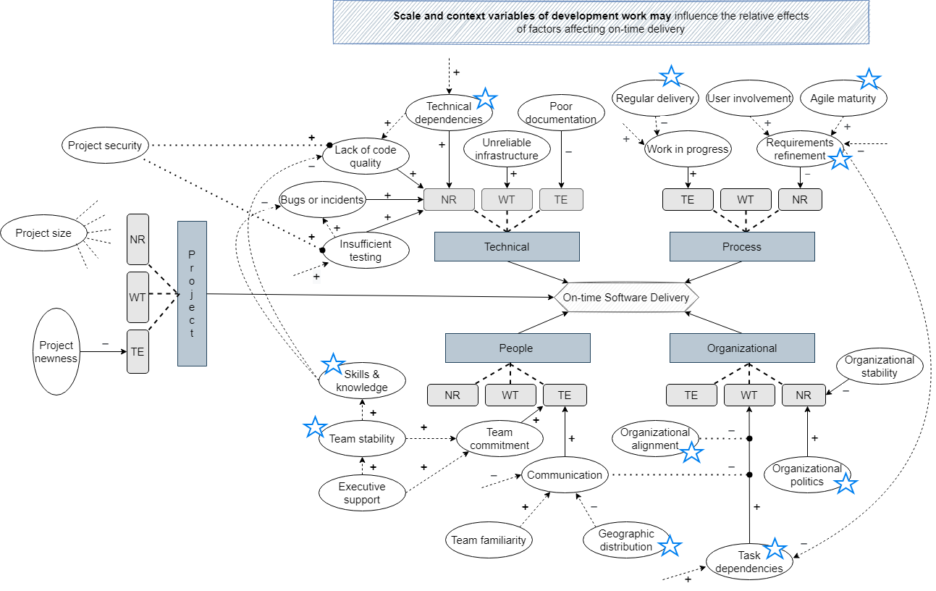
Conceptual Framework
Factors interact hierarchically;
organizational factors interact with people factors, which in turn impact technical factors.

Slide 14
Conceptual Framework
Factors interact hierarchically;
organizational factors interact with people factors, which in turn impact technical factors.

Slide 15

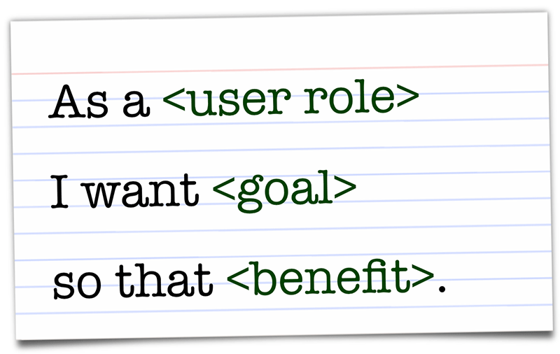
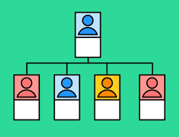
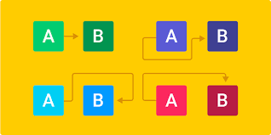
How to apply this in practice?
On-time software delivery requires a holistic approach
The top most influential factors are not in software!
Invest in your requirements refinement, organizational environment, dependency management

Slide 16





Elvan Kula e.kula@tudelft.nl @KulaElvan AI for Fintech Research
Interested? Contact me!

