Slide 1
DEVWAHRPHOBIA
Play Book and instruction manual

Slide 2
INTRODUCTION
Devwahrphobia is a game created on the RPG Maker MV engine and was developed as a project proposal and finals requirement for the developer’s college course.
Devwahrphobia is not a full release game, and this booklet is only for the demo and any specification attached to the game.
The information in this booklet will include, but not less than, general story of the game, controls, walkthrough, item information, area information, sprite images, and guiding the user in playing or using the game.
Devwahrphobia is a free game and is not for sale, any assets used is open source or created by the developers.

Slide 3
SYSTEM REQUIREMENTS
CPU: Dual Core running at 1.5Ghz
Ram: 1 GB
OS: Windows 7 or higher (32bit/64bit)
Graphics: Capable of running DirectX 9/OpenGL 4.1 or higher (Can run on Integrated graphics)
Disk Space: 200 MB

Slide 4
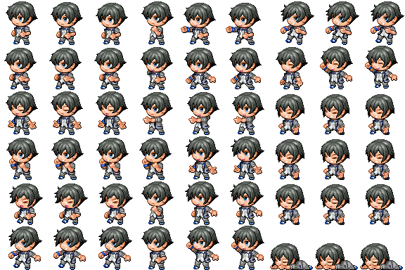

ABOUT THE GAME
Devwahrphobia is about a young guy who always avoid going to school. Despite being forced by his friends; he always slacks off somewhere or stays at home. One day he decided to go to school, along the way he suddenly fainted and woke up in a strange school building realizing that he and his friends were transported to this school. Roaming the corridors of this school are homework and textbooks given with life out to hunt these people. It is up to him to save his friends and escape the nightmare he is in.

Slide 5
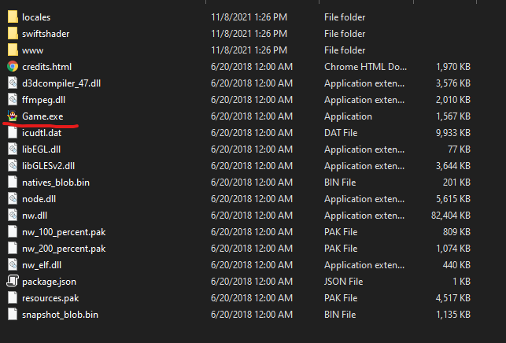
STARTING THE GAME
After downloading the game, it will be in a .zip file and needs to be extracted, this can be done by using WinRAR or 7Zip to name a few.
Once extracted there will be a folder containing the game and its files.
To start the game, run the “Game.exe” file seen inside the folder. See picture below:
WARNING: Please do not tamper with the files inside of this folder, this may alter the game and change the nature of the game and may render unplayable.

Slide 6
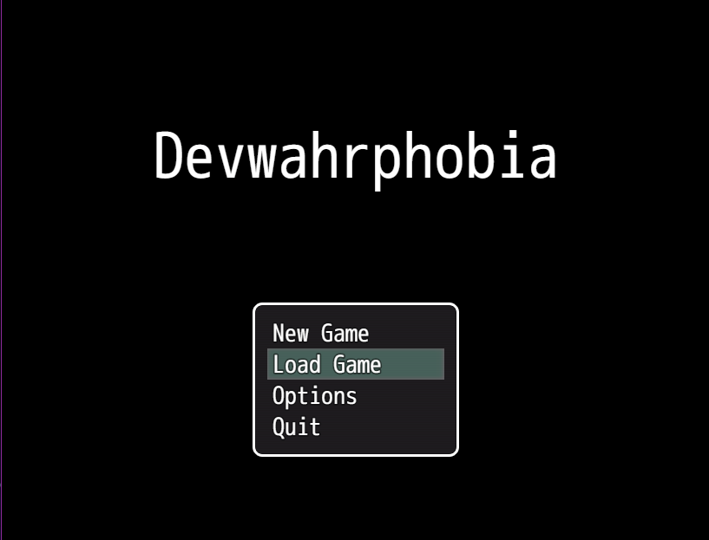
NAVIGATING THE MENU
The game starts with this menu, photo on the right.
Menu Controls:
Arrow Keys – Change selected Option
Space Bar or Z – Choose highlighted Option
Escape – Go back to previous screen
Menu Selection:
New Game – Starts a new game
Load Game – Continues a save game
Options – Opens the option screen
Quit – Closes the game and returns to desktop

Slide 7
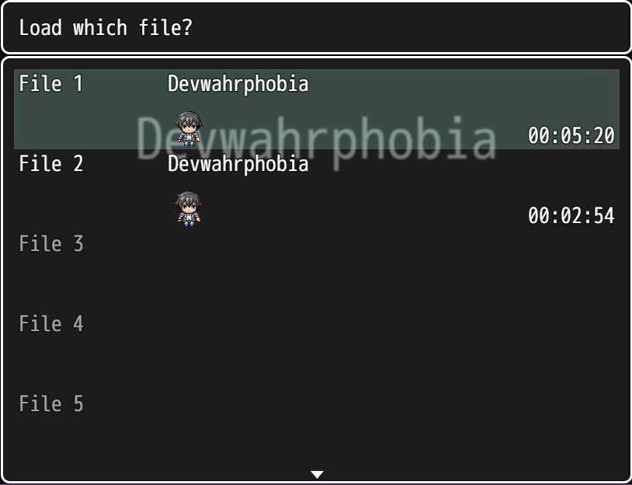
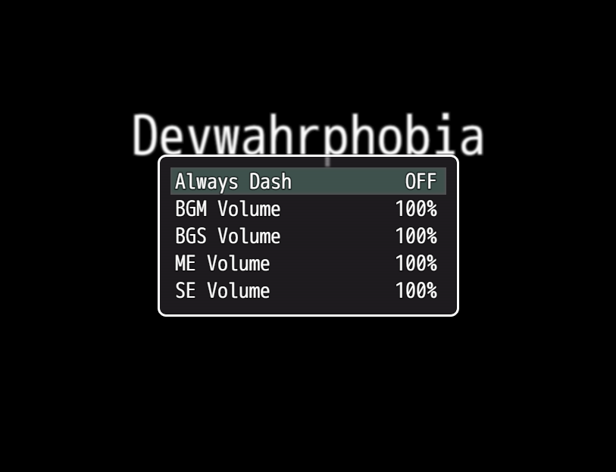
NAVIGATING THE MENU
Load Game Screen:
You can save up to 20 files and shows any important details such as the people in your team and the time stamp
You can navigate this using the menu controls
Options Screen:
Always Dash – Makes running permanent instead of holding a button
BGM Volume – Controls volume for background music
BGS Volume – Controls volume for background sounds
ME Volume – Controls volume for music effects
SE Volume – Controls volume for sound effects
When changing volume, you can decrease and increase it in increments of 20

Slide 8
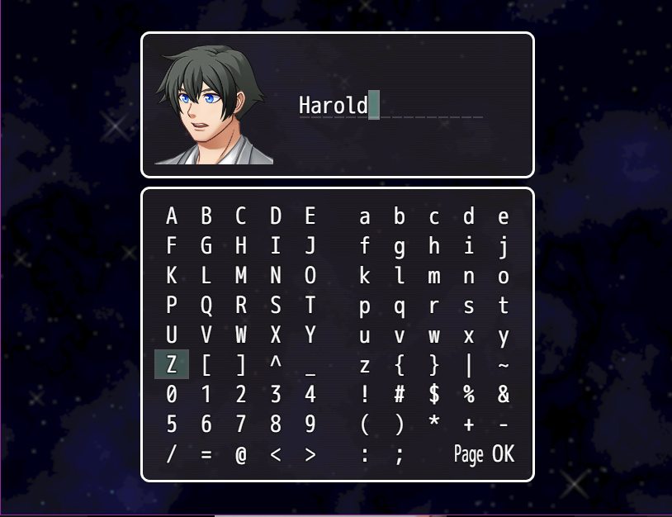
STARTING A NEW GAME
Once you start a game, the game will ask for your name: use the Arrow Keys to select the letters you want to enter, Escape if you want to delete, Spacebar or Z to select highlighted character and Left Shift to quickly highlight the finish button.
Note: if you can’t find the character or letter you desire, you may use Q or W to show more.
Once this is done the game will proceed normally.

Slide 9
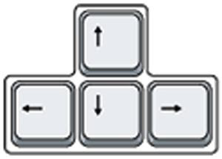
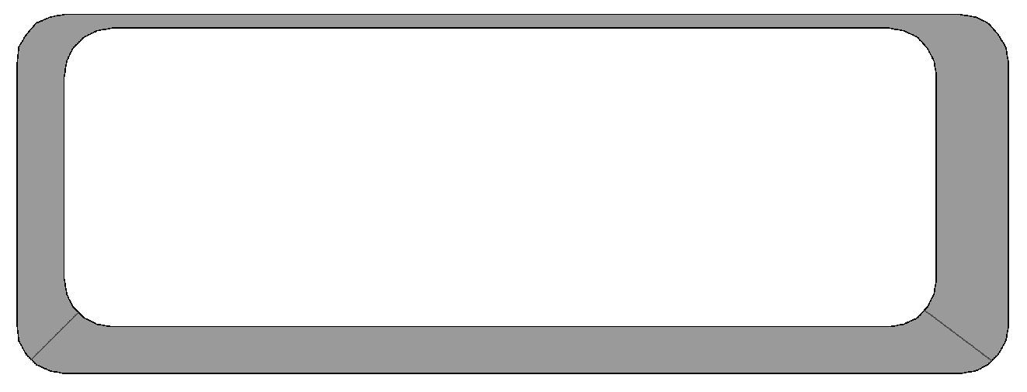

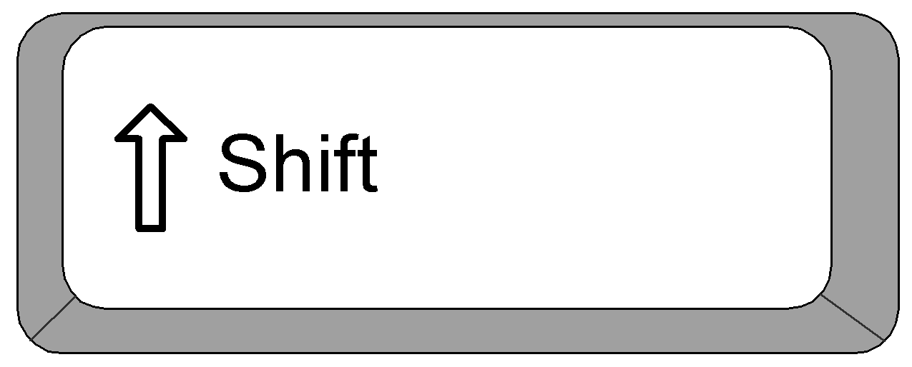

GAME CONTROLS
Basic controls is as follows:
Arrow Keys – Directional movement
Spacebar or Z key – Action button
Shift Key – Toggles sprint or walk
Esc Key – Toggles pause menu and resume

Slide 10
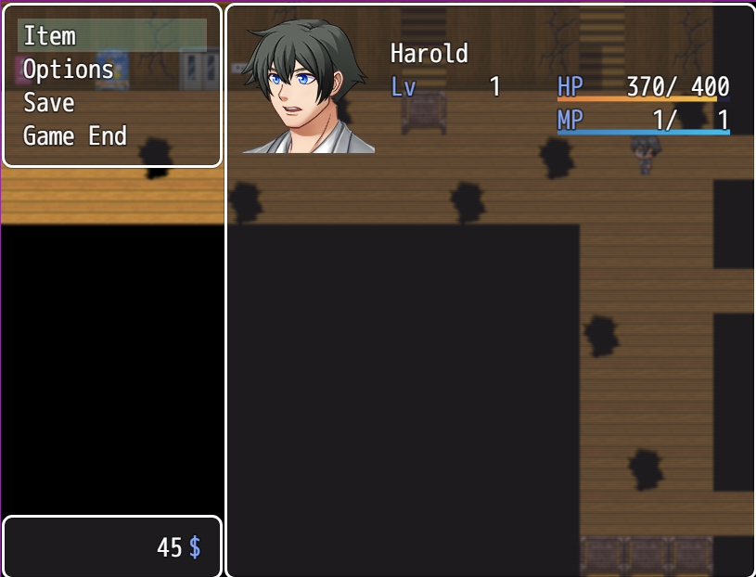
PAUSE MENU CONTROLS
Shows player name, stats (Hp, Lvl and Energy) and how much game currency the player has.
Item – Shows all the items the player currently have
Options – Opens the option menu, see page 7 for more details.
Save – Saves the game into a save slot
Game End – Returns the game back to the main menu.
The game is paused while in this state.

Slide 11
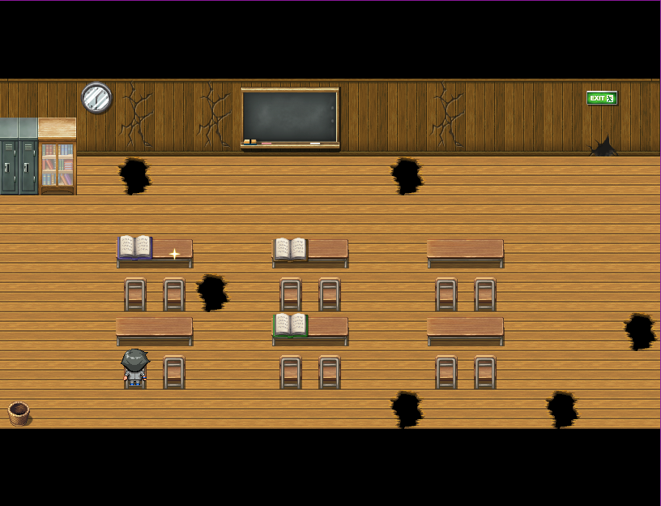
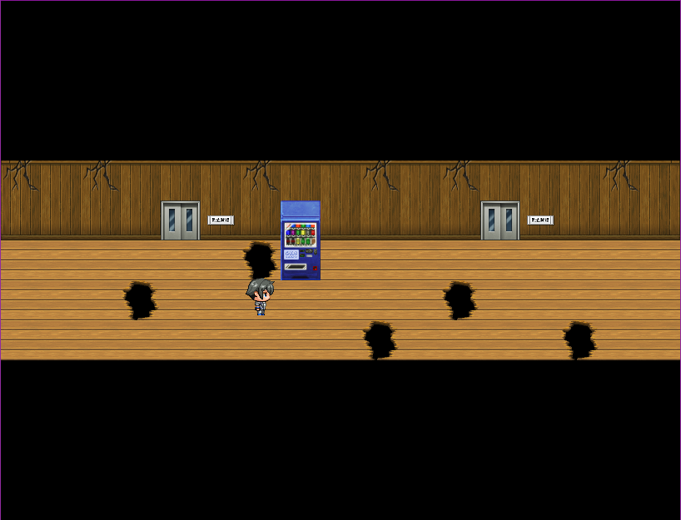
WALKTHROUGH
You will start trapped in a room, you must find a way to get out and progress. There is a hole on the wall that the player can not fit in, marked by the exit sign. The player can find a baseball bat in the room that they can use to widen the hole. This will progress you to the North West Hallway.
Nothing of big importance is here in this hallway so you may now proceed further into the hallway to the North Hallway.
Here you will see the Infirmary and the Art Room, more details about these rooms will be added later for now you may proceed further into the Hallway.

Slide 12
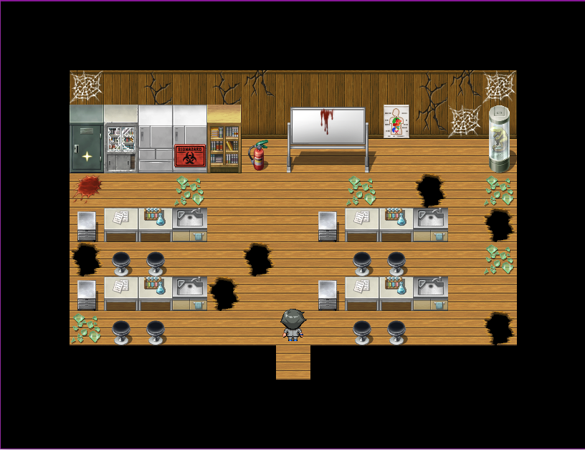
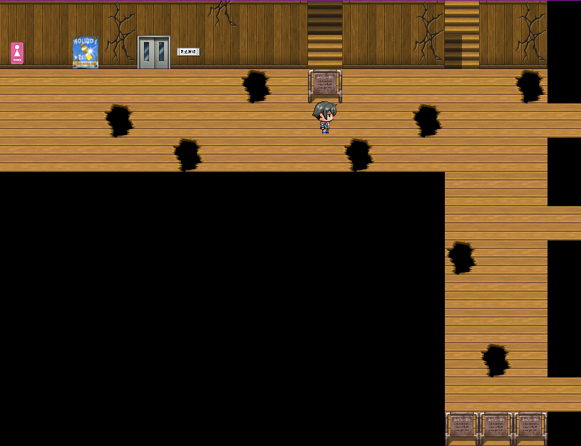
WALKTHROUGH
When you reach the North East Hallway, you can see the bathrooms, Science Lab, Principal’s Office and the Teachers Lounge, you should progress to the Science Lab first.
In here, you can see a shiny object on the top left area of the Science Lab, when they interact with it, they will receive the Storage Key. Be careful! There are broken glass in this room that will damage to the player!
Once you have the key, go out and proceed along the hallway, you will see a set of stairs leading up, this will lead to the rooftop.

Slide 13
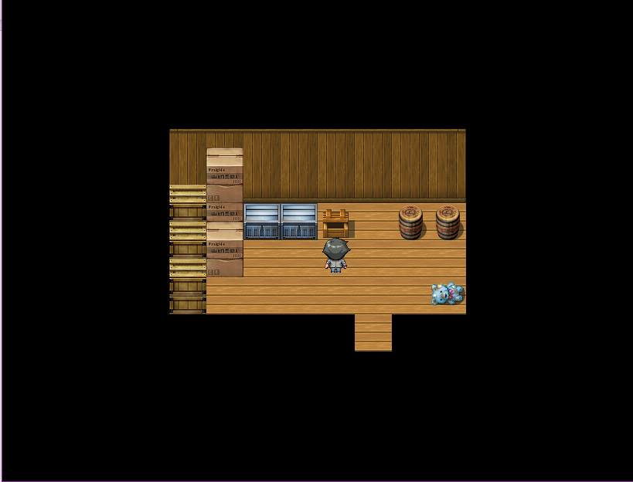
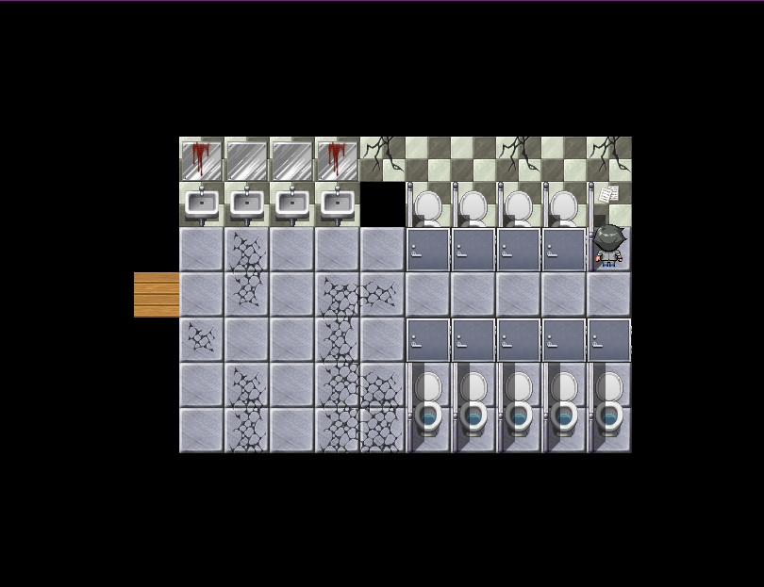
WALKTHROUGH
On the roof, there is a small shack, this is the Storage room, use the key to unlock it. Inside there is a chest containing Pliers and a Broken Stuffed toy, later the toy will serve its purpose.
Go back down, and go to the Male Comfort Room, there will be a vent where you can use the Pliers to cut it open and gain access to the Female Comfort Room.
In here, there is a note inside one of the stalls, you can read this and it will tell you about a painting. With this you can leave the room and backtrack towards the Art Room. Hint: You can unlock the door in the Female Comfort Room for easy access.

Slide 14
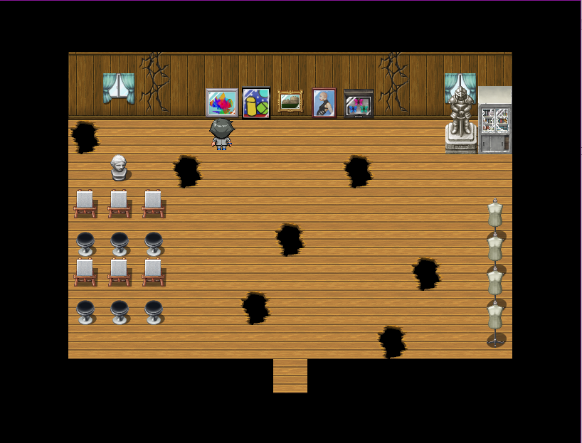
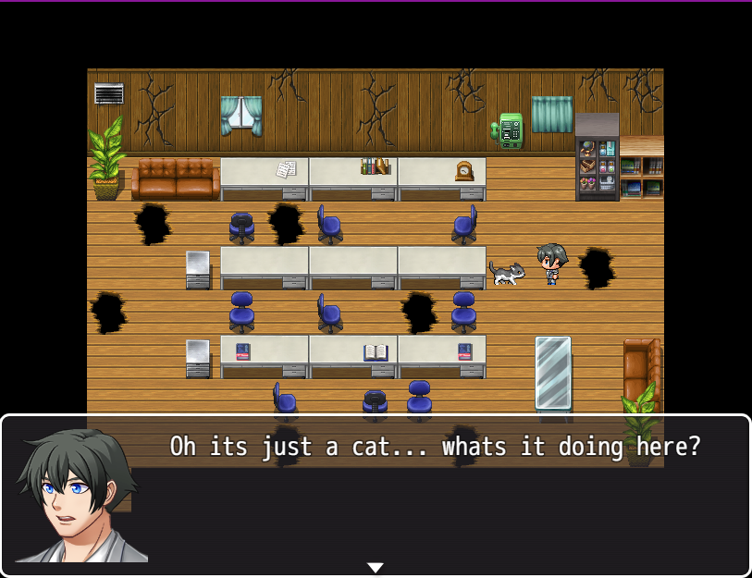
WALKTHROUGH
When the player reaches the Art Room, there will be 5 paintings hanging on the wall. The player must find the correct painting being described by the note found in the Female Comfort Room to receive a key.
If you got the key, go back to the North East Hallway and open the Teachers Lounge room. Hint: Choosing the incorrect painting will cause you to take damage
Once inside the Teachers Lounge, there is a cat with a key in its collar, when attempting to take it the cat will be agitated and you must find a way to calm it down.

Slide 15
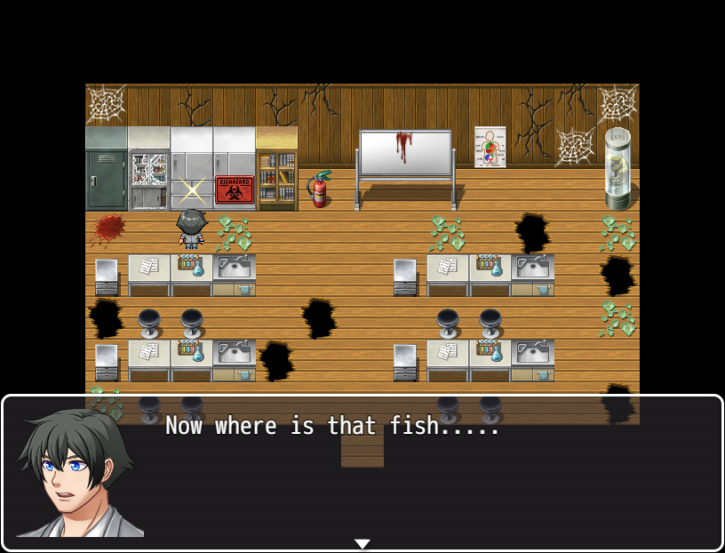
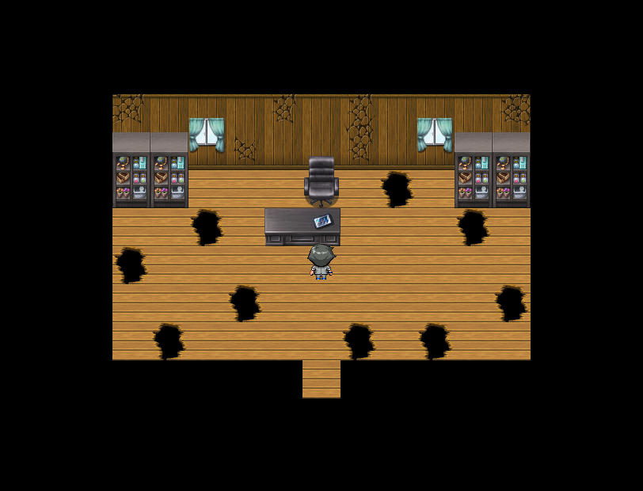
WALKTHROUGH
Go back to the storage room and get the stuffed toy, this will give you the Ball of Yarn. Give this to the cat to calm it down.
After giving the yarn to the cat, go to the Science Lab, you will see a highlighted item and you will receive a frozen fist. Give this to the cat which will make it stay put and be able to get the key. This key is for the Principal’s Office
Go to the Principal’s Office and here you will see a smartphone. By interacting with this the game will end.

Slide 16
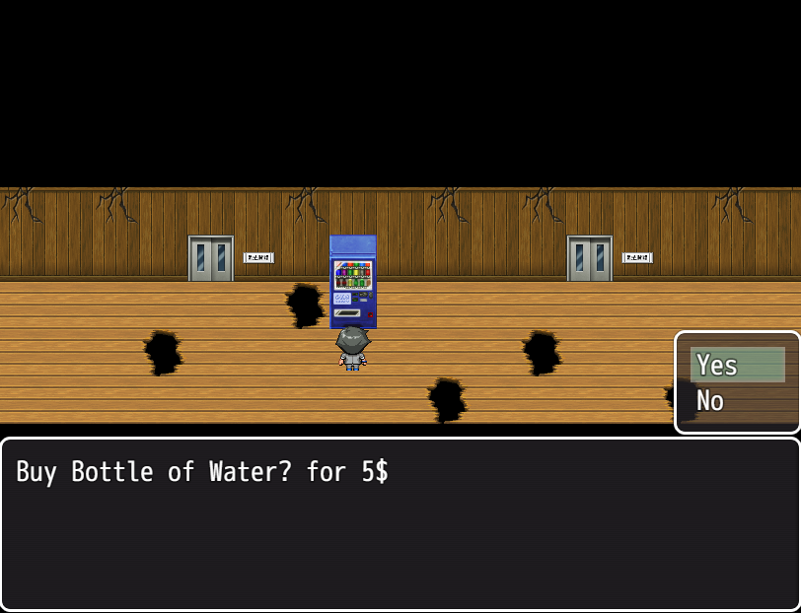
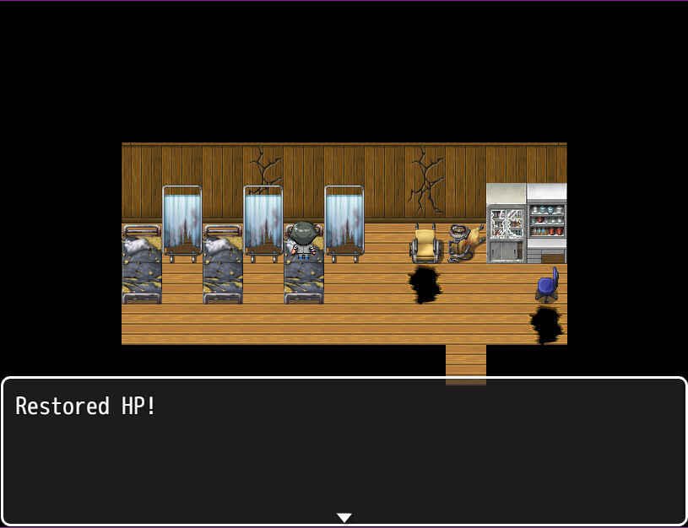
WALKTHROUGH - EXTRAS
Every object in the game has their own dialogue, it may be describing or joking about that object.
There is a vending machine in the North Hallway, when interacted it will give the option for the player to buy bottled water. Using this item will restore 10 hp to the player.
In the Infirmary, you can rest on the beds and it will restore the player’s hp back to full.

Slide 17
CREDITS
Devwahrphobia was created by:
Huet, Nicolas Eduardo
Hermoza, Harold Matthew
Celen, Aleck Miguel
Created on RPG Maker MV Ver. 1.6.1
Credits – See file on game data “credits.html”

