Slide 1
DEVWAHRPHOBIA
Play Book and instruction manual

Slide 2
INTRODUCTION
Devwahrphobia is a game created on the RPG Maker MV engine and was developed as a project proposal and finals requirement for the developer’s college course.
Devwahrphobia is not a full release game, and this booklet is only for the demo and any specification attached to the game.
The information in this booklet will include, but not less than, general story of the game, controls, walkthrough, item information, area information, sprite images, and guiding the user in playing or using the game.
Devwahrphobia is a free game and is not for sale, any assets used is open source or created by the developers.

Slide 3
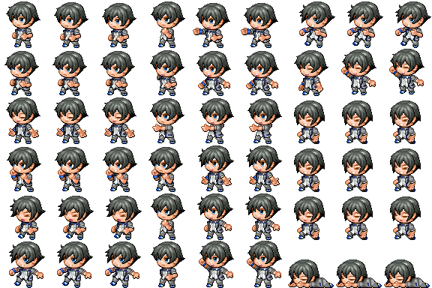

ABOUT THE GAME
Devwahrphobia is about a young guy who always avoid going to school. Despite being forced by his friends; he always slacks off somewhere or stays at home. One day he decided to go to school, along the way he suddenly fainted and woke up in a strange school building realizing that he and his friends were transported to this school. Roaming the corridors of this school are homework and textbooks given with life out to hunt these people. It is up to him to save his friends and escape the nightmare he is in.

Slide 4
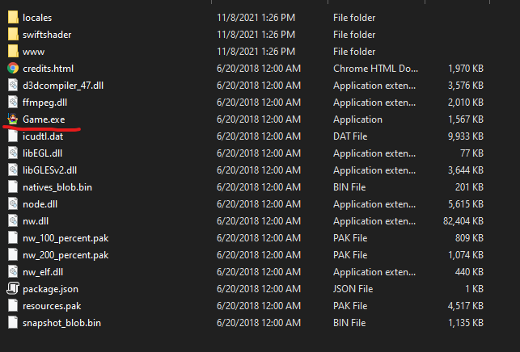
STARTING THE GAME
After downloading the game, it will be in a .zip file and needs to be extracted, this can be done by using WinRAR or 7Zip to name a few.
Once extracted there will be a folder containing the game and its files.
To start the game, run the “Game.exe” file seen inside the folder. See picture below:
WARNING: Please do not tamper with the files inside of this folder, this may alter the game and change the nature of the game and may render unplayable.

Slide 5
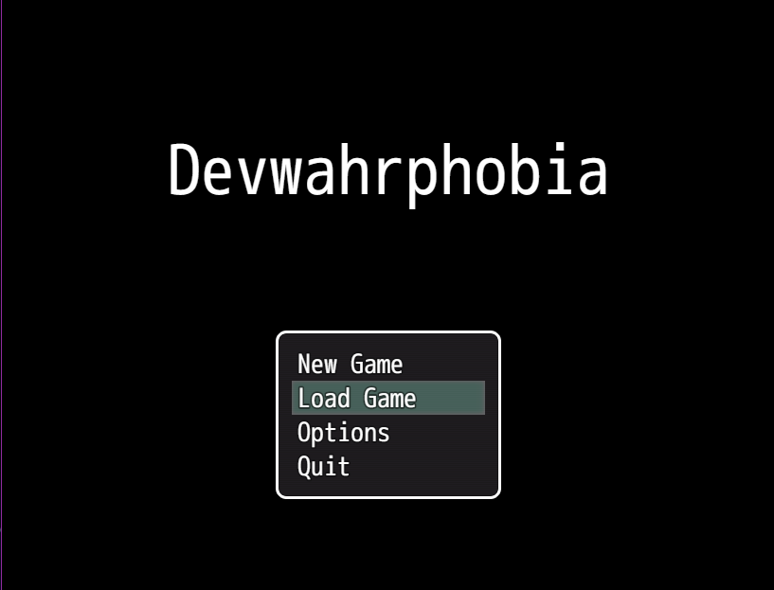
NAVIGATING THE MENU
The game starts with this menu, photo on the right.
Menu Controls:
Arrow Keys – Change selected Option
Space Bar or Z – Choose highlighted Option
Escape – Go back to previous screen
Menu Selection:
New Game – Starts a new game
Load Game – Continues a save game
Options – Opens the option screen
Quit – Closes the game and returns to desktop

Slide 6
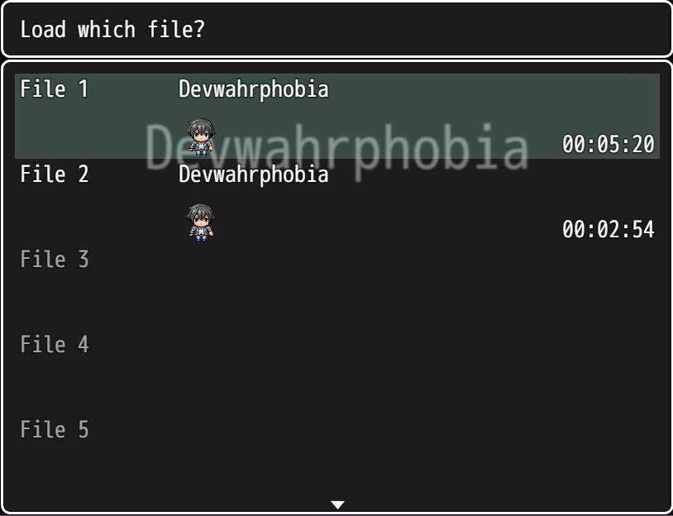
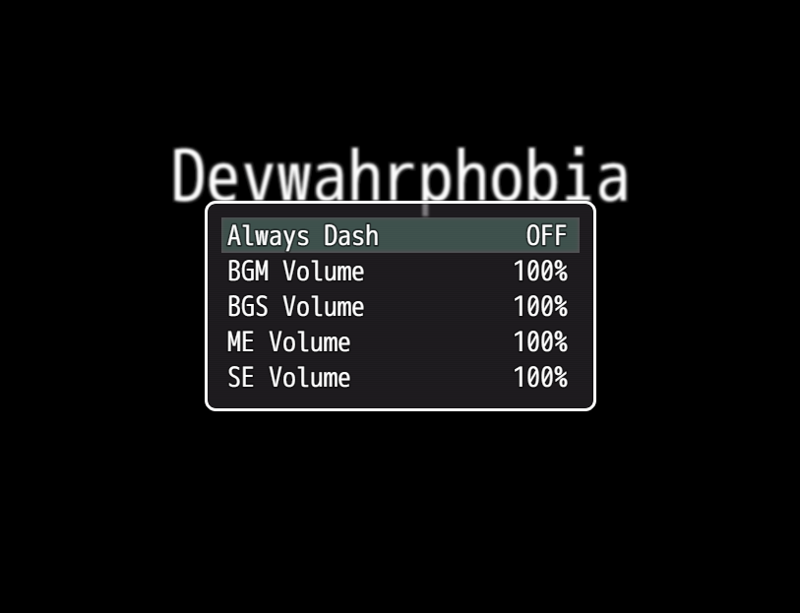
NAVIGATING THE MENU
Load Game Screen:
You can save up to 20 files and shows any important details such as the people in your team and the time stamp
You can navigate this using the menu controls
Options Screen:
Always Dash – Makes running permanent instead of holding a button
BGM Volume – Controls volume for background music
BGS Volume – Controls volume for background sounds
ME Volume – Controls volume for music effects
SE Volume – Controls volume for sound effects
When changing volume, you can decrease and increase it in increments of 20

Slide 7
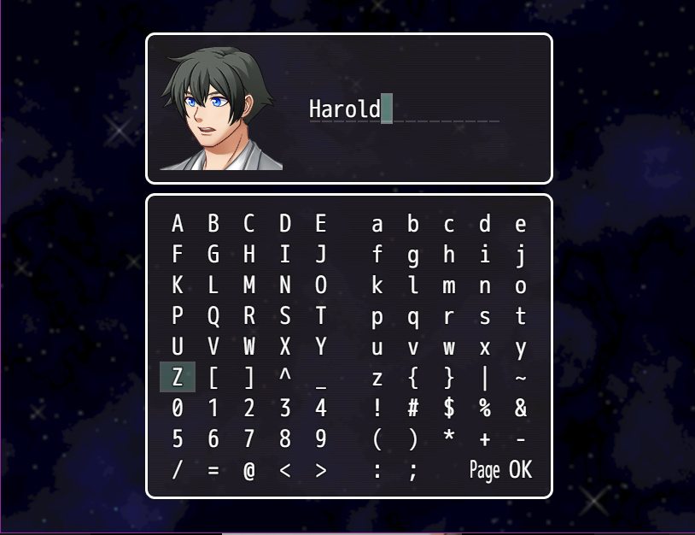
STARTING A NEW GAME
Once you start a game, the game will ask for your name: use the Arrow Keys to select the letters you want to enter, Escape if you want to delete, Spacebar or Z to select highlighted character and Left Shift to quickly highlight the finish button.
Note: if you can’t find the character or letter you desire, you may use Q or W to show more.
Once this is done the game will proceed normally.

Slide 8
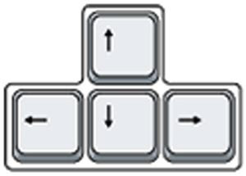
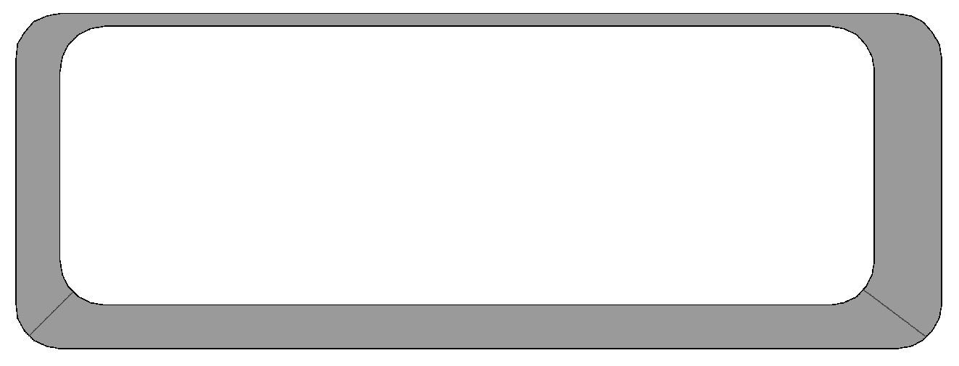
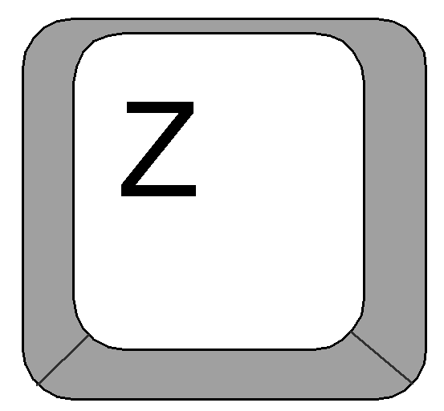
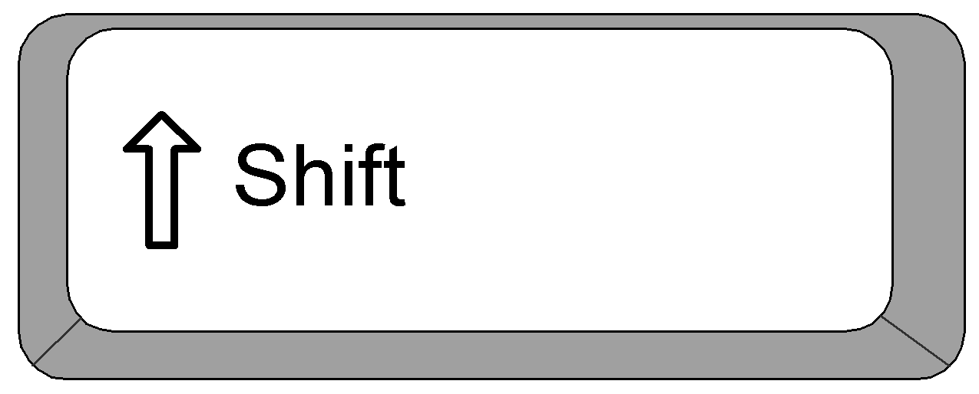
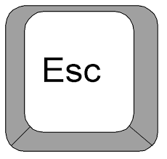
GAME CONTROLS
Basic controls is as follows:
Arrow Keys – Directional movement
Spacebar or Z key – Action button
Shift Key – Toggles sprint or walk
Esc Key – Toggles pause menu and resume

Slide 9
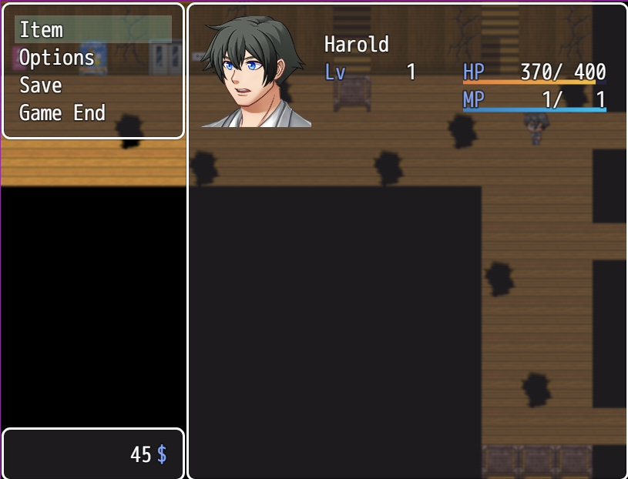
PAUSE MENU CONTROLS

