Slide 1

Text-to-SQL Conversion System
Natural Language Interface for SQL Query Generation
NEVIL ITALIYA

Slide 2
AGENDA
Overview
Dataset & Preprocessing
System Architecture
Agent Overview
Core Technologies
Live Demo / Workflow
Design Decisions
Challenges & Solutions
Future Work
Q&A

Slide 3
Overview
This project presents a Text-to-SQL Conversion System that transforms natural language queries into valid SQL statements using a fine-tuned LLM (GPT-3.5 Turbo).
Key Objectives:
- Enable non-technical users to query databases with natural language
- Ensure SQL is accurate, secure, and efficient
- Support evaluation and real-time interaction via CLI and Web UI

Slide 4
Dataset & Preprocessing
Dataset: Northwind (classic sales database)
Preprocessing Steps:
Loaded schema into SQLite format
SQLite is lightweight and easily embedded
Indexed key columns (CustomerID, CategoryID, etc.)
Limited to 5 key tables: Customers, Orders, OrderDetails, Products, Categories
Ensured data integrity and query performance

Slide 5
System Architecture
Modular Pipeline:
1. Natural language input from user
2. Prompt construction using schema-aware template
3. SQL generation via fine-tuned GPT-3.5 Turbo
4. SQL optimization (removes SELECT *, adds LIMIT)
5. Validation and safety checks
6. SQL execution on SQLite
7. Evaluation metrics (optional)
Supports both CLI and Streamlit Web UI.

Slide 6
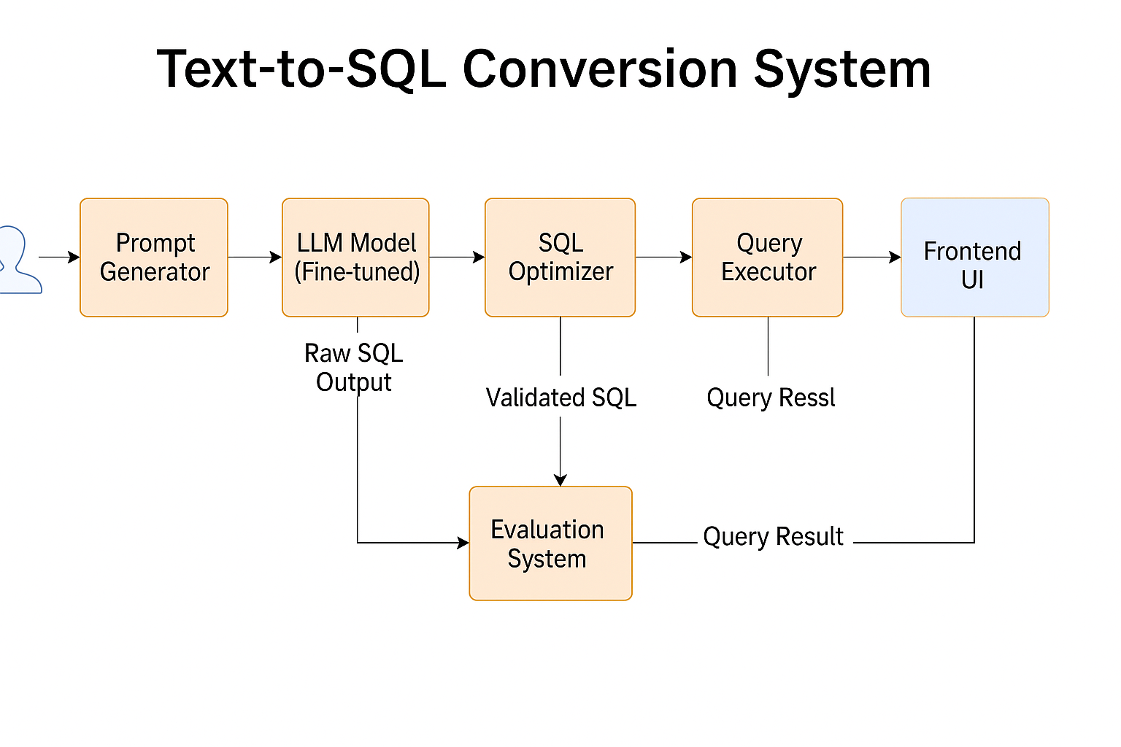

System Architecture
Query result

Slide 7
Overview
LLM Agent (GPT-3.5 Turbo fine-tuned):
Converts schema-aware prompts into SQL
Follows strict prompt instructions (no INSERT/UPDATE)
Understands context like 'discontinued products' or 'unshipped orders'
Returns clean, optimized SQL with support for aliases and filters
The model was fine-tuned on a curated dataset of NL → SQL pairs, guided by schema rules and safe constraints.

Slide 8
🧰 Core Technologies
Language Model: OpenAI GPT-3.5 Turbo (fine-tuned)
Backend: Python 3.11, SQLite
Frontend: Streamlit (for interactive UI)
Evaluation: Precision, Recall, F1 Score, Execution Match
Prompt Engineering: schema + rules + examples
Safe Execution: `SELECT`-only validation, error handling

Slide 9
🖥 Live Demo / Workflow
1. User enters a question (e.g. "Show all customers from Germany")
2. Model generates SQL: SELECT CustomerID, CompanyName FROM Customers WHERE Country = 'Germany';
3. Query is optimized (adds LIMIT if needed)
4. Results shown in a table
5. Optional: Evaluation tab compares model output with ground-truth SQL (Exact Match, F1, Execution Match)
✅ Available as CLI and Streamlit Web App

Slide 10
🧠 Design Decisions
🛠️ Tools Chosen — Why?
OpenAI GPT-3.5 Turbo – Best-in-class performance, supported fine-tuning
SQLite – Lightweight, serverless, and easy to bundle
Streamlit – Easy to build interactive UIs with zero frontend coding
Python – Simple and widely used for LLM + NLP tasks
Modular structure – Enables independent testing and extension

Slide 11
🧠 Design Decisions
Chose SQLite + Northwind for simplicity and clarity
Separated prompt logic, optimization, execution, and evaluation into modules
Fine-tuned GPT-3.5 Turbo for consistent performance
Evaluation designed to be both text-based and execution-based
These tools were chosen to reduce setup complexity and ensure everything runs locally with minimal dependencies.

Slide 12
⚠️ Challenges & Solutions
Challenge: Handling variations in SQL (column order, aliases)
→ Solution: Execution-based evaluation + similarity scoring
Challenge: Avoiding unsafe SQL (DROP, UPDATE)
→ Solution: SELECT-only validation + error feedback
Challenge: Complex queries (aggregates, joins)
→ Solution: Prompt schema with examples + fine-tuning
Challenge: Clean presentation
→ Solution: Streamlit UI with structured tabs

Slide 13
🧰 Future Work
Add more support for multi-table JOINs and subqueries
Fine-tune on more diverse schemas and datasets
Include model confidence and error explanations
Expand test set and integrate user feedback

Slide 14
🙏 Thank You / Q&A
Thank you! I’m happy to answer any questions.
GitHub: https://github.com/nevil-06/Jonas-Assessment-Project2
Contact: italiya5@uwindsor.ca

