Slide 1
ANLP Project: Speculative Decoding
Team 10 – Spectrum
Nevil Sakhreliya 2023201005
Prakhar Jain 2022121008
Aditya Gupta 2023201009
Guide: Prof. Manish Shrivastava

Slide 2
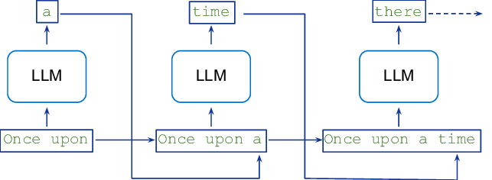
Introduction
Inference from large autoregressive models like Transformers is slow - decoding K tokens takes K serial runs of the model.

Slide 3
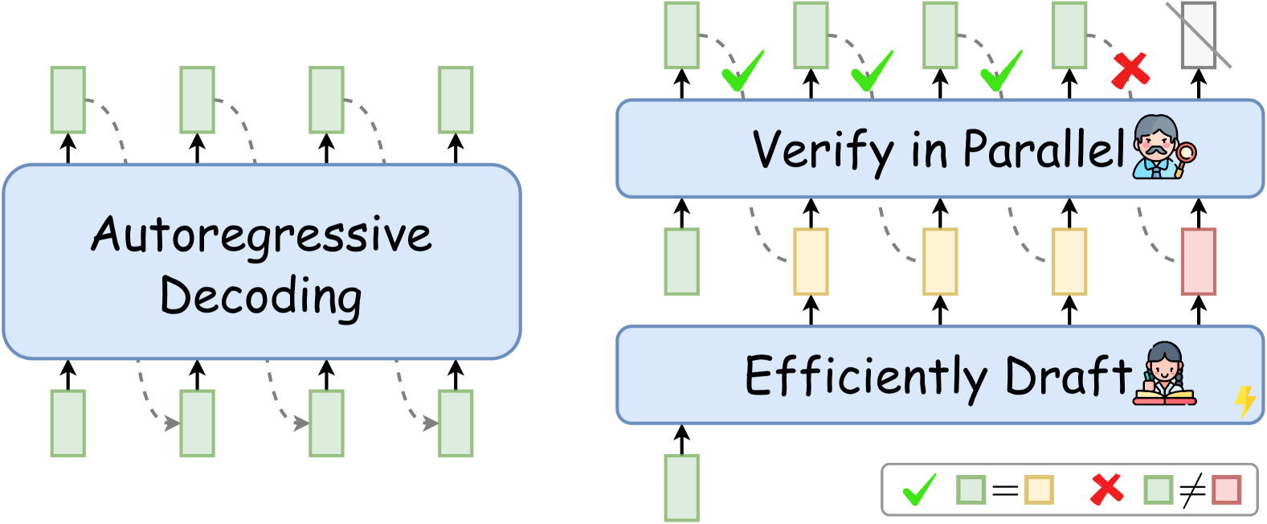
Introduction
Speculative decoding accelerates large language models (LLMs) by generating responses faster without compromising quality.
It incorporates a smaller, faster “draft” model to produce preliminary predictions. The main, more powerful model evaluates these predictions in parallel, reducing computational overhead.

Slide 4
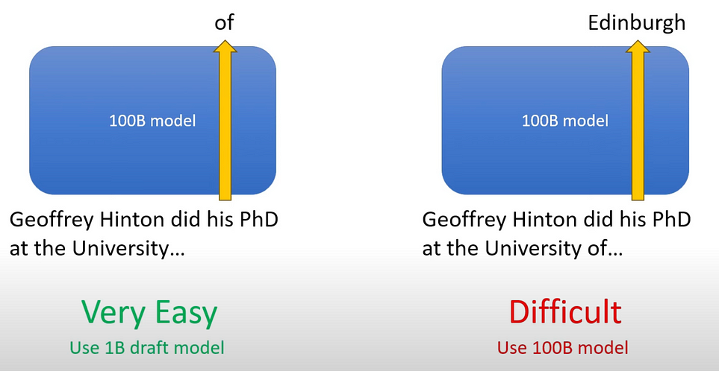
Key Ideas
Utilizing a Smaller Model for Easy Tokens: Predicting simple tokens like ‘of’ can be done by a smaller model, while complex tokens such as Edinburgh may require the larger model.

Slide 5
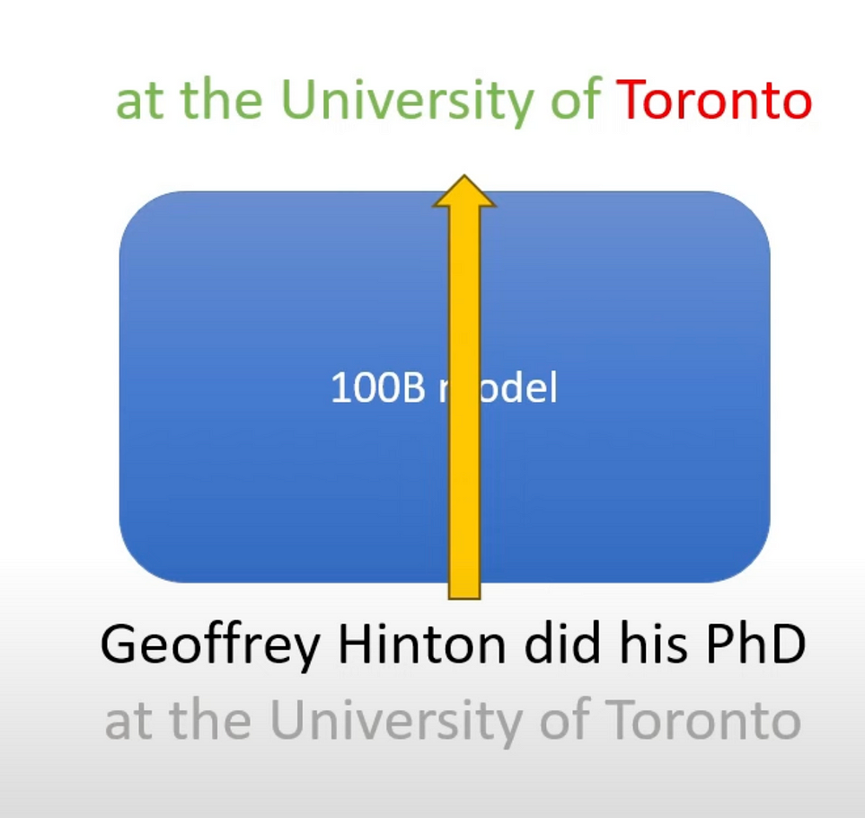
Key Ideas
Even though Transformer models typically generate one word at a time, they can process multiple tokens at once. While generating the next token, they can check all tokens in the sequence at once.

Slide 6
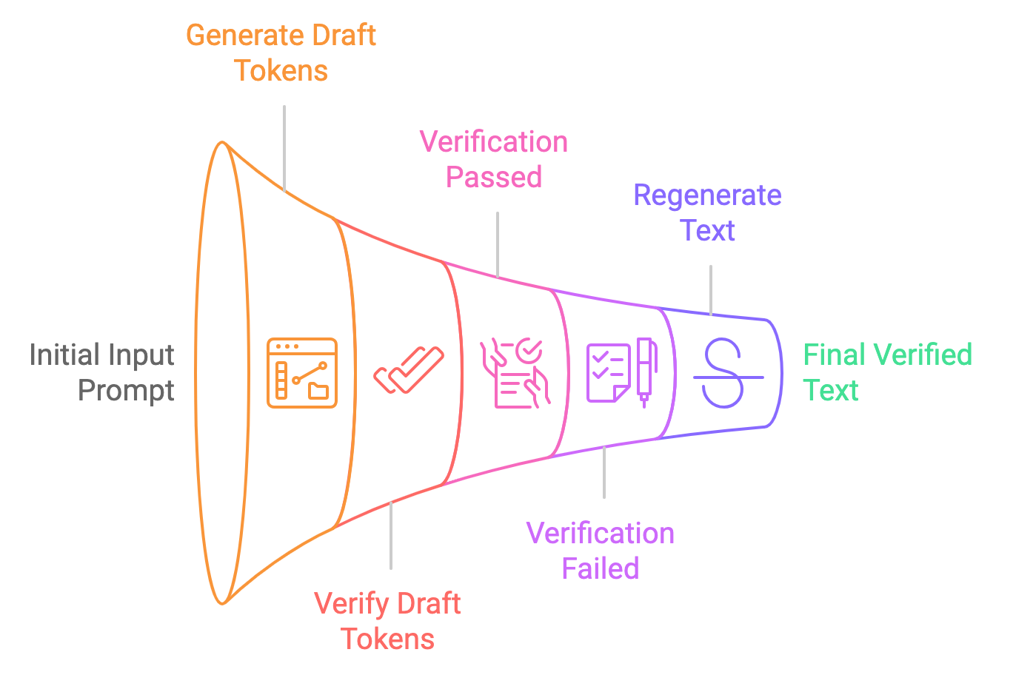
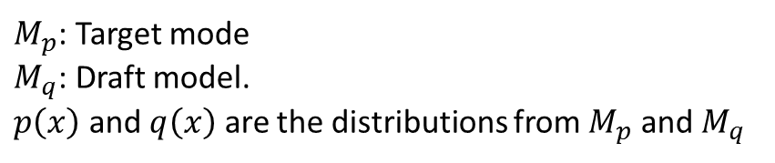
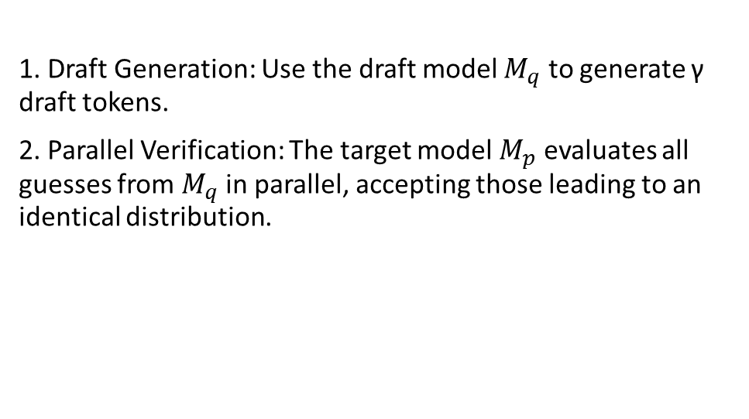
Speculative Sampling
$M_{p}$: Target mode
$M_{q}$: Draft model.
$p\left(x\right)$ and $q\left(x\right)$ are the distributions from $M_{p}$ and $M_{q}$
1. Draft Generation: Use the draft model $M_{q}$ to generate γ draft tokens.
2. Parallel Verification: The target model $M_{p}$ evaluates all guesses from $M_{q}$ in parallel, accepting those leading to an identical distribution.

Slide 7
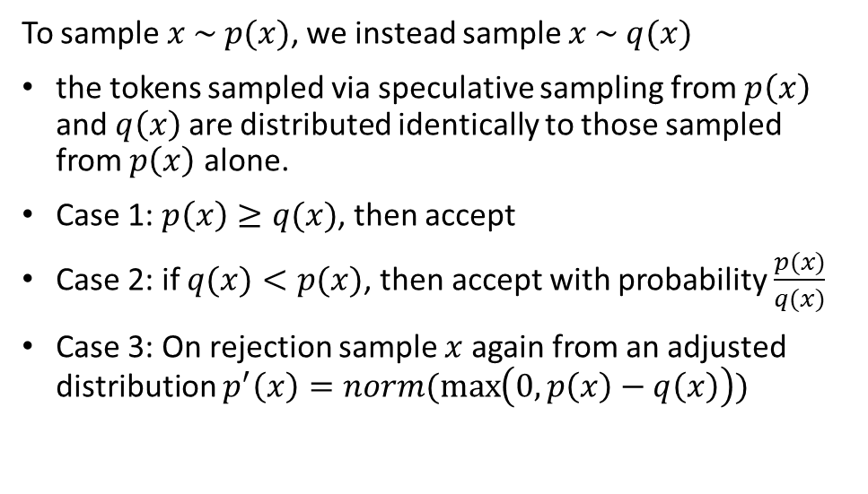
Speculative Sampling
$M_{p}$: Target mode
$M_{q}$: Draft model.
$p\left(x\right)$ and $q\left(x\right)$ are the distributions from $M_{p}$ and $M_{q}$
To sample $x \sim p(x)$, we instead sample $x \sim q(x)$
the tokens sampled via speculative sampling from $p\left(x\right)$ and$q\left(x\right)$are distributed identically to those sampled from $p\left(x\right)$ alone.
Case 1: $p\left(x\right)≥q(x)$, then accept
Case 2: if $q(x)<p(x)$, then accept with probability $\frac{p(x)}{q(x)}$
Case 3: On rejection sample $x$ again from an adjusted distribution $p^{′}\left(x\right)=norm(\max\left(0, p\left(x\right)−q\left(x\right)\right))$

Slide 8
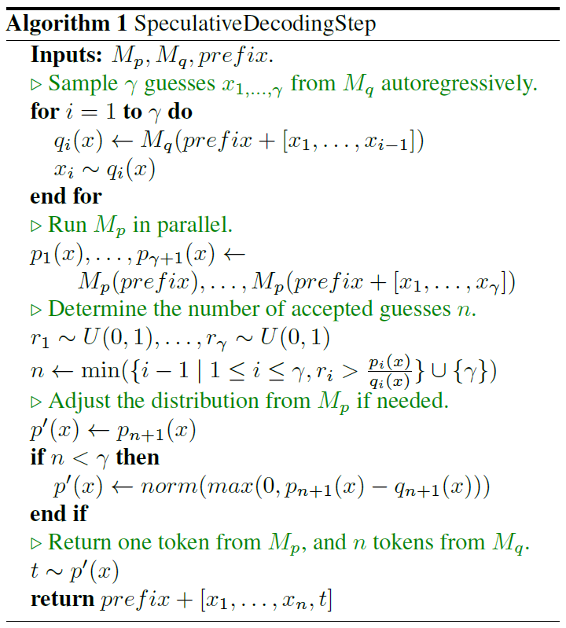

Slide 9
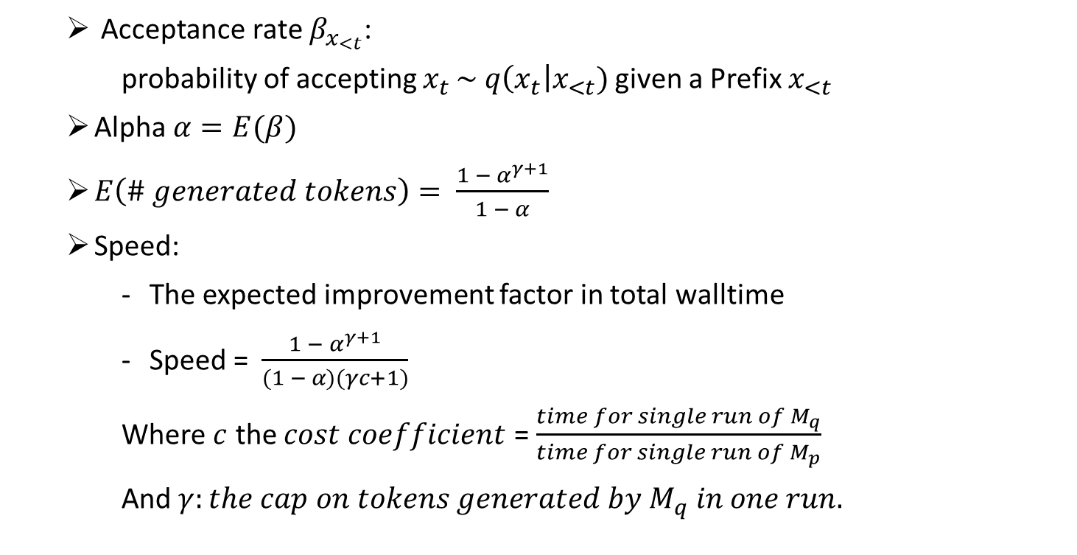
Evaluation Metrics
Acceptance rate $β_{x_{<t}}$:
probability of accepting $x_{t }\sim q\left(x_{t}\right|x_{<t})$given a Prefix $x_{<t}$
Alpha $α=E(β)$
$E\left(\# generated tokens\right)= \frac{1 − α^{γ+1}}{1 − α}$
Speed:
The expected improvement factor in total walltime
Speed = $\frac{1 − α^{γ+1}}{(1 − α)(γc+1)}$
Where $c$ the $cost coefficient$ = $\frac{time for single run of M_{q}}{time for single run of M_{p}}$
And $γ:the cap on tokens generated by M_{q} in one run.$

Slide 10
Baseline
Model | Parameters | Time per Token (seconds)
gpt2-large | 812 M | 0.0327
gpt2-medium | 380 M | 0.0187
gpt2 | 137 M | 0.0092
distilgpt2 | 88.2 M | 0.0045

Slide 11

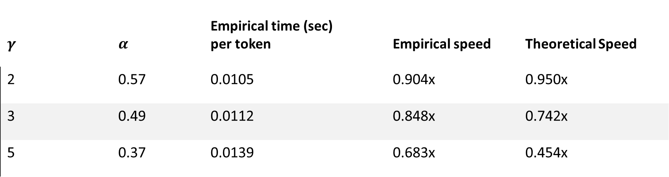
Target Model – GPT2-Small
Draft Model – Distilgpt2
$$c=0.4967$$
$$γ$$ | $$α$$ | Empirical time (sec) per token | Empirical speed | Theoretical Speed
2 | 0.57 | 0.0105 | 0.904x | 0.950x
3 | 0.49 | 0.0112 | 0.848x | 0.742x
5 | 0.37 | 0.0139 | 0.683x | 0.454x

Slide 12

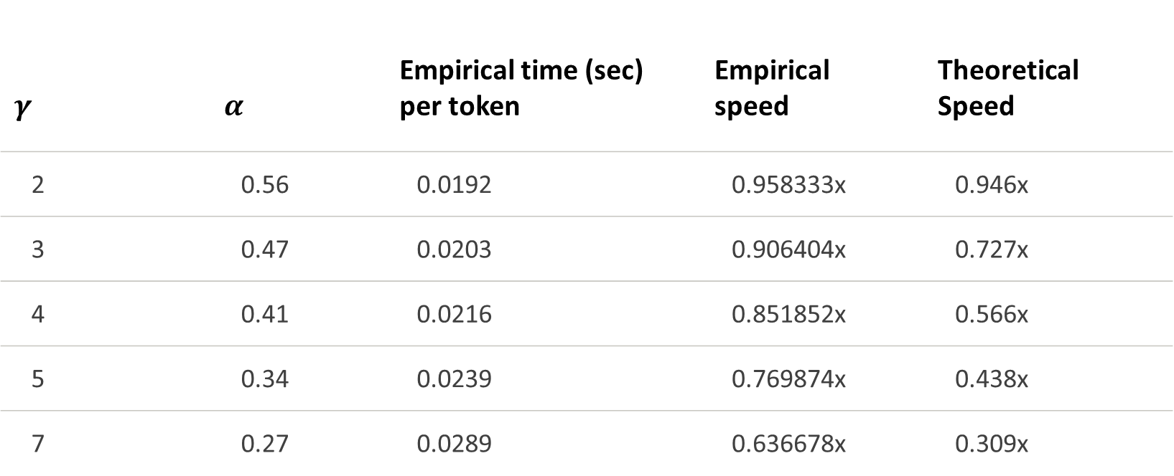
Target Model – GPT2-Medium
Draft Model – GPT2-Small
$$c=0.4895$$
$$γ$$ | $$α$$ | Empirical time (sec) per token | Empirical speed | Theoretical Speed
2 | 0.56 | 0.0192 | 0.958333x | 0.946x
3 | 0.47 | 0.0203 | 0.906404x | 0.727x
4 | 0.41 | 0.0216 | 0.851852x | 0.566x
5 | 0.34 | 0.0239 | 0.769874x | 0.438x
7 | 0.27 | 0.0289 | 0.636678x | 0.309x

Slide 13

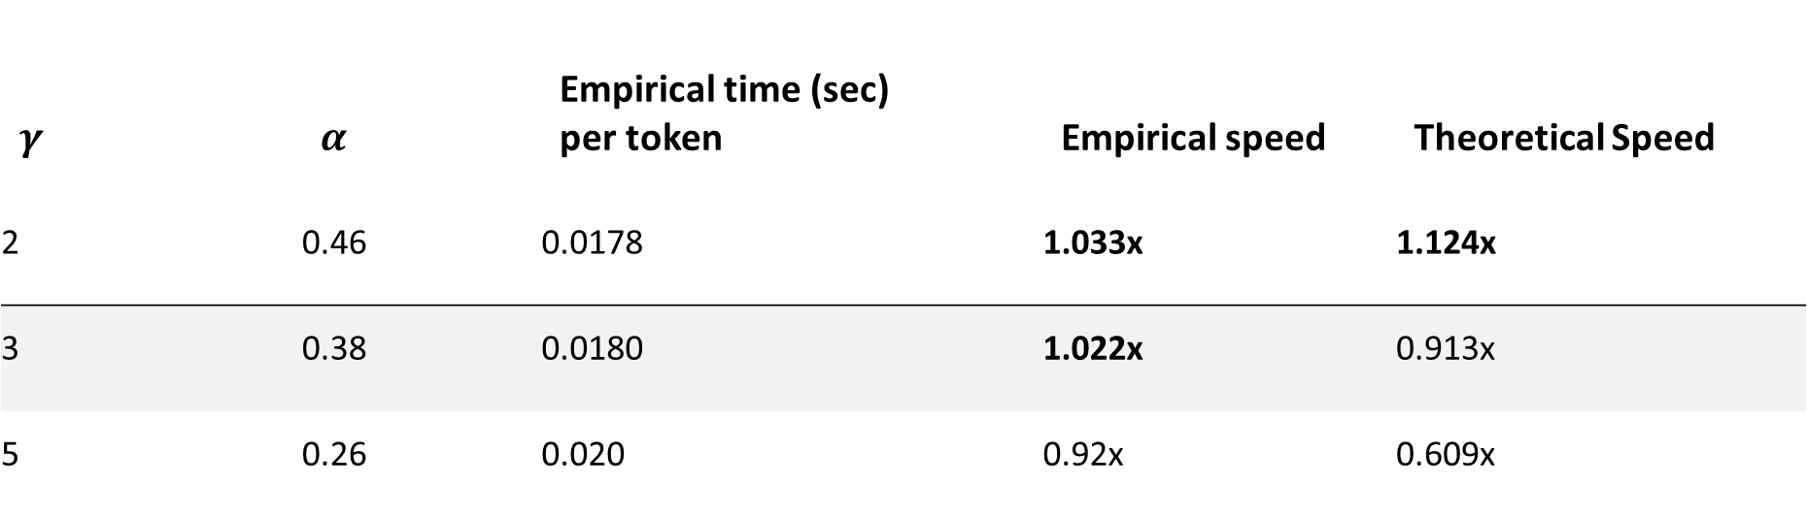
Target Model – GPT2-Medium
Draft Model – Distilgpt2
$$c=0.2432$$
$$γ$$ | $$α$$ | Empirical time (sec) per token | Empirical speed | Theoretical Speed
2 | 0.46 | 0.0178 | 1.033x | 1.124x
3 | 0.38 | 0.0180 | 1.022x | 0.913x
5 | 0.26 | 0.020 | 0.92x | 0.609x

Slide 14

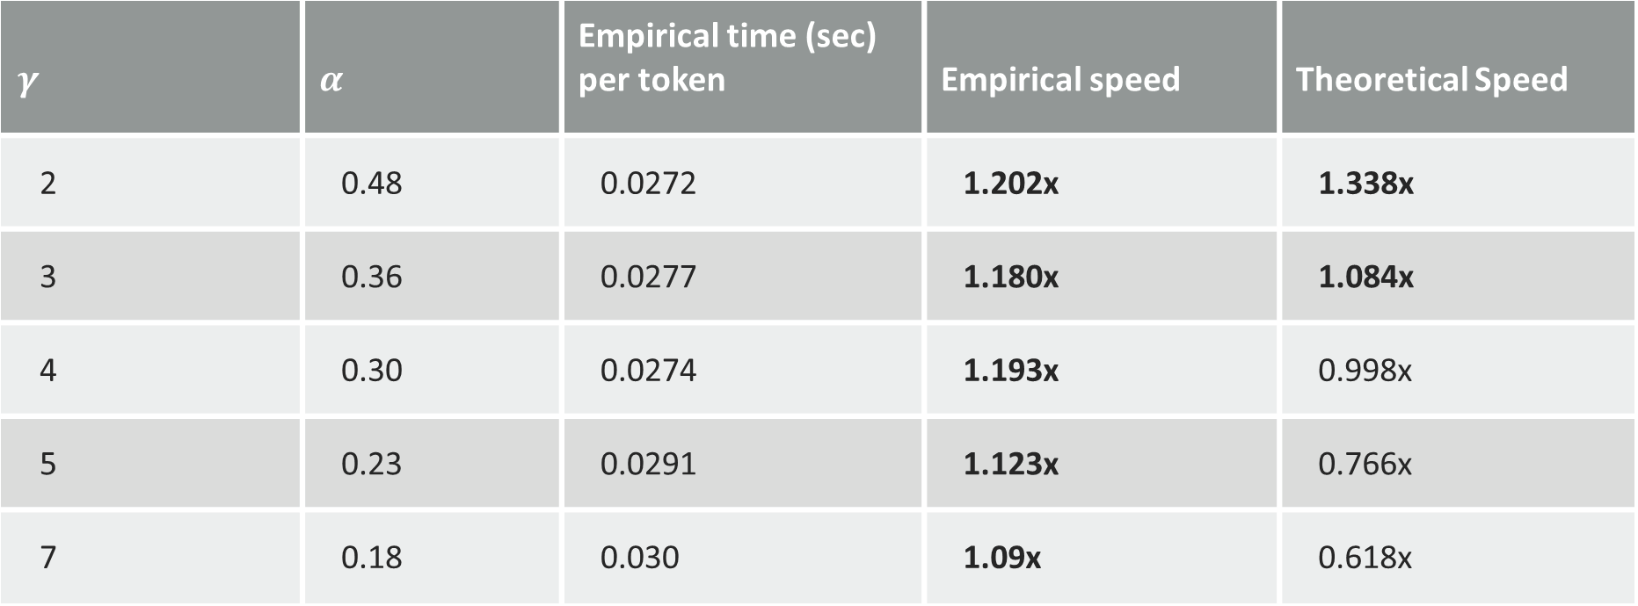
Target Model – GPT2-Large
Draft Model – Distilgpt2
$$c=0.139$$
$$γ$$ | $$α$$ | Empirical time (sec) per token | Empirical speed | Theoretical Speed
2 | 0.48 | 0.0272 | 1.202x | 1.338x
3 | 0.36 | 0.0277 | 1.180x | 1.084x
4 | 0.30 | 0.0274 | 1.193x | 0.998x
5 | 0.23 | 0.0291 | 1.123x | 0.766x
7 | 0.18 | 0.030 | 1.09x | 0.618x

Slide 15
Hierarchical Speculative Decoding

Slide 16
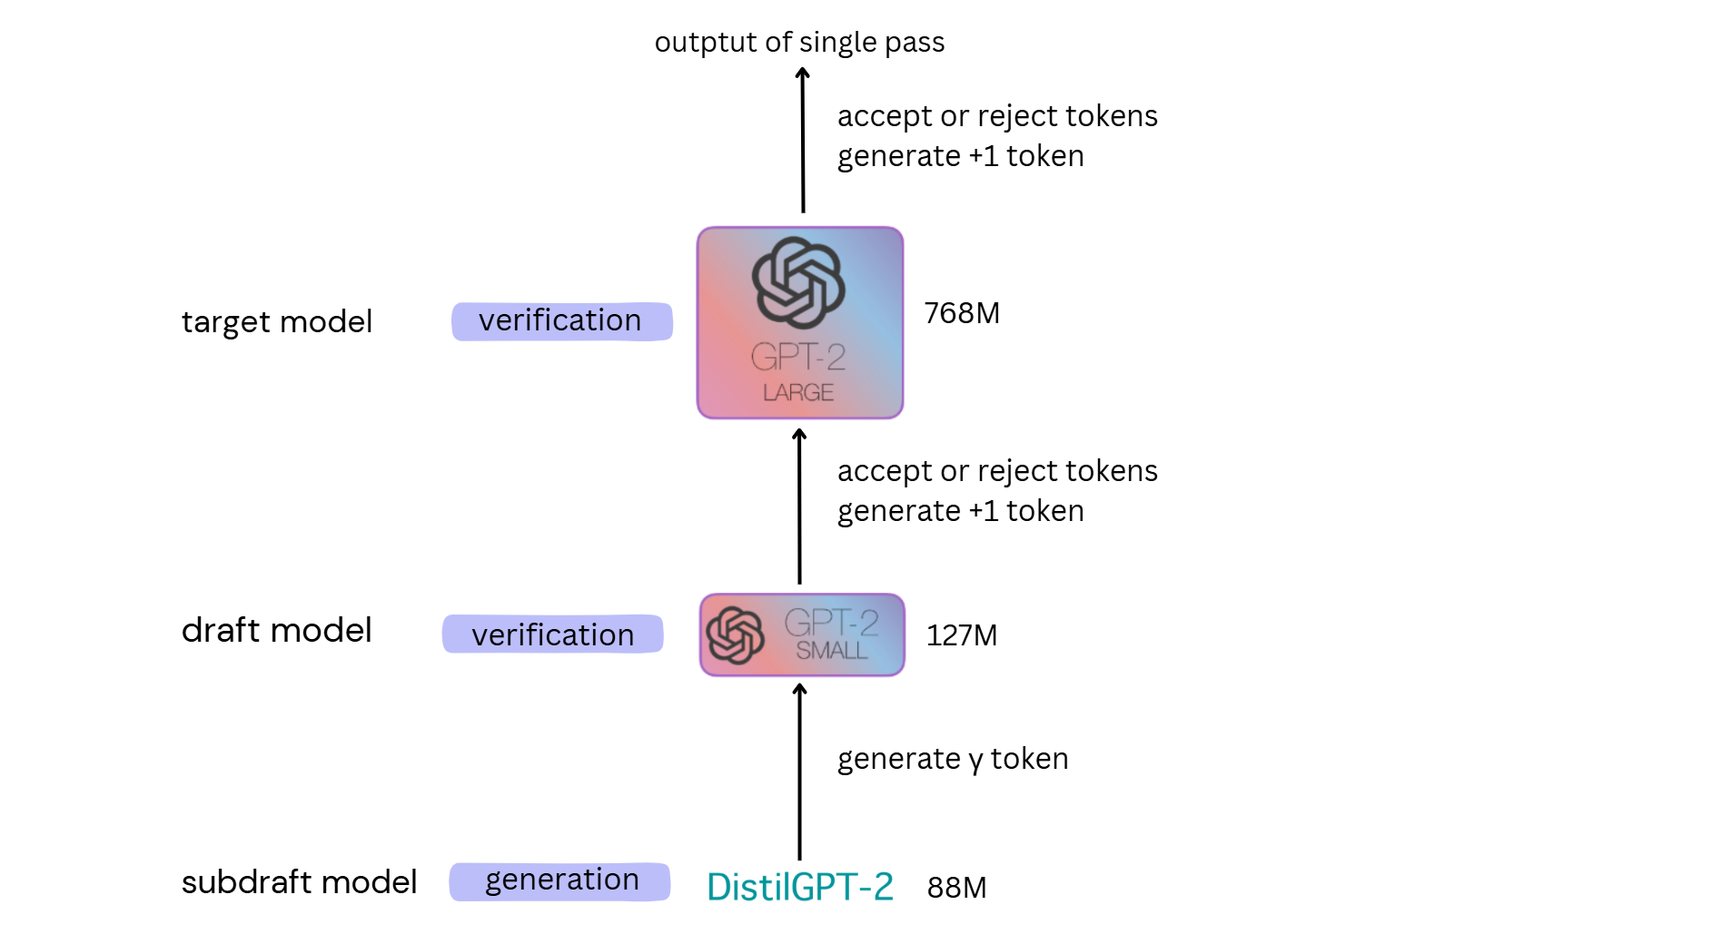

Slide 17
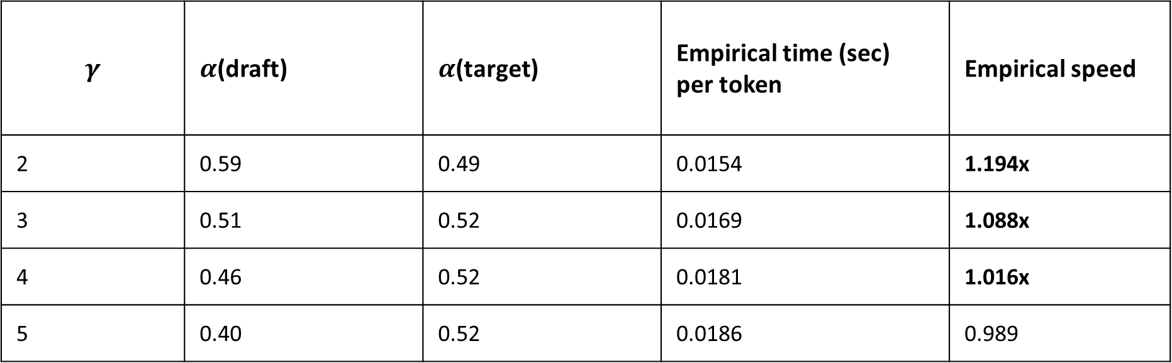
Target Model – GPT2-Medium
Draft Model – GPT2-Small
Subdraft Model – Distilgpt2
$$γ$$ | $α$(draft) | $α$(target) | Empirical time (sec) per token | Empirical speed
2 | 0.59 | 0.49 | 0.0154 | 1.194x
3 | 0.51 | 0.52 | 0.0169 | 1.088x
4 | 0.46 | 0.52 | 0.0181 | 1.016x
5 | 0.40 | 0.52 | 0.0186 | 0.989

Slide 18
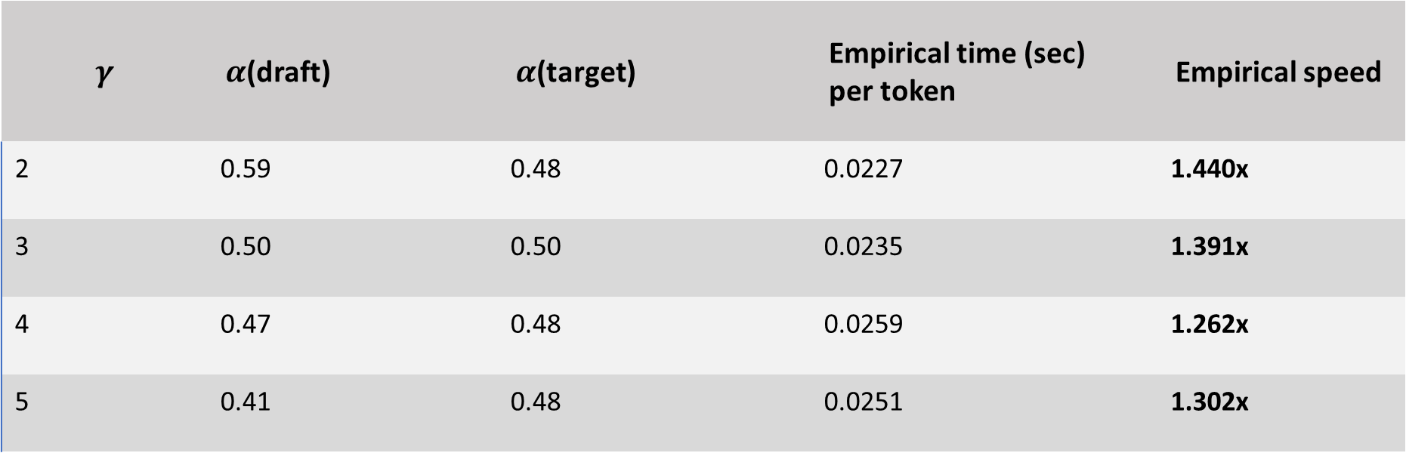
Target Model – GPT2-Large
Draft Model – GPT2-Small
Subdraft Model – Distilgpt2
$$γ$$ | $α$(draft) | $α$(target) | Empirical time (sec) per token | Empirical speed
2 | 0.59 | 0.48 | 0.0227 | 1.440x
3 | 0.50 | 0.50 | 0.0235 | 1.391x
4 | 0.47 | 0.48 | 0.0259 | 1.262x
5 | 0.41 | 0.48 | 0.0251 | 1.302x

Slide 19


Adaptive Gamma
$$c=0.139$$
initial gamma | alpha | Empirical time (Sec) per token | Empirical speed
3 | 0.45 | 0.0267 | 1.224x
Target Model – GPT2-Large
Draft Model – Distilgpt2
If acceptance rate > 0.80:
$$γ= γ+1$$
If acceptance rate < 0.20:
$$γ= γ−1$$

Slide 20
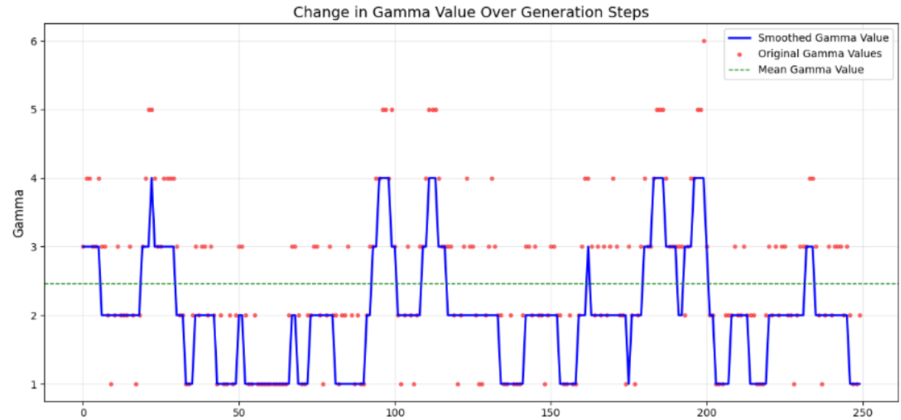
Adaptive Gamma

Slide 21
Conclusion
Impact of γ:
As γ increases both α and speed decreases.
Theoretical speed diverges from empirical results at higher γ, posing challenges for large-scale predictive modeling.
Hierarchical Speculative Decoding:
Using Subdraft model showed promising results with improvement over the using single level of draft models

Slide 22
Conclusion
Adaptive Gamma:
Adaptive γ improves empirical speed slightly compared to static scaling.
Dynamic adjustments based on model confidence can optimize processing times.
Speculative Decoding Observations:
Higher effectiveness depends on a much smaller draft model relative to the target model.
Original study: T5-XXL (11B) target and T5-small (77M) draft (~140x smaller) achieved 3.4x speedup.
Current study: GPT-Large (812M) target and DistilGPT-2 (88.2M) draft (~9.2x smaller) achieved only 1.202x speedup at γ = 2.
Key Insight:
Tuning γ or adopting adaptive strategies balances efficiency and performance, crucial for resource-constrained scenarios.

Slide 23
Thank You

