Slide 1
STUDENT MANAGEMENT SYSTEM
NEVIL PAUL
EBEON112693659

Slide 2
Full Stack Application – Student Management System Student Management System is an Application where you can store a student's mark , result , name and other details. This Application is developed in Angular(Frontend) and Spring Boot(Backend). An Student management system that allows adding, deleting, reading, and updating student information is a software solution designed to help institution manage their workforce effectively.
Overall, an employee management system with these functionalities can help organizations optimize their workforce management and improve their bottom line.
INTRODUCTION

Slide 3
Spring Boot Framework
Angular CLI
TECHNOLOGIES USED
f
FULL
STACK APPLICATION
Node JS
MySQL
Hibernate
JPA

Slide 4
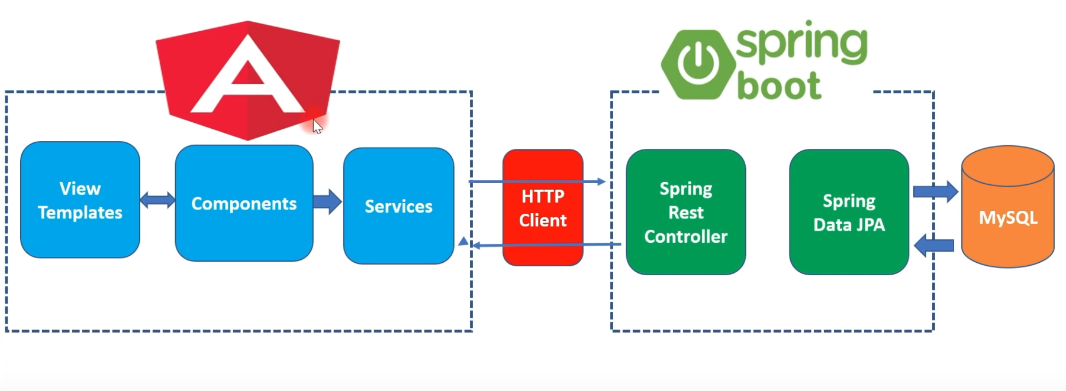
Architecture of Angular, Spring & MySQL

Slide 5
Angular 15
TypeScript
FRONTEND TECHNOLOGIES
Node JS & NPM
VS Code IDE
Angular CLI

Slide 6
Spring Boot
SpringData JPA (Hibernate)
BACKEND
TECHNOLOGIES
JDK 11
Embedded Tomcat Server
MySQL DATABASE

Slide 7
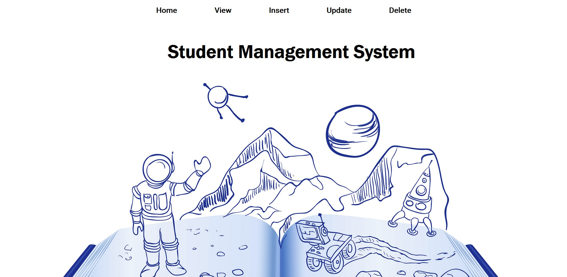
HOME PAGE

Slide 8
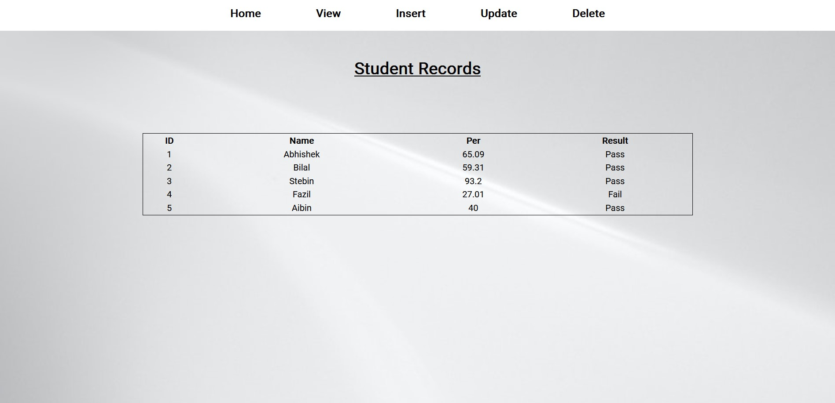
VIEW PAGE

Slide 9
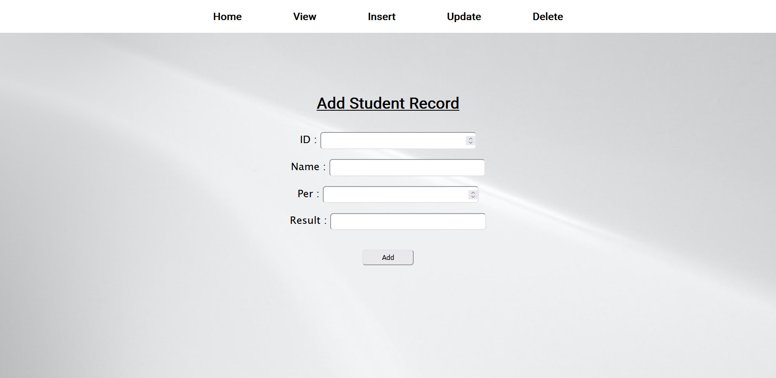
INSERT PAGE

Slide 10
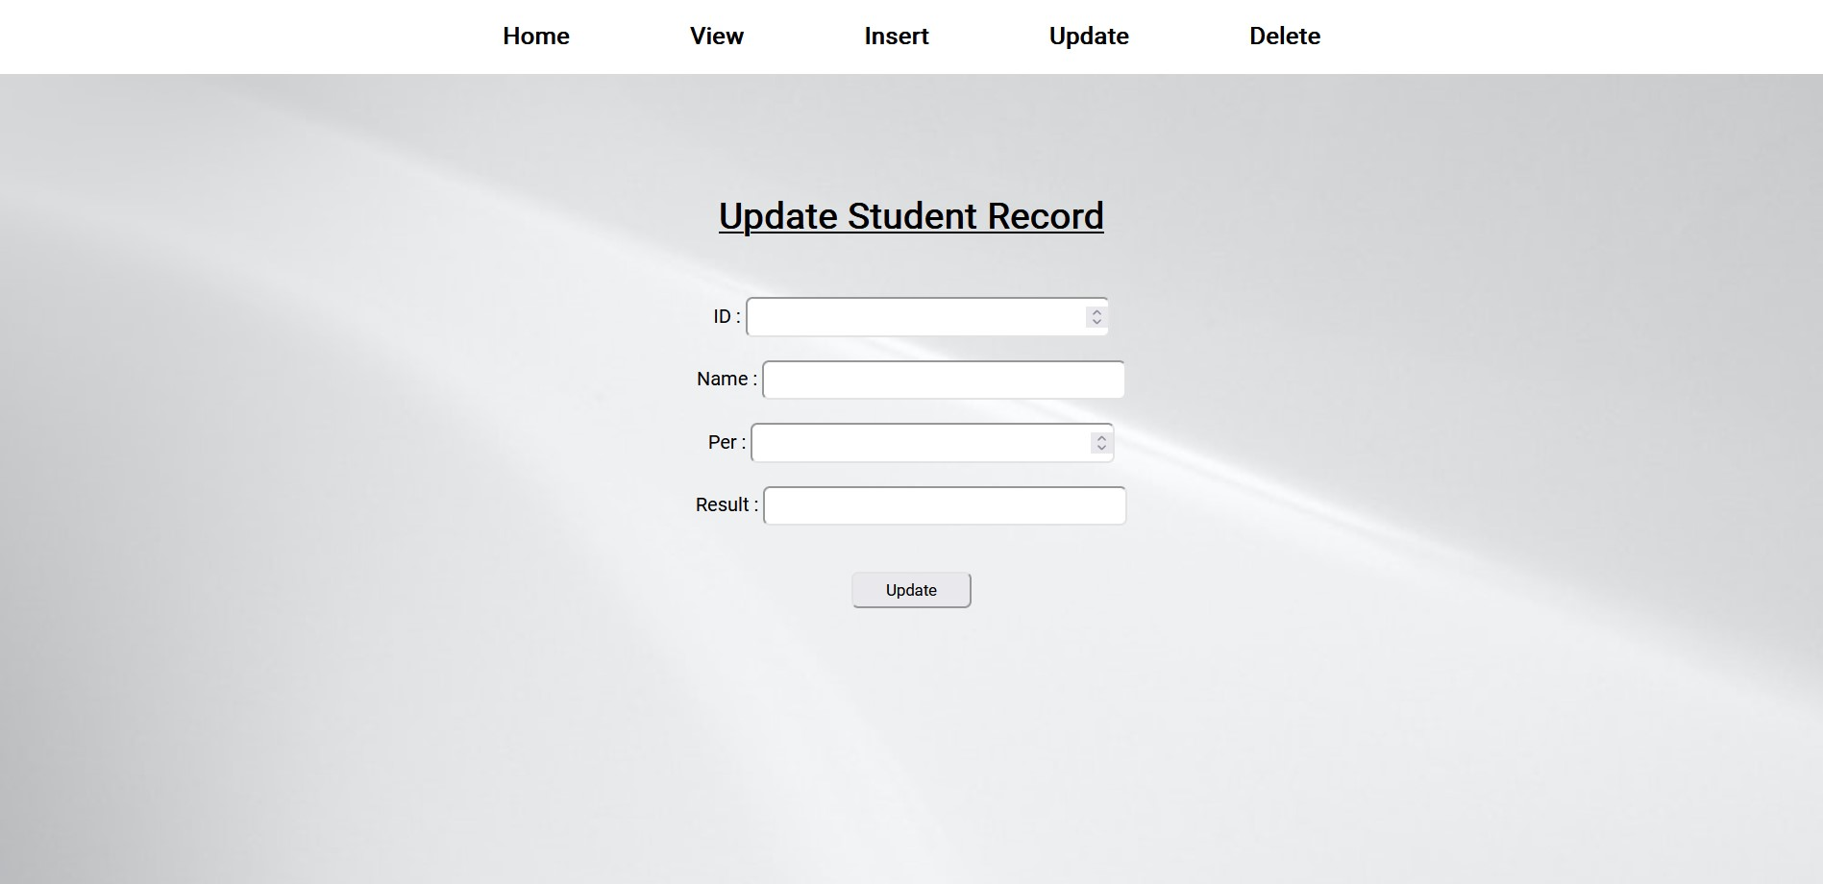
UPDATE PAGE

Slide 11
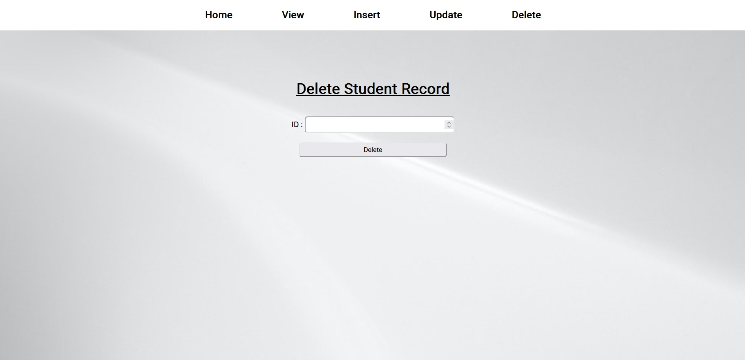
DELETE PAGE

Slide 12
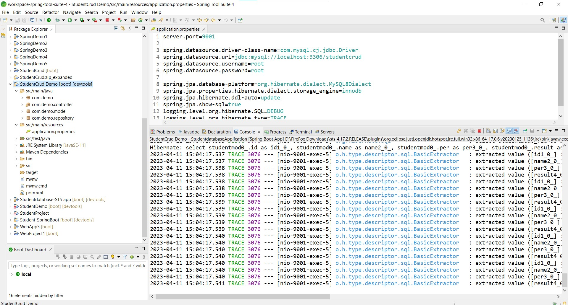
SPRING BOOT APPLICATION

Slide 13
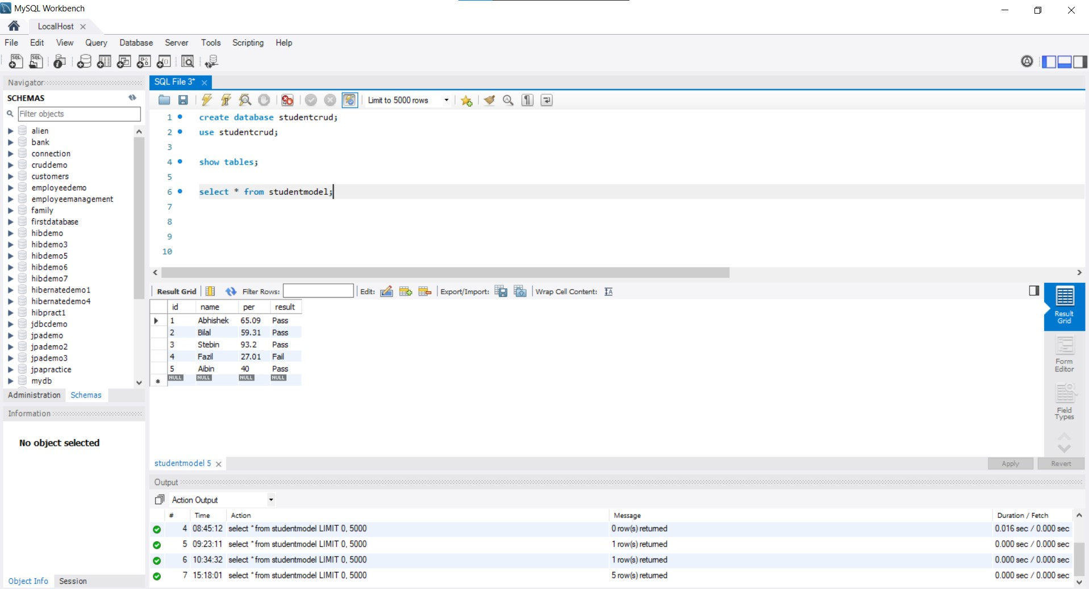
MYSQL CODE

Slide 14
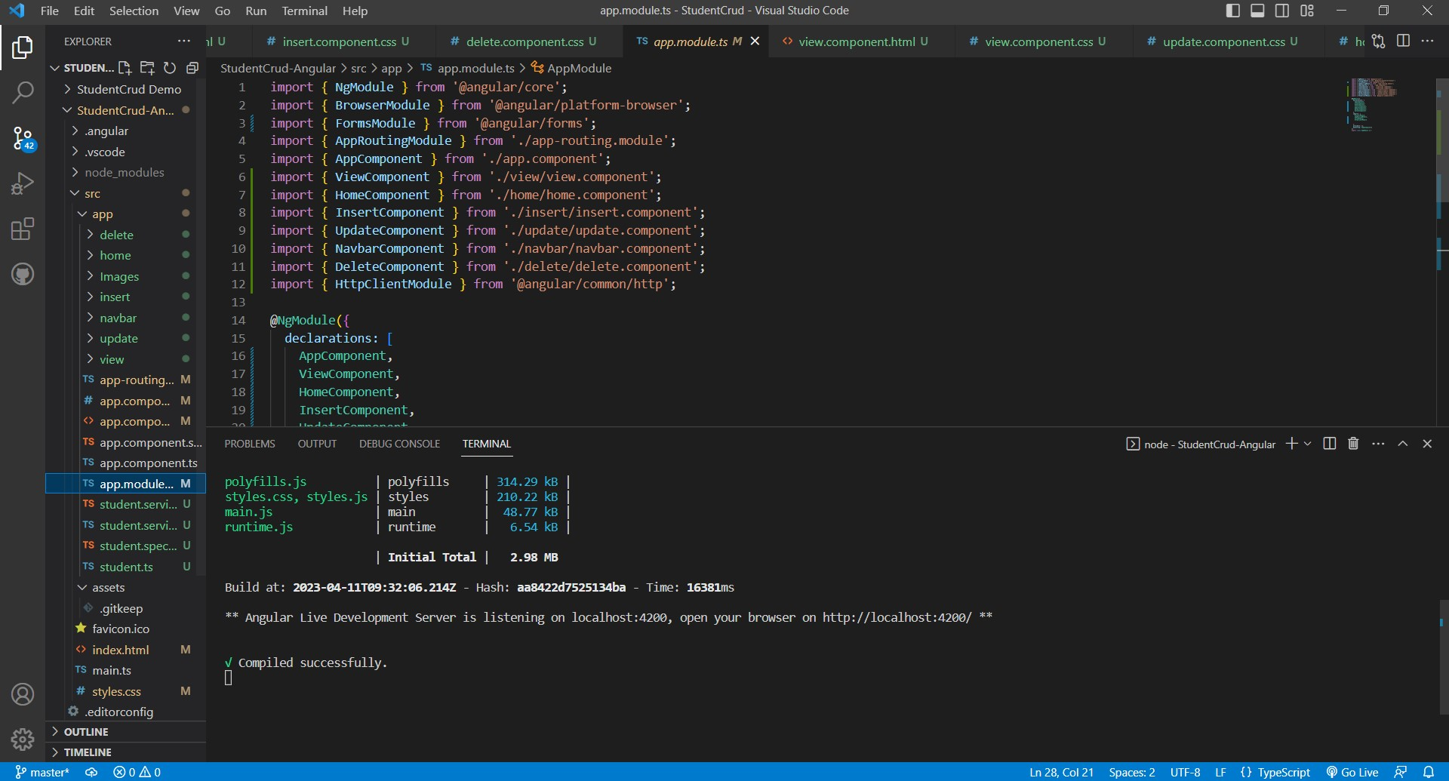
ANGULAR JS

Slide 15
The Scope of the project is as follows:
To Assist the staff in capturing the effort spent on their respective working areas
To utilize resources in an efficient manner by increasing their productivity through automation
The System generates types of information that can be used for various purposes
FUTURE SCOPE

Slide 16

GITHUB LINK
https://github.com/nevilpaul12/Student-Crud

Slide 17

THANK YOU

