Slide 1

SMART WATER USAGE ADVISOR
An AI-powered assistant for early leak detection and personalized water-saving guidance in urban households
SDG 6 — Clean Water & Sanitation | Secondary: SDG 12
Nevil Usdad
Sutex Bank College Of Computer Applications & Science
1M1B AI for Sustainability Virtual Internship | IBM SkillsBuild & AICTE

Slide 2



The Problem
“How might we use AI to help urban households detect potential water leaks early and reduce wasteful daily habits through personalized guidance, so that domestic water consumption can become more sustainable?”
Who Faces It
The Gap
Why It Persists
Urban household members — renters, homeowners, and apartment residents managing their own daily water use.
Leaks go unnoticed until a bill spike; wasteful habits (long showers, running taps, over-watering) are never flagged in real time.
No accessible, low-cost tool exists that combines leak self-diagnosis with personalized, adaptive habit feedback.
Smart Water Usage Advisor | 1M1B AI for Sustainability Internship
2

Slide 3

SDG Alignment
PRIMARY
SECONDARY
SDG 6
SDG 12
Clean Water and Sanitation
Responsible Consumption & Production
The advisor directly supports sustainable, efficient domestic water use — catching leaks early and cutting avoidable daily wastage before it accumulates.
By nudging households toward mindful, resource-efficient habits, the project also reinforces responsible consumption of a shared natural resource.
Smart Water Usage Advisor | 1M1B AI for Sustainability Internship
3

Slide 4

AI Solution Overview
A hybrid design: rule-based logic for diagnosis, generative AI for personalized guidance.
Module 1: Leak Detection
Module 2: Habit Advisory
Rule-based logic + AI explanation
Fully AI-generated, personalized
4 simple yes/no questions (meter movement, bill spikes, damp patches, cistern behavior)
Rule engine scores answers → No Leak / Possible Minor Leak / Likely Major Leak
AI explains the result in plain language and gives 1-2 concrete next steps
User describes daily habits: shower length, dishwashing, gardening, laundry
AI applies known usage benchmarks to estimate monthly consumption — shown transparently
Identifies biggest waste source + gives 2 personalized, practical tips with estimated savings
Smart Water Usage Advisor | 1M1B AI for Sustainability Internship
4

Slide 5

Target Users & Why AI Is Needed
Target Users: Urban household members — particularly in water-stressed cities — including renters, homeowners, and apartment/hostel residents who manage their own water usage.
Why AI — Not a Static Form or Leaflet
Pattern-based flagging
Personalization at scale
Combines multiple weak signals (meter movement, bill, dampness) into one reliable leak-likelihood flag — hard to do with fixed rules alone.
Every household's habits differ; AI generates tailored tips instead of one generic tip-sheet for everyone.
Natural language guidance
Transparent reasoning
Turns numeric flags and calculations into clear, reassuring, actionable explanations anyone can follow.
Shows its calculation and states assumptions, so users can trust and verify the guidance — not a black box.
Smart Water Usage Advisor | 1M1B AI for Sustainability Internship
5

Slide 6
Prototype Demo — Leak Detection
Run on IBM BOB — Household B (Possible Minor Leak)
INPUT
AI OUTPUT
Meter moves (taps off)
Yes
Your water meter is still moving even when all the taps are off, which suggests a small amount of water may be escaping somewhere in your home's pipes or fittings. The good news is the other signs — bill, walls, cistern — all look normal, so if there is a leak, it's likely small and caught early.
Bill spike
No
Damp patches
No
Cistern running
No
Next Steps
Put food colouring in the toilet tank, wait 15 min without flushing — colour in the bowl signals a silent toilet leak.
Turn off the main stopcock overnight; if the meter still moves, contact your water supplier to check the supply pipe.
Resulting Flag
Possible Minor Leak
Smart Water Usage Advisor | 1M1B AI for Sustainability Internship
6

Slide 7
Prototype Demo — Habit Advisory
Run on IBM BOB — Household B habits, with transparent calculation
Habit | Calculation | Monthly
Shower | 12 min × 9 L/min × 30 days | 3,240 L
Dishes (tap running) | 6 L/min × ~10 min × 30 days (assumed) | 1,800 L
Garden hose | 15 L/min × 10 min × 30 days | 4,500 L
Washing machine (half-full) | 65 L ÷ 0.5 × 15 runs/month (assumed) | 1,950 L
ESTIMATED MONTHLY TOTAL
11,490 L
⚠ Assumption noted: dish-washing session length assumed at 10 min/day — flagged by the AI for transparency.
Biggest Area of Waste: Garden watering — ~4,500 L/month (39% of total use), largely lost to daytime evaporation.
Water early morning + timer nozzle
Only run full laundry loads
Before 8 a.m. cuts watering time nearly in half with the same plant health.
Waiting for a full load could save ~975 L/month vs. half-full runs.
Smart Water Usage Advisor | 1M1B AI for Sustainability Internship
7

Slide 8
Testing & Refinement — Sample Households
A synthetic dataset of 4 household profiles validates the advisor across the full range of outcomes.
Household | Scenario | Leak Flag | Est. Monthly Use | Key Tip
A | Efficient user | No Leak | ~3,095 L | Low-flow showerhead → save ~400 L/mo
B | Minor leak + moderate habits | Possible Minor Leak | ~11,490 L | Full laundry loads → save ~975 L/mo
C | Wasteful, no leak | No Leak | ~13,900 L (est.) | Reduce shower & garden time
D | Major leak, multiple signs | Likely Major Leak | ~2,850 L (habits only) | Call a plumber within 1–2 days
Testing across efficient, moderate, wasteful, and urgent-leak scenarios confirmed the advisor responds appropriately in each case — reassuring when safe, specific when habits waste water, and urgent when a major leak is likely. Mentor feedback will be used to refine wording and thresholds further.
Smart Water Usage Advisor | 1M1B AI for Sustainability Internship
8

Slide 9



Responsible AI Considerations
Fairness
Transparency
Benchmarks (L/min, load size) are general averages, not tied to income, region, or household type. Assumptions are stated explicitly, not silently applied.
The AI shows its calculation steps and flags every assumption made due to missing data, so users can verify the reasoning themselves.
Ethics
Privacy
The advisor gives guidance and next steps only — it never claims certainty about a leak or replaces a licensed plumber for confirmed major issues.
Only water-usage habits and yes/no meter observations are collected — no names, addresses, or account numbers are needed or stored.
Smart Water Usage Advisor | 1M1B AI for Sustainability Internship
9

Slide 10
Expected Impact
Early
2
3
leak detection — weeks before a bill spike would reveal it
personalized tips per household, grounded in transparent calculations
stakeholder groups benefit directly
Households
Water Utilities
Environment
Lower water bills, reduced wastage, and an easy first check before calling a plumber.
Reduced overall demand and non-revenue water loss if adopted at scale across a city.
Less strain on local water sources — especially valuable in water-stressed Indian cities.
Smart Water Usage Advisor | 1M1B AI for Sustainability Internship
10

Slide 11



How This Project Was Built
A design-thinking process, from empathy to a tested prototype.
1. Empathize
2. Define
3. Ideate
4. Prototype
5. Test & Refine
Identified who struggles with unnoticed leaks and untracked water habits, and why the problem persists.
Wrote a clear problem statement, target users, and the specific gaps existing tools don't cover.
Brainstormed a hybrid design: rule-based leak scoring plus generative AI for personalized guidance.
Built prompt workflows tested on IBM BOB, and a working interactive tool combining logic + live AI calls.
Ran the advisor across 4 household scenarios covering the full range of outcomes to validate behavior.
Smart Water Usage Advisor | 1M1B AI for Sustainability Internship
11

Slide 12

System Flow
How a user's answers travel through the advisor to become personalized guidance.
User Input
Rule Engine
AI Layer
Output
4 leak questions or daily habit details
Scores answers / calculates usage benchmarks
Generates plain-language explanation & tips
Flag + next steps, or savings plan
The rule engine and AI layer are deliberately separate: the rule engine gives consistent, explainable scoring for leak likelihood, while the AI layer handles the parts that benefit from natural language — explaining results and personalizing tips. This hybrid keeps the system transparent while still feeling like a real conversation.
Smart Water Usage Advisor | 1M1B AI for Sustainability Internship
12

Slide 13
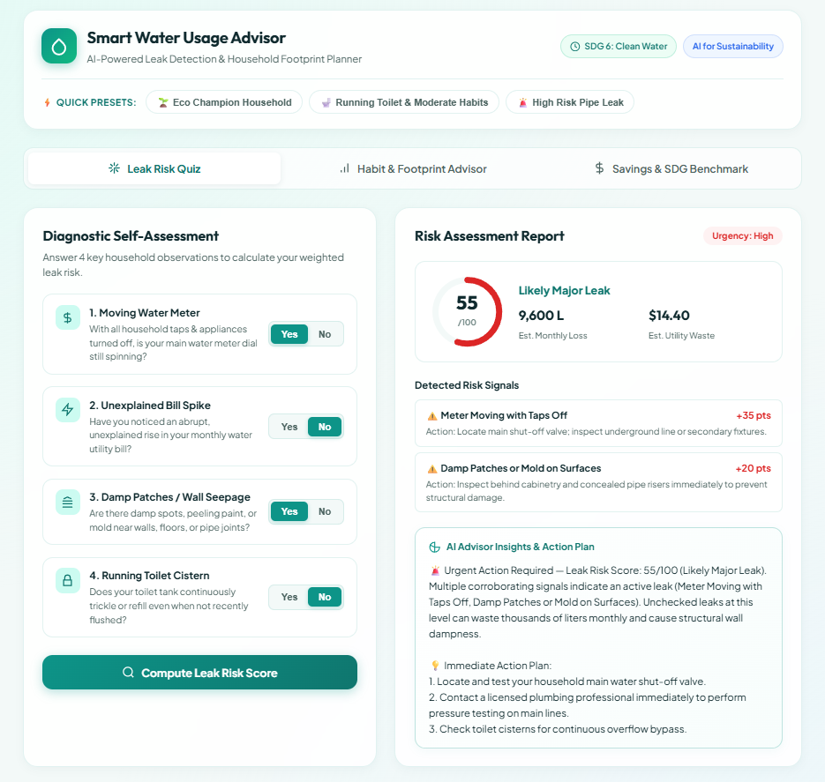
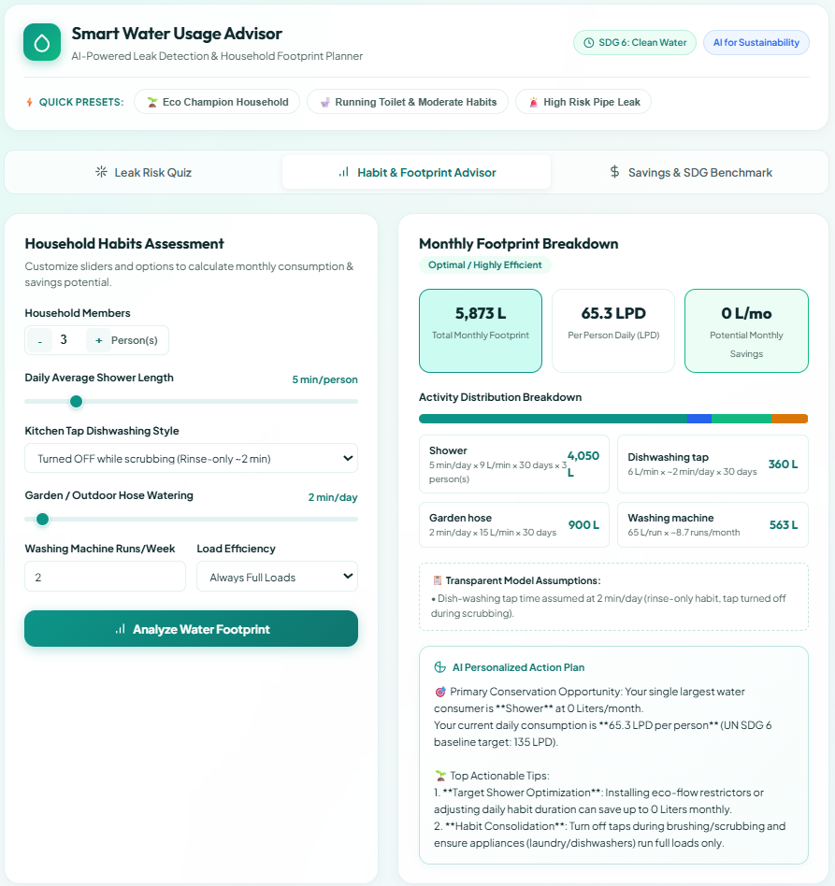
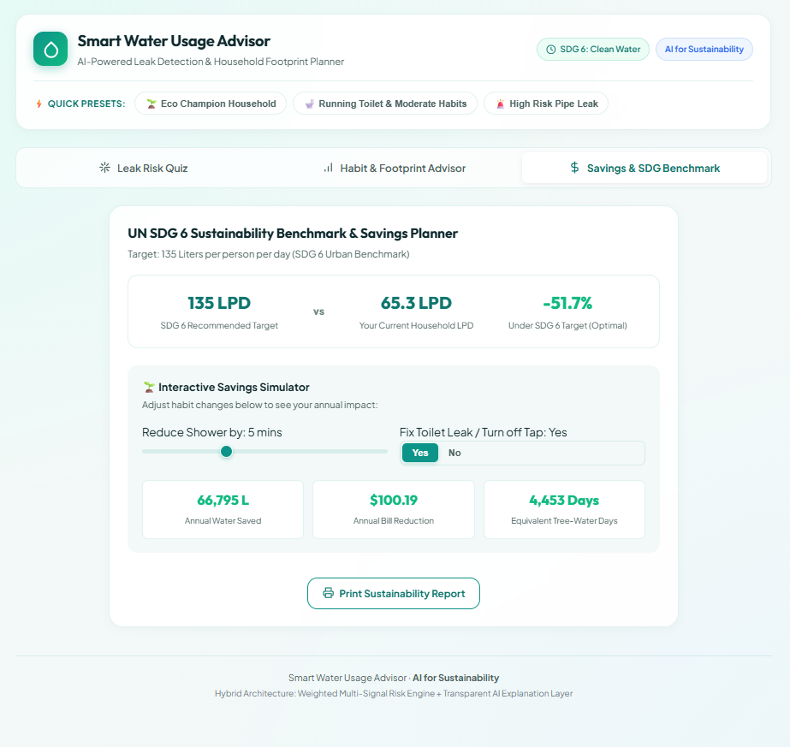
Working Prototype — Interactive Tool
A live tool combining the rule engine and AI layer — built and tested end-to-end.
Smart Water Usage Advisor | 1M1B AI for Sustainability Internship
13

Slide 14
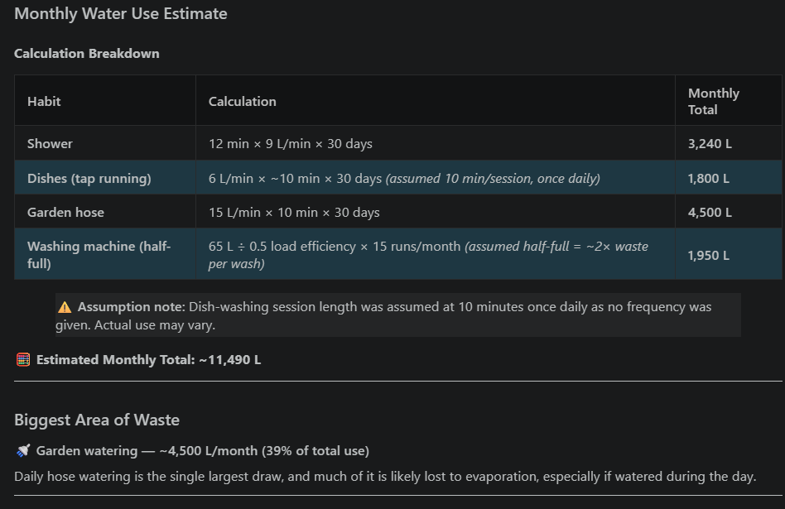
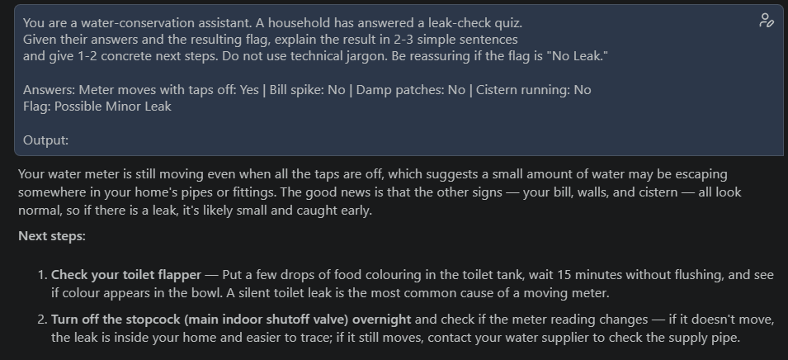

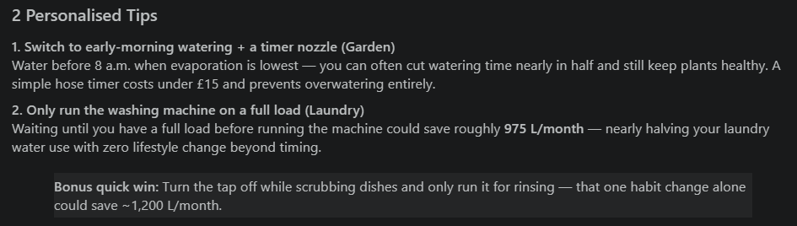
Prototype Evidence — Real AI Conversation
Actual screenshots from running the prompts on IBM BOB (or your chosen AI tool).
PASTE SCREENSHOT
PASTE SCREENSHOT
Leak Detection Conversation
Habit Advisory Conversation
Smart Water Usage Advisor | 1M1B AI for Sustainability Internship
14

Slide 15
Case Deep-Dive — Household D
Multiple warning signs, showing how the advisor handles an urgent case.
INPUT SIGNALS
WHY THIS MATTERS
Meter moves with taps off: Yes
Unexplained bill spike: Yes
Damp patches near pipes: Yes
Cistern refilling on its own: Yes
When multiple signals agree, the rule engine escalates the flag from “minor” to “urgent,” and the AI's tone shifts accordingly — from reassuring to direct. Instead of generic DIY tips, the response prioritizes fast action:
Turn off the main stopcock and observe whether damp patches worsen
Contact a plumber within 1–2 days rather than waiting for the next bill cycle
Avoid using habit tips as a substitute for addressing the leak first
Likely Major Leak — Urgent
Smart Water Usage Advisor | 1M1B AI for Sustainability Internship
15

Slide 16

Tools & Technologies Used
IBM BOB
Prompt Engineering
Ran the leak-detection and habit-advisory prompts to generate real AI explanations and tips.
Designed structured prompts that ask the AI to show its reasoning and flag assumptions.
Rule-Based Logic
HTML / JavaScript
A simple scoring system (JavaScript) converts yes/no answers into a leak-likelihood flag.
Built the working interactive prototype combining the rule engine with live AI calls.
Smart Water Usage Advisor | 1M1B AI for Sustainability Internship
16

Slide 17

Future Scope & Scalability
Smart Meter Integration
Regional Language Support
Connect to IoT water meters for real-time, automatic leak detection instead of self-reported answers.
Offer the advisor in local languages to reach a wider range of urban and semi-urban households.
Utility Dashboard
Community Rollout
Aggregate anonymized household data to help municipal water utilities spot neighborhood-level waste patterns.
Pilot with a housing society or hostel to test real-world adoption and refine the advisor with real feedback.
Smart Water Usage Advisor | 1M1B AI for Sustainability Internship
17

Slide 18
Key Learnings
AI doesn't need to be complex to be useful — combining simple rules with a well-designed prompt created a genuinely helpful tool.
Transparency matters as much as accuracy: showing calculations and stating assumptions made the advisor's output trustworthy, not just impressive.
Designing for real households (not abstract users) forced concrete choices — like what counts as an 'urgent' leak — that a generic tool would skip.
Testing across multiple scenarios (efficient, wasteful, urgent) revealed edge cases that a single demo run would have missed.
Smart Water Usage Advisor | 1M1B AI for Sustainability Internship
18

Slide 19
Thank You
Small, everyday water habits — and the leaks we never notice — add up. AI can turn invisible waste into a clear, personal, and actionable story for every household.
Nevil Usdad | Sutex Bank College Of Computer Applications & Science
1M1B AI for Sustainability Virtual Internship — IBM SkillsBuild & AICTE

