Slide 1
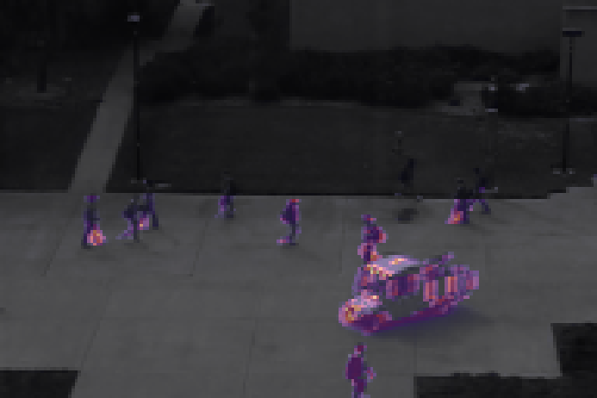
MSC DATA SCIENCE / 2026–27 BATCH / SECOND REVIEW
REC · CAM-02 · 23.10.2026
01 / 19 · COVER
Video Anomaly
Detection for
Intelligent Surveillance.
CAM-02 · UCSD PED2 · TEST004
LIVE
From proposal to working pipeline: data acquired and verified, CAE and masked ViT-AE trained on normal-only footage, and first frame-level results on UCSD Ped2.
MASKED VIT-AE + MOTION · RECONSTRUCTION ERROR
AUC 88.2
SECOND REVIEW
23 — 25 OCTOBER 2026
SUBMITTED BY
SPECIALIZATION
GUIDE
REVIEW WINDOW
Naveen
Data Science
Praveen T
23 — 25 Oct 2026
Roll No. — 24EMDT7218
Computer Vision · Deep Learning
Dept. of Computer Science
Second Review · Panel Session
01 / 19

Slide 2
VAD · SECOND REVIEW / AGENDA
REC · CAM-02 · 23.10.2026
02 / ROADMAP · MAPPED TO THE REVIEW RUBRIC
Six criteria, one walk-through.
Each section answers one rubric criterion; the footer of every slide names the criterion it evidences.
#
CRITERION
EVIDENCE
SLIDES
MARKS
01
Literature Review & Theoretical Background
Conceptual framework · 23 sources · evolution of methods · research gaps
04 – 06
8
02
Research Design / Project Plan
Sampling plan · experimental design · tools · milestones
07 – 08
6
03
Data Collection Progress
Acquisition · integrity verification · exploratory analysis
09 – 10
6
04
Analysis & Interpretation (Preliminary)
Models built · frame-level AUC · ROC · localisation · ablations
11 – 15
8
05
Consistency with Objectives
SMART objectives vs evidence · scope refinement · next steps
16 – 17
6
06
Presentation & Clarity
Logical sequence · one message per slide · reproducible figures
all
6
TOTAL · 40 MARKS
02 / 19

Slide 3
VAD · SECOND REVIEW / STATUS
REC · CAM-02 · 23.10.2026
03 / SINCE THE FIRST REVIEW
From plan to a working pipeline.
Everything promised for the Review 2 gate is in place; Avenue and ComplexVAD scale-up move into the final month.
Literature review
DONE
Dataset acquired
DONE
23 sources (Scopus/JCR venues: CVPR, ICCV, TPAMI, TIP, ACM CSUR)
UCSD Ped2 downloaded, integrity-verified against official counts
Preprocessing pipeline
DONE
Baseline CAE
DONE
Resize, 5-frame clips, motion channels, cached tensors
Trained on normal clips · frame AUC 87.6 %
Advanced ViT model
PRELIMINARY
CUHK Avenue · ComplexVAD
NEXT
Masked ViT-AE trained · frame AUC 88.2 %
Same pipeline; Avenue next, ComplexVAD licence + subset
RUBRIC · CONSISTENCY WITH OBJECTIVES · 6 MARKS
03 / 19

Slide 4
VAD · SECOND REVIEW / 01 · LITERATURE
REC · CAM-02 · 23.10.2026
04 / THEORETICAL BACKGROUND
Anomaly = what a model of normal cannot explain.
One-class novelty detection (Chandola et al., 2009; Pang et al., 2021): learn p(x | normal) from normal footage only, score deviations.
01
02
03
04
05
NORMAL-ONLY VIDEO
›
REPRESENTATION LEARNER
›
RECONSTRUCTION ERROR
›
ANOMALY SCORE s(t)
›
DECISION + LOCATION
Unlabelled footage of everyday scenes
CAE / masked ViT-AE learns the normal manifold
‖x − x̂‖² per pixel → error map
Patch-max, temporally smoothed
s(t) > τ → alert + heat map
Training set
Hasan 2016 · He 2022
Liu 2018 · Gong 2019
Ramachandra 2022
Sabokrou 2018
THREE DESIGN QUESTIONS THAT ORGANISE THE LITERATURE — AND THIS PROJECT'S ANSWER
What signal?
Appearance · optical flow · objects · scene graphs
Appearance + frame-difference motion
Which learner?
Sparse coding · CAE · ConvLSTM · GAN · memory-AE · transformers
CAE vs masked ViT-AE, same pipeline
How to decide?
Global τ · per-video normalisation · patch / object level
Patch-max score, τ from training scores
RUBRIC · LITERATURE REVIEW & THEORETICAL BACKGROUND · 8 MARKS
04 / 19

Slide 5
VAD · SECOND REVIEW / 01 · LITERATURE
REC · CAM-02 · 23.10.2026
05 / EVOLUTION OF METHODS · 2010 → 2025
Fifteen years, six families of VAD.
Each family fixed a weakness of the last. Reconstruction remains the dominant unsupervised paradigm; transformers and VLMs are the current frontier.
2010–13
2016–17
2018
2019–21
2021–24
2024–25
Classical
Reconstruction
Prediction & weak sup.
Memory-augmented
Self-sup. & masked
Vision-language
Dynamic textures, sparse coding; introduced UCSD Ped2 & Avenue
Conv / ConvLSTM autoencoders learn temporal regularity
Predict the future frame; MIL ranking on UCF-Crime
Memory of normal prototypes stops AEs reconstructing anomalies
Proxy tasks, masked auto-encoding, ViT tokens
CLIP-style semantics; complex interaction anomalies
Mahadevan · CVPR 2010
Lu · ICCV 2013
Hasan · CVPR 2016
Luo · ICME 2017
Liu · CVPR 2018
Sultani · CVPR 2018
Gong · ICCV 2019
Park · CVPR 2020
Liu · ICCV 2021
Georgescu · CVPR 2021
He · CVPR 2022
Ristea · CVPR 2024
Wu · AAAI 2024
Mumcu · WACV-W 2025
THIS PROJECT SITS IN THE HIGHLIGHTED FAMILY: CAE (RECONSTRUCTION) VS MASKED ViT-AE (SELF-SUPERVISED, MASKED)
RUBRIC · LITERATURE REVIEW & THEORETICAL BACKGROUND · 8 MARKS
05 / 19

Slide 6
VAD · SECOND REVIEW / 01 · LITERATURE
REC · CAM-02 · 23.10.2026
06 / COMPARATIVE REVIEW & RESEARCH GAPS
The field so far — and its gaps.
Published frame-level AUC (%), as reported by each paper. Ped2 is near-saturated; complex interaction anomalies are not.
STUDY | VENUE | APPROACH | PED2 | AVENUE
Hasan et al. 2016 | CVPR | Conv AE | 90.0 | 70.2
Luo et al. 2017 | ICME | ConvLSTM-AE | 88.1 | 77.0
Liu et al. 2018 | CVPR | Future-frame prediction | 95.4 | 85.1
Gong et al. 2019 | ICCV | Memory-augmented AE | 94.1 | 83.3
Park et al. 2020 | CVPR | Memory-guided (MNAD) | 97.0 | 88.5
Liu et al. 2021 | ICCV | Hybrid flow (HF²-VAD) | 99.3 | 91.1
GAP 01
Autoencoders generalise too well
Plain AEs can rebuild anomalies (Gong 2019). Masking is a cheaper remedy than memory — tested here with a masked ViT-AE.
GAP 02
CNN vs transformer is rarely isolated
Papers change inputs, losses and data at once. This project fixes the pipeline and swaps only the learner.
GAP 03
Small anomalies get averaged away
Ped2 anomalies cover a median 1.2 % of the frame — frame-mean error dilutes them.
Values as reported by the original authors; protocols differ slightly between papers.
GAP 04
Interaction anomalies are unsolved
Best ComplexVAD frame AUC ≈ 0.60 (Mumcu 2025): a realistic target there is far below 0.90.
RUBRIC · LITERATURE REVIEW & THEORETICAL BACKGROUND · 8 MARKS
06 / 19

Slide 7
VAD · SECOND REVIEW / 02 · RESEARCH DESIGN
REC · CAM-02 · 23.10.2026
07 / SAMPLING PLAN & EXPERIMENTAL DESIGN
A controlled experiment: change one thing at a time.
Same data, same preprocessing, same scoring — only the learner (and, in the ablation, the motion input) changes.
SAMPLING PLAN
EXPERIMENTAL DESIGN
EVALUATION PROTOCOL
Population
Independent var.
Primary metric
Fixed-camera pedestrian-walkway CCTV (UCSD Ped2)
Learner: PCA · CAE · masked ViT-AE
Frame-level AUC-ROC (target > 0.90)
Training sample
Ablation
Secondary
16 normal-only videos · 2,550 frames
Motion channels on / off (CAE)
EER · PR-AUC · precision / recall at τ
Test sample
Controls
Threshold τ
12 videos · 2,010 frames · 82 % anomalous
128×192 input, clip length 5, σ = 3 smoothing
99th percentile of training (normal) scores
Unit of analysis
Replication
Uncertainty
5-frame clip centred on each frame
3 random seeds per deep model, mean ± sd
95 % bootstrap CI, resampling whole videos
Per epoch
Leakage guard
Significance
Random 50 % of clips (adjacent frames are near-duplicates)
No anomaly labels touch training or τ
Mann-Whitney U, Cohen's d
RUBRIC · RESEARCH DESIGN / PROJECT PLAN · 6 MARKS
07 / 19

Slide 8
VAD · SECOND REVIEW / 02 · PROJECT PLAN
REC · CAM-02 · 23.10.2026
08 / TOOLS IDENTIFIED & MILESTONES
Four months, four gates — on track.
Updated Gantt: literature, data and baseline closed; the advanced model and second benchmark run into November.
AUG
SEP
OCT
NOV
Literature & scoping
Data & preprocessing
Baseline CAE
Masked ViT-AE
Avenue · ComplexVAD
Experiments & thesis
Review gates
R1
R2 · NOW
DRAFT
VIVA
TOOLS IDENTIFIED — AND USED
Python 3.13
PyTorch 2.x
OpenCV
NumPy · SciPy
scikit-learn
Matplotlib
Git · GitHub
Colab GPU (scale-up)
RUBRIC · RESEARCH DESIGN / PROJECT PLAN · 6 MARKS
08 / 19

Slide 9
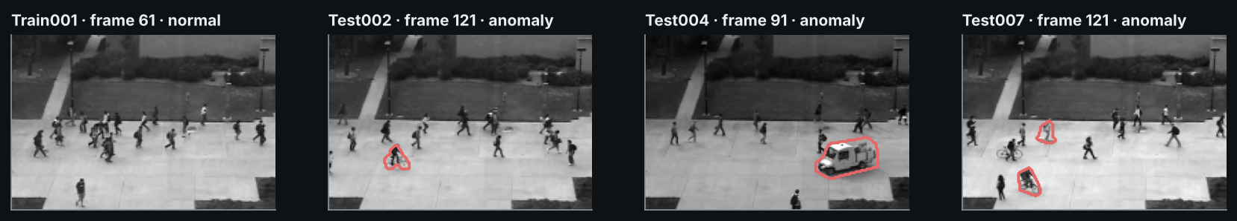
VAD · SECOND REVIEW / 03 · DATA COLLECTION
REC · CAM-02 · 23.10.2026
09 / ACQUISITION & VERIFICATION
Authentic, verified benchmark data.
Public, peer-reviewed benchmark with pixel-level ground truth; every count checked against the official release before any modelling.
INTEGRITY CHECK · scripts/prepare_data.py
OFFICIAL
FOUND
UCSD Ped2
ACQUIRED · VERIFIED
Train videos
16
16
✓
Mahadevan et al., CVPR 2010
460 MB · 28 videos · 240×360 · pixel masks
Test videos
12
12
✓
CUHK Avenue
NEXT · SAME PIPELINE
Train frames
2,550
2,550
✓
Lu et al., ICCV 2013
37 videos · 640×360 · frame + pixel GT
Test frames
2,010
2,010
✓
ComplexVAD
LICENCE · SUBSET
Pixel masks
2,010
2,010
✓
Mumcu et al., WACV-W 2025 (MERL)
39 GB · 34 h · 217 videos · 40 anomaly types
RUBRIC · DATA COLLECTION PROGRESS · 6 MARKS
09 / 19

Slide 10
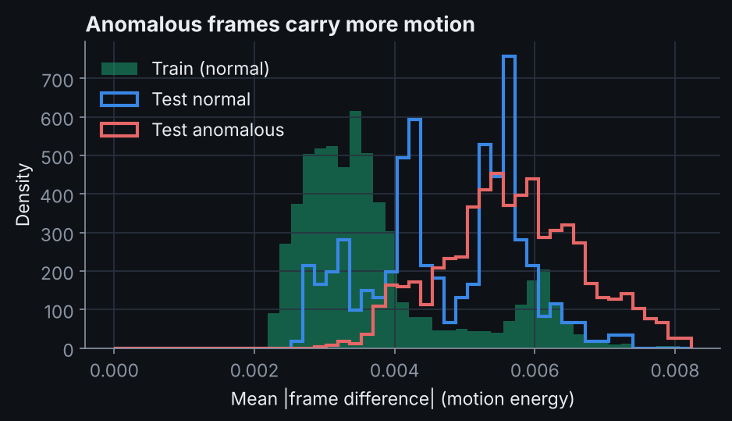
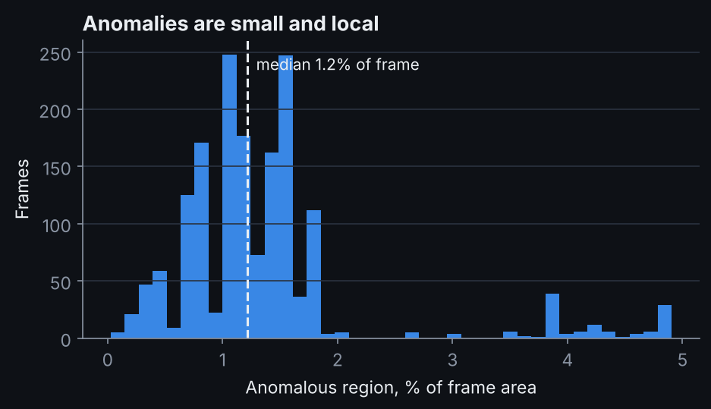
VAD · SECOND REVIEW / 03 · DATA COLLECTION
REC · CAM-02 · 23.10.2026
10 / EXPLORATORY DATA ANALYSIS
What the data told us before modelling.
Two findings shaped the design: anomalies move differently, and they are small.
0.93
1.2 %
4 of 12
COHEN'S D
MEDIAN ANOMALY AREA
TEST VIDEOS 100 % ANOMALOUS
Motion energy, anomalous vs normal test frames · Mann-Whitney p < 10⁻42
90 % of anomalous regions cover < 1.8 % of the frame
82 % of test frames are anomalous, which inflates PR-AUC and breaks per-video normalisation
→ add frame-difference motion channels
→ score with patch-max, not frame mean
→ AUC-ROC on global scores as primary
RUBRIC · DATA COLLECTION PROGRESS · 6 MARKS
10 / 19

Slide 11
VAD · SECOND REVIEW / 04 · ANALYSIS
REC · CAM-02 · 23.10.2026
11 / THE PIPELINE AS BUILT
Two learners, one pipeline.
Both models see the same 9-channel clip and are scored identically; only the representation learner differs.
INPUT CLIP
BASELINE · Hasan et al. 2016
ADVANCED · He et al. 2022 · Ristea et al. 2024
5 frames
Convolutional Autoencoder
Masked ViT Autoencoder
grayscale · 128×192
3 conv stages, 24→48→96 channels, max-pool ×3
16×16 patches → 96 tokens, dim 192, 4 layers, 4 heads
4 motion maps
64-channel 16×24 bottleneck, no skip connections
Train: hide random 50 % of tokens, inpaint them
|frame t − frame t−1| × 4
Symmetric transposed-conv decoder, sigmoid output
Test: two checkerboard masks → every patch predicted while hidden
Loss: MSE on every pixel of normal clips
Loss: MSE on hidden patches only
9 channels
centred on scored frame
0.48 M
37
12
2.69 M
149
20
PARAMETERS
FPS · 4-CORE CPU
EPOCHS
PARAMETERS
FPS · 4-CORE CPU
EPOCHS
SCORING (BOTH) · squared-error map → max over 16×16 patches → Gaussian smoothing σ = 3 frames → τ = P99 of training scores
RUBRIC · ANALYSIS & INTERPRETATION (PRELIMINARY) · 8 MARKS
11 / 19

Slide 12
VAD · SECOND REVIEW / 04 · ANALYSIS
REC · CAM-02 · 23.10.2026
12 / PRELIMINARY RESULTS · UCSD PED2
Best frame-level AUC: 88.2 %.
Masked ViT-AE + motion. Patch-max score, one global threshold across all test videos, mean of seeds; CI = 95 % bootstrap over videos.
MODEL | AUC | ± SD | EER | PR-AUC | 95 % CI
PCA baseline | 86.8 | — | 19.3 | 97.0 | 73–96
CAE (appearance only) | 76.9 | — | 29.4 | 93.6 | 57–90
CAE + motion | 87.6 | 0.2 | 20.0 | 97.3 | 76–95
Masked ViT-AE + motion | 88.2 | 0.0 | 21.5 | 97.3 | 77–96
UNSUPERVISED OPERATING POINT · MASKED VIT-AE + MOTION
100 %
48 %
65 %
0 %
PRECISION
RECALL
F1
FALSE-ALARM RATE
τ = 99th percentile of scores on normal training clips — chosen without any anomaly label; global (un-normalised) scores.
RUBRIC · ANALYSIS & INTERPRETATION (PRELIMINARY) · 8 MARKS
12 / 19

Slide 13
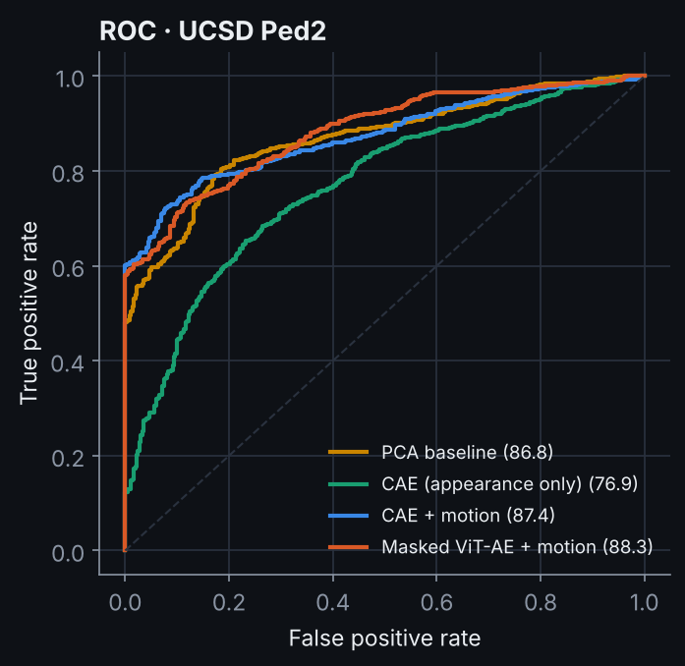
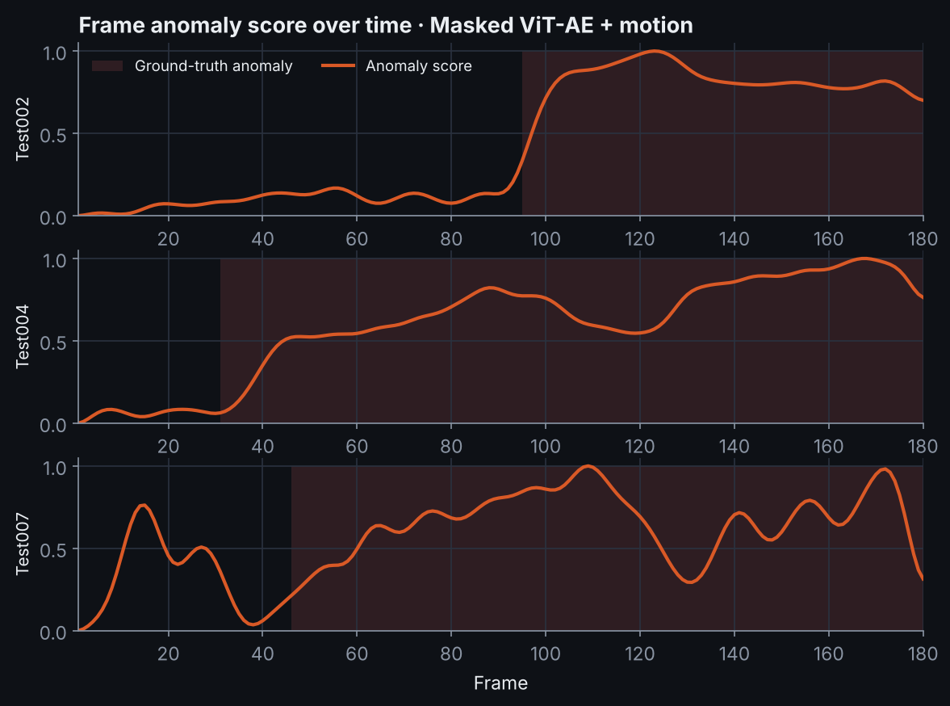
VAD · SECOND REVIEW / 04 · ANALYSIS
REC · CAM-02 · 23.10.2026
13 / HOW THE SCORES BEHAVE
Scores rise when anomalies enter the scene.
Left: ROC of every model. Right: Masked ViT-AE + motion score over time with ground-truth anomalous frames shaded.
RUBRIC · ANALYSIS & INTERPRETATION (PRELIMINARY) · 8 MARKS
13 / 19

Slide 14
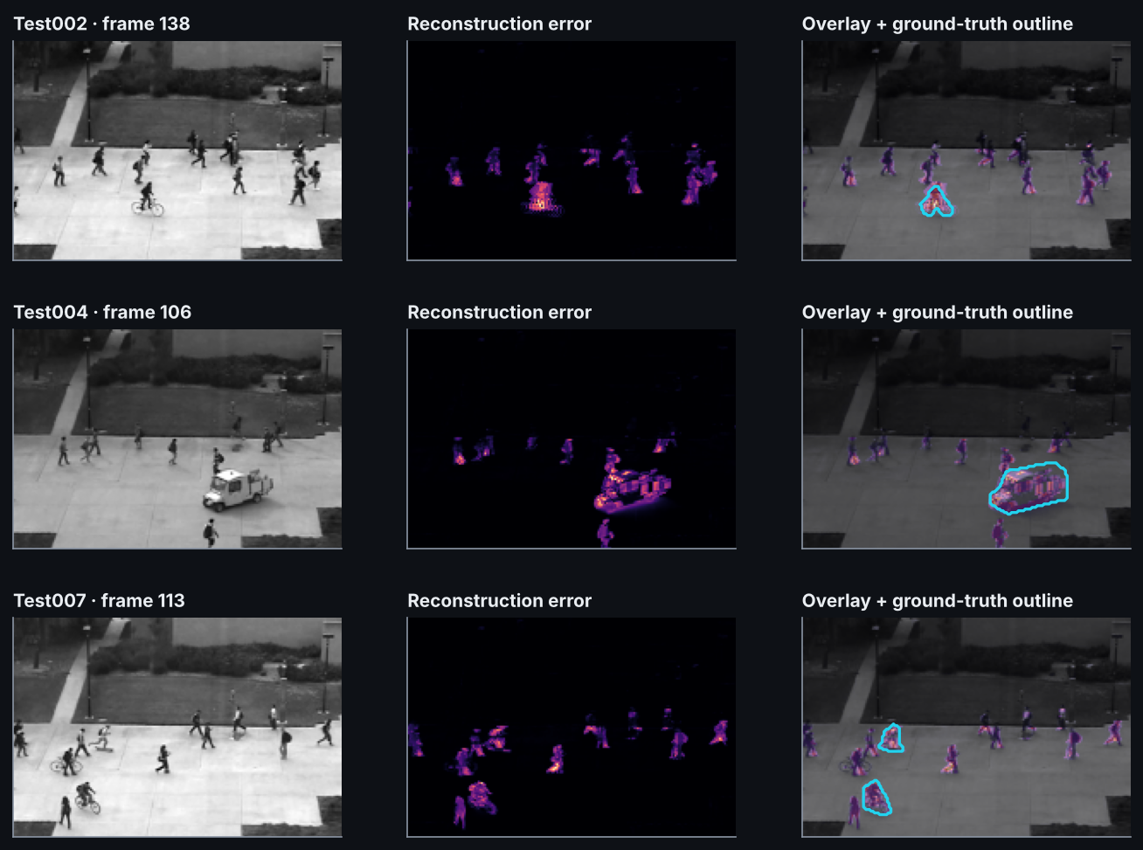
VAD · SECOND REVIEW / 04 · ANALYSIS
REC · CAM-02 · 23.10.2026
14 / SPATIAL LOCALISATION
Not just when — also where.
Per-pixel reconstruction error doubles as an explanation: the operator sees which region triggered the alert.
Vehicles and cyclists peak
The strongest error sits on the cart and bicycles, inside the cyan ground-truth outline; the background stays dark.
Pedestrians are the noise floor
Walkers still leave weaker error. In Test007 that floor causes a false peak before the anomaly starts (slide 13): a case for object-level scoring.
Explainability objective
Every alert carries where (heat map), when (score curve) and why (reconstruction error).
RUBRIC · ANALYSIS & INTERPRETATION (PRELIMINARY) · 8 MARKS
14 / 19

Slide 15
VAD · SECOND REVIEW / 04 · ANALYSIS
REC · CAM-02 · 23.10.2026
15 / INTERPRETATION & ABLATIONS
What the numbers mean.
Ablations isolate the effect of each design decision; all values are frame-level AUC (%).
MODEL | FRAME MEAN PER-VIDEO | PATCH MAX PER-VIDEO | FRAME MEAN GLOBAL | PATCH MAX GLOBAL
PCA baseline | 87.7 | 86.2 | 76.2 | 86.8
CAE (appearance only) | 83.7 | 70.2 | 64.2 | 76.9
CAE + motion | 87.8 | 87.1 | 70.8 | 87.6
Masked ViT-AE + motion | 89.1 | 84.4 | 73.0 | 88.2
+10.8 pts
Motion channels (CAE)
Frame differences help: anomalies are partly defined by how things move, as the EDA predicted.
+15.2 pts
Patch-max vs frame mean
Small anomalies are no longer averaged away by thousands of normal pixels.
+0.6 pts
Masked ViT-AE vs CAE
GLOBAL = one threshold for all videos (primary, highlighted) · PER-VIDEO = min-max within each video (literature protocol; distorted on Ped2 because 4 test videos are 100 % anomalous)
A tie at this stage (within ~1 pt); the ViT gets there with 4× faster CPU inference.
STABILITY ACROSS 3 SEEDS · AUC STANDARD DEVIATION
± 0.2
± 0.0
Differences smaller than ~1 pt are within run-to-run noise.
−3.9 pts
Per-video normalisation
Hurts on Ped2: in the 4 fully anomalous videos it stretches anomalous frames down to 0. Global scores are the honest number.
CAE + MOTION
MASKED VIT-AE
RUBRIC · ANALYSIS & INTERPRETATION (PRELIMINARY) · 8 MARKS
15 / 19

Slide 16
VAD · SECOND REVIEW / 05 · CONSISTENCY
REC · CAM-02 · 23.10.2026
16 / OBJECTIVES → EVIDENCE
Every SMART objective, checked.
The Review 1 commitments, the evidence produced so far, and their status at the Review 2 gate.
OBJECTIVE
EVIDENCE AT REVIEW 2
STATUS
S
Unsupervised frame-level detection with spatial localisation
Normal-only training; frame scores + heat maps (slides 13–14)
MET
M
Frame-level AUC-ROC > 0.90
88.2 % on Ped2 (Masked ViT-AE + motion, 3 seeds) · 1.8 pts to go, plan on slide 17
PARTIAL
A
Public data, proven architectures, modest compute
Runs end-to-end on a 4-core CPU in ~2 h; GPU optional
MET
R
Real-world surveillance relevance
Alerts carry location + score; τ set without labels
MET
T
Delivered Aug – Nov 2026
Review 2 gate met on schedule; Avenue / ComplexVAD in Nov
ON TRACK
+
CAE vs ViT head-to-head comparison
Same pipeline, same scoring, 3 seeds each (slides 12, 15)
PRELIMINARY
RUBRIC · CONSISTENCY WITH OBJECTIVES · 6 MARKS
16 / 19

Slide 17
VAD · SECOND REVIEW / 05 · CONSISTENCY
REC · CAM-02 · 23.10.2026
17 / SCOPE REFINEMENT & NEXT STEPS
Same objectives, sharper scope.
One evidence-based adjustment: the > 0.90 AUC target applies to Ped2 / Avenue; ComplexVAD is reported against its published baseline.
NEXT STEPS → FINAL REVIEW
SCOPE REFINEMENT
Primary benchmarks
01
Close the Ped2 gap to 0.90: GPU training, longer schedules, optical-flow input
Oct 25 – Nov 2
UCSD Ped2 (done) → CUHK Avenue (next): the datasets the >0.90 target was set against.
02
Run the identical pipeline on CUHK Avenue
Oct 28 – Nov 6
ComplexVAD
03
ViT temporal head (SRU++ / attention over clips) + memory module
Nov 1 – 12
Best published frame AUC is 0.60 (Mumcu 2025). Evaluate on a subset; success = beating that baseline, not 0.90.
04
ComplexVAD subset: frame + region-level AUC vs published baseline
Nov 8 – 18
Unchanged
05
Failure-case taxonomy, runtime budget, thesis chapters 4–5
Nov 12 – 26
Unsupervised setting · CAE vs ViT comparison · localisation · Aug–Nov timeline.
RISKS & MITIGATION
ComplexVAD size (39 GB) → frame sub-sampling + Colab GPU. ViT data-hunger → masking + pre-trained patch embeddings.
RUBRIC · CONSISTENCY WITH OBJECTIVES · 6 MARKS
17 / 19

Slide 18
VAD · SECOND REVIEW / REFERENCES
REC · CAM-02 · 23.10.2026
18 / SELECTED REFERENCES · FULL LIST (23) IN docs/literature_review.md
Grounded in peer-reviewed work.
01
Chandola, Banerjee & Kumar (2009). Anomaly detection: A survey. ACM Computing Surveys, 41(3).
10
Gong et al. (2019). Memorizing normality to detect anomaly (MemAE). ICCV.
02
Mahadevan et al. (2010). Anomaly detection in crowded scenes. CVPR.
11
Park, Noh & Ham (2020). Learning memory-guided normality for anomaly detection. CVPR.
03
Lu, Shi & Jia (2013). Abnormal event detection at 150 FPS in MATLAB. ICCV.
12
Pang, Shen, Cao & van den Hengel (2021). Deep learning for anomaly detection: a review. ACM Computing Surveys, 54(2).
04
Hasan et al. (2016). Learning temporal regularity in video sequences. CVPR.
13
Liu et al. (2021). Hybrid VAD via memory-augmented flow reconstruction and flow-guided prediction. ICCV.
05
Sabokrou et al. (2017). Deep-Cascade: cascading 3D deep neural networks… IEEE Trans. Image Processing, 26(4).
14
Dosovitskiy et al. (2021). An image is worth 16×16 words: Transformers for image recognition. ICLR.
06
Sabokrou et al. (2018). Deep-anomaly: fully convolutional neural network… Computer Vision and Image Understanding, 172.
15
He et al. (2022). Masked autoencoders are scalable vision learners. CVPR.
07
Liu, Luo, Lian & Gao (2018). Future frame prediction for anomaly detection – a new baseline. CVPR.
16
Ramachandra, Jones & Vatsavai (2022). A survey of single-scene video anomaly detection. IEEE TPAMI, 44(5).
08
Sultani, Chen & Shah (2018). Real-world anomaly detection in surveillance videos. CVPR.
17
Ristea et al. (2024). Self-distilled masked auto-encoders are efficient video anomaly detectors. CVPR.
09
Kiran, Thomas & Parakkal (2018). Deep learning methods for unsupervised VAD: an overview. Journal of Imaging, 4(2).
18
Mumcu, Jones, Cherian & Yilmaz (2025). ComplexVAD: Detecting interaction anomalies in video. WACV Workshops.
RUBRIC · LITERATURE REVIEW & THEORETICAL BACKGROUND · 8 MARKS
18 / 19

Slide 19
VAD · SECOND REVIEW
“
A model of normal is only as good as the anomalies it refuses to rebuild.
— WORKING PREMISE, REVISITED
Thank you.
Questions & discussion welcome.
CANDIDATE
GUIDE
CODE
PROGRAMME
Naveen
Praveen T
github.com/nevin7771
MSc Data Science
24EMDT7218
Dept. of Computer Science
video-anomaly-detection
Second Review · 2026–27
19 / 19

