Slide 1
Compiler Design assignment
Compute – programming language compiler

Slide 2
Features
A simple programming language used for implementing arithmentic and comparision operations for integers.
Supports sinlge character variables.
Evaluates and prints the expression.
Intermediate code generation in the form of three address code quadraples.
Uses line number tracking for tracking the line at which error occured.

Slide 3
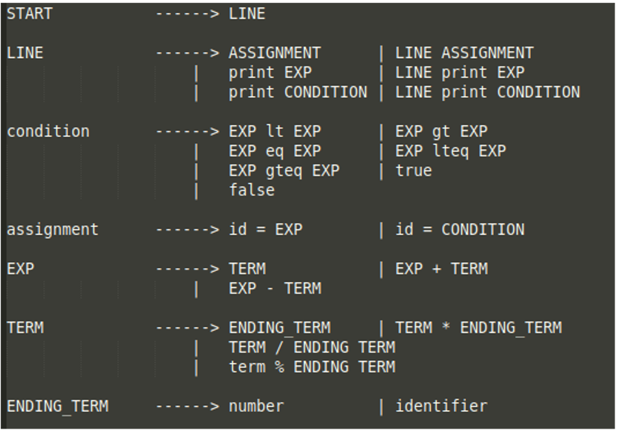
Grammar of the language.

Slide 4
Symbol table implementation
Variables can be assigned from a-z and A-Z.
Uses a Symbol Table of size 52.
Simple hashing algorithm of computing the array index is done based on the character.
This assigns the address from a-z and A-Z from 0 to 51st position in the table.
The values of the variables are stored against these address.

Slide 5
Semantic analysis implementation.
Defined under the union are the types,
int num; char id; struct incod code;
Code consists of codeVariable and value.
Code is used for expressions and conditions.
Used for storing the representation after the reduction to three address code and the value obtained after computing.

Slide 6
Three address code generation.
Uses the struct threeAddress defined under the name quadraple. Has members :
Result – The result of the current three address computation.
Operator – The operator in the computation.
Operand_1 – The first operand.
Operand_2 – The second operand.

Slide 7
Three address code generation. (Contd.)
Uses an array of this structure for storing expressions as the compiler parses.
The final code is generated by traversing this array and the code is written in the file program.txt
All the data in the struct are represented as strings.

Slide 8
Conclusion
Successfully implemented lexical, syntax and semantic analysis of the designed grammar.
Implemented the three address code generation.
https://github.com/nevinbaiju/compute-language-compiler

