Slide 1

TERM PROJECT
Front End Web Development I

Slide 2
PROJECT GROUP MEMBERS
ABRAHAM TOM C0849351
NEVIN GEORGE VARGHESE C0815504
RONY THOMAS C0836455
SARIN CHACKO SAM C0805633

Slide 3

WEBSITE FOR YASH’s SNOW BLOWERS

Slide 4
PURPOSE OF WEBSITE
YASH’s SNOW BLOWERS (YSB) is one of the leading snowblower manufacturing company headquartered in Montreal , Quebec since 1994. They offer numerous snowblowers which are more powerful, more efficient and more reliable based on user needs/demands.
This website aims to provide user with a brief description of YASH’s SNOWBLOWERS as a growing product based company.
This website also provides the details on all the products offered by the company
And details to contact the company or locate nearby office
This website also enables user to understand more about the products offered by the company from the gallery pictures uploaded on the website
To sum up , this website aims to provide an offlline store experience to the user (without the option of purchasing products online )

Slide 5
TARGET AUDIENCE
YASH’s SNOWBLOWER website mainly aims to target senior citizens who wants to remove snow from their premises with minimum physical effort by using autoClear YSBs models offered by the company.
Also this website targets audience who are in need of efficient and reliable snowblowers to remove the snow from their premises

Slide 6
PAGES INCLUDED IN THE WEBSITE
Home Page : This page aims to provide a brief description of products offered by YSB company and
Contact Page: This page enables user to fill forms to contact the company for their queries/orders and also enables them to see the nearest YSB office
About Page: This page mainly consist of detailed description of the YSB company’s history of leading the market with their innovative products
Products Page : This page consist details of all the products offered by YSB company including all product images,descriptions etc

Slide 7
GRAPHICS USED
The visual representations used on the website are
JPEG
PNG
Google Map

Slide 8
COLOUR SCHEME
#000 (black)
#FFF (white)
#61941E (Bright green)
#F2F2F2 (Light grey)
Reference : https://www.canva.com/color-palette/

Slide 9
FONT STYLES USED
Verdana
Sans-seriff

Slide 10
FEATURES
Mobile compatibility /responsive webpages using mediaquery
Google map to show location of the office
Image gallery to let users know more about YSB’s
Contrasting colour scheme
Forms for users to get in touch or contact the company
Informative header and footer

Slide 11
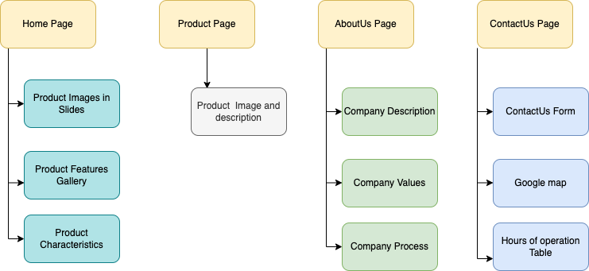
SITEMAP

Slide 12

WIRE FRAME

Slide 13
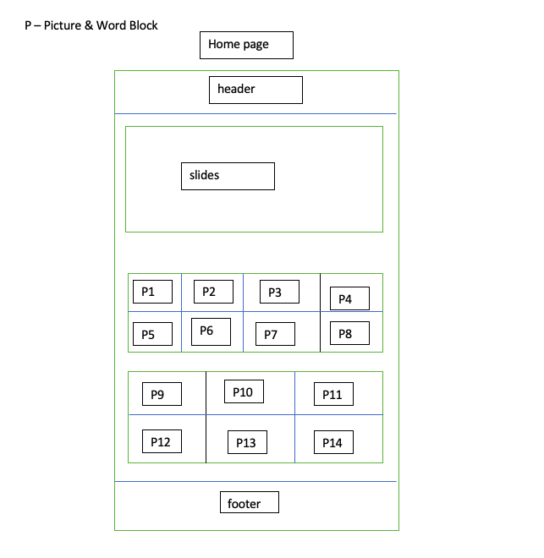

Slide 14
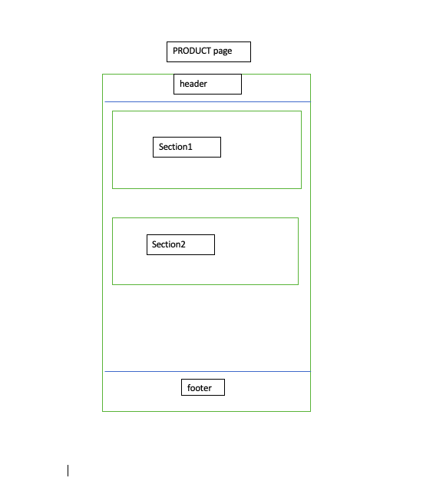

Slide 15
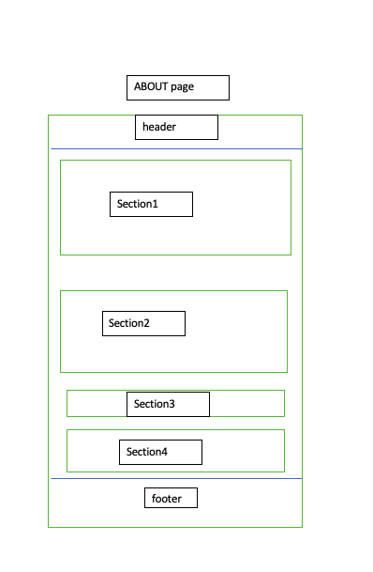

Slide 16
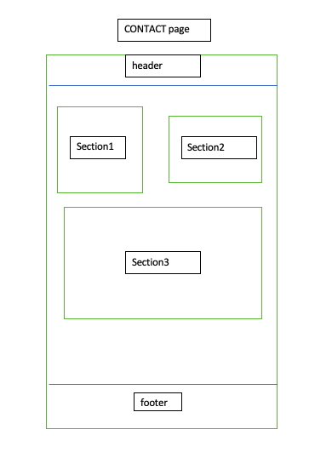

Slide 17

Thank you

