Slide 1
Problem 1- Network Anomaly Analysis
By: Abed, Nevin and Heshan

Slide 2
Problem Statement
Problem: Classify network packets as normal or various attack types using network traffic features
Dataset: ~400,000 samples with 41 features (protocol details, connection statistics, traffic patterns)
Challenges:
Severe class imbalance (some attacks have very few examples)
Potential data leakage from connection counting features
Missing values in categorical features
Goal: Create a robust model that accurately identifies attack types while addressing data leakage issues

Slide 3
Understanding/ Organization of the data
41 features + target class variable (26 unique attack types)
3 categorical features: protocol_type (5 types), service (68 types), flag (13 types)
Key observations:
Only 22,469 complete cases out of 528,603 rows
128,935 duplicate records removed
36,061 samples with empty class labels removed
Extreme outliers (shouldn’t be removed)
Preprocessing Strategy:
Split data before any processing (70% train, 30% test)
Missing values handled by:
Categorical: Mode imputation from training set
Numerical: Median imputation from training set

Slide 4
Feature Selection & Data Leakage
Identified Data Leakage Concerns:
Highly correlated features (17 redundant features with >0.95 correlation)
Traffic volume metrics might leak information about attack type
Feature Selection Approach:
Random Forest importance scores to identify key predictors
Correlation analysis to remove redundant features
Created reduced feature set without leaky features
Result: Reduced from 41 to 24 features with minimal performance impact
Top Important Features:
Connection counts (count, srv_count)
Bytes transferred (src_bytes, dst_bytes)
Service rates (same_srv_rate)

Slide 5
Success Criteria Identification
Project Success Metrics:
Primary Objective: Accurate multi-class classification of network traffic
Critical Success Factors:
Identifying data leakage and addressing it properly
Creating a generalizable model that doesn't overfit
Effectively handling class imbalance
Identifying meaningful feature subsets
Specific Targets:
Overall accuracy > 95% on test set
Identifying at least 80% of redundant/leaky features
Establishing reusable preprocessing pipeline for network data

Slide 6
Evaluation Criteria
Data Preprocessing:
Minimal information loss while handling missing values
Effective deduplication without introducing bias
Proper train/test split preventing data leakage
Feature Selection:
Reduction in dimensionality while maintaining performance
Identification of meaningful feature groups
Correlation analysis accuracy
Model Performance:
Per-class precision, recall, and F1 scores
Performance on minority classes
Generalization to unseen data
Learning curve analysis for overfitting detection

Slide 7
Model Implementation & Evaluation
Model Selection: Random Forest
Advantages for our dataset:
Handles missing values natively
Works well with categorical features
Robust to outliers
Effective with class imbalance
Performance Metrics:
Overall accuracy:
With all features: 99.92%
Without leaky features: 99.71%
Per-class performance analysis:
Exceptional detection of majority classes (>99% F1)
Poor performance on rare attack types (some with 0% recall)
Macro-average F1: 60.4% vs Weighted-average F1: 99.7%

Slide 8
Key Findings & Research Questions
Major Insights:
Model relies heavily on traffic volume metrics rather than behavioral patterns
Excellent overall accuracy masks poor performance on rare attacks
Removing 40% of features only reduced accuracy by 0.21%
Research Questions:
How do protocol metadata features alone (protocol_type, service, flag) perform compared to traffic volume metrics?
What are the distinctive patterns of minority attack classes that differentiate them from normal traffic?
Can we identify early warning signals for specific attack types from temporal connection patterns?

Slide 9
Future Work & Conclusion
Next Steps:
Hierarchical classification approach:
First classify normal vs. attack
Then identify specific attack type
Address class imbalance:
SMOTE oversampling for rare classes
Class-weighted loss functions
Create specialized models for rare attack types
Deeper analysis of temporal patterns in connections
Conclusion:
Developed high-accuracy model with reduced feature set
Identified key challenges in minority class detection
Established framework for robust network intrusion detection

Slide 10
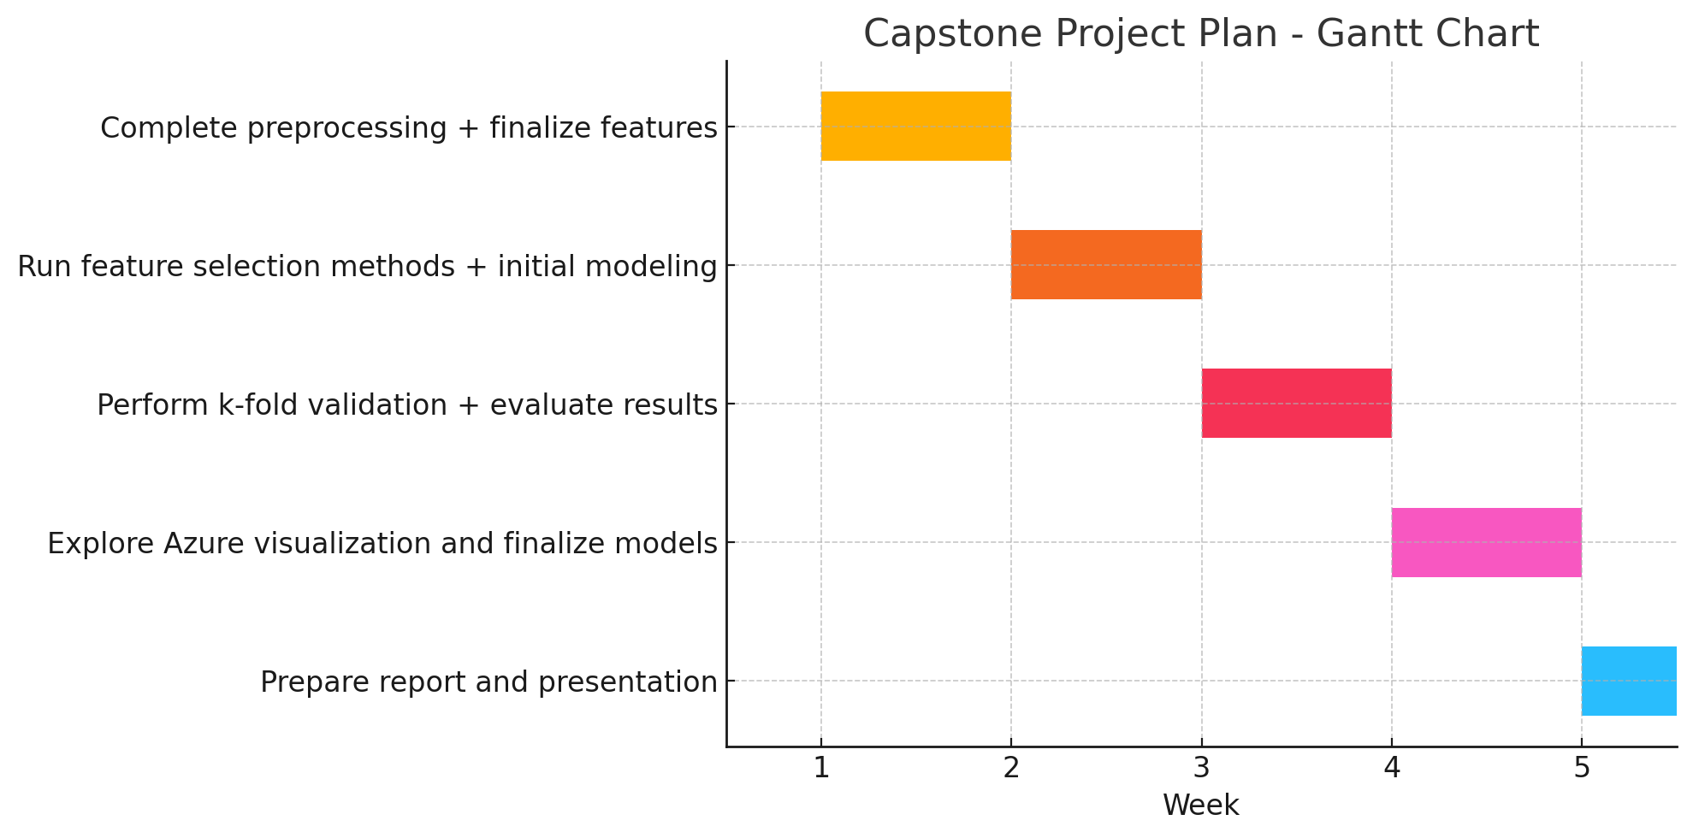
Project plan

