Slide 1
Presented By: Name: Nevin Richard Austin S Reg. no:au813821244043 College Name: Saranathan College of Engineering
Final Project
3/21/2024 Annual Review

Slide 2
PROJECT TITLE
Next Word Prediction with Deep Learning
in NLP

Slide 3


AGENDA
Creating a Next Word Prediction with Deep Learning in NLP
involves several steps. Below is a general agenda
Model Architecture
Training and Optimization
Inference and Prediction
Import libraries
Understanding and preprocessing the dataset
Defining the Model
Train the Model
Predicting the next word
Conclusion

Slide 4

PROBLEM STATEMENT
Clear articulation of the problem: "Given a sequence of words, the task is to predict the most probable next word.“
Importance of accurate next word prediction in improving user experience in applications like auto-complete, language translation, and conversational agents.

Slide 5
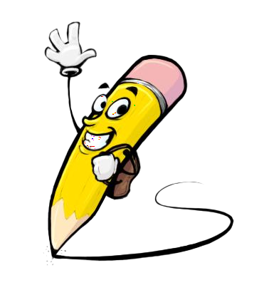
PROJECT OVERVIEW
1)Dataset:
Description of the dataset used for training and testing
Data preprocessing steps (e.g., tokenization, padding, etc.)
Visualization of dataset statistics (e.g., distribution of words)
2)Model Architecture:
Detailed explanation of the proposed Deep Learning architecture
Description of layers, activations, and parameters
Visualization of the model architecture (e.g., flowchart, diagram)
3)Training Process:
Explanation of the training pipeline
Training hyper parameters and optimization techniques
Visualization of training/validation loss and accuracy curves

Slide 6
PROJECT OVERVIEW
4)Evaluation Metrics:
Overview of evaluation metrics used to assess model performance
Metrics such as perplexity, accuracy, etc.
Comparison with baseline models
5)Results:
Presentation of experimental results
Quantitative analysis of model performance
Qualitative analysis through examples and visualizations

Slide 7

WHO ARE THE END USERS?
The end users for Next Word Prediction with Deep Learning in NLP could include:
General Users
Developers and Engineers
Language Learners
Accessibility Users
Content Creators
Medical Professionals
Educators and Researchers

Slide 8

YOUR SOLUTION AND ITS VALUE PROPOSITION
The solution of Next Word Prediction with Deep Learning in NLP project offers several key value propositions:
Enhanced User Experience
Increased Typing Efficiency
Language Understanding and Assistance
Adaptability and Personalization
Support for Multiple Languages and Domains

Slide 9

THE WOW IN YOUR SOLUTION
1)Accessibility and Inclusivity: By offering predictive text input capabilities, the solution promotes accessibility and inclusivity for users with disabilities or special needs. It enables individuals with motor impairments, visual impairments, or language-related difficulties to communicate more effectively and independently, thereby reducing barriers to access information and participate in digital communication.
2)Efficient Content Generation: For content creators, writers, and professionals, the solution streamlines the writing process and facilitates content generation. By suggesting the next word based on context, the solution can inspire creativity, overcome writer's block, and expedite the drafting of documents, articles, or social media posts.
3)Time and Cost Savings: The solution saves time and effort for users by reducing the need for manual typing and editing. In business settings, it can lead to increased efficiency in communication, faster response times in customer service, and overall cost savings by optimizing workflow processes.
9

Slide 10
MODELLING
To create Next Word Prediction with Deep Learning in NLP
you'll need to follow a structured approach. Here's a step-by-step:
Data Preprocessing:
Sequence Generation: Create input-output pairs where the input is a sequence of words and the output is the next word in the sequence.
Word Embedding:
Map each word in the vocabulary to a high-dimensional vector representation
Model Architecture Selection:
Recurrent Neural Networks (RNNs): LSTM (Long Short-Term Memory) or GRU (Gated Recurrent Unit) networks are commonly used due to their ability to capture long-term dependencies.
Evaluation:
Evaluate the trained model on the test set using metrics like perplexity, accuracy, or BLEU score.
Deployment:
Deploy the trained model in production environments, either as part of a standalone application or integrated into existing systems.
10

Slide 11
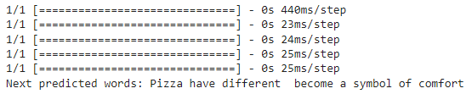
RESULTS
Deep learning in NLP has several useful applications, including next-word prediction. We can efficiently capture the sequential dependencies in text data and produce precise predictions by applying models like LSTM or GRU. Next-word prediction models keep getting better thanks to deep learning developments and the accessibility of big text corpora, which enhance user experience and enable a variety of NLP applications.
THANK YOU
11

