Slide 1
Sustainability Score Evaluation
By Team Explorers, NSBE Hackathon

Slide 2
Importance of Sustainability Score
1. Environmental Preservation: Sustainability ensures the conservation of natural resources and ecosystems, vital for the well-being of present and future generations.
2. Shift in Values: Prioritizing sustainability over wealth and technological advancement emphasizes the importance of responsible stewardship of the planet.
3. Competitive Drive: Introducing sustainability scores fosters healthy competition among individuals and organizations, driving innovation and continuous improvement in sustainable practices.
4. Collective Responsibility: Maintaining sustainability scores collectively reinforces the commitment to environmental conservation and contributes to broader sustainability efforts.
5. Tangible Metrics: Sustainability scores serve as measurable indicators of progress, promoting accountability and motivation for individuals and communities to achieve environmental goals.

Slide 3
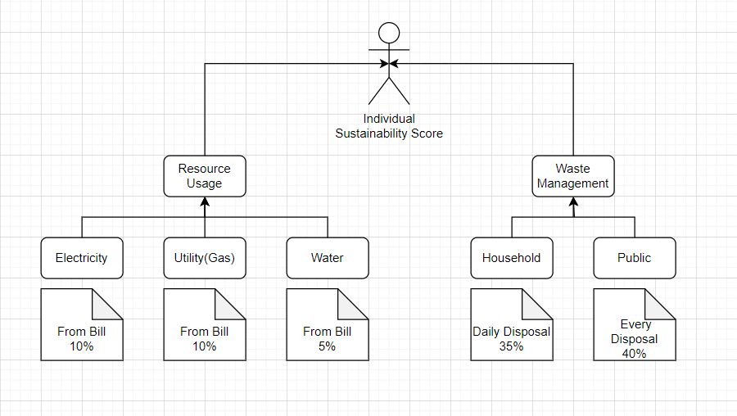
Approach

Slide 4
Prototype
1. Implement a distinct identification number to assign and track sustainability scores for individuals, ensuring accountability and accurate record-keeping.
2. Develop a comprehensive index that encompasses various sustainability factors, including weighted contributions, upper and lower boundaries, ensuring a holistic approach to score calculation.
3. Utilize advanced algorithms to calculate sustainability scores for each individual, incorporating the weighted contributions of different factors and considering upper and lower boundaries for accurate assessment.
4. Integrate computer vision technology into waste management practices, enabling facial recognition for individuals and updating scores accordingly. Implement object detection algorithms to identify disposal practices and assign scores based on adherence to correct waste disposal methods.
5. Maintain a centralized database to store and manage sustainability scores, facilitating real-time updates and ensuring accurate tracking of individual sustainability efforts. Regularly update scores based on usage data and incorporate mechanisms for data integrity and security.

Slide 5
Implementation Results-

