Slide 1
Underexplored mechanisms in Muon
Direction correction, learning-rate robustness, and momentum timing
Students: Nevo Jonathan Sznajder, Itay Asolin
Mentors: Tehila Dahan, Kfir Y. Levy
ResNet-18 / CIFAR-100 and TinyViT-5M / ImageNet-100
Muon project
1
Notes:
Introduce the project as a controlled study of small modifications around Muon, not as a claim of a new universal optimizer.
The talk is organized around three mechanisms: MARS-style direction correction, momentum decay, and a Mu2SGD-inspired secondary estimator.

Slide 2
Project summary
CONDITIONAL
STRONGEST
NEGATIVE RESULT
MARS gives selected higher-LR gains
Momentum decay is the clearest positive result
Mu² changes direction, not outcomes
Clean ResNet confirmations show small improvements at the higher tested matrix learning rates. TinyViT gives a smaller matched improvement in one selected condition.
Late β decay improves final accuracy under the tested constant-LR policy, but gives no mean improvement under the tested cosine-LR policy.
The correction survives Muon's polar transform, yet broad sweeps and three-seed stress tests show no consistent accuracy benefit.
Muon project
2
Notes:
Give the audience the destination before the technical background.
The strongest positive result is late momentum decay under constant learning rate. MARS gives smaller improvements in selected higher-learning-rate conditions.
The Mu2-style correction is a useful negative result because we verified it changes the direction but does not reliably improve accuracy.

Slide 3
Presentation outline
1
2
3
4
Background
Protocol
Ablations
Synthesis
→
→
→
Gradient descent, momentum, and Muon
Models, datasets, parameter split, and schedules
MARS, momentum decay, and Mu²
Interactions, limitations, and claims
Muon project
3
Notes:
The first third builds enough optimization background for a mixed audience.
The results are then grouped by mechanism rather than by chronology, which makes the argument easier to follow.

Slide 4
Gradient descent
A model predicts, a loss measures error, and the optimizer chooses the next parameter update.
1
2
3
4
Mini-batch
→
Forward pass
→
Loss + gradient
→
Optimizer
images + labels
model predictions
local direction
filtered matrix update
θₜ₊₁ = θₜ − ηₜ · updateₜ
Muon project
4
Notes:
For a non-specialist audience, explain the loop before naming the optimizers.
The project changes the rule that turns noisy minibatch gradients into a matrix update; the model, data, and training budget stay fixed inside each comparison.

Slide 5
Learning rate and momentum
SCALE
MEMORY
Learning rate ηₜ
Momentum βₜ
Multiplies the final update. A high value moves quickly but can destabilize training; a cosine schedule gradually reduces the reachable distance late in training.
Averages recent directions. High β retains a long memory; lowering β makes the estimate respond more quickly to the latest gradients.
η high → larger step
η low → smaller step
β high → longer memory
β low → shorter memory
Muon project
5
Notes:
Separate the two controls explicitly because the central momentum result is an interaction between them.
A decaying learning rate shrinks all remaining parameter motion. A decaying beta changes which historical directions are emphasized.

Slide 6
Muon
It replaces the raw matrix direction by an approximate polar factor before applying the learning rate.
Matrix gradient
Approximate polar update
Gₜ
If Z = UΣVᵀ, then O(Z) ≈ UVᵀ
→
momentum + Nesterov
Magnitude information is strongly normalized.
Orientation remains central.
↓
Newton–Schulz ×5
θₜ₊₁ = θₜ − ηₜ O(Zₜ)
Source: Jordan (2024), Muon: An optimizer for hidden layers in neural networks.
Muon project
6
Notes:
Muon is not applied uniformly to every tensor in our implementation.
For matrix parameters it uses momentum, Nesterov-style lookahead, and five Newton–Schulz steps to approximate the polar update. Biases and normalization parameters use an internal AdamW branch.
Source: Keller Jordan, 2024.

Slide 7
Methods tested
DIRECTION CORRECTION
MEMORY CONTROL
RECURSIVE HISTORY
MARS-inspired
Momentum decay
Mu²-inspired
mₜ = gₜ + γₜ(gₜ − gₜ₋₁)
Does a local gradient-difference correction improve robustness at stressed learning rates?
βₜ decreases during a chosen window.
Does shortening memory accelerate or improve late training, and how does the LR schedule change that effect?
rₜ = gₜ + αₜ(hₜ₋₁ − gₜ₋₁)
hₜ₋₁ is the stored previous Nesterov signal. Does this history correction improve Muon?
Muon project
7
Notes:
Each mechanism has a distinct role: MARS changes the current direction using a gradient difference, momentum decay changes memory length, and Mu2 adds a recursive estimator.
The core question is not whether one package wins everywhere, but which mechanism changes behavior under which stress.

Slide 8
Prior work and the remaining question
Work
Core mechanism
What was already established
STORM / μ²-SGD
Same-sample recursive correction; μ² adds Anytime averaging
Variance reduction and LR robustness under stated theory assumptions
MARS
Scaled correction for preconditioned optimizers
AdamW, Lion, and Shampoo variants
MARS-M
MARS-style correction inside Moonlight / Muon
Matrix scaling, clipping, theory, and language / vision experiments
DEMON
Momentum coefficient decays with remaining training horizon
Derived schedule; tested with SGDM and Adam
Remaining question
Which isolated mechanisms transfer into Muon, under which learning-rate regime, and do their effects combine?
We claim controlled transfer evidence, not algorithmic priority over the cited methods.
Muon project
8
Notes:
STORM introduced same-sample recursive gradient correction; Mu2-SGD combines a related correction with Anytime iterate averaging and proves learning-rate robustness under convex assumptions.
MARS scales the correction for preconditioned optimizers. MARS-M later carries that construction into Moonlight and Muon, including matrix-aware scaling and clipping.
DEMON derives a nonlinear momentum-decay schedule from the cumulative future influence of momentum, but studies SGDM and Adam rather than Muon.
Our contribution is a controlled vision ablation: isolate the mechanisms, keep the training recipe fixed, and test where each transfers into Muon.
Sources: https://arxiv.org/html/2304.04172 ; https://arxiv.org/html/2411.10438 ; https://arxiv.org/html/2510.21800v2 ; https://arxiv.org/abs/1910.04952

Slide 9
A modular Muon update
Each tested mechanism enters at a separate point in the same matrix-parameter path.
cₜ = gₜ + γₜ(gₜ − gₜ₋₁)
MARS-inspired direction correction
rₜ = cₜ + αₜ(hₜ₋₁ − cₜ₋₁)
History correction using the stored prior Nesterov signal
mₜ = βₜmₜ₋₁ + (1 − βₜ)rₜ
Muon momentum with an optional β schedule
hₜ = (1 − βₜ)rₜ + βₜmₜ
Nesterov signal sent to the polar map and stored for step t+1
qₜ = P_NS(hₜ)
Five Newton–Schulz steps
Wₜ₊₁ = (1 − ηₜλ)Wₜ − ηₜqₜ
Decoupled weight decay and matrix update
γ = 0 removes MARS, α = 0 removes Mu², constant β removes momentum decay
Muon project
9
Notes:
This is the actual order implemented in the combined optimizer: MARS correction, Mu2-inspired recursive estimator, scheduled Muon momentum, Nesterov signal, Newton–Schulz polar map, then the outer parameter update.
The implementation passes the estimator tensor into Muon in place. Muon overwrites that tensor with h_t, the Nesterov-combined pre-polar signal, so the next recurrence uses h_(t-1), not a literal untouched r_(t-1).
Setting gamma to zero removes MARS. Setting alpha to zero removes the Mu2-inspired estimator. Holding beta constant removes momentum decay.
Non-matrix parameters remain in the same auxiliary AdamW branch in every matched comparison.

Slide 10
Models and datasets
CONTROLLED LAB
STRESS TEST
ResNet-18 / CIFAR-100
TinyViT-5M / ImageNet-100
Purpose: broad mechanism discovery
• 32×32 images, 100 classes
• 50k train / 10k test
• CIFAR stem: 3×3, stride 1, no max pool
• Strong convolutional inductive bias
• Full LR grid repeated on seeds 42–44
Purpose: cross-architecture confirmation
• 224×224 images, 100 classes
• 130k train / 5k validation
• Published TinyViT-5M topology, task head: 5.10M params
• Local-window attention + hierarchical stages
• Selected cells confirmed on seeds 42–44
Muon project
10
Notes:
ResNet on CIFAR-100 is the fast controlled lab: broad grids and repeated seeds are inexpensive.
TinyViT on ImageNet-100 is the larger confirmation workload: higher-resolution data, heavier augmentation, and a transformer-like architecture provide a meaningful stress test.
We do not compare absolute accuracy across the two datasets.

Slide 11
ResNet-18 and CIFAR-100
50,000
10,000
100
32 × 32
training images
test images
classes
input resolution
MODEL
DATA
EVIDENCE
Architecture
Augmentation
Role in the study
Torchvision ResNet-18 with residual blocks, a 3×3 stride-1 stem, and no initial max pooling.
Random crop with padding 4, horizontal flip, and standard CIFAR normalization.
Broad grids, coefficient sweeps, full factorials, and three-seed confirmations where claims are made.
Muon project
11
Notes:
CIFAR-100 has 100 fine-grained classes and small images, making complete grids feasible.
The modified CIFAR stem avoids the aggressive downsampling used for ImageNet-sized inputs.
This workload is where we establish clean learning-rate, coefficient, and factorial ablations.

Slide 12
TinyViT-5M and ImageNet-100
130k
5k
100
224²
5.10M
training images
validation images
classes
input resolution
task parameters
MODEL
REGULARIZATION
ROLE
Published topology
Heavy data recipe
Interpretation
tiny_vit_5m_224 with stage dimensions [64, 128, 160, 320], depths [2, 2, 6, 2], and local-window attention.
Random resized crop, flip, color jitter, RandAugment, random erasing, Mixup 0.8, CutMix 1.0, and label smoothing 0.1.
A hybrid convolution/attention architecture evaluated on a second workload with higher resolution and heavier augmentation.
TinyViT-5M architecture; trained from scratch for 50 epochs without distillation.
Muon project
12
Notes:
This is the real tiny_vit_5m_224 architecture, not a compact proxy.
Replacing the 1000-class head by a 100-class head yields 5,103,864 trainable parameters, which explains the difference from the canonical 5.4M label.
The experiment is from scratch for 50 epochs on ImageNet-100; it does not reproduce TinyViT's ImageNet-1K pretraining and distillation recipe.

Slide 13
Training protocol
50
128
5
1.0
42–44
epochs
batch size
epoch eval interval
gradient-norm clip
confirmation seeds
METRIC
COMPARISON
REPRODUCIBILITY
Final-epoch reporting
Matched seeds
Non-bitwise execution
We report the last evaluated accuracy. Threshold plots separately describe speed, avoiding a best-checkpoint/final-accuracy mix.
Compared conditions reuse the same nominal seeds and locked hyperparameters. No seed-specific retuning is performed.
BF16/TF32, cuDNN kernels, and augmentation streams mean a nominal seed does not imply an identical trajectory.
Muon project
13
Notes:
These are short, from-scratch optimizer comparisons with the same 50-epoch budget and batch size on both workloads.
Final accuracy is the final evaluated epoch, not a best-checkpoint cherry pick. Error bars are sample standard deviations across the stated seeds.

Slide 14
Parameter split used in this study
AdamW is an internal auxiliary branch here, not a full-model baseline in the reported comparisons.
RANK ≥ 2
RANK < 2
Matrix parameters: Muon
Lower-dimensional tensors: AdamW
Includes classifier weights. Convolution kernels [out, in, kH, kW] are reshaped to [out, in·kH·kW].
• experiment matrix LR
• β defined by the tested policy
• Nesterov direction
• 5 Newton–Schulz steps
• matrix weight decay 5×10⁻⁴
Examples: biases, normalization scales
• fixed LR 0.001
• betas (0.9, 0.999)
• epsilon 10⁻⁸
• weight decay 0
• unchanged across clean matched grids
Muon project
14
Notes:
This slide resolves the most important implementation ambiguity.
Rank-2-or-higher parameters, including classifier weights, use Muon and the experiment matrix learning rate. Biases, normalization scales, and other rank-1 tensors use a fixed AdamW branch.
For convolution weights shaped [out, in, kH, kW], the implementation reshapes to [out, in·kH·kW], applies the Muon update, and restores the original tensor shape afterward.
The outer scheduler changes only the matrix learning rate.

Slide 15
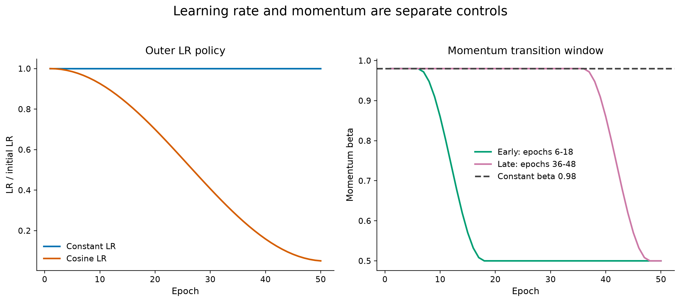
Learning-rate and momentum schedules
Muon project
15
Notes:
Define the schedules once here so later result slides can stay uncluttered.
Cosine matrix LR decays to 5% of the initial value over 50 epochs. Momentum changes happen in a specified early or late window. Gamma and alpha are either fixed or explicitly scheduled.

Slide 16
Experiment methodology
DISCOVERY
EVIDENCE
SCOPE
Exploratory grids
Matched confirmations
Two workload roles
Purpose: map the design space quickly
• many coefficients and schedules
• often nominal seed 42
• descriptive, not a final ranking
• failed regions retained as evidence
Purpose: support the reported claims
• seeds 42, 43, 44
• same hyperparameters per seed
• paired comparisons where possible
• mean ± sample SD
Purpose: balance scale and cost
• ResNet: complete, inexpensive ablations
• TinyViT: selected transfer tests
• no claim of universal optimality
• backup contains full coverage
Seed 42 also appears in exploration, so the confirmations are replicated evidence, not a held-out test set.
Muon project
16
Notes:
Be transparent about evidence levels. Broad seed-42 sweeps locate behavior; seeds 42–44 confirm the cells that support the claims.
The full ResNet LR grid is three-seed. TinyViT confirmations are targeted because the workload is more expensive.
This asymmetry is appropriate for a semester project as long as it is explicit.

Slide 17
MARS corrects the gradient before Muon
mₜ = gₜ + γₜ (gₜ − gₜ₋₁)
SIGNAL
CORRECTION
STRENGTH
Current gradient
Gradient difference
Coefficient γ
gₜ provides the present minibatch direction.
gₜ − gₜ₋₁ changes local directional responsiveness. Any stabilization interpretation remains a hypothesis.
γ = 0 recovers the exact within-implementation Muon control; positive γ is swept explicitly.
Unlike MARS-M, this study omits β/(1−β) scaling and corrected-gradient clipping.
Muon project
17
Notes:
Our implementation is a deliberately simple MARS-inspired correction, not the full MARS optimizer and not a claim of first combining MARS and Muon.
MARS-M previously studied a MARS–Muon combination. We isolate the consecutive-gradient term and examine it with momentum timing across two vision workloads.
Sources: Yuan et al. 2024; Liu et al. 2025, MARS-M.

Slide 18
MARS-M previously combined variance reduction with Muon
MARS scaled STORM-style correction for preconditioned optimizers; MARS-M carried it into Moonlight / Muon.
Cₜ = ∇f(Xₜ, ξₜ) + γₜ β/(1−β) [∇f(Xₜ, ξₜ) − ∇f(Xₜ₋₁, ξₜ)]
Mₜ = βMₜ₋₁ + (1−β) Clip(Cₜ, 1)
Oₜ = NewtonSchulz(Mₜ)
Xₜ₊₁ = Xₜ − ηₜ[0.2 Oₜ √max(m,n) + λXₜ]
What MARS-M established
What we isolate
• A formal MARS–Muon construction
• Improved results on language modeling and vision
• A stronger nonconvex stationarity rate under its assumptions
• The consecutive-gradient correction cₜ = gₜ + γₜ(gₜ−gₜ₋₁)
• Learning-rate robustness in two controlled vision workloads
• Interactions with momentum decay and the Mu²-inspired module
MARS-M also studies a consecutive-gradient approximation. We examine a simplified correction within our Muon implementation and its interaction with momentum schedules.
Liu, Yuan, and Gu, MARS-M: When Variance Reduction Meets Matrices, 2025
Muon project
18
Notes:
MARS-M is prior work on combining a MARS-style corrected gradient with a Muon or Moonlight matrix update.
The formal construction uses a same-sample gradient difference, beta over one minus beta scaling, clipping, and matrix-dependent output scaling. Approximate MARS-M also discusses consecutive-minibatch gradients and omission of corrected-gradient clipping.
Consecutive-minibatch gradients and omission of corrected-gradient clipping are also discussed in approximate MARS-M. Our contribution is the controlled experimental study, not those choices themselves.
MARS-M reports improved language-modeling and computer-vision results and gives a first-order stationarity rate of order T to the minus one third up to logarithmic factors, compared with a previously established T to the minus one quarter rate for Muon.
Source: https://arxiv.org/html/2510.21800v2

Slide 19
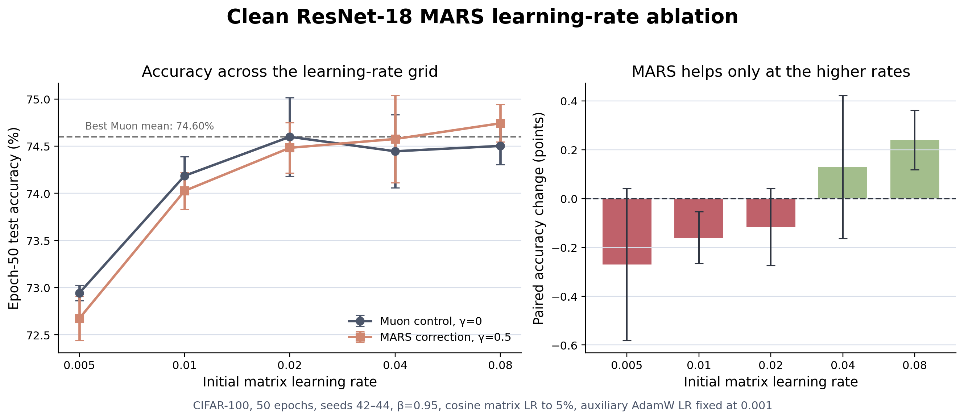
ResNet-18 MARS learning-rate ablation
Dots = individual seeds. Left error bars = per-condition sample SD; right error bars = sample SD of paired seed differences.
Muon project
19
Notes:
This is the cleanest ResNet learning-rate result: beta 0.95, fixed auxiliary AdamW LR, seeds 42–44.
Gamma 0.5 slightly hurts at the lowest rates, then adds 0.13 points at LR 0.04 and 0.24 points at LR 0.08.
The claim is a small improvement in selected higher-LR conditions, not a uniform robustness or stabilization result.

Slide 20
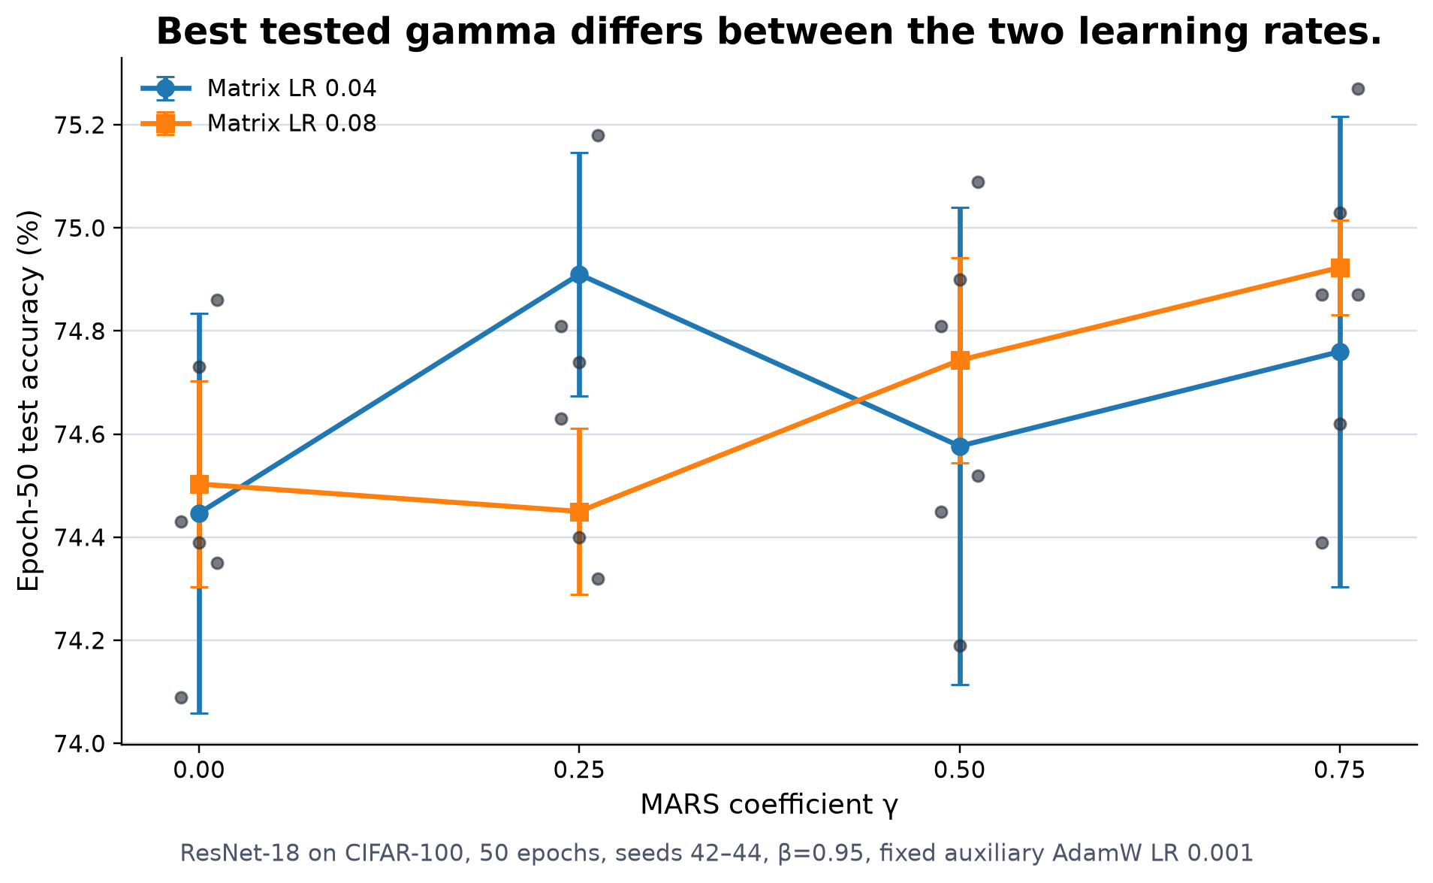
MARS coefficient ablation
Dots = individual seeds; markers = means; error bars = per-condition sample SD.
Muon project
20
Notes:
At LR 0.04, gamma 0.25 is the best tested point at 74.91 ± 0.24 percent.
At LR 0.08, gamma 0.75 is the best tested point at 74.92 ± 0.09 percent.
These are in-grid optima; do not turn them into a universal coefficient recommendation.

Slide 21
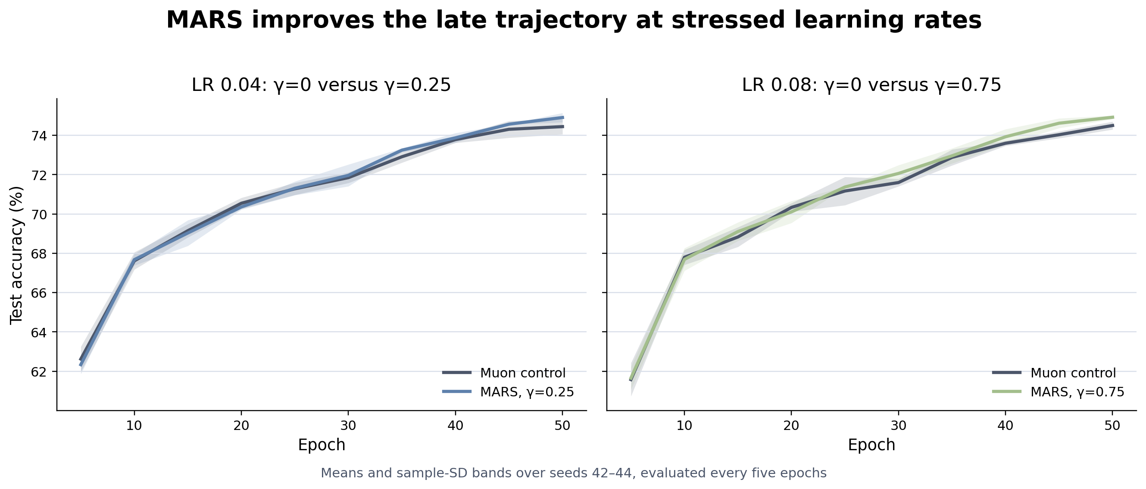
MARS learning curves
Lines = three-seed means; bands = per-condition sample SD.
Muon project
21
Notes:
The trajectories overlap through much of training; the corrected runs separate late rather than winning immediately.
The final paired improvements are 0.46 points at LR 0.04 with gamma 0.25 and 0.42 points at LR 0.08 with gamma 0.75.

Slide 22
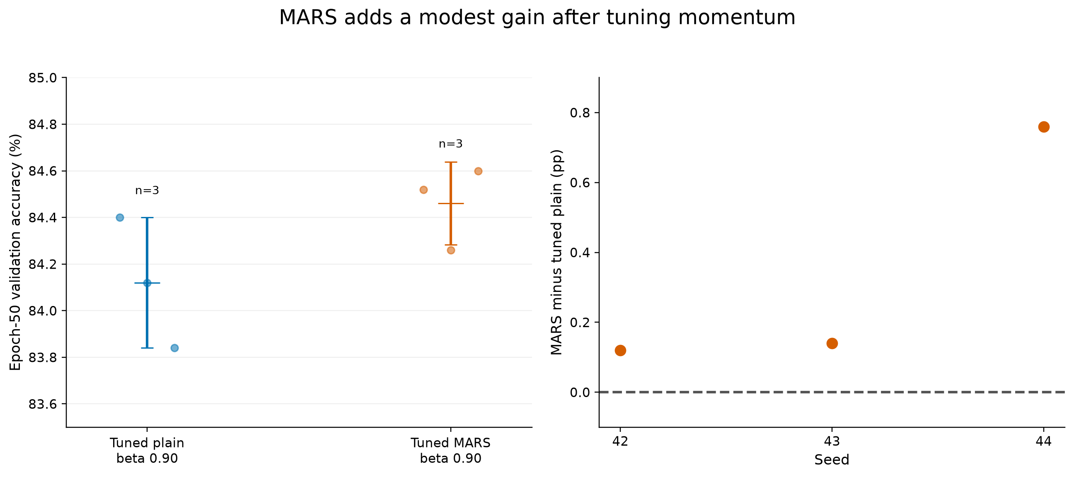
TinyViT MARS confirmation
Dots = individual seeds; crossbars = per-condition mean ± sample SD. Reported MARS change uses matched seed labels.
TinyViT-5M / ImageNet-100; cosine matrix LR 0.01; β = 0.90; γ = 0.35
Muon project
22
Notes:
This is the clean cross-architecture confirmation at cosine matrix LR 0.01 and beta 0.90.
MARS raises mean accuracy from 84.12 ± 0.28 to 84.46 ± 0.18 percent.
The much larger historical high-LR gap is preserved in backup; the main claim uses this cleaner matched comparison.

Slide 23
MARS results
EVIDENCE
BOUNDARY
NON-CLAIM
Established
Conditional
Not claimed
• Small gains in selected higher-LR cells
• Clean ResNet confirmations
• One matched TinyViT increment
• Stress-dependent coefficient response
• Little or negative gain at lower LR
• Best γ differs by regime
• Separation often appears late
• Universal superiority
• First MARS–Muon combination
• One coefficient for every regime
Calibrated claim: small improvements in selected higher-LR conditions, not direct evidence of variance reduction or universal stabilization.
Muon project
23
Notes:
Use this slide as the transition from MARS to momentum.
The supported statement is a small improvement in selected higher-LR conditions. We do not claim that every gamma helps, that MARS wins at low LR, or that our formula reproduces MARS-M.

Slide 24
Momentum decay shortens directional memory
mₜ = βₜmₜ₋₁ + (1 − βₜ)gₜ
sₜ = (1 − βₜ)gₜ + βₜmₜ
β(e) = β₀ + ½(βf − β₀)[1 − cos(πτ(e))]
τ(e) = clip[(e − es)/(ef − es), 0, 1]
Memory length
Tested late schedule
What changes
A useful approximation is 1/(1−β). β=.98 retains roughly 50 steps; β=.50 retains roughly 2.
β₀=.98, βf=.50, es=36, ef=48. The transition is cosine-smooth inside that epoch window.
The schedule changes which directions dominate the Nesterov signal. It does not directly reduce the learning rate.
Muon project
24
Notes:
With constant beta, the contribution of an older gradient decays geometrically. Lowering beta shortens this memory during the chosen window.
For Muon this matters because the polar map removes much radial scale but preserves orientation: changing which gradients are remembered changes the direction sent into the polar map.
Source context: DEMON, Chen et al. 2021; our schedule is tested directly inside Muon.

Slide 25
DEMON studied momentum decay before Muon
βₜ = βinit (1−t/T) / [(1−βinit) + βinit(1−t/T)]
DEMON
This study
• Derived from cumulative future momentum influence
• β decays across the remaining training horizon
• Evaluated with SGDM and Adam
• Broad model / dataset / budget study
• Selected β windows: early and late
• Applied only to Muon's matrix momentum
• Crossed with constant and cosine matrix LR
• Replicated early and late windows on seeds 42–44
The novelty is the controlled Muon interaction, not the idea of decaying momentum itself.
Muon project
25
Notes:
DEMON chooses beta so that the cumulative future contribution beta over one minus beta falls with the remaining training fraction.
The original study evaluates this schedule with SGDM and Adam across many model, dataset, and training-budget combinations.
Our schedule is not a reproduction of DEMON. We use selected early and late cosine windows and place them specifically inside Muon's matrix branch.
The new controlled question is the interaction between beta timing and constant versus cosine outer learning rate.
Source: Chen et al., Decaying Momentum Helps Neural Network Training, https://arxiv.org/abs/1910.04952

Slide 26
Early momentum decay gives a transient post-baseline boost
ResNet-18 / CIFAR-100; seeds 42, 43, and 44; paired gap centered at epoch 5
Cosine LR; beta 0.98 to 0.50 after epoch 6 through epoch 18
Each curve shows how the between-condition accuracy gap changes relative to epoch 5.
Matrix LR 0.04
Matrix LR 0.08
Thin lines = individual seeds; thick line = mean.
Thin lines = individual seeds; thick line = mean.
Peak post-baseline gains: +1.70 ± 0.42 pp at epoch 10 and +3.30 ± 0.55 pp at epoch 15; ± is paired-difference sample SD.
Muon project
26
Notes:
These are ResNet-18 on CIFAR-100 paired seed differences for seeds 42, 43, and 44. Each seed pair is centered at its epoch-5 difference, before beta can change. Evaluation occurs every five epochs.
A configuration audit found that the paired runs match in model, data, seed, optimizer, LR schedule, and all optimizer fields except beta endpoint and schedule. Beta is identical through epoch 6 and changes only afterward.
The independent runs are not bitwise-coupled. Their raw epoch-5 mean offsets are plus 1.21 points at LR 0.04 and plus 0.05 points at LR 0.08, so the figure removes that pre-intervention offset instead of attributing it to beta decay.
For each seed, we plot [early-decay accuracy − constant-beta accuracy] at epoch t, minus the same difference at epoch 5. This subtracts the observed baseline gap; it does not eliminate subsequent execution variability or establish causality.
After baseline-centering, the mean gain peaks at 1.70 plus or minus 0.42 points at epoch 10 for LR 0.04 and 3.30 plus or minus 0.55 points at epoch 15 for LR 0.08. These are sample SDs of paired seed changes.
The original uncentered final paired differences remain available in the archived curves: −0.66 ± 0.68 pp at LR 0.04 and −0.82 ± 0.48 pp at LR 0.08. These raw endpoint differences are different quantities from the baseline-centered endpoints plotted here.
The advantage then contracts and reverses. The result is a transient speed effect during the decay window, not an endpoint improvement under cosine LR.

Slide 27
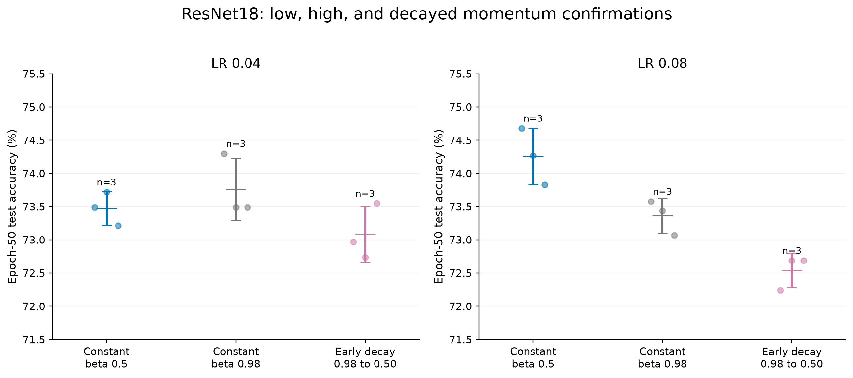
Low constant momentum is not uniformly better
ResNet-18 / CIFAR-100; cosine LR; 50 epochs; seeds 42, 43, and 44
Beta 0.50 loses at LR 0.04 but wins at LR 0.08
Dots = individual seeds; crossbars = per-condition mean ± sample SD.
Muon project
27
Notes:
This is ResNet-18 on CIFAR-100 with cosine learning-rate decay for 50 epochs. The graph shows seeds 42, 43, and 44 at matrix learning rates 0.04 and 0.08.
The three policies are constant beta 0.50, constant beta 0.98, and early cosine decay from beta 0.98 to 0.50 during epochs 6 through 18.
At LR 0.04, constant beta 0.50 reaches 73.47 plus or minus 0.26 percent, below constant beta 0.98 at 73.76 plus or minus 0.47 percent.
At LR 0.08, constant beta 0.50 reaches 74.26 plus or minus 0.43 percent, above constant beta 0.98 at 73.36 plus or minus 0.26 percent.
Early decay ends below the constant policies at both rates. The transient gain shown earlier therefore cannot be summarized as low momentum being universally preferable.

Slide 28
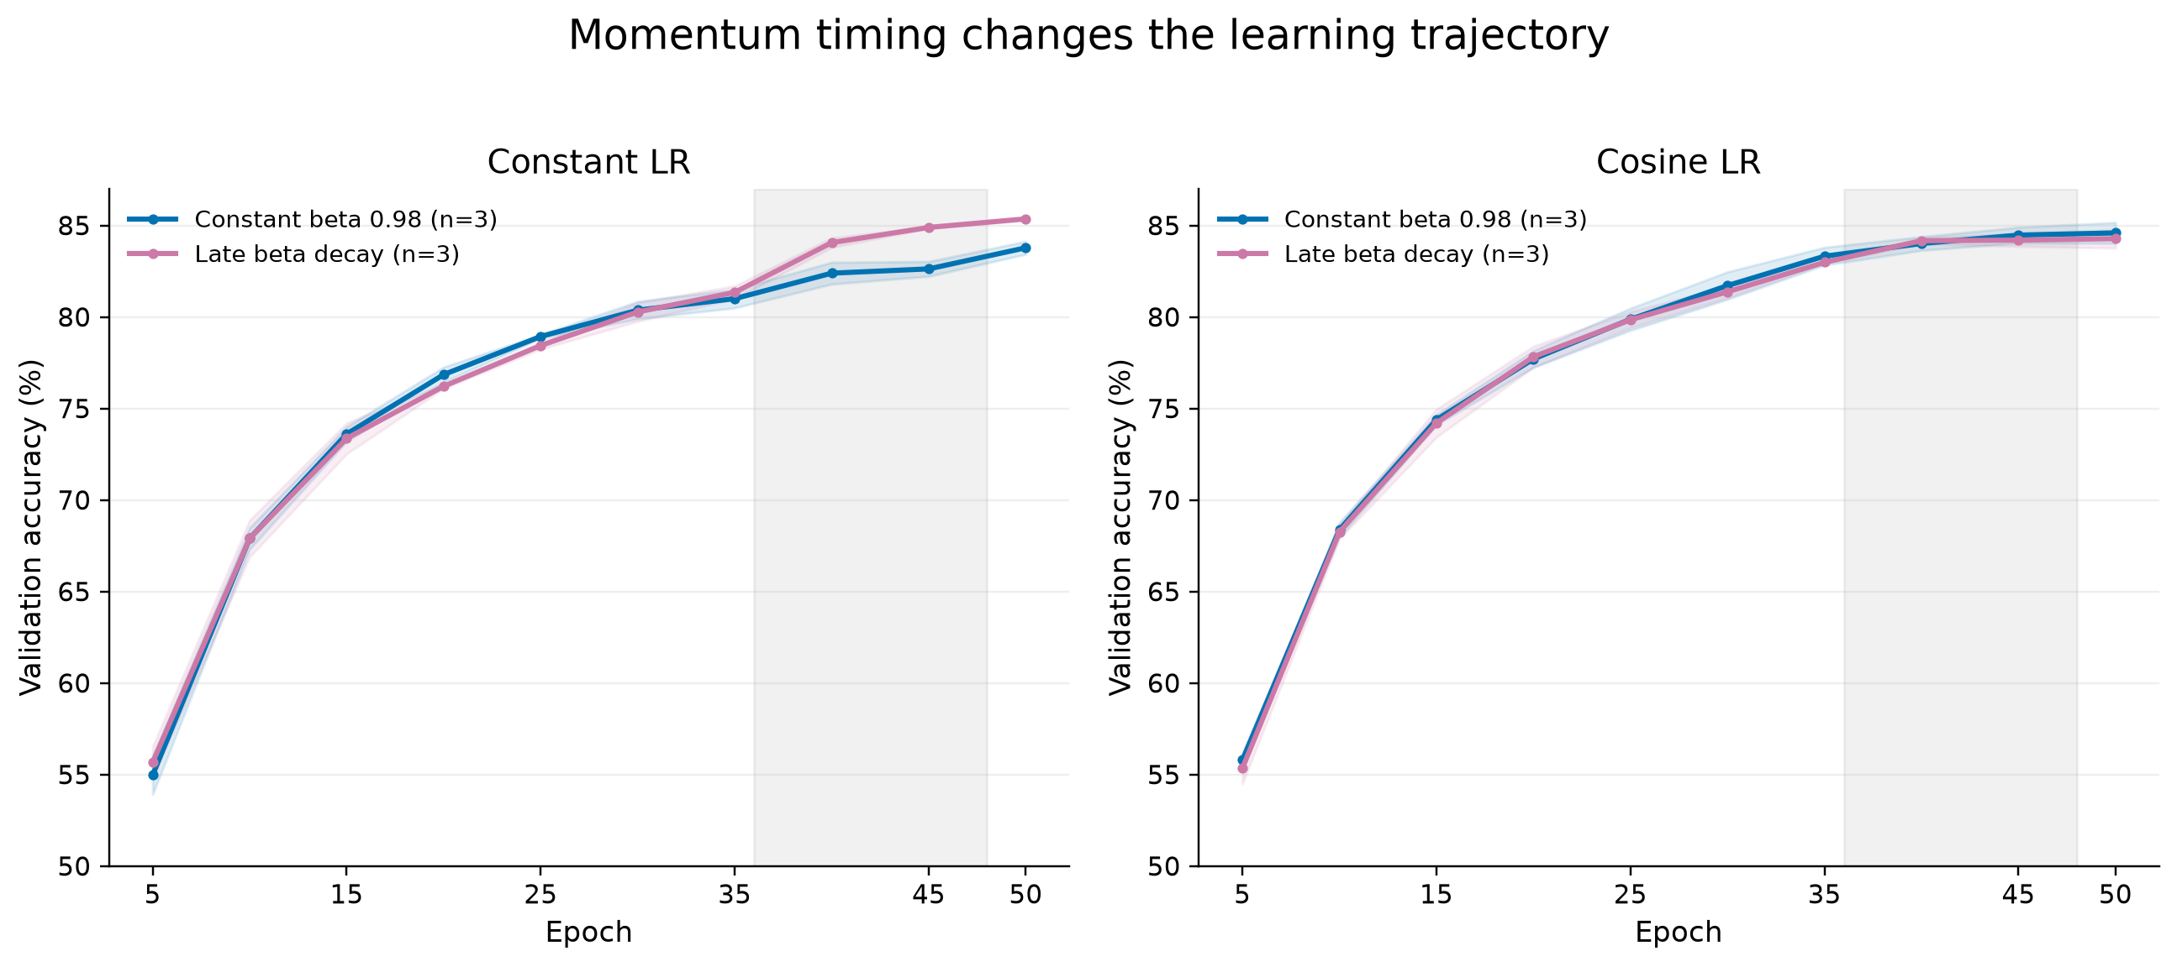
Three-seed timing of the momentum-decay gain
Seeds 42, 43, and 44; evaluated every 5 epochs
Epoch 50 under constant LR: +1.58 ± 0.33 percentage points
Lines = means; bands = per-condition sample SD. The +1.58 ± 0.33 result is mean ± sample SD of paired seed differences.
Muon project
28
Notes:
Each curve is the mean across seeds 42, 43, and 44. Shading shows the sample standard deviation. Test accuracy was recorded every five epochs.
All cells start at matrix LR 0.0025. The crossed choices are constant versus cosine LR and constant beta 0.98 versus late beta decay from 0.98 to 0.50 during epochs 36 through 48.
Under constant LR, the momentum-decay curve separates after the scheduled transition and finishes 1.58 plus or minus 0.33 percentage points higher. Under cosine LR, the curves remain close and the final paired change is negative.

Slide 29
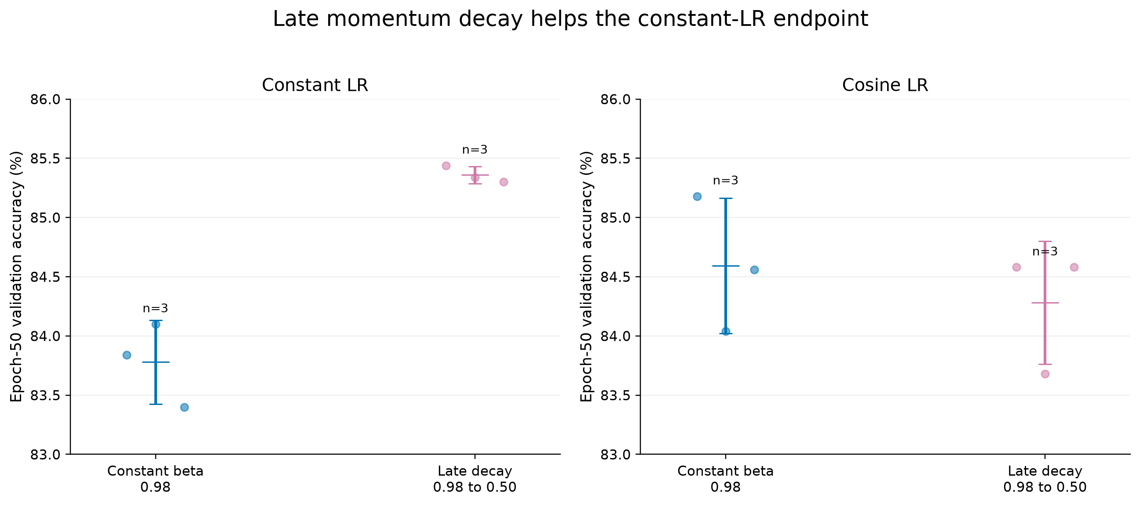
TinyViT final accuracy
Dots = individual seeds; crossbars = per-condition mean ± sample SD. Reported changes are mean ± sample SD of paired seed differences.
Muon project
29
Notes:
Under constant LR, late beta decay improves final accuracy by 1.58 ± 0.33 points.
Under cosine LR, the paired change is negative: minus 0.31 ± 0.31 points.
This is the cleanest quantitative statement of the interaction.

Slide 30
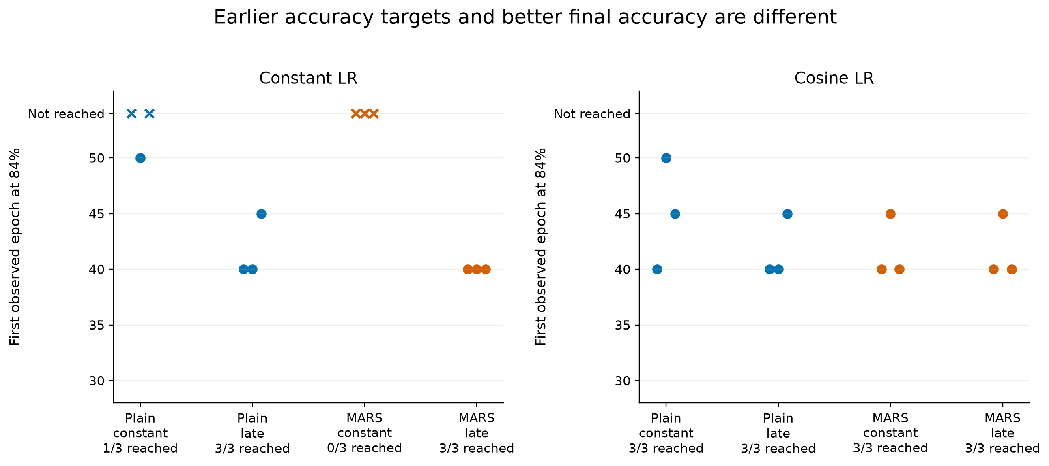
Convergence speed and final accuracy
Muon project
30
Notes:
This plot records the first evaluation epoch that reaches 84 percent, with five-epoch resolution.
Some seeds never reach the threshold and remain censored rather than being silently dropped.
A method can reach a target sooner without finishing best, or finish best without crossing earliest.

Slide 31
Constant versus cosine learning rate
COMPATIBLE CONTROLS
TIMESCALE MISMATCH
Constant LR + late β decay
Cosine LR + late β decay
1. β decay shortens directional memory
2. recent gradients rotate the estimate
3. Muon preserves the changed orientation
4. constant η leaves substantial path length
5. the model can act on the refreshed direction
1. β decay still changes orientation
2. however, ηₜ is already small
3. the remaining cumulative displacement is limited
4. the smaller outer learning rate may limit the effect of changing direction
5. any directional gain may not reach a new region
Mechanistic hypothesis, not a causal proof: the observed interaction is consistent with path-length × orientation coupling.
Muon project
31
Notes:
This is a theoretical interpretation consistent with the experiment, not a convergence theorem for neural networks.
Beta decay reorients the memory estimate toward recent gradients. If the outer learning rate has already decayed, the remaining path length is too small to realize much benefit from that reorientation.
Muon approximately cancels radial magnitude, but it does not cancel angular error, so direction quality still matters.

Slide 32
Prior μ²-SGD results without Muon
xₜ₊₁ = [α₁:ₜ / α₁:ₜ₊₁]xₜ + [αₜ₊₁ / α₁:ₜ₊₁]wₜ₊₁
dₜ₊₁ = gₜ₊₁ + (1−βₜ₊₁)(dₜ − g̃ₜ)
gₜ₊₁ = ∇f(xₜ₊₁; zₜ₊₁), g̃ₜ = ∇f(xₜ; zₜ₊₁)
Μ²-SGD
WITHOUT MUON
CONTROLLED TRANSFER
Published method
Published evidence
Our question
Same-sample gradient correction plus an Anytime query average. The proof uses the complete construction.
ResNet-18 / CIFAR-10 and a small CNN / MNIST, three seeds, fixed γ=.10 and β=.90; improved learning-rate robustness was reported.
Does our μ²-inspired history correction improve Muon?
The prior result motivates the transfer test; our plug-in is not a reproduction of the full μ²-SGD algorithm.
Dahan and Levy, Do Stochastic, Feel Noiseless, 2023/2025
Muon project
32
Notes:
The full algorithm couples an Anytime query average with a corrected momentum estimator.
The two gradients in the correction use the same fresh sample, which is essential to the variance-reduction analysis. Our plug-in does not reproduce that oracle construction or the Anytime query average.
Under convexity, a bounded domain, bounded stochastic-gradient variance, and smooth sample losses, the paper proves that the estimator error decays on the order of one over t up to constants and logarithmic terms.
The deep-learning heuristic in the original work uses fixed gamma 0.1 and beta 0.9 and reports improved learning-rate robustness on ResNet-18 with CIFAR-10 and on a small CNN with MNIST.
Those results motivate our question, but they do not imply that one component will transfer through Muon's polar update.
Source: https://arxiv.org/html/2304.04172

Slide 33
Our test: does the correction help Muon?
rₜ = gₜ + αₜ (hₜ₋₁ − gₜ₋₁)
hₜ₋₁ is the previous Nesterov-combined pre-polar signal stored in place; it is not an untouched rₜ₋₁.
ONLY ONE CHANGE
DID IT ACT?
DID IT HELP?
Matched control
Mechanism check
Outcome check
The α=0 run is ordinary Muon with the same β, learning rate, regularization, seed, and auxiliary AdamW branch.
We measure the angle between corrected and uncorrected matrix updates before and after Muon's polar transform.
We compare final accuracy in a broad coefficient sweep and in matched three-seed confirmations.
The experiment separates geometric activity from optimization benefit: a changed update direction is necessary, but it may still be worse.
Muon project
33
Notes:
This is not a claim to reproduce the complete Mu2SGD algorithm. The implemented history correction uses h_(t-1), the prior Nesterov-combined pre-polar signal stored by Muon's in-place update.
A deterministic three-step optimizer trace confirms the distinction: the implemented in-place state gives nonzero correction and post-polar angles after step one, while a preserve-estimator literal recurrence stays exactly equal to the raw gradient and has zero angles.
We sweep the correction coefficient broadly, then confirm representative matched cells across seeds 42 to 44.
The main conclusion does not depend on an alpha schedule: the correction is active geometrically but does not improve accuracy consistently.

Slide 34
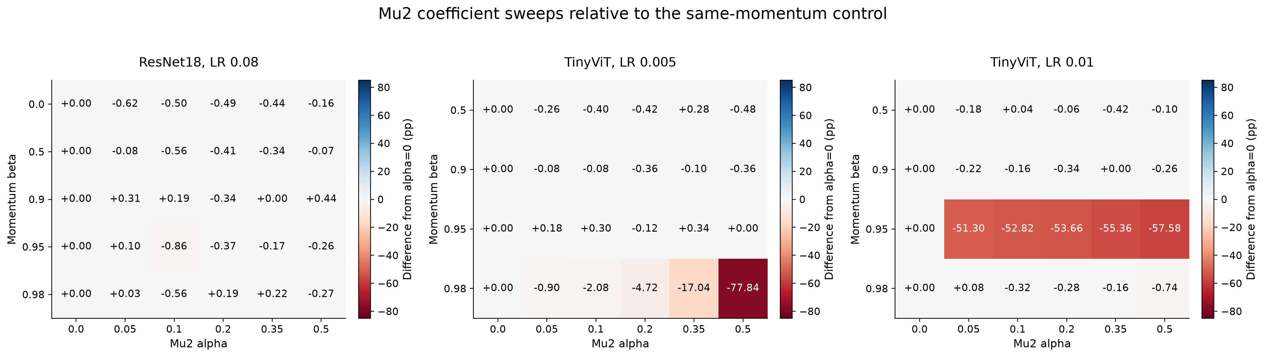
Broad coefficient search found no stable gain
Exploratory seed-42 cells; each value is matched to alpha 0 at the same beta and LR. No uncertainty interval is implied.
Muon project
34
Notes:
This heatmap summarizes 78 fixed-coefficient seed-42 cells. Each positive-alpha cell is compared with alpha zero at the same beta and LR.
A few cells improve, but the response is inconsistent and high-memory settings can degrade sharply.
Treat this as exploration, not as a replicated optimizer ranking.

Slide 35
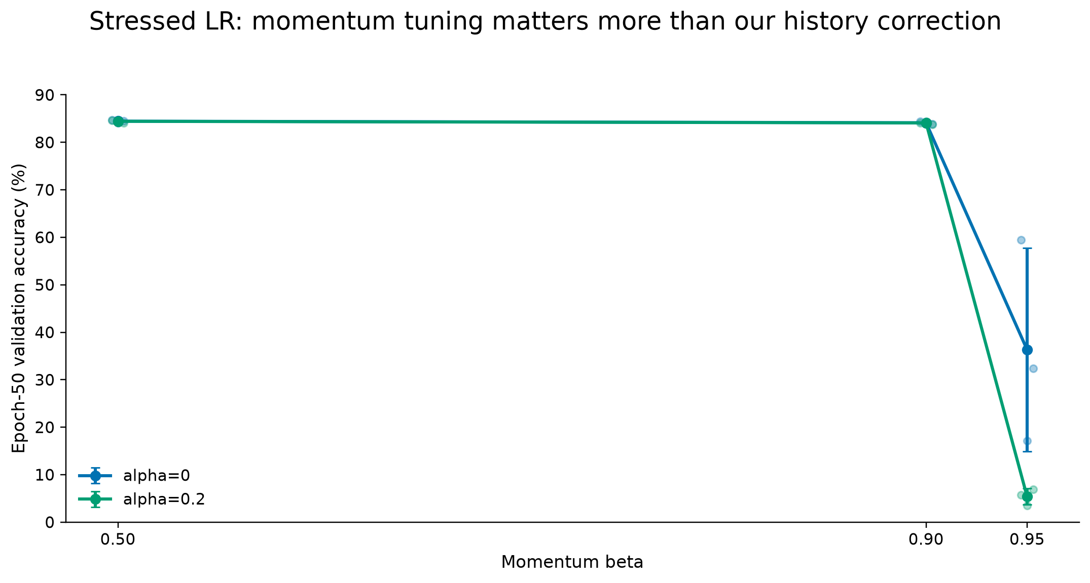
Three-seed confirmation: no consistent accuracy gain
Small dots = individual runs; large markers and error bars = per-condition mean ± sample SD across three seeds.
Muon project
35
Notes:
On TinyViT at cosine matrix LR 0.01, beta 0.5 and 0.9 show essentially zero mean change from alpha 0.20.
At beta 0.95 the correction worsens an already unstable control.
Lowering beta matters more than enabling this estimator in the tested regime.

Slide 36
How we verified that the direction changed
Angles are computed over all matrix tensors at the same optimizer state.
cos θ = Σᵢ⟨aᵢ,bᵢ⟩F / √[(Σᵢ‖aᵢ‖F²)(Σᵢ‖bᵢ‖F²)]
θ = arccos[clip(cos θ, −1, 1)] × 180/π
relative correction = √[Σᵢ‖rᵢ − gᵢ‖F² / Σᵢ‖gᵢ‖F²]
Pre-polar angle
Post-polar angle
Compare the raw and corrected Nesterov signals before orthogonalization. This tests whether the recursive estimator changes the direction entering Muon.
Apply five Newton–Schulz steps to both counterfactual signals, then measure the angle again. A nonzero value shows that Muon's polar map did not erase the correction.
The diagnostic runs once per epoch and reports one aggregate angle for the matrix-parameter branch.
Muon project
36
Notes:
For each diagnostic point we accumulate Frobenius inner products and squared norms across every matrix parameter before computing one global angle.
The pre-polar counterfactual compares the raw-gradient Muon Nesterov signal with the corrected-estimator Nesterov signal using matched old momentum.
The post-polar counterfactual applies the same Newton–Schulz map to both signals before measuring the angle again.
The relative correction norm measures the size of the estimator displacement relative to the raw gradient.

Slide 37
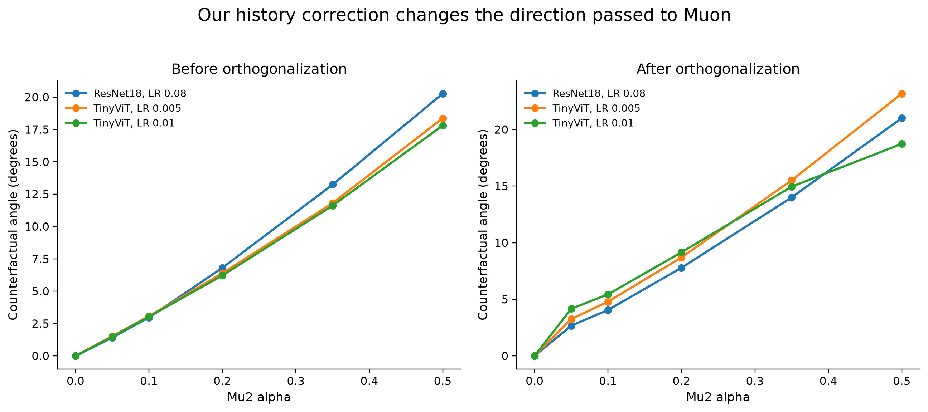
Our history correction changes Muon's direction
Seed 42 only; first-minibatch diagnostics sampled once per epoch and averaged over epochs 2–50; not a variance estimate.
Muon project
37
Notes:
We measured the angle between directions with and without our history correction at the same state, before and after Muon's approximate polar transform.
The angle increases with alpha and remains nonzero after orthogonalization.
Therefore the negative accuracy result is not because the correction vanished numerically.
Each plotted point is the mean of first-minibatch diagnostics sampled once per epoch over epochs 2–50. All curves use seed 42 only.
This is a local same-state counterfactual, not a separate training trajectory, endpoint statistic, or gradient-variance estimate.

Slide 38
μ²-inspired history correction: no consistent accuracy gain
OBSERVED
INTERPRETATION
RESULT
Geometric influence
Optimization ambiguity
Empirical verdict
The stored-history correction changes rₜ, and that angular change remains after the polar transform.
Different is not necessarily better. Recursive history can lag the local gradient or rotate away from useful descent directions.
Across broad sweeps and matched confirmations, α provides no consistent gain and can worsen unstable high-memory cells.
The history correction changes the post-polar update direction, but provides no consistent accuracy gain across the tested settings.
Muon project
38
Notes:
A nonzero angular change from our history correction is necessary to influence Muon, but it is not sufficient for optimization benefit.
Our history correction changes historical weighting and can introduce lag, bias, or misalignment with the local descent direction. We did not measure gradient variance.
The heavy TinyViT augmentation recipe and non-bitwise execution can magnify trajectory sensitivity near the LR boundary, but the experiments do not causally isolate which source dominates.

Slide 39
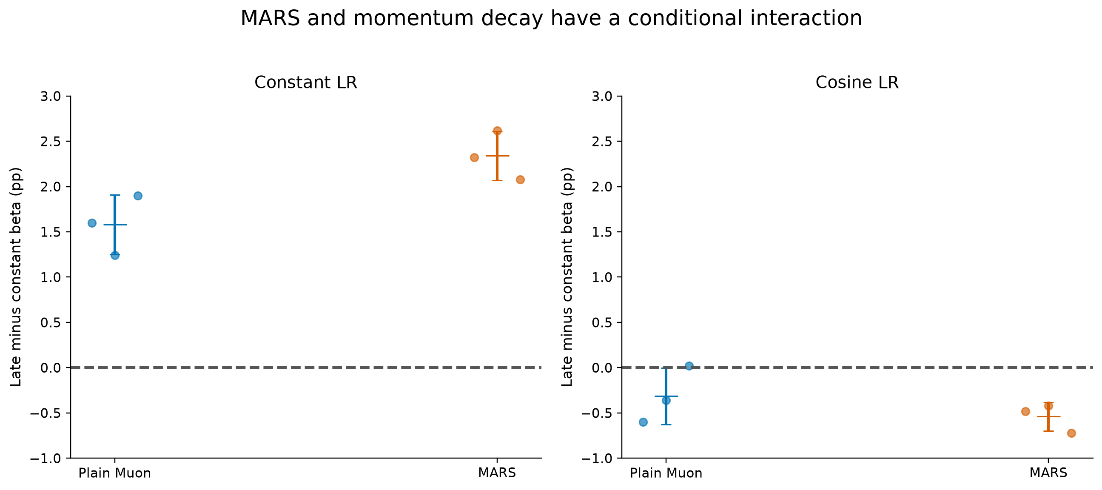
TinyViT MARS and late-momentum interaction
TinyViT-5M / ImageNet-100; initial LR 0.0025; 50 epochs; seeds 42, 43, and 44
Late beta decay: 0.98 to 0.50 during epochs 36 to 48. MARS gamma 0.35; Mu² alpha 0.
Dots = paired seed differences; crossbars = paired mean ± paired-difference sample SD.
The +0.18 ± 0.29 pp MARS increment after late decay is descriptive and does not establish additive synergy.
Muon project
39
Notes:
This is TinyViT-5M trained from scratch on ImageNet-100 for 50 epochs. Every cell uses initial LR 0.0025 and seeds 42, 43, and 44.
The eight-cell matched factorial crosses constant or cosine learning rate, gamma zero or 0.35, and constant beta 0.98 or late beta decay from 0.98 to 0.50 during epochs 36 through 48. Mu2 alpha is zero throughout.
The vertical axis is a paired seed-level contrast: epoch-50 accuracy with late beta decay minus accuracy with constant beta 0.98. Positive values favor late decay.
Under constant LR, late decay gives plus 1.58 percentage points for plain Muon and plus 2.34 points with MARS. Under cosine LR, the contrasts are minus 0.31 and minus 0.54 points.
The MARS increment after selecting late decay is only plus 0.18 plus or minus 0.29 points under constant LR, so the strongest cell does not establish additive synergy.

Slide 40
Results summary
Mechanism
What it changes
Where tested
Observed role
MARS-inspired
Gradient difference
Selected higher-LR cells
Small conditional gain
Momentum choice and scheduling
Directional memory
Stress cells; late constant-LR window
Lower fixed β avoids collapse in tested stress cells; late β decay adds 1.58 pp under constant LR.
Mu²-inspired
Recursive direction
Broad α–β sweeps
Mostly neutral or negative
Muon project
40
Notes:
This map is the clean conceptual summary of the project.
MARS has the clearest role near LR stress. Momentum memory and the outer learning rate interact strongly on TinyViT. Mu2 influences direction but lacks reliable accuracy benefit in these grids.
On TinyViT at cosine LR 0.01, beta 0.5 and 0.9 converge near 84 percent while beta 0.95 is unstable. At constant LR 0.0025, late beta decay from 0.98 to 0.50 improves the three-seed endpoint by 1.58 points over constant beta 0.98. The same late decay does not improve the cosine-LR endpoint.

Slide 41
Main conclusions
SUPPORTED
OUT OF SCOPE
We do claim
We do not claim
• MARS gives small improvements in selected higher-LR conditions
• lower β prevents TinyViT collapse at stressed LR 0.01
• under constant LR 0.0025, late β decay adds 1.58 pp; it does not help under cosine LR
• Mu2 changes direction without consistent accuracy gains
• combined mechanisms are not reliably additive
• a universally superior Muon variant
• a full reproduction of MARS, MARS-M, or Mu2SGD
• that ImageNet difficulty alone causes instability
• a convergence theorem for nonconvex neural-network training
Muon project
41
Notes:
State the claims with the same discipline used in the report.
We show empirical conditionality, not universal convergence guarantees. The value is in isolating mechanisms under controlled settings and retaining negative evidence.
TinyViT does not simply prefer low momentum. Lower beta prevents collapse under the stressed LR, while the best moderate-LR policy uses high momentum first and decays it late only when the learning rate remains constant.

Slide 42
Limitations and future work
SCALE
MECHANISM
EVIDENCE
Transfer
Diagnostics
Confirmation
Add another convolutional model, another transformer, and at least one additional dataset while keeping the same comparison contract.
Measure variance, gradient/update angles, memory age, and sharpness to test the proposed orientation and path-length explanation.
Choose coefficients on an exploration split, freeze them, and repeat all claim cells across more seeds or longer budgets.
Muon project
42
Notes:
The most natural extension is broader model and dataset coverage, especially because compute is inexpensive for this project.
A stronger causal analysis would measure gradient variance, directional age, curvature, and alignment rather than inferring mechanism from schedules and outcomes.
A full-model AdamW baseline would answer a different question and should remain separate from this Muon-internal ablation study.

Slide 43
Selected sources
Jordan, K. et al. (2024). Muon: An optimizer for hidden layers in neural networks.
https://kellerjordan.github.io/posts/muon/
Chen, J. et al. (2021). Decaying Momentum Helps Neural Network Training.
https://arxiv.org/abs/1910.04952
Yuan, H. et al. (2024). MARS: Unleashing the Power of Variance Reduction for Training Large Models.
https://arxiv.org/abs/2411.10438
Wu, K. et al. (2022). TinyViT: Fast Pretraining Distillation for Small Vision Transformers. ECCV.
https://arxiv.org/abs/2207.10666
Liu, Y., Yuan, A., & Gu, Q. (2025). MARS-M: When Variance Reduction Meets Matrices, v2.
https://arxiv.org/html/2510.21800v2
Krizhevsky, A. (2009). Learning Multiple Layers of Features from Tiny Images.
https://www.cs.toronto.edu/~kriz/learning-features-2009-TR.pdf
Dahan, T. & Levy, K. Y. (2025). Do Stochastic, Feel Noiseless: Stable Stochastic Optimization via a Double Momentum Mechanism.
https://arxiv.org/abs/2304.04172
Shekhar, A. (2021). ImageNet100. Kaggle dataset.
https://www.kaggle.com/datasets/ambityga/imagenet100
Cutkosky, A. & Orabona, F. (2019). Momentum-Based Variance Reduction in Non-Convex SGD. NeurIPS.
https://arxiv.org/abs/1905.10018
Muon project
43
Notes:
Do not read this slide. Keep it available for questions and attribution.

Slide 44
Questions?
MARS, momentum decay, and the Mu²-inspired estimator
Nevo Jonathan Sznajder, Itay Asolin
Muon project
44
Notes:
Pause here for questions. The remaining slides are backup material for detailed experimental questions.

Slide 45
Backup
Additional experiments and diagnostics
Muon project
45
Notes:
Backup divider. Use only in response to questions.

Slide 46
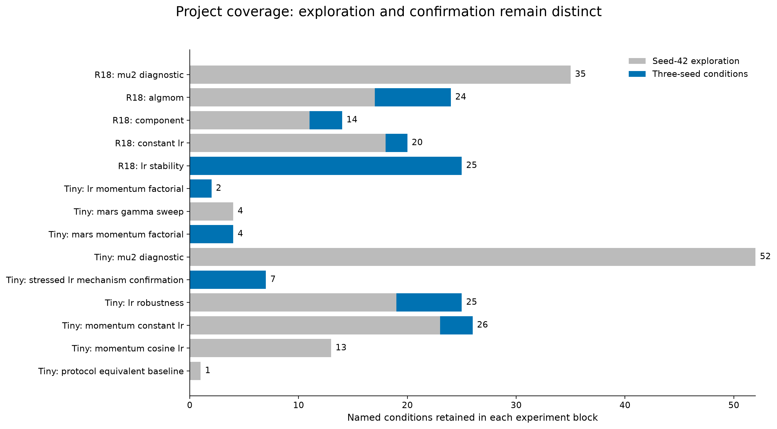
Experiment coverage
Muon project
46
Notes:
Use this to answer questions about whether the coefficient and schedule space was explored sufficiently.

Slide 47
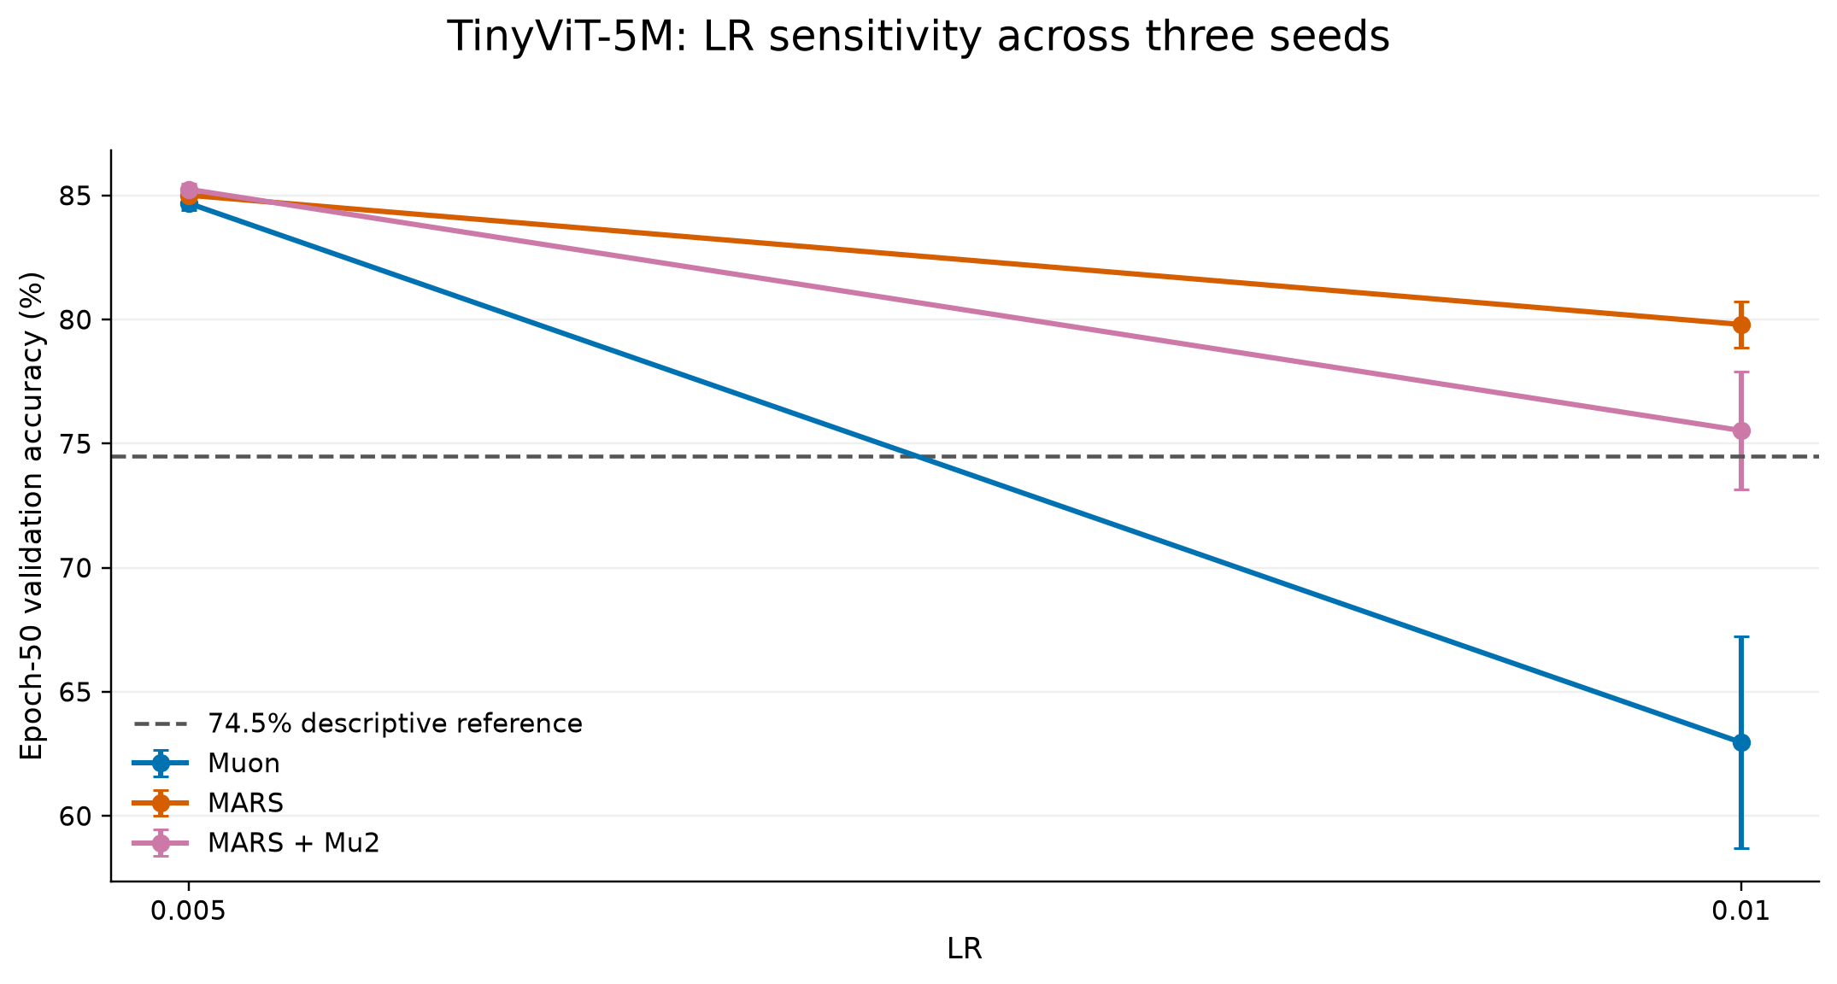
Historical TinyViT stressed-LR confirmation
Muon project
47
Notes:
This older package shows a much larger descriptive gap at LR 0.01, but the cleaner matched comparison supports the main claim.
It remains useful provenance, but the main deck uses the cleaner tuned-control comparison for the primary cross-architecture MARS claim.

Slide 48
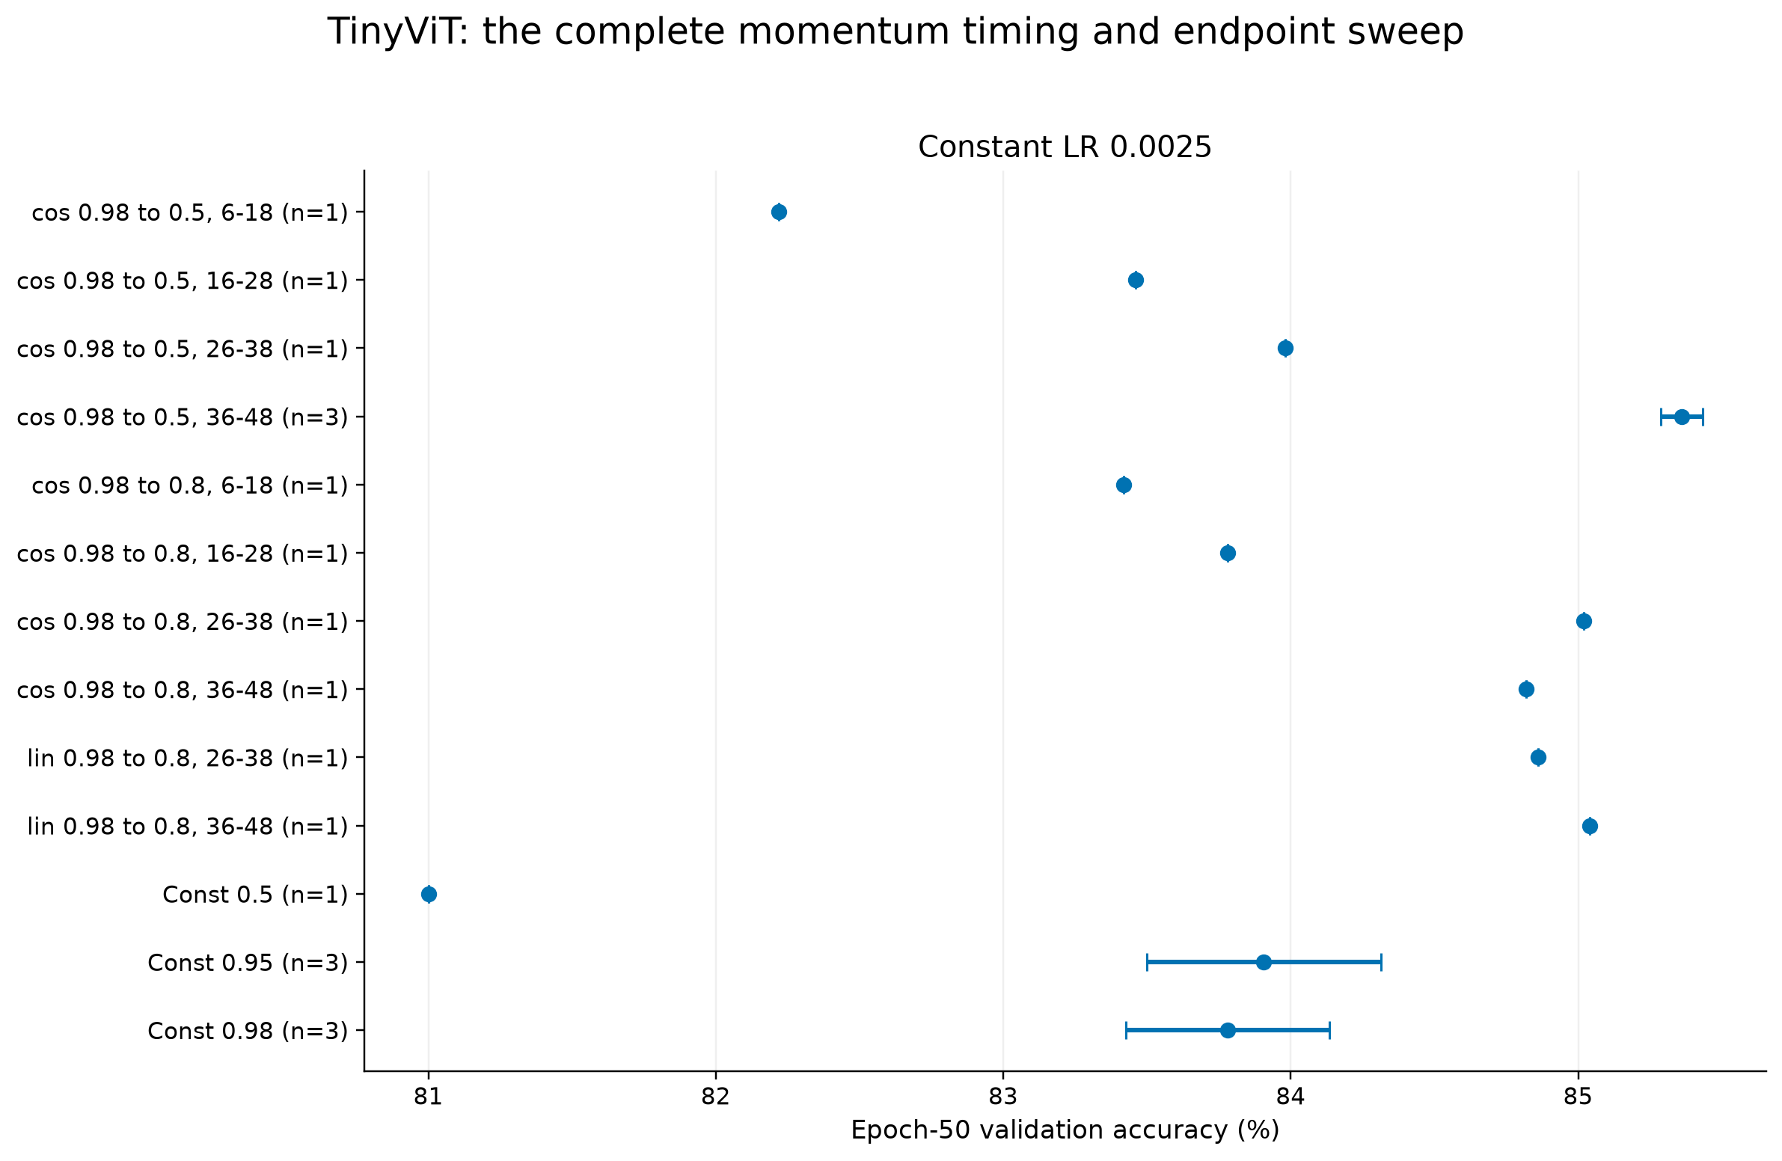
TinyViT momentum policy sweep under constant LR
Muon project
48
Notes:
This slide documents the wider policy search from which the late-decay confirmation was selected.

Slide 49
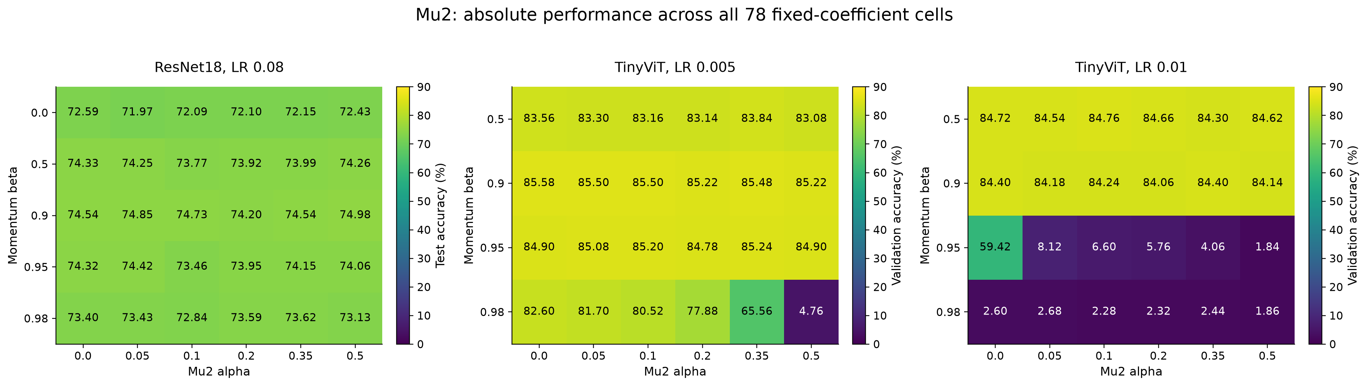
Mu² absolute surfaces
Muon project
49
Notes:
Use this for detailed questions about alpha, beta, and LR coverage beyond the matched-delta summary.

Slide 50
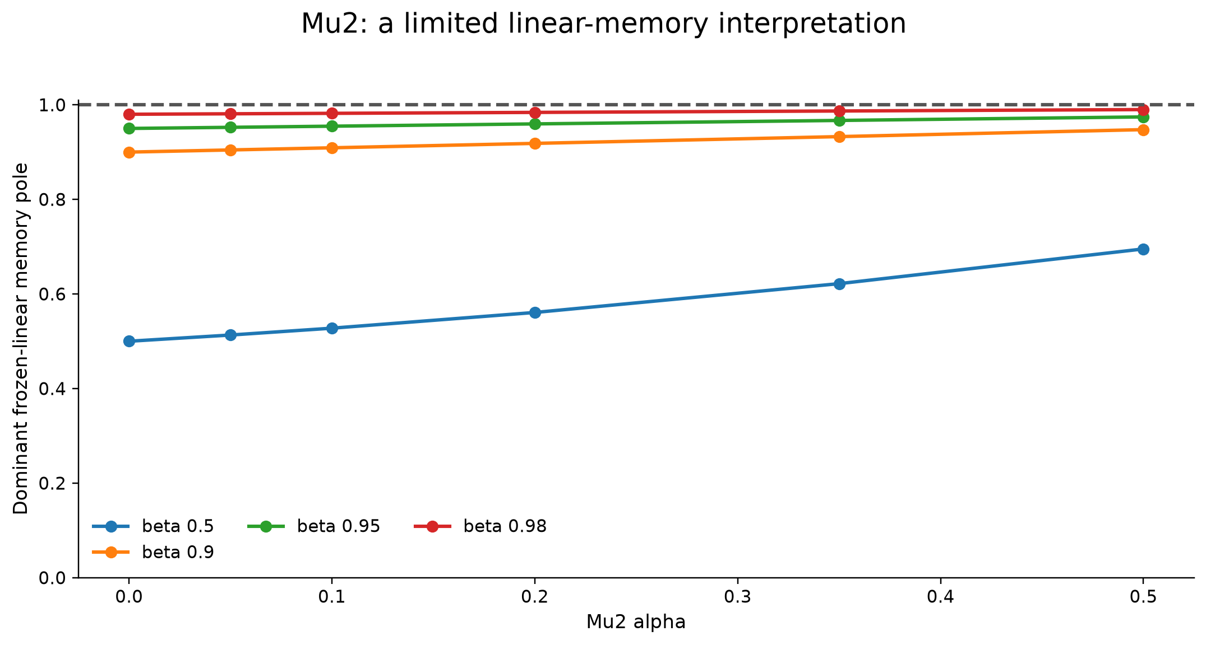
Linear-memory analysis
[mₜ, hₜ]ᵀ = A[mₜ₋₁, hₜ₋₁]ᵀ + b(gₜ − αgₜ₋₁)
A = [[β, α(1−β)], [β², α(1−β²)]], b = [1−β, 1−β²]ᵀ; h is the stored Nesterov signal
The pole summarizes frozen linear memory only; it is not a variance-reduction or convergence guarantee.
Muon project
50
Notes:
This analysis uses the implemented state: h_t is the Nesterov-combined pre-polar signal stored in place, not an untouched recursive estimator.
For a frozen scalarized recurrence, A maps the previous Muon momentum and stored h state. The plotted dominant eigenvalue is the memory pole of this two-state system.
Emphasize that the analysis is stylized and does not prove the cause of the neural-network outcomes.

