Slide 2
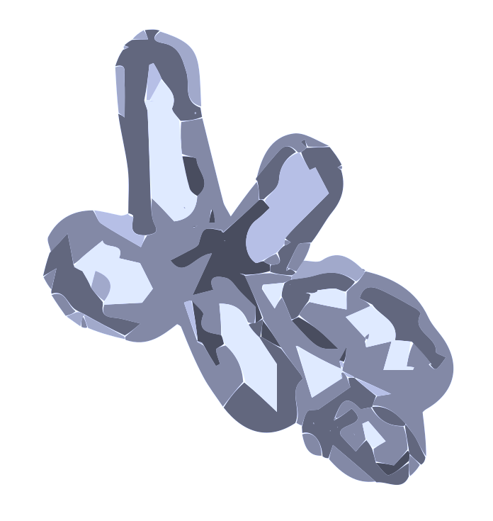
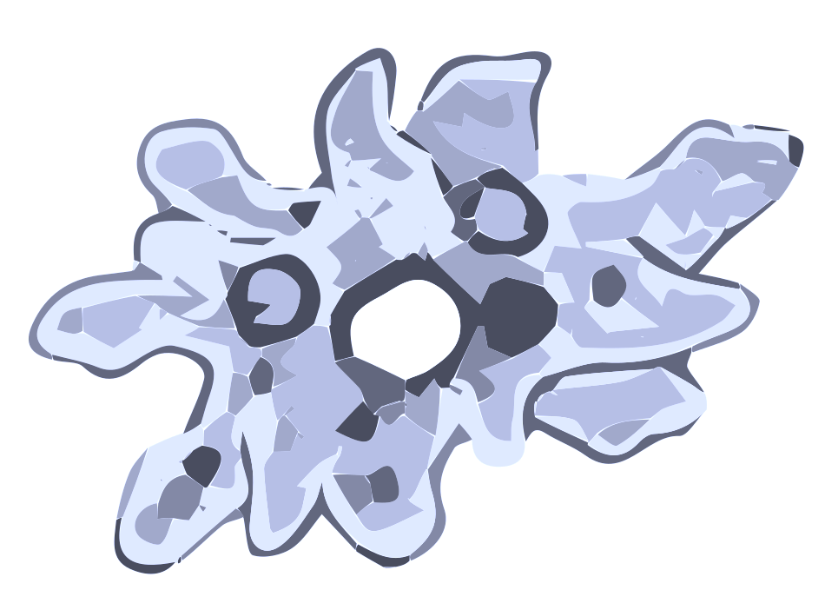


Prokaryotes
(Micro)eukaryotes
Viruses
Modular
Genome-resolved
Multi-Omics

