Slide 1

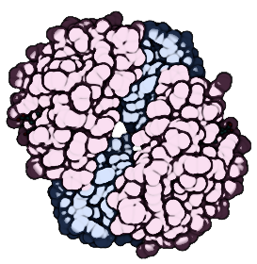

Reads
Contigs
Genes
Proteins
Genomes
preprocess
binning-viral
annotate
classify-viral
assembly
binning-prokaryotic
cluster*
classify-prokaryotic
coverage
binning-eukaryotic
profile-pathway
classify-eukaryotic
mapping | index
cluster*
profile-taxonomy
github.com/jolespin/veba
biosynthetic

Slide 2
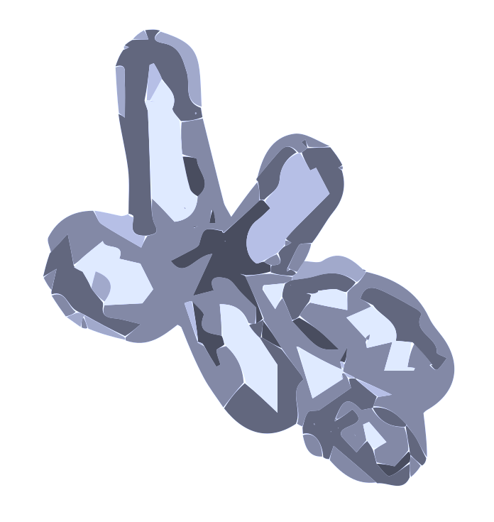
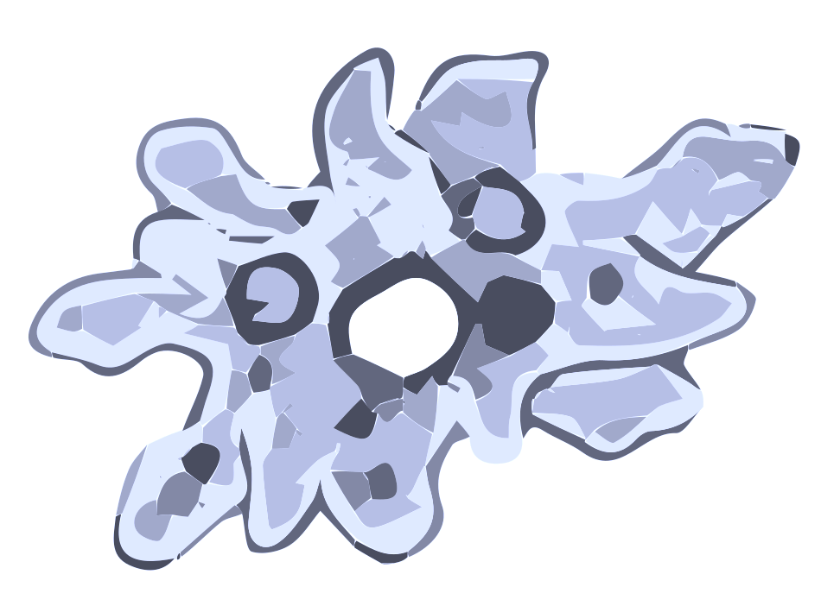


Prokaryotes
(Micro)eukaryotes
Viruses
Reads
Contigs
Genes
Proteins
Genomes
A modular end-to-end software suite for in silico genome-resolved metagenomics and metatranscriptomics

