Slide 1


AS
Intelligent Scalable Multi-Agent Architecture for Product Development
A hierarchical, modular AI framework
spanning vehicle systems from concept to validation
Madhupranavi S
Revanth Kannan G
Siddhant Erande
Notes:
1.7.2013
1
‹#›

Slide 2
The Problem We're Solving
Scope:
Multi-domain Product Development — The framework spans all major engineering systems in a vehicle program — Integration, Vehicle System, CAB, E&E, Drivetrain, and Engine — each with their own subsystems and design complexity
Subsystem-level intelligence — Within each domain, individual subsystems such as Frames, Suspension, Steering, and Fuel System are addressed independently with their own dedicated agent layer
End-to-end engineering tasks — Each subsystem covers the full engineering workflow — from expert advisory and design calculations through to verification, validation, and failure mode analysis
Vision:
A connected, automated, intelligent layer across all PD systems
Automated — Agents handle repetitive engineering tasks end-to-end
Expert-Augmented — Domain knowledge and engineering rules embedded in every agent
Connected — All systems communicate through a central orchestrator
Notes:
1.7.2013
2
‹#›

Slide 3











ARCHITECTURE OVERVIEW
N · N-1 · N-2 · Agent Layer
N
CENTRAL ORCHESTRATOR
Central
Orchestrator
N-1
Integration
Vehicle
System
CAB
E&E
Drivetrain
Engine
Domain
Systems
N-2
Frames
Suspension
Steering
Fuel
System
+ More
Agents
Sub
Systems
Agents
Expert
Advisor
Design
Calculation
Verification & Validation
DFMEA
Others...
Per Sub-
System
Same agent set for every subsystem — infinitely extensible
Notes:
1.7.2013
2
‹#›

Slide 4
WHY THIS APPROACH
Modular — Each subsystem agent follows the exact same pattern. Once the framework is built for one subsystem like Suspension, the same blueprint applies directly to Steering, Frames, Fuel System, and every other subsystem without redesigning or rebuilding from scratch. This means parallel development across teams is possible from day one.
Scalable — The N → N-1 → N-2 hierarchy is designed to grow. New domains, new subsystems, and new agent types can be plugged in at any level without touching the rest of the architecture. As the program expands, the system expands with it — not against it.
Human-in-the-Loop — This is augmentation, not replacement. Engineers remain fully in control. Agents surface recommendations, automate calculations, flag risks, and generate reports — but every critical design decision is reviewed, validated, and owned by the engineer. The system supports judgment, it does not replace it.
Domain-Aware — Generic AI is not sufficient for engineering work. Each agent is grounded in domain-specific knowledge — suspension dynamics, DFMEA methodology, V&V standards, load cases — not just language understanding. The intelligence is engineering-first, not generic-first.
Extensible — The agent layer is not fixed. As needs evolve, new agents can be added to any subsystem — cost estimation, supplier selection, regulatory compliance, weight optimization. The architecture is built to accommodate this without structural change.
Notes:
1.7.2013
2
‹#›

Slide 5
PR
Ride Optimization
Physics-based and surrogate modelling approaches for suspension stiffness and damping optimisation
Madhupranavi S
Notes:
1.7.2013
1
‹#›

Slide 6
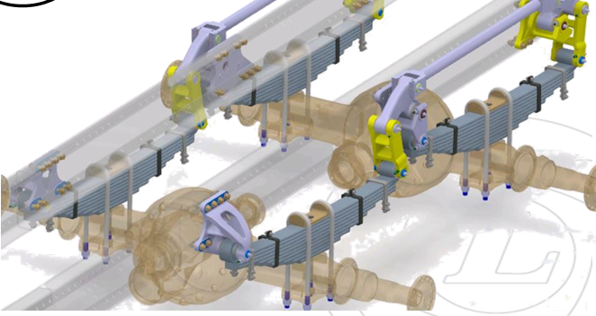
Ride Optimisation
The suspension system is a key component influencing ride comfort and driving performance.
Heavy commercial vehicles experience continuous road excitations, transmitting vibrations through the suspension to the cabin and ultimately the driver seat.
Ride comfort is quantified using RMS acceleration at the cabin seat, a standard measure of whole-body vibration linked to: Driver fatigue, Discomfort, Long-term health impacts
Goal:
Determine optimal suspension parameters for a 6×2 vehicle with Non-Reactive Suspension (NRS) to minimize cabin seat RMS acceleration.
Develop a fast and accurate suspension dynamics model that captures full system behavior and supports efficient optimization to automatically identify the optimal stiffness and damping configuration for improved ride comfort.
Notes:
1.7.2013
11
‹#›

Slide 7
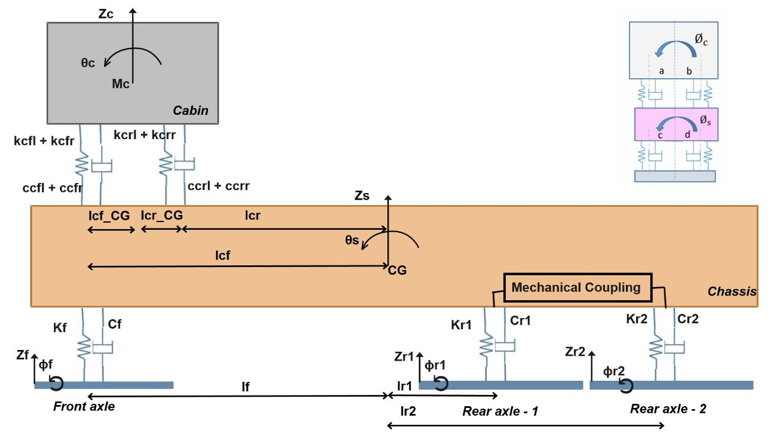
System Definition
The system under consideration is a 6×2 heavy commercial vehicle equipped with a Non-Reactive Suspension (NRS) configuration, designed to improve ride comfort and stability.
Consists of the cabin and chassis (sprung mass) with bounce (z), pitch (θ), and roll (ϕ) motions.
Each of the three axles exhibits bounce (z) and roll (ϕ) dynamics.
The rear tandem axles are mechanically coupled, which is a defining feature of the NRS setup. This arrangement allows load sharing without inducing additional pitch or roll moments, helping maintain vehicle attitude stability
Notes:
1.7.2013
11
‹#›

Slide 8
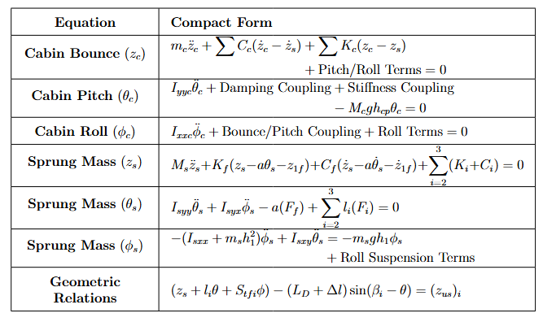
System Definition
The system is formulated using axle displacements, with primary focus on cabin seat-level RMS acceleration.
Minimize cabin seat-level RMS acceleration through parameter optimization.
Tunable Parameters
KF – Front axle spring stiffness
CF – Front axle damping
K2 – Rear axle 1 spring stiffness
K3 – Rear axle 2 spring stiffness
Notes:
1.7.2013
11
‹#›

Slide 9
Two Approaches
Physics-Based Approach
Deep Learning Surrogate Approach
WORKFLOW
WORKFLOW
1. Define Suspension ODE System
1. Generate training data from ODE simulations
↓
↓
2. Simulate Road Input → ODE Solve
2. Train deep learning model on system response
↓
↓
3. Extract RMS Acceleration
3. Trained model predicts RMS in milliseconds
↓
↓
4. Optimise Stiffness & Damping
4. Plug into optimiser — repeated runs at low cost
✓ Physically reliable — grounded in mechanics
✓ No training data required
✓ Near-instant inference once trained
✓ Scales easily — no re-simulation needed
✓ Interpretable and explainable results
✓ Real measurement data can be incorporated
✗ Computationally expensive — 10–11 hrs per run
✗ Upfront cost — data generation and training
✗ Every parameter change requires full re-run
✗ Accuracy bounded by training data quality
Notes:
1.7.2013
11
‹#›

Slide 10
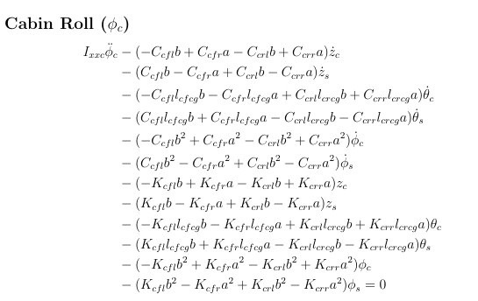
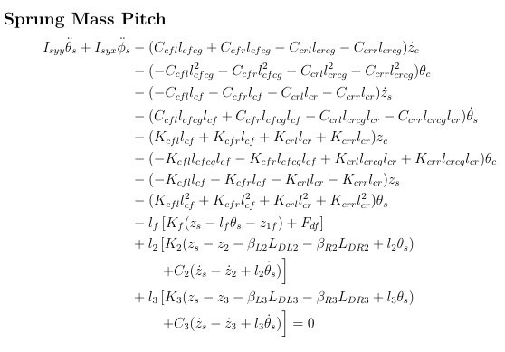
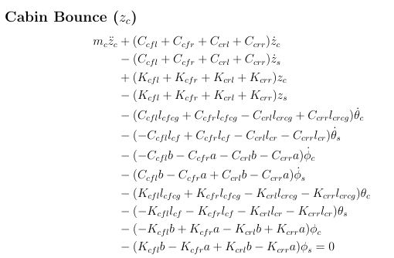
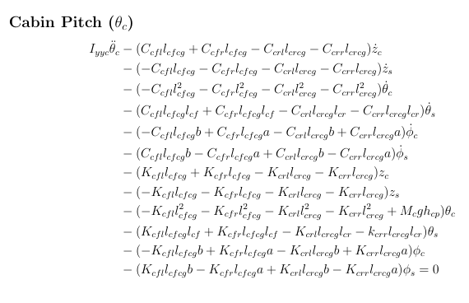
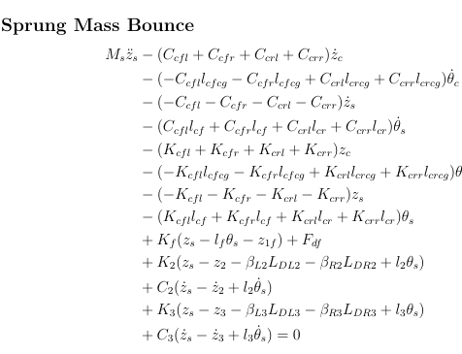
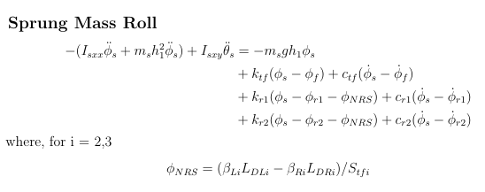
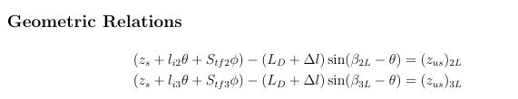
Physics Based Approach
The physics-based approach involves solving the ODEs (as mentioned earlier), which are detailed here and these equations describe the system dynamics and are used to obtain the response.
Notes:
1.7.2013
11
‹#›

Slide 11




Physics Based Approach
The ODEs mentioned above are represented as 6-DOF suspension model with two geometric constraints:
Now, formulating the constrained KKT conditions based on the above: to enforce the constraints, introduce Lagrange multipliers λ, which generate constraint forces, where G(q)=∂g/∂q.
Baumgarte stabilization corrects this drift continuously by adding a term, which behaves like a critically damped spring pulling the constraint back toward zero.
And it has a damping ratio and a correction stiffness that control how fast the constraint error is removed.
This is solved using the standard KKT formulation with
Notes:
1.7.2013
11
‹#›

Slide 12
Shock Absorbing Character
Design Approaches for Two-Stage Asymmetric Damper Integration:
Option 1: Direct Optimization – Two-Stage Asymmetric Damper
The nonlinear damper characteristics are optimized directly, along with key vehicle and suspension stiffness parameters.
Optimization is performed using the fully nonlinear damping model within the ODE framework.
The optimization simultaneously tunes:
1. K_F , C_F , K_2 , K_3
2. Damping parameters: cs− , Asymmetry Ratio, γc , γr
Option 2: Two-Phase Optimization with Curve Fitting
A two-phase strategy is adopted to improve robustness and reduce computational complexity:
Phase 1: Linear Optimization
Optimize linear suspension and damper parameters: K_F , C_F , K_2 , K_3
Phase 2: Nonlinear Curve Fitting
Fit nonlinear damper parameters based on optimized linear response: cs− , Asymmetry Ratio, γc , γr
The front damper relative velocity time history from Phase 1 represents the actual operating velocity distribution.
Nonlinear damper parameters are identified using a weighted least-squares curve fitting approach.
Notes:
1.7.2013
11
‹#›

Slide 13
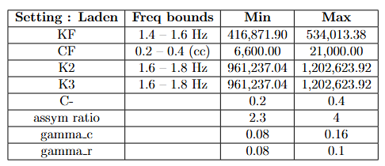
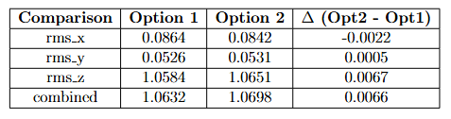
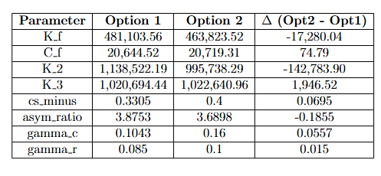
Shock Absorbing Character
Results and Observation:
Notes:
1.7.2013
11
‹#›

Slide 14
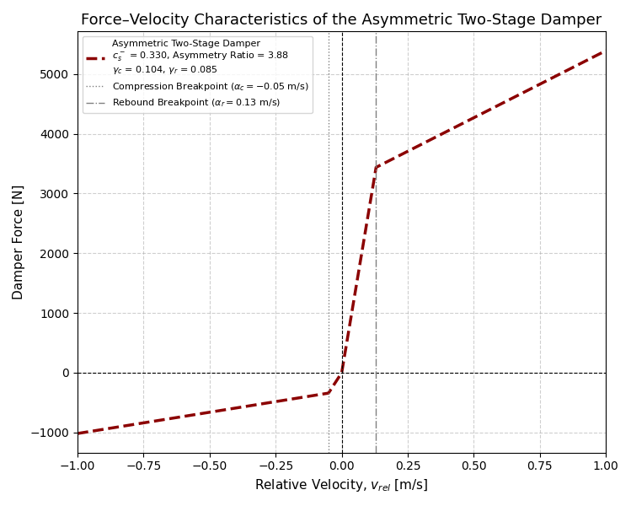
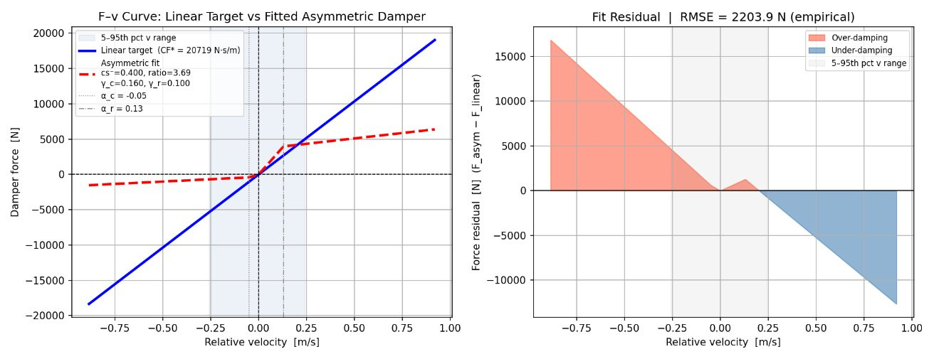
Shock Absorbing Character
Observation:
Both approaches — directly optimising with the nonlinear damper embedded in the ODE and optimising for linear parameters followed by a curve fit — produced comparable RMS acceleration results. Since the performance is equivalent, Option 1 is the preferred approach. Embedding the nonlinear damper directly into the optimisation ensures the solver always operates on the true system representation, eliminating the post-processing curve fitting step, preserving physical consistency throughout, and reducing the risk of approximation error introduced by fitting a nonlinear curve after the fact. This makes Option 1 the cleaner and more rigorous pipeline.
Notes:
1.7.2013
11
‹#›

Slide 15
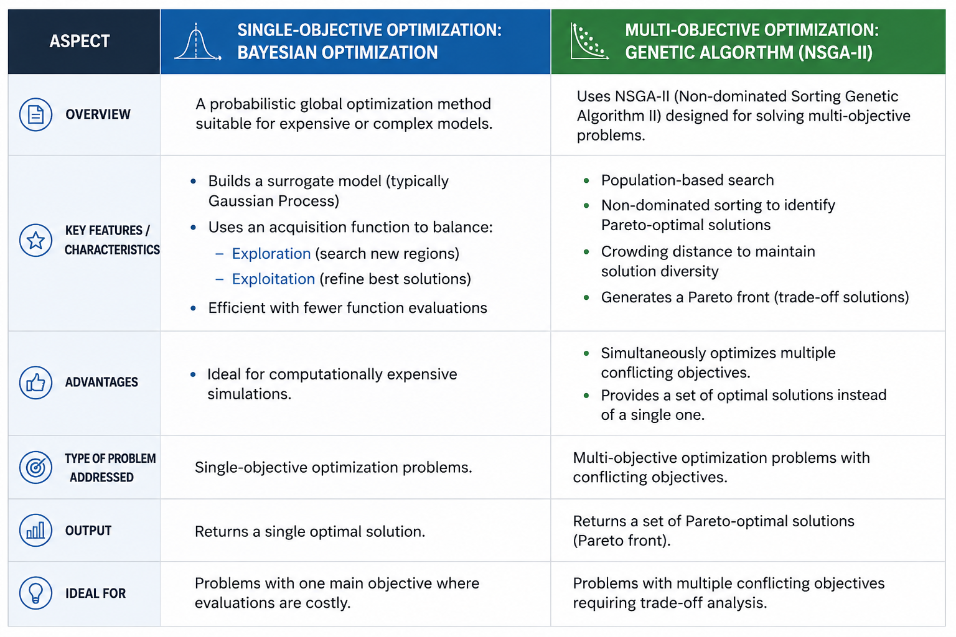
Optimisation
The design approach considers: Single-objective optimization & Multi-objective optimization
The cabin seat RMS (Root Mean Square) is computed based on: Bounce acceleration (ẍc), Roll acceleration (ϕ̈c), Pitch acceleration (θ̈c)
These accelerations are evaluated at the seat level to assess ride comfort.
Optimization can be applied as:
Single-objective optimization → Focus on minimizing a scalar objective function, aggregate effect of multiple DOFs
Multi-objective optimization → Optimize each DOF independently to obtain trade-off solutions
Notes:
1.7.2013
11
‹#›

Slide 16
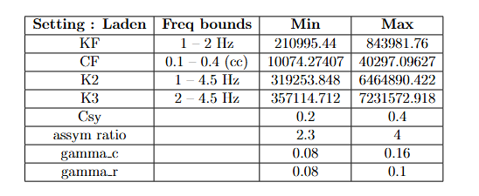
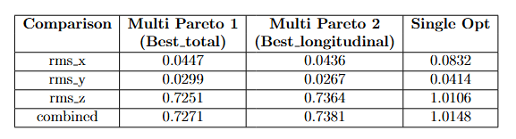
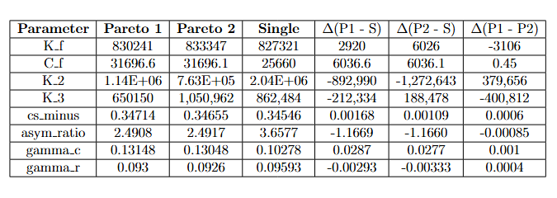
Results & Observation
Notes:
1.7.2013
11
‹#›

Slide 17
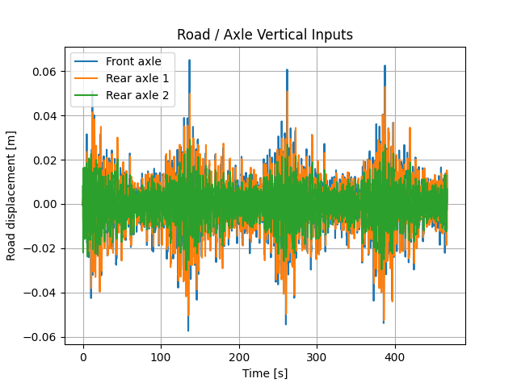
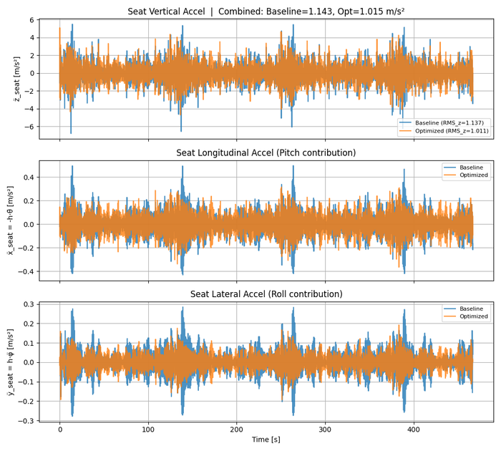
Results & Observation
The Plots corresponding to
Notes:
1.7.2013
11
‹#›

Slide 18
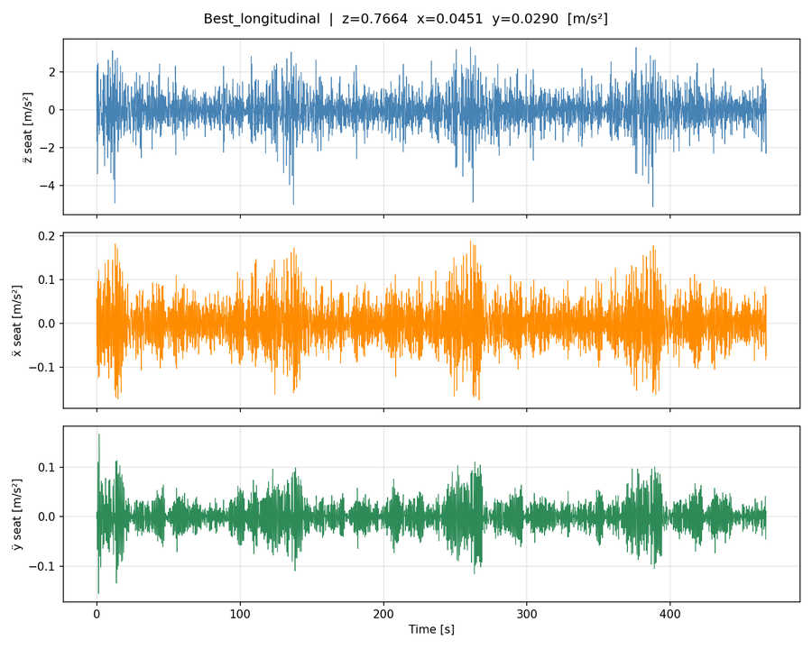
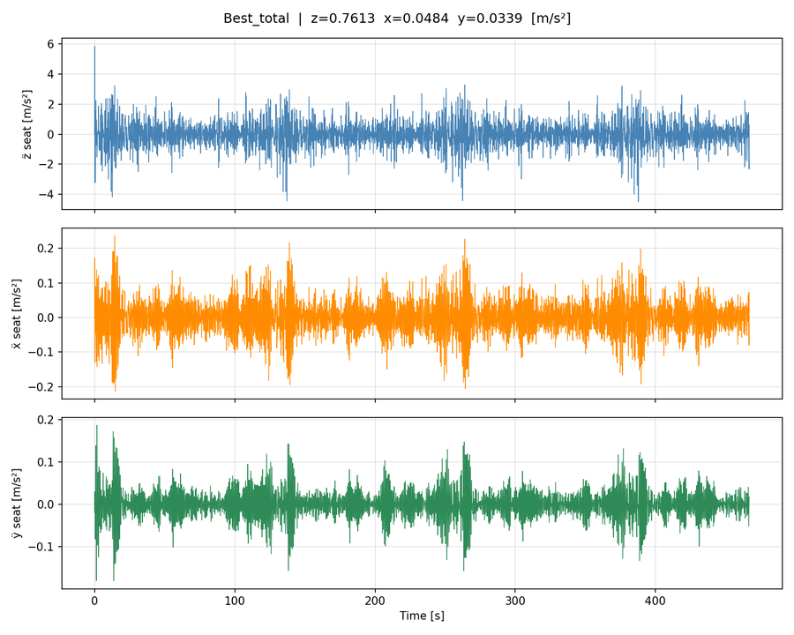
Results & Observation
The Plots corresponding to
Notes:
1.7.2013
11
‹#›

Slide 19
Inference and Transition
Key Observation:
Multi-objective optimisation (NSGA-II) outperforms single-objective — it captures the full trade-off space and gives the engineer flexibility to select a solution based on priority. Both methods are available and the choice can be embedded in the workflow based on design parameters and the frequency range of interest.
The Bottleneck:
The physics-based approach, despite its reliability, takes an average of 10–11 hours per full optimisation run. Any change to the setup — road class, speed, parameter bounds, damper model — requires a complete re-run. For a team iterating rapidly across design variants, this is a significant bottleneck.
Why Physics-Based Remains Valuable
Why a Surrogate Model Makes Sense
→ Ground truth — results are exact by construction
→ Once trained — full optimisation in minutes
→ No data dependency — works from first principles
→ Repeated design iterations at negligible compute cost
→ Essential for validation of any surrogate model
→ Real measurement data can be fed into training directly
→ Full interpretability of optimised parameters
→ Scales across configurations without re-simulation
To get the speed advantage of a surrogate while preserving physical reliability, we build a Physics-Informed Neural Network — a deep learning model trained not just on simulation data but constrained by the governing equations of motion. The network can only learn solutions that are physically consistent.
Notes:
1.7.2013
11
‹#›

Slide 20
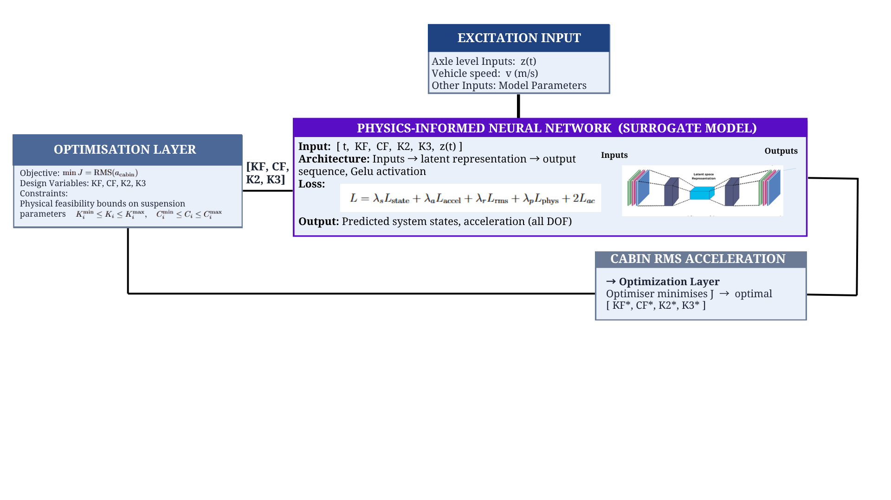
Surrogate Modelling
What PINN does differently
A Physics-Informed Neural Network embeds the governing ODE directly into the training loss. The network is penalised not just for deviating from data but also for violating the physics of the system — forcing it to learn solutions that are physically consistent even where data is sparse.
Data Loss: Ldata​=MSE(y^​,y) Physics Loss: Lphys​=(ODE Residual)2
Total Loss: L=λ1Ldata+λ2Lphys
Detailed picture of Architecture diagram:
Notes:
1.7.2013
11
‹#›

Slide 21
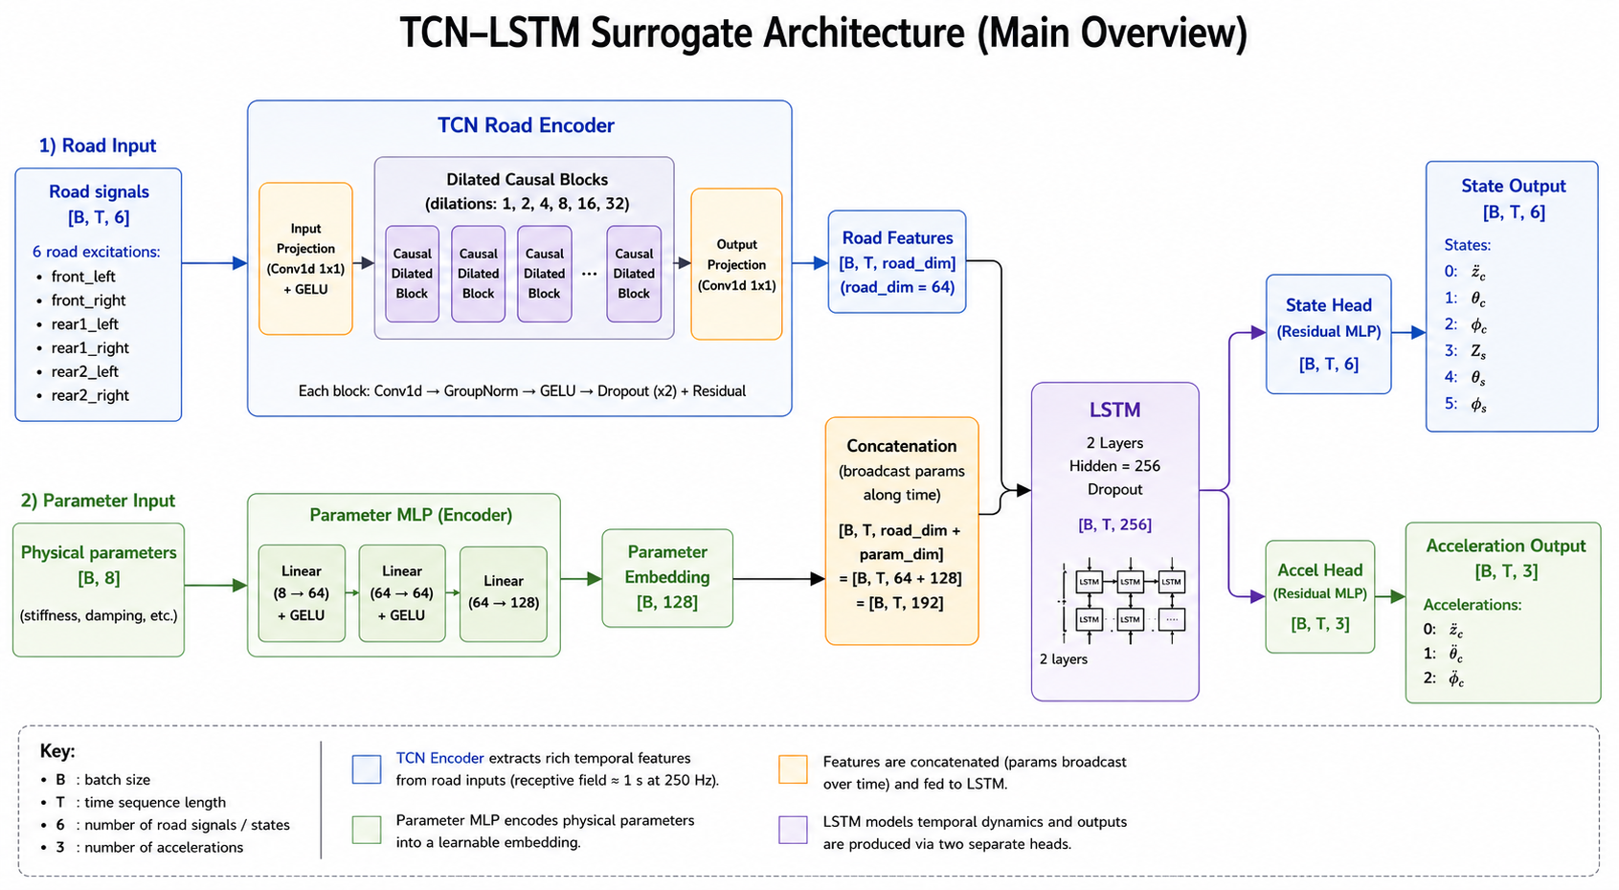
Surrogate Modelling
Detailed Architecture:
Road Inputs + Physical Parameters → TCN Encoder + Parameter MLP → Feature Fusion → LSTM → State & Acceleration Heads → Physics-Informed Loss
Training evaluvation:
Notes:
1.7.2013
11
‹#›

Slide 22
Surrogate Modelling
Test Evaluvation:
The surrogate modelling approach, trained on the current simulation dataset, successfully converged to an optimised solution with a cabin seat RMS acceleration of ______ m/s². This demonstrates that the trained model has sufficiently captured the suspension system dynamics to drive meaningful optimisation. The framework is deployment-ready — substituting the simulation dataset with real measured road and vehicle response data would further improve prediction accuracy and make the optimised parameters directly reflective of real operating conditions.
Notes:
1.7.2013
11
‹#›

Slide 23
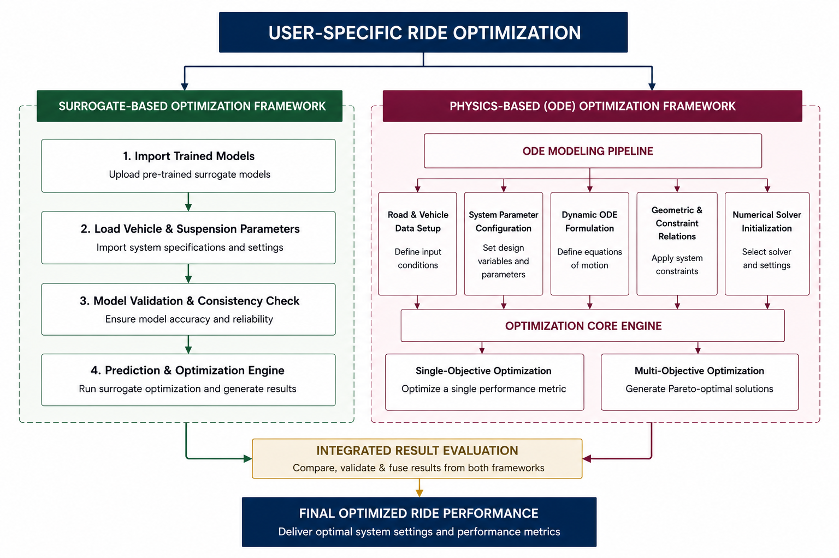
Generalised Framework
Framework Highlights
Integrates both surrogate-based and ODE-based approaches, making the framework highly adaptable and flexible.
Enables seamless switching between different use cases and modeling strategies.
Supports a wide range of optimization algorithms for diverse problem requirements.
Facilitates effective comparison of results to support better decision-making.
Notes:
1.7.2013
11
‹#›

Slide 24
Fitting in Agentic Architecture
1
2
3
4
5
Parse &
Validate
Load
Road Data
Pre-flight
Test
Run
Optimiser
Generate
Outputs
Physics code checked for syntax & model validity
Input road profile loaded & verified
Stability check; compute-time estimate
Multi-objective (Pareto) or single-objective
Results packaged into structured summary
The ODE, solver, and optimiser are tools the agent calls — they do not decide whether results make sense or what to do when something goes wrong. That is the agent's job.
At every stage, the agent chooses one of four paths:
Proceed — stage completed cleanly, move forward. Retry — recoverable failure, reattempt before deciding whether to continue. Warn — completed but result is outside expected bounds, flag it and continue. Stop — failure makes continuing meaningless, halt and return a structured explanation.
Every decision is recorded — which path, and why. That audit trail is part of the structured output available to downstream agents and the user.
The physics never changes run to run. What the agent adds is the reasoning layer above it — deciding whether the tools are working, whether results are trustworthy, and ensuring nothing downstream receives incomplete information.
Notes:
1.7.2013
11
‹#›

Slide 25
Demo
Notes:
1.7.2013
11
‹#›

Slide 26
Thank You!
Questions?
Let's dig in.
Notes:
1.7.2013
11
‹#›

