Slide 1
CRUD Demo on Spring Boot

Slide 2
Source Code
來源:
https://www.javaguides.net/2022/12/spring-boot-dto-example-tutorial.html

Slide 3
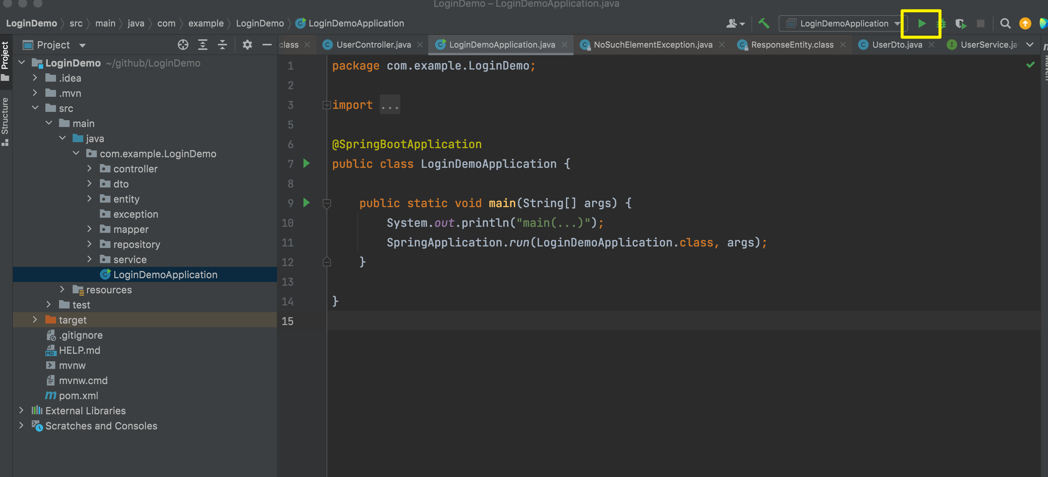
執行專案

Slide 4
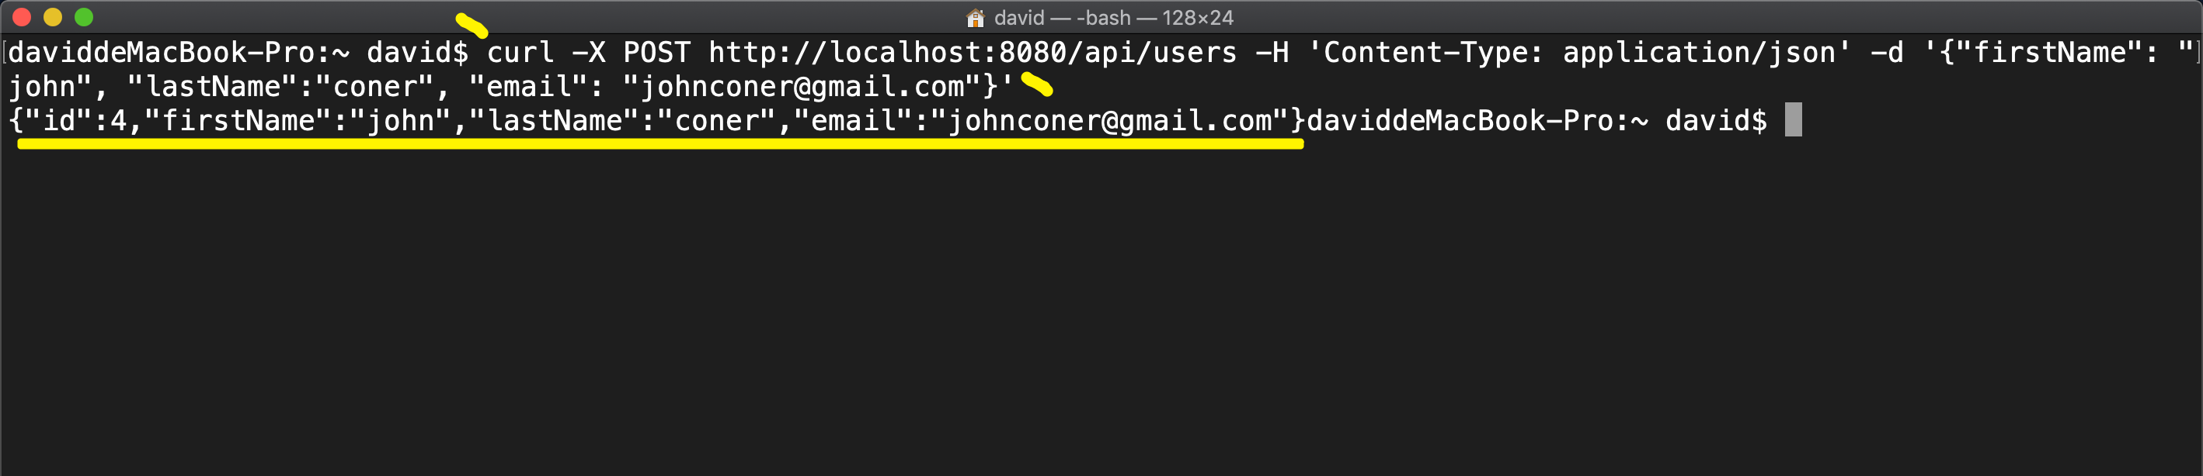
Create User REST API
從Client端送出 http POST request
curl -X POST http://localhost:8080/api/users -H 'Content-Type: application/json' -d '{"firstName": "john", "lastName":"coner", "email": "johnconer@gmail.com"}'

Slide 5
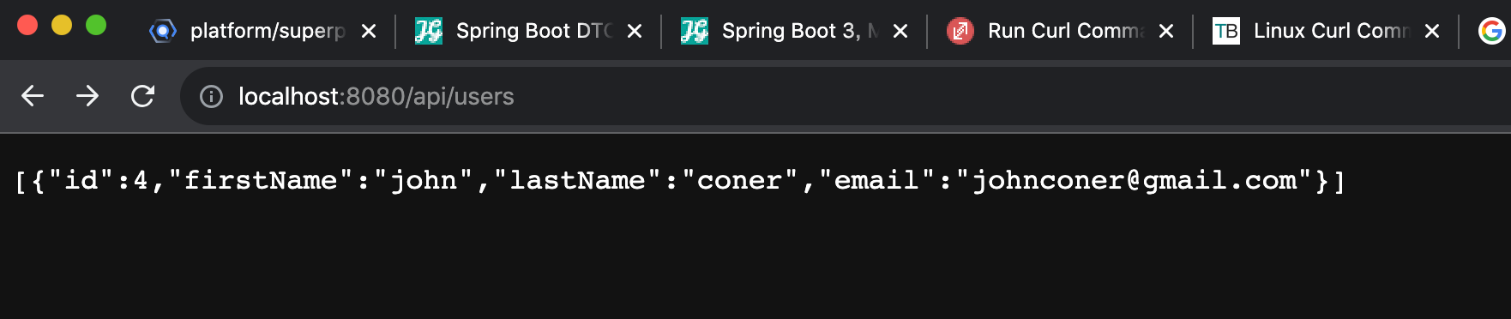
列出所有的User

Slide 6
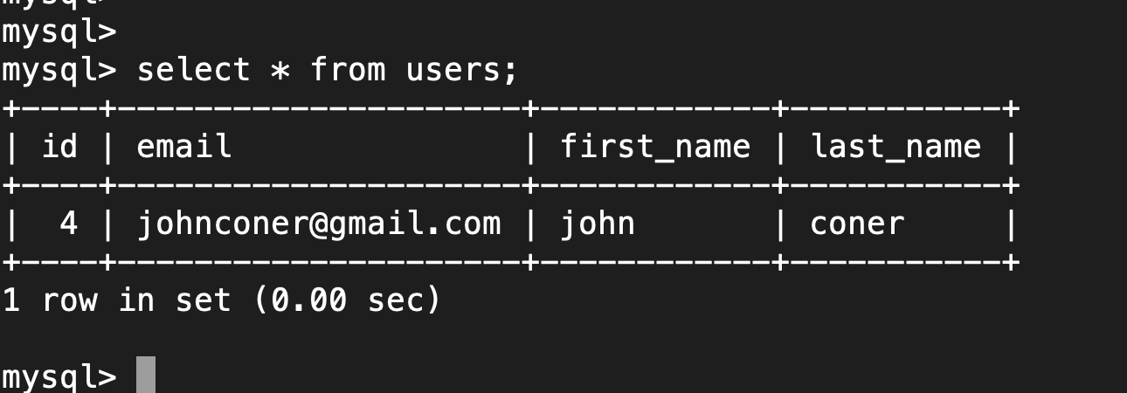
檢查是否新增到DB

Slide 8
Get All Users REST API
從Client端送出 http GET request
curl -X GET http://localhost:8080/api/users/4

Slide 9
查詢到剛新增的User

Slide 11
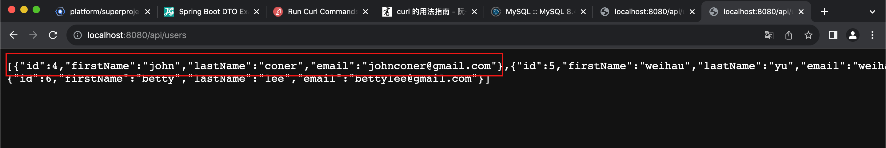
Update User REST API
從Client端送出 http PUT request
curl -X PUT http://localhost:8080/api/users/4 -H 'Content-Type: application/json' -d '{"firstName": "john", "lastName:"hsu", "email": "john_hsu@gmail.com"}'

Slide 12
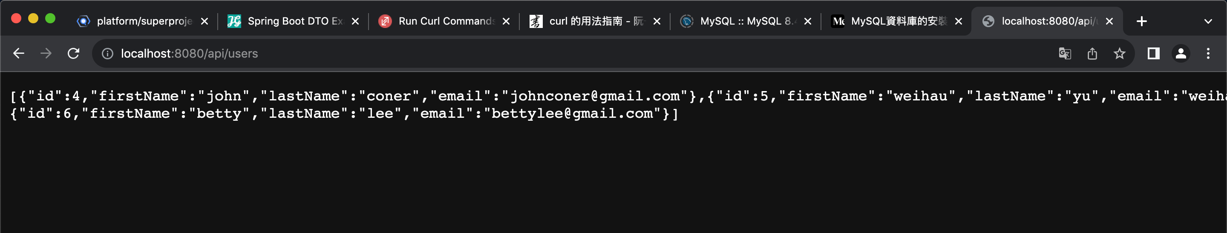
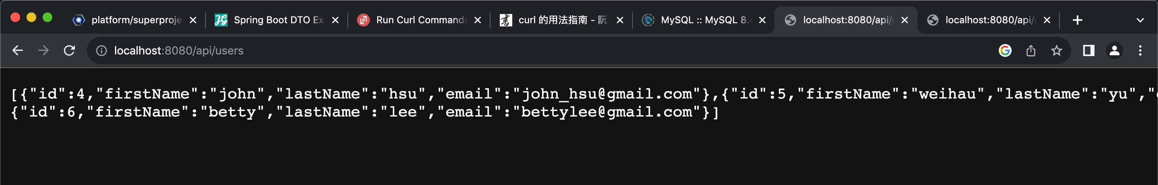
更新User 資訊

Slide 14
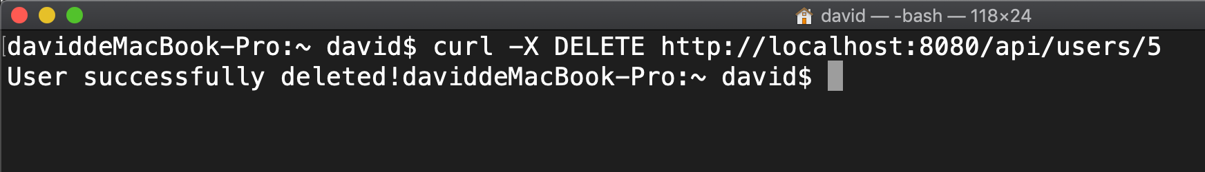
Delete User REST API
從Client端送出 http DELETE request
curl -X delete http://localhost:8080/api/users/5

Slide 15
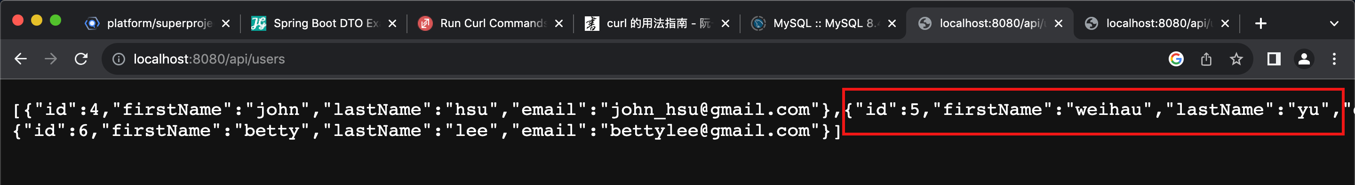
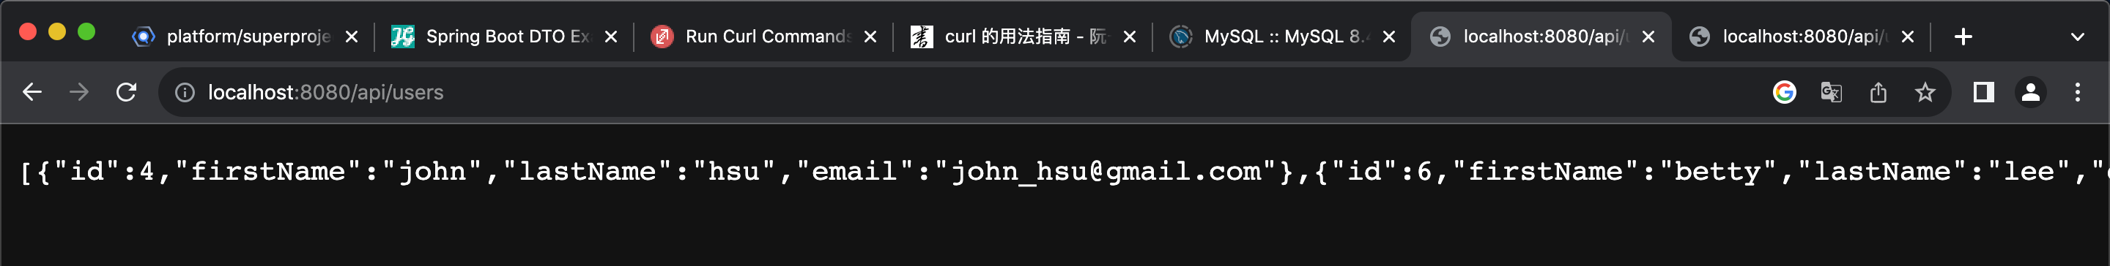
刪除User

Slide 16
