Slide 1

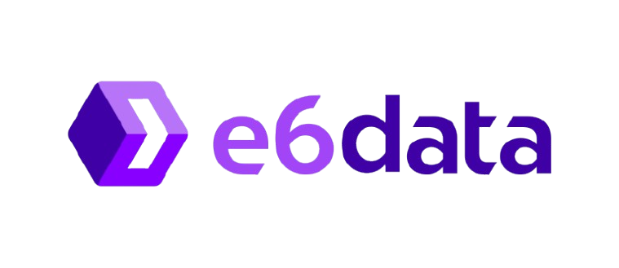
HACKATHON PROJECT OVERVIEW
Project Name: MetaQuery: Seamless Insights, One Query Away.
Problem Statement & ID: 2 - S3 Metastore Viewer for Parquet , Iceberg ,
Delta & Hudi Tables.
Team Name: A.D.O.R.
College: Vishwakarma Institute of Technology
City: Pune

Slide 2
PROPOSED SOLUTION
How the Solution Works & Addresses the Problem
Solution
Extracts metadata directly from S3/Azure/MinIO without a metastore.
Supports Parquet, Iceberg, Delta, and Hudi formats.
Interactive UI for schema, partitions, snapshots, and data insights.
Enables version-aware navigation and real-time table tracking.
Supports Automated Schema Detection – Instantly identifies table structures without manual setup.
Integrate Object Storage – Extracts metadata directly from S3/Azure/MinIO without metastore.
Backend – Parses manifests and metadata files via REST API.
Frontend – Provides an interactive UI for schemas, partitions, snapshots, and table properties.
Schema & Snapshot Visualization – Tracks schema evolution and version history in real time.
Efficient & Scalable – Eliminates manual setup, supports multiple formats (Parquet, Iceberg, Delta, Hudi), and improves metadata accessibility for large datasets.

Slide 3
PROPOSED SOLUTION
How It Solves the Problem:
Eliminates the need for external metastore services like Hive/Glue.
Supports all major lakehouse formats (Iceberg, Delta, Hudi).
Interactive and seamless UI for interacting and working with data tables.
Real-time table evolution tracking.
Innovation & Uniqueness:
Table Comparison Engine: Detects schema, partition, and snapshot differences.
AI-Driven Storage Optimization: Automates file compaction, partition tuning, and compression for cost and performance efficiency.
Seamless Multi-Cloud Support: Secure access to object storage (S3, MinIO, Azure) with IAM-based authentication.
Trino Integration: Enables fast SQL querying and analytics on metadata.

Slide 4
APPROACH
Methodology to Solve the Problem:
S3 Bucket Access & Metadata Extraction: Connect to Object Storage (AWS S3, MinIO, Azure Blob) using IAM roles or credentials .Parse Metadata from Iceberg manifests, Delta transaction logs, Hudi timelines, and Parquet footers. Extract Versioning & Snapshot Information to enable historical data exploration
Metadata Parsing & Schema Mapping: Extract Schema Details (column names, data types, partitioning strategies). Capture Partition Statistics & Metrics for efficient query planning and optimization. Store Parsed Metadata Temporarily in structured JSON format for fast visualization
Cost & Storage Optimization Analysis: Identify Storage Inefficiencies (small files, redundant data copies)Recommend Format-Specific Optimizations (compression, compaction, sorting techniques)Visualize Storage Metrics & Cost Savings Opportunities
Real-time Monitoring & Alerts: Continuous Metadata Monitoring for schema changes and table evolution. Automated Alerting Mechanism triggered by metadata modifications or anomalies. Track Table Evolution & Schema History over time

Slide 5
APPROACH
Table-to-Table Comparison Engine: Analyse Schema Differences between tables across multiple formats (Iceberg vs Delta vs Hudi)Compare Partition Strategies & Snapshots for performance benchmarking. Visualize Differences Clearly on Interactive UI.
Trino Integration for Query Execution: Generate Optimized Trino Queries directly from metadata insights. Enable Cross-format Querying without dedicated metastore services. Visualize Query Performance Benefits from Metadata-driven Optimizations.
Interactive UI for Metadata Visualization: Intuitive Web Interface for browsing schemas, partitions, snapshots, and storage metrics. Filtering, Searching & Analytics Features for rapid metadata exploration. Exportable Reports & Insights on storage efficiency, cost optimization, and table evolution.

Slide 6
USPs & Features
Unique Selling Points (USPs):
Table Comparison: Shows differences between two tables (schema, partitions, and data snapshots).
AI Powered Storage Optimization: Uses AI to compact small files, optimize partitions, and suggest efficient compression for cost savings and performance.
Seamless Multi-Cloud Integration: Effortlessly supports different cloud object storage without requiring reconfiguration, along with secure access to private buckets through IAM role-based authentication.
Key Features:
Storage and Cost Optimization
Format Interoperability
Multi Cloud Support
Potential Trino Dialect Integration
Seamless Table Evolution and Comparison

Slide 7
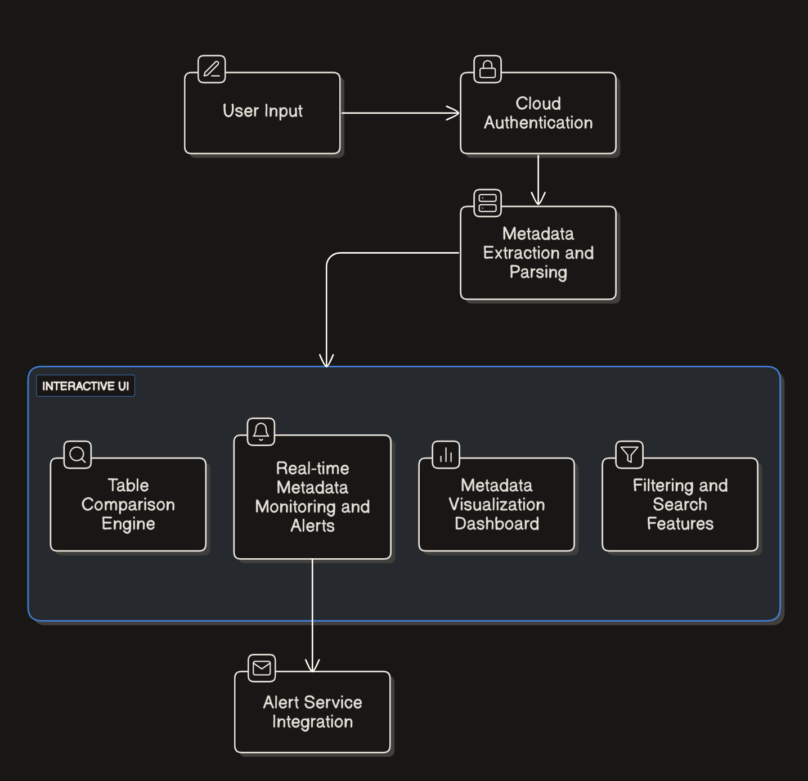
Technologies & Implementation
Tech Stack
Flow Chart :
Programming Languages: JavaScript, Python
Frameworks: NodeJs, ExpressJs, FastAPI
Cloud Authentication: Multi-Cloud IAM Authentication
Infrastructure & Storage: Amazon S3 / MinIO / Azure Blob Storage
Machine Learning & AI Frameworks

Slide 8
Potential Impact
On Target Audience
Social Impact
Breaking Down Data Barriers: Direct S3/object storage exploration without metastore dependencies
Query-Optimized Decision Making: Exposes partition statistics and file-level metadata for intelligent predicate pushdown
Reduced Technical Complexity: Single interface for Iceberg manifests, Delta logs, and Hudi timelines eliminates format-specific expertise requirements
Economic Benefits
Storage Optimization & Format Interoperability: Leverages low-cost storage with multi-format support, reduces data duplication, and enables optimization through various techniques and a consistent interface, preventing vendor lock-in and associated cost premiums.
Faster Time-to-Insight: Use of efficient metadata parsing and partition pruning without compute resource allocation

Slide 9
Team Details
Darshan Atkari SY, Computer Engineering, VIT Pune atkaridarshan04@gmail.com
Om Rahade SY, Mechanical Engineering, VIT Pune omrahade@gmail.com
Rugwed Ushir SY, Mechanical Engineering, VIT Pune rugwedushir25@gmail.com
Anup Barde SY, ENTC Engineering, VIT Pune anupbarde300@gmail.com

