Slide 1
Klotski Puzzle and Klotski Solver
Zhifan Yang
Ocaml Project

Slide 2
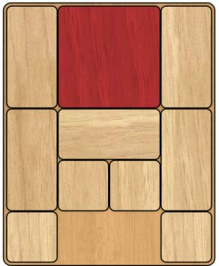
What is Klotski
Is a sliding block puzzle game which was invented around 20th century
Its purpose is to move the biggest square to the exit
Can only move blocks in vertical or horizontal direction, and cannot remove any block from the board.
Has many variants and different openings
Not a easy puzzle; many people give up midway
The most basic opening of Klotski

Slide 3
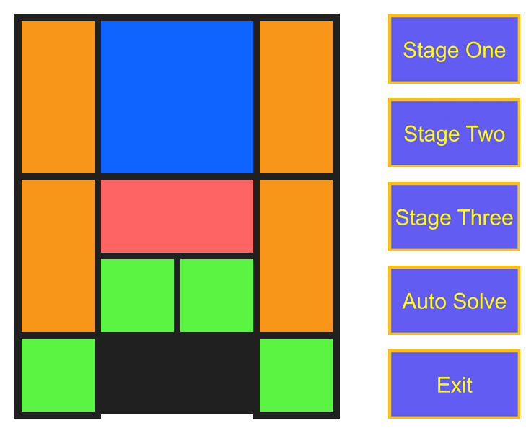
My Klotski Program
Play Klotski with three different openings
Get help from the computer to automatically solve the puzzle at any time; watch the solution

Slide 4
Representation of the game board
The game board can be represented as a 4x5 table
Each cell in this table can be described by its x coordinate and y coordinate
4
3
2
1
0
 | 0 | 1 | 2 | 3

Slide 5
Representation of the blocks
Total ten blocks. Assign them with a name and color
Description | Assigned Name | Assigned Color
2X2 Square | A | Blue
1X2 Rectangle | B1 | Orange
1X2 Rectangle | B2 | Orange
1X2 Rectangle | B3 | Orange
1X2 Rectangle | B4 | Orange
2X1 Rectangle | C | Red
1X1 Square | D1 | Green
1X1 Square | D2 | Green
1X1 Square | D3 | Green
1X1 Square | D4 | Green

Slide 6
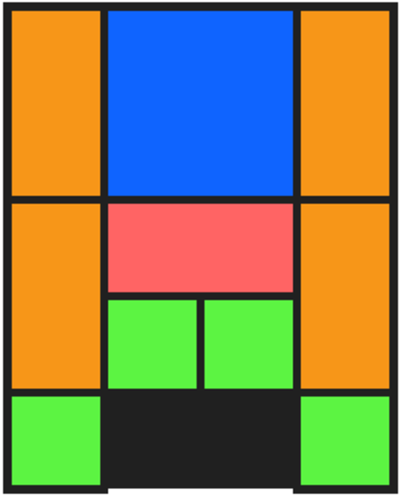
Representation of the blocks
Use tuple to represent each block
The first element is a string, which is name of the block
The second element is a variant type, which contains five integers:
X: x coordinate of the block
Y: y coordinate of the block
W: width of the block
H: height of the block
C: color of the block
For example: ("D1", {x=0; y=0; w=1; h=1; c=0x5cf442})

Slide 7
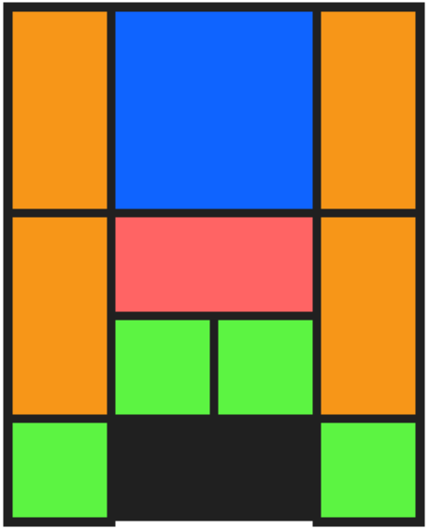
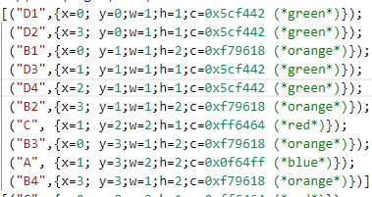
Transformation
For some blocks which occupy more than one cell, the x and y indicate the lower-left corner of the block. However, the program still knows they occupy more than one cell, because their width and/or height are larger than 1.

Slide 8
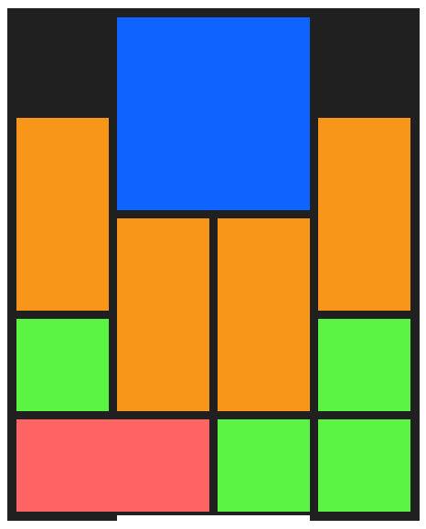
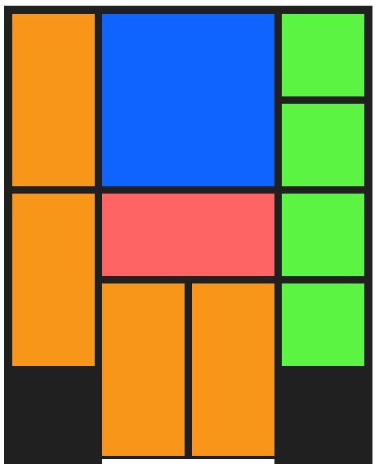
Three Different Openings

Slide 9
User Action
Clicks on any button
Button action
Directly move the block
The block is movable
A User clicks
Check the block’s surrounding cells
Ask for users’ input then move the block
Clicks on the game board
Determine which block it clicks
The block is not movable
Not a block
Clicks on other things
Use the original block list and refresh the screen
Generate a new block list and refresh the screen

Slide 10
A Special Case
If the mouse clicks within this kind of area, the program will think it does not click on any block
However, this is not correct, sometimes.
Add a check function
If the mouse clicks at cross section, horizontal aisle or vertical aisle, the program will check the neighboring cells. If they belongs to the same block, the mouse actually hits the block!

Slide 11
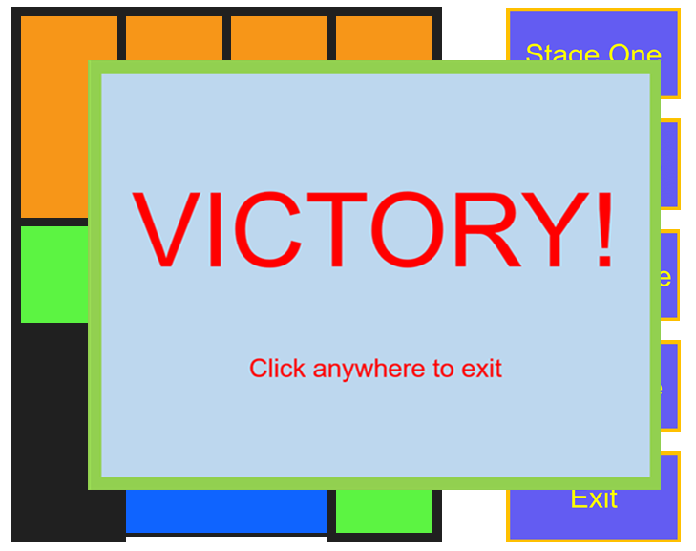
Victory Check
Right after the screen is refresh, the program will check if the block list is in “victory state”, i.e. Block A’s x = 1 and y=0
If not, wait for user’s input
If it is, generate a victory screen

Slide 12
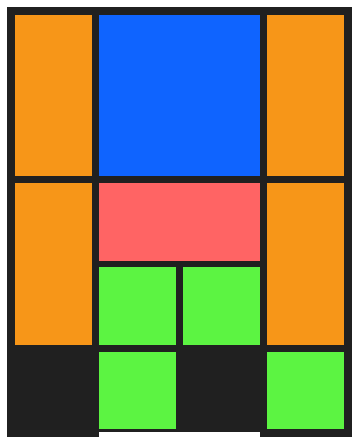
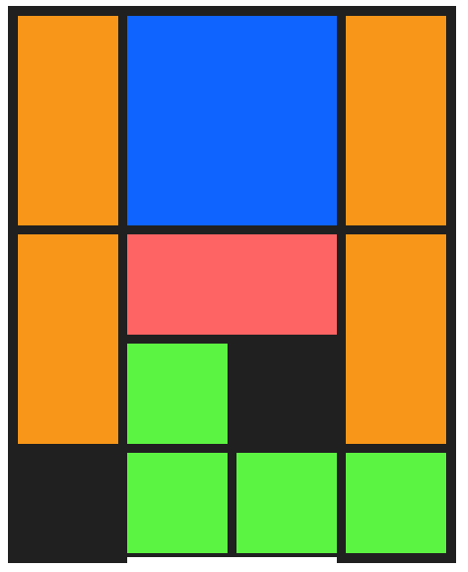
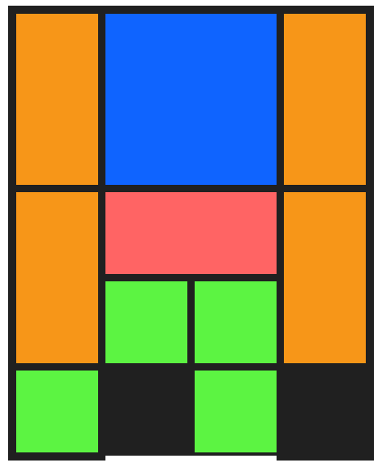
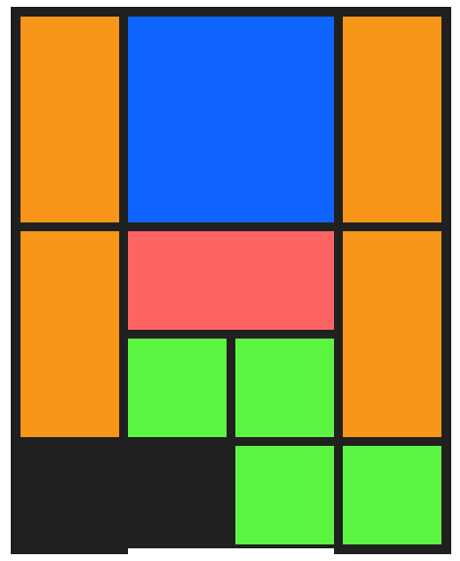
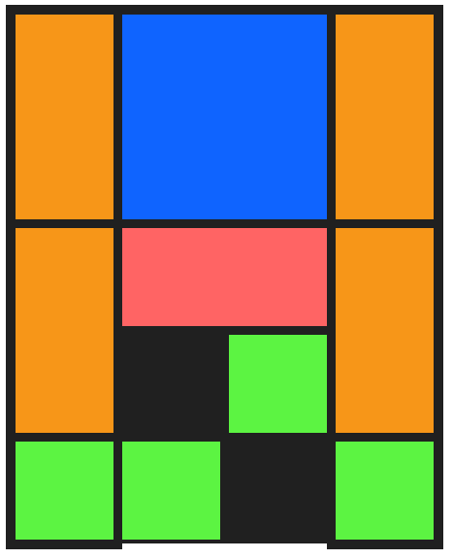
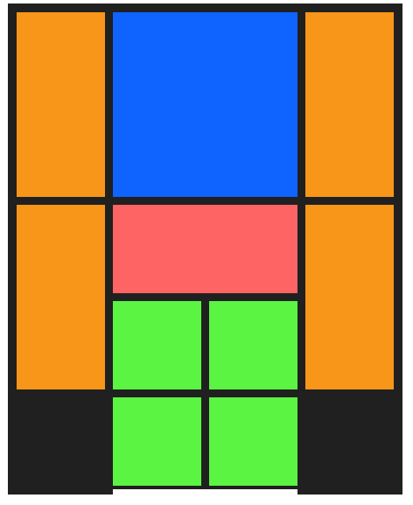
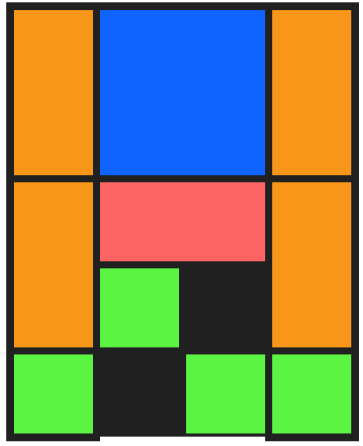
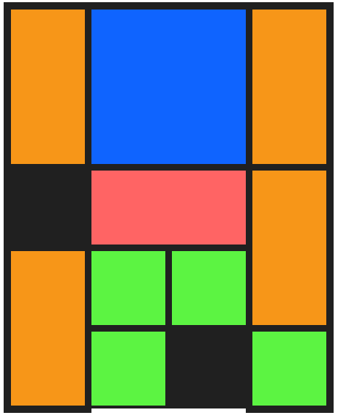
Auto Solving Function
……
……
……
……

Slide 13
Backtrack and Show the Solution
After the solution tree is generated, backtracking the solution tree to generate a path, which is our solution
Display solution through a simple animation

Slide 14
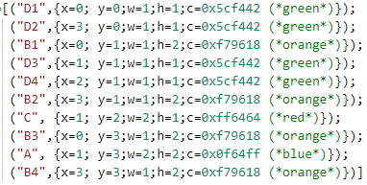

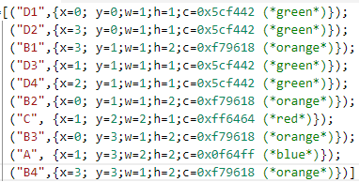
Auto Solving Comparison
Actually they are the same, but the program will treat them different
Need to override Pervasives.compare
If this number is the same, then it is the same

Slide 15


