Slide 1

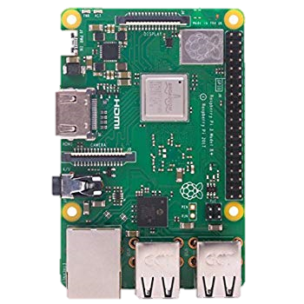
ROBOTICS CLUB MNNIT
A BRIEF
IntroDUCTION
To your new
MINI computer
RASPBERRY PI

Slide 2
What is this Raspberry pi ?
The Raspberry Pi is a credit-card sized computer that plugs into your TV and a Keyboard.
It’s a capable little PC which can be used for many of the things that your desktop PC does.
Raspberry Pi is even more than computer as it provides access to the on-chip hardware i.e. GPIOs for developing an application.
Where it is Used ?
DESKTOP PC
ROBOTICS
IOT
WIRELESS PRINT SERVER
MEDIA SERVER
GAME SERVERS
WEB SERVERS
FM RADIO STATION

Slide 3
What Makes It So USEFUL ?
PRICE :- You are getting a whole computer in less than 3000 Rs.
A FULL OPERATING SYSTEM :- Rasbian, Ubuntu Mate, Windows 10 IOT Core etc.
COMMUNITY :- A great supportive community.
POWER CONSUMPTION :- Raspbeery Pi Model B uses about 5W of power.
CONSTANT IMPROVEMENT :- RASPBERRY Pi 4 has 4 GB of RAM.

Slide 4
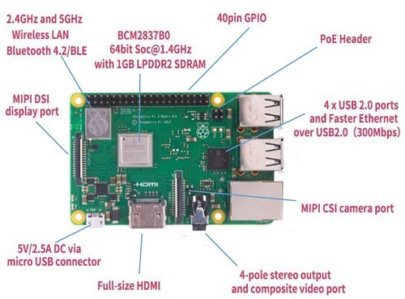
TECH SPECIFICATIONS
Quad core 64-bit processor clocked at 1.4GHz
1GB LPDDR2 SRAM
Dual-band 2.4GHz and 5GHz wireless LAN
Bluetooth 4.2 / BLE
Higher speed ethernet up to 300Mbps
Power-over-Ethernet capability (via a separate PoE HAT)
Size is 85mm x 56mm x 17mm

Slide 5
COMPONENTS REQUIRED TO GET STARTED
Raspberry Pi 3 Model B+
Monitor, Mouse and Keyboard
Memory Card – 16 GB Class 10
Power Supply – 5V 2.5 Amp USB power adapter
RPI Camera
HDMI Cable
Ethernet Cable
Heat Sink or Fan
Raspberry Pi Case

Slide 6
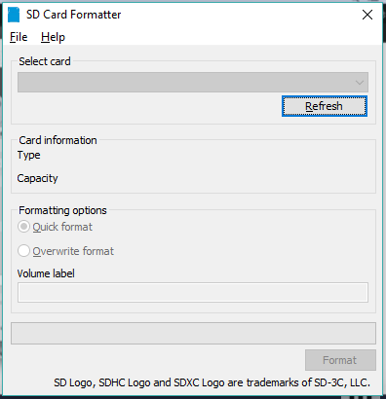
Steps to install the OS
Step 1 : Gather all the things needed
Step 2 : Format the SD Card
2.1 Download and install the “SD Card Formatter” from the below link –
https://www.sdcard.org/downloads/formatter/eula_windows/index.html
2.2 Open the software and select your card and click on Format

Slide 7
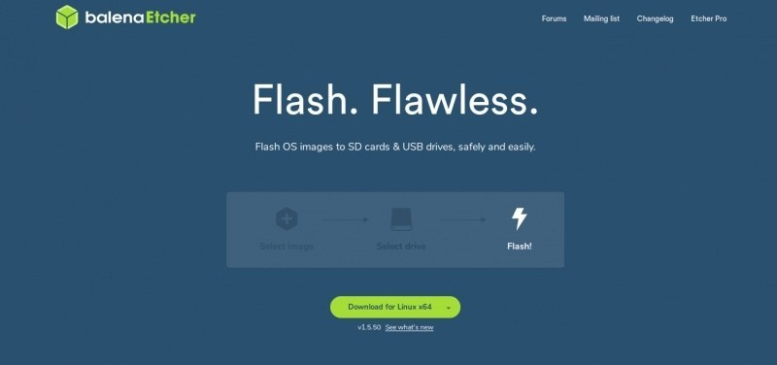
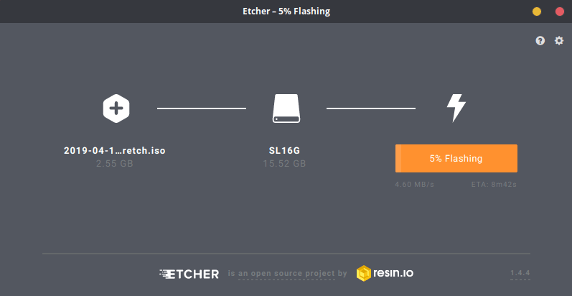
Step 3 : Write the OS to the memory card
3.1 : Download and install “Etcher” from the link below :
https://www.balena.io/etcher/
3.2 : select the OS image you just downloaded and click flash.

Slide 8
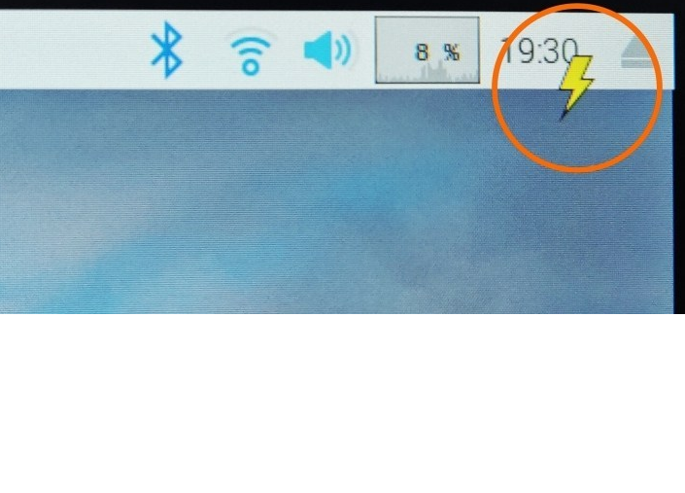
Step 4. Powering up the Raspberry Pi
4.1 Insert the Micro SD card into the Pi.
4.2 Connect the HDMI cable to your display, wire up the mouse and keyboard.
4.3 Plug in the power cable to turn on the Pi.
Caution : If you see a golden lightning bolt on the top right of the screen, it means that there is a power supply issue (usually low voltage). Most mobile chargers are not ideal to power a Raspberry Pi, poor quality USB cables contribute to this issue as well.

Slide 9
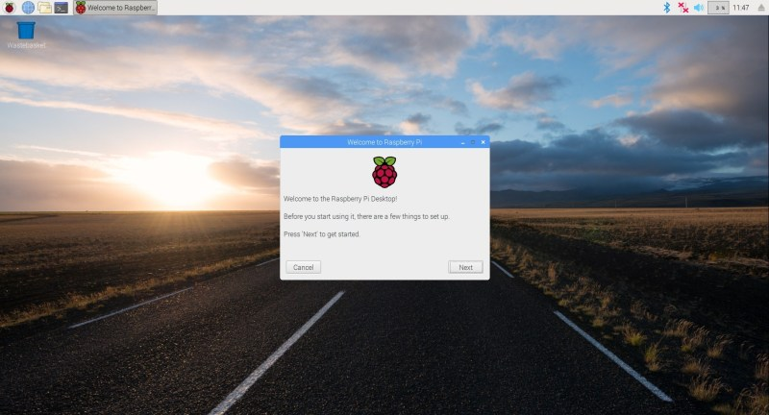
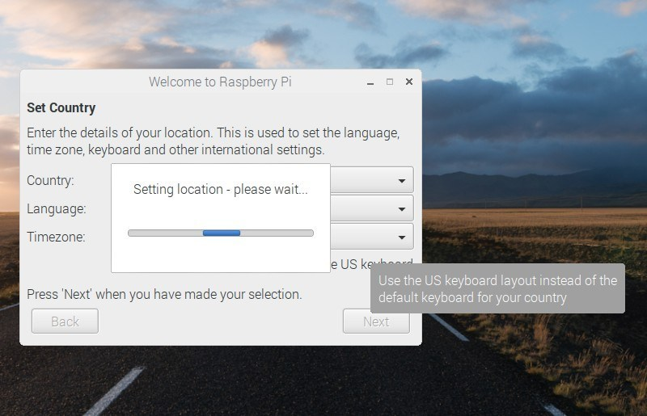
Step 5 : Initial Configuration of Raspbian OS
5.1 First boot can take about a minute or two, once the Pi has booted up you are taken to the welcome screen for initial setup.
5.2 Click next, set your country, language and keyboard preference.

Slide 10
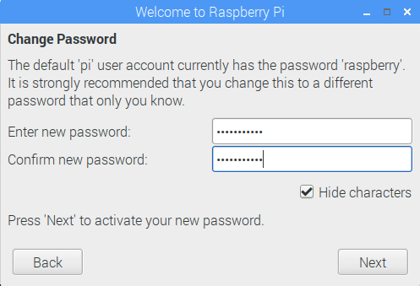
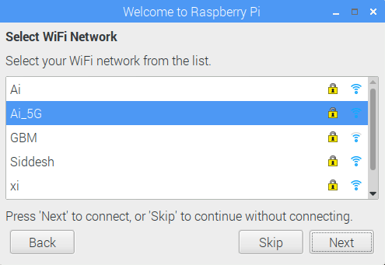
5.3 Set a new password, the default being ‘raspberry’.
5.4 Connect to your WiFi network if you haven’t plugged in an Ethernet cable.

Slide 11
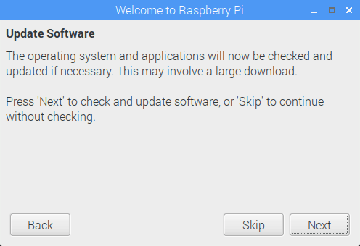
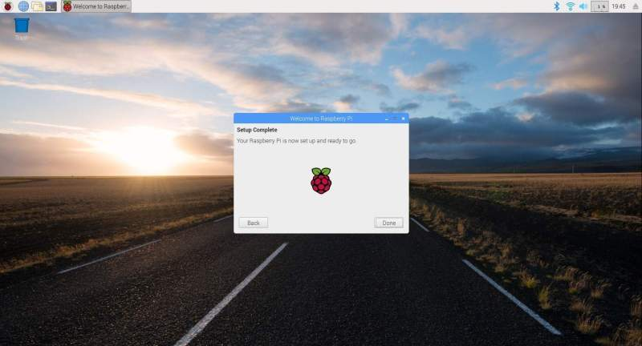
5.5 Update the Raspbian OS, this step will take a while depending on network speeds.
5.6 Once the Raspberry Pi has finished updating, the initial setup is done!.

Slide 12
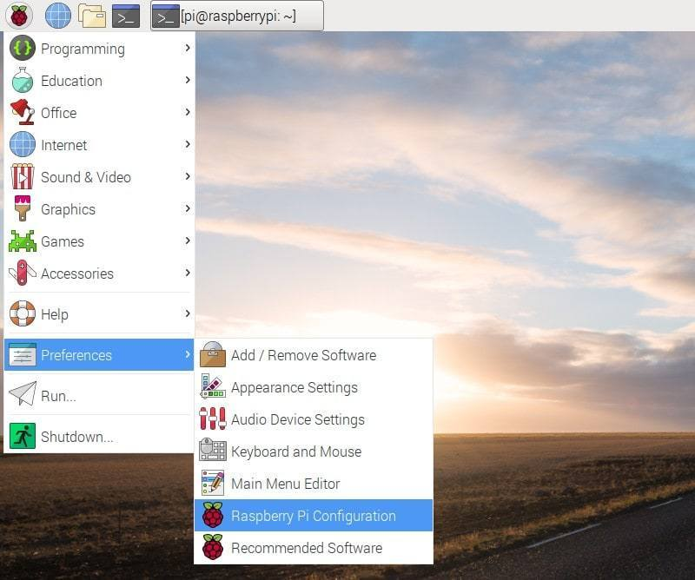
Raspberry Pi Configuration Wizard
You can access the configuration wizard by navigating through the menu.

Slide 13
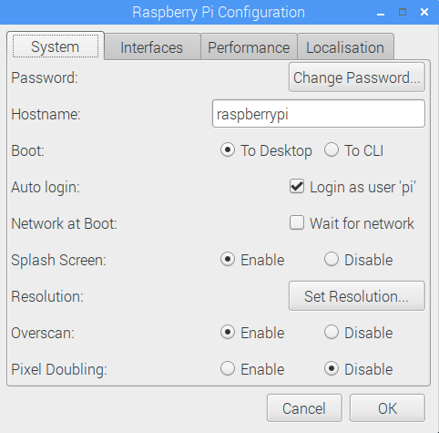
In the System tab, you can change the password, set a new hostname for your Pi, change the boot options and more. Booting to CLI(Command Line Interface) is preferable when you are running network or server applications.

Slide 14
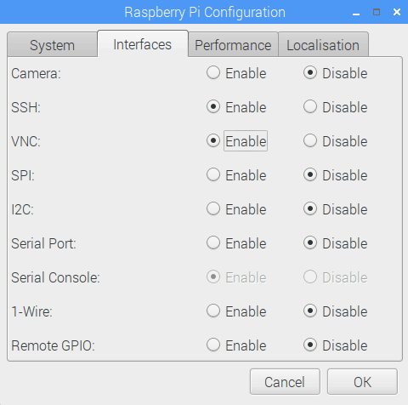
In the Interfaces tab, you can enable or disable all the different methods to interface with your Raspberry Pi.
SSH (Secure Shell) is disabled by default and needs to be enabled if you want to SSH into Raspberry Pi and access it via network. Using VNC is another popular method to access a Raspberry Pi over the network. VNC streams the whole desktop GUI of the Pi to another device and you can interact with it like you would when directly using the Pi.
You can also enable or disable the GPIO bound interfaces in this tab.

Slide 15

Now you can go ahead and explore rest of the Raspbian OS.
BUT WAIT !!!!!
What will you do if you don’t have a Desktop ?
How can we use it in robot when there is a
cable connected to it ?
How can you access it remotely ?

