Slide 1
The Technology Value Stream
Amanda New | CSD380 | Module 1

Slide 2
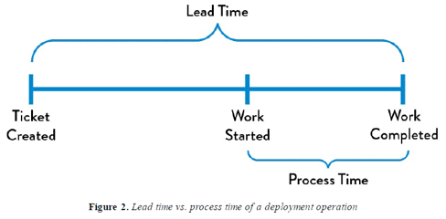
Performance Measures
Value Streams have two measures of performace:
Lead Time
Processing Time
(Also known as Touch Time or Task Time)

Slide 3
Lead Time VS Processing Time
Lead Time:
Starts when request is made, ends when request is fulfilled
Processing Time:
Starts when work begins on a project, ends when work is complete

Slide 4
Main Focus
Lead Time:
Main focus is customer service. Since this is what the customer experiences, the main goal for improvement is to minimize the customer's time waiting from request to completion.
Processing Time:
Main focus is efficiency. Finding ways to achieve a fast flow while also making sure to put out quality work, get feedback and improve as time goes on.

Slide 5
Common Delay Scenario
A common scenario ran into is deployment lead times requiring months to be completed.
Common in large companies with large teams
Can have a significant impact on value streams; roles may be adjusted or changed based on current needs
Fixing problems requires a lot of time allotted to certain tasks, and even longer to test once corrected.

Slide 6
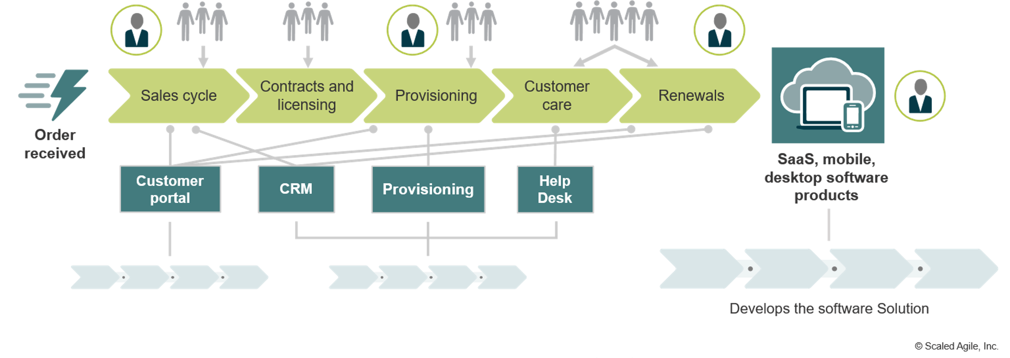
Common Issues
Customer unhappy with current offerings
Slow delivery of products or updates
Layoffs/lower budgets
Lack of organization
Lack of communication between client and team
Lack of communication internally between team members
Lack of visibility

Slide 7
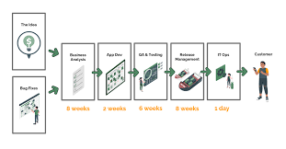
Ideal DevOps Scenario
Clear understanding of value stream to avoid uncertainty regarding tasks
Clear communication between client and team
Clear communication internally with team members
Clear feedback and proper listening to feedback given
Cut unnecessary work to optimize time and spending
High employee moral

Slide 8
Benefits of A Good DevOps Value Stream
Good organization can help clear confusion around tasks needed to be completed, as well as prioritizing tasks as you go.
No missed deadlines
Strong employee moral
Customer retention/recommendations
Strong positive company reputation
Larger team/company = larger projects = larger budgets

Slide 9
Ways to Improve Value Stream
Learn from mistakes of others, have a diverse team with different insights on how to improve a process.
Track everything, make improvements and changes as needed
Invest in your team and in your software
Be selective in projects taken
Streamline operations to create a faster flow and allow your team to delover faster

Slide 10
Sources
The DevOps Handbook: How to Create World-Class Agility, Reliability, & Security in Technology Organizations Second Edition; Gene Kim, Jez Humble, Patrick Debois, John Willis, & John Allspaw; IT Revolution Press; 2016
What is Value Stream Management? | Atlassian
Value Stream Management: Explained in Plain English — DevOps Institute

