Slide 1

Just Culture
Barriers for a learning culture
Amanda new | csd380

Slide 2
What is Just Culture?
Learning to improve a design through mistakes by taking accountability, learning and growing as a team from them
Knowing that while you may have individual faults or hands in a mistake, most large-scale mistakes are the result of multiple people and/or systems in place
Balancing allowing risks and diversity of ideas without compromising security through managing behavoral choices

Slide 3
Behavioral Risks and How to Mitigate
Normal slip ups or mistakes, typically human errors – Look at system in place and make changes where needed to prevent or decrease simple mistakes from happening in the future
Risks created by negligence of team – Training and disciplinary action if needed
Times when risks are taken, but end up with a negative result, putting a system at risk – Examine choices made, redesign features that may have led to the system being at risk, and coach/train team if needed

Slide 4
Fear Culture
Lack of accountability causes teams to place blame on one another, so creating an environment that is able to take ownership of their responsibilities is important to prevent a fear of taking risks
A "fear" filled environment can lead to staff withholding information, retribution, or even a fear of losing job security
Most issues/errors not reported are out of fear of disciplinary action

Slide 5
Communication and Trust
Having an open line of communication between teams helps to mitigate fear and promote a just culture
Lack of transparency can increase fear of disciplinary action, especially when those actions aren't consistent
Lack of feedback and action can cause confusion if team isn't given the opportunity to improve
Leadership models are important when it comes to understanding how your team operates, and the best practices that will help them be more successful

Slide 6
Bias
Outcome Bias: Judging and "coaching" based on the overall outcome versus the behavior that led to it
Attribution Bias: Focusing on a personal flaw versus finding aspects in a system that may have contributed to a mistake
These can increase environment hostility, retaliation, and slow down production of projects and even increase the amount of errors/mistakes since there is a fear of speaking up

Slide 7
Just Culture in Software Development- Why it's a Factor
Software systems have a lot of people working on a team and collaborating with other teams across a project.
Larger teams mean more risk and mistake exposure, so having management that knows how to navigate issues locally within a team is important for team morale and productivity
Unrealistic deadlines can lead to at-risk behavior, and cause teams to become negligent to meet a goal
Focus on what failed, why it failed, what in the system allowed it to fail, and give corrective action when needed

Slide 8
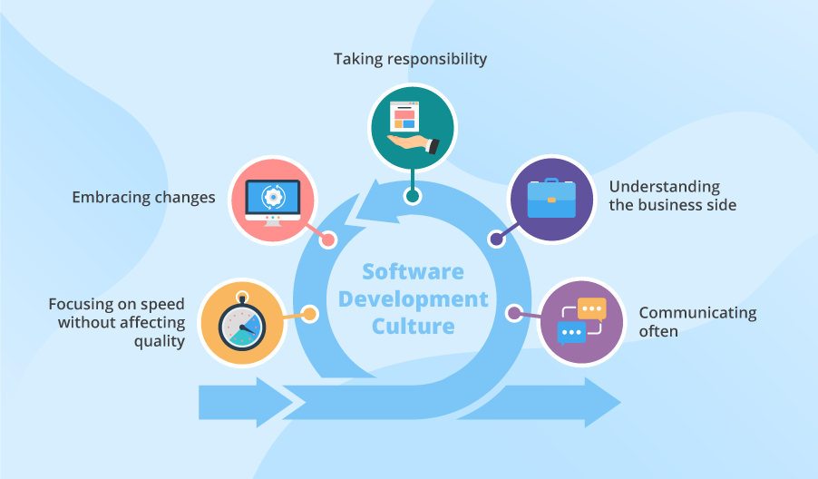

Slide 9
Conclusion
Promote a collaborative and dependable work environment; give feedback without creating fear
Keep assessments fair and unbiased, focus on the systems in place versus the individuals making the mistakes
Clearly communicate with your team, and with other teams, and promote an environment free of worry of disciplinary action (unless necessary)

Slide 10
Sources:
Agile Software Development Culture Hacked
Building a Just Culture | SKYbrary Aviation Safety
Reckoning with the Harm We Do: in Search of Restorative Just Culture in Software and Web Operations - InfoQ
Why is culture so important in software development?

