Slide 1
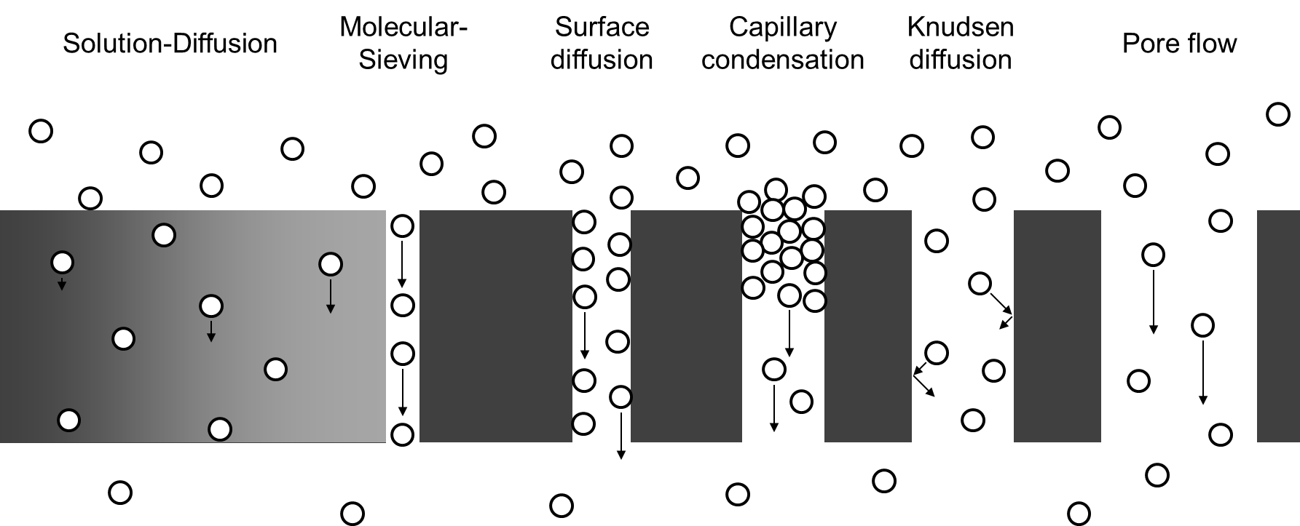

DyNAMICS OF CONDENSED MATTER
Impact of Hydrophobicity
On structure and dynamics
Inside nanopores

Slide 2
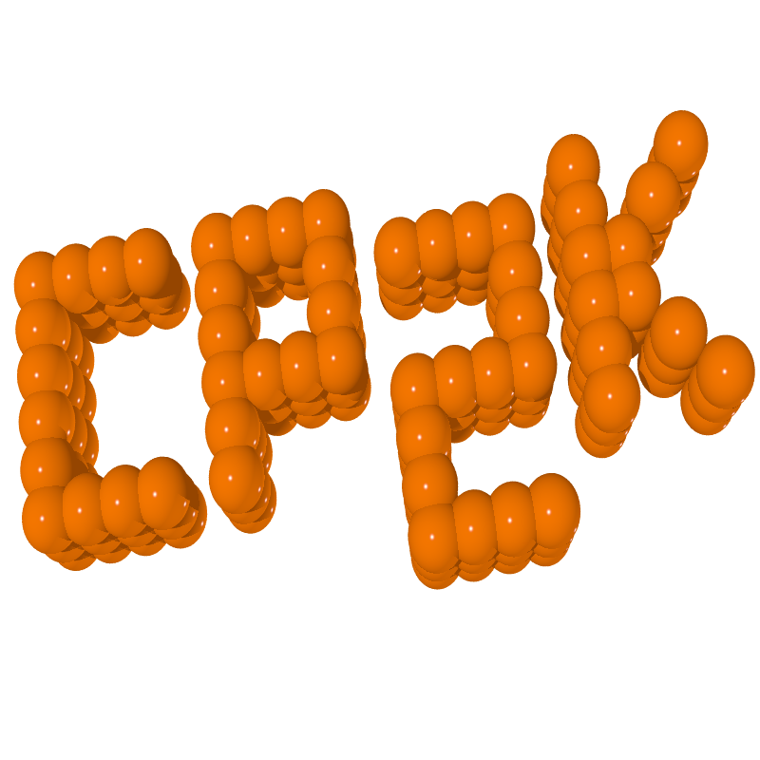
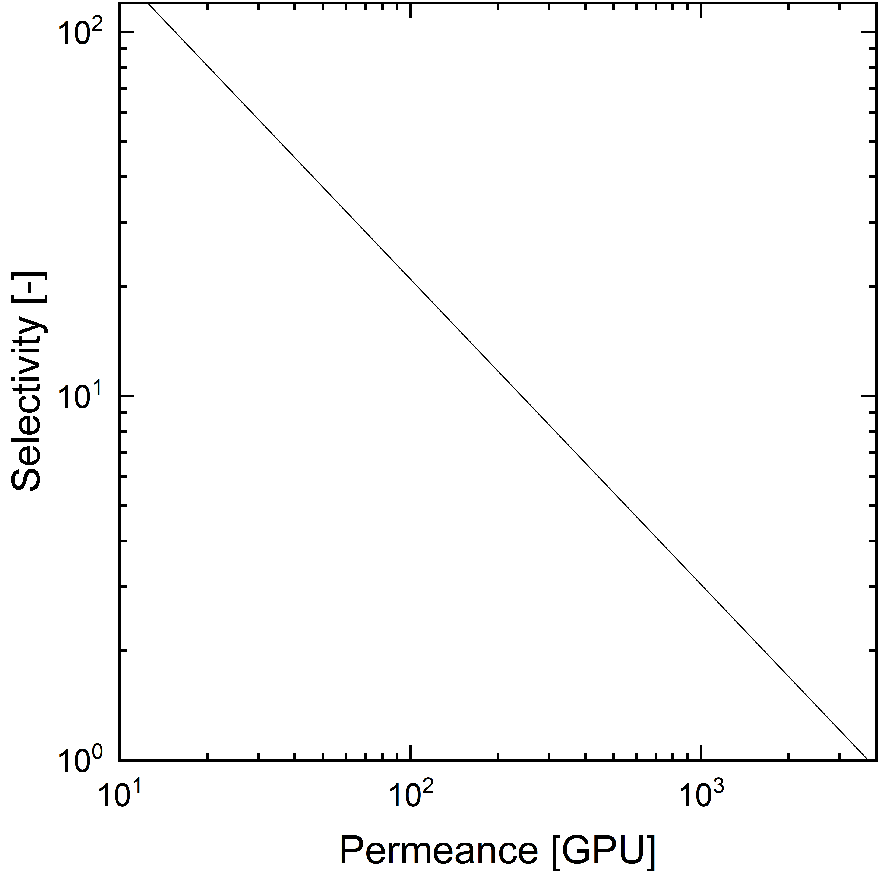
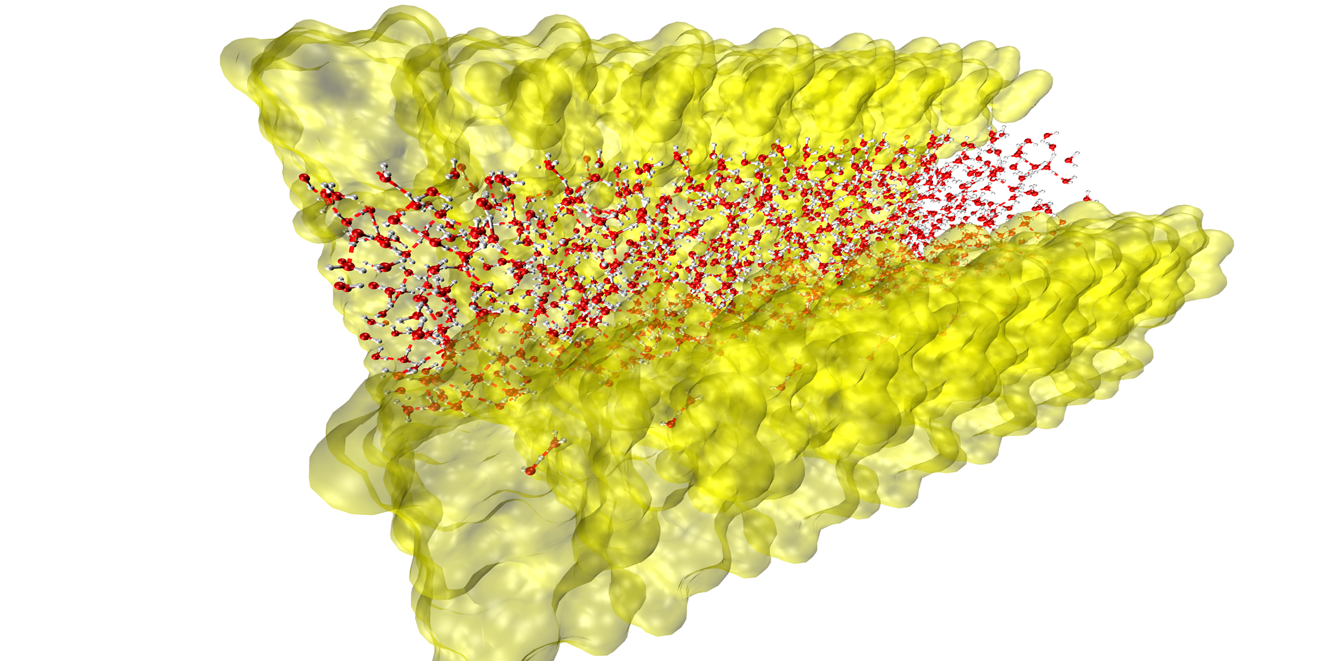
Engineer the membranes of the future
Understand on a molecular level
SFG
IR
VIS

Slide 3
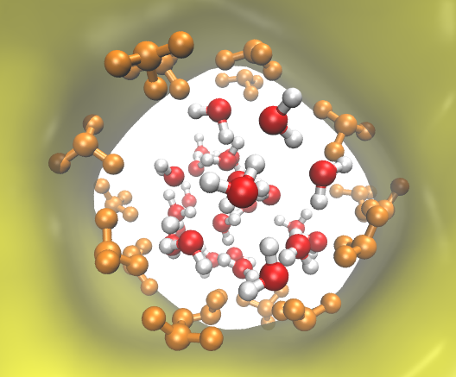
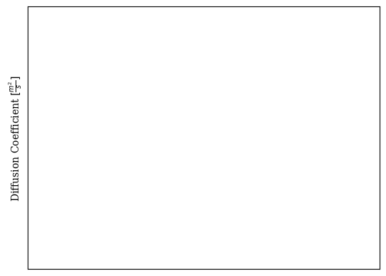

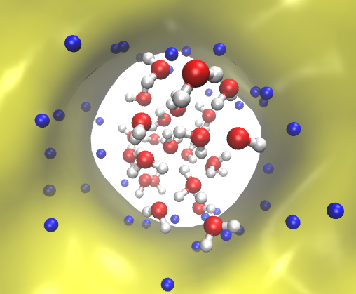
How fast is diffusion?
Super-diffusive?
1.3 nm
0.25 nm

Slide 4
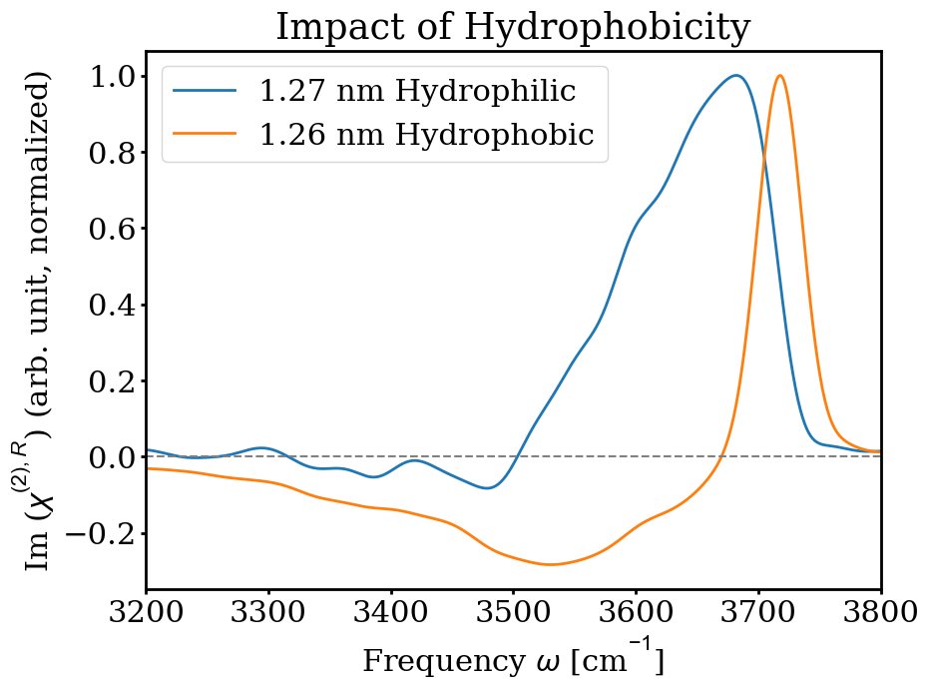
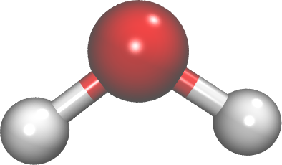
To understand what is happening
Molecular structure and bonding
Hydrophobic
Hydrophilic
stronger bonding
Weaker bonding

