Slide 1
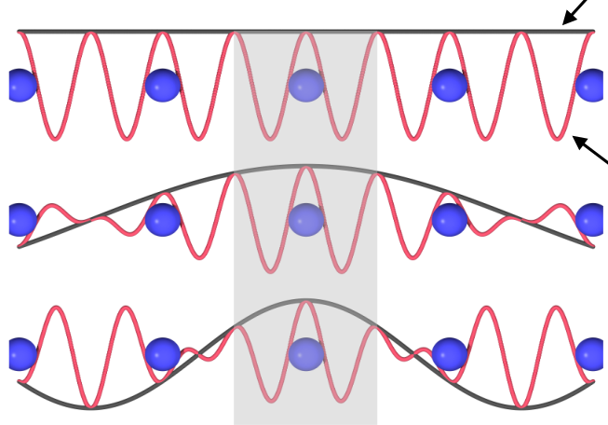

Bloch‘s Theorem
Using symmetry
a
K = 0
|C| = 1

Slide 2







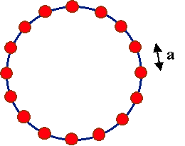



C^{N} =1
pbc
x
Bloch's theorem states that solutions to the Schrödinger equation in a periodic potential take the form of a plane wave modulated by a periodic function
N

Slide 3


While Bloch functions are the eigenstates of the Hamiltonian for a given band
and a given crystal momentum, they are oscillating and delocalized in real
space.
Often, orbitals that are localized in real space offer more microscopic insights
into the underlying chemical and physical processes.

Slide 4
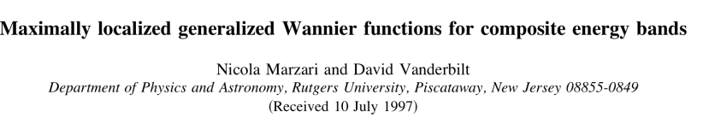
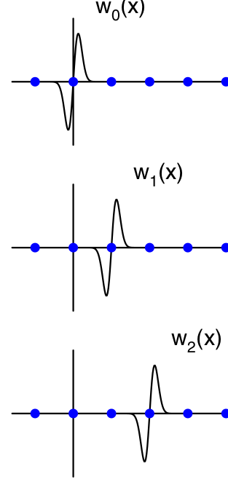



Slide 5
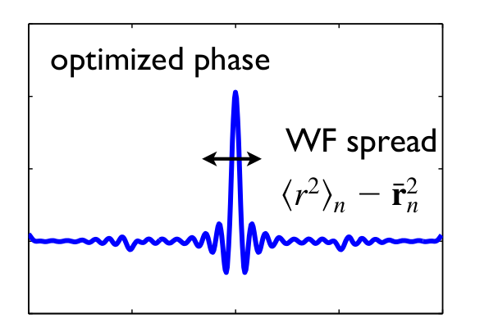
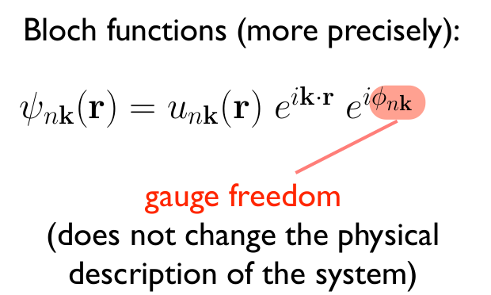
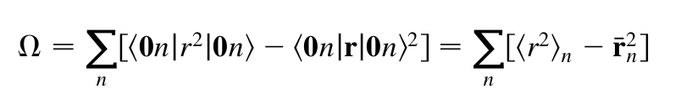

Slide 6
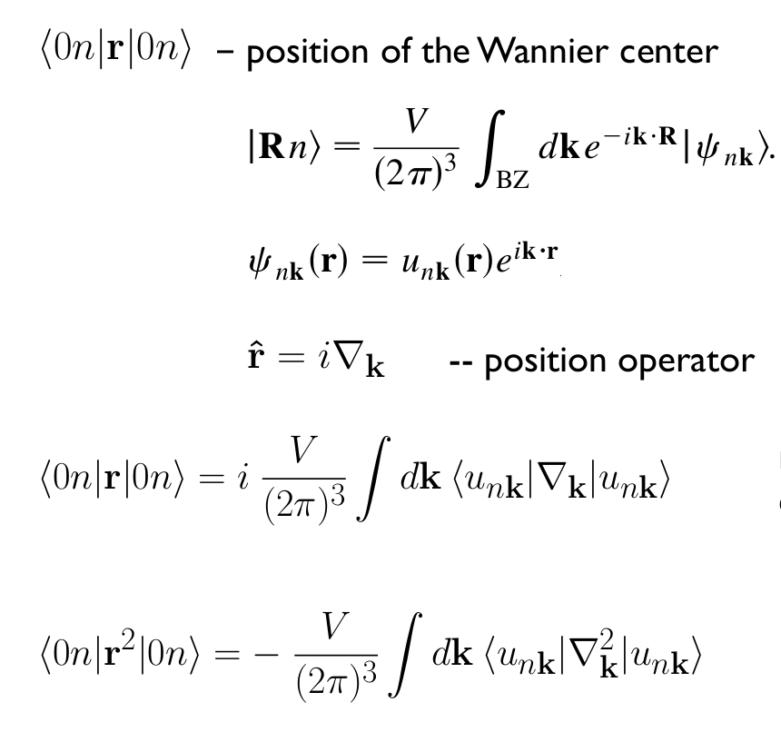

Slide 7


