Slide 1
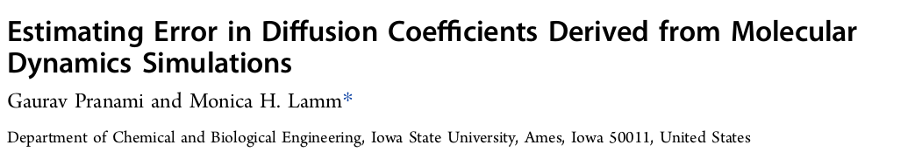
Issues of Diffusion Coefficients Calculation from Molecular Simulations
Statistical Uncertainty
Observables with long-range or long-lived correlations
Initial condition bias
Finite simulation box size
Question based on those issues
Length of the simulation to satisfy ergodic hypothesis
Intervall between two successive samples
Are Multiple Independent Simulations necessary
Not known a priori

Slide 2
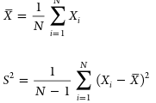
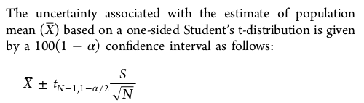
Statistical Uncertainty
Sample mean
Used to estimate population mean and
Variance from a sample of N independet
Measurements of the random variable X
Sample variance
Valid: if X is normally distributed or
if sample size is sufficiently large
Errors with X are often reported as X +- S → Spread around estimated mean
95 % confidence Interval (alpha =0.05) → 95 % of intervals contain population mean
X± S /√N is often used (68,2 %)

Slide 3
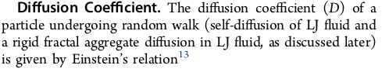


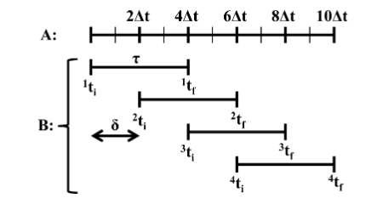

Sample Correlation
Know what you need. Uncorrelated or Correlated sampling!

Slide 4
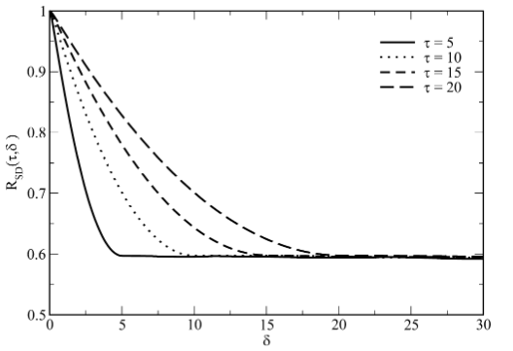

Sampling Squared Displacements
An accurate value of delta has to be determined to ensure Independent sampling
Decorrelates to a value of
δ → τ
Should be sampled as non overlapping intervals

Slide 5
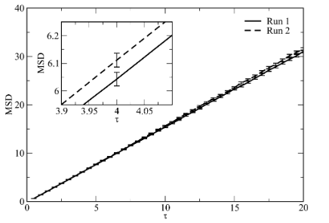
Linear Regression to calculate the Diffusion Coefficient
1/6 of the the slope of the linear fit of MSD
As a fucntion of tau
This would also produce the statistical
Uncertainty associated with the fitting parameter
But this is only valid if
Existence of SD having finite mean and variance
Linear relationship between MSD and tau (Einstein‘s relation)
Independence of SD samples
Normal distribution of SD
Constant variance in SD as a function of tau
Uncertainty in D can not be determined

Slide 6
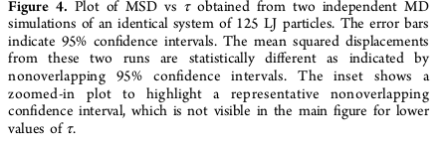
Using Multiple Independent Simulations
An estimate of mean of D and its uncertainty using Students t-distribution can be obtained from multiple independent simulations
Or the confidence interval for the MSD can be determined invoking the central limit theorem if sample size ~>40.

Slide 7

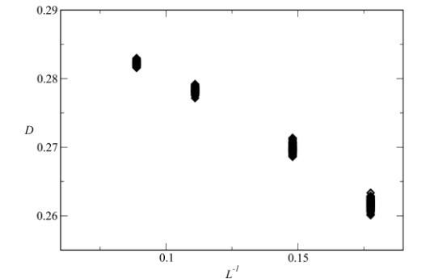
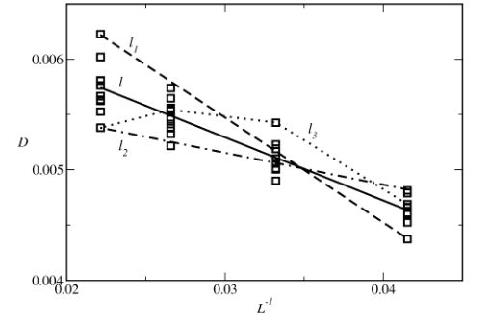
Diffusion as a Function of Simulation Box Length.
Motion of particles compromising a fluid induces a flow field leading to hydrodynamic
interactions
Well known is this correctionfor the effects of a finite simulation box of size L

Slide 8
Conclusion
Choose the correct sample interval and separation to achieve correlation or uncorrrelated sampling depending on requirement
Uncertainty of D can not be obtained from linear regression fitting as normal distribution and homoscedasticity are violated
But Muliple Independent Simulations can be used to calculate the uncertainty in D
Multiple Independent Calculations also show that the MSD from 2 MD simulations can be statistically different even for long simulations (simulation time not long enough to erase memory of intial state)

