Slide 1
Presentation Outlines
Motivation
Objective
Introduction
Convex hull algorithms
Proposed algorithm
Performance Evaluation
Achievement and future work
Conclusion

Slide 2
Motivation
Line fitting.
Non-crossing matching.
Robotics(Hidden object determination).
Efficiency frontier analysis.
Feature extraction.

Slide 3
Objective
The main objective of this research work is to devise a graham scan algorithm that use point elimination technique and find whether it is better than the existing graham scan algorithm for convex hull problem.

Slide 4
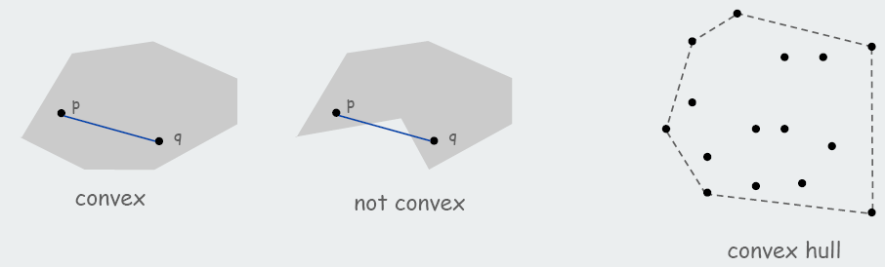
Introduction
A set of points is convex if for any two points p and q in the set, the line segment pq is completely in the set.
Convex hull- Smallest convex set containing all the points.

Slide 5
Properties of Convex hull
There are two main properties of convex hulls:
All of the points in the final polygon must be indented outwards, or more formally, convex.
The most extreme point on any axis is part of the convex hull.

Slide 6
Convex Hull Algorithms
Gift wrapping
Graham scan
Quick Hull
Divide and Conquer
Monotone chain
Incremental convex hull algorithm
Marriage-before-conquest
Chan's algorithm

Slide 7
Comparison of Convex Hull Algorithms
Algorithm Speed Discovered by
Brute Force O(n³) [Anon, the dark ages]
Gift Wrapping O(nh) [Chand & Kapur, 1970]
Graham Scan O(n log n) [Graham, 1972]
Jarvis’ March O(nh) [Jarvis, 1973]
QuickHull O(nh) [Eddy, 1977], [Bykat, 1978]
Divide-and-Conquer O(n log n) [Preparata & Hong, 1977]
Monotone Chain O(n log n) [Andrew, 1979]
Incremental O(n log n) [Kallay, 1984]
Marriage-before- Conquest O(n log h) [Kirkpatrick & Seidel, 1986]
Chan O(n log h) [Timothy Chan, 1996]

Slide 8
Our Proposed Algorithm
Points reduction from input dataset
Elimination of non-hull points
Applying any O(nlogn) algorithm on existing points
Expected better run-time

Slide 9
Point Reduction Procedure
Find 8 optimal points by
Building Quadrilateral
Triangulation
Removal of points inside
Quadrilateral
Triangles

Slide 10
Building Quadrilateral
Four boundary points calculation
Vertically lowest (bottom-most) point
Vertically highest (top-most) point
Left-most point
Right-most point

Slide 11
Building Quadrilateral (Cont..)
Drawing Quadrilateral using four points
Points inside Quadrilateral
Not hull points
Removal of points

Slide 12
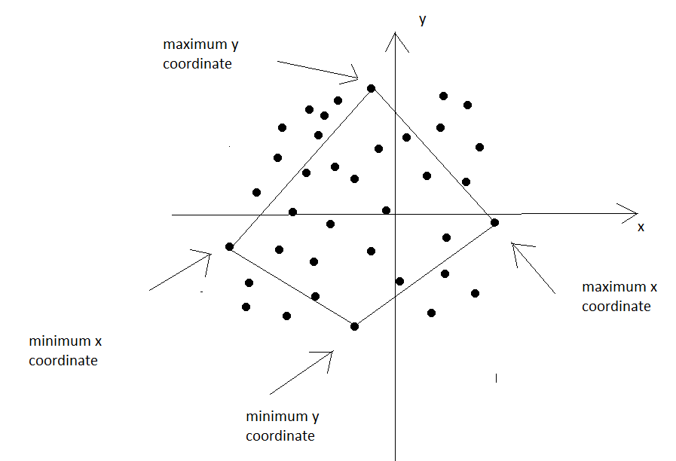
Building Quadrilateral (Cont..)
Figure 1: Building Quadrilateral

Slide 13
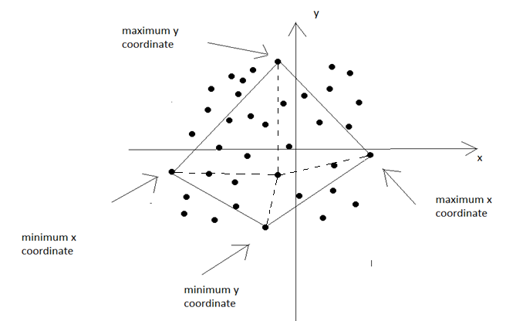
Building Quadrilateral (Cont..)
Figure 2: Checking non hull points

Slide 14
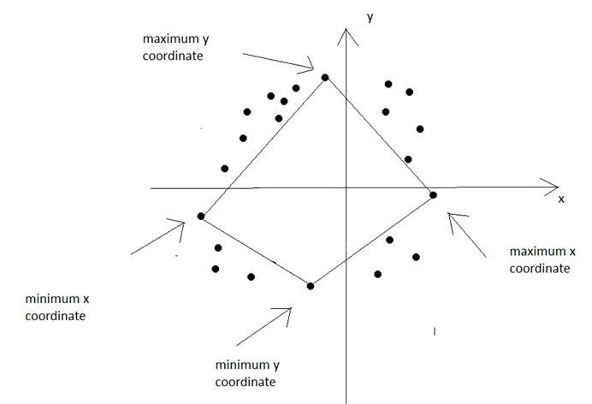
Building Quadrilateral (Cont..)
Figure 3: Elimination Of Points Inside Quadrilateral

Slide 15
Triangulation
Another optimization
Drawing four triangles
Using edges from quadrilateral
Four furthest points in
top-right
top-left
bottom-right
bottom-left regions

Slide 16
Triangulation (Cont..)
Points inside triangles
Also not hull points
Removal of points

Slide 17
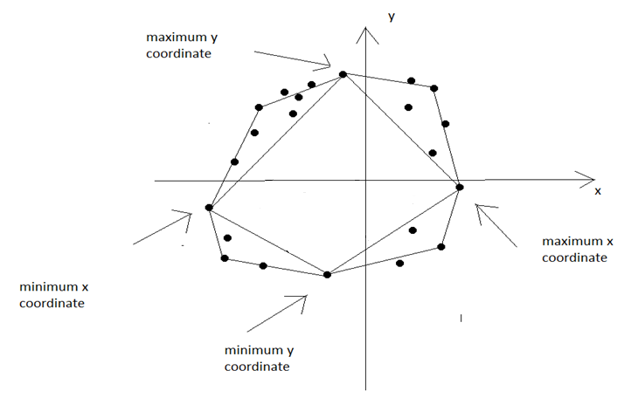
Triangulation(Cont..)
Figure 4: Triangulation

Slide 18
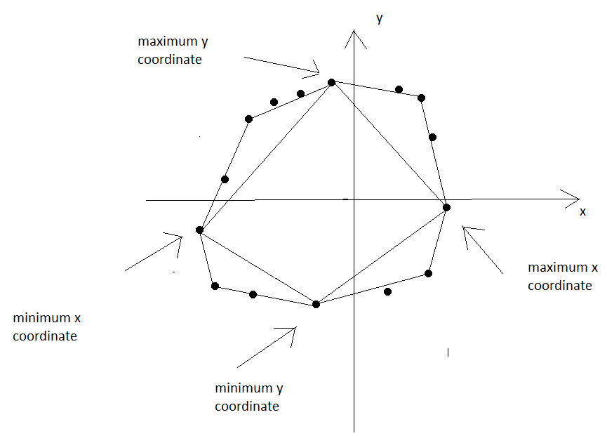
Triangulation (Cont.)
Figure 5: Elimination Of Points Inside Triangles

Slide 19
Implementation
The algorithm is implemented in C++.
Compiler:
Code::Blocks 10.05
Machine Specification:
Processor: Core 2 Duo
Processor Speed: 2.20 GHz
Ram: 2 GB

Slide 20
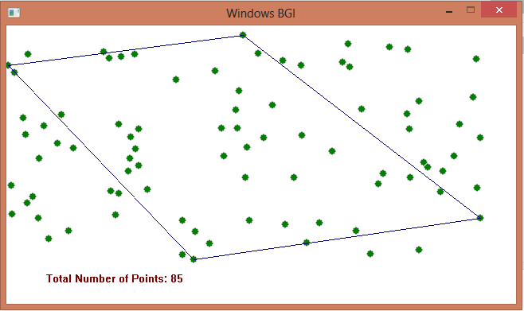
Experiment and Result
Building quadrilateral using four extreme points
Figure 6: Building Quadrilateral

Slide 21
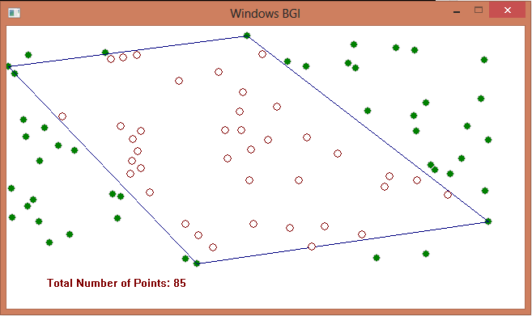
Experiment and Result (Cont..)
Eliminating points which is inside the quadrilateral.
Figure 7: Elimination Of Points Inside Quadrilateral

Slide 22
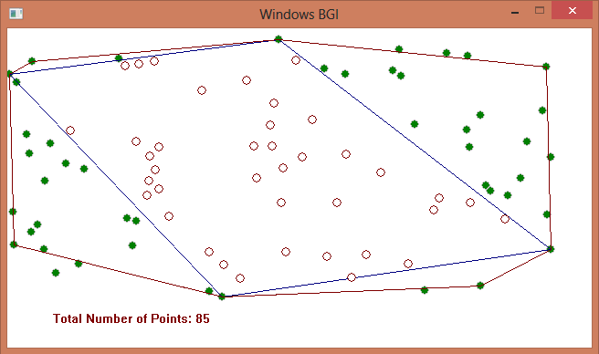
Experiment and Result (Cont..)
Triangulation using another four extreme points
Figure 8: Triangulation

Slide 23
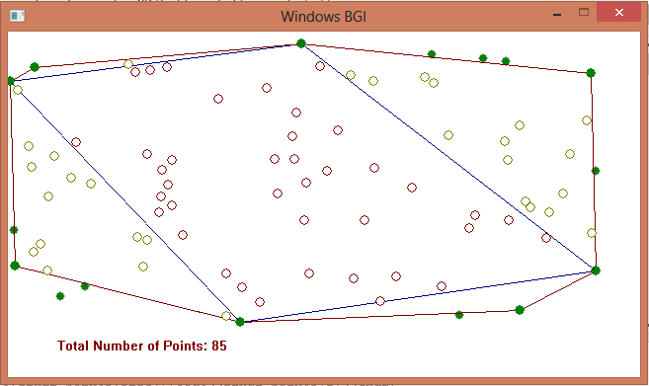
Experiment and Result (Cont..)
Eliminating the points which are inside the triangles
Figure 9: Elimination Of Points Inside Triangles

Slide 24
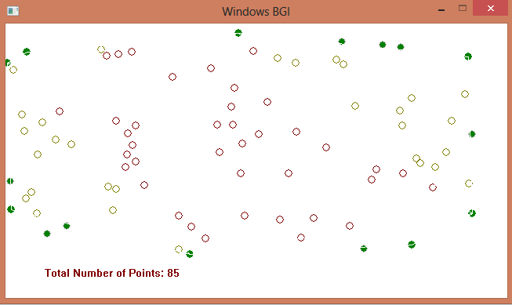
Experiment and Result (Cont..)
Points that are exists.
Figure 10: Existing Points

Slide 25
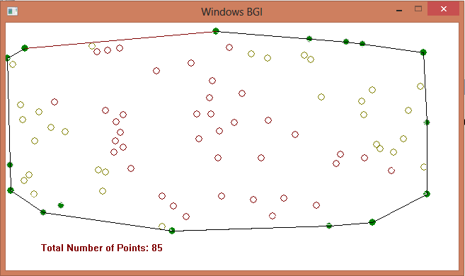
Experiment and Result (Cont..)
After applying Graham’s Scan to these points we get the convex hull
Figure 11: Convex Hull

Slide 26
Performance Comparison
Input Size | Our Modification | Graham Scan’s Algorithm
100 | 0.00000 Sec | 0.00000 Sec
10000 | 0.03100 Sec | 0.04600 Sec
100000 | 0.42200 Sec | 0.67000 Sec
1000000 | 4.69600 Sec | 8.22100 Sec

Slide 27
Achievement
Number of points very large
Evenly distributed points
All points not hull point

Slide 28
Future Work

Slide 29
References
[1] Gift wrapping algorithm, Internet: http://en.wikipedia.org/wiki/Gift_wrapping_algorithm, September 25, 2011.
[2] Graham's Scanning, Internet: http://www.personal.kent.edu/~rmuhamma/Compgeometry/MyCG/ConvexHull/GrahamScan/grahamScan.htm, September 27, 2011

Slide 30
Thank You very much for your patient hearing

