Slide 1

CUSTOMER RETENTION data analysis in e-commerce business
SIDDA LAKSHMI PRANEETHA

Slide 2
CONTENTS
1.Problem statement & objective
2.Literature Review
3.Exploratory Data Analysis
4.Conclusions

Slide 3

E-COMMERCE
E-commerce (electronic commerce") is trading in products or services using computer networks, such as the Internet. Electronic commerce draws on technologies such as mobile commerce, electronic funds transfer, supply in chain management, Internet marketing, online transaction processing, electronic data interchange (EDI), inventory management systems, and automated data collection.
E.g.: Amazon, Flipkart, Paytm and other online platforms.

Slide 4
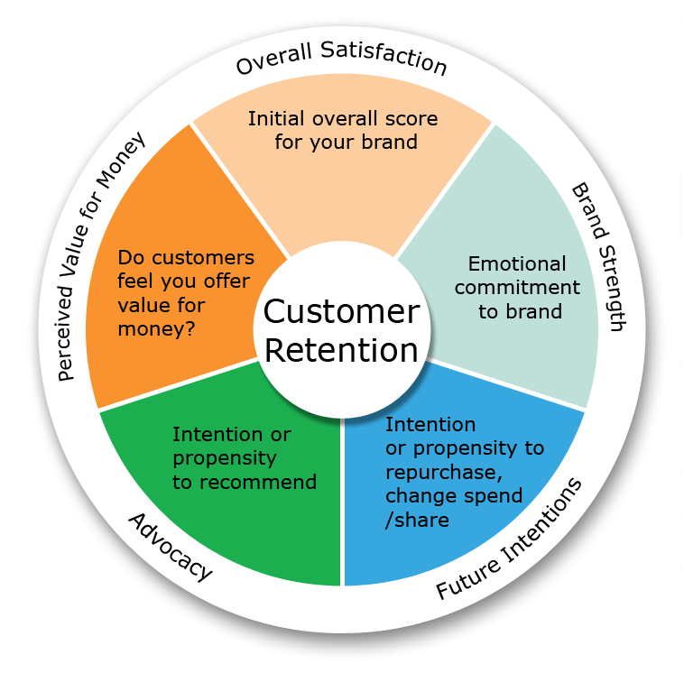
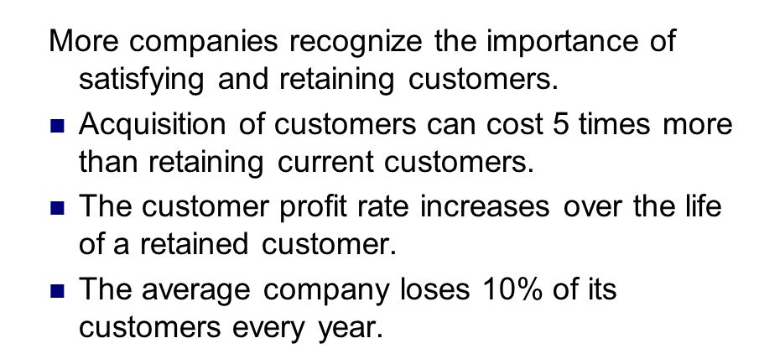
Customer retention
WHAT IS CUSTOMER RETENTION
Customer retention is the practice of business activities that relates increased number of repeat customer activities. There by increased profitability and sustainability of the business.
FACTS ON CUSTOMER RETENTION

Slide 5

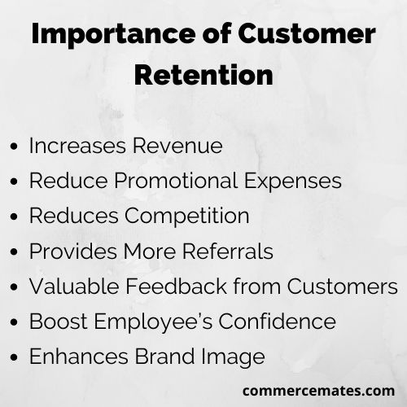
IMPORTANCE OF CUSTOMER RETENTION

Slide 6
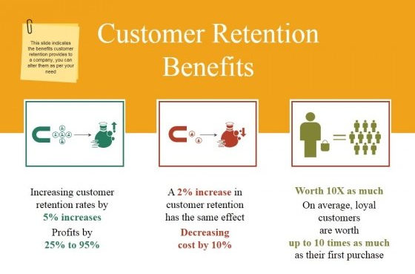
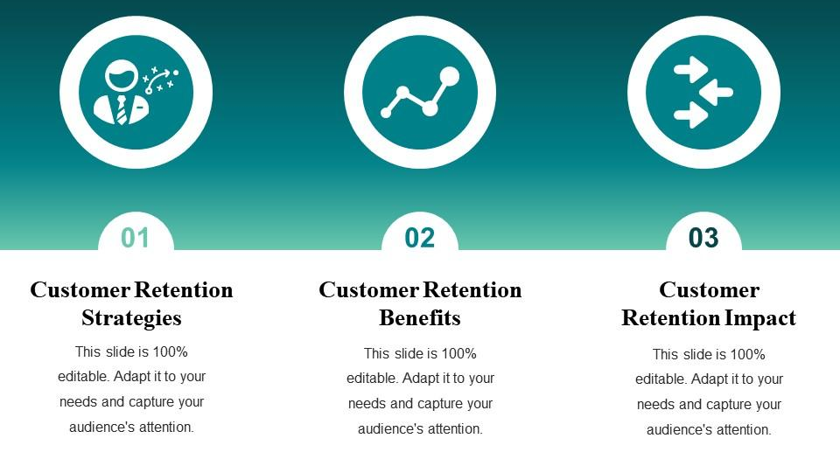
Benefits of customer Retention

Slide 7

Literature Review
Customer satisfaction has emerged as one of the most important factors that guarantee the success of online store; it has been posited as a key stimulant of purchase, repurchase intentions and customer loyalty. A comprehensive review of the literature, theories and models have been carried out to propose the models for customer activation and customer retention. Five major Factors that contributed to the success of an e-commerce store have been identified as service quality, system quality, information quality, trust and net benefit. The research furthermore investigated the factors that influence the online customers repeat purchase intention.
Purchase Intention
User Satisfaction
Net Advantages
Data Quality
Framework Quality

Slide 8

Exploratory Data Analysis
There are 269 rows and 71 columns.
There are no missing values in the dataset.
There are unwanted characters in columns.
There are 70 object type variable, and one is int64 variable, however it is also categorical in nature.
Data Cleansings & Pre – processing
There are a lot of special characters and space in the column name.
There are numeric bullets in some of the columns we will remove it.
To fix the column problem following command has been used.
df.columns=df.columns.str.replace(‘[#,@,&,\t,]’,’ ’)
df.columns= df.columns.str.replace(‘\d+’,’ ‘)
df.columns= df.columns.str.strip()

Slide 9
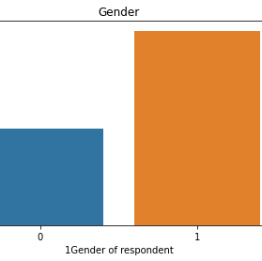
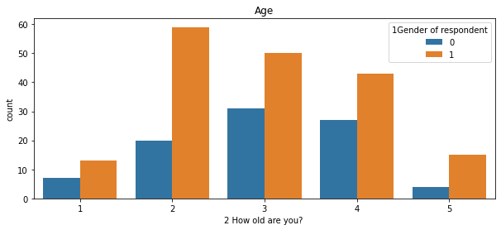
Exploratory Data Analysis(EDA)
Majority,181 of the customers are Female where as Male are 88
Majority,81 of the customers are from age group 31-40years

Slide 10
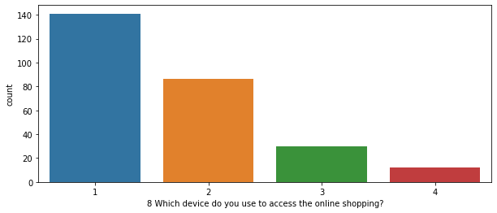
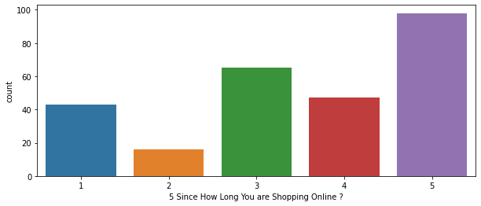
Majority of people are using mobile internet so here we can see smartphones are used
Majority of shopping from morethan 4years

Slide 11
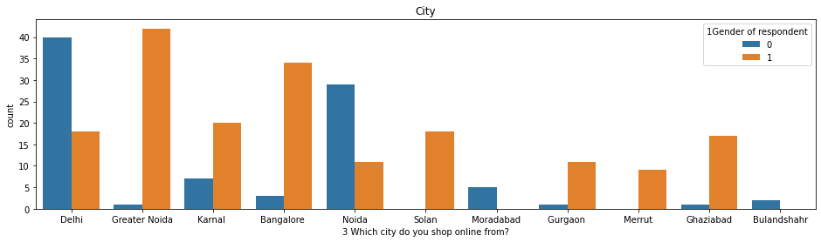
Delhi is most prone for online shopping followed by Noida & Greater Noida
Moradabad and Bulandshahr has the the least number of shoppers
Majority of people are shopping morethan 4years

Slide 12
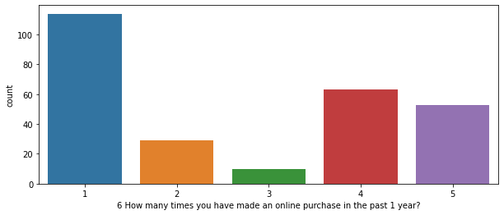
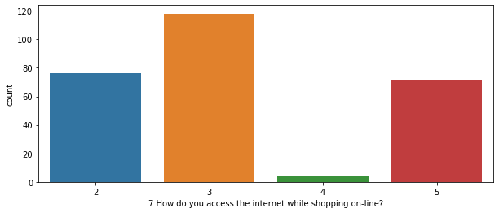
Majority of the respondents has shopped lessthan 10times
Very few are frequent buyers
Almost all the respondents prefer WiFI and Mobile internet
Dial up network is not preferable

Slide 13

Multivariate analysis

Slide 14
OBSERVATIONS
1.Maximum people have shopped from AMAZON,FLIPKART,PAYTM,MYNTRA,SNAPDEAL
2.Most people found easy to use Amazon,Flipkart,Paytm,Myntra,Snapdeal
3.Amazon & Flipkart are best among all
4.In visual appealing,variety of products,relevant description,fastloading,reliability,payment options,delivery speed,privacy of customers, Amazon & Flipkart are the best choices
5.Paytm & Snapdeal need to shorten longer delivery period
6.Myntra,Snapdeal,Paytm need to improve in late declaration of prices

Slide 15
conclusions
Comparing the customer’s perception and the company’s performance we can conclude that
High Customer satisfaction and Retention:
1.AMAZON.COM
2.FLIPKART.COM
High Risk of Customer Churn:
1.MYNTRA.COM
2.SNAPDEAL.COM

Slide 16

This Photo by Unknown Author is licensed under CC BY-SA-NC

