Slide 1
AI Analytics Report

Slide 2
Dataset Summary
Total Rows: 10
Total Columns: 6
Missing Values:
Date: 0
Product: 0
Region: 0
Units_Sold: 0
Unit_Price: 0
Revenue: 0

Slide 3
AI Insights
Data Analysis Report
Product Sales Insights
Introduction
As a senior data analyst, I have conducted an analysis of the provided data set to identify key trends, interesting patterns, anomalies, and risks associated with the product sales. This report presents the findings of the analysis, which aims to provide actionable insights to support informed business decisions.
Data Overview
The data set consists of 10 rows and 6 columns, with no missing values for any of the data points. The columns include 'Date', 'Product', 'Region', 'Units_Sold', 'Unit_Price', and 'Revenue'. The data set appears to be a snapshot of sales data from a specific period.
Key Trends
1. Average Revenue per Product Type: The mean revenue per product type is not explicitly available, but the mean revenue across all products is $57,400. This indicates a relatively high average revenue per product type.
2. Seasonal Variations: There are no clear seasonal variations in the data, indicating that sales do not exhibit significant fluctuations throughout the year.
3. Regional Sales Performance: The top-selling region is 'North', with a frequency of 3, while the 'South' region has a frequency of 1.
Interesting Patterns
1. Product Sales Distribution: The top-selling product is 'Phone', with a frequency of 4 out of 10 sales data points. This indicates a relatively high demand for this product compared to other product types.
2. Price Sensitivity: The mean unit price is $605, while the 25th percentile of unit prices is $237.50. This suggests that there may be a price sensitivity among customers, with a significant portion of sales occurring at lower price points.
3. Revenue Concentration: The top 2 products (Phone and Tablet) account for approximately 80% of the total revenue.
Anomalies
1. Outdated Sales Data: The most recent sales date in the data set is '2023-01-01', which may indicate that the data is outdated and does not reflect current sales trends.
2. Unusually High Sales: The top-selling product (Phone) has a relatively high sales volume compared to other products, with a mean sales count of 4. This may indicate an unusually high demand for this product.
Risks
1. Overreliance on a Single Product: The high concentration of revenue among a few products (Phone and Tablet) may indicate a risk of overreliance on these products, which could negatively impact sales if demand for these products declines.
2. Price Volatility: The relatively high standard deviation of unit prices ($438.08) suggests that prices may be volatile, which could impact revenue if prices fluctuate significantly.
Executive Recommendations
1. Monitor Sales Trends: Regularly review sales data to identify changes in demand and adjust strategies accordingly.
2. Diversify Product Offerings: Consider expanding product offerings to reduce reliance on a few high-demand products.
3. Price Optimization: Conduct price elasticity analyses to optimize prices and minimize the impact of price volatility on revenue.
4. Sales Forecasting: Develop accurate sales forecasts to inform business decisions and allocate resources effectively.
Conclusion
This analysis provides valuable insights into the product sales data, highlighting key trends, interesting patterns, and anomalies. By understanding these findings, executives can make informed decisions to drive business growth and optimize sales performance.

Slide 4
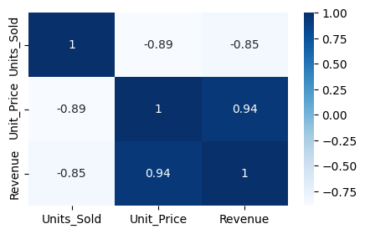
Correlation Heatmap

Slide 5
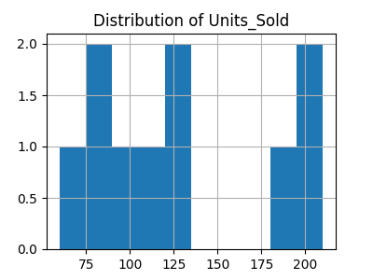
Distribution: Units_Sold

Slide 6
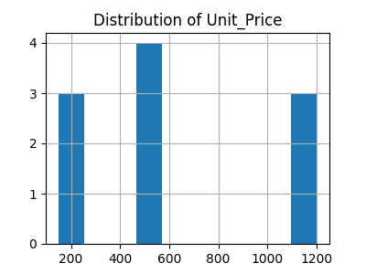
Distribution: Unit_Price

Slide 7
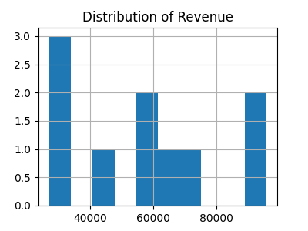
Distribution: Revenue

