Slide 1
Graphical Analysis Report

Slide 2
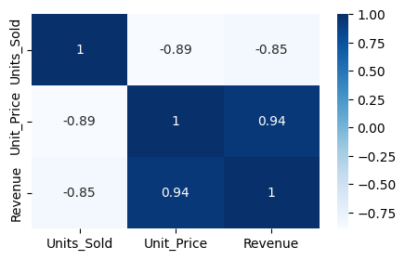
Correlation Heatmap

Slide 3
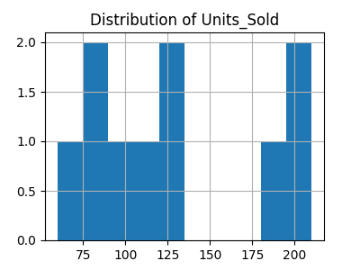
Distribution: Units_Sold

Slide 4
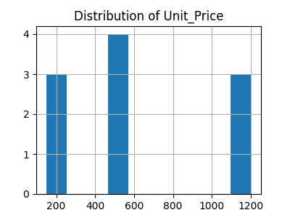
Distribution: Unit_Price

Slide 5
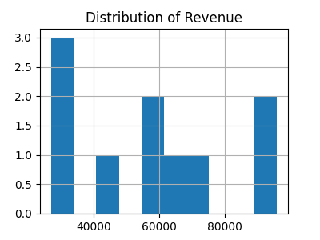
Distribution: Revenue

