Slide 1
Agentic RAG Chatbot

Slide 2
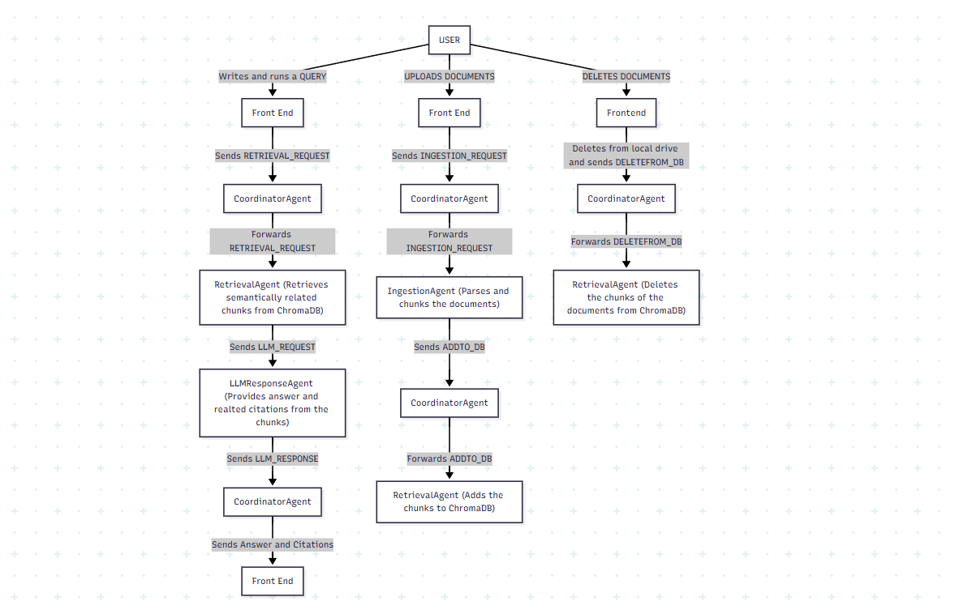
System Architecture
Architecture and Flow Diagram:
Agent Roles:
1. IngestionAgent: Parses and chunks the content
2. RetrievalAgent: Embeds and performs semantic search and fetches relevant context
3. LLMResponseAgent: Builds prompt, interacts with LLM, returns response
Workflow:
1. User uploads document(s)
2. IngestionAgent processes and indexes chunks
3. User submits question
4. RetrievalAgent finds top-k relevant chunks
5. LLMResponseAgent forms prompt and fetches answer
6. UI displays answer + citations

Slide 3
Technology Stack
Frontend: Gradio UI
LLM: Groq (LLaMA 70B) via API
Embeddings: sentence-transformers
Vector DB: Chroma
Backend Agents: Python (modular)
File Parsing: PyMuPDF, python-pptx, python-docx, Pandas

Slide 4
Challenges faced
1. Handling unstructured documents and tables
2. Ensuring efficient chunking and retrieval
3. Prompt formatting for optimal LLM answers

Slide 5
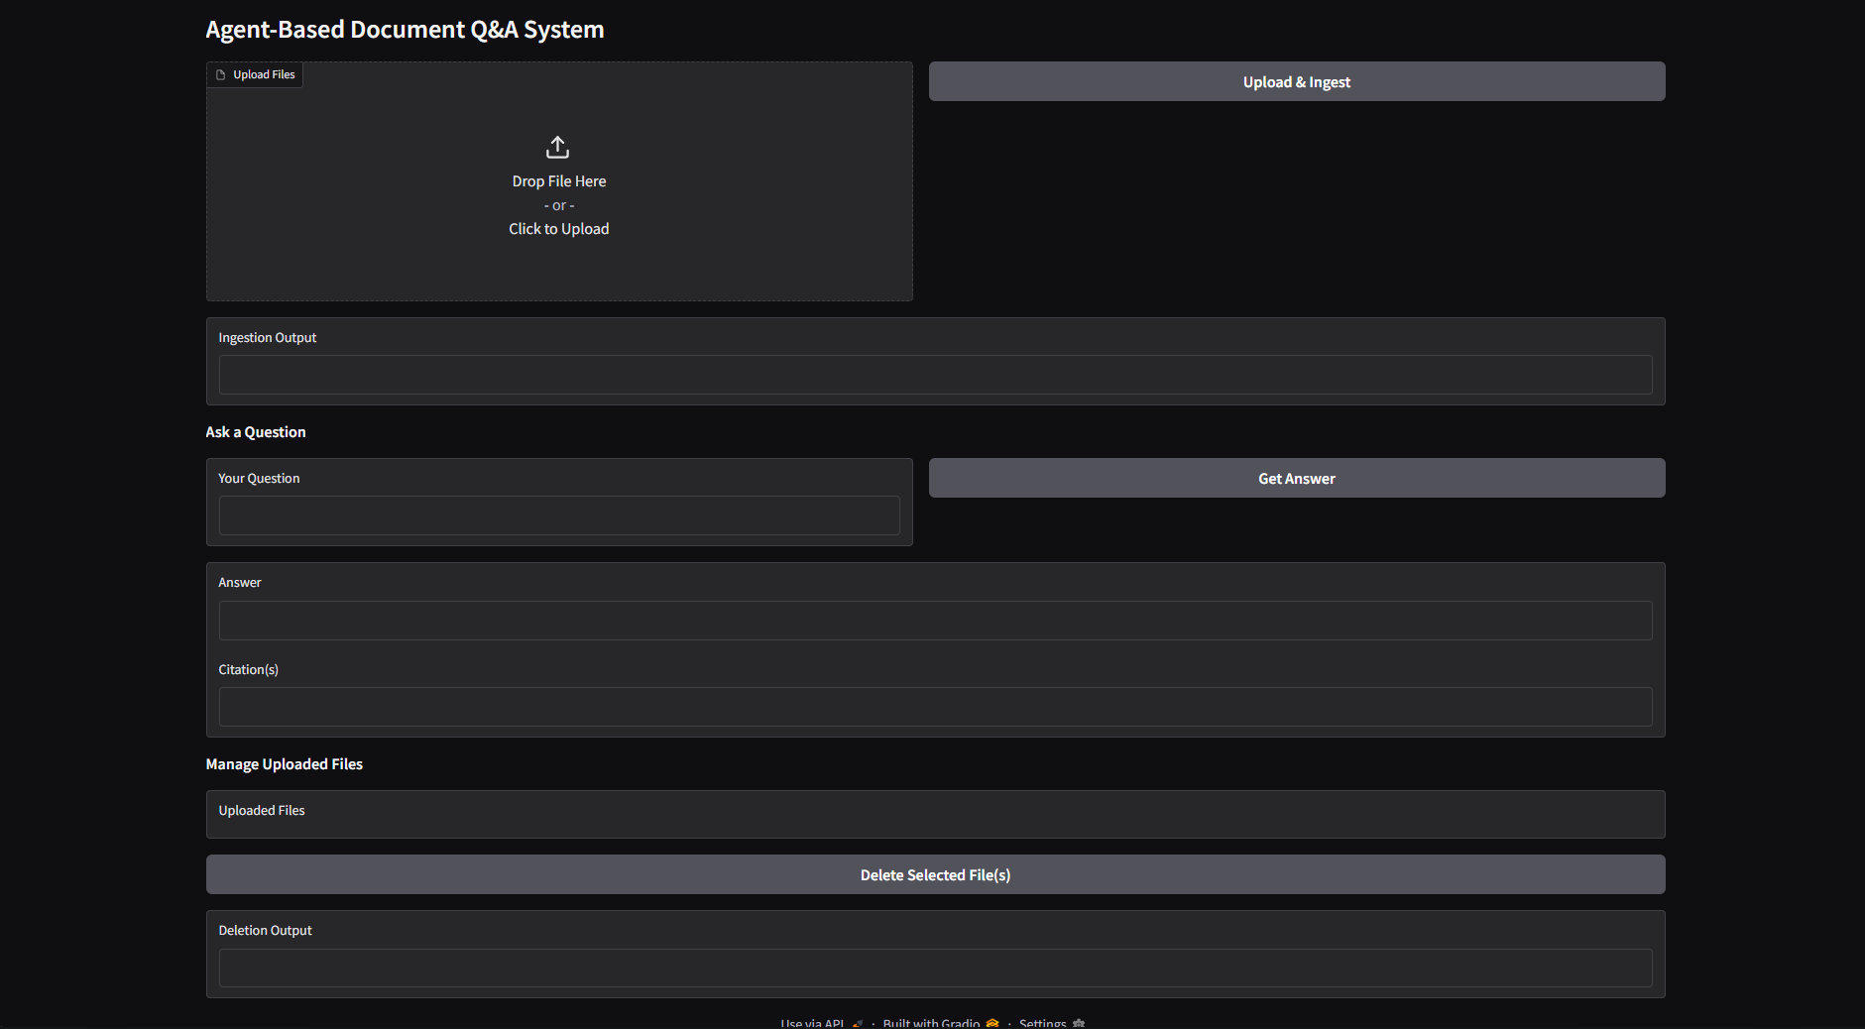
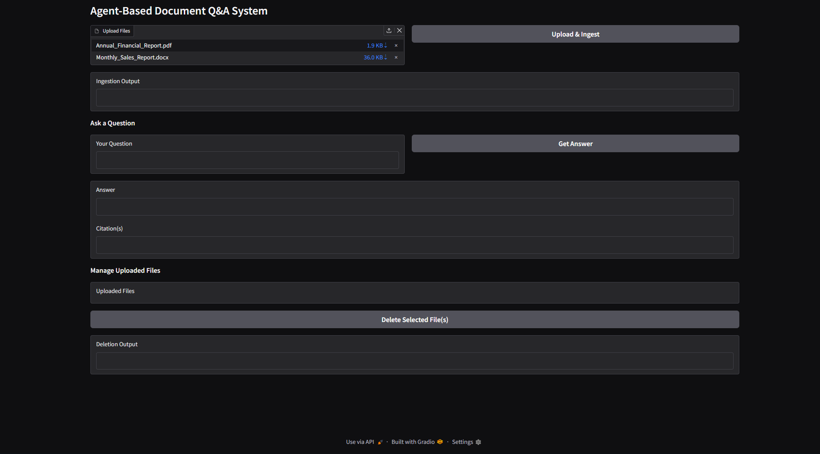
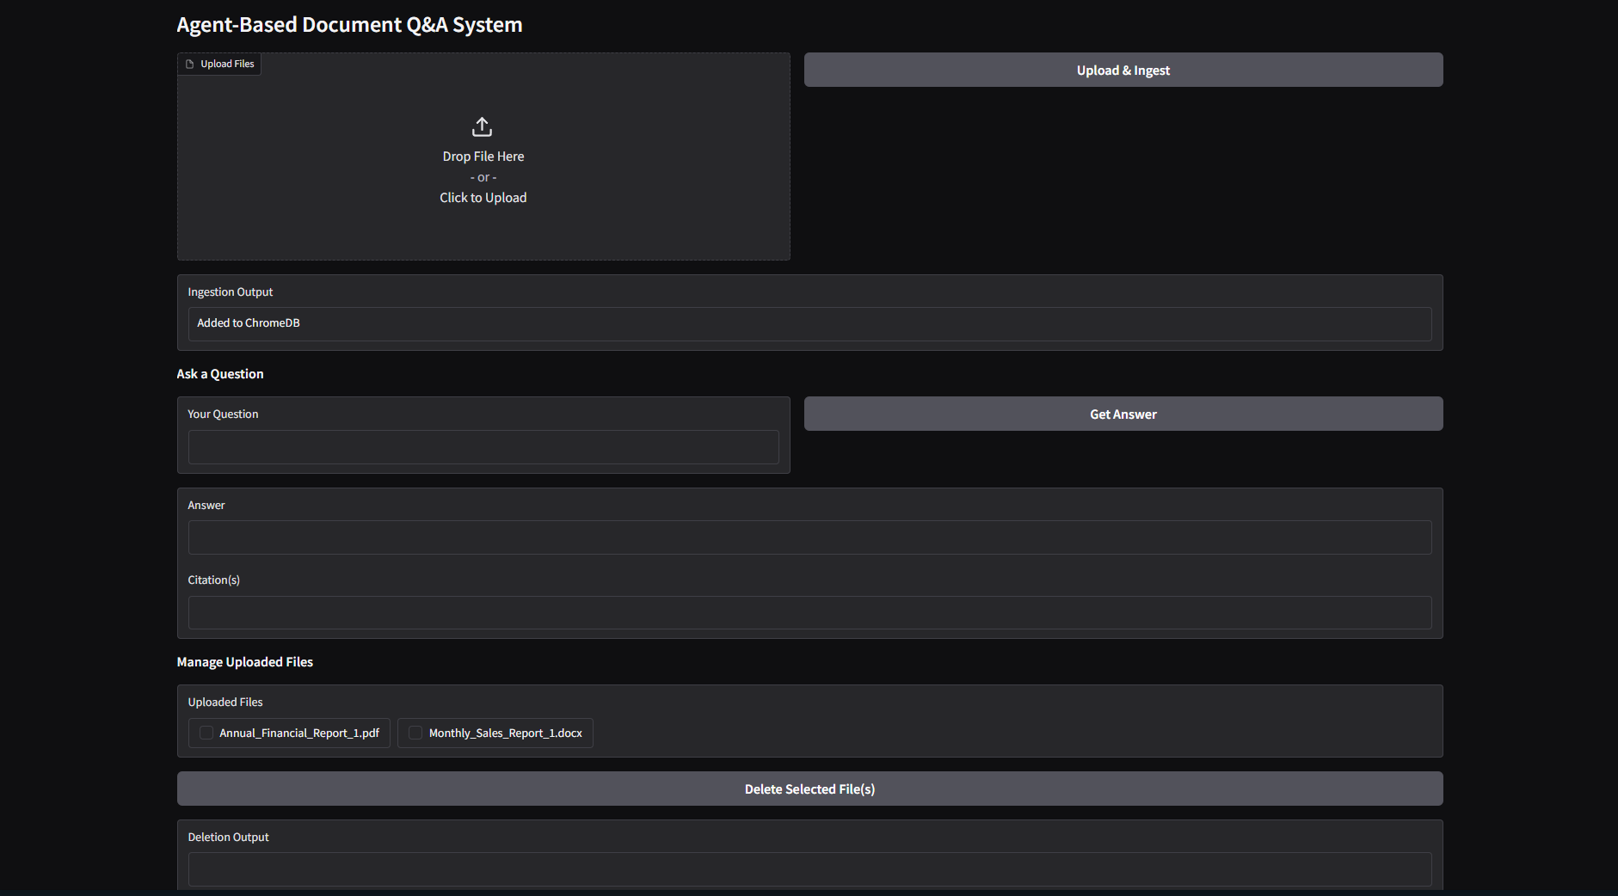
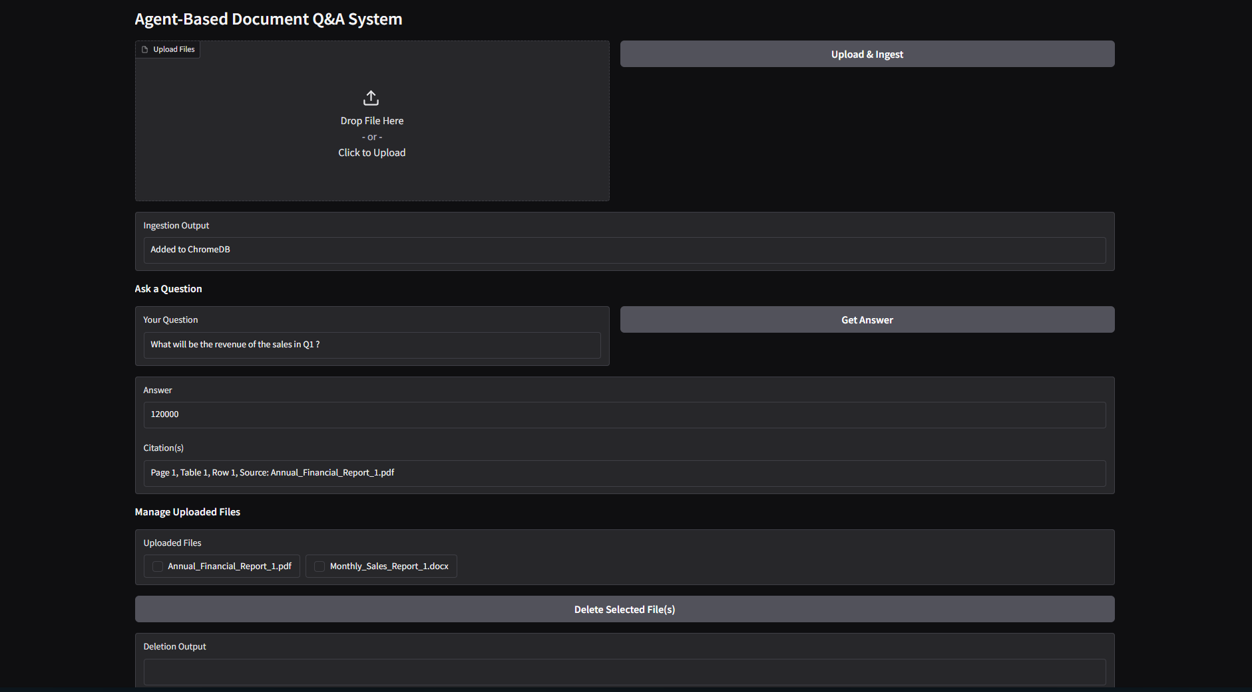
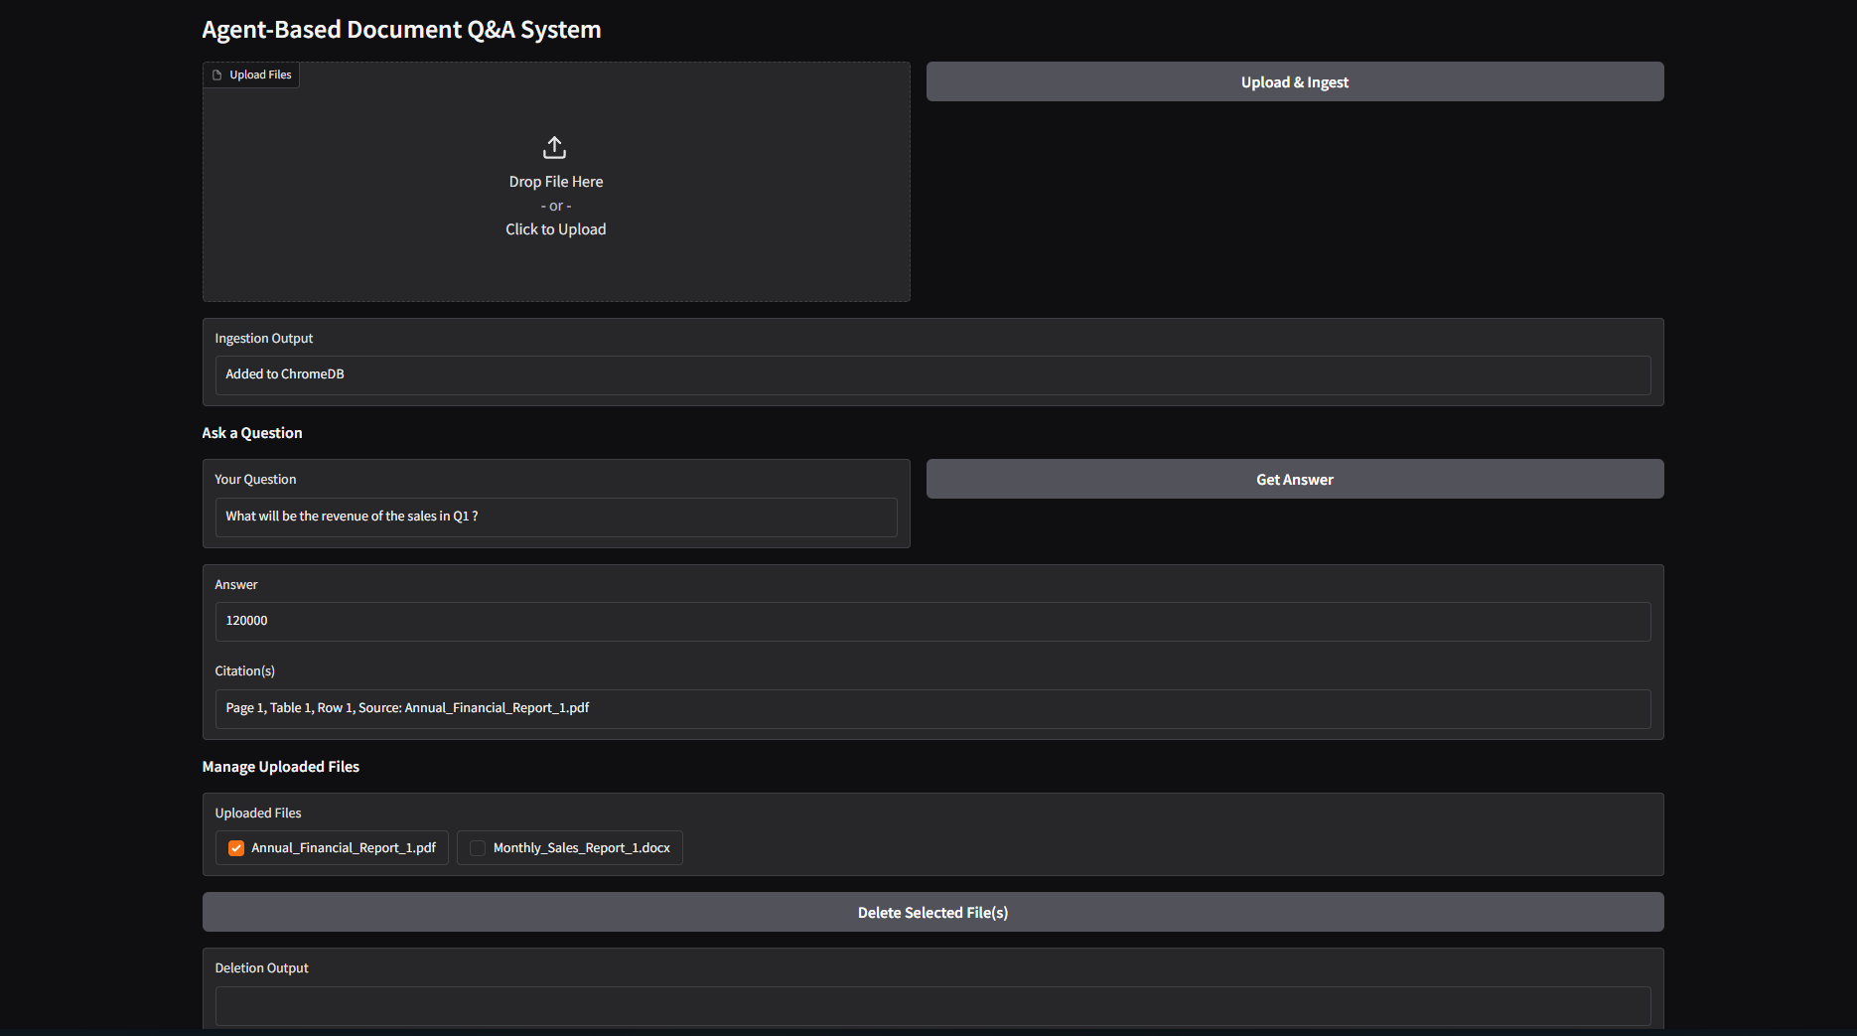
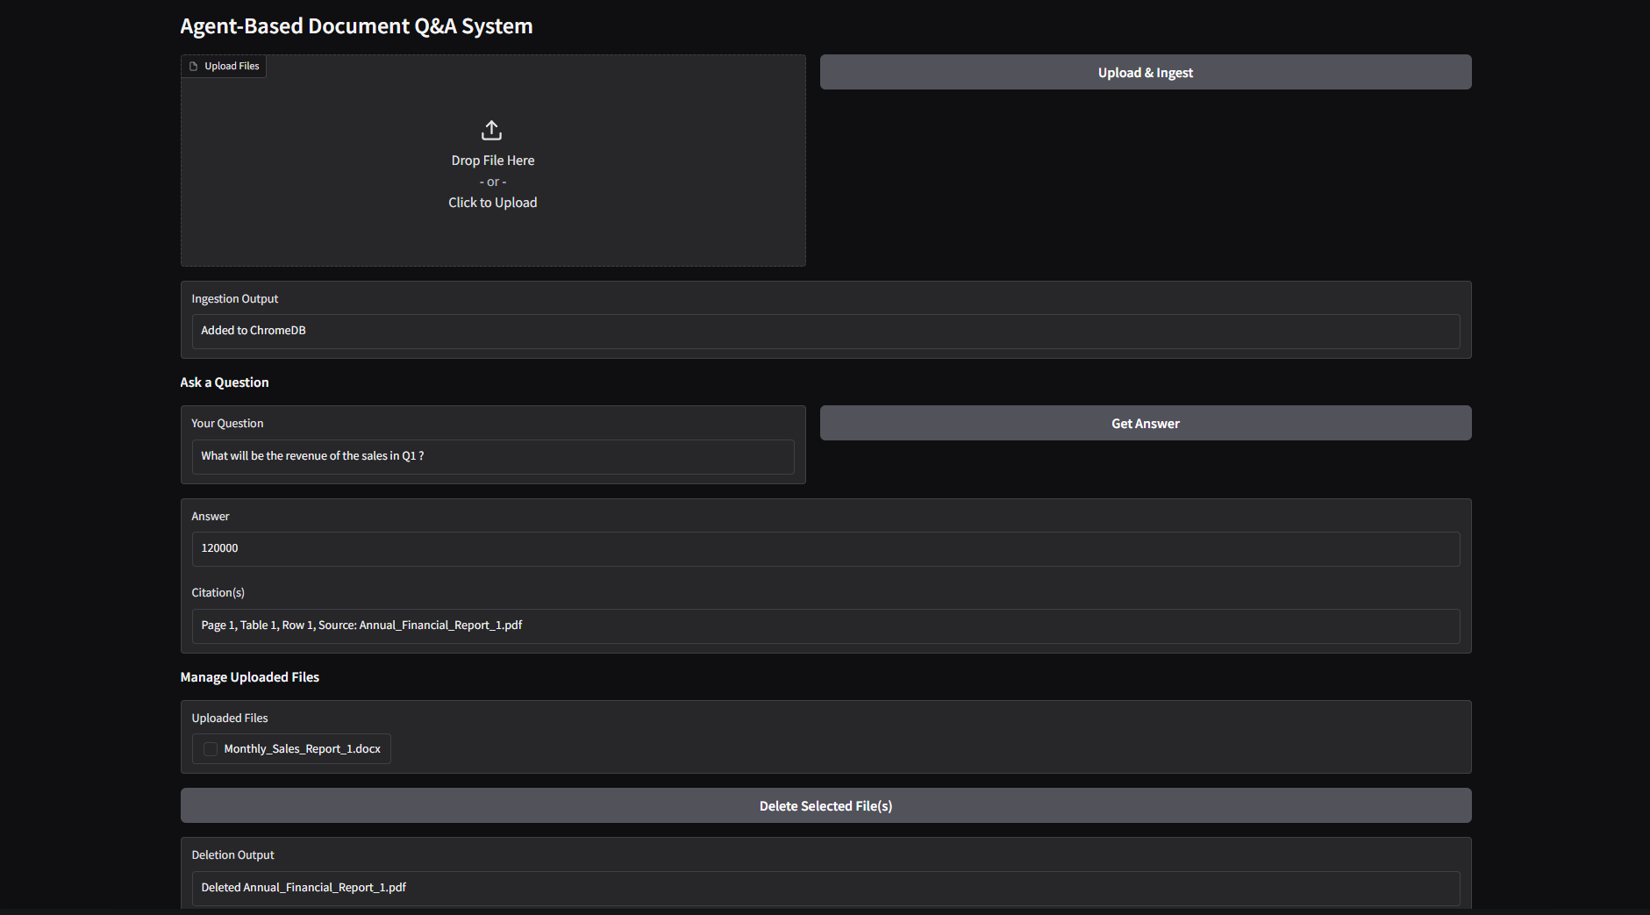
Ui screenshots

Slide 6
future enhancements
1. Specific-document Querying
Allow users to query across specific documents.
2. Model Switching / Custom LLM Backends
- Support switching between models like GPT-4, Claude, Mistral, or private local models.
- Add dropdown in UI to select model provider and customize prompts accordingly.
3. Metadata Filtering & Advanced Search
- Filter results by:
Source (filename)
Page number
Table/slides only
- UI controls to help users narrow down context chunks manually.
4. Session Management & User Authentication
- Enable login sessions per user.
- Store personal document sets and maintain per-user retrieval history.
5. Background Processing & Async Queues
Enable batch ingestion of large documents without UI lag.
Move ingestion to a Celery or async worker model for scalability.
6. Deployment on Cloud
- Add Docker + Railway/Vercel/AWS deployment support.
- Host as a persistent web service with storage + logs + uptime monitoring.
7. PDF Highlighted Answer Report
- Auto-generate a PDF report with:
User’s question
Generated answer
Citations
Highlighted context passages

