Slide 1

Green Computing
Under the Guidance of:
Prof. Nizar Banu
Christ University Bangalore
Presented By:
Avatansh Awasthi
4MCA- (1947208)

Slide 2
Contents
Introduction
Definition
Need
Areas of Concern
Advantages
Disadvantages
Conclusion
References

Slide 3

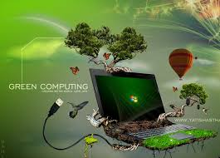
Introduction
Green Computing is a branch of Computing in general.
As the name indicates this branch of computing deals with computing in greener ways.
By greener we refer to the usage of computing is a sustainable manner.

Slide 4

Definition of Cloud Computing
Green computing, green ICT as per International Federation of Global & Green ICT "IFGICT", green IT, or ICT sustainability, is the study and practice of environmentally sustainable computing or IT.
Green computing is defined as “ the study and practice of designing, manufacturing, using, and disposing of computers, servers, and associated subsystems(such as monitors, printers, storage devices, and networking and communications systems) efficiently and effectively with minimal or no impact on the environment ”.

Slide 5
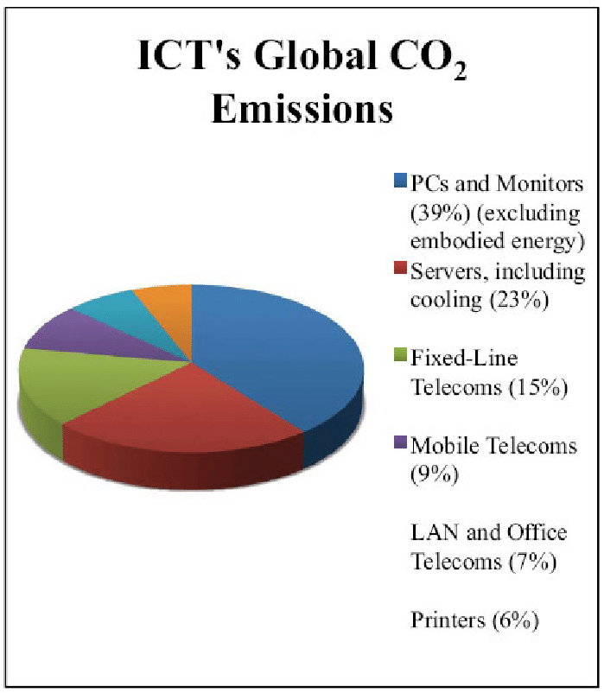
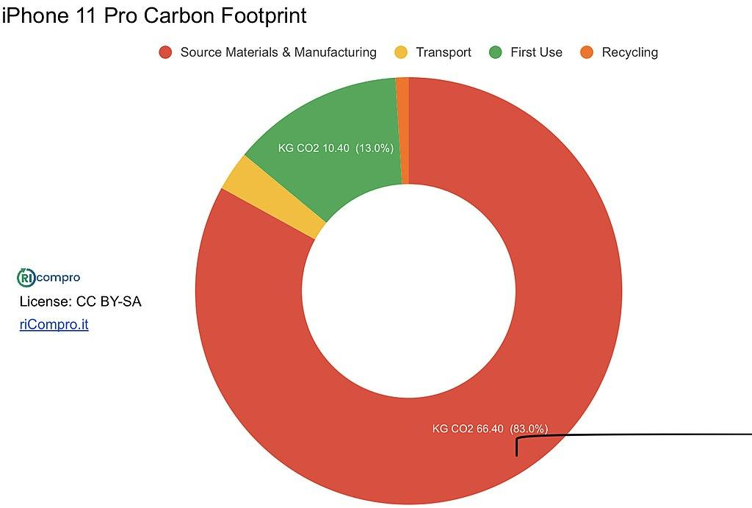
Need of Cloud Computing
Following are the major reasons for the need of cloud computing:
Reduce Non-biodegradable material usage.
Maximize Energy Efficiency.
Promote Recyclability.
Device efficient Disposal Methods.
Reduce Carbon Footprint.
Reduce GHG emissions.
Ultimately for the sustainable coexistence of computing for future generations.

Slide 6
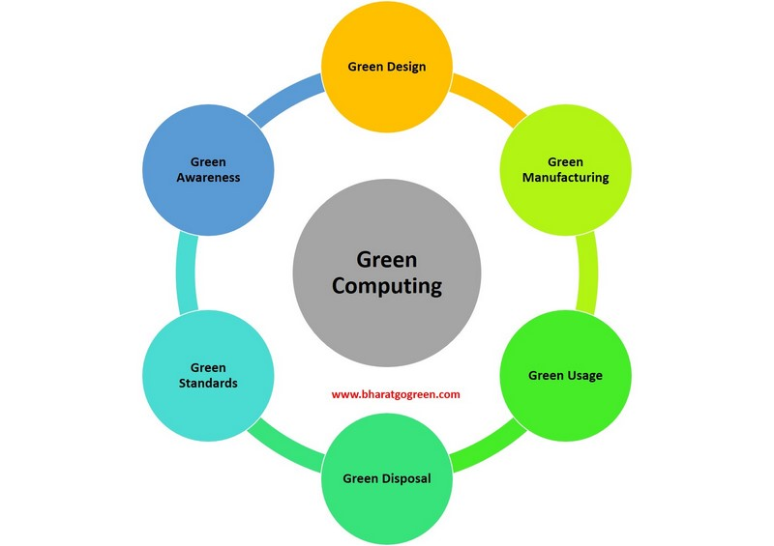

Slide 7

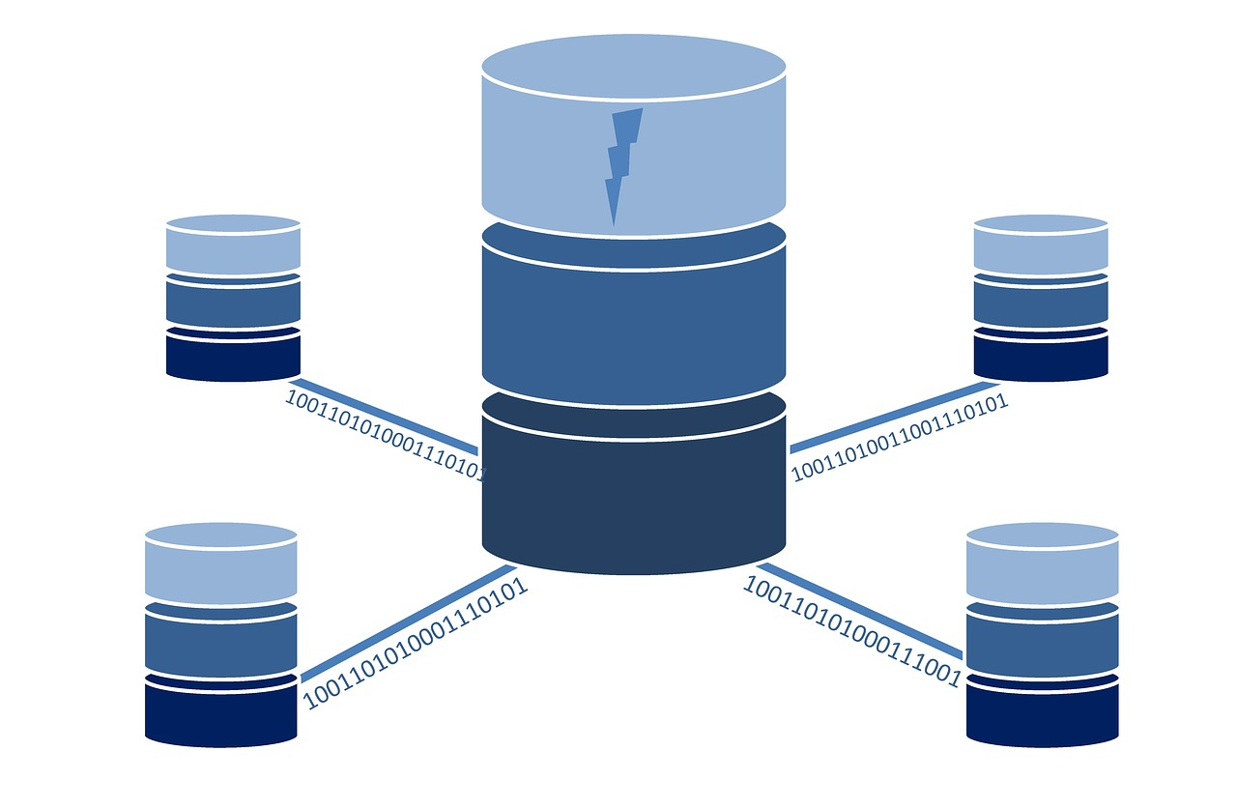


Areas of Concern
Product longevity
Data center design
Software and deployment optimization
Power management
Materials recycling
Cloud computing
Edge Computing
Telecommunication network devices energy indices

Slide 8
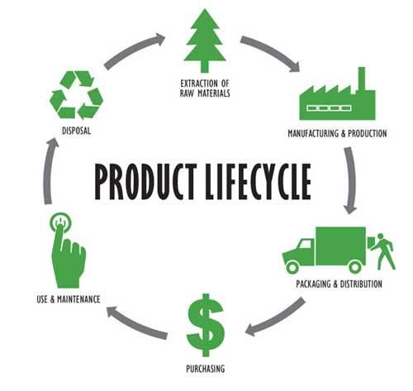
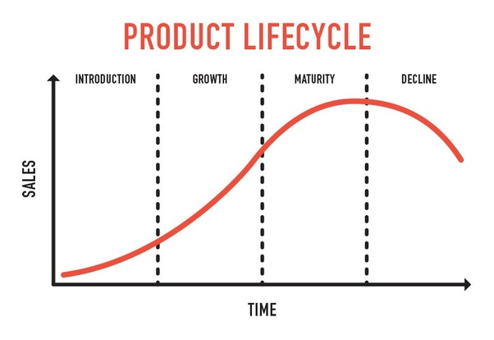
Product longevity
Product lifetime or product lifespan is the time interval from when a product is sold to when it is discarded.

Slide 9
Discussion on Product Longevity
Issue:
Products are of very short life-span, hence they get degraded and discarded.
Products are designed in a very poor manner.
Products use harmful and hazardous materials which are non-biodegradable.
Since, the products are less reliable, large amounts of them are manufactured, also when they are of no use they are not discarded properly.
Solution:
Green Computing provides the solution for all the above discussed issues.
Study and research for selection of safe, eco friendly, biodegradable and durable materials along with sustainable design for future is possible.
Ensuring the above solution we can have a significantly long product lifespan along with minimal effect to the environment upon disposal can be accomplished.

Slide 10
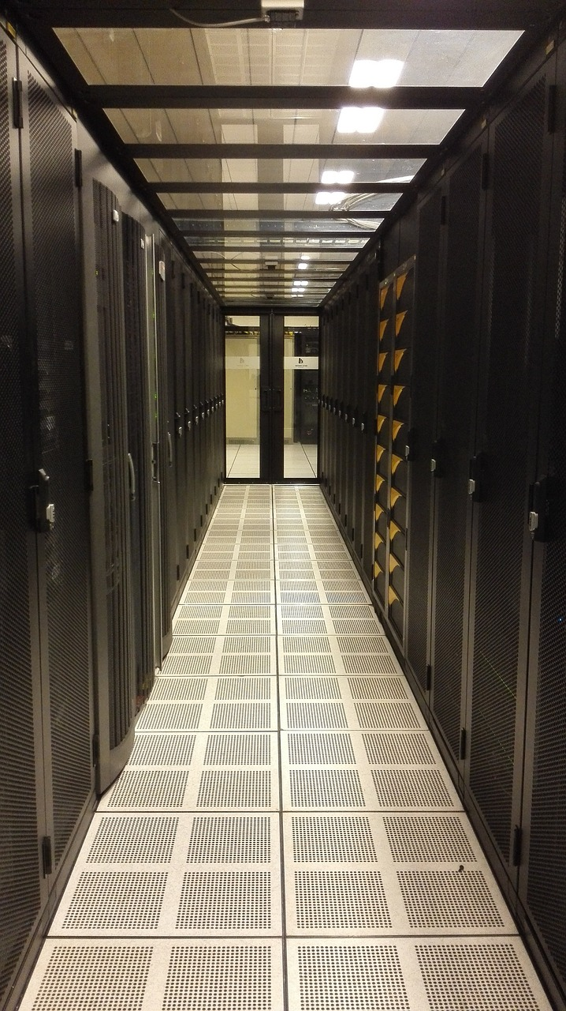
Data center design
Energy efficient data center design should address all of the energy use aspects included in a data center:
IT equipments
HVAC(Heating, ventilation and air conditioning) equipments
Actual location of Data Center
Configuration and construction of Data Center
Additional energy efficient design opportunities include on-site electrical generation and recycling of waste heat.
Energy efficient data center design should help to better utilize a data center's space, and increase performance and efficiency.

Slide 11


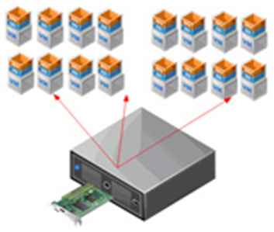
Software and deployment optimization
This refers to the following:
Algorithmic efficiency- A measure of the average execution time necessary for an algorithm to complete work on a set of data. Algorithm efficiency is characterized by its order.
Resource allocation- is the process of assigning and managing assets in a manner that supports an organization's strategic goals.
Computer virtualization- refers to the abstraction of computer resources, such as the process of running two or more logical computer systems on one set of physical hardware.

Slide 12
Power management
Power management of the following is to be done under the guidance of green computing:
Data Center - they need to be designed in such a way that they perform efficiently without consuming too much power and emitting CO2.
Operating System - we need to figure out which and what are the factors that affect the OS in order to run them optimally and utmost efficiency.
Power Supply - there is a demand to make the power supplies more efficient by using sustainable technologies achieving more than 70-80% efficiency.
Storage - Consume less, store more data. Eg. Solid State Drives.
Video Card - More performance and less power wastage is desirable.
Display - Display need to be more efficient as they consume a large amount of power due to millions and billions of pixels working endlessly.

Slide 13


Materials Recycling
Recycling computing equipments keeps harmful materials such as lead, mercury, and hexavalent chromium(highly hazardous) out of landfills.
Replacing and recycling equipments saving further energy and emissions.
Hence, saving time, energy and essential resources also minimizing ecological imbalance caused by these harmful elements.

Slide 14
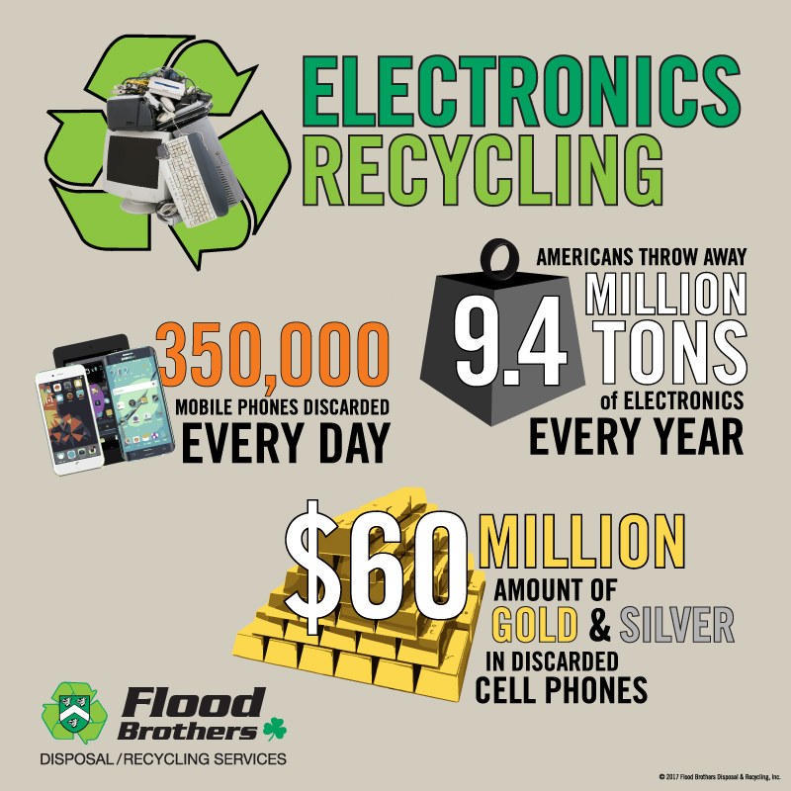
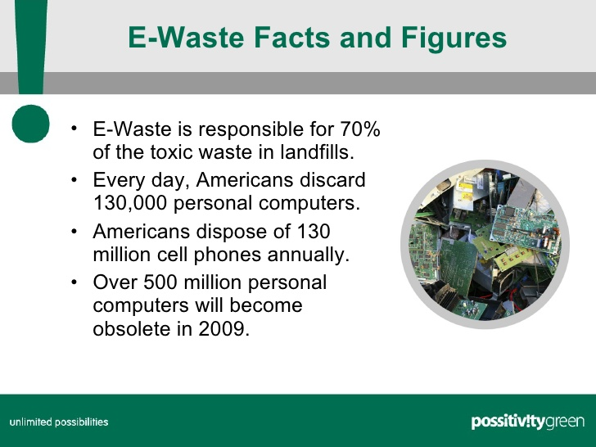

Slide 15

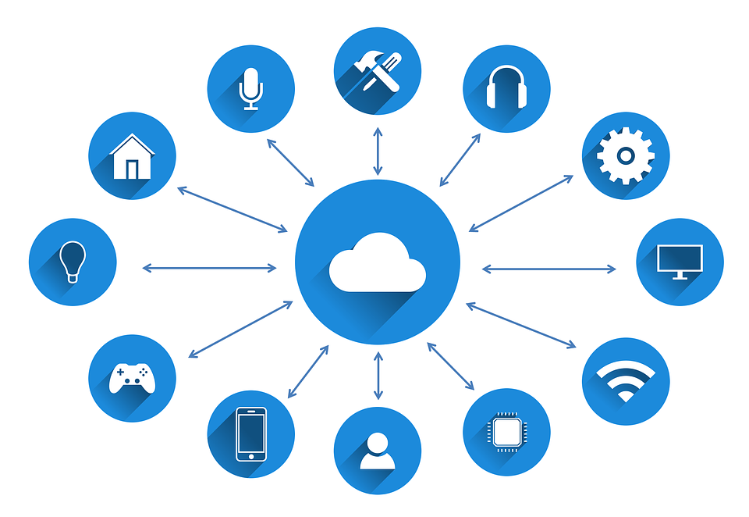
Cloud computing
Cloud computing addresses two major challenges related to Green computing – energy usage and resource consumption.
Virtualization, Dynamic provisioning environment, multi-tenancy, green data center approaches are enabling cloud computing to lower carbon emissions and energy usage up to a great extent.
A new emerging branch of Cloud computing called Serverless computing is also responsible for contributing by optimising and efficiently handling large amount of requests on the cloud.

Slide 16


Slide 17
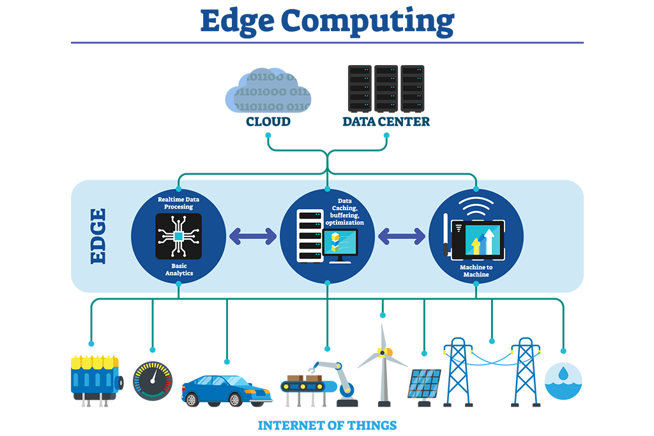
Edge Computing
Edge computing is a distributed computing paradigm that brings computation and data storage closer to the location where it is needed, to improve response times and save bandwidth.

Slide 18
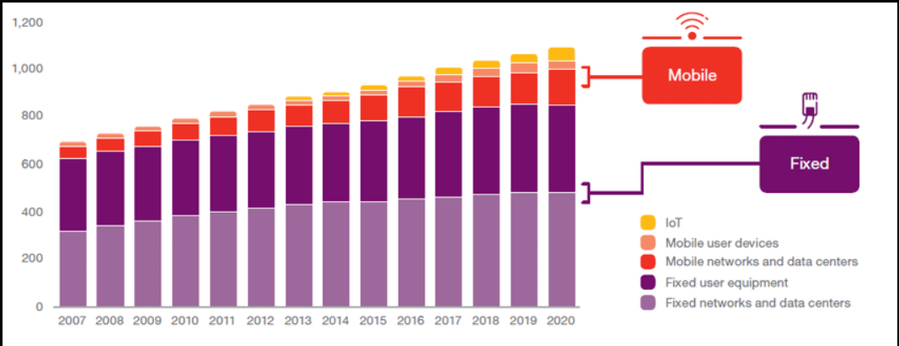
Telecom. network devices energy indices

Slide 19
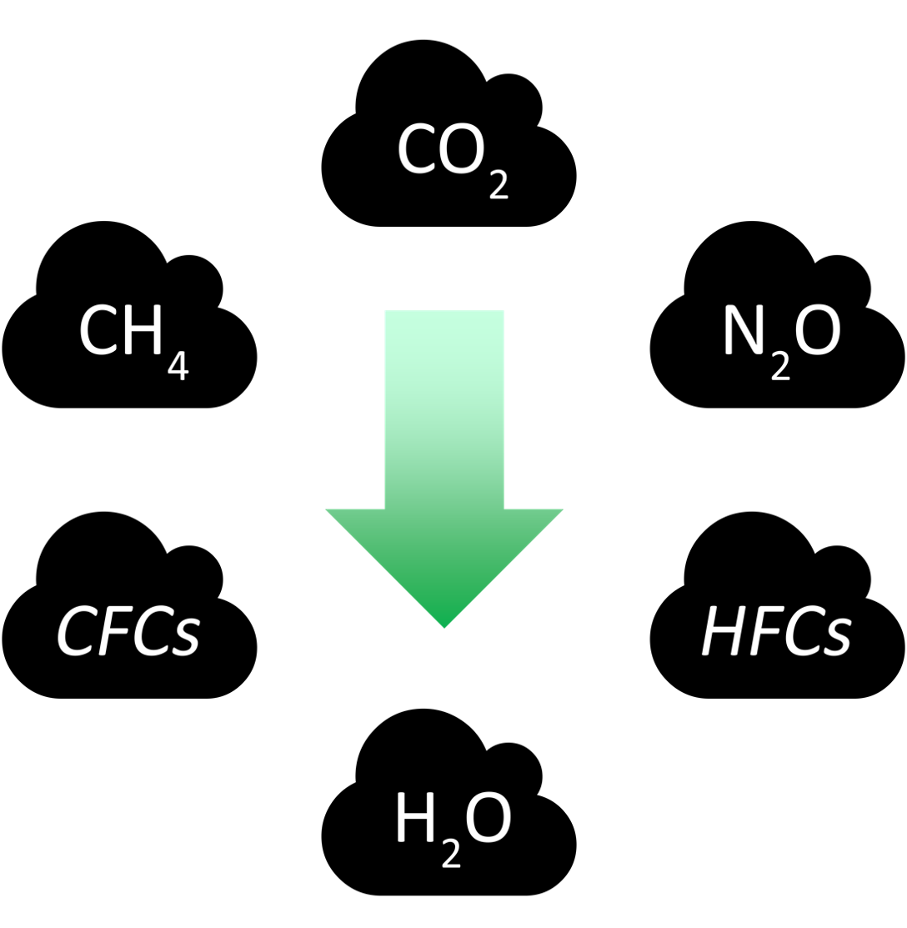


Advantages
Reduced energy consumption.
Reduced GHG emission.
Less fossil fuel consumption.
Cost-effective
Effective utilisation of resources.
Encourages reuse and recycle.
Promotes non-toxic materials.
Heat Reduction.

Slide 20

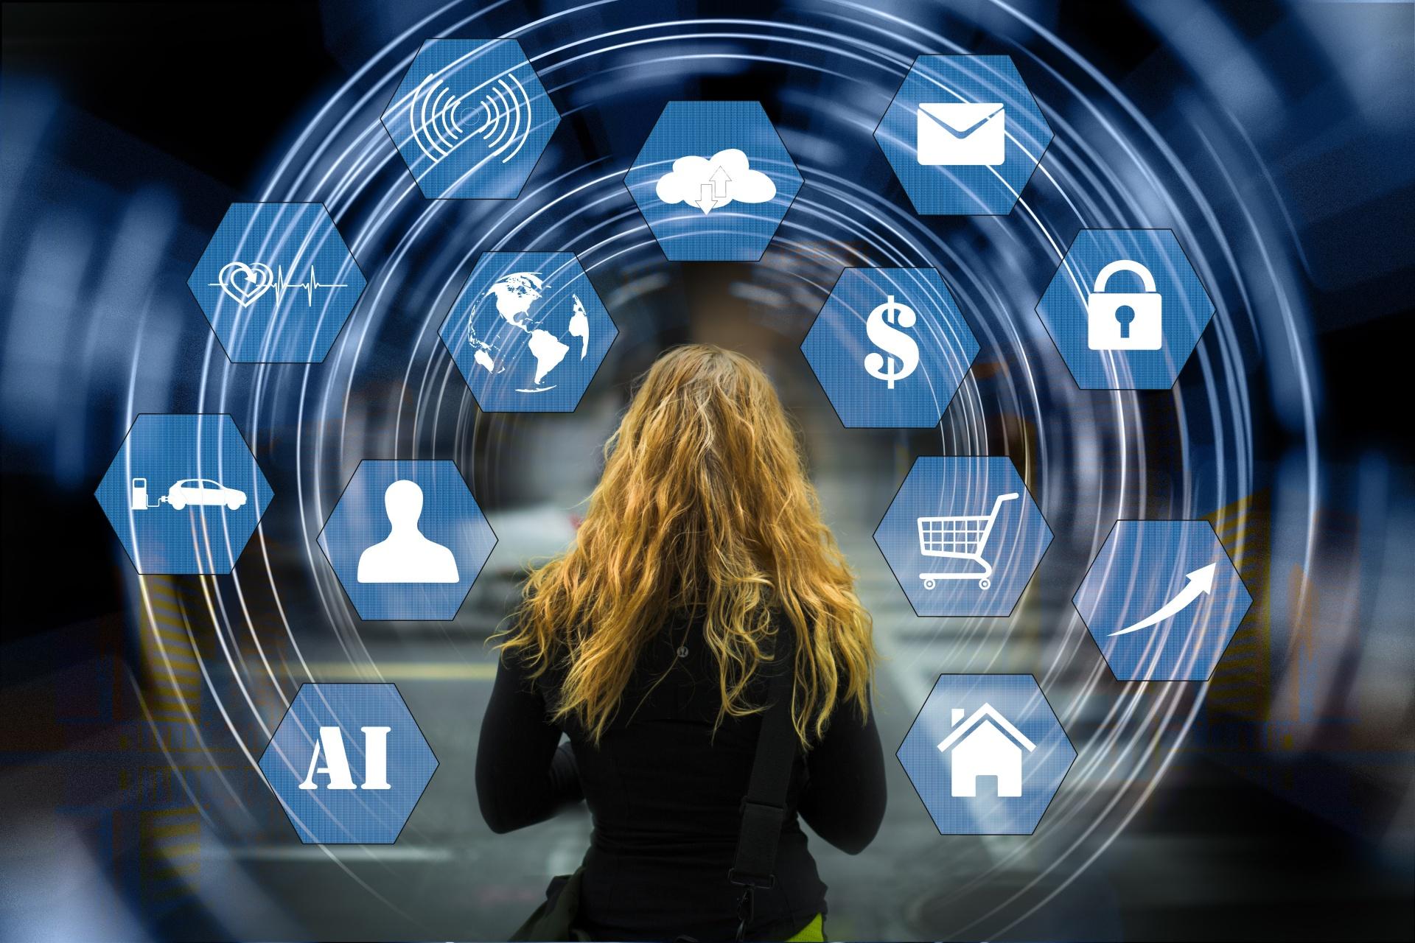

Disadvantages
Initial implementation in any concerned area is costly.
There is a frequent change in technology.
It can be a burden to someone.
Disparity between user and organisations.
Fewer related courses and publications.
Minimal awareness within community.

Slide 21
Conclusion
Many IT Organisation have stated or will start to adopt green computing practices.
Wipro has launched its range of eco-friendly products called greenware.
IT companies like Samsung and Apple etc have started and are operating large scale recycling programs.
The government are slowly becoming aware of the green practices, and are trying to invest and start to fund different programmes to promote such green ways.
Now, it the responsibility of us individuals to also adapt, apply and, practice these green ways in day to day activities.
By adopting green practices we get eco friendly environment, along with benefits such as cost reduction, energy conservation and waste minimisation.

Slide 22
References
[1]. https://www.youtube.com/results?search_query=serverless+computing
[2]. https://bharatgogreen.com/green-computing/
[3]. https://www.geeksforgeeks.org/virtualization-to-promote-
green-computing/
[4]. https://en.wikipedia.org/wiki/Green_computing
[5]. https://en.wikipedia.org/wiki/Green_computing#Product_longevity
[6]. https://en.wikipedia.org/wiki/Green_computing#Data_center_design
[7]. https://en.wikipedia.org/wiki/Green_computing#Software_and_
deployment_optimization
[8]. https://en.wikipedia.org/wiki/Green_computing#Power_management
[9]. https://www.tandfonline.com/doi/full/10.11120/ital.2010.09020006
[10]. https://www.downtoearth.org.in/blog/waste/e-waste-disposal-what-
india-can-learn-from-norway-48398

Slide 23


