Slide 1


Sustainability Capstone: Decarbonising Travel
A Data-Driven Path to Net Zero by 2030
Speaker: Sujay M S
Institute: NITK Surthkal
Year : Third Year
Email ID: sujayms934@gmail.com

Slide 2



Results at a Glance (Executive Summary)
178.1M
$140.5M
Total kg CO₂e Emissions
Total Travel Spend
Top Insight: Unregulated out-of-policy bookings (18.39%) and extreme reliance on long-haul flights drive the vast majority of our 178M kg CO₂e footprint.
Top Recommendation: Mandate pre-booking automated approvals and systematically shift short-haul routes (like Madrid-Berlin) to rail travel.
Projected Impact: Decarbonizing travel is critical to Celonis' 2030 Net Zero target. Our integration cuts total emissions by ~35M kg and saves ~$26M annually.

Slide 3



The Baseline: Our Carbon Footprint
Our analysis using the Celonis platform identified 178,090,088 kg ${\text{CO}}_{2}\text{e}$generated across 65,289 employee business trips, averaging ~2.73 metric tons per trip.
Industry Benchmark: The tech and professional services sector averages 2–10 tCO₂e per employee annually. Our heavy reliance on air travel pushes us toward the extreme upper bound.
Our footprint is highly concentrated: Air travel (Business and Economy) accounts for over 95% of total travel emissions. Train and EV usage is virtually non-existent.
To achieve Net Zero by 2030, we must aggressively decouple corporate growth from aviation dependence.

Slide 4
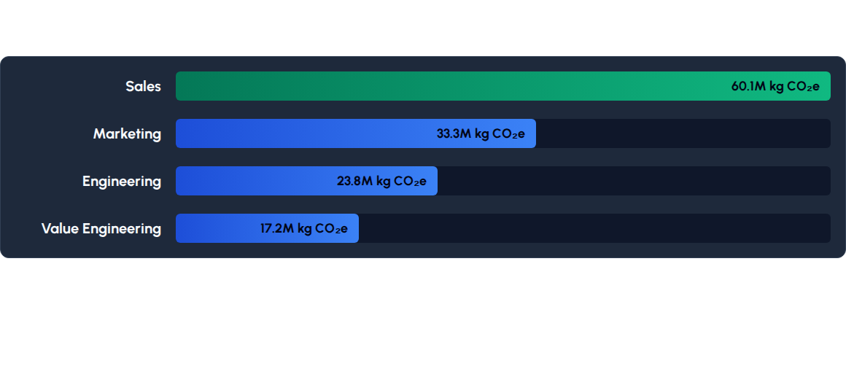
Hotspot Analysis: Where are we burning carbon?
Sales and Marketing are our largest carbon drivers. Geographically, departures from Australia (AU) and Brazil (BR) dominate the footprint, largely driven by ultra-long-haul routes like Sydney-Frankfurt (37.9M kg CO₂e).

Slide 5
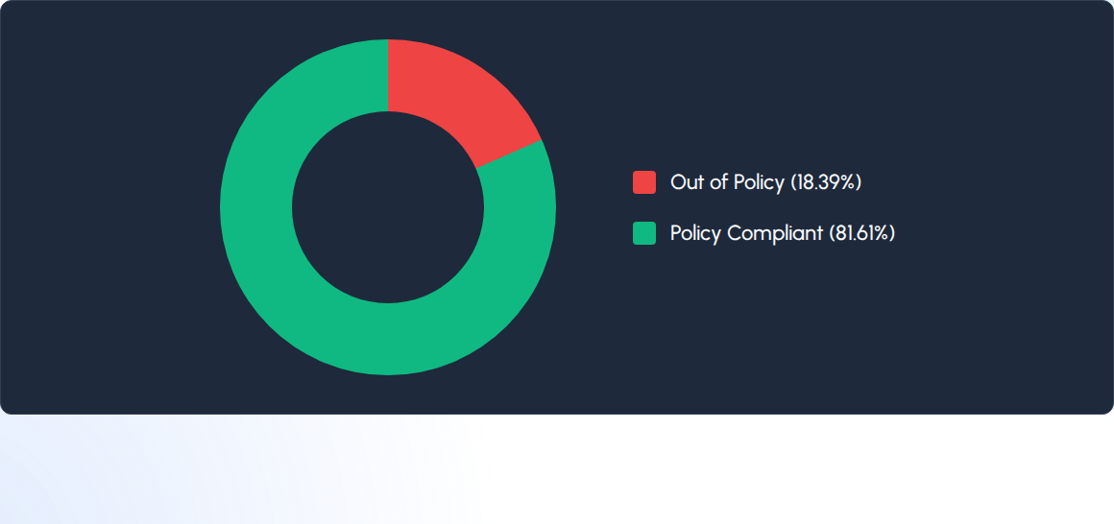
Inefficiencies Identified: Policy Bypass
Nearly 1 in 5 trips bypass standard corporate travel policies. These unchecked bookings evade automated carbon constraints, directly causing an estimated 32.7M kg of excess CO₂e and $25.8M in unregulated spend.

Slide 6









Low Carbon Strategic Recommendations
Mandate Short-Haul Rail
Pre-Booking Automation
Virtual-First Enablement
Replacing the Madrid-Berlin flight route (and similar short-hauls) with rail travel would reduce emissions by 2.96M kg CO₂e and save associated aviation costs annually.
Enforcing automated Celonis policy checks eliminates the 18.39% out-of-policy rate, saving up to 32.7M kg CO₂e and $25.8M per year.
Shifting internal/enablement travel (7.1% of trips) to virtual meetings avoids 12.6M kg CO₂e and significant operational costs annually.

Slide 7
Strategic Integration Roadmap (To 2030)
Year 4+: Net Zero
Year 2: Control
Full Net-Zero alignment with predictive CO₂ routing and integrated sustainable aviation fuel (SAF) offset purchasing.
Roll out strict carbon budgets per Business Unit, specifically targeting the Sales and Marketing divisions.
Year 1: Foundation
Year 3: Optimization
Implement automated policy checks in Celonis to block high-emission variants and eliminate the 18% out-of-policy rate.
Enforce mandatory rail adoption for all short-haul routes globally, removing flights under 500km.

Slide 8
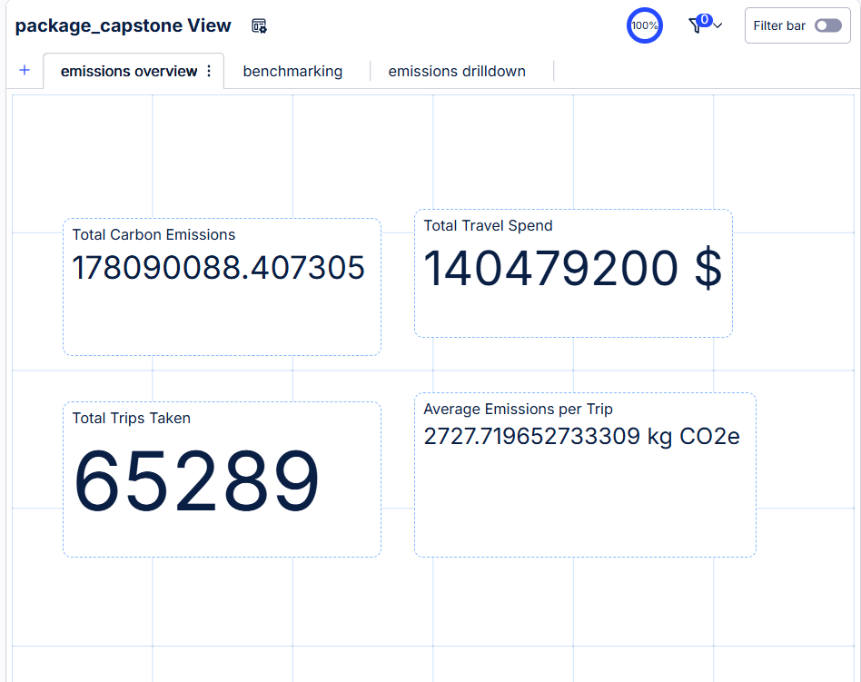
Dashboard View 1: Emissions Overview
The Macro Baseline
This view establishes our baseline carbon footprint and travel spend at a glance. It directly answers the executive question of our overall emissions profile.
Total Impact: 178M kg CO₂e
Financial Spend: $140.4M
Volume: 65,289 trips evaluated

Slide 9
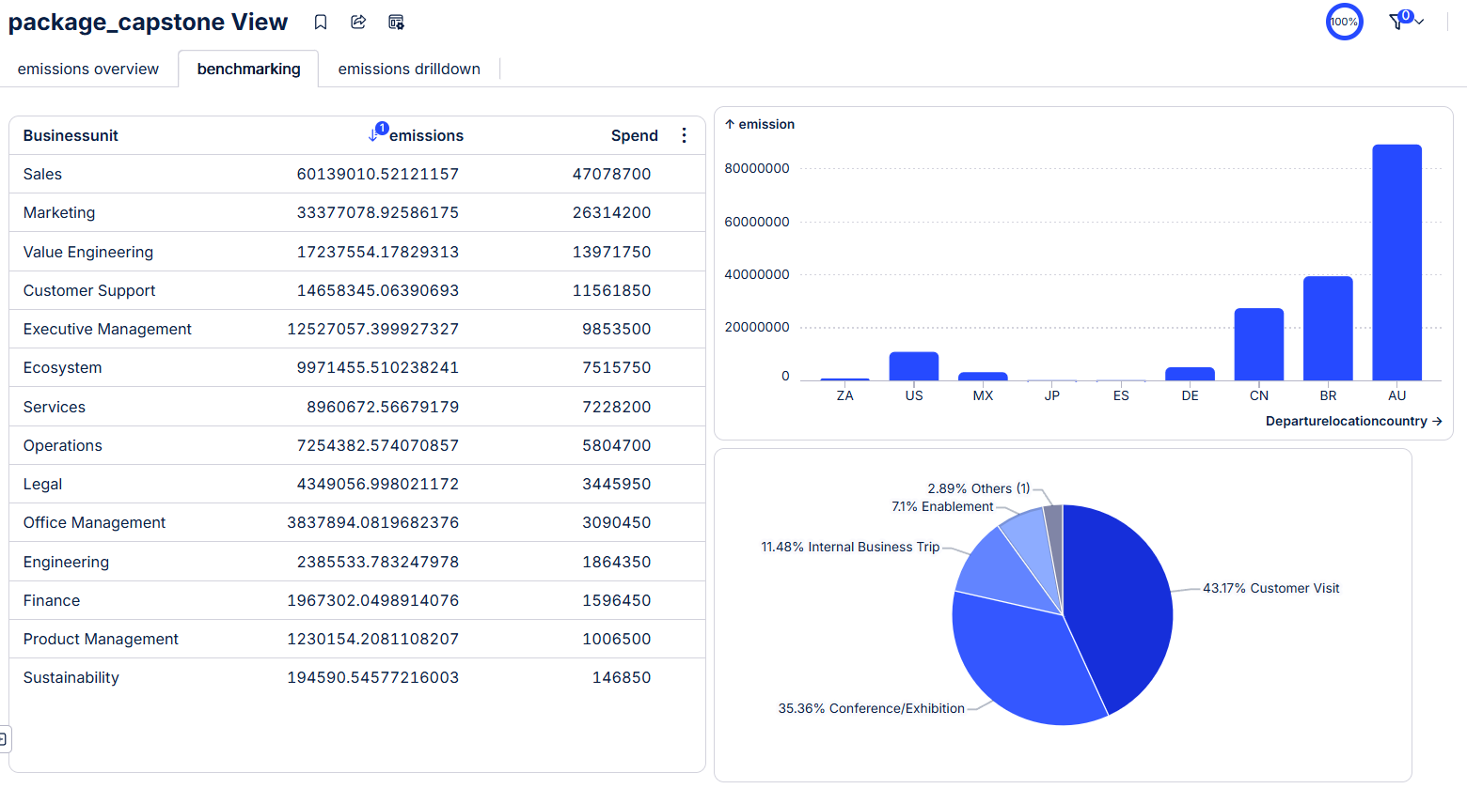
Dashboard View 2: Benchmarking
Identifying Internal Drivers
The benchmarking tab isolates the specific divisions and geographies responsible for the highest carbon output, revealing clear targets for intervention.
Top Emitters: Sales & Marketing BU
Top Geographies: Australia (AU) & Brazil (BR)
Travel Purpose: Core business dominates, but enablement remains a viable reduction target.

Slide 10
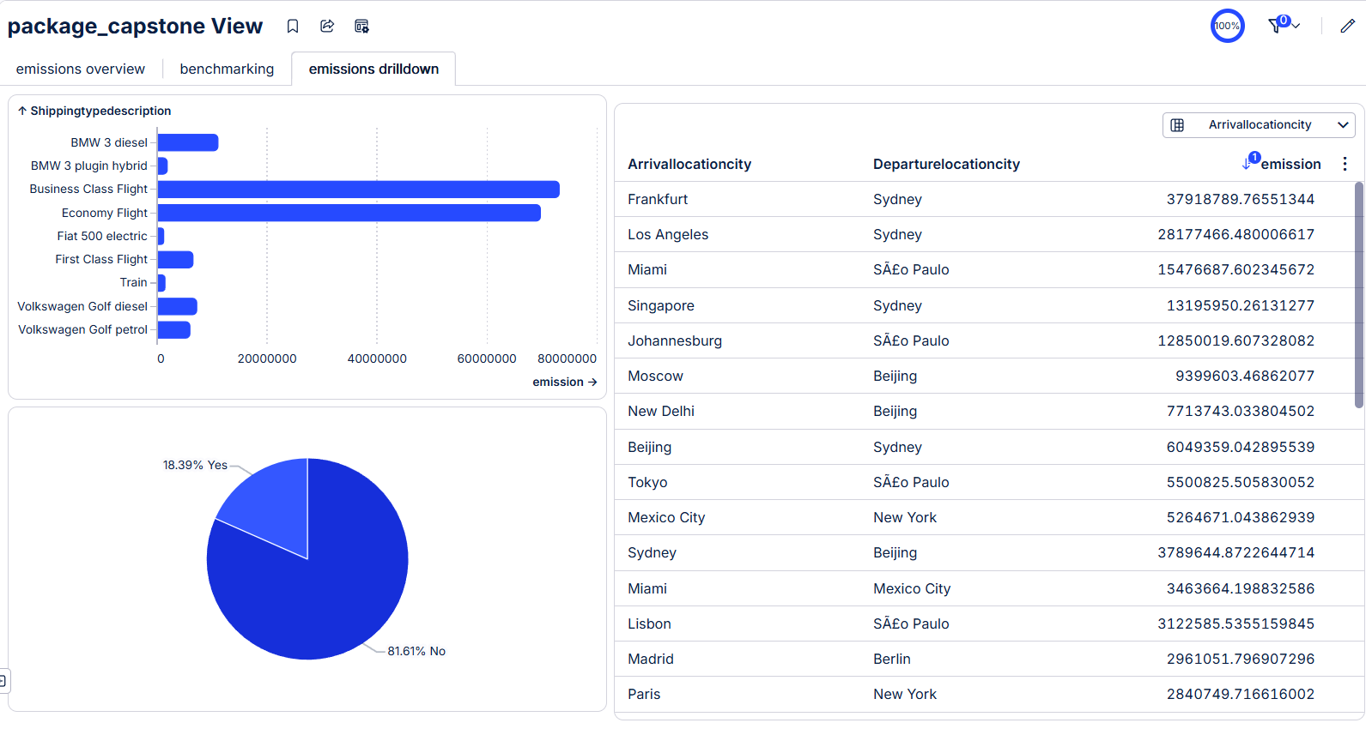
Dashboard View 3: Drilldown
Actionable Interventions
The drilldown view exposes the specific process inefficiencies and operational habits that we can immediately target for our "Quick Wins".
Policy Violations: 18.39% of trips are out-of-policy.
Transport: Extreme reliance on Aviation over Rail.
Route Optimization: Specific short-hauls (e.g., Madrid-Berlin) flagged for rail conversion.

Slide 11
Questions?
Thank you for your commitment to a sustainable future.
Celonis Sustainability Capstone | Presentation

