Slide 1

greenDAO
an object/relational mapping (ORM) tool for Android

Slide 2
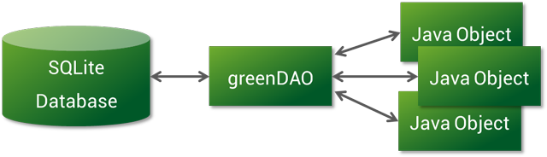
Features
A
Object/relation mapping (ORM)
greenDAO’s essence is offer an object oriented interface to data stored in the relational database SQLite. Just define for data model, and greenDAO will create Java data objects (entities) and DAOs (data access objects).

Slide 3
B
Slim library
greenDAO’s core library is less than 100k in size, so adding greenDAO does not hurt your APK size.
C
Protocol buffers support
greenDAO lets you persist protocol buffer (protobuf) objects directly into the database. If you talk via protobuf to your server, you do not need another mapping.
D
Code generation
greenDAO will generate Java data objects (entities) and DAO objects.
E
Performance
We are confident in greenDAO’s performance and invite you to compare greenDAO against other ORMs.And we will see it in the second powerpoint.
F
Open Source
greenDAO’s source code is completely available on GitHub.

Slide 4
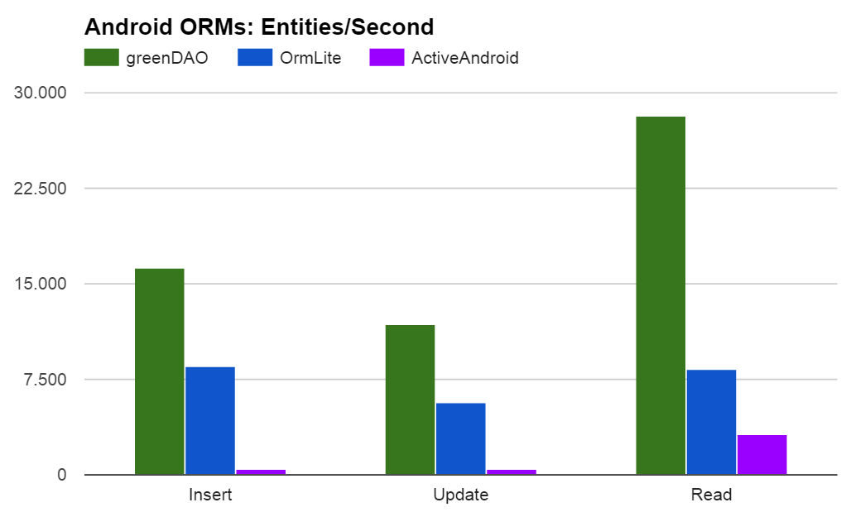
greenDAO inserts and updates entities around 2 times faster, and loads entities around 4 times faster than ORMLite. For typical applications the loading speed is the most relevant one.

Slide 5
Introduction
A
DAO Code Generation Project
B
Core Classes
C
Core Initialization

Slide 6
DAO Code Generation
Its task is to generate code specific to your project domain

Slide 7
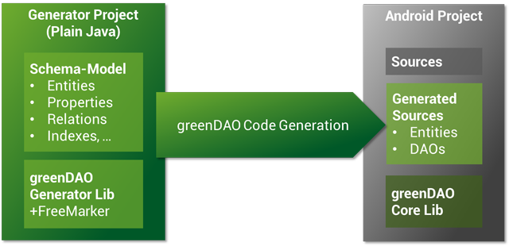
The generator project is an normal Java (not Android!) project. Make sure the greenDAO generator library (greenDAO-generator.jar) and the Freemarker library (freemarker.jar) are in its classpath.
Create an executable Java class, model your entities and trigger the code generation.

Slide 8
Core Classes

Slide 9
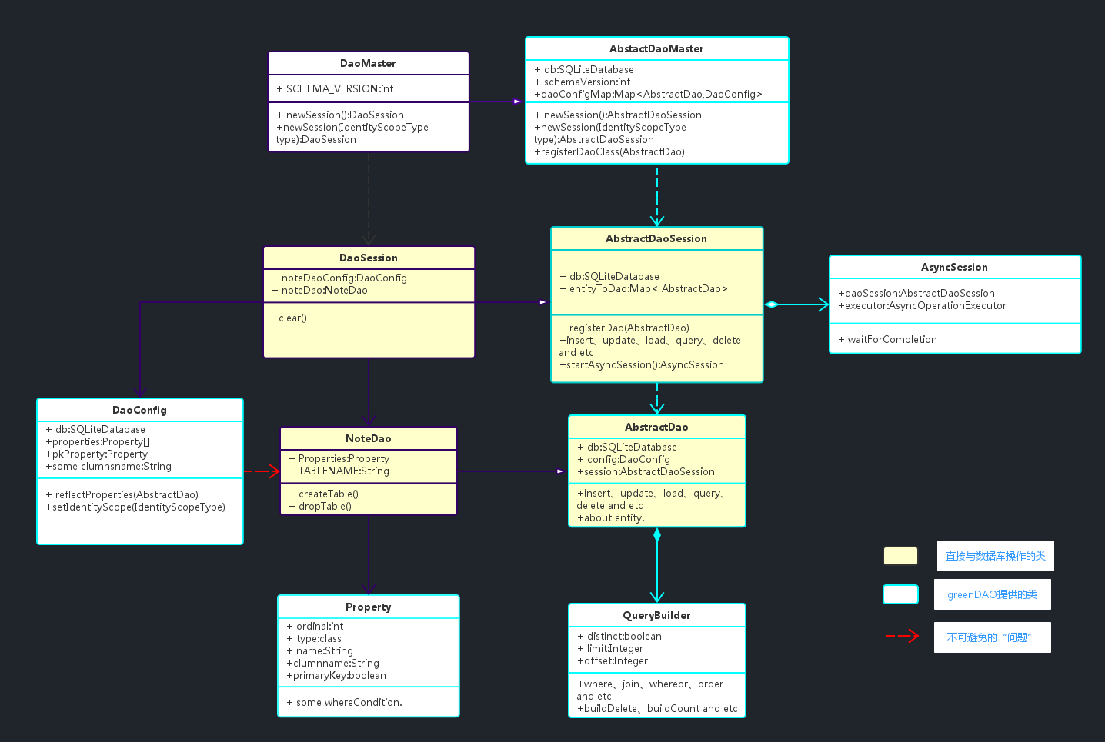

Slide 10
DaoMaster
The entry point for using greenDAO. DaoMaster holds the database object (SQLiteDatabase) and manages DAO classes (not objects) for a specific schema. It has static methods to create the tables or drop them. Its inner classes OpenHelper and DevOpenHelper are SQLiteOpenHelper implementations that create the schema in the SQLite database.
DaoSession
Manages all available DAO objects for a specific schema, which you can acquire using one of the getter methods. DaoSession provides also some generic persistence methods like insert, load, update, refresh and delete for entities. Lastly, a DaoSession objects also keeps track of an identity scope.
DAOs
Data access objects (DAOs) persists and queries for entities. For each entity, greenDAO generates a DAO. It has more persistence methods than the DaoSession, for example: count, loadAll, and insertInTx.
Entities
Persistable objects. Usually, entities are generated (you do not have to), and are objects representing a database row using standard Java properties

Slide 11
Core Initialization

Slide 12
