Slide 1
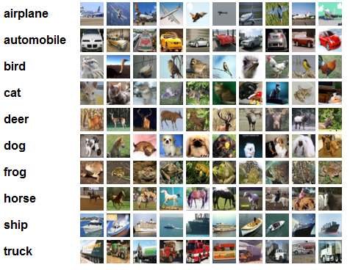
CIFAR-10

Slide 2
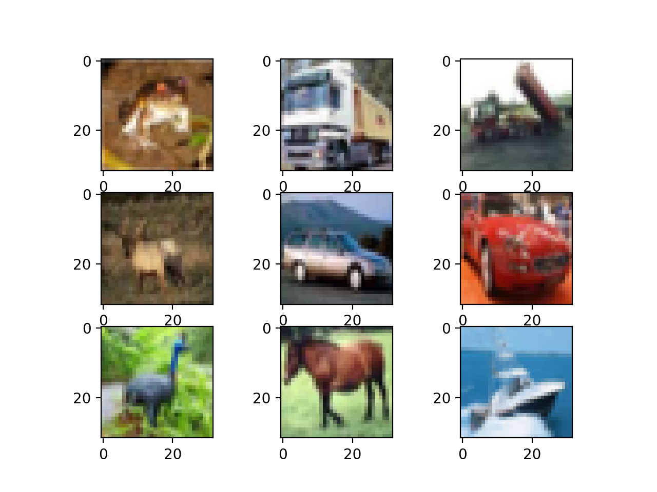
CIFAR-10
- Shape of each data : [3, 32, 32]
- Range : 0 to 255
- You can see the image of each data.
(available in the assignment code)

Slide 3
Code review
[Objective]
Your model should classifiy of the images into 10 classes.
[Classes]
classes = ('plane', 'car', 'bird', 'cat', 'deer', 'dog', 'frog', 'horse', 'ship', 'truck')
[PyTorch Code structure]
- LeNet5_model.py
- LeNet5_train.py
- LeNet5_evaluation.py
[TensorFLow Code structure]
- lenet.py
- lenet_train.py
- lenet_eval.py
- data_helpers.py

Slide 4
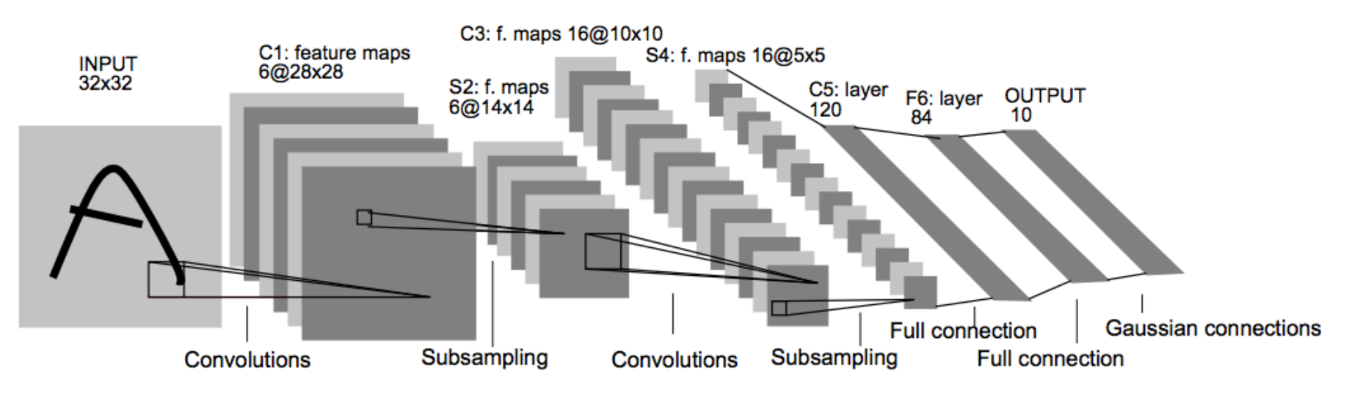
LeNet-5 [1]
[1] LeCun, Yann, et al. "Gradient-based learning applied to document recognition." Proceedings of the IEEE 86.11 (1998): 2278-2324.

Slide 5
LeNet-5
6
output
channel
kernel
size
input
channel
stride
padding
Conv2d(3,6,5,1,0)
ReLU
[3, 32, 32]
[6, 28, 28]

Slide 6
LeNet-5
Pooling(2,2)
kernel
size
stride
[6, 28, 28]
[6, 14, 14]

Slide 7
LeNet-5
Conv2d(6,16,5,1,0)
ReLU
[6, 14, 14]
[16, 10, 10]

Slide 8
LeNet-5
Pooling(2, 2)
[16, 10, 10]
[16, 5, 5]

Slide 9
LeNet-5
Reshape([16,5,5]→[16*5*5])
Fully Connected(16*5*5,120)
ReLU
Fully Connected(120,84)
ReLU
Fully Connected(84,10)
[10]
Class size
[16, 5, 5]

Slide 10
Assignment 3: LeNet
[Objective]
Your model should classifiy of the images into 10 classes.
[Requirements]
1. Implement LeNet5 model with Pytorch or Tensorflow.
(Basic code is provided)
2. You should experiment with settings stated in the evaluation report, and report the result of each settings.
3. You should attach the plot of the validation dataset accuracy plot.
4. You should report the experimental results.
(all kinds of additional experiments are recommended)
model
"Truck"

Slide 11
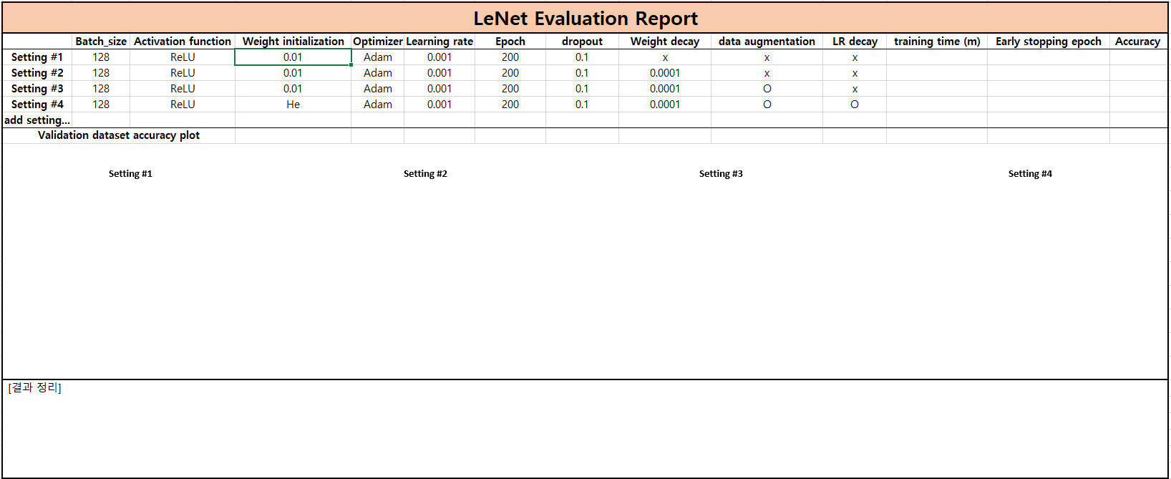
Assignment 3: LeNet
[Evaluation report]

Slide 12
Assignment 3: LeNet
Evaluation Criteria
Simplicity | How concisely did you write the code? - 배점 6점 Convolution, pooling, and FC layers: 5점 Filter initialization: 1점 Learning rate decay: 1점
Performance | How well did the results of the code perform? - 배점 2점 - acc 73%이상 달성 시 만점
Brevity and Clarity | How concisely and clearly did you explain the results? - 배점 2점

Slide 13
Assignment 3: LeNet
- Due to : ~ 9.27(Sun)
- Submission : Online submission on blackboard
- Your submission should contain
1) The whole code of your implementation
2) The evaluation report
- You must implement the components yourself!
- File name : StudentID_Name.zip

